Slide 1


E-commerce 2021: Business. Technology. Society.
Sixteenth Edition
Chapter 4
Building an E-commerce Presence: Websites, Mobile Sites, and Apps
Copyright © 2022, 2019, 2018 Pearson Education, Inc. All Rights Reserved
Notes:
If this PowerPoint presentation contains mathematical equations, you may need to check that your computer has the following installed:
1) MathType Plugin
2) Math Player (free versions available)
3) NVDA Reader (free versions available)

Slide 2
Learning Objectives
4.1 Understand the questions you must ask and answer, and the steps you should take, in developing an e-commerce presence.
4.2 Explain the process that should be followed in building an e-commerce presence.
4.3 Identify and understand the major considerations involved in choosing web server and e-commerce merchant server software.
4.4 Understand the issues involved in choosing the most appropriate hardware for an e-commerce site.
4.5 Identify additional tools that can improve website performance.
4.6 Understand the important considerations involved in developing a mobile website and building mobile applications.

Slide 3
Walmart Website Redesign: Going Upscale in Its Fight to Compete With Amazon
Class Discussion
  Why is Walmart considered an underdog in the e-commerce arena?
  What was Walmart’s objective in redesigning its website?
  How does Walmart’s website differ from Amazon’s website?
  How has the Covid-19 pandemic impacted Walmart?

Slide 4
Imagine Your E-commerce Presence (1 of 3)
What’s the idea? The vision includes:
  Mission statement
  Target audience
  Intended market space
  Strategic analysis
  Marketing matrix
  Development timeline
  Preliminary budget

Slide 5
Imagine Your E-commerce Presence (2 of 3)
Where’s the money?
  Business model(s)
  Revenue model(s)
Who and where is the target audience?
  Demographics, lifestyle, consumption patterns, etc.
What is the ballpark? Characterize the marketplace
  Size, growth, demographics, structure

Slide 6
Imagine Your E-commerce Presence (3 of 3)
Where’s the content coming from?
Know yourself-S W O T analysis
Develop an e-commerce presence map
Develop a timeline: Milestones
How much will this cost?
  Simple website: up to $5000
  Small startup: $25,000 to $50,000
  Large corporate website: $100,000+ to millions

Slide 7
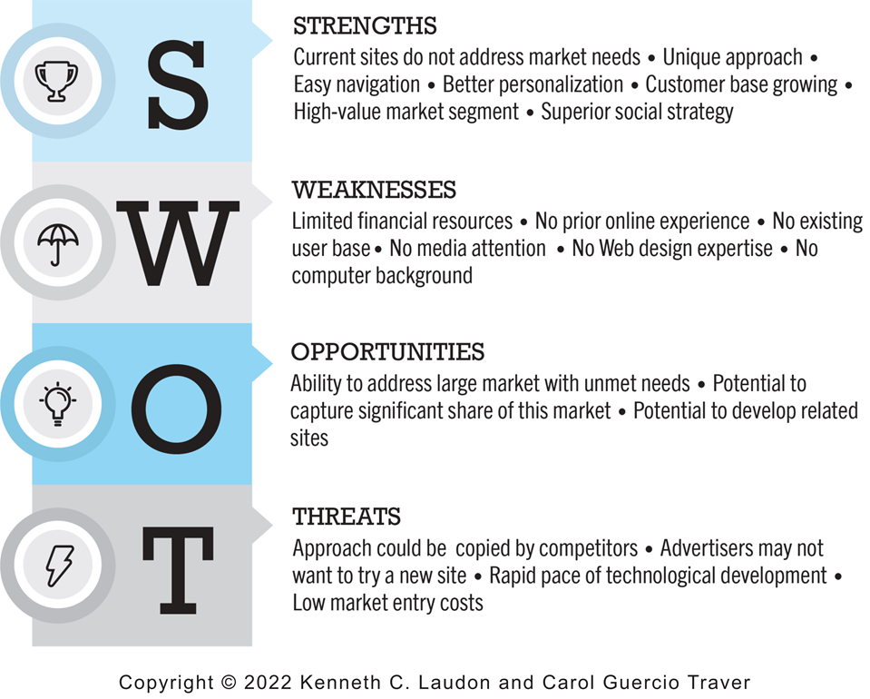
Figure 4.1 S W O T Analysis
Notes:
Figure 4.1, Page 193.
A SWOT analysis describes your firm’s strengths, weaknesses, opportunities, and threats.
Alt Text
Long description: An example of a SWOT analysis describes various strengths, weaknesses, opportunities, and threats, as follows: Strengths are current sites do not address market needs, unique approach, easy navigation, better personalization, customer base growing, high value market segment, and superior social strategy. Weaknesses are limited financial resources, no prior online no existing user base, no media attention, no web design expertise, and no computer background. Opportunities are ability to address large market with unmet needs, potential to capture significant share of this market, potential to develop related sites. Threats are approach could be copied by competitors, advertisers may not want to try a new site, rapid pace of technological development, low market entry costs.

Slide 8
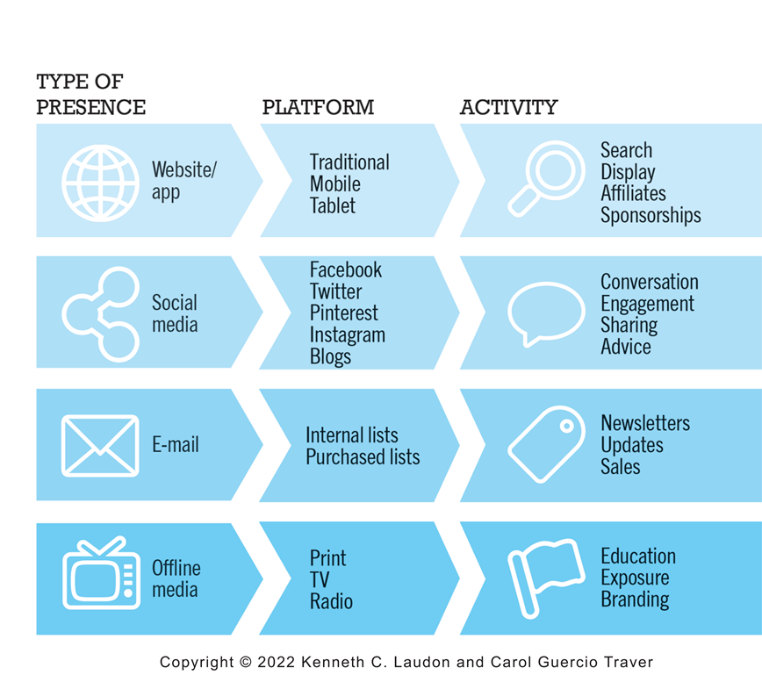
Figure 4.2 E-commerce Presence Map
Notes:
Figure 4.2, Page 194.
An e-commerce presence requires firms to consider the four different kinds of presence, and the platforms and activities associated with each type of presence.
Alt Text
Long description: A map depicts the different types of e-commerce presence, the platforms on which each is used and related activities for each, as follows: Type of presence, website or app. Platform, traditional, mobile, tablet. Activity, search, display, affiliates, and sponsorships. Type of presence, social media. Platform, Facebook, Twitter, Pinterest, Instagram, and blogs. Activity, conversation, engagement, sharing, and advice. Type of presence: email. Platform, internal lists, purchased lists. Activity, newsletters, updates, and sales. Type of presence, offline media. Platform, print, radio, and t v. Activity, education, exposure, branding.

Slide 9
Building an E-commerce Site: A Systematic Approach
Most important management challenges:
  Developing a clear understanding of business objectives
  Knowing how to choose the right technology to achieve those objectives
Main factors to consider
  Management
  Hardware architecture
  Software
  Design
  Telecommunications
  Human resources

Slide 10
Planning: The Systems Development Life Cycle
Methodology for understanding business objectives of a system and designing an appropriate solution
Five major steps:
  Systems analysis/planning
  Systems design
  Building the system
  Testing
  Implementation

Slide 11
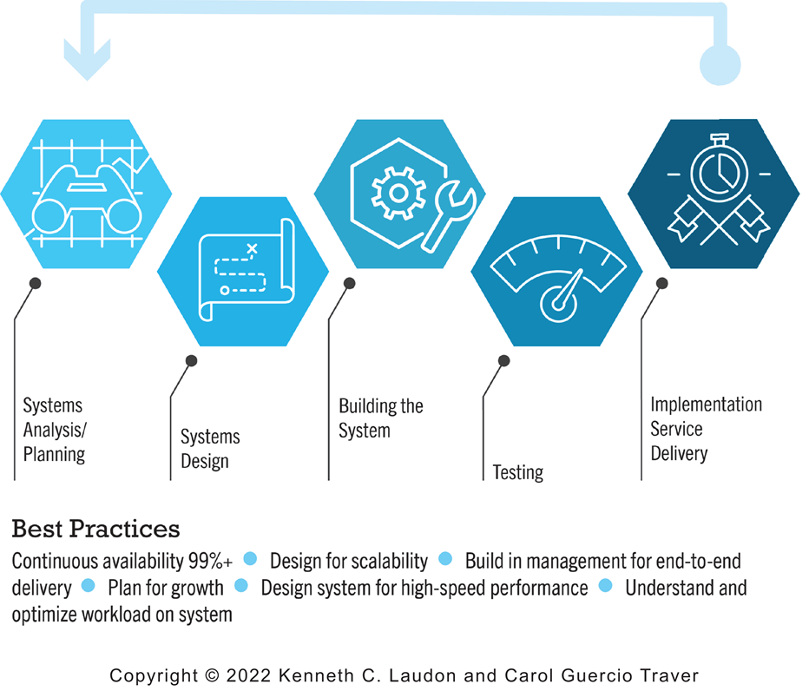
Figure 4.5 Systems Development Life Cycle
Notes:
Figure 4.5, Page 198.
Alt Text
Long description: An illustration depicts the five major steps in the systems development life cycle, as follows: The systems development life cycle begins with systems analysis and planning, then systems design, then building the system, then testing, and then implementation service delivery. Best practices include continuous availability of 99% or more, design for scalability, build in management for end-to-end delivery, plan for growth, design system for high-speed performance, understand and optimize workload on system.

Slide 12
System Analysis/Planning
Business objectives:
  List of capabilities you want your site to have
System functionalities:
  List of information system capabilities needed to achieve business objectives
Information requirements:
  Information elements that system must produce in order to achieve business objectives

Slide 13
Table 4.2 System Analysis, Business Objectives, System Functionalities, and Information Requirements for a Typical E-commerce Site (1 of 2)
Business Objective | System Functionality | Information Requirements
Display goods | Digital Catalog | Dynamic text and graphics catalog
Provide product information | Product database | Product description, stocking numbers, inventory levels
Personalize/customize product | Customer on-site tracking | Site log for every customer visit; data mining capability to identify common customer paths and appropriate responses
Engage customers in conversations | On-site blog; user forums | Software with blogging and community forum functionality
Execute a transaction | Shopping cart/payment system | Secure credit card clearing; multiple payment options
Accumulate customer information | Customer database | Name, address, phone, and e-mail for all customers; online customer registration

Slide 14
Table 4.2 System Analysis, Business Objectives, System Functionalities, and Information Requirements for a Typical E-commerce Site (2 of 2)
Business Objective | System Functionality | Information Requirements
Provide after-sale customer support | Sales database | Customer I D, product, date, payment, shipment date
Coordinate marketing/advertising | Ad server, e-mail server, e-mail, campaign manager, ad banner manager | Site behavior log of prospects and customers linked to e-mail and banner ad campaigns
Understand marketing effectiveness | Site tracking and reporting system | Number of unique visitors, pages visited, products purchased, identified by marketing campaign
Provide production and supplier links | Inventory management system | Product and inventory levels, supplier I D and contact, order quantity data by product

Slide 15
Systems Design: Hardware and Software Platforms
System design specification:
  Description of main components of a system and their relationship to one another
Two components of system design:
  Logical design
    Data flow diagrams, processing functions, databases
  Physical design
    Specifies actual physical, software components, models, and so on

Slide 16
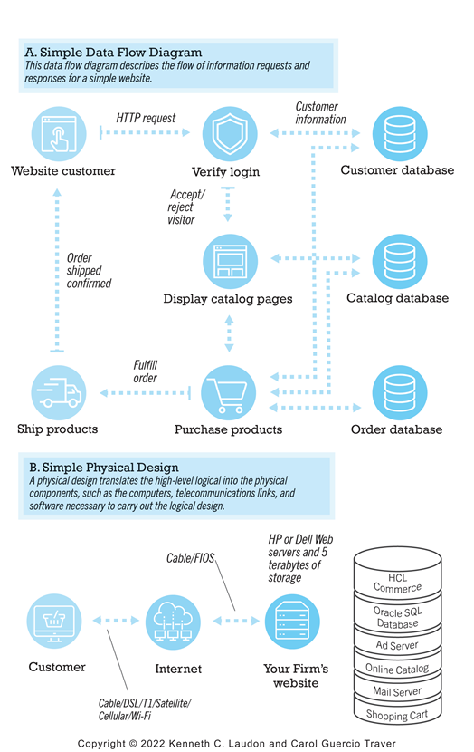
Figure 4.6 A Logical and Physical Design for a Simple Website
Notes:
Figure 4.6 Page 201.
Alt Text
Long description: An illustration depicts a simple data flow diagram and physical design for a simple website, as follows: A, simple data flow diagram. The data flow diagram describes the flow of information requests and responses for a simple website. A website customer submits an H T T P request. Login is verified, and the visitor accepted or rejected based on information exchanged with the customer database. Catalog pages are displayed, based on information from the catalog database. The customer purchases products, and the purchase is entered into the order database. The order is fulfilled, products are shipped, order is shipped and confirmed, and sent to the website customer. B, simple physical design. A physical design translates the high level logical into the physical components, such as computers, telecommunications links, and software necessary to carry out the logical design. The customer uses cable, D S L, T 1, satellite, cellular or WI FI to connect to the internet, which is connected by cable or FIOS to your firm’s website, hosted by H P or Dell Web servers and 5 terabytes of storage. The website includes H C L Commerce, Oracle S Q L database, ad server, online catalog, mail server, and shopping cart.

Slide 17
Building the System: In-House Versus Outsourcing
Outsourcing: Hiring vendors to provide services involved in building site
Build own versus outsourcing:
  Build your own requires team with diverse skill set; choice of software tools; both risks and possible benefits
Host own versus outsourcing
  Hosting: Hosting company responsible for ensuring site is accessible 24/7, for monthly fee
  Co-location: Firm purchases or leases web server (with control over its operation), but server is located at vendor’s facility

Slide 18
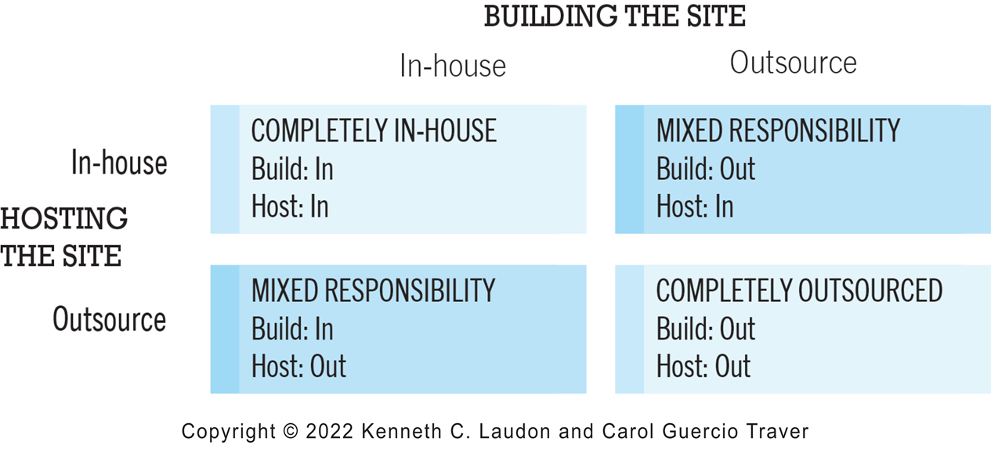
Figure 4.7 Choices in Building and Hosting
Notes:
Figure 4.7, Page 202.
You have a number of alternatives to consider when building and hosting an e-commerce site.
Alt Text
Long description: A matrix with four squares depicts the choices in building and hosting an e commerce site: either in house or outsource, as follows: At the intersection of hosting the site in house and building the site in house, a square with the following label: completely in house, build in, host in. At the intersection hosting the site in house, building the site outsource, a square with the following label: mixed responsibility, build out, host in. At the intersection of hosting the site outsource, building the site in house, a square with the following label: mixed responsibility, build in, host out. At the intersection of hosting the site outsource and building the site outsource, a square with the following label: complete in house, build out, host out.

Slide 19
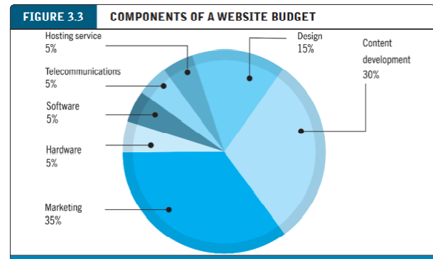
COMPONENTS OF A WEBSITE BUDGET

Slide 20
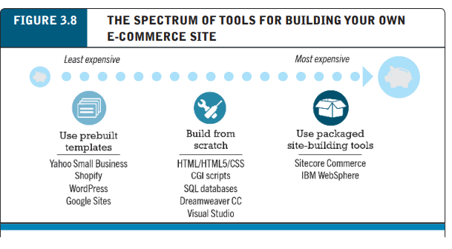
TOOLS FOR BUILDING YOUR OWN E-COMMERCE SITE

Slide 21
Insight on Business: Weebly Makes Creating Websites Easy
Class Discussion
  What value does Weebly offer to small businesses?
  Are there any drawbacks to using Weebly to create an e-commerce presence?
  How are service providers like Weebly changing the nature of e-commerce?
  Wix
  Content management system (CMS)

Slide 22
Testing the System
Testing
  Unit testing: involves testing the site’s program modules one at a time
  System testing: involves testing the site as a whole, in a way the typical user will use the site
  Acceptance testing: verifies that the business objectives of the system as originally conceived are in fact working
  A/B testing (split testing): involves showing two versions of a web page or website to different users to see which one performs better
  Multivariate testing: A template test compares the same general page content using two different layouts and or design treatments.

Slide 23
Implementation, Maintenance, and Optimization
Systems break down unpredictably
Maintenance is ongoing
Web Team
Maintenance costs: Similar to development costs
  A $40K e-commerce site may require $40K annually to upkeep
Benchmarking: (a process in which the site is compared with those of competitors in terms of response speed, quality of layout, and design) and keeping the site current on pricing and promotions

Slide 24
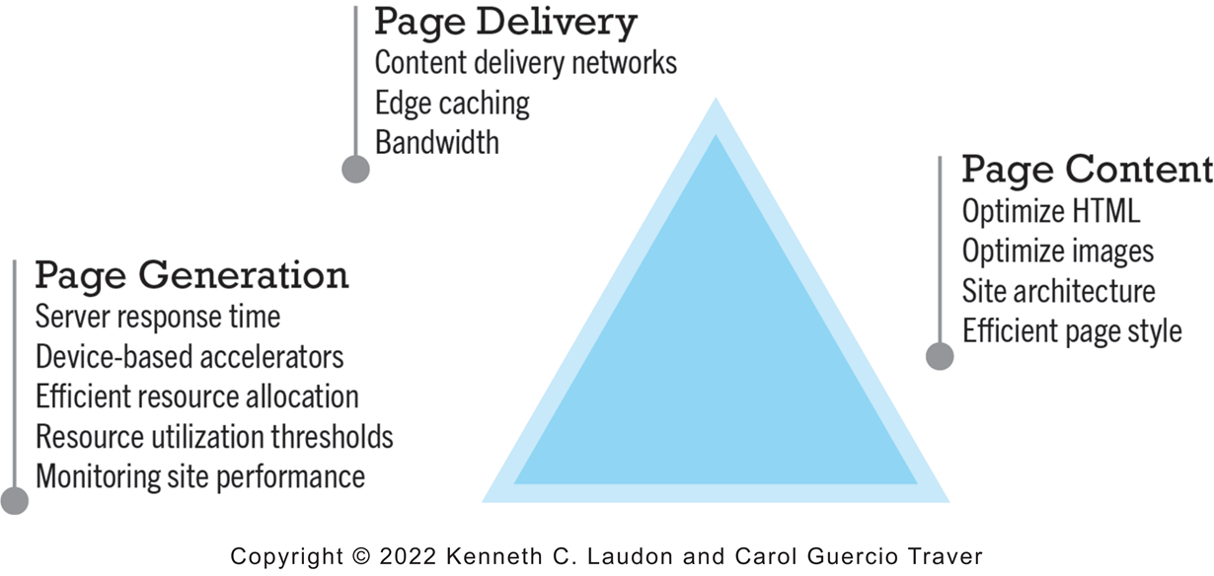
Figure 4.10 Factors in Website Optimization
Notes:
Figure 4.10, Page 209.
Website optimization requires that you consider three factors: page content, page generation, and page delivery.
Alt Text
Long description: An illustration depicts three major factors in website optimization, as follows: Page generation factors are server response time, device-based accelerators, efficient resource allocation, resource utilization thresholds, monitoring site performance. Page delivery factors are content delivery networks, edge caching, and bandwidth. Page content factors include optimize H T M L, optimize images, site architecture, and efficient page style.

Slide 25
Alternative Web Development Methodologies
Prototyping: consists of building a sample or model rapidly and inexpensively to test a concept or process
Agile development: breaks down a large project into a series of smaller subprojects that are completed in short periods of time using iteration and continuous feedback
DevOps: builds on agile development principles as an organizational strategy to create a culture and environment that further promote rapid and agile development practices (development and operation)
Component-based development: enables a system to be built by assembling and integrating various software components that already have been assembled and which provide common functions
Web services: loosely coupled, reusable software components using XML and other open protocols and standards that enable one application to communicate with another with no custom programming required to share data and services
  Service-oriented architecture (S O A)
  Microservices

Slide 26
Simple versus Multi-Tiered Website Architecture
System architecture
  Arrangement of software, machinery, and tasks in an information system needed to achieve a specific functionality
Two-tier
  Web server and database server
Multi-tier
  Web application servers
  Backend, legacy databases

Slide 27
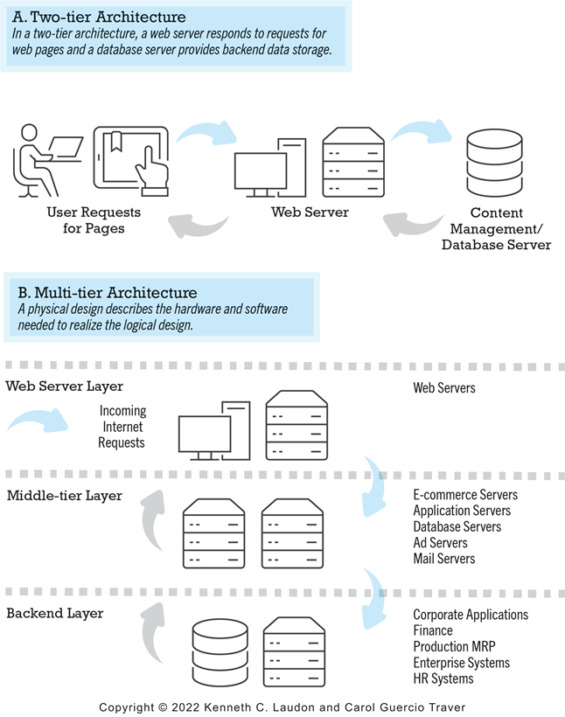
Figure 4.11 Two-Tier and Multi-tier E-commerce Site Architectures
Notes:
Figure 4.11, Page 213.
Alt Text
Long description: An illustration provides an overview of two tier and multi tier e commerce site architectures, as follows: A, two tier architecture. In a two tier architecture, a web server responds to requests for web pages and a database server provides backend data storage. User requests for pages are sent to the web server to the content management or database server, which sends the pages back through the web server. B, multi tier architecture. A physical design describes the hardware and software needed to realize the logical design. In the web server layer, incoming internet requests are sent to the web servers. The middle tier layer includes e commerce servers, application servers, database servers, ad servers, and mail servers. The backend layer includes corporate applications, finance, production M R P, enterprise systems, and H R systems. Incoming internet requests are sent through each layer and then returned up through the layers to the web server layer.

Slide 28
Web Server Software
Apache
  Leading web server software
  Works with UNIX, Linux operating systems
  Reliable, stable, part of open software community
Microsoft’s Internet Information Server (I I S)
  Second major web server software
  Windows-based
  Integrated, easy-to-use

Slide 29
Table 4.4 Basic Functionality Provided by Web Servers
Functionality | Description
Processing of H T T P requests | Receive and respond to client requests for H T M L pages
Security services (Secure Sockets Layer)/Transport Layer Security | Verify username and password; process certificates and private/public key information required for credit card processing and other secure information
File Transfer Protocol | Permits transfer of very large files from server to server
Search engine | Indexing of site content; keyword search capability
Data capture | Log file of all visits, time, duration, and referral source
E-mail | Ability to send, receive, and store e-mail messages
Site management tools | Calculate and display key site statistics, such as unique visitors, page requests, and origin of requests; check links on pages

Slide 30
Site Management Tools
Basic tools included in all web servers
  Verify that links on pages are still valid
  Identify orphan files: files on the site that are not linked to any pages
Third-party software for advanced management
  Monitor customer purchases
  Marketing campaign effectiveness
  Keep track of hit counts and other statistics
  Example: Webtrends Analytics 10

Slide 31
Dynamic Page Generation Tools
Dynamic H T M L (D H T M L): used to change a way a web page looks but does not generate a unique web page
Dynamic page generation:
  Contents stored in database and fetched when needed to create a unique web page
Advantages
  Lowers menu costs
  Permits easy online market segmentation
  Enables cost-free price discrimination
  Enables content management system (C M S)

Slide 32
Application Servers
Web application servers:
  Provide specific business functionality required for a website
  Type of middleware
    Isolate business applications from Web servers and databases
  Single-function applications being replaced by integrated software tools that combine all functionality needed for e-commerce site

Slide 33
E-commerce Merchant Server Software
Provides basic functionality for sales
  Online catalog
    List of products available on website
  Shopping cart
    Allows shoppers to set aside, review, edit selections, and then make purchase
  Credit card processing
    Typically works in conjunction with shopping cart
    Verifies card and puts through credit to company’s account at checkout

Slide 34
Merchant Server Software Packages (1 of 3)
Integrated environment that includes most of functionality needed
  Shopping cart
  Merchandise display
  Order management

Slide 35
Merchant Server Software Packages (2 of 3)
Different options for different-sized businesses
  Small and medium-sized businesses: Shopify; Bigcommerce, Vendio, open-source solutions
  Mid-range: H C L Commerce; Sitecore Experience Commerce
  High-end: S A P Hybris Commerce, Oracle A T G Web Commerce, Magento
Many now also available as cloud-based SaaS solutions.

Slide 36
Merchant Server Software Packages (3 of 3)
Key factors in selecting a package
  Functionality
  Support for different business models, including m-commerce
  Business process modeling tools
  Visual site management and reporting
  Performance and scalability
  Connectivity to existing business systems
  Compliance with standards
  Global and multicultural capability
  Local sales tax and shipping rules

Slide 37
Choosing Hardware
Hardware platform:
  Underlying computing equipment needed for e-commerce functionality
Objective:
  Enough platform capacity to meet peak demand without wasting money
Important to understand the factors that affect speed, capacity, and scalability of a site

Slide 38
Right-Sizing Your Hardware Platform: The Demand Side
Customer demand:
  Most important factor affecting speed of site
Factors in overall demand:
  Number of simultaneous users in peak periods
  Nature of customer requests (user profile)
  Type of content (dynamic versus static Web pages)
  Required security
  Number of items in inventory
  Number of page requests
  Speed of legacy applications

Slide 39
Right-Sizing Your Hardware Platform: The Supply Side
Scalability:
  Ability of site to increase in size as demand warrants
Ways to scale hardware:
  Vertically
    Increase processing power of individual components
  Horizontally
    Employ multiple computers to share workload
  Improve processing architecture
  Outsource hosting, use content delivery network

Slide 40
Table 4.8 Vertical and Horizontal Scaling Techniques
Technique | Application
Use a faster computer | Deploy edge servers, presentation servers, data servers, etc.
Create a cluster of computers | Use computers in parallel to balance loads.
Use appliance servers | Use special-purpose computers optimized for their task.
Segment workload | Segment incoming work to specialized computers.
Batch requests | Combine related requests for data into groups, process as group.
Manage connections | Reduce connections between processes and computers to a minimum.
Aggregate user data | Aggregate user data from legacy applications in single data pools.
Cache | Store frequently used data in cache rather than on the disk.

Slide 41
Table 4.9 Improving the Processing Architecture of Your Site
Architecture Improvement | Description
Separate static content from dynamic content | Use specialized servers for each type of workload.
Cache static content | Increase R A M to the gigabyte range and store static content in R A M.
Cache database lookup tables | Use cache tables used to look up database records.
Consolidate business logic on dedicated servers | Put shopping cart, credit card processing, and other C P U-intensive activity on dedicated servers.
Optimize A S P code | Examine your code to ensure it is operating efficiently.
Optimize the database schema | Examine your database search times and take steps to reduce access times.

Slide 42
Other E-commerce Site Tools
Website design: Basic business considerations
  Enabling customers to find and buy what they need
Tools for search engine optimization
  Search engine placement
    Metatags, titles, content
    Identify market niches
    Offer expertise
    Links
    Buy ads
    Local e-commerce

Slide 43
E-commerce Website Features That Annoy Customers (1 of 2)
Requiring user to view ad or intro page before going to website content
Pop-up and pop-under ads and windows
Too many clicks to get to the content
Links that don’t work
Confusing navigation; no search function
Requirement to register and log in before viewing content or ordering
Slow loading pages
Content that is out of date

Slide 44
E-commerce Website Features That Annoy Customers (2 of 2)
Inability to use browser’s Back button
No contact information available (web form only)
Unnecessary splash/flash screens, animation, etc.
Music or other audio that plays automatically
Unprofessional design elements
Text not easily legible due to size, color, format
Typographical errors
No or unclear returns policy

Slide 45
Table 4.11 The Eight Most Important Factors in Successful E-commerce Site Design
Factor | Description
Functionality | Pages that work, load quickly, and point the customer toward your product offerings
Informational | Links that customers can easily find to discover more about you and your products
Ease of use | Simple foolproof navigation
Redundant navigation | Alternative navigation to the same content
Ease of purchase | One or two clicks to purchase
Multi-browser functionality | Site works with the most popular browsers
Simple graphics | Avoids distracting, obnoxious graphics and sounds that the user cannot control
Legible text | Avoids backgrounds that distort text or make it illegible

Slide 46
Tools for Interactivity and Active Content
Java, J S P, and JavaScript (including Node.j s)
  JavaScript-based tools: React, Vue, Angular J S, D3, jQuery and Ajax)
  Typescript
A S P (Active Server Pages)/A S P.NET
ColdFusion
P H P, Ruby on Rails, Django
Other design elements:
  Widgets, mashups

Slide 47
Personalization Tools
Personalization: ability to treat people based on personal qualities and prior history with site
  Website personalization alters site based on who is viewing it
Customization: ability to change the product to better fit the needs of the customer
  E-commerce customization focuses on generating personalized product recommendations
Cookies a basic method to achieve personalization
Other more sophisticated tools available

Slide 48
The Information Policy Set
Privacy policy
  Set of public statements declaring how site will treat customers’ personal information that is gathered by site
Accessibility rules
  Set of design objectives that ensure users with disabilities can effectively access site

Slide 49
Insight on Society: Designing for Accessibility
Class discussion:
  Why might some merchants be reluctant to make their websites accessible to users with disabilities?
  How can websites be made more accessible?
  Should all websites be required by law to provide “equivalent alternatives” for visual and sound content?
  What additional accessibility problems do mobile devices pose?

Slide 50
Developing a Mobile Website and Building Mobile Applications
Types of m-commerce software
  Mobile website
    Responsive Web design
  Mobile Web app
  Native app
  Hybrid app
    Runs inside native container
    App distribution
    Based on H T M L5, C S S, JavaScript

Slide 51
Planning and Building a Mobile Presence
Identify business objectives, system functionality, and information requirements
Choice:
  Mobile website or mobile Web app
    Less expensive
  Native app
    Can use device hardware, available offline

Slide 52
Table 4.13 Unique Features That Must Be Taken Into Account When Designing a Mobile Presence
Feature | Implications For Mobile Platform
Hardware | Mobile hardware is smaller, and there are more resource constraints in data storage and processing power.
Connectivity | The mobile platform is constrained by slower connection speeds than desktop websites.
Displays | Mobile displays are much smaller and require simplification. Some screens are not good in sunlight.
Interface | Touch-screen technology introduces new interaction routines different from the traditional mouse and keyboard. The mobile platform is not a good data entry tool but can be a good navigational tool.

Slide 53
Mobile Presence Design Considerations
Platform constraints
  Graphics, file sizes
Mobile first design
  Desktop website design after mobile design
Responsive web design (R W D)
  C S S site adjusts layout of site according to device screen resolutions
Adaptive web design (A W D)
  Server delivers different templates or versions of site optimized for device

Slide 54
Cross-Platform Mobile App Development Tools
Objective C, Java
Low cost, open-source alternatives
  Flutter
  React Native
  Appery.io
  Codiqa
  Swiftic
  PhoneGap
  Axway Appcelerator

Slide 55
Mobile Presence: Performance and Cost Considerations
Mobile first design
  Most efficient
Mobile website
  Resizing existing website for mobile access is least expensive
Mobile web app
  Can utilize browser A P I
Native app
  Most expensive; requires more programming

Slide 56
Insight on Technology: Duolingo’s Mobile App Powers Language Learning
Class Discussion
  Why do you think Duolingo’s mobile app has been such a major factor in its success?
  What business model does Duolingo use?
  Why is A/B testing an important part of Duolingo’s process?

Slide 57
Careers in E-commerce
Position: U X Designer
Qualification/Skills
Preparing for the Interview
Possible Interview Questions

Slide 58

Copyright
This work is protected by United States copyright laws and is provided solely for the use of instructors in teaching their courses and assessing student learning. Dissemination or sale of any part of this work (including on the World Wide Web) will destroy the integrity of the work and is not permitted. The work and materials from it should never be made available to students except by instructors using the accompanying text in their classes. All recipients of this work are expected to abide by these restrictions and to honor the intended pedagogical purposes and the needs of other instructors who rely on these materials.

