Slide 1
Mycotoxins

Slide 2
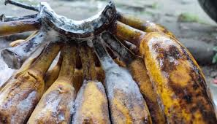
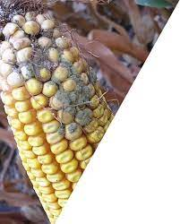
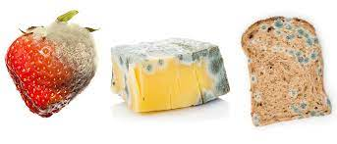
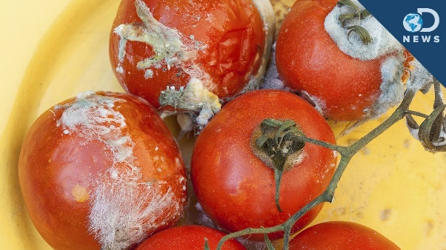
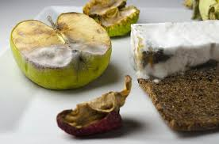
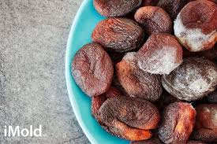
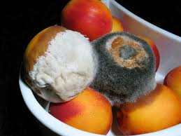
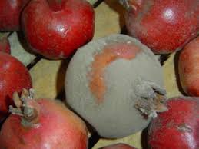
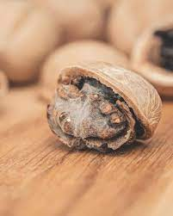
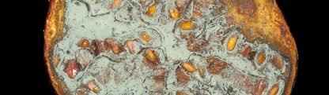
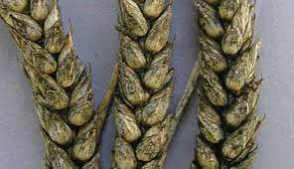

Slide 3
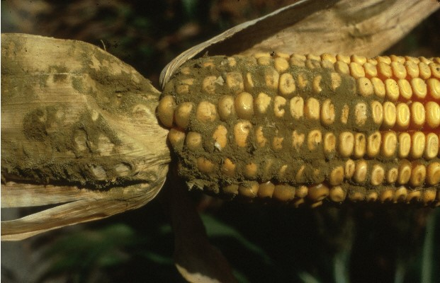
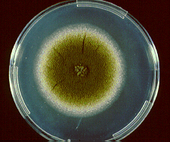
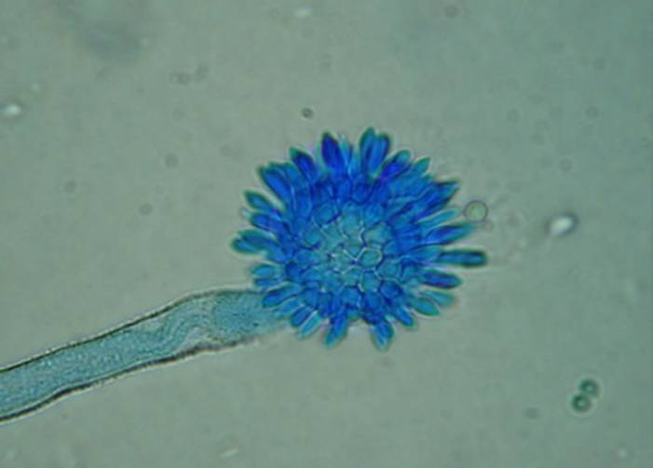
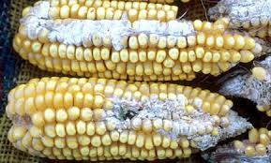
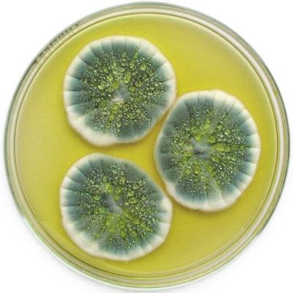
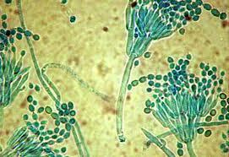
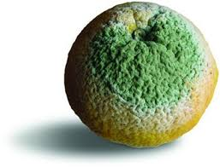
Fungi, Mycotoxins
Aspergillus sp.
Penicillium sp.

Slide 4
Ergotism (10th centuary)
Fungi (Claviceps family)-active against rye (particularly susceptible)
History of ergot/ergotism (clinical syndrome) are linked to the history and distribution of rye (barley and oats-more resistant)
Epidemics of clinical ergotism are due to a wet season, which favors germination, followed by dry and windy weather, which favors the dissemination of the ascospores
Disease/Symptoms: pains in one of the limbs (calf of leg). Weeks later, the foot or hand becomes swollen and inflamed followed by characteristic, violent burning (neuropathic).

Slide 5
Ergotism (10th centuary)
Common in the Middle Ages (Saint Anthony’s fire or sacred fire).
Sensations of heat and cold alternated in the limb followed by numbness and the pains disappear.
The skin turns cold and red/violet vesicles appear. The diseased part became black (gangrenous) and the toes and feet could fall off without pain.

Slide 6
Mycotoxins
Mycotoxins are fungal metabolites which, when ingested, inhaled or absorbed through the skin, can cause disease or death in man and domestic animals, including birds.
Mycotoxins are produced during fungal growth. They are chemically stable once formed, and persist in food even after the destruction of the fungi that produced them
Mycotoxins may occur in processed foods, but are much less important than when they occur in commodities such as grains or nuts.

Slide 7
Mycotoxins
Mycotoxins effects on human/animal health
Most important mycotoxins
Neurotoxin: interfere with the function of nervous tissue, may cause irreversible cell damage and death
Teratogens: interfere with the development of a fetus, causing birth defects.
Nephrotoxins: causes damage to kidneys
Hepatotoxins: cause acute/chronic liver disease
Immunosuppressive agents: inhibit or prevent activity of the immune system
Carcinogens: cause cancer
Aflatoxins
Ochratoxin A
Fumonisins
Deoxynivalenol
Zearalenone
Ergoline alkaloids

Slide 8
Aflatoxins
Chemical Characterization
Four important naturally occurring:
Aflatoxins B1 and B2, named because of their blue fluorescence under UV light
Aflatoxins G1 and G2, fluoresce greenish
When aflatoxins B1 and G1 are ingested by lactating animals, small proportions (1 to 2%) are excreted in milk
Aflatoxins M1 and M2, are hydroxylated derivatives of the parent compounds (B1 and B2).

Slide 9
Aflatoxins

Slide 10
Fungal Sources
Aflatoxins are produced in foods primarily by:
Aspergillus flavus – growth range 10-48 C, aw 0.82, pH 3.4-10
A. parasiticus closely related species
Both species produce rapidly growing colonies characterized by green conidia (asexual spores) borne on phialides
A. flavus bears conidia on two rows of supporting cells (phialides), while A. parasiticus spores are borne on phialides alone.
A. flavus isolates produce B aflatoxins (only 40% of strains)
A. parasiticus- all strains produce both G and B mycotoxins

Slide 11
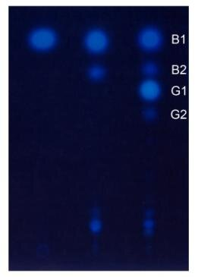
Aflatoxins
TLC profile of aflatoxin production on a silica gel 60 F 254 plate.
From left to right: AFB 1 standard, A. flavus A-11 (isolated from soybean) and A. parasiticus NRRL 2999.

Slide 12
Growth characteristics
Detection of A. flavus from food :
Culturing on A. flavus and A. parasiticus agar for 48 hours at 30 °C
the reverse will display a brilliant orange-yellow color
growth range 10-48 °C,
aw 0.80 to 0.82
pH 3.4-10
Heat resistance of A. flavus conidia
D43 >160 hours
D52 40-45 min
D60 1 min at neutral pH and hi aw

Slide 13
Analysis of aflatoxins
Unevenly distributed in foods especially in peanuts
Sampling is the largest source of error
Sampling plans developed for for 10-ton lots, and for bag stacks
All methods use samples of >8 kg and Subsamples of >500 g
Extraction by solvents (polar/nonpolar) depends on food matrix
Methanol:water-80:20 used for maize, peanuts, cottonseed
The method for aflatoxin assays is thin-layer chromatography (TLC), inexpensive, reliable, recommended for less developed economies.
For acceptable/not acceptable testing immunochemical methods are used.
For high-volume analytical labs or regulatory authorities, TLC is used with mass spectroscopy
Detection limits are < 1 mg per Kg

Slide 14
Occurrence of Aflatoxins in Foods, and Regulation
Levels of aflatoxins in foods are highly variable
Peanuts, maize, and cottonseed may contain unacceptable levels of aflatoxins,
assays are carried out at wholesale and finished products
Other closely watched commodities are tree nuts
pistachios and brazil nuts, figs, and spices. Levels in these items may exceed regulatory limits
Under inadequate storage conditions, other grains
rice may permit growth of A. flavus and aflatoxin production.

Slide 15
Occurrence of Aflatoxins in Foods, and Regulation
Regulation of aflatoxin levels in foods:
Limit of detection: 5 mg/kg, as the permitted limit, this level is hard to achieve in peanuts
safe limit for human consumption: 15 mg/kg (peanuts).
Levels in most foods where aflatoxin is less likely to occur, remain lower, usually <5 mg/kg
safe levels of aflatoxins have now been established
aflatoxin levels are closely controlled in developed countries,
it has been estimated that up to 5 billion people worldwide are at risk from exposure to uncontrolled levels of aflatoxins in their diets

Slide 16
Control of Aflatoxins in Foods
Control of aflatoxins is very difficult - invasion of A. flavus (A. parasiticus in peanuts) occurs before harvest
In peanuts, infection by A. flavus may occur while nuts are still in the ground - responsible for high levels of aflatoxins
In the absence of pre-harvest infection + rapid and effective drying: peanuts can be produced free of any appreciable level of aflatoxin.
Preharvest infection is due to high spore numbers in soil
Reduction of spores is used for control

Slide 17
Control of Aflatoxins in Foods
plant stress induced by drought:
Irrigation, is regarded as the most effective method for reducing aflatoxin formation in peanuts
Use of drought resistant crop
Weed control and wider spacing between rows

Slide 18
Food Association
Spores and hyphae of toxigenic molds are detected in many foods
corn, wheat, barley, rye, rice, beans, peas, peanuts, bread, cheeses, dry sausages, spices, apple cider
Feeding moldy products to food animals/birds result in contamination of products as milk, eggs with mycotoxins
Many of the mycotoxins are resistant to heat used in the normal preparation of foods
Molds do not grow in vacuum packaged foods
In the US, the regulatory agencies have set limits of aflatoxins in peanut butter 20 ppb and milk 2 ppb

Slide 19
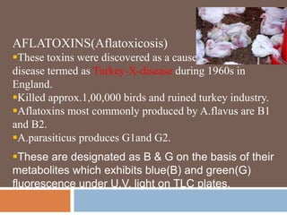
Outbreaks - Turkey X disease

Slide 20
Prevention of mycotoxin-induced disease
Avoiding
Prevent contamination and growth in food/feed
Eating a product in which molds have grown
Trimming foods with mold growth is not a good practice
Diluting
Heating can reduce the load of mold/spores
Use anaerobic packaging, reduce Aw to 0.6, freezing
Cleaning
solvent extraction methods, treatment with chemicals to inactivate afltatoxins: NH₃
Adding preservatives- organic acids prevent mold growth
Testing: old and new methods (HPLC , immune, molecular)
Drying of grains and storage environment

Slide 21
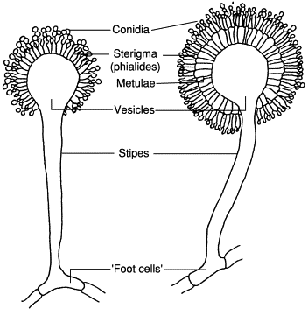
Identification
Aspergillus flavus
Colony is cottony to granular
Yellow
Long rough conidiophores
Globose vesicle
Uni and bi-seriate phialides that cover the entire vesicle
Long chains of circular conidia

