Slide 1
Anatomy and physiology of the vestibular system
Amal Abu Kteish
aabukteish@birzeit.edu

Slide 2
https://www.youtube.com/watch?v=dSHnGO9qGsE
https://www.youtube.com/watch?v=cv5Fnvn7sPE

Slide 3
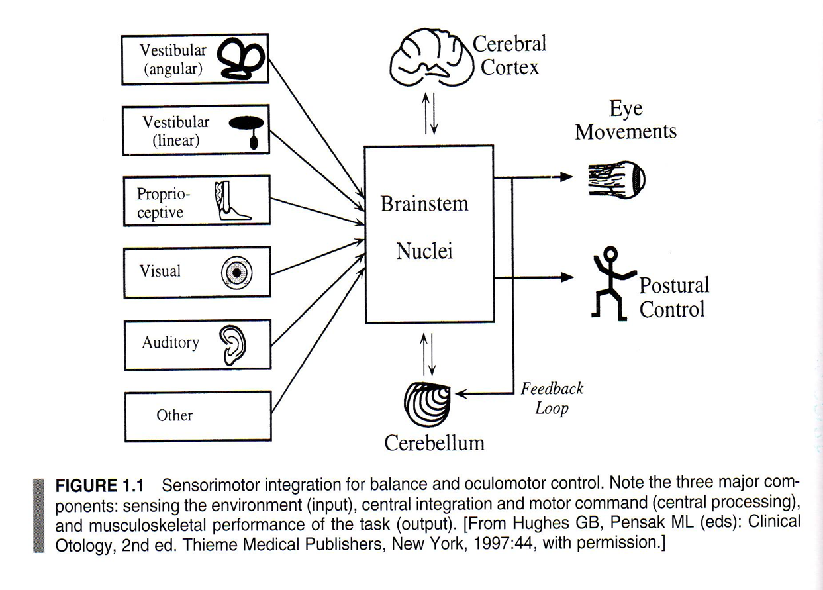
Balance

Slide 4
Overview
Vestibular system translates head movements into electrical signals.
It detects head movements and responds with postural adjustment and reflexive eye movements to stabilize images and prevent the body from falling.
Therefore any abnormality in one of the vestibular end organs will lead to loss of balance.
The vestibular function cannot be assessed directly, we assess the reflexes (secondary motor responses).

Slide 5
Cont.
The eye and body movement output of the central vestibular system is generally described in terms of three simple reflexes, the vestibulo-ocular reflex (VOR), the vestibulocollic reflex (VCR), and the vestibulospinal reflex (VSR).
The VOR generates eye movements that enable clear vision while the head is in motion.
The VCR acts on the neck musculature to stabilize the head.
The VSR generates compensatory body movement in order to maintain head and postural stability and thereby prevent falls.

Slide 6
Cont.
Vestibular end organs are located in the petrous portion of the temporal bone (bony labyrinth).
The bony labyrinth contains the membranous labyrinth that is filled with perilymph (high Na and low k) similar to CSF.
The membranous labyrinth is suspended from bony labyrinth by endolymph (high k and low Na ) similar to intracellular fluid.
Inside the membranous labyrinth lies the five vestibular end organs ; 3 semicircular canals and 2 otolith organs.

Slide 7
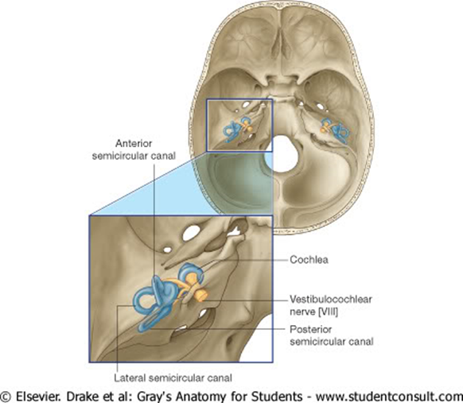

Slide 8
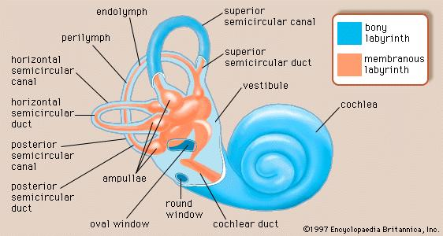

Slide 9
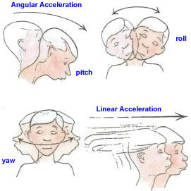
Semicircular canals
There are three semicircular canals:
lateral – horizontal
anterior - superior
posterior – inferior vertical
They respond to angular acceleration of head and convert it to electrical signals
That are transmitted
through the vestibular
nerve to the vestibular
nucleus.

Slide 10
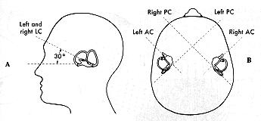
The three canals are orthogonal to each other (right angle) and respond to rotations in three dimensional space.
The canals in the right and left inner ears are arranged in complementary coplanar plains.
Meaning that the lateral canals from left and right inner ear lie in same plane.

Slide 11
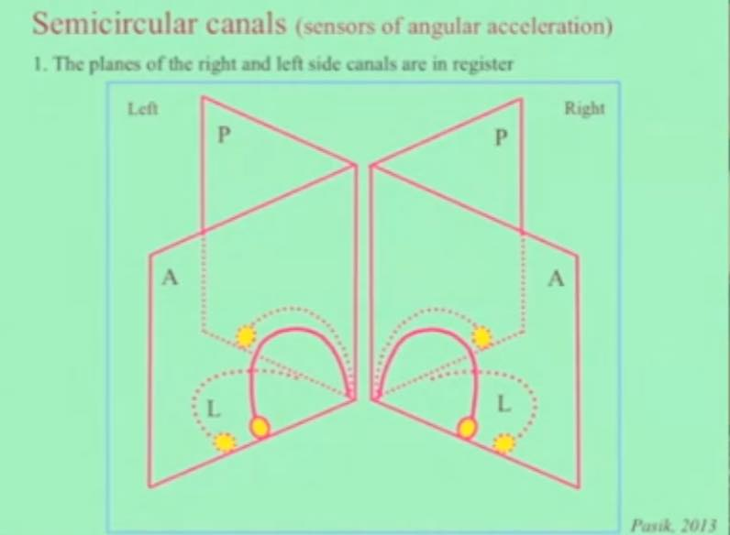

Slide 12
The canals are filled with endolymph and forms a closed
ring with a shared cavity in the utricular sac.
The lateral SCC communicates at both ends with the utricle.
The vertical canals (anterior and posterior) communicate with the utricle at one end and join together at the other end.
Each SCC is dilated at one end closest to the utricle forming the ampulla.
The ampulla is the location of the crista ampularis (where sensory hair cells are located)—the sense organ of balance.

Slide 13
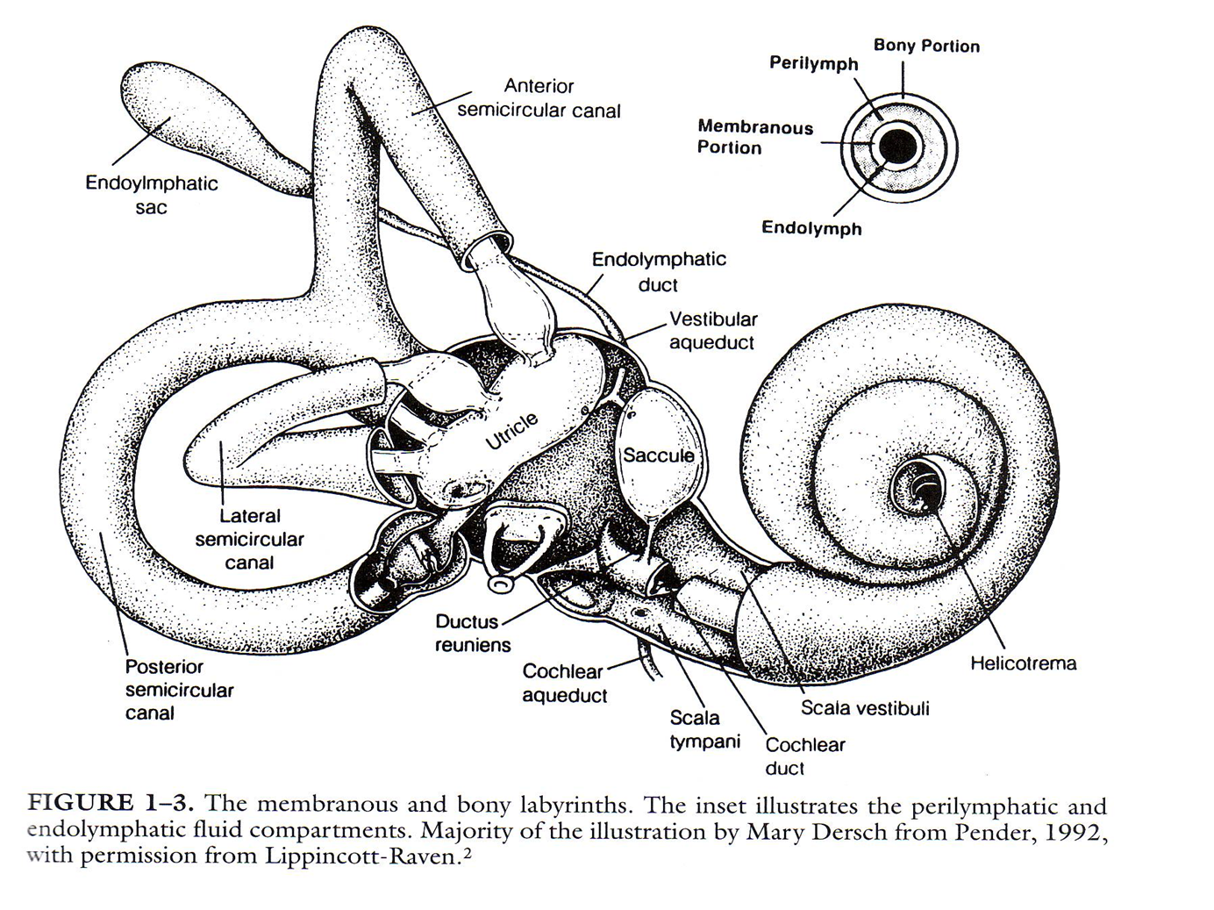

Slide 14
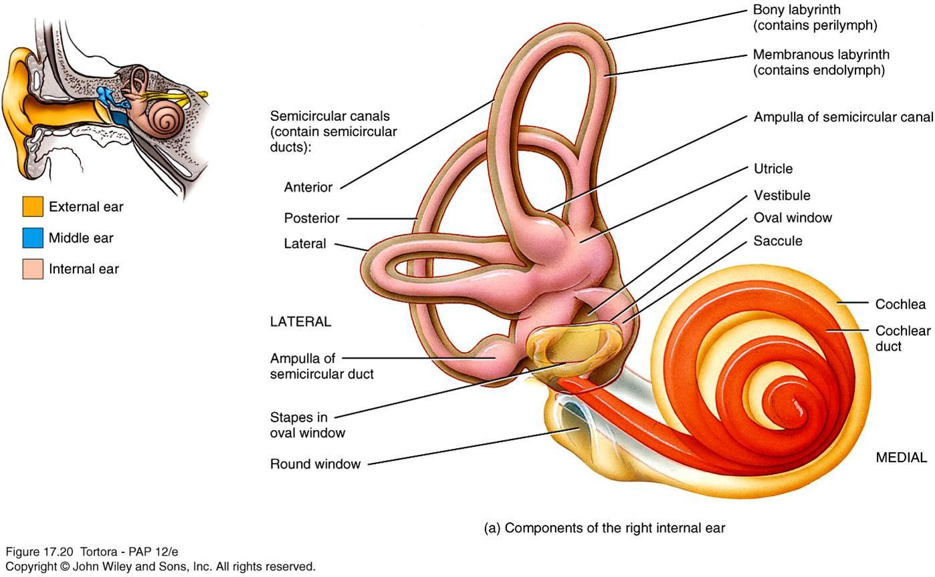

Slide 15
Approx orthogonal arrangement
Lateral canal slopes downwards and backwards by approx 30o to the horizontal (in upright human)
Longest canal is posterior – 22mm.
Shortest canal is lateral – 12 mm.

Slide 16
The SCCs enlarge at one end to form the ampulla.
Within the ampulla a gelatinous structure called the cupula.
The cupula is believed to be porous and therefore contains endolymph within its structure
The cupula has same specific gravity as the surrounding endolymph in the canal duct and is not sensitive to gravity
Positioned beneath it is the crista which contains hair cells.

Slide 17
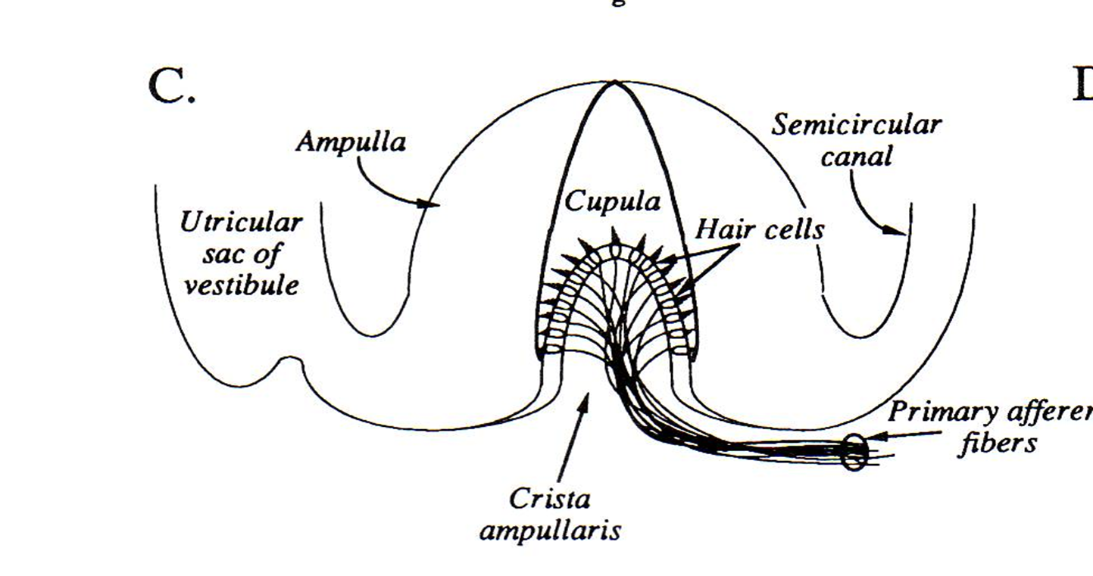

Slide 18
Otolith organs
utricle and saccule respond to linear acceleration of the head and static tilt with regards to the gravity.
The saccule responds to linear vertical acceleration because it is oriented vertically.
The utricle senses tilt horizontal translation e.g. front/back, side/side.
The saccule and utricle are filled with endolymph and each house a sensory organ called the macula.

Slide 19
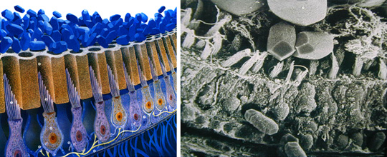
The hair cells in the macula of the otolith organs, which are similar to those in the cristae, are embedded in the otolith membrane, a gelatinous structure that contains a large number of protien calcium carbonate granules called otoconia.
The otoconia has much more mass than cupula and is sensitive to gravity
and linear
acceleration.

Slide 20
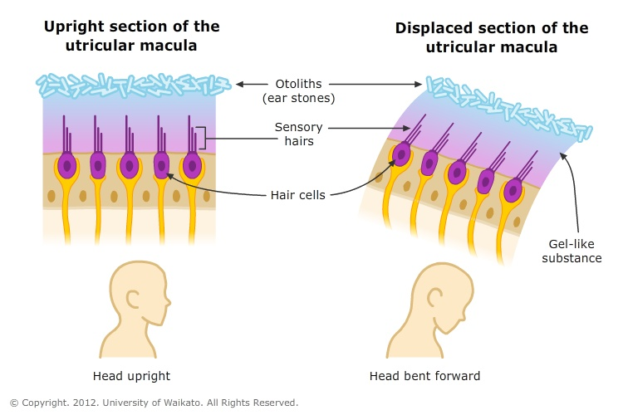

Slide 21
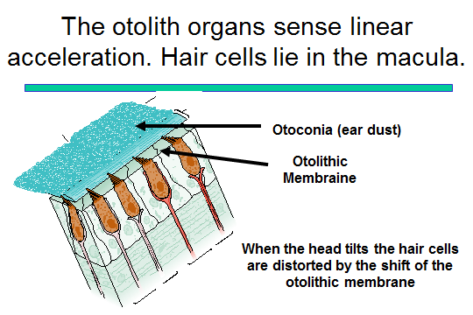

Slide 22
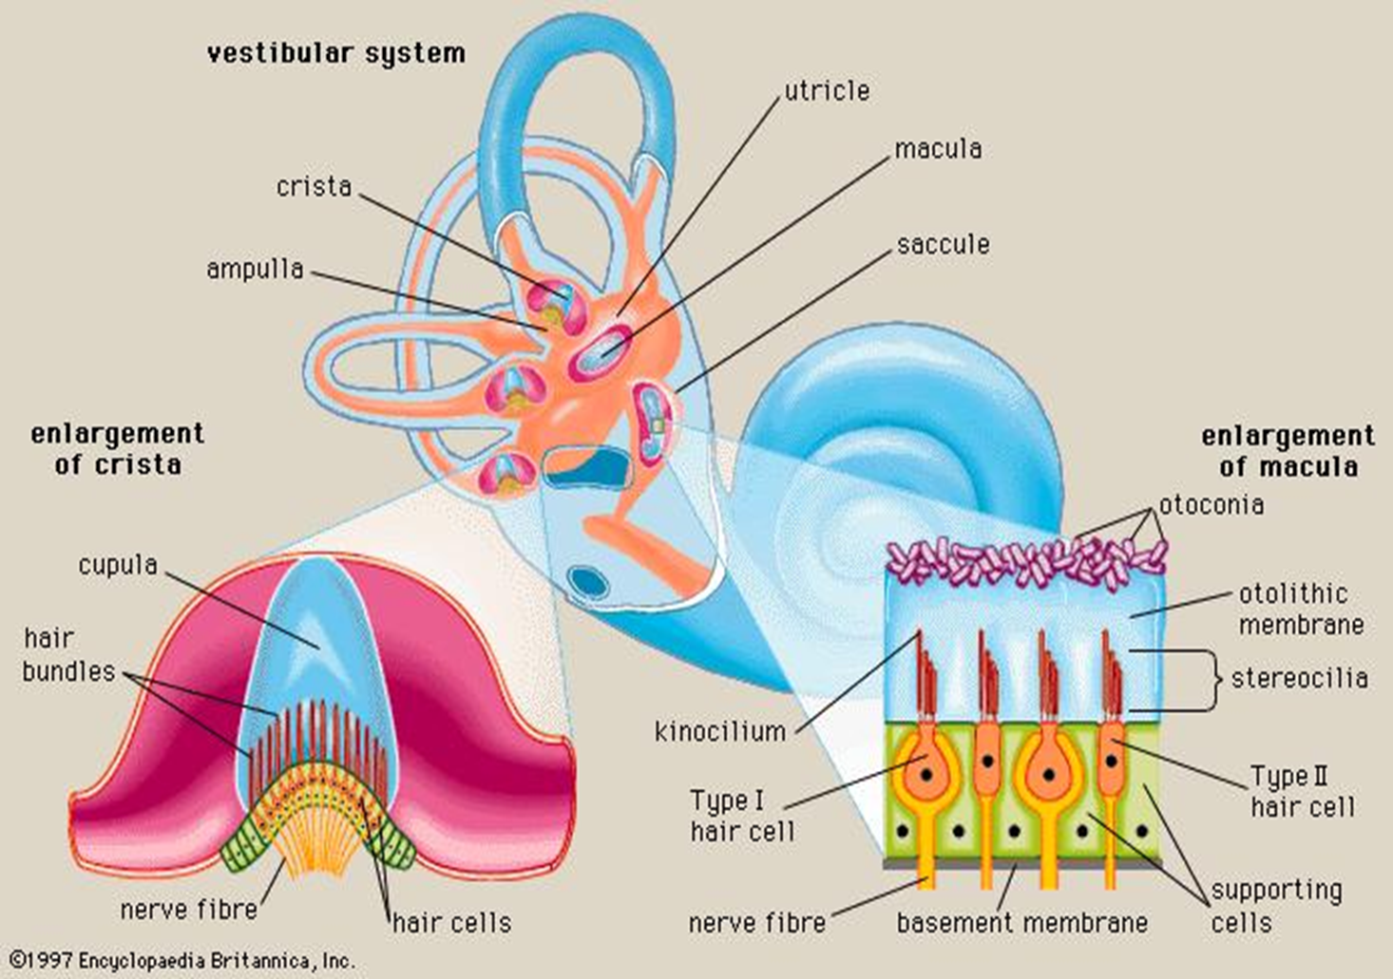

Slide 23
Hair cells
The SCCs and otolith organs both have specialized hair cells that transduce mechanical force into nerve action potential.
There two types of hair cells:
Globular or flask shaped (large nerve terminal surrounding the base).
Cylindrical (multiple nerve terminals at their base)
Each hair cell possesses several shorter stereocilia and a
single tall kinocilium at one margin of the cell.

Slide 24
Stereocilia contains ion channels.
The stimuli that causes change in hair cell movement will cause the K+ in the surrounding endolymph to come in the cells.
Each cell has presynaptic vesicles that are innervated by nerve fiber from vestibular nerve where synapses happens.

Slide 26
These ciliated sensory hair cells contain vesicles that possess neurotransmitters. The tips of the cilia are connected by tip links that open and close mechanosensory channels.
Deflection of the stereocilia toward the kinocilium opens the mechanosensory channels at the tips causing an influx of potassium effectively depolarizing (i.e., exciting) the cell.

Slide 27
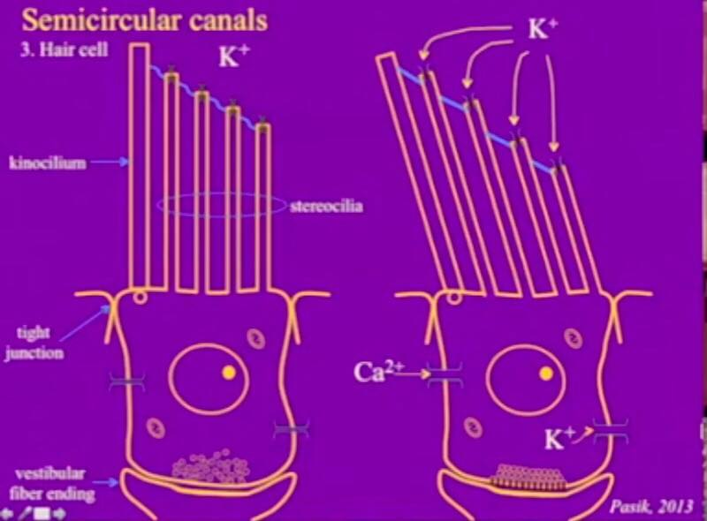

Slide 28
The excitation opens voltage-gated calcium channels releasing neurotransmitters from the hair cell and thus increasing the firing rate of the vestibular nerve associated with the hair cell.
Whereas motion of stereocilia away from kinocilium causes inhibition (hyperpolarization) decrease in neural firing rate.
In other words, the axons in the vestibular nerve are always firing at a baseline rate (tonically active) but can be adjusted to fire more or less depending on the direction of head movement.

Slide 29
In the lateral SCC the kinocilia are directed toward the utricular side of the ampulla so the firing rate increases
when endolymph moves toward the utricle and ampulla
In contrast, the kinocilia of the posterior and superior SCCs are directed toward the canal side of the ampulla so that the firing rate increases when endolymph flows away from the utricle and ampulla.

Slide 30
How does hair cell deflection happen
Subject rotates and accelerates to right
Bony and membranous labyrinths move with head
Endolymph lags behind
Produces relative flow of endolymph in the opposite direction to that of rotation
Results in cupula deflection.

Slide 31
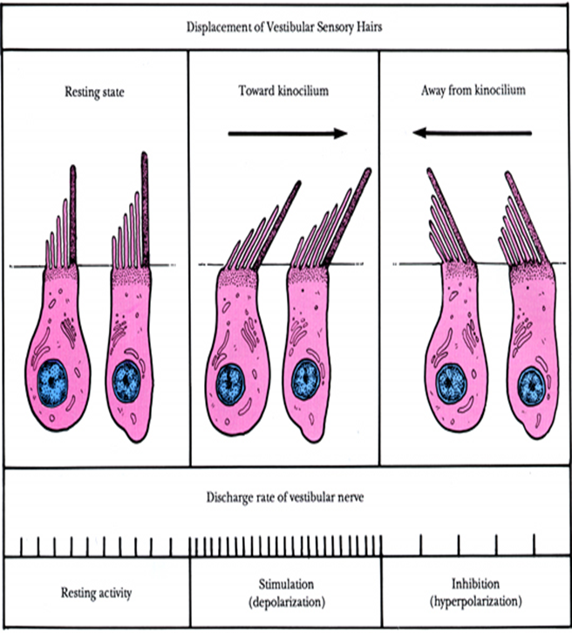
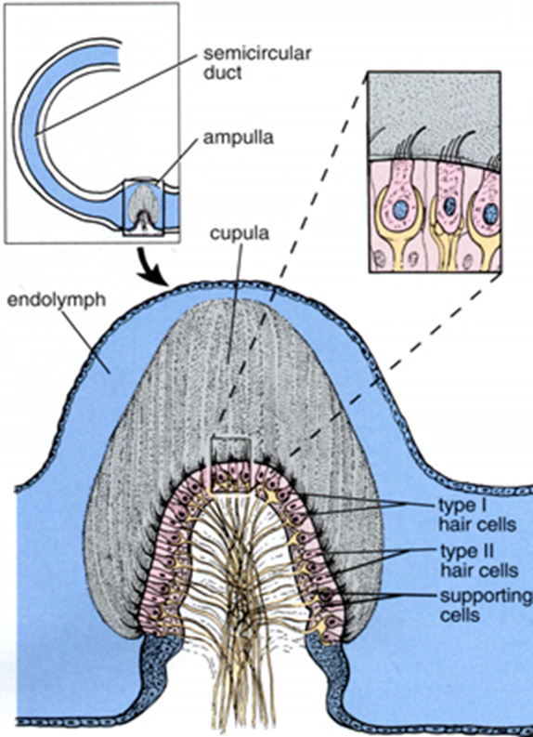

Slide 33
What happens when we rotate to the right?
With rotation to right, cupula in right lateral canal deflected towards utricle, causes excitation of neural firing
Cupula in left lateral canal deflected away from utricle, causes inhibition of neural firing
Individual perceives rotation to right

Slide 34


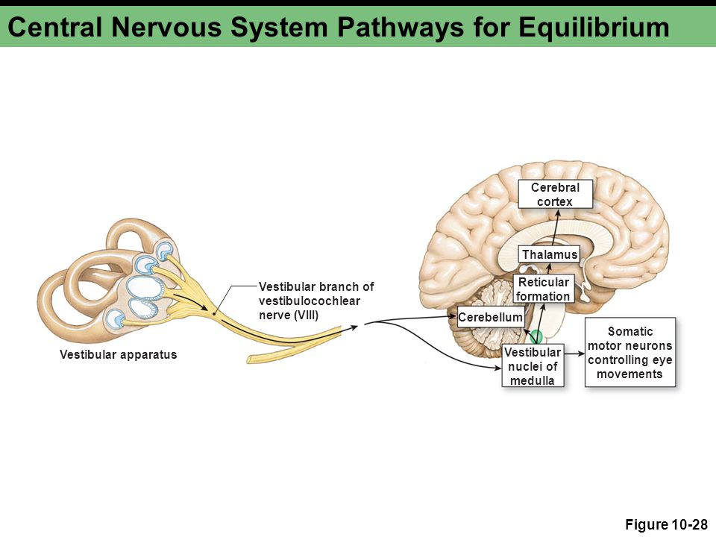
Neural pathway
Nerve fibers vestibulocochlear nerve
vestibular reflex in medulla oblongata and will decussate to thalamus primary sensory area in partial lobe of cerebral cortex

Slide 35
Ascending pathways
Vestibular nerve
Vestibular nuclei
Cerebellum
Oculomotor complex
CN 3, 4, and 6
Along with vestibulospinal reflexes coordinate head and eye movements.

Slide 36
VIII cranial nerve
The vestibular nerve consists of ∼15,000 single nerve
fibers that discharge spontaneously at rates from 10 to 100 spikes/second. This means, at any moment, there can be >1,000,000 spikes/second passing through the central vestibular system.
These fibers travel from the membranous labyrinth through the internal auditory canal and terminate in the vestibular nuclei (VN).

Slide 37
The superior portion of vestibular nerve innervates the horizontal and anterior SCC and utricle.
The inferior portion innervates the posterior SCC and saccule.

Slide 38
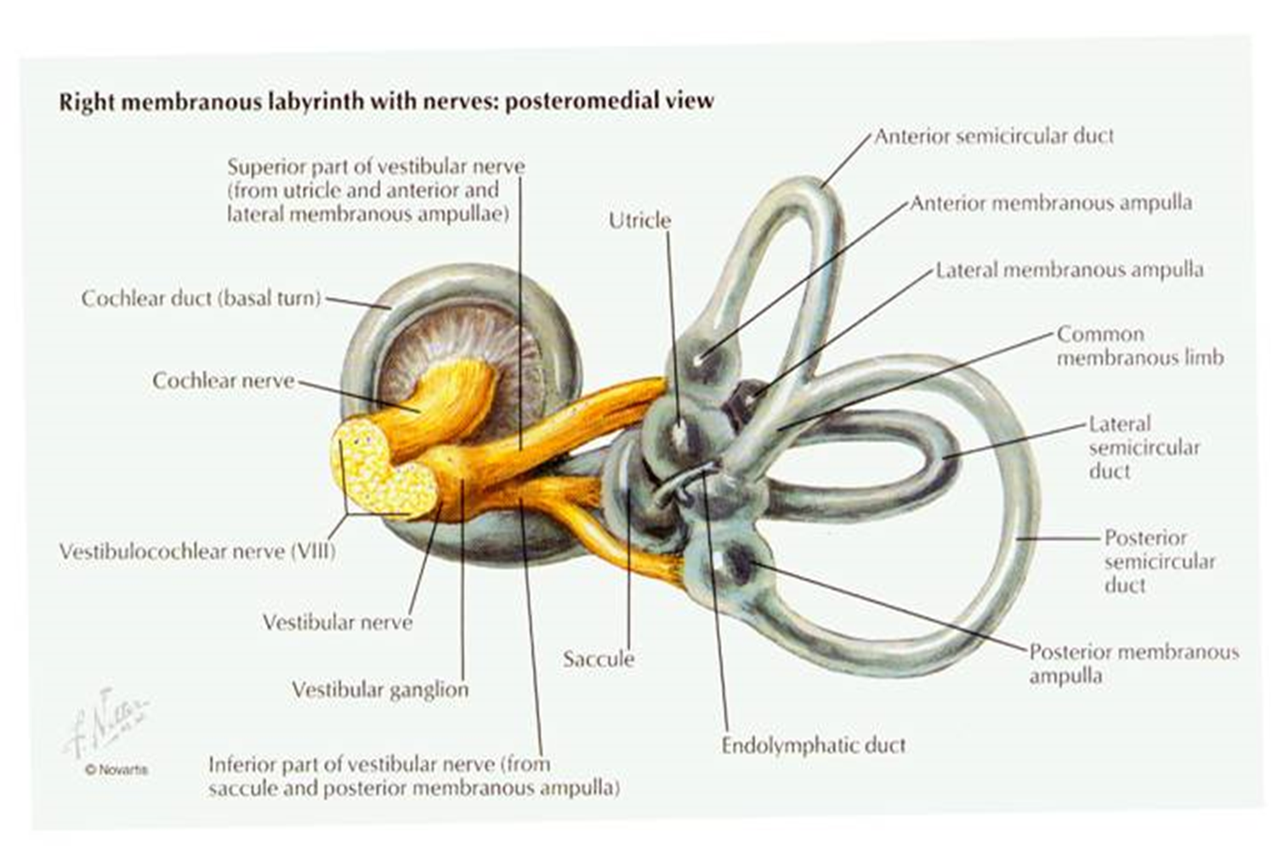

Slide 39
Vestibular nuclei
There are four main VN within the brainstem: superior, lateral, medial, and inferior/descending.
The VN receive primary input from the vestibular
portion of cranial nerve VIII.
The VN also send projections to the cerebral cortex for perception of motion and to cerebellar pathways to coordinate compensatory eye and head movements and postural changes.

Slide 40
Cerebellum
Afferents from the medial and inferior VN project to the flocculus, nodulus, uvula, and fastigial nucleus of the cerebellum. These areas of the cerebellum are collectively known as the vestibulocerebellum.

Slide 41
Thalamus
Connection with vestibular cortex and reticular formation → arousal and conscious awareness of body; discrimination between self movement vs. that of the environment
Vestibular Cortex
Junction of parietal and insular lobe Target for afferents along with the cerebellum
Both process vestibular information with somatosensory and visual input

Slide 42
