Slide 1
Chapter 12 Exception Handling and Text IO

Slide 2
Exception-Handling Overview
Show runtime error
Quotient
Run
Fix it using an if statement
QuotientWithIf
Run
With a method
QuotientWithMethod
Run

Slide 3
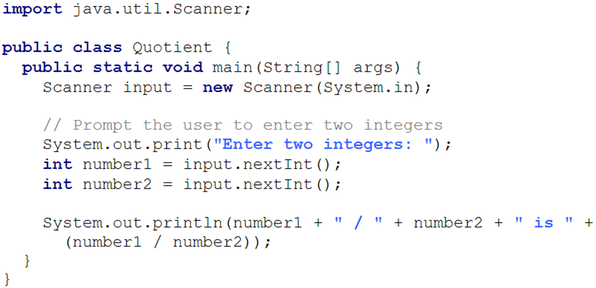
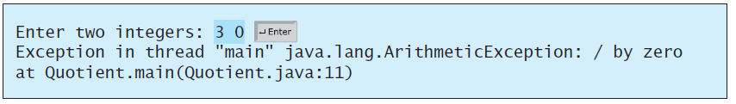
Runtime Error?

Slide 4
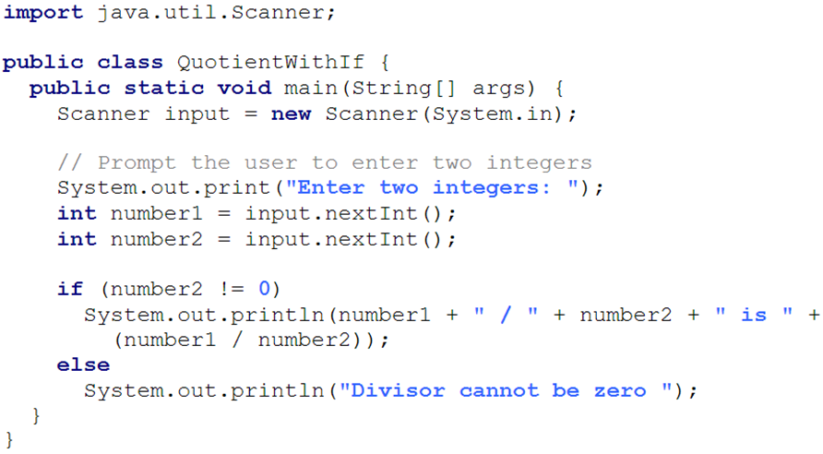
Fix it Using an if Statement

Slide 5
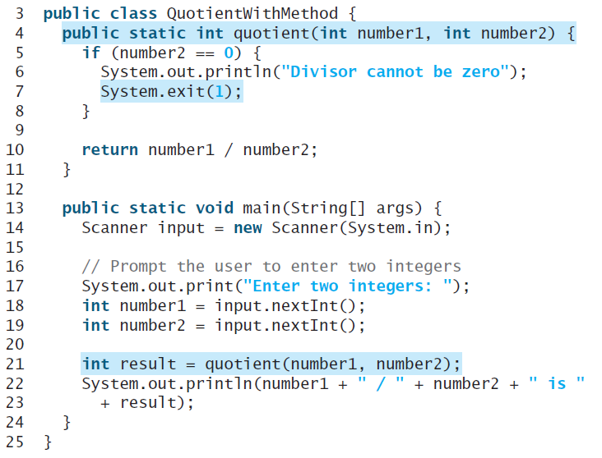
Suppose there is another method that can throw the exception

Slide 6
Exception Advantages
QuotientWithException
Run
Now you see the advantages of using exception handling. It enables a method to throw an exception to its caller. Without this capability, a method must handle the exception or terminate the program.

Slide 7
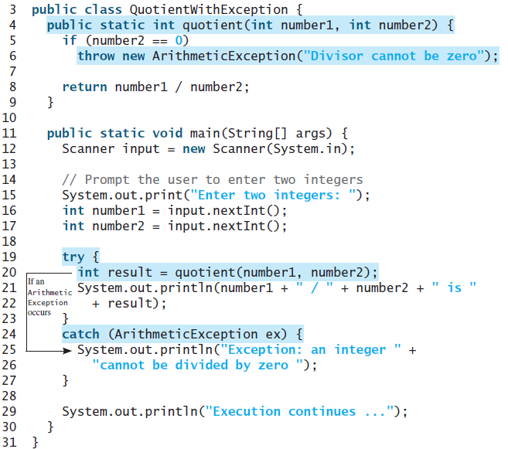

Slide 8
Handling InputMismatchException
InputMismatchExceptionDemo
Run
By handling InputMismatchException, your program will continuously read an input until it is correct.

Slide 9
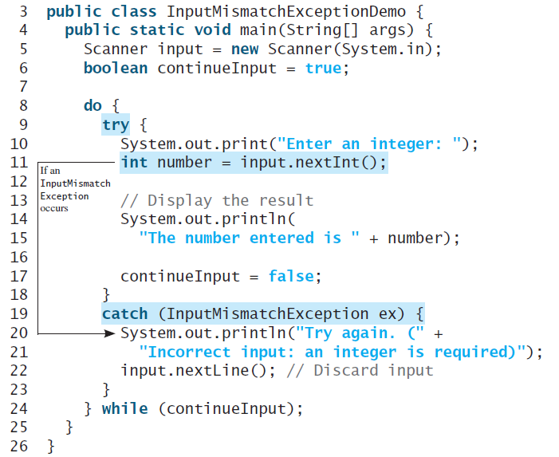
Handling an exception and continuing program execution

Slide 10
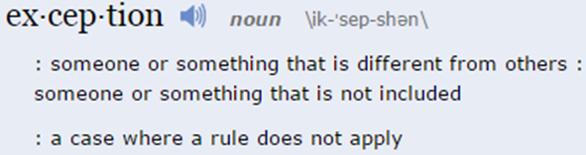
Exception Handling
Exception handling technique enables a method to throw an exception to its caller.
Without this capability, a method must handle the exception or terminate the program.

Slide 11
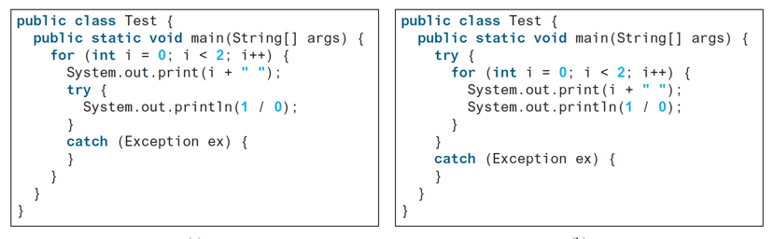
What's the Output?

Slide 12
Exception Types

Slide 13
System Errors
System errors are thrown by JVM and represented in the Error class. The Error class describes internal system errors. Such errors rarely occur. If one does, there is little you can do beyond notifying the user and trying to terminate the program gracefully.

Slide 14
Exceptions
Exception describes errors caused by your program and external circumstances. These errors can be caught and handled by your program.

Slide 15
Runtime Exceptions
RuntimeException is caused by programming errors, such as bad casting, accessing an out-of-bounds array, and numeric errors.

Slide 16
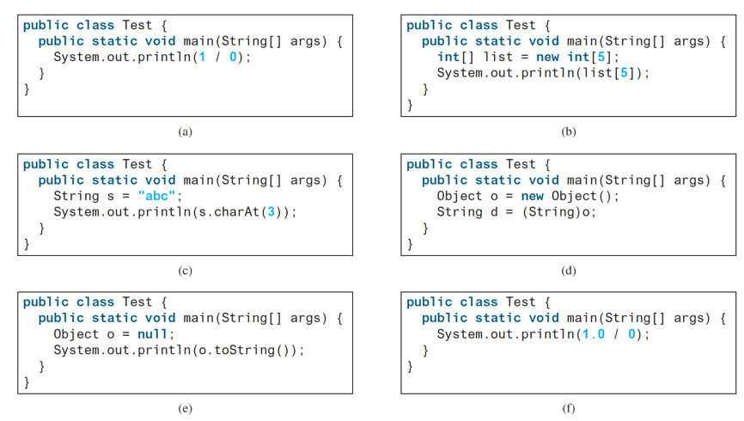
What is the Exception?!
Notes:
a. ArithmeticException
b. ArrayIndexOutOfBoundsException
c. StringIndexOutOfBoundsException
d. ClassCastException
e. NullPointerException
f. No exception

Slide 17
Checked Exceptions vs. Unchecked Exceptions
RuntimeException, Error and their subclasses are known as unchecked exceptions.
All other exceptions are known as checked exceptions, meaning that the compiler forces the programmer to check and deal with the exceptions.

Slide 18
Unchecked Exceptions
In most cases, unchecked exceptions reflect programming logic errors that are not recoverable.
For example:
  a NullPointerException is thrown if you access an object through a reference variable before an object is assigned to it.
  an IndexOutOfBoundsException is thrown if you access an element in an array outside the bounds of the array.
These are the logic errors that should be corrected in the program.

Slide 19
Unchecked Exceptions
Unchecked exception.

Slide 20
Declaring, Throwing, and Catching Exceptions

Slide 21
Declaring Exceptions
Every method must state the types of checked exceptions it might throw. This is known as declaring exceptions.
public void myMethod()
throws IOException
public void myMethod()
throws IOException, OtherException

Slide 22
Throwing Exceptions
When the program detects an error, the program can create an instance of an appropriate exception type and throw it.
This is known as throwing an exception.
throw new TheException();
TheException ex = new TheException();
throw ex;

Slide 23
Throwing Exceptions Example
/** Set a new radius */
public void setRadius(double newRadius)
throws IllegalArgumentException {
if (newRadius >= 0)
radius = newRadius;
else
throw new IllegalArgumentException(
"Radius cannot be negative");
}

Slide 24
Catching Exceptions
try {
statements; // Statements that may throw exceptions
}
catch (Exception1 exVar1) {
handler for exception1;
}
catch (Exception2 exVar2) {
handler for exception2;
}
...
catch (ExceptionN exVar3) {
handler for exceptionN;
}

Slide 25
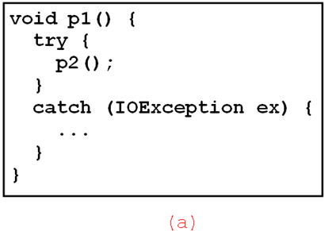
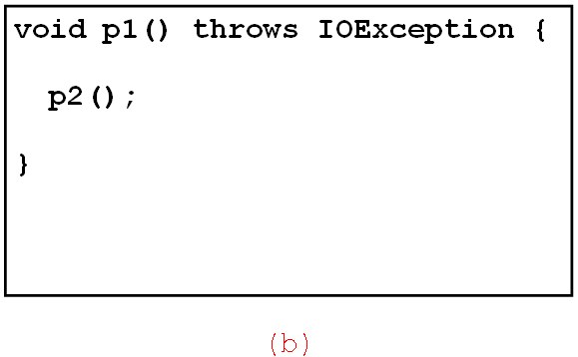
Catch or Declare Checked Exceptions
Java forces you to deal with checked exceptions.
You must invoke it in a try-catch block or declare to throw the exception in the calling method.
For example, suppose that method p1 invokes method p2 and p2 may throw a checked exception (e.g., IOException), you have to write the code as follow:

Slide 26
Catching Exceptions

Slide 27
Catch or Declare Checked Exceptions
Suppose p2 is defined as follows:

Slide 28
Catch or Declare Checked Exceptions
Java forces you to deal with checked exceptions. If a method declares a checked exception (i.e., an exception other than Error or RuntimeException), you must invoke it in a try-catch block or declare to throw the exception in the calling method. For example, suppose that method p1 invokes method p2 and p2 may throw a checked exception (e.g., IOException), you have to write the code as shown in (a) or (b).

Slide 29
Example: Declaring, Throwing, and Catching Exceptions
Objective: This example demonstrates declaring, throwing, and catching exceptions by modifying the setRadius method in the Circle class defined in Chapter 9. The new setRadius method throws an exception if radius is negative.
CircleWithException
TestCircleWithException
Run

Slide 30
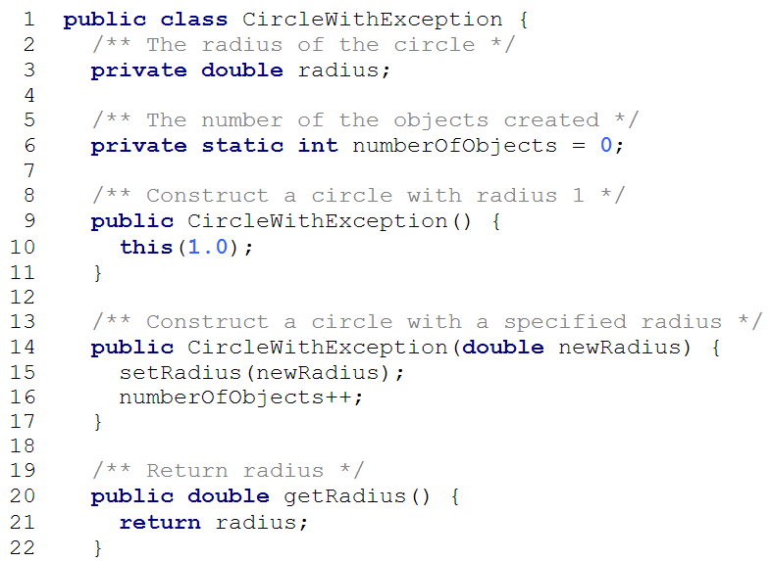
throws IllegalArgumentException

Slide 31
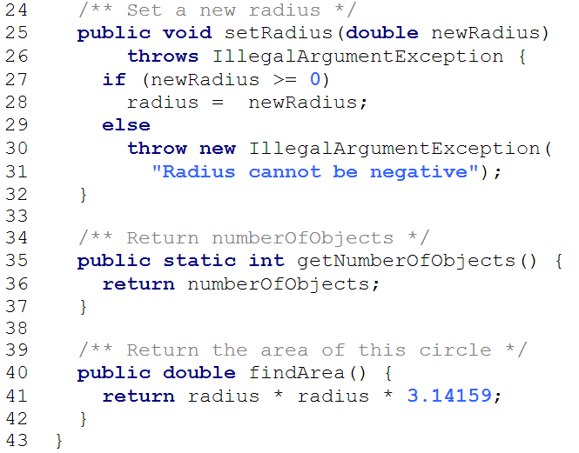

Slide 32
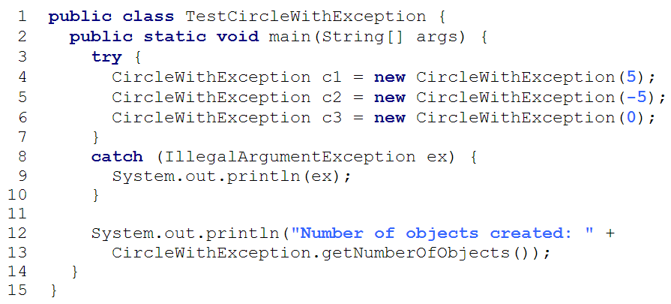

Slide 33
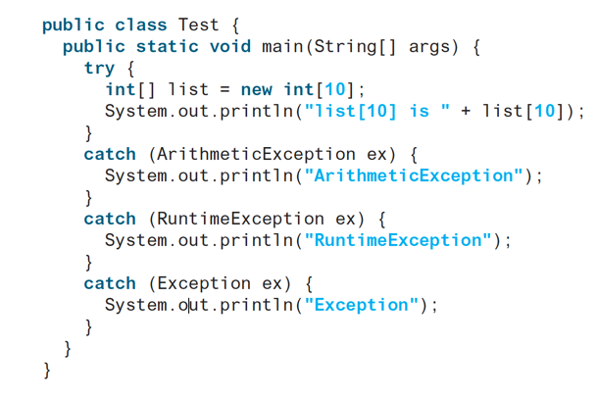
What’s the Exception?

Slide 34
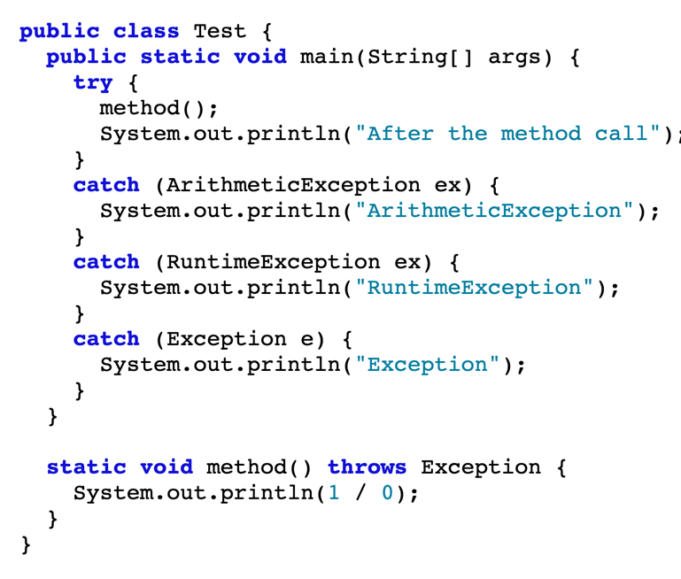
What’s the Exception?

Slide 35
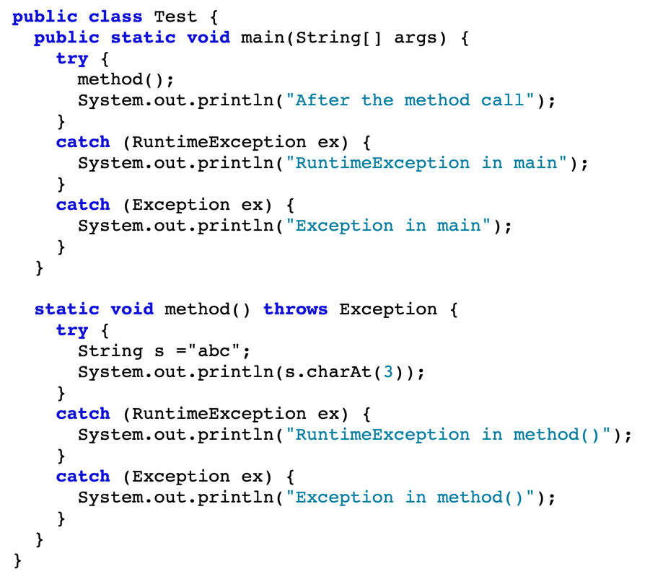
What’s the Exception

Slide 36
The finally Clause
try {
statements;
}
catch(TheException ex) {
handling ex;
}
finally {
finalStatements;
}

Slide 37
What happens?
1. If no exception arises in the try block, finally block is executed and the next statement after the try statement is executed.
2. If a statement causes an exception in the try block that is caught in a catch block, the rest of the statements in the try block are skipped, the catch block is executed, and the finally clause is executed. The next statement after the try statement is executed.
3. If one of the statements causes an exception that is not caught in any catch block, the other statements in the try block are skipped, the finally clause is executed, and the exception is passed to the caller of this method.
The finally block executes even if there is a return statement prior to reaching the finally block.
Note: The catch block may be omitted when the finally clause is used.

Slide 38
Trace a Program Execution
animation
Suppose no exceptions in the statements
try {
statements;
}
catch(TheException ex) {
handling ex;
}
finally {
finalStatements;
}
Next statement;

Slide 39
Trace a Program Execution
animation
The final block is always executed
try {
statements;
}
catch(TheException ex) {
handling ex;
}
finally {
finalStatements;
}
Next statement;

Slide 40
Trace a Program Execution
animation
Next statement in the method is executed
try {
statements;
}
catch(TheException ex) {
handling ex;
}
finally {
finalStatements;
}
Next statement;

Slide 41
Trace a Program Execution
animation
try {
statement1;
statement2;
statement3;
}
catch(Exception1 ex) {
handling ex;
}
finally {
finalStatements;
}
Next statement;
Suppose an exception of type Exception1 is thrown in statement2

Slide 42
Trace a Program Execution
animation
try {
statement1;
statement2;
statement3;
}
catch(Exception1 ex) {
handling ex;
}
finally {
finalStatements;
}
Next statement;
The exception is handled.

Slide 43
Trace a Program Execution
animation
try {
statement1;
statement2;
statement3;
}
catch(Exception1 ex) {
handling ex;
}
finally {
finalStatements;
}
Next statement;
The final block is always executed.

Slide 44
Trace a Program Execution
animation
try {
statement1;
statement2;
statement3;
}
catch(Exception1 ex) {
handling ex;
}
finally {
finalStatements;
}
Next statement;
The next statement in the method is now executed.

Slide 45
Trace a Program Execution
animation
try {
statement1;
statement2;
statement3;
}
catch(Exception1 ex) {
handling ex;
}
catch(Exception2 ex) {
handling ex;
throw ex;
}
finally {
finalStatements;
}
Next statement;
statement2 throws an exception of type Exception2.

Slide 46
Trace a Program Execution
animation
try {
statement1;
statement2;
statement3;
}
catch(Exception1 ex) {
handling ex;
}
catch(Exception2 ex) {
handling ex;
throw ex;
}
finally {
finalStatements;
}
Next statement;
Handling exception

Slide 47
Trace a Program Execution
animation
try {
statement1;
statement2;
statement3;
}
catch(Exception1 ex) {
handling ex;
}
catch(Exception2 ex) {
handling ex;
throw ex;
}
finally {
finalStatements;
}
Next statement;
Execute the final block

Slide 48
Trace a Program Execution
animation
try {
statement1;
statement2;
statement3;
}
catch(Exception1 ex) {
handling ex;
}
catch(Exception2 ex) {
handling ex;
throw ex;
}
finally {
finalStatements;
}
Next statement;
Rethrow the exception and control is transferred to the caller

Slide 49
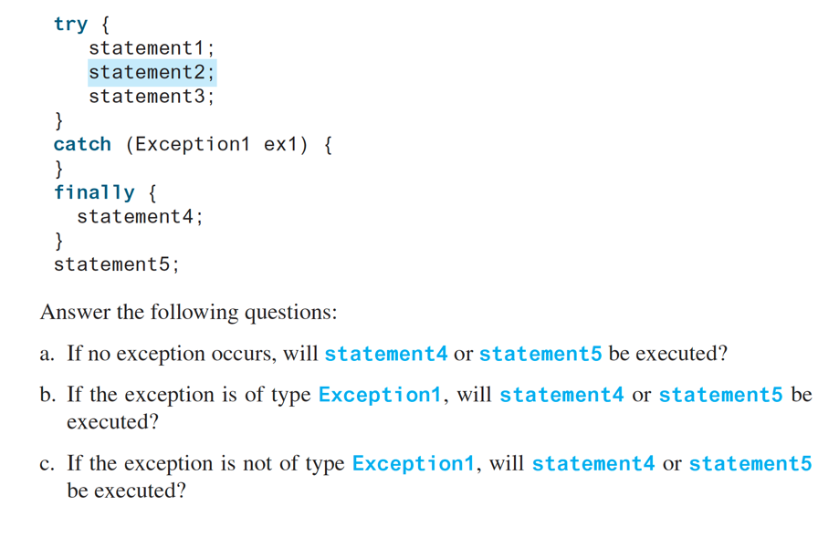
Answer this

Slide 50
Cautions When Using Exceptions
Exception handling separates error-handling code from normal programming tasks, thus making programs easier to read and to modify.
Be aware, however, that exception handling usually requires more time and resources because it requires instantiating a new exception object, rolling back the call stack, and propagating the errors to the calling methods.

Slide 51
When to Throw Exceptions
An exception occurs in a method.
If you want the exception to be processed by its caller, you should create an exception object and throw it.
If you can handle the exception in the method where it occurs, there is no need to throw it.

Slide 52
Rethrowing Exceptions
try {
statements;
}
catch(TheException ex) {
perform operations before exits;
throw ex;
}

Slide 53
When to Use Exceptions
When should you use the try-catch block in the code? You should use it to deal with unexpected error conditions.
Do not use it to deal with simple, expected situations. For example, the following code
try {
System.out.println(refVar.toString());
}
catch (NullPointerException ex) {
System.out.println("refVar is null");
}

Slide 54
When to Use Exceptions
is better to be replaced by
if (refVar != null)
System.out.println(refVar.toString());
else
System.out.println("refVar is null");

Slide 55
Defining Custom Exception Classes
Use the exception classes in the API whenever possible.
Define custom exception classes if the predefined classes are not sufficient.
Define custom exception classes by extending Exception or a subclass of Exception.

Slide 56
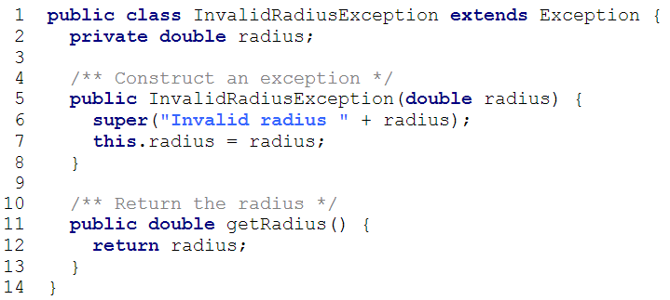
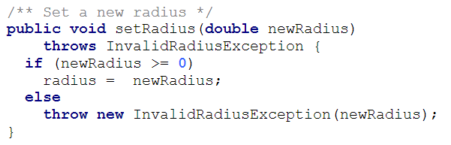
Custom Exception Class Example
In Listing 13.8, the setRadius method throws an exception if the radius is negative. Suppose you wish to pass the radius to the handler, you have to create a custom exception class.
InvalidRadiusException
CircleWithRadiusException
TestCircleWithRadiusException
Run

Slide 57
The File Class
The File class is intended to provide an abstraction that deals with most of the machine-dependent complexities of files and path names in a machine-independent fashion.
The filename is a string.
The File class is a wrapper class for the file name and its directory path.

Slide 58
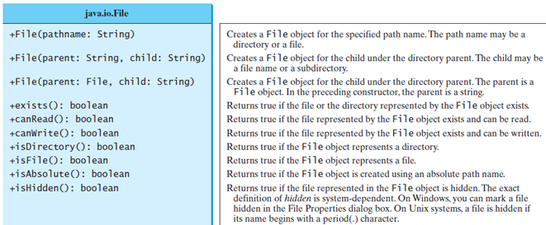
File class

Slide 59
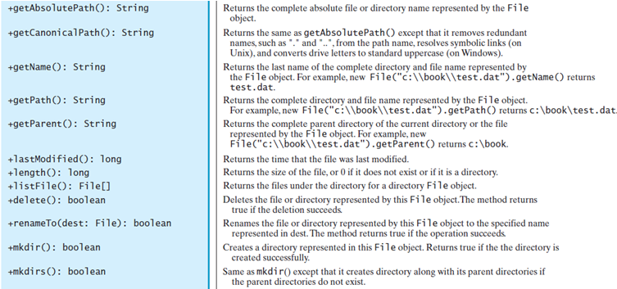
File class

Slide 60
Text I/O
A File object encapsulates the properties of a file or a path, but does not contain the methods for reading/writing data from/to a file.
In order to perform I/O, you need to create objects using appropriate Java I/O classes.
The objects contain the methods for reading/writing data from/to a file.
This section introduces how to read/write strings and numeric values from/to a text file using the Scanner and PrintWriter classes.

Slide 61
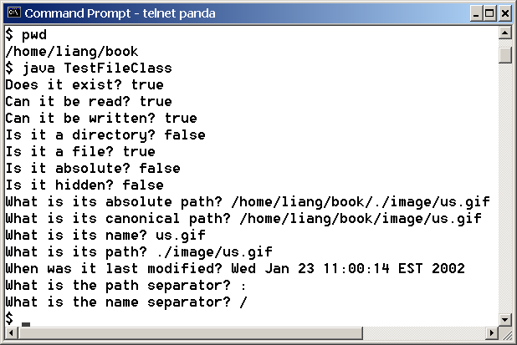
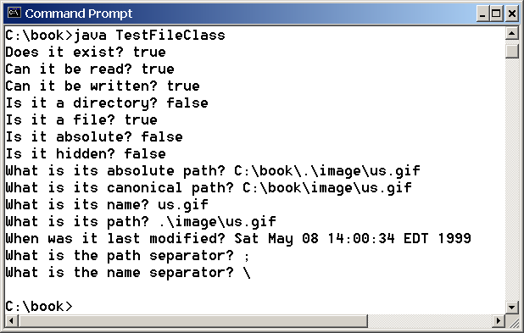
Problem: Explore File Properties
Objective: Write a program that demonstrates how to create files in a platform-independent way and use the methods in the File class to obtain their properties. The following figures show a sample run of the program on Windows and on Unix.
TestFileClass
Run

Slide 62
Writing Data Using PrintWriter
WriteData
Run

Slide 63
Try-with-resources
Programmers often forget to close the file. JDK 7 provides the followings new try-with-resources syntax that automatically closes the files.
try (declare and create resources) {
Use the resource to process the file;
}
WriteDataWithAutoClose
Run

Slide 64
Reading Data Using Scanner
ReadData
Run

Slide 65
Problem: Replacing Text
Write a class named ReplaceText that replaces a string in a text file with a new string. The filename and strings are passed as command-line arguments as follows:
  java ReplaceText sourceFile targetFile oldString newString
For example, invoking
  java ReplaceText FormatString.java t.txt StringBuilder StringBuffer
replaces all the occurrences of StringBuilder by StringBuffer in FormatString.java and saves the new file in t.txt.
ReplaceText
Run

Slide 66
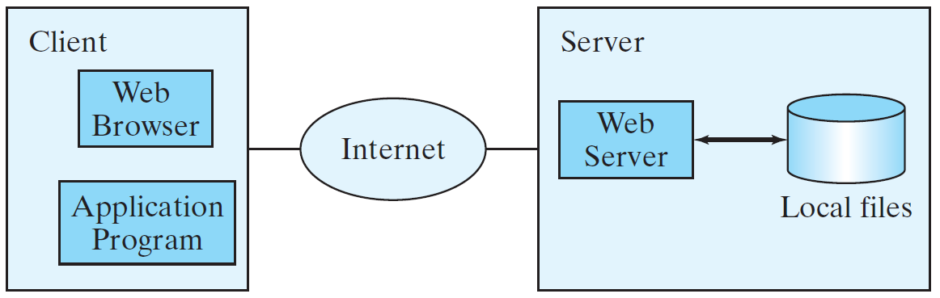
Reading Data from the Web
Just like you can read data from a file on your computer, you can read data from a file on the Web.

Slide 67
Reading Data from the Web
URL url = new URL("www.google.com/index.html");
After a URL object is created, you can use the openStream() method defined in the URL class to open an input stream and use this stream to create a Scanner object as follows:
Scanner input = new Scanner(url.openStream());
ReadFileFromURL
Run

