Slide 1

Referencing for Academic Writing
Final Year Project
Dr. Samer Zein

Slide 2
What is Referencing?
Referencing is the process of acknowledging other people’s work when you have used it as evidence in your assignments, presentations or research.
It is vital that you distinguish their work from your own contribution, and you do this by referencing.
It allows your reader to locate the source material easily so that they can verify the validity of your arguments.
Academic Referencing, CS Dept., Birzeit University
Dr. Samer Zein

Slide 3
How it is done?
You identify or cite the sources you have used by placing indicators in the text of your assignment, called citations or in-text citations.
Full details of the original sources are provided in a reference list at the end of your work.
In some cases you may also need to include a bibliography, which includes all material used in the preparation of your work, both cited items and background reading you did not cite
Academic Referencing, CS Dept., Birzeit University
Dr. Samer Zein

Slide 4
A measure of creditability
It builds on other skills, including searching for relevant sources of information evaluating the:
  Academic credibility of sources,
  Distinguishing between facts and opinions in other authors’ work,
  Understanding how their work can influence and evidence your thoughts on the subject,
  And being able to communicate your views in writing and speaking
Academic Referencing, CS Dept., Birzeit University
Dr. Samer Zein

Slide 5
When you should reference?
You are expected to reference every time you use someone else’s work or ideas in your own work.
This includes
  all material available on the internet.
  Journal papers
  Conference papers.
  Reports
  Dissertations
  Books
Academic Referencing, CS Dept., Birzeit University
Dr. Samer Zein

Slide 6
What is Plagiarism?
Plagiarism means the unacknowledged use of someone else’s work.
This includes material or ideas from any (published or
unpublished) sources, whether print, electronic (even if freely available on the internet) or audiovisual.
Using the words or ideas of others without citing and referencing them would be construed as plagiarism and is a very serious academic offence.
Academic Referencing, CS Dept., Birzeit University
Dr. Samer Zein

Slide 7
IEEE Citation Style
The IEEE style is a numeric style, where citations are numbered [1] in the order of appearance.
This citation leads your reader to a full reference to the source in the list of references at the end of your work.
Each citation number should be enclosed in square brackets on the same line as the text, before any punctuation, with a space before the bracket [2].
Once a source has been cited, the same number is re-used for all subsequent citations to the same source.
Academic Referencing, CS Dept., Birzeit University
Dr. Samer Zein

Slide 8
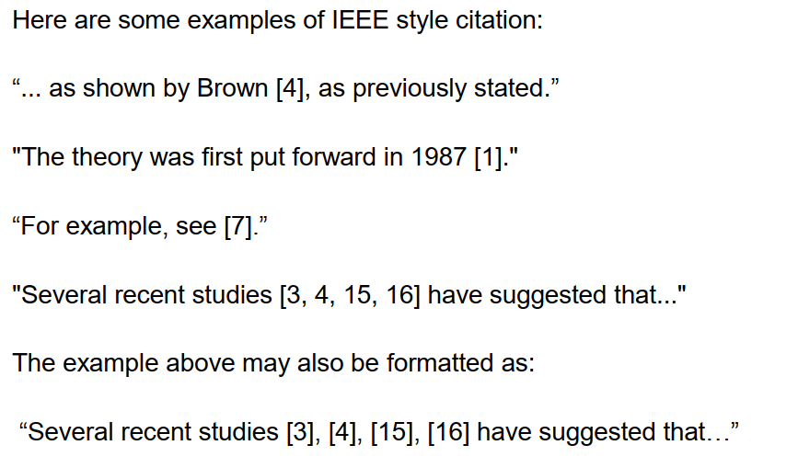
Examples of in-text Citation.
Academic Referencing, CS Dept., Birzeit University
Dr. Samer Zein

Slide 9
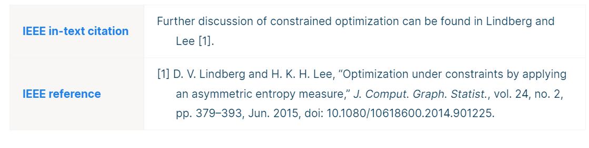
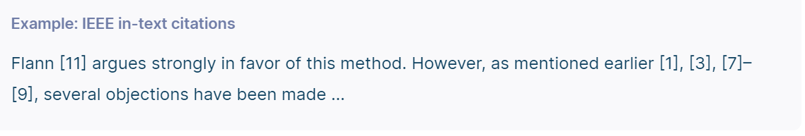
Examples cont.
Academic Referencing, CS Dept., Birzeit University
Dr. Samer Zein

Slide 10
Examples: Quoting text from other source
When directly quoting a source, you should include the citation number in square brackets immediately following the quote.
You should also put the quoted text in quotation marks and include the page number (if available) from which the quote is taken.
Example: Let's say you are quoting from a journal article:
"The integration of AI in software engineering is transforming traditional development practices" [1, p. 123].
Academic Referencing, CS Dept., Birzeit University
Dr. Samer Zein

Slide 11
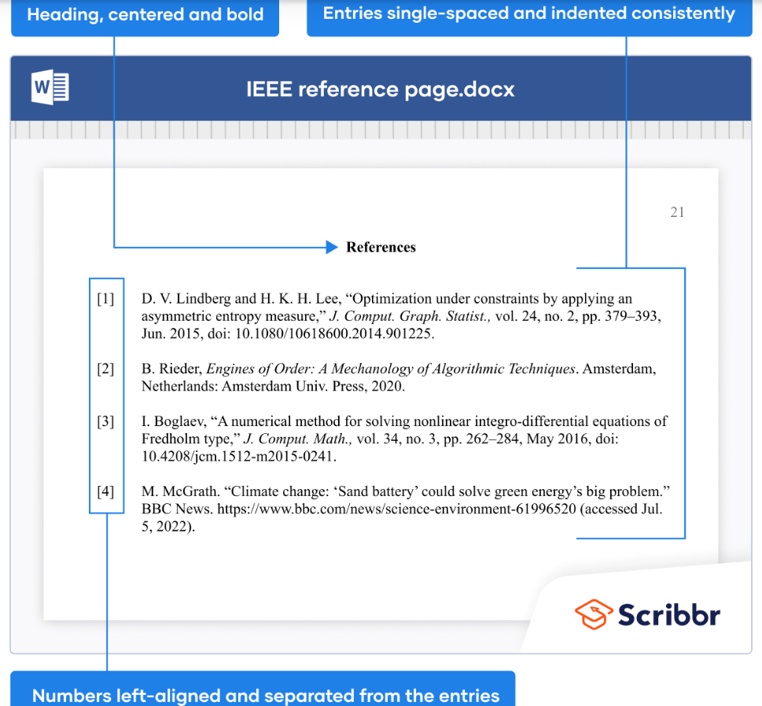
Dr. Samer Zein

Slide 12
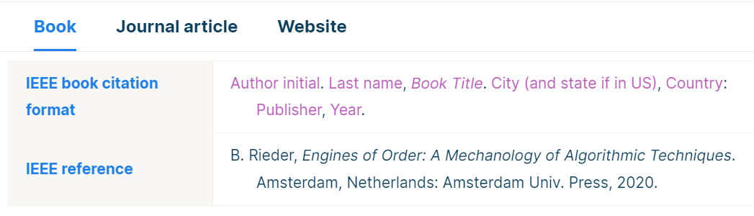
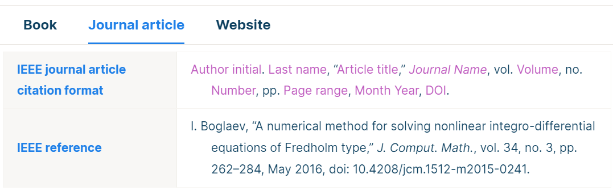
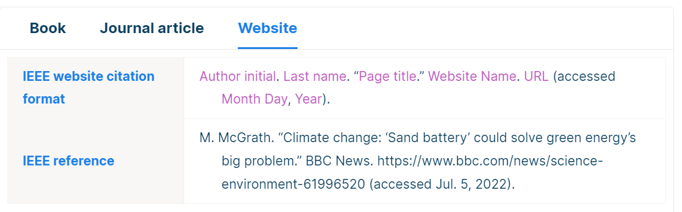
Academic Referencing, CS Dept., Birzeit University
Dr. Samer Zein

