Slide 1

Fundamentals of nursing NURS 1100“LAB”
Iron deficiency anemia
Name : Fatima Yousef
Student number :1201624

Slide 2

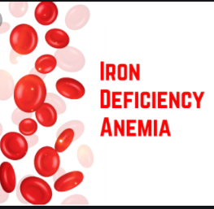
Contents:-
1-Definition of Iron deficiency anemia
2- Signs and symptoms
3- Causes
4-Diagnosis
5-Treatment
6-Care plan as a nurse
7-References

Slide 3
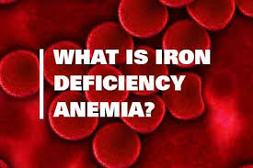
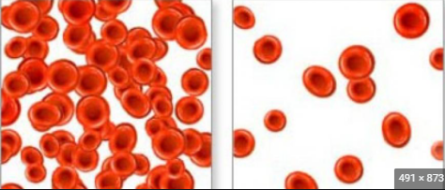
Iron deficiency anemia
normal
anemia
Is the most common type of anemia, and it occurs when your body doesn’t have enough of the mineral Iron, your body needs iron to make hemoglobin , when there isn’t enough iron in your blood stream , the rest of your body can’t get the amount of oxygen it needs..

Slide 4
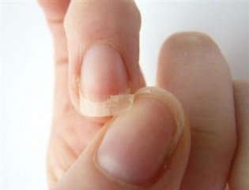
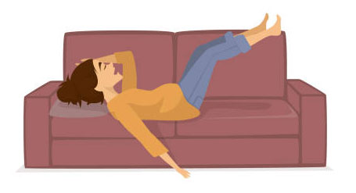

Signs and symptoms :-
Anemia resulting from iron deficiency is slight to a degree
that we do not notice, and whenever the level of iron in the
blood decreases, symptoms of the disease appear, including :
Extreme fatigue
Weakness
Pale skin
Chest pain, fast heartbeat or shortness of breath
Headache, dizziness
Cold hands and feet
Inflammation or soreness of your tongue
Brittle nails
Unusual cravings for non-nutritive substances, such as ice,
dirt or starch
Poor appetite, especially in infants and children

Slide 5
Causes:-
Iron deficiency anemia occurs when the body does not have enough iron to produce hemoglobin, and the reasons for this occurrence include:-
1- Inadequate iron intake.
2-Pregnancy or blood loss due to menstruation.
3-Internal bleeding.
4-Inability to absorb iron.
5- Endometriosis

Slide 6
Diagnosis
A doctor can diagnose anemia with blood tests, These include:
-Complete blood cell (CBC) test
CBC measures the amount of all components in the blood, including:
- Red blood cells ( RBCs )
- White blood cells ( WBCs )
- hemoglobin
- Hematocrit
- platelets

Slide 7
-test blood through A microscope
These blood tests will provide information, including:
-the iron level in blood
-RBC size and color (RBCs are pale i they’re deficient in iron)
-ferritin levels
-total iron – binding capacity (TIBC)
-Tests for internal bleeding

Slide 8
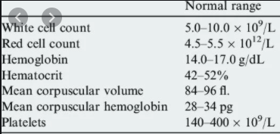
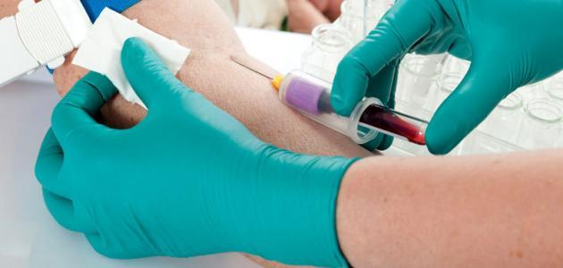
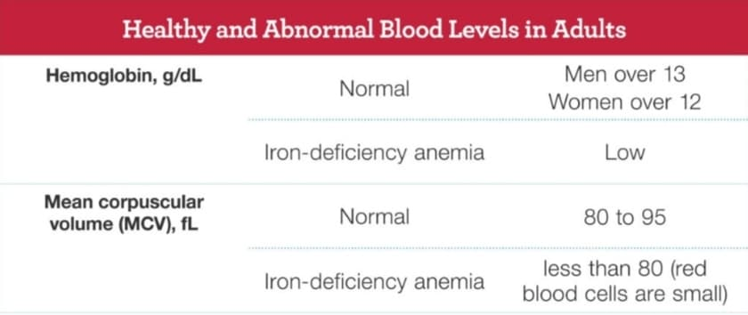

Slide 9
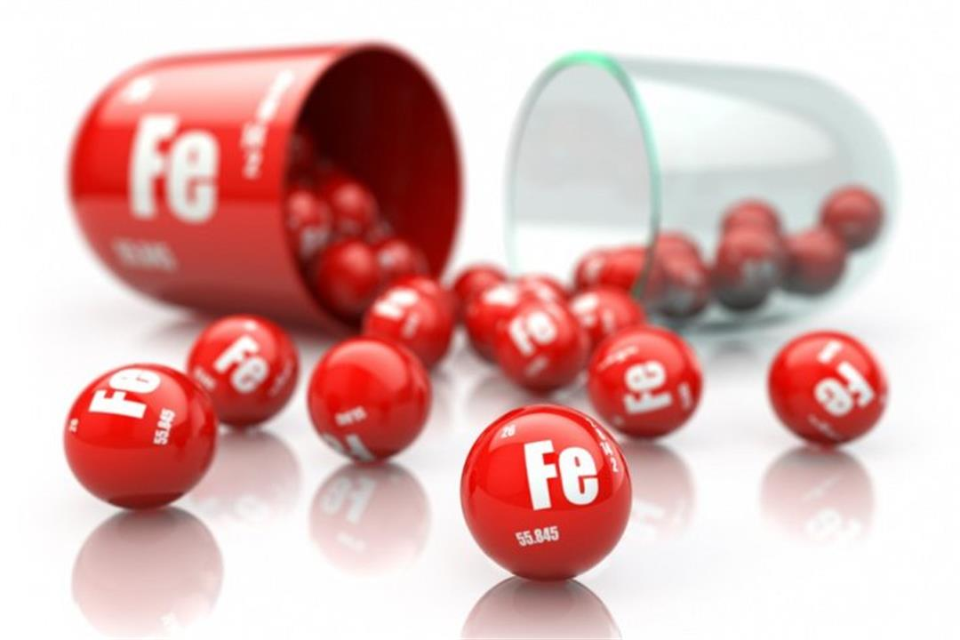
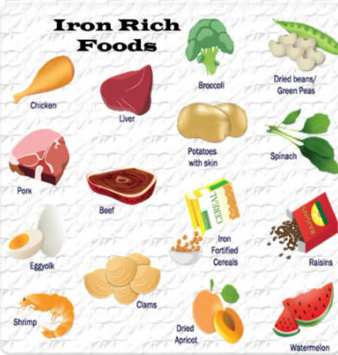
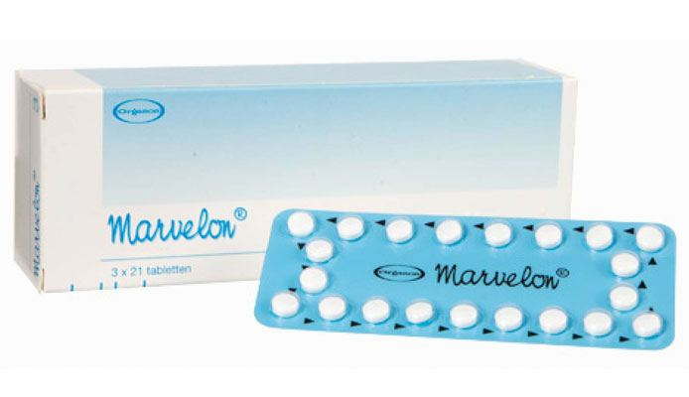
Treatment :-
-Iron supplements
-Diet
-Treating the underlying
cause of bleeding

Slide 10

Care plan as a nurse 1:-
risk for Fatigue r/t Decreased hemoglobin and diminished oxygen-carrying capacity of the blood.
Nursing diagnosis | goals | Desired outcome: the client will
Fatigue r/t low red blood cell count | Increase iron , folic acid , and vitamin B intake | Verbalize use of energy conservation principles

Slide 11

Care plan as a nurse 2
Risk for decreased cardiac output related to inadequate RBC’s pumped by the heart to meet the oxygen needs of the tissues.
Nursing Interventions | Rationale
Monitor pulse oximetry and report O2 saturation <92%. | O2 sat of <92% indicates the need to supplement oxygen in the myocardium.
Measure and chart Intake and output q shift. | Decreased urine output may be a sign of decreased renal perfusion from a decreased in cardiac output

Slide 12
Care plan as a nurse 3 :-
Risk for bleeding
Nursing Interventions | Rationale
Instruct the client about bleeding precautions .Instruct the client to use an electric shaver, not a razor. Use a soft toothbrush when brushing the teeth. Using pads instead of tampons. | Once the client’s platelet count drops to 50,000mm^{3,} bleeding precaution should be instituted immediately to avoid risk of spontaneous bleeding.
Anticipate the need for a platelet transfusion once the platelet count drops to a very low value. | Platelet replacement may be required to reduce the risk of bleeding.

Slide 13
References:-
https://nursestudy.net/anemia-care-plan/?fbclid=IwAR1eV-_M6TMwwULNMaNbQuTuMIzScRNlnHB00ltanMI_GQIRBCTbv69DlGk
https://nurseslabs.com/4-anemia-nursing-care-plans/4/
https://www.healthline.com/health/iron-deficiency-anemia#causes
https://www.mayoclinic.org/diseases-conditions/iron-deficiency-anemia/symptoms-causes/syc-20355034

