Slide 1

FUNDAMENTALS OF NURSING 1- LAB
Presentation 1
Atherosclerosis
Student Name: Yafa Nimer Ahmad Abu Layya
Number: 1201212
Instructor: Mr. Maram Jaghama

Slide 2
Objectives:
I'm going to talk about ☺
Definition of Atherosclerosis.
Clarification of Signs and symptoms.
Explain the Causes.
The Diagnosis.
Describe the Treatment.
Care Plan as a nurse.

Slide 3
Atherosclerosis
Atherosclerosis: is the most common arterial disease. The term means "hardening of the arteries", abnormal accumulation of fat, calcium, blood components, carbohydrates, and glial tissue within (the lining) arterial walls of large and medium-sized and the lumen, and this may cause an occlusion in the artery if it accumulates more and more until blocking the lumen, or may occur decrease in blood flow through it. And atherosclerosis can develop at any point in the body, but some areas are in danger, such as areas where arterioles divide or branch into smaller vessels.

Slide 4
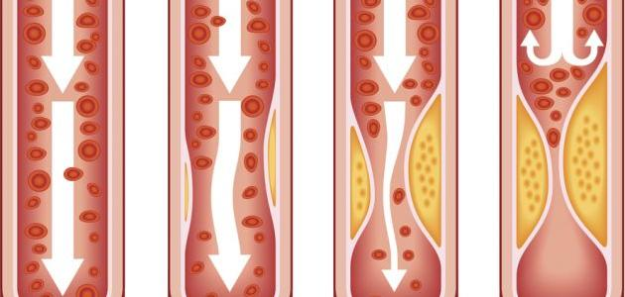

Slide 5
Signs and Symptoms:
The clinical signs and symptoms resulting from atherosclerosis depend on the organ or tissue affected.
Obese.
Hypertension .
High Cholesterol.
Confusion.*
Dyspnea.
Exhaustion and stress.
Tachycardia.
Notes:
Confusion: If there is a blockage in the arteries supplying the brain with blood, and for those who suffer from mental problems, such as: The patient suffers from acute kidney failure due to a high level of creatinine in the blood.

Slide 6
8. Pain – can be on the chest (if coronary artery is affected) or the limbs (if peripheral arteries are affected) especially the legs.
9. Palpitations.
10. Fatigue.
11. Weakness or myalgia.
Atherosclerosis develops gradually. Mild atherosclerosis usually doesn't have any symptoms. Symptoms of moderate to severe atherosclerosis depend on which arteries are affected.

Slide 7
Causes:
Smoking and other sources of tobacco.*
High blood pressure.
High cholesterol and High triglycerides, a type of fat (lipid) in your blood.
Insulin resistance, obesity or diabetes.
Inflammation from diseases, such as arthritis, lupus or infections, or inflammation of unknown cause.
Notes:
1. Carbon monoxide, a toxin produced by burning tobacco, combines more readily with hemoglobin than oxygen, depriving the tissues of oxygen. The amount of tobacco used, inhaled or chewed, is directly related to the extent of the disease, and cessation of tobacco use reduces the risks.

Slide 8
Diagnosis:
Your doctor will start with a physical exam. They’ll listen to your arteries and check for weak or absent pulses.
Tests to Diagnose Atherosclerosis:-
The one test that can directly show blocked arteries is called angiography or Catheter.
Blood tests.*
Chest X-ray.*
CT scan or magnetic resonance angiography (MRA).*
EKG.* (ECG)
Stress test.*
Notes:
2. To look for things that raise your risk of having atherosclerosis, like high cholesterol or blood sugar.
3. To check for signs of heart failure.
4. To look for hardened or narrowed arteries.
5. A record of your heart’s electrical activity.
6. In which you exercise while health care professionals watch your heart rate, blood pressure, and breathing

Slide 9
Treatment
we can slow or stop atherosclerosis by taking care of the risk factors.
Lifestyle changes: a healthy diet, exercise, and no smoking.
Medication: that supplement dietary modiﬁcation and exercise are used to reduce blood lipid levels.*
Angiography and stenting.
And there are many other treatment, like: Bypass surgery, Endarterectomy, Fibrinolytic therapy.
Notes:
2. Drugs for high cholesterol and high blood pressure will slow and may even halt atherosclerosis.

Slide 10
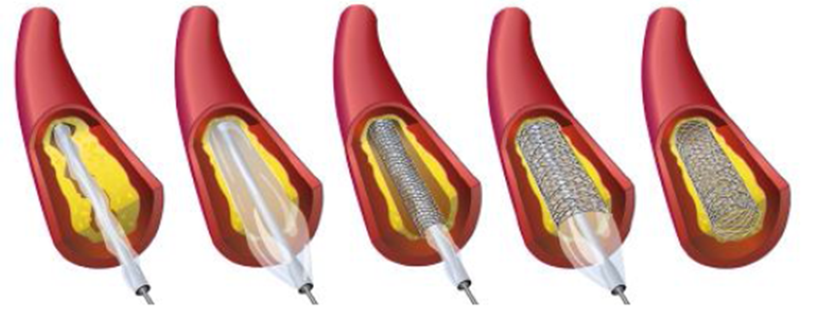
Catheter
A long, flexible catheter will be threaded through your arteries to the narrowed artery. Then, a smaller balloon catheter will be fed through the flexible catheter and inflated at the narrowed area to open it. In many cases, your doctor will also place a mesh coil called a stent at the narrowed portion to help keep the artery open. The catheter can be inserted in either your wrist or groin for this procedure. this helps ease symptoms, but it does not prevent heart attacks.

Slide 11
Nursing care plans for ATHEROSCLEROSIS
Risk for decreased cardiac output r/t myocardial ischemia.
INTERVENTIONS | RATIONALES
Assess the patient’s vital signs and characteristics of heartbeat at least every 4 hours. | To assist in creating an accurate diagnosis and monitor effectiveness of medical treatment.
Administer prescribed medications for atherosclerosis. | Aspirin. Nitrates. Anti-cholesterol drugs (e.g. statins). Beta blockers, Calcium channel blockers. Ranolazine.
Administer supplemental oxygen, as prescribed. Discontinue if SpO2 level is above the target range, or as ordered by the physician. | To increase the oxygen level and achieve an SpO2 value within the target range.

Slide 12
2. Acute Pain r/t decreased myocardial blood flow.
INTERVENTIONS | RATIONALES
Place the patient in complete bed rest when in severe pain, educate patient on stress management, deep breathing exercises, and relaxation techniques. | Stress causes a persistent increase in cortisol levels, which has been linked to people with cardiac issues. The effects of stress are likely to increase myocardial workload.
Assess the patient’s vital signs and characteristics of pain at least 30 minutes after administration of medication. | To monitor effectiveness of medical treatment for the relief of pain. The time of monitoring of vital signs may depend on the peak time of the drug administered.
Administer prescribed medications that alleviate the symptoms of pain (chest pain or angina, or leg/limb pain). | Aspirin. Nitrates. Anti-cholesterol drugs (e.g. statins). Beta blockers, Calcium channel blockers. Ranolazine.

Slide 13
3. Risk for impaired tissue perfusion.
INTERVENTIONS | RATIONALES
Maintain optimal cardiac output. | This ensures adequate perfusion of vital organs.
Note urine output. | Reduced renal perfusion may take place due to vascular occlusion.
Check for optimal fluid balance. Administer IV fluids as ordered. | Sufficient fluid intake maintains adequate filling pressures and optimizes cardiac output needed for tissue perfusion.

Slide 14
References:
https://www.webmd.com/heart-disease/what-is-atherosclerosis#1
https://www.webmd.com/heart-disease/silent-symptoms-diagnosing-atherosclerosis#1
https://www.mayoclinic.org/diseases-conditions/arteriosclerosis-atherosclerosis/symptoms-causes/syc-20350569
To know how to do the catheter in arteries or Cardiac catheterization: https://www.mayoclinic.org/tests-procedures/cardiac-catheterization/about/pac-20384695#:~:text=The%20catheter%20can%20be%20inserted,narrowed%20area%20to%20open%20it.
file:///C:/Users/User/Desktop/Medical%20Surgical.pdf .
https://nursestudy.net/atherosclerosis-nursing-care-plans/?fbclid=IwAR2lrjW-BUpChI1QI1PPpzlAYn99Q5rgtRMLA7oV2heSrrAcXgvW4XBfYtQ .

