Slide 1
Behavior Change
Chapter 15

Slide 2
The ultimate goal of community nutrition is to design programs that improve people’s health and nutritional status
Evidence- based theories and strategies to consider when designing a nutrition intervention program that targets lifestyle change related to eating patterns and physical activity
Are attitudes and beliefs important for behavior change?
Can interventions target attitudes and behaviors?

Slide 3
The incorporation of behavior change theories in program planning is critical to the nutrition care process because the theories suggest the questions that community nutritionists should ask to understand why consumers do what they do

Slide 4
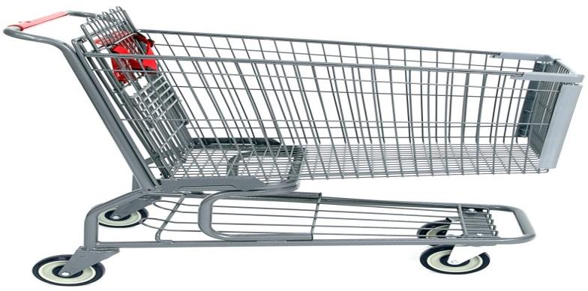
Introduction Designing interventions
Collect information about your target population
Why they engage in a certain behavior
Understanding the behavior of your target population is an important step in developing strategies to influence and CHANGE their behavior
Have tools and strategies to influence behavior such as?
Posters
Cooking demonstrations
Newspaper articles
Health fair
Modeling the behavior?
(observational learning)

Slide 5
A community nutritionist job is to understand the target population and select the appropriate behavior change model/ strategy to cause change
Some strategies target changes in attitudes and beliefs (i.e., motivational interviewing)
Some strategies directly target behavior change (i.e., goal setting and problem solving)

Slide 6
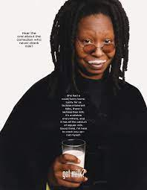
Tools for Promoting Behavior Change
Nutrition education: provide knowledge to a group or individual to facilitate voluntary adoption of eating and other nutrition-related behaviors
Understanding population ( beliefs and attitudes allows us to create the appropriate educational material
Social marketing: commercial marketing techniques to influence voluntary behavior.
“Got Milk?
"Milk Mustache" ads featuring famous people with milk mustaches
https://www.youtube.com/watch?v=eph6_fz49rc&t=60s
https://www.fastcompany.com/40556502/got-milk-how-the-iconic-campaign-came-to-be-25-years-ago

Slide 7
Tools for Promoting Behavior Change
Behavioral counselling
one-on-one counseling
A collaborative activity during which a counselor and client jointly set priorities, establish goals, and create an action plan
Environmental change
For example: Changing the environment to promote more physical activity

Slide 8
Health Behavior Theories

Slide 9
The transtheoretical model
Describes an individual’s motivation and readiness to change a problematic behavior
The model is founded on three assumptions:
1) behavior change involves a series of steps
2) there are common stages and processes of change across a variety of health behaviors
3) tailoring an intervention to the stage of change people are in at the moment is more effective than not considering the stage people are in

Slide 10
The transtheoretical model
The five stages through which people move
Precontemplation—The individual is either unaware of or not interested in making a change.
Contemplation—The individual is thinking about making a change, usually within the next six months
Preparation—The individual actively decides to change and plans a change, usually within one month. The individual may have already tried changing in the recent past.
Action—The individual is trying to make the desired change and has been working at making the change
Maintenance—The individual has sustained the change for six months or longer; the changed behavior has become a part of his or her daily routine.

Slide 11
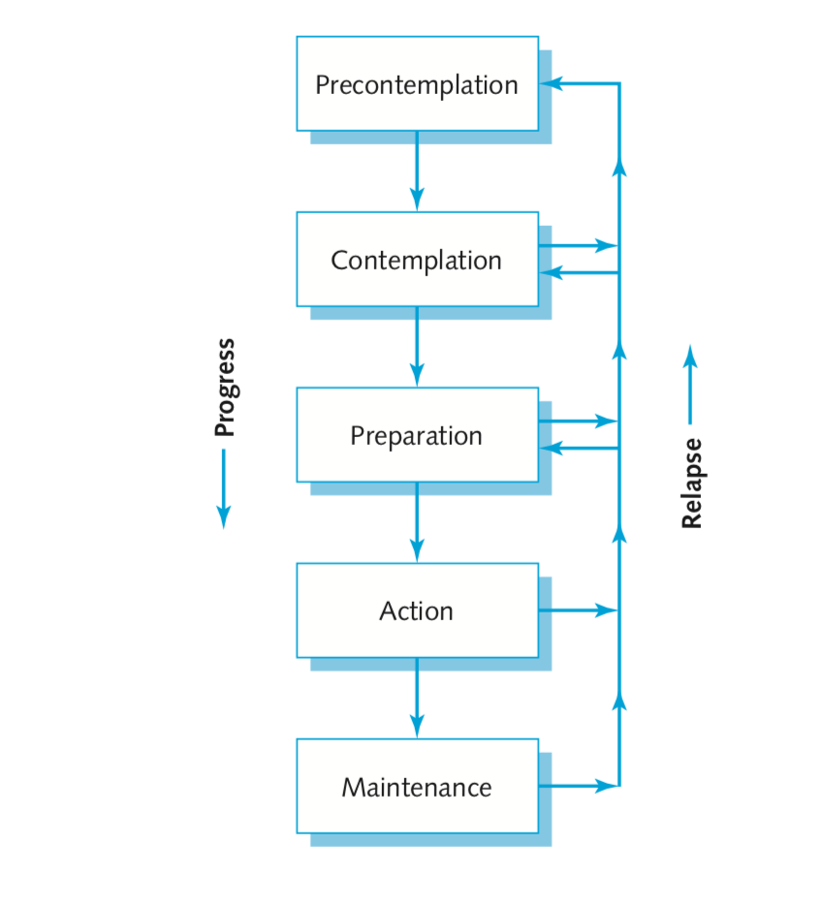
Example
“Smoking is cool” “I use a patch” “I’ll never smoke again”
“Smoking isn’t cool” “I need to quit”

Slide 12
The key here is to develop an intervention strategy that will meet people’s needs in a manner appropriate to the stage they are in
Both individuals and communities can be assessed for their state of readiness to change

Slide 13
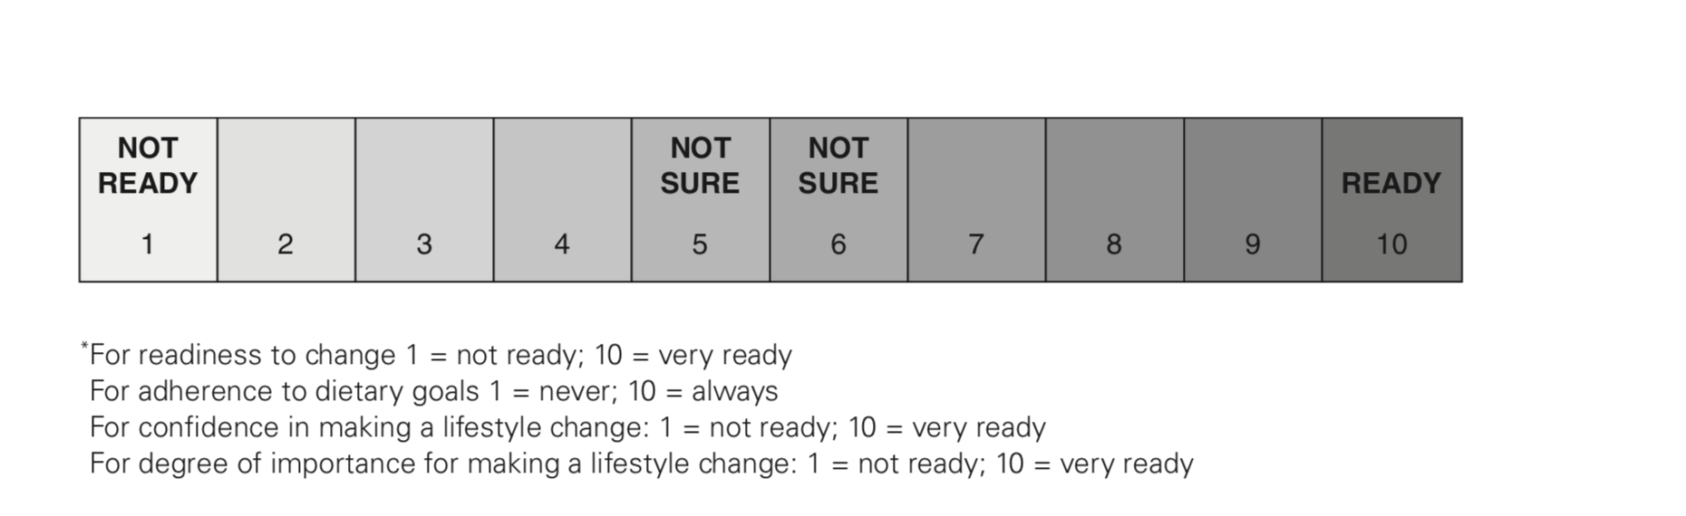
Readiness for change?
Bauer, Liou & Sokolik. (2012). Nutri.on Counseling & Educa.on Skill Development.
Notes:
Studies show that Patients at highest risk of adverse health outcomes had the greatest readiness to change.

Slide 14
 | Intervention Strategies
Pre-contemplation | Build self awareness, discuss risks and benefits, assess knowledge and attitudes, acknowledge emotions
Contemplation | Explore pros and cons, assess knowledge and attitudes, decrease barriers to change, increase confidence, encourage a support network
Preparation | Facilitate SMART goal setting and action plan development, reinforce small accomplishments
Action | Provide self-help materials, refer to a self-management program
Maintenance | Coach on preparation of high-risk situations, link with online/community groups, encourage self monitoring

Slide 15
Application on an individualized level
stage-matched personalized assessment reports
self-help manuals
Newsletters
monthly individual phone counseling for patients with diabetes to enhance PA, eating, and glycemic control
Ex: community nut working at a local Fitness club
Knows from studies: an association between the presence of chronic diseases such as hypertension, diabetes, heart disease, and dyslipidemia and readiness to change behavior in the areas of physical activity, fat intake, fruit and vegetable intake, and smoking
Data shows people in the precontemplation, contemplation, and preparation stages consumed fewer fruits and vegetables than people in the action or maintenance stages.
To increase awareness (precontemplation stage)→ special lectures on heart disease and hypertension
contemplation and preparation stages→ four cooking demonstrations featuring heart-healthy recipes prepared with local fresh fruits and vegetables;
Action stage—that is, those who had participated in one of the special events or attended a cooking demonstration—she offered a 20-minute individual counseling session to answer questions about reading food labels, identifying food sources of fat, and calculating saturated fat and trans fat intake.

Slide 16
Application in community
Example: eating disorders prevalence is high at a specific school
Community is in the precontemplation phase→ no discussion of the problem has occurred between parents, teachers, students , school staff, health professionals in the area
First step: enhance awareness of the problem in the community by holding meeting, identify pros and cons of action, identify resources for addressing the problem, and discuss desirable actions
Notes:
As a first step in moving the community to the contemplation stage, the group decided to hold a citywide meeting of stakeholders and key community leaders to assess their perception of the problem, enhance awareness of the problem, identify pros and cons of action, identify resources for addressing the problem, and discuss desirable actions.

Slide 17
Motivational Interviewing theory
”A a way of interacting with the client that actively facilitates the client’s exploring and resolving his or her own uncertainty about change, building confidence, and enhancing his or her commitment to change”
DO NOT PROVIDE INFO or ADVICE to patient
Patients does most of the work by identifying barriers and resistance with the guidance of the counselor
The counselor listens carefully to client responses and provides information only when the client requests or desires it
Notes:
client-centered counseling model in order to “help clients build commitment and reach a decision to change.

Slide 18
Four general principles RULE
1) “resisting the righting reflex”—or the urge to confront the client about the need for behavior change
2) understanding and exploring the client’s own motivations
3) listening with empathy
4) empowering the client, encouraging hope and optimism.

Slide 19
4 skills for Motivational interviewing
Open-ended questions
Affirmations
Reflective listening
Summaries
https://www.youtube.com/watch?v=Cfl4d-qQ-co

Slide 20
The Health Belief Model Three components
A person will adopt a behavior if failing to do so has consequences that threaten his or her lifestyle
Changing behavior depends on a balance between barriers and benefits of change
Benefits of a certain behavior change: if I choose high fiber foods I will lose weight
Expected barriers: choosing high-fiber foods requires skill in label reading and knowledge of food composition
Self-Efficacy: The belief that you can successfully do something

Slide 21
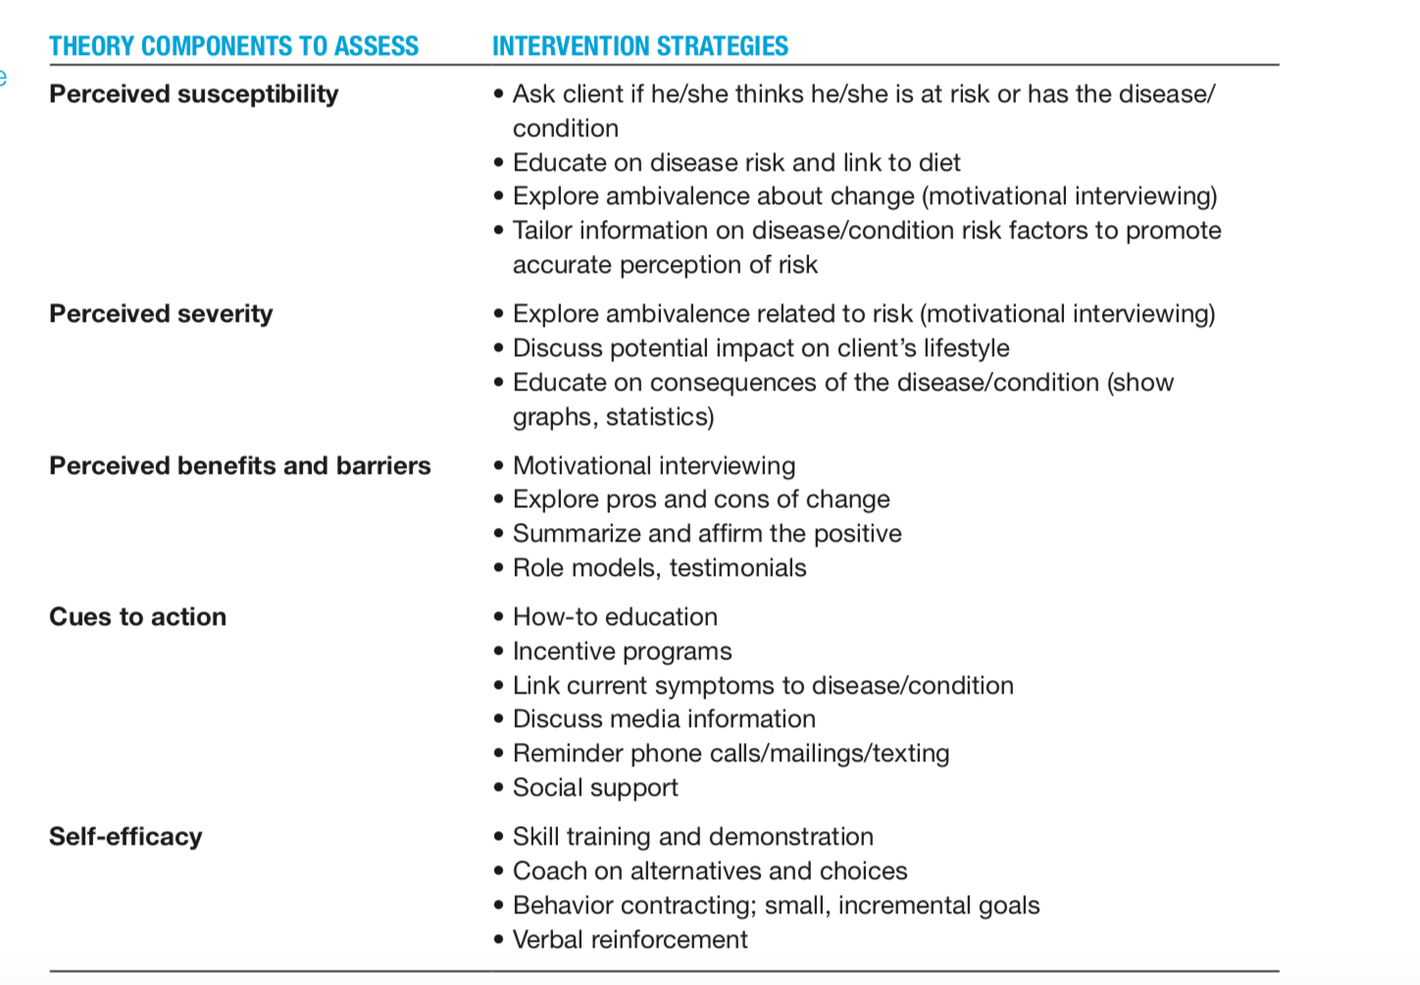
The Health Belief Model
strategies appropriate for the various components of the health belief model

Slide 22
The American Cancer Society (ACS) made rec’d
Intake of fruits and veg increased but Intake of saturated fat is still above the recommended level and obesity is a widespread public health problem.
Survey findings: Researchers found that adults who believed strongly in a connection between diet and cancer, and who were knowledgeable about health recommendations, made a greater number of positive dietary changes than those who had little belief
Strategies to influence the beliefs of people in high-risk groups

Slide 23
The Theory of Planned Behavior (Theory of reasoned action)
Behavior is determined directly by a person’s intention to perform the behavior
Intentions are influenced by attitudes ( what I expect as the outcome and beliefs about my self-efficacy) and subjective norms ( what others around me expect)
According to this theory, if people evaluate a recommended behavior as positive (attitude), and if they think their significant others want them to do it (subjective norm), the result is a higher intention (motivation

Slide 24
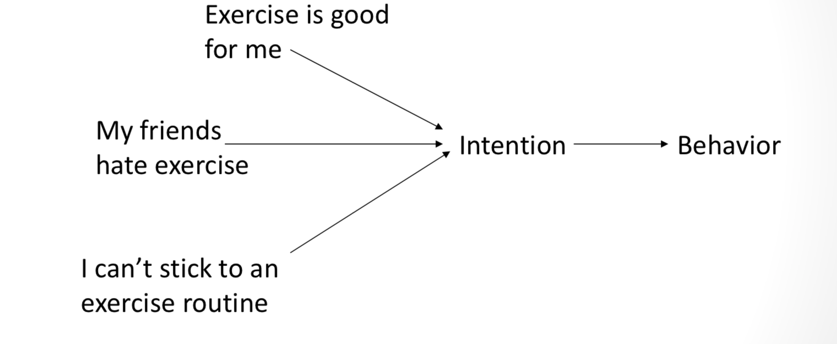
Attitude?
Self efficacy ?
Normative beliefs?

Slide 25
Social Cognitive Theory
Social cognitive theory (SCT) explains behavior in terms of a model in which behavior, personal factors such as cognition, and the environment interact constantly, such that a change in one area has implications for the others
Example:
A change in the environment (For example: the loss of a spouse’s support for a weight-loss effort) produces a change in the individual (a decrease in the incentive to lose weight) and consequently a change in behavior (abandonment of a regular exercise routine)

Slide 26
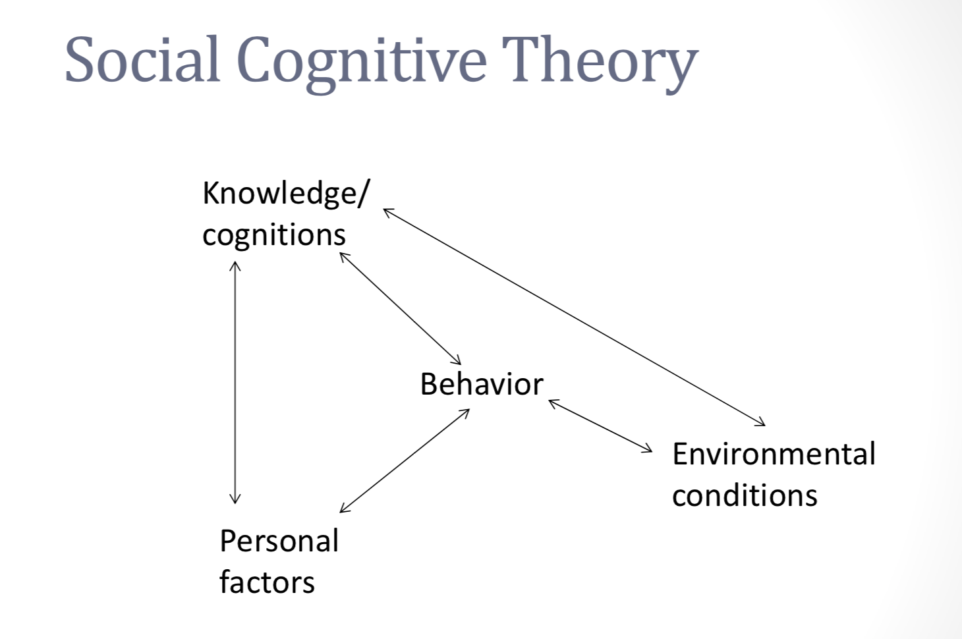
An individual’s confidence (self-efficacy)
Ability to perform a particular behavior (behavioral capacity)
His or her perception of the probable outcome ( Benefits/barriers) influence the amount of effort he or she will invest in a behavior change
Reinforcements: Promoting incentives and rewards that encourage behavior change.

Slide 27
The Diffusion of Innovation Model
Knowledge—The individual is aware of the innovation and has acquired some information about it.
Persuasion—The individual forms an attitude either in favor of or against the innovation.
Decision—The individual performs activities that lead to either adopting or rejecting the innovation.
Confirmation—The individual looks for reinforcement for his or her decision and may change it if exposed to counter-reinforcing messages.

Slide 28
Diffusion of Innovation Model
Consumers can be classified according to how readily they adopt new ideas
• Innovators – first to adopt new idea
• Early adopters – e.g. opinion leaders
• Early majority – somewhat cautious
• Late majority – skeptical, adopt only through peer pressure
• Laggards – last to adopt

Slide 29
Think about how health promotion activities are influenced by the theories of behavior change
websites, posters, and brochures target people at which phase?
Advocating for change in laws, making new policies. For example, calling for smoke-free restaurants or a ban on advertising sponsored by tobacco companies at athletic event ?
Working with clients to make simple dietary changes, reinforcing healthful eating habits, coping with setbacks?
Notes:
in the contemplation and preparation stages of change
people in the maintenance stage

Slide 30
The challenge comes in thinking of new ways of delivering health messages and services to vulnerable populations
Despite successful community interventions , many people in the communities are not getting the message. What is needed to ensure the success of community interventions?
Better understanding of the community factors that influence change and of the reasons that consumers resist change
Think of new ways to reach your target audience
Plan strategies for finding out why your clients are resisting a behavior change
Be creative
Share your ways!

Slide 31
Social marketing
Social marketing A method for changing consumer behavior; the design, implementation, and management of programs that seek to increase the acceptability of a social idea or practice
a strategy for changing consumer behavior
combines the best elements of consumer behavior theory with marketing tools and skills to help consumers change their beliefs, attitudes, values, actions, or behaviors
Emphasize the benefit of adopting a new practice/ or abandoning a non beneficial behavior

Slide 32

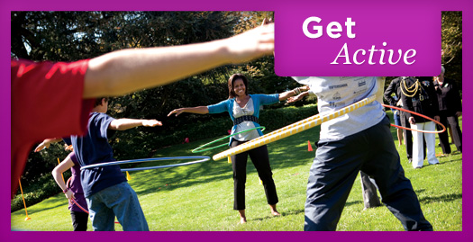
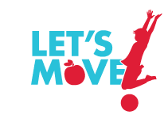
Lets move!
In 2010 , a campaign launched by Michelle Obama
Strategies that will prevent and combat obesity.
“America's Move to Raise A Healthier Generation of Kids”
https://letsmove.obamawhitehouse.archives.gov/about

Slide 33
'Life is Sweeter with Less Sugar’
An UNRWA campaign in response to high rates of diabetes and hypertension
In 2011, UNRWA spent 41 per cent of its medication budget treating refugees with diabetes and hypertension
https://www.unrwa.org/newsroom/features/making-life-sweeter

Slide 34
Using Social Marketing Effectively
Know your target group
Know your competition
Don’t highlight problems without solutions
Be prepared
Persevere

Slide 35
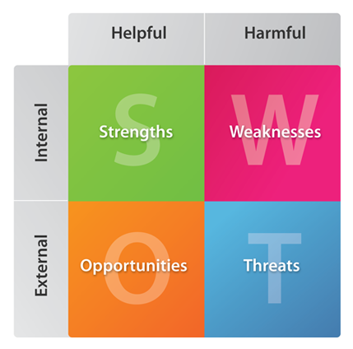
SWOT Analysis
Example
Funding for the clinics is sufficient for 3 years
Not all services can be offered at the mobile clinic
insurance health coverage and sustainability of mobile clinic
Expanding the project and reaching more outreach communities/ collaboration with----

