Slide 1


Slide 2
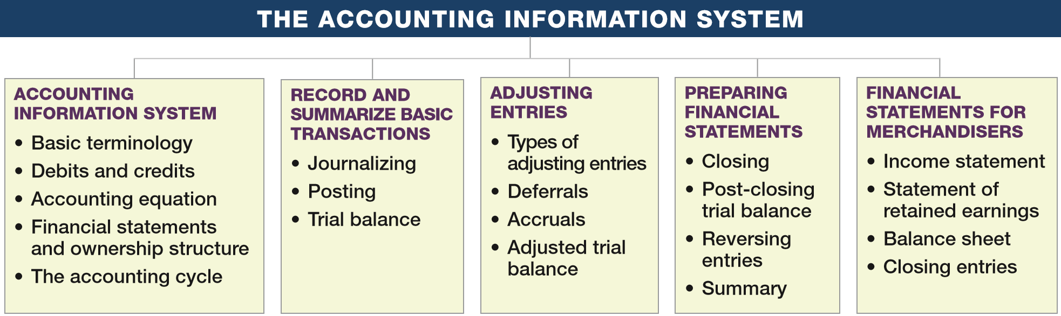
PREVIEW OF CHAPTER 3
Intermediate Accounting
16th Edition
Kieso ● Weygandt ● Warfield

Slide 3
LEARNING OBJECTIVES
3
The Accounting Information System
After studying this chapter, you should be able to:
Understand the basic accounting information system.
Record and summarize basic transactions.
Identify and prepare adjusting entries.
Prepare financial statements from the adjusted trial balance.
Prepare closing entries.
Prepare financial statements for a merchandising company.
LO 1

Slide 4
ACCOUNTING INFORMATION SYSTEM
  Accounting information system
  Collects and processes transaction data.
  Disseminates the financial information to interested parties.
LO 1

Slide 5
ACCOUNTING INFORMATION SYSTEM
  Helps management answer such questions as:
  How much and what kind of debt is outstanding?
  Were sales higher this period than last?
  What assets do we have?
  What were our cash inflows and outflows?
  Did we make a profit last period?
  Are any of our product lines or divisions operating at a loss?
  Can we safely increase our dividends to stockholders?
  Is our rate of return on net assets increasing?
LO 1

Slide 6
ACCOUNTING INFORMATION SYSTEM
Basic Terminology
  Event
  Transaction
  Account
  Real Account
  Nominal Account
  Ledger
  Journal
  Posting
  Trial Balance
  Adjusting Entries
  Financial Statements
  Closing Entries
LO 1

Slide 7
ACCOUNTING INFORMATION SYSTEM
Debits and Credits
  An account shows the effect of transactions on a given asset, liability, equity, revenue, or expense account.
  Double-entry accounting system (two-sided effect).
  Recording done by debiting at least one account and crediting another.
  DEBITS must equal CREDITS.
LO 1

Slide 8

Debits and Credits
An arrangement that shows the effect of transactions on an account.
Debit = “Left”
Credit = “Right”
Account
An Account can be illustrated in a T-Account form.
LO 1

Slide 9

Debits and Credits
If the sum of Debit entries are greater than the sum of Credit entries, the account will have a debit balance.
Transaction #1
$10,000
$3,000
Transaction #2
Transaction #3
8,000
Balance
$15,000
LO 1

Slide 10

Debits and Credits
If the sum of Credit entries are greater than the sum of Debit entries, the account will have a credit balance.
Transaction #1
$10,000
$3,000
Transaction #2
8,000
Transaction #3
Balance
$1,000
LO 1

Slide 11

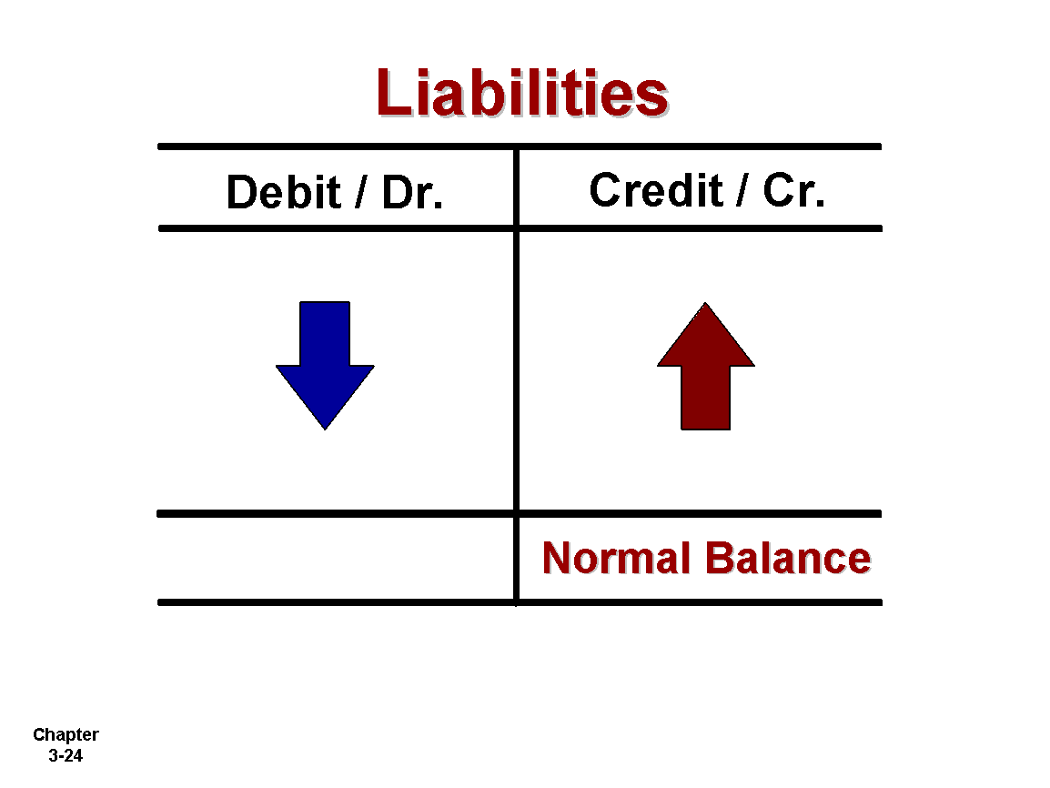
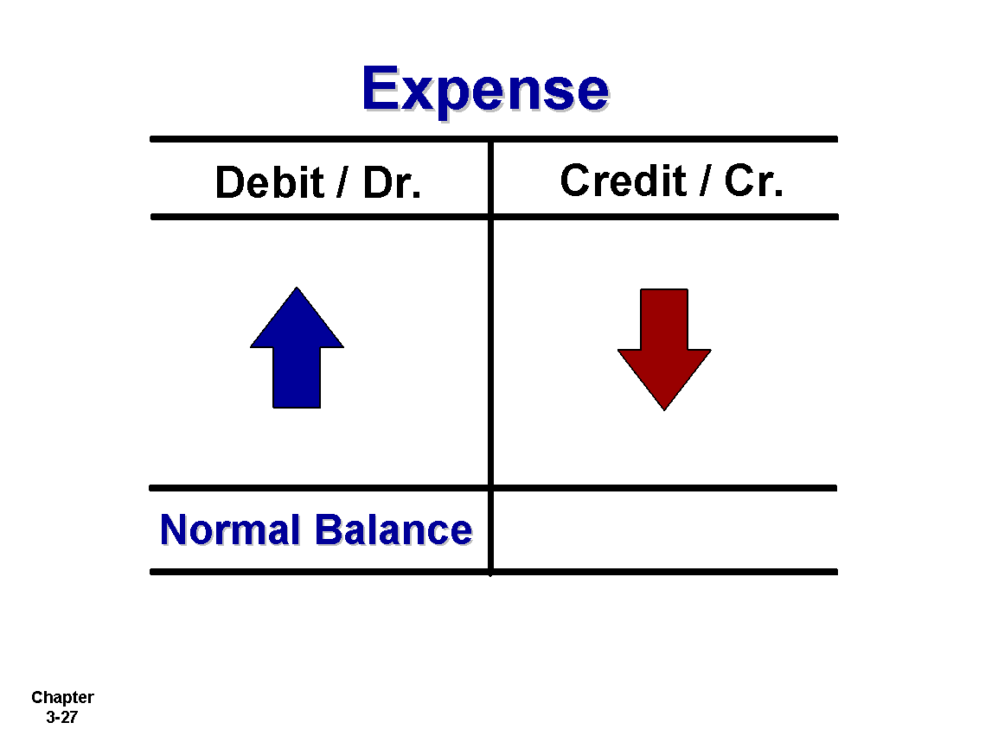
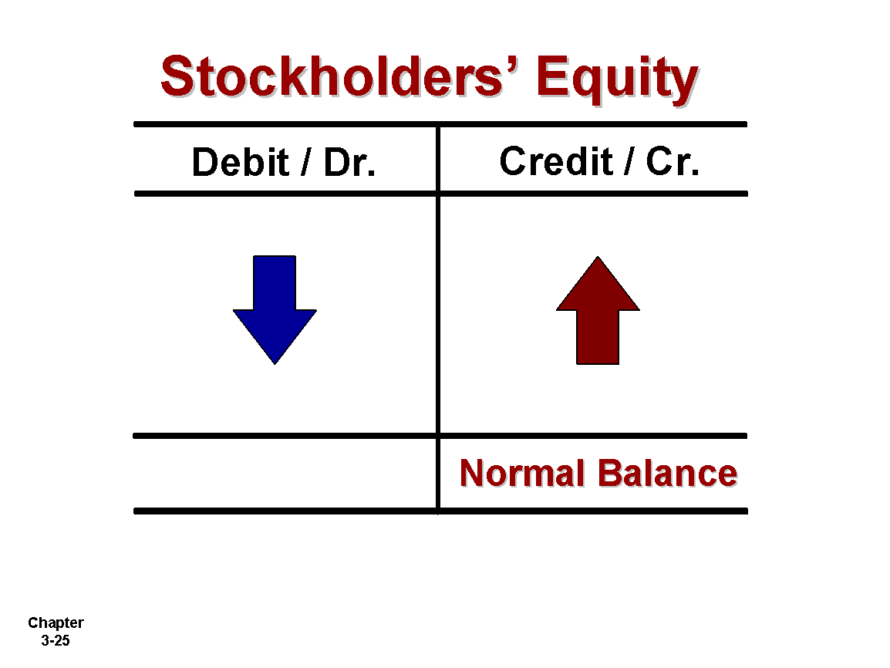
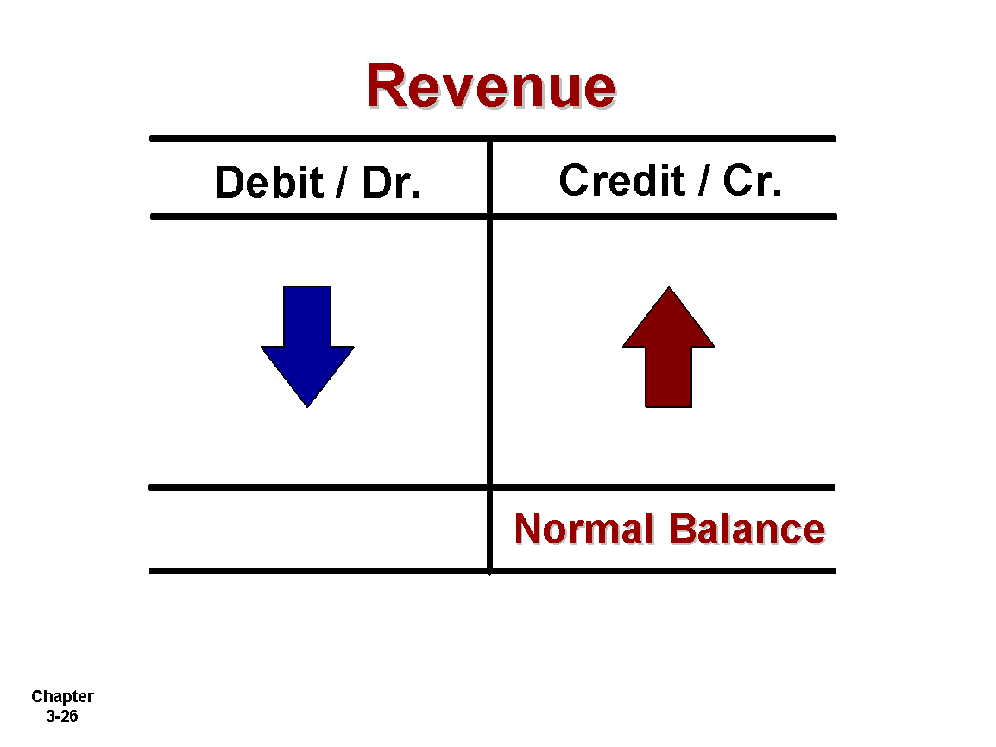
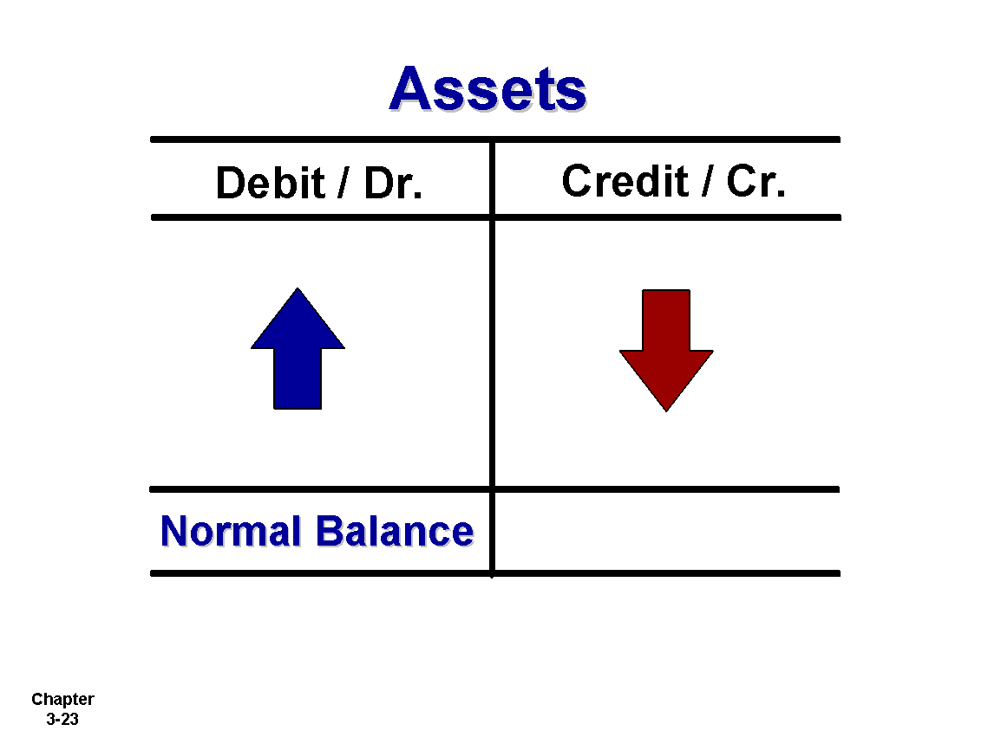
Debits and Credits Summary
Normal Balance Debit
Normal Balance Credit
LO 1

Slide 12
Debits and Credits Summary
Balance Sheet
Income Statement
Asset
Liability
+
-
=
Equity
Revenue
Expense
Debit
Credit
LO 1

Slide 13
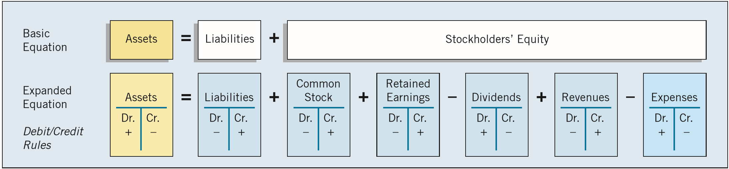
The Accounting Equation
Relationship among the assets, liabilities and stockholders’ equity accounts of a business:
ILLUSTRATION 3-3
Expanded Equation and Debit/Credit Rules and Effects
The equation must be in balance after every transaction. For every Debit there must be a Credit.
LO 1

Slide 14
Double-Entry System Illustration
Owners invest $40,000 in exchange for common stock.
Assets
Liabilities
Stockholders’ Equity
=
+
+ 40,000
+ 40,000
LO 1

Slide 15
Double-Entry System Illustration
2. Disburse $600 cash for secretarial wages.
Assets
Liabilities
Stockholders’ Equity
=
+
- 600
- 600 (expense)
LO 1

Slide 16
Double-Entry System Illustration
3. Purchase office equipment priced at $5,200, giving a 10 percent promissory note in exchange.
Assets
Liabilities
Stockholders’ Equity
=
+
+ 5,200
+ 5,200
LO 1

Slide 17
Double-Entry System Illustration
4. Received $4,000 cash for services performed.
Assets
Liabilities
Stockholders’ Equity
=
+
+ 4,000
+ 4,000 (revenue)
LO 1

Slide 18
Double-Entry System Illustration
5. Pay off a short-term liability of $7,000.
Assets
Liabilities
Stockholders’ Equity
=
+
- 7,000
- 7,000
LO 1

Slide 19
Double-Entry System Illustration
6. Declared a cash dividend of $5,000.
Assets
Liabilities
Stockholders’ Equity
=
+
+ 5,000
- 5,000
LO 1

Slide 20
Double-Entry System Illustration
7. Convert a long-term liability of $80,000 into common stock.
Assets
Liabilities
Stockholders’ Equity
=
+
- 80,000
+ 80,000
LO 1

Slide 21
Double-Entry System Illustration
8. Pay cash of $16,000 for a delivery van.
Assets
Liabilities
Stockholders’ Equity
=
+
- 16,000
+ 16,000
Note that the accounting equation equality is maintained after recording each transaction.
LO 1

Slide 22
Ownership Structure
Ownership structure dictates the types of accounts that are part of or affect the equity section.
Proprietorship or Partnership
Corporation
Owner’s Capital
Owner’s Drawing
Common Stock
Paid-in Capital in Excess of Par
Dividends
Retained Earnings
LO 1

Slide 23
Financial Statements
Balance Sheet
Stockholders’ Equity
Common Stock
(investments by stockholders)
Retained Earnings
(net income retained in business)
Dividends
Net income or Net loss (revenues less expenses)
Income Statement
Statement of Retained Earnings
ILLUSTRATION 3-4
Financial Statements and Ownership Structure
LO 1

Slide 24
The Accounting Cycle
ILLUSTRATION 3-6
The Accounting Cycle
Transactions
Reversing entries
Journalization
Post-closing trail balance
Posting
Closing
Trial balance
Statement preparation
Work Sheet
Adjustments
Adjusted trial balance
LO 1

Slide 25
Identify and Recording Transactions
What to Record?
The FASB uses the phrase “transactions and other events and circumstances that affect a business enterprise.”
Types of Events:
  External – between an entity and its environment.
  Internal – event occurring entirely within an entity.
LO 1

Slide 26
LEARNING OBJECTIVES
3
The Accounting Information System
After studying this chapter, you should be able to:
Understand the basic accounting information system.
Record and summarize basic transactions.
Identify and prepare adjusting entries.
Prepare financial statements from the adjusted trial balance.
Prepare closing entries.
Prepare financial statements for a merchandising company.
LO 2

Slide 27
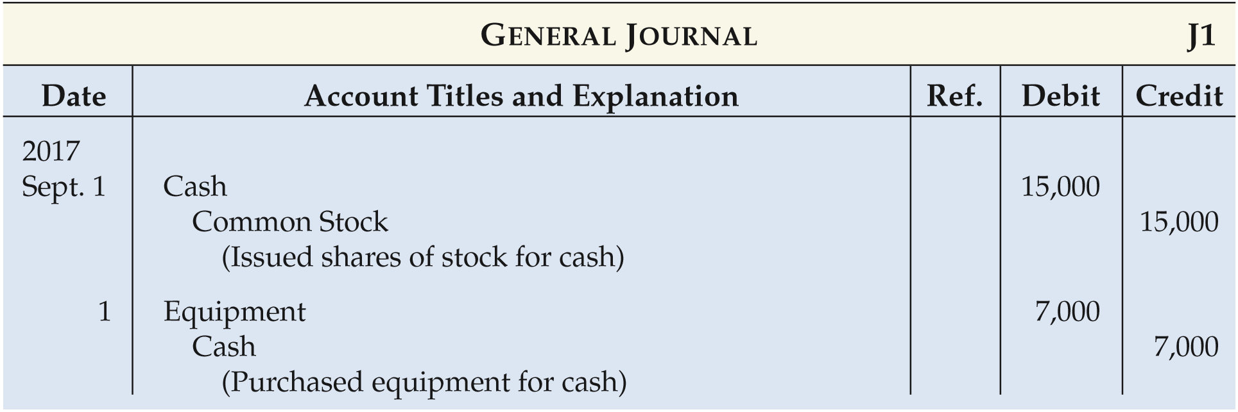

Journalizing
General Journal – a chronological record of transactions. Journal Entries are recorded in the journal.
September 1: Stockholders invested $15,000 cash in the corporation in exchange for shares of stock. Purchased computer equipment for $7,000 cash.
ILLUSTRATION 3-7
Technique for journalizing
LO 2

Slide 28
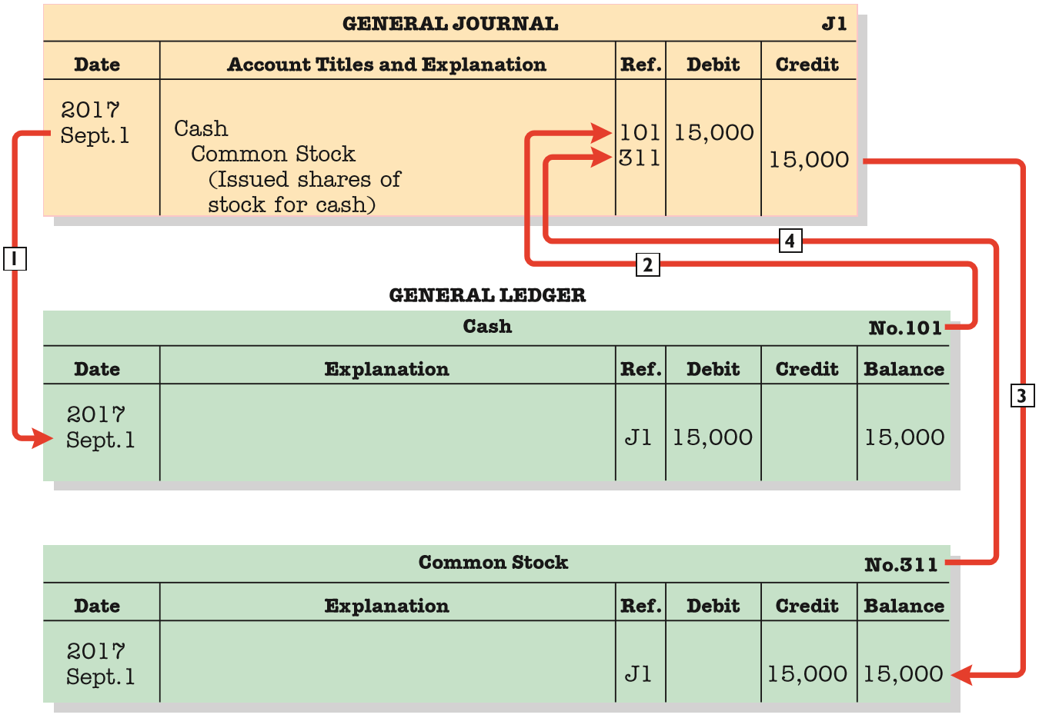
Posting
Posting – Transferring amounts from journal to ledger.
ILLUSTRATION 3-8 Posting a Journal Entry
LO 2

Slide 29
Posting
An Expanded Example
The purpose of transaction analysis is
  to identify the type of account involved, and
  to determine whether a debit or a credit is required.
Keep in mind that every journal entry affects one or more of the following items: assets, liabilities, stockholders’ equity, revenues, or expenses.
LO 2

Slide 30
Posting
1. October 1: Stockholders invest $100,000 cash in an advertising venture to be known as Pioneer Advertising Inc.
Oct. 1
Cash
100,000
Common Stock
100,000
Cash
Common Stock
Debit
Credit
Debit
Credit
100,000
100,000
LO 2

Slide 31
Posting
2. October 1: Pioneer Advertising purchases office equipment costing $50,000 by signing a 3-month, 12%, $50,000 note payable.
Oct. 1
Equipment
50,000
Notes Payable
50,000
Equipment
Notes Payable
Debit
Credit
Debit
Credit
50,000
50,000
LO 2

Slide 32
Posting
3. October 2: Pioneer Advertising receives a $12,000 cash advance from R. Knox, a client, for advertising services that are expected to be completed by December 31.
Oct. 2
Cash
12,000
Unearned Service Revenue
12,000
Cash
Unearned Service Revenue
Debit
Credit
Debit
Credit
100,000
12,000
12,000
LO 2

Slide 33
Posting
4. October 3: Pioneer Advertising pays $9,000 office rent, in cash, for October.
Oct. 3
Rent Expense
9,000
Cash
9,000
Cash
Rent Expense
Debit
Credit
Debit
Credit
100,000
9,000
9,000
12,000
LO 2

Slide 34
Posting
5. October 4: Pioneer Advertising pays $6,000 for a one-year insurance policy that will expire next year on September 30.
Oct. 4
Prepaid Insurance
6,000
Cash
6,000
Cash
Prepaid Insurance
Debit
Credit
Debit
Credit
100,000
9,000
6,000
12,000
6,000
LO 2

Slide 35
Posting
6. October 5: Pioneer Advertising purchases, for $25,000 on account, an estimated 3-month supply of advertising materials from Aero Supply.
Oct. 5
Supplies
25,000
Accounts Payable
25,000
Supplies
Accounts Payable
Debit
Credit
Debit
Credit
25,000
25,000
LO 2

Slide 36
Posting
7. October 9: Pioneer Advertising signs a contract with a local newspaper for advertising inserts (flyers) to be distributed starting the last Sunday in November. Pioneer will start work on the content of the flyers in November. Payment of $7,000 is due following delivery of the Sunday papers containing the flyers.
A business transaction has not occurred. There is only an agreement between Pioneer Advertising and the newspaper for the services to be performed in November. Therefore, no journal entry is necessary in October.
LO 2

Slide 37
Posting
8. October 20: Pioneer Advertising’s board of directors declares and pays a $5,000 cash dividend to stockholders.
Oct. 20
Dividends
5,000
Cash
5,000
Cash
Dividends
Debit
Credit
Debit
Credit
100,000
9,000
5,000
12,000
6,000
5,000
LO 2

Slide 38
Posting
9. October 26: Employees are paid every four weeks. The total payroll is $2,000 per day. The pay period ended on Friday, October 26, with salaries and wages of $40,000 being paid.
Oct. 26
Salaries and Wages Expense
40,000
Cash
40,000
Cash
Salaries and Wages Expense
Debit
Credit
Debit
Credit
100,000
9,000
40,000
12,000
6,000
5,000
40,000
LO 2

Slide 39
Posting
10. October 31: Pioneer Advertising receives $28,000 in cash and bills Copa Company $72,000 for advertising services of $100,000 performed in October.
Oct. 31
Cash
28,000
Accounts Receivable
72,000
Service Revenue
100,000
Cash
Accounts Receivable
Service Revenue
Debit
Credit
Debit
Credit
Debit
Credit
100,000
9,000
72,000
100,000
12,000
6,000
28,000
5,000
40,000
80,000

Slide 40
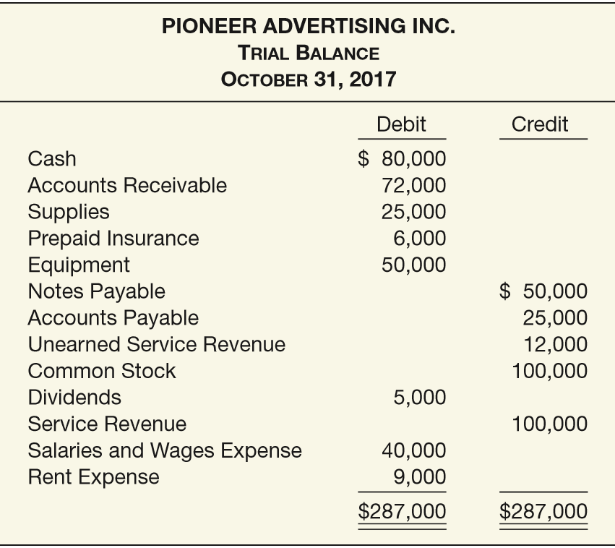
Trial Balance
Trial Balance – A list of each account and its balance; used to prove equality of debit and credit balances.
ILLUSTRATION 3-19
Trial Balance (Unadjusted)
LO 2

Slide 41
LEARNING OBJECTIVES
3
The Accounting Information System
After studying this chapter, you should be able to:
Understand the basic accounting information system.
Record and summarize basic transactions.
Identify and prepare adjusting entries.
Prepare financial statements from the adjusted trial balance.
Prepare closing entries.
Prepare financial statements for a merchandising company.
LO 3

Slide 42
ADJUSTING ENTRIES
Makes it possible to:
  Report on the balance sheet the appropriate assets, liabilities, and owner’s equity at the statement date.
  Report on the income statement the proper revenues and expenses for the period.
    Revenues are recorded in the period in which services are performed.
    Expenses are recognized in the period in which they are incurred.
LO 3

Slide 43
Types of Adjusting Entries
Deferrals
Accruals
1. Prepaid Expenses. Expenses paid in cash before they are used or consumed.
3. Accrued Revenues. Revenues for services performed but not yet received in cash or recorded.
2. Unearned Revenues.
Cash received before services are performed.
4. Accrued Expenses. Expenses incurred but not yet paid in cash or recorded.
ILLUSTRATION 3-20
Categories of Adjusting Entries
LO 3

Slide 44
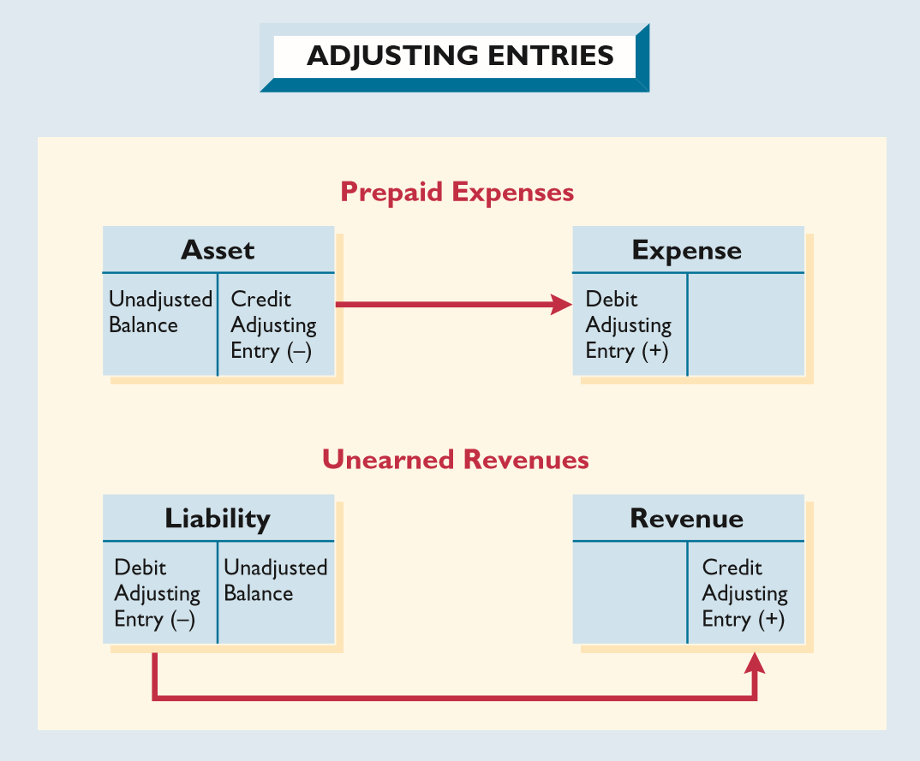
Adjusting Entries for Deferrals
Deferrals are either
  prepaid expenses or
  unearned revenues.
ILLUSTRATION 3-21 Adjusting Entries for Deferrals
LO 3

Slide 45
Prepaid Expenses
Prepaid Expenses. Assets paid for and recorded before a company uses them.
Cash Payment
BEFORE
Expense Recorded
Prepayments often occur in regard to:
  insurance
  supplies
  advertising
  rent
  buildings and equipment
LO 3

Slide 46
Prepaid Expenses
Supplies. Pioneer Advertising purchased advertising supplies costing $25,000 on October 5. Prepare the journal entry to record the purchase of the supplies.
Oct. 5
Supplies
25,000
Cash
25,000
Supplies
Cash
Debit
Credit
Debit
Credit
25,000
25,000
LO 3

Slide 47
Prepaid Expenses
Supplies. An inventory count at the close of business on October 31 reveals that $10,000 of the advertising supplies are still on hand.
Oct. 31
Supplies Expense
15,000
Supplies
15,000
Supplies
Supplies Expense
Debit
Credit
Debit
Credit
25,000
15,000
15,000
10,000
LO 3

Slide 48
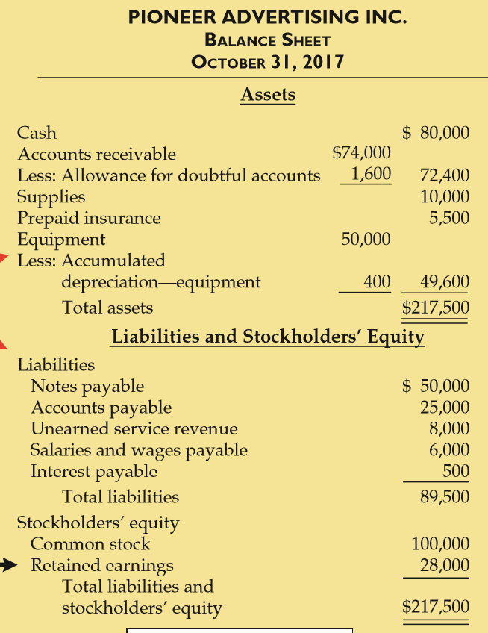
Prepaid Expenses
Statement Presentation:
Supplies identifies that portion of the asset’s cost that will provide future economic benefit.
ILLUSTRATION 3-35

Slide 49
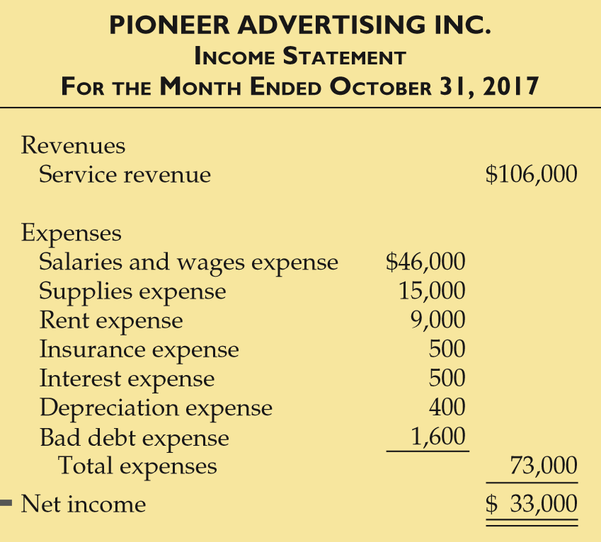
Prepaid Expenses
Statement Presentation:
Supplies expense identifies that portion of the asset’s cost that expired in October.
ILLUSTRATION 3-34
LO 3

Slide 50
Prepaid Expenses
Insurance. On Oct. 4th, Pioneer Advertising paid $6,000 for a one-year fire insurance policy, coverage beginning October 1. Prepare the entry to record the purchase of the insurance.
Oct. 4
Prepaid Insurance
6,000
Cash
6,000
Prepaid Insurance
Cash
Debit
Credit
Debit
Credit
6,000
6,000
LO 3

Slide 51
Prepaid Expenses
Insurance. An analysis of the policy reveals that $500 ($6,000 ÷ 12) of insurance expires each month. Prepare the entry to record the insurance cost expired in October.
Oct. 31
Insurance Expense
500
Prepaid Insurance
500
Prepaid Insurance
Insurance Expense
Debit
Credit
Debit
Credit
6,000
500
500
5,500
LO 3

Slide 52
Prepaid Expenses
Statement Presentation:
Prepaid insurance identifies that portion of the asset’s cost that will provide future economic benefit.
ILLUSTRATION 3-35

Slide 53
Prepaid Expenses
Statement Presentation:
Insurance expense identifies that portion of the asset’s cost that expired in October.
ILLUSTRATION 3-34
LO 3

Slide 54
Prepaid Expenses
Depreciation. Pioneer Advertising estimates depreciation on its office equipment to be $400 per month. Prepare the entry to record depreciation for the month of October.
Oct. 31
Depreciation Expense
400
Accumulated Depreciation
400
Depreciation Expense
Accumulated Depreciation
Debit
Credit
Debit
Credit
400
400
LO 3

Slide 55
Prepaid Expenses
Statement Presentation:
Accumulated Depreciation is a contra asset account.
ILLUSTRATION 3-35

Slide 56
Prepaid Expenses
Statement Presentation:
Depreciation expense identifies that portion of the asset’s cost that expired in October.
ILLUSTRATION 3-34
LO 3

Slide 57
Unearned Revenues
Receipt of cash before the services are performed is recorded as a liability called unearned revenues.
Cash Receipt
BEFORE
Revenue Recorded
Unearned revenues often occur in regard to:
  rent
  airline tickets
  tuition
  magazine subscriptions
  customer deposits
LO 3

Slide 58
Unearned Revenues
Unearned Revenue. Pioneer Advertising received $12,000 on October 2nd from KC for advertising services expected to be completed by December 31. Prepare the journal entry to record the receipt on October 2nd.
Oct. 2
Cash
12,000
Unearned Service Revenue
12,000
Cash
Unearned Service Revenue
Debit
Credit
Debit
Credit
12,000
12,000
LO 3

Slide 59
Unearned Revenues
Unearned Revenues. Analysis reveals that Pioneer Advertising earned $4,000 of the advertising services in October. Prepare the entry to record the revenue for services performed.
Oct. 31
Unearned Service Revenue
4,000
Service Revenue
4,000
Service Revenue
Unearned Service Revenue
Debit
Credit
Debit
Credit
100,000
4,000
12,000
4,000
104,000
8,000
LO 3

Slide 60
Unearned Revenues
Statement Presentation:
Unearned service revenue identifies that portion of the liability for which services have not been performed.
ILLUSTRATION 3-35

Slide 61
Unearned Revenues
Statement Presentation:
Service Revenue includes the portion of unearned service revenue for which services were performed in October.
ILLUSTRATION 3-34
LO 3

Slide 62
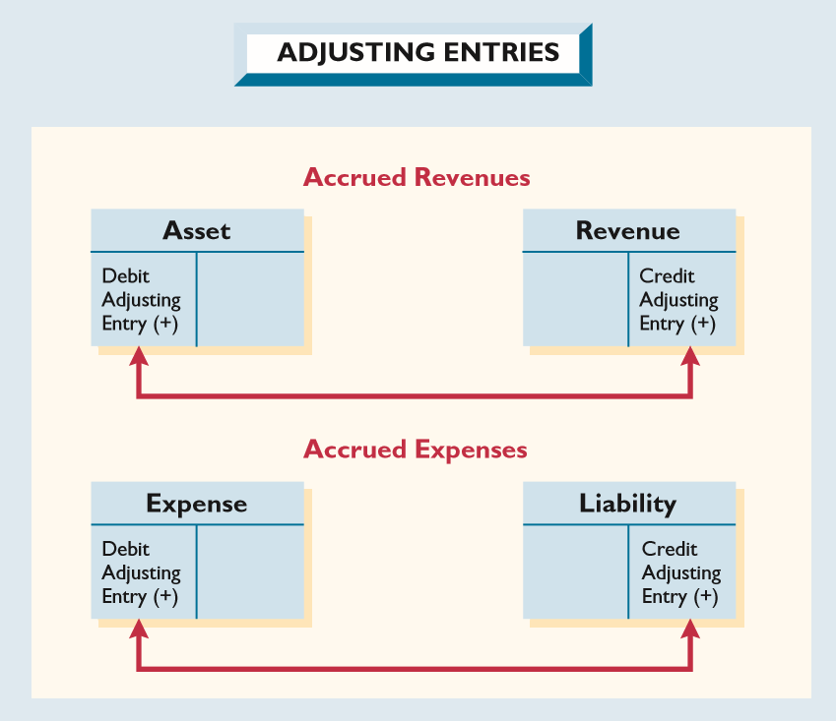
Adjusting Entries for Accruals
Accruals are either
  accrued revenues or
  accrued expenses.
ILLUSTRATION 3-27 Adjusting Entries for Accruals
LO 3

Slide 63
Accrued Revenues
Revenues recorded for services performed but cash has yet to be received at the statement date are accrued revenues.
Adjusting entry results in:
Revenue Recorded
BEFORE
Cash Receipt
Accrued revenues often occur in regard to:
  rent
  interest
  services performed
LO 3

Slide 64
Accrued Revenues
Accrued Revenues. In October Pioneer Advertising performed services worth $2,000 that were not billed clients before Oct. 31. Prepare the entry to revenues for services performed.
Oct. 31
Accounts Receivable
2,000
Service Revenue
2,000
Accounts Receivable
Service Revenue
Debit
Credit
Debit
Credit
72,000
100,000
2,000
4,000
2,000
74,000
106,000

Slide 65
Accrued Revenues
ILLUSTRATION 3-35
ILLUSTRATION 3-34
LO 3

Slide 66
Adjusting Entries for Accrued Expenses
Expenses incurred but not yet paid in cash or recorded.
Adjusting entry results in:
Expense Recorded
BEFORE
Cash Payment
Accrued expenses often occur in regard to:
  rent
  interest
  taxes
  salaries
LO 3

Slide 67
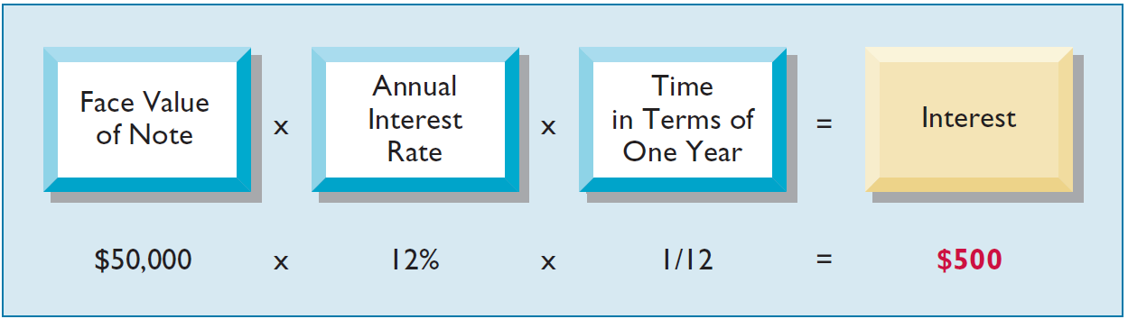
Accrued Expenses
Accrued Interest. Pioneer Advertising signed a three-month note payable in the amount of $50,000 on October 1. The note requires interest at an annual rate of 12 percent. Three factors determine the amount of the interest accumulation:
1
2
3
ILLUSTRATION 3-29
Formula for Computing Interest
LO 3

Slide 68
Accrued Expenses
Accrued Interest. Pioneer signed a three-month, 12%, note payable in the amount of $50,000 on October 1. Prepare the adjusting entry on Oct. 31 to record the accrual of interest.
Oct. 31
Interest Expense
500
Interest Payable
500
Interest Expense
Interest Payable
Debit
Credit
Debit
Credit
500
500
LO 3

Slide 69
Accrued Expenses
ILLUSTRATION 3-35
ILLUSTRATION 3-34
LO 3

Slide 70
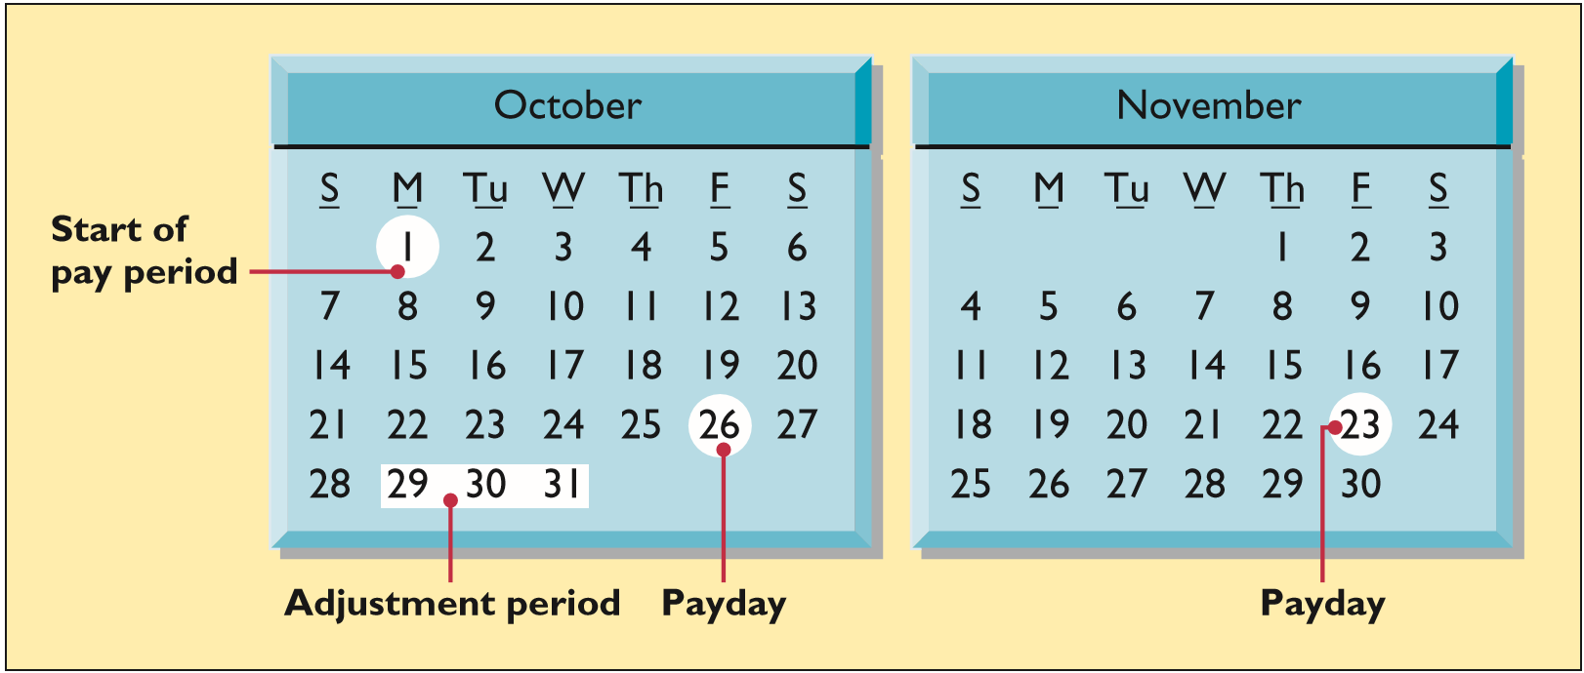
Accrued Expenses
Accrued Salaries and Wages. At October 31, the salaries and wages for these days represent an accrued expense and a related liability to Pioneer. The employees receive total salaries of $10,000 for a five-day work week, or $2,000 per day.
LO 3

Slide 71
Accrued Expenses
Accrued Salaries. Employees receive total salaries and wages of $10,000 for a five-day work week, or $2,000 per day. Prepare the adjusting entry on Oct. 31 to record accrual for salaries.
Oct. 31
Salaries and Wages Expense
6,000
Salaries and Wages Payable
6,000
Salaries and Wages Expense
Salaries and Wages Payable
Debit
Credit
Debit
Credit
40,000
6,000
6,000
46,000
LO 3

Slide 72
Accrued Expenses
Accrued Salaries. On November 23, Pioneer will again pay total salaries and wages of $40,000. Prepare the entry to record the payment of salaries on November 23.
Nov. 23
Salaries and Wages Payable
6,000
Salaries and Wages Expense
34,000
Cash
40,000
Salaries and Wages Expense
Salaries and Wages Payable
Debit
Credit
Debit
Credit
34,000
6,000
6,000
LO 3

Slide 73
Accrued Expenses
ILLUSTRATION 3-35
ILLUSTRATION 3-34
LO 3

Slide 74
WHAT DO THE NUMBERS MEAN? AM I COVERED?
WHAT’S YOUR PRINCIPLE
Rather than purchasing insurance to cover casualty losses and other obligations, some companies “self-insure.” That is, a company decides to pay for any possible claims, as they arise, out of its own resources. The company also purchases an insurance policy to cover losses that exceed certain amounts.
For example, Almost Family, Inc., a healthcare services company, has a self-insured employee health-beneﬁt program. However, Almost Family ran into accounting problems when it failed to record an accrual of the liability for beneﬁts not covered by its back-up insurance policy. This led to restatement of Almost Family’s ﬁscal results for the accrual of the beneﬁt expense.
LO 3

Slide 75
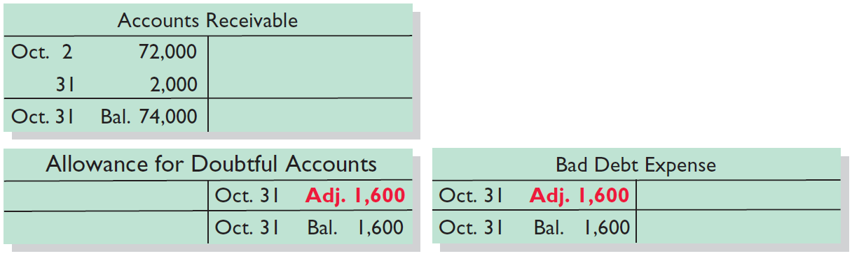
Accrued Expenses
Bad Debts. Pioneer Advertising reasonably estimates a bad debt expense for the month of $1,600. Prepare the entry to record the bad debts for the month of October.
Oct. 31
Bad Debt Expense
1,600
Allowance for Doubtful Accounts
1,600
ILLUSTRATION 3-32
Adjustment for Bad Debt Expense
LO 3

Slide 76
Accrued Expenses
ILLUSTRATION 3-35
ILLUSTRATION 3-34
LO 3

Slide 77
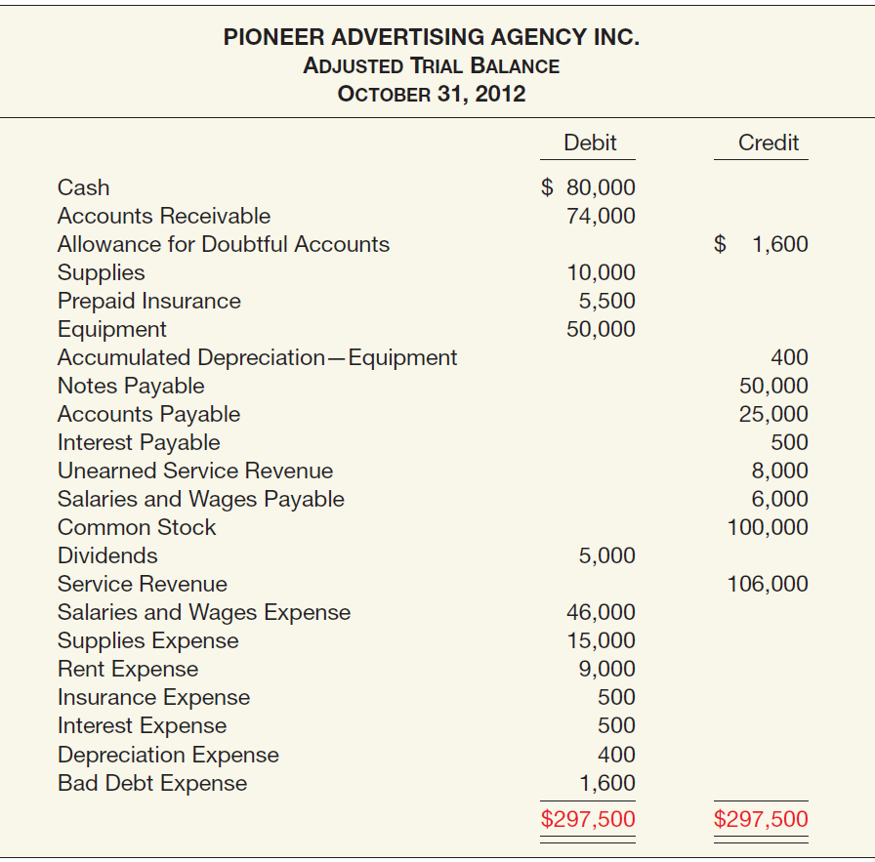
Adjusted Trial Balance
PIONEER ADVERTISING INC.
Adjusted Trial Balance
October 31, 2017
Shows the balance of all accounts, after adjusting entries, at the end of the accounting period.
ILLUSTRATION 3-33 Adjusted Trial Balance
LO 3

Slide 78
LEARNING OBJECTIVES
3
The Accounting Information System
After studying this chapter, you should be able to:
Understand the basic accounting information system.
Record and summarize basic transactions.
Identify and prepare adjusting entries.
Prepare financial statements from the adjusted trial balance.
Prepare closing entries.
Prepare financial statements for a merchandising company.
LO 4

Slide 79
PREPARING FINANCIAL STATEMENTS
Financial Statements are prepared directly from the Adjusted Trial Balance.
Income Statement
Retained Earnings Statement
Balance Sheet
LO 4

Slide 80
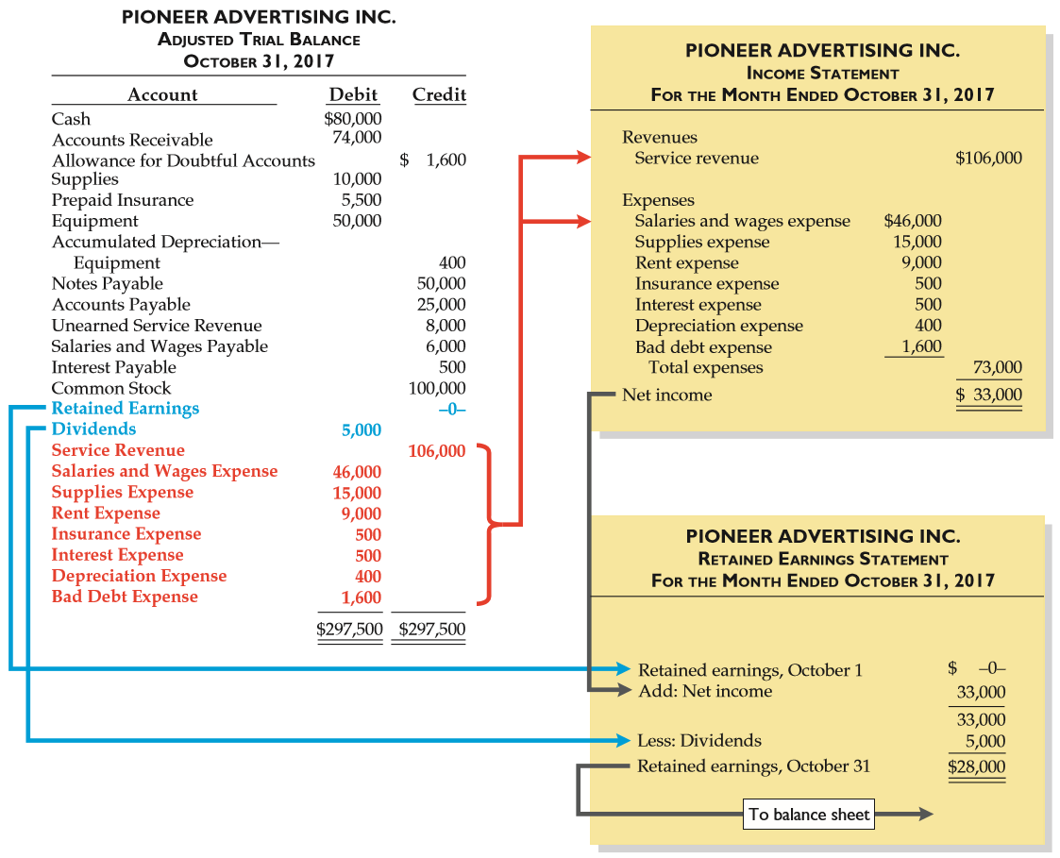
ILLUSTRATION 3-34
Preparation of the Income Statement and Retained Earnings Statement from the Adjusted Trial Balance

Slide 81
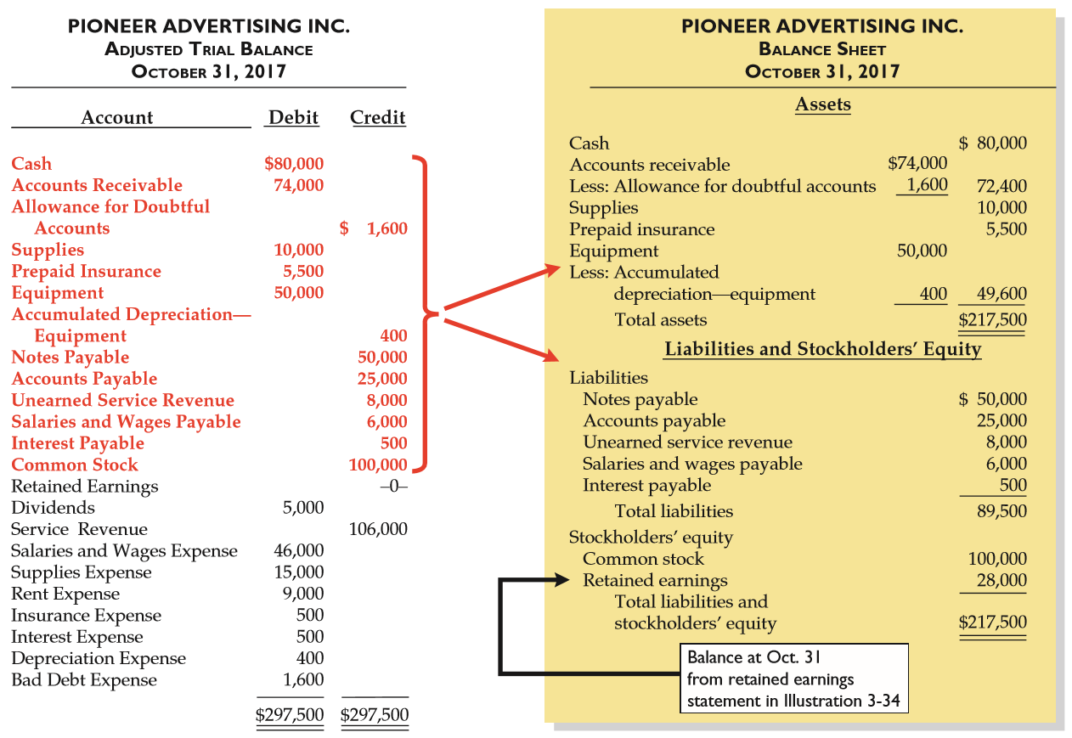
ILLUSTRATION 3-35
Preparation of the Balance Sheet from the Adjusted Trial Balance
LO 4

Slide 82
WHAT DO THE NUMBERS MEAN? 24/7 ACCOUNTING
WHAT’S YOUR PRINCIPLE
To achieve the vision of “24/7 accounting,” a company must be able to update revenue, income, and balance sheet numbers every day within the quarter and publish them on the Internet. Such real-time reporting responds to the demand for more timely ﬁnancial information made available to all investors—not just to analysts with access to company management.
Two obstacles typically stand in the way of 24/7 accounting: having the necessary accounting systems to close the books on a daily basis, and reliability concerns associated with unaudited real-time data. Only a few companies have the necessary accounting capabilities. Cisco Systems, which pioneered the concept of the 24-hour close, is one such company.
LO 4

Slide 83
LEARNING OBJECTIVES
3
The Accounting Information System
After studying this chapter, you should be able to:
Understand the basic accounting information system.
Record and summarize basic transactions.
Identify and prepare adjusting entries.
Prepare financial statements from the adjusted trial balance.
Prepare closing entries.
Prepare financial statements for a merchandising company.
LO 5

Slide 84
Closing
Closing Entries
  To reduce the balance of the nominal (temporary) accounts to zero in order to prepare the accounts for the next period’s transactions.
  To transfer all income statement account balances to the Retained Earnings account in owner’s equity.
  Balance sheet (asset, liability, and equity) accounts are not closed.
  Dividends are closed directly to the Retained Earnings account.
LO 5

Slide 85
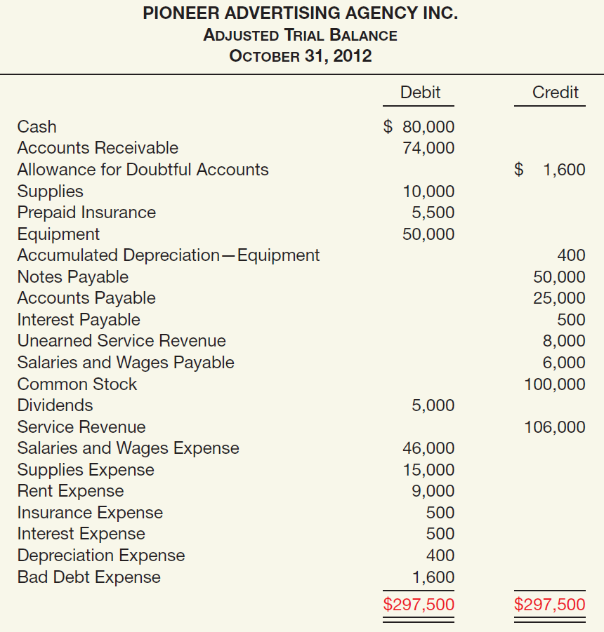
Closing Entries
PIONEER ADVERTISING AGENCY INC.
Adjusted Trial Balance
October 31, 2017
ILLUSTRATION 3-33
Closing Journal Entries:
Retained Earnings 5,000
Dividends 5,000
Service Revenue 106,000
Salaries & Wages Expense 46,000
Supplies Expense 15,000
Rent Expense 9,000
Insurance Expense 500
Interest Expense 500
Depreciation Expense 400
Bad Debt Expense 1,600
Retained Earnings 33,000
LO 5

Slide 86
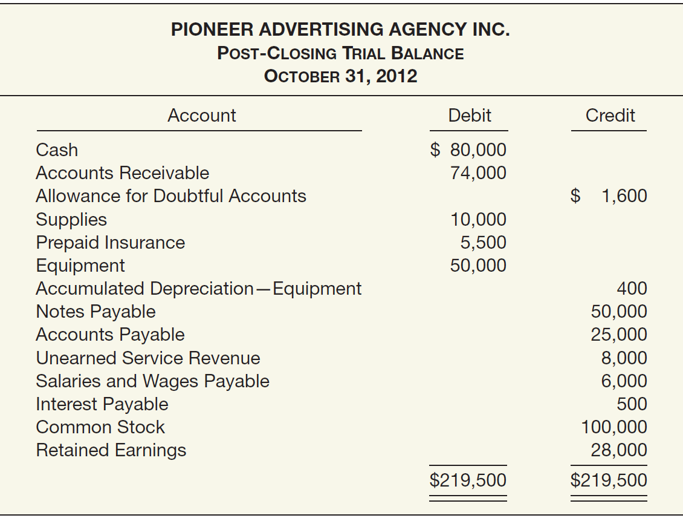
Post-Closing Trial Balance
ILLUSTRATION 3-38
PIONEER ADVERTISING INC.
Post-Closing Trial Balance
October 31, 2017
LO 5

Slide 87
Accounting Cycle Summarized
Enter the transactions of the period in appropriate journals.
Post from the journals to the ledger (or ledgers).
Take an unadjusted trial balance (trial balance).
Prepare adjusting journal entries and post to the ledger(s).
Take a trial balance after adjusting (adjusted trial balance).
Prepare the financial statements from the second trial balance.
Prepare closing journal entries and post to the ledger(s).
Take a post-closing trial balance (optional).
Prepare reversing entries (optional) and post to the ledger(s).
LO 5

Slide 88
WHAT DO THE NUMBERS MEAN? HEY, IT’S COMPLICATED
WHAT’S YOUR PRINCIPLE
The economic volatility of the past few years has left companies hungering for more timely and uniform ﬁnancial information to help them react quickly to fast-changing conditions. As one expert noted, companies were extremely focused on trying to reduce costs and plan for the future better, but a lot of them discovered that they didn’t have the information they needed and they didn’t have the ability to get that information. The unsteady recession environment also made it risky for companies to interrupt their operations to get new systems up to speed. So what to do? Try to piecemeal upgrades each year or start a major overhaul of their internal systems? Best Buy, for example, has standardized as many of its systems as possible and has been steadily upgrading them over the past decade.
Acquisitions can wreak havoc on reporting systems. Best Buy is choosy about when to standardize for companies it acquires, but it sometimes has to implement new systems after international deals. In other situations, a major overhaul is needed. For example, it is common for companies with a steady stream of acquisitions to have 50 to 70 general ledger systems. In those cases,
continued
LO 5

Slide 89
WHAT DO THE NUMBERS MEAN? HEY, IT’S COMPLICATED
WHAT’S YOUR PRINCIPLE
a company cannot react well unless its systems are made compatible. So is it the big bang (major overhaul) or the piecemeal approach? It seems to depend. One thing is certain—good accounting systems are a necessity. Without one, the risk of failure is high.
Source: Emily Chasan, “The Financial-Data Dilemma,” Wall Street Journal (July 24, 2012), p. B4.
LO 5

Slide 90
LEARNING OBJECTIVES
3
The Accounting Information System
After studying this chapter, you should be able to:
Understand the basic accounting information system.
Record and summarize basic transactions.
Identify and prepare adjusting entries.
Prepare financial statements from the adjusted trial balance.
Prepare closing entries.
Prepare financial statements for a merchandising company.
LO 6

Slide 91
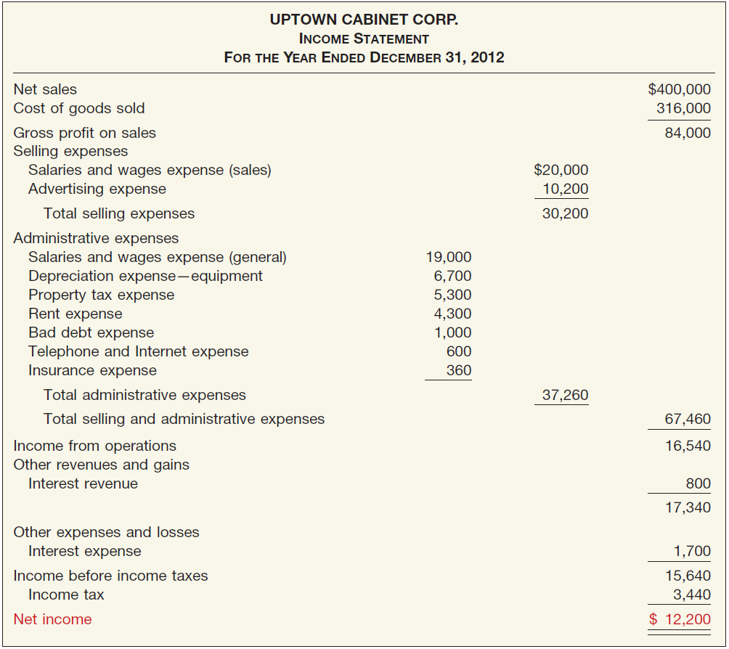
STATEMENTS OF A MERCHANDISING COMPANY
UPTOWN CABINET CORP.
Income Statement
For the Year Ended December 31, 2017
ILLUSTRATION 3-39
Income Statement for a Merchandising Company
LO 6

Slide 92
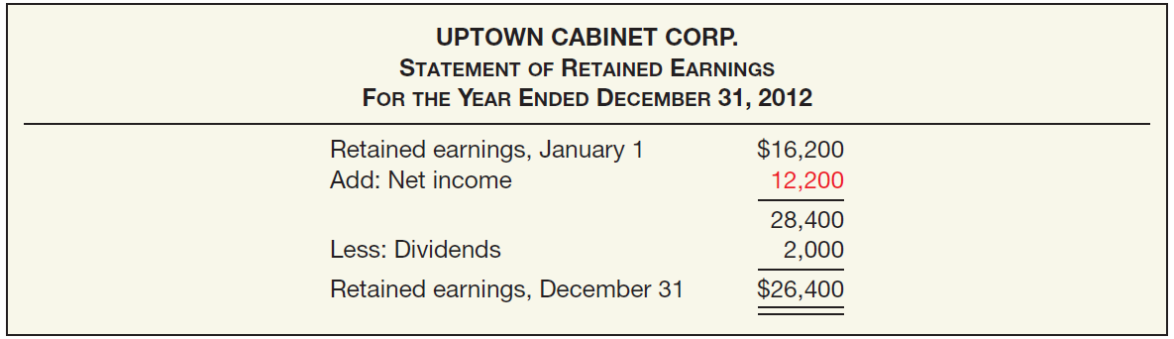
STATEMENTS OF A MERCHANDISING COMPANY
UPTOWN CABINET CORP.
Statement of Retained Earnings
For the Year Ended December 31, 2017
ILLUSTRATION 3-40
Statement of Retained Earnings for a Merchandising Company
LO 6

Slide 93
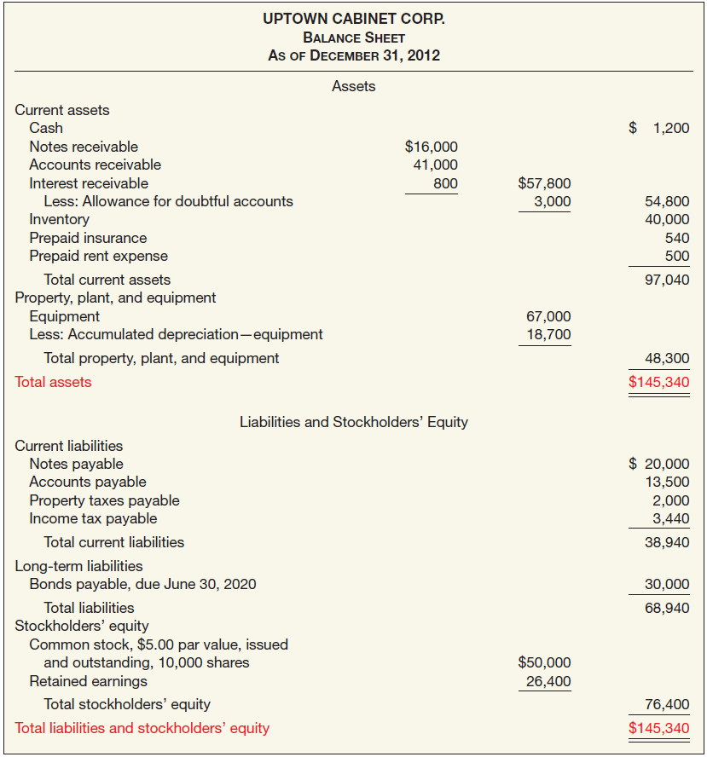
UPTOWN CABINET CORP.
Balance Sheet
As of December 31, 2017
ILLUSTRATION 3-41 Balance Sheet for a Merchandising Company
LO 6

Slide 94
WHAT DO THE NUMBERS MEAN? STATEMENTS, PLEASE
WHAT’S YOUR PRINCIPLE
The use of a worksheet at the end of each month or quarter enables a company to prepare interim ﬁnancial statements even though it closes the books only at the end of each year. For example, assume that Google closes its books on December 31, but it wants monthly ﬁnancial statements. To do this, at the end of January, Google prepares an adjusted trial balance (using a worksheet as illustrated in Appendix 3C) to supply the information needed for statements for January. At the end of February, it uses a worksheet again. Note that because Google did not close the accounts at the end of
January, the income statement taken from the adjusted trial balance on February 28 will present the net income for two months. If Google wants an income statement for only the month of February, the company obtains it by subtracting the items in the January income statement from the corresponding items in the income statement for the two months of January and February. If Google executes such a process daily, it can realize “24/7 accounting” (see the “What Do the Numbers Mean?” box on page 106).
LO 6

Slide 95
APPENDIX 3A
CASH-BASIS ACCOUNTING VERSUS
ACCRUAL-BASIS ACCOUNTING
Most companies use accrual-basis accounting. They
  recognize revenue when the performance obligation is satisfied and
  expenses in the period incurred,
  without regard to the time of receipt or payment of cash.
Under the strict cash-basis, companies
  record revenue only when they receive cash, and
  record expenses only when they disperse cash.
Cash basis financial statements are not in conformity with GAAP.
LO 7 Differentiate the cash basis of accounting from the accrual basis of accounting.

Slide 96
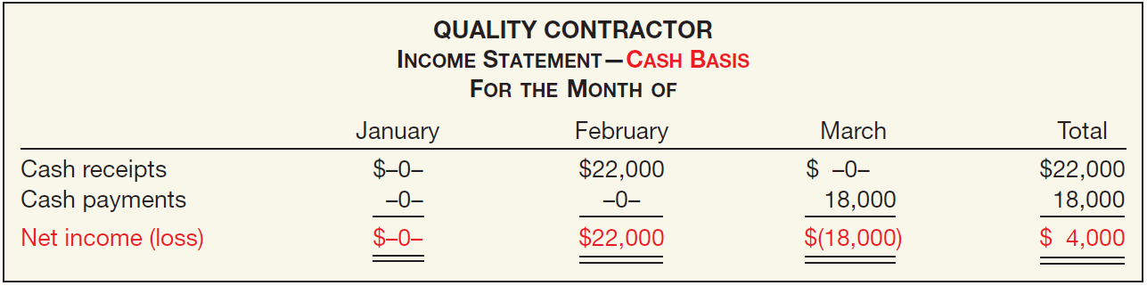

APPENDIX 3A
CASH-BASIS ACCOUNTING VERSUS
ACCRUAL-BASIS ACCOUNTING
Illustration: Quality Contractor signs an agreement to construct a garage for $22,000. In January, Quality begins construction, incurs costs of $18,000 on credit, and by the end of January delivers a finished garage to the buyer. In February, Quality collects $22,000 cash from the customer. In March, Quality pays the $18,000 due the creditors.
ILLUSTRATION 3A-1
Income Statements—Cash Basis
LO 7

Slide 97
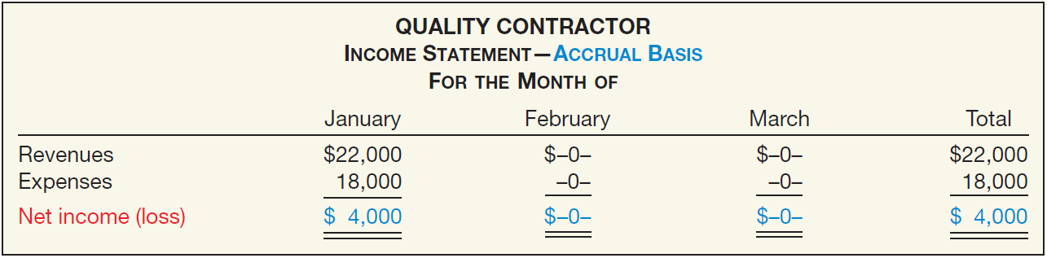
APPENDIX 3A
CASH-BASIS ACCOUNTING VERSUS
ACCRUAL-BASIS ACCOUNTING
Illustration: Quality Contractor signs an agreement to construct a garage for $22,000. In January, Quality begins construction, incurs costs of $18,000 on credit, and by the end of January delivers a finished garage to the buyer. In February, Quality collects $22,000 cash from the customer. In March, Quality pays the $18,000 due the creditors.
ILLUSTRATION 3A-2
Income Statements— Accrual Basis
LO 7

Slide 98
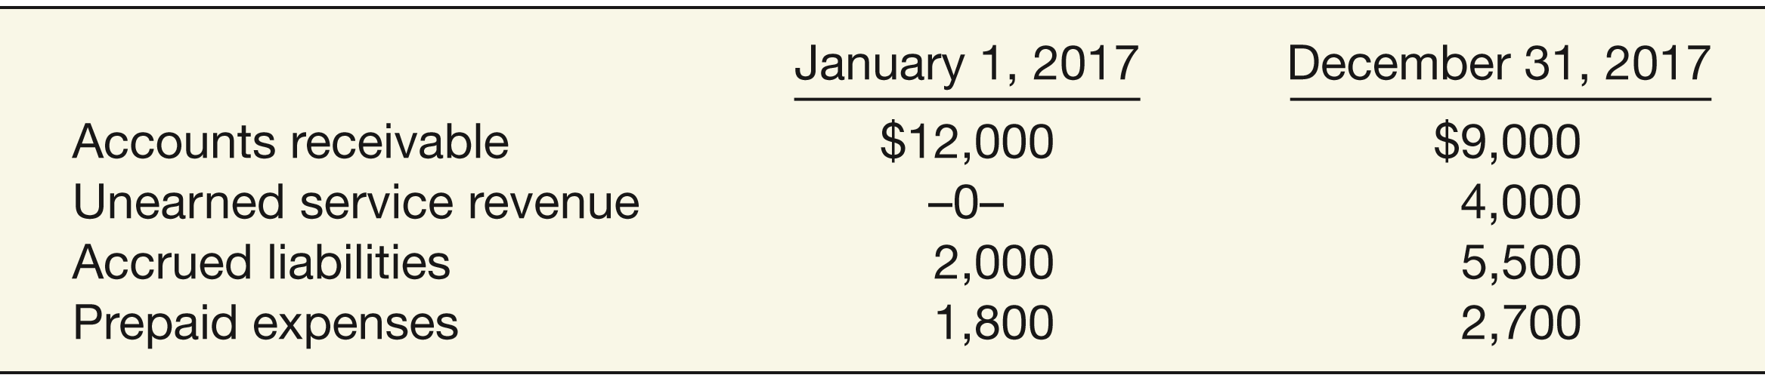
APPENDIX 3A
CASH-BASIS ACCOUNTING VERSUS
ACCRUAL-BASIS ACCOUNTING
Conversion From Cash Basis To Accrual Basis
Illustration: Dr. Diane Windsor, like many small business owners, keeps her accounting records on a cash basis. In the year 2017, Dr. Windsor received $300,000 from her patients and paid $170,000 for operating expenses, resulting in an excess of cash receipts over disbursements of $130,000 ($300,000 - $170,000). At January 1 and December 31, 2017, she has accounts receivable, unearned service revenue, accrued liabilities, and prepaid expenses as shown here.
ILLUSTRATION 3A-5
Financial Information Related to Dr. Diane Windsor
LO 7

Slide 99
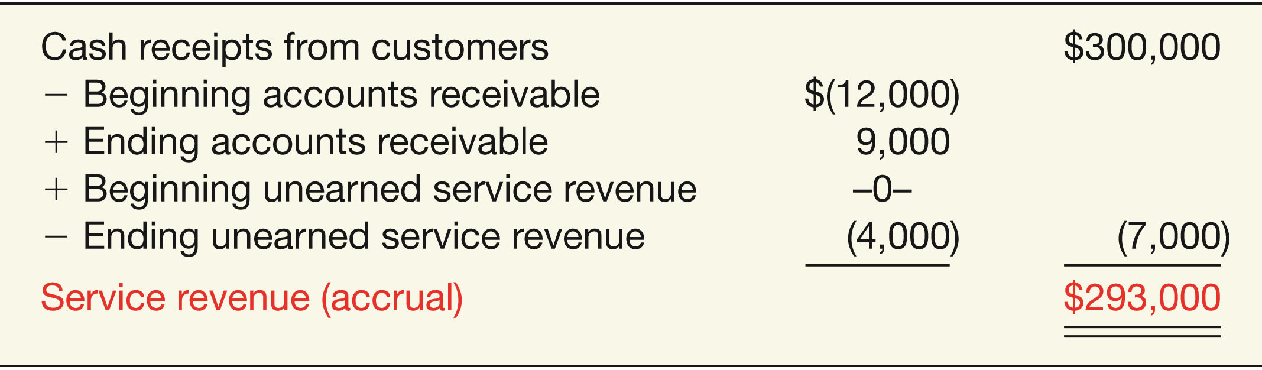
APPENDIX 3A
CASH-BASIS ACCOUNTING VERSUS
ACCRUAL-BASIS ACCOUNTING
Illustration: Calculate service revenue on an accrual basis.
ILLUSTRATION 3A-8
Conversion of Cash Receipts to Service Revenue
ILLUSTRATION 3A-5
LO 7

Slide 100
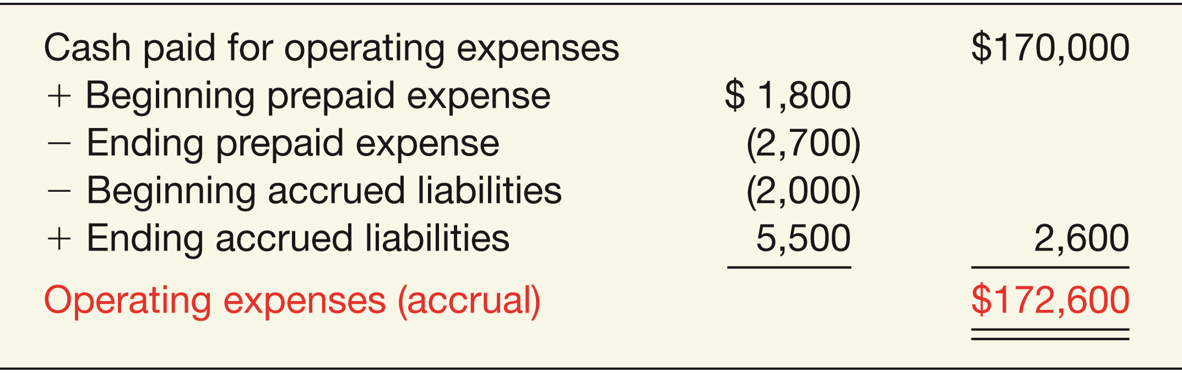
APPENDIX 3A
CASH-BASIS ACCOUNTING VERSUS
ACCRUAL-BASIS ACCOUNTING
Illustration: Calculate operating expenses on an accrual basis.
ILLUSTRATION 3A-11
Conversion of Cash Paid to Operating Expenses
ILLUSTRATION 3A-5
LO 7

Slide 101
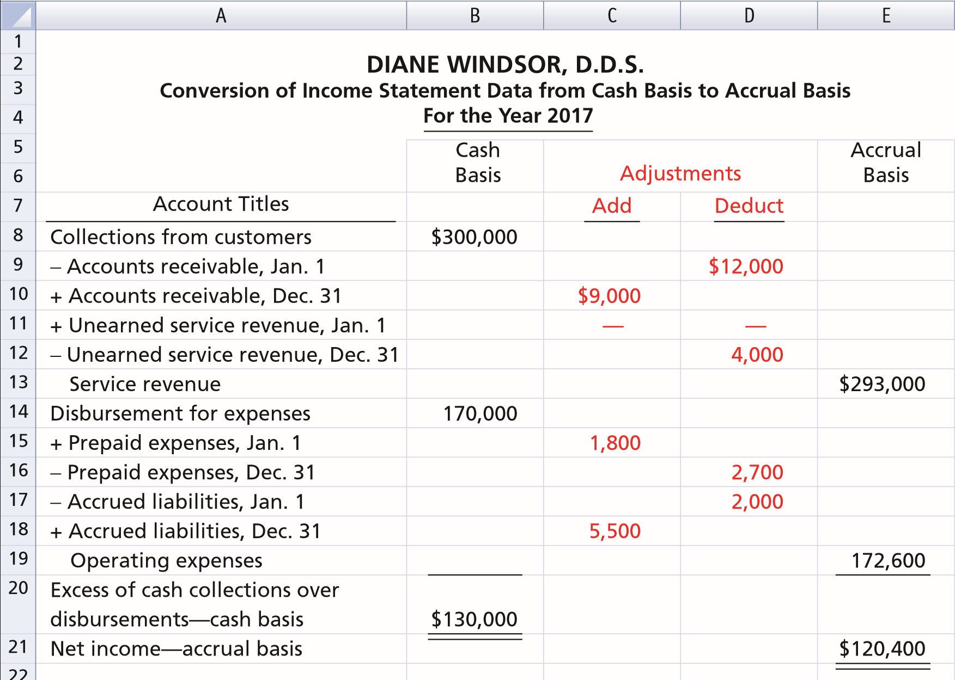
APPENDIX 3A
CASH-BASIS ACCOUNTING VERSUS
ACCRUAL-BASIS ACCOUNTING
ILLUSTRATION 3A-12
LO 7

Slide 102
APPENDIX 3A
CASH-BASIS ACCOUNTING VERSUS
ACCRUAL-BASIS ACCOUNTING
Theoretical Weaknesses of the Cash Basis
Today’s economy is considerably more lubricated by credit than by cash.
The accrual basis, not the cash basis, recognizes all aspects of the credit phenomenon.
Investors, creditors, and other decision makers seek timely information about a company’s future cash flows.
LO 7

Slide 103
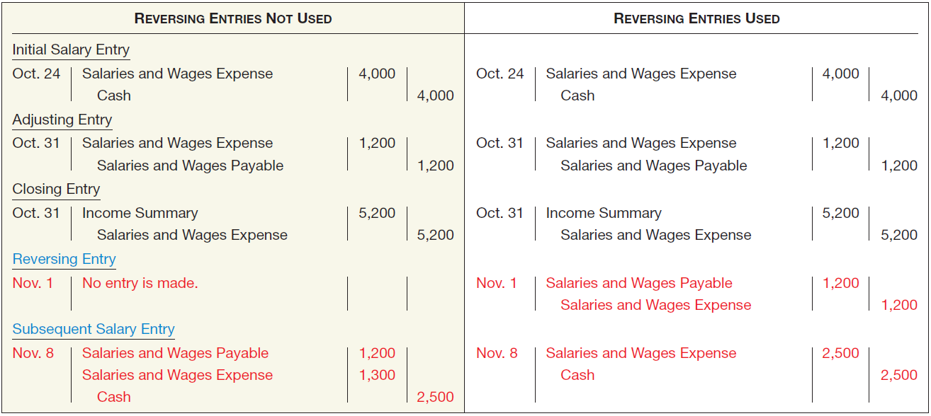
APPENDIX 3B
USING REVERSING ENTRIES
ILLUSTRATION OF REVERSING ENTRIES—ACCRUALS
ILLUSTRATION 3B-1
Comparison of Entries for Accruals, with and without Reversing Entries
LO 8 Identifying adjusting entries that may be reversed.

Slide 104
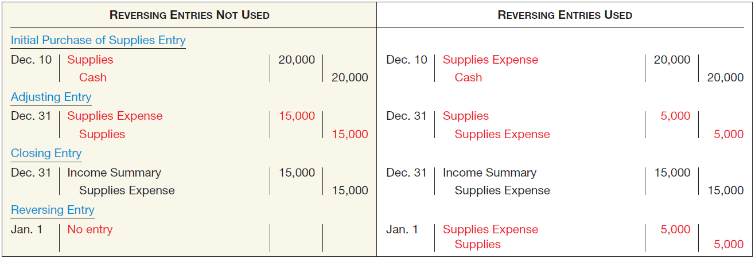
APPENDIX 3B
USING REVERSING ENTRIES
ILLUSTRATION OF REVERSING ENTRIES—DEFERRALS
ILLUSTRATION 3B-2
Comparison of Entries for Deferrals, with and without Reversing Entries
LO 8

Slide 105
APPENDIX 3B
USING REVERSING ENTRIES
SUMMARY OF REVERSING ENTRIES
  All accruals should be reversed.
  All deferrals for which a company debited or credited the original cash transaction to an expense or revenue account should be reversed.
  Adjusting entries for depreciation and bad debts are not reversed.
Recognize that reversing entries do not have to be used. Therefore, some accountants avoid them entirely.
LO 8

Slide 106
APPENDIX 3C
USING A WORKSHEET: THE ACCOUNTING CYCLE REVISITED
A company prepares a worksheet either on
  columnar paper or
  within a computer spreadsheet.
A company uses the worksheet to adjust
  account balances and
  to prepare financial statements.
LO 9 Prepare a 10-column worksheet.

Slide 107
APPENDIX 3C
USING A WORKSHEET: THE ACCOUNTING CYCLE REVISITED
WORKSHEET COLUMNS
  Trial Balance Columns
  Adjustment Columns
LO 9

Slide 108
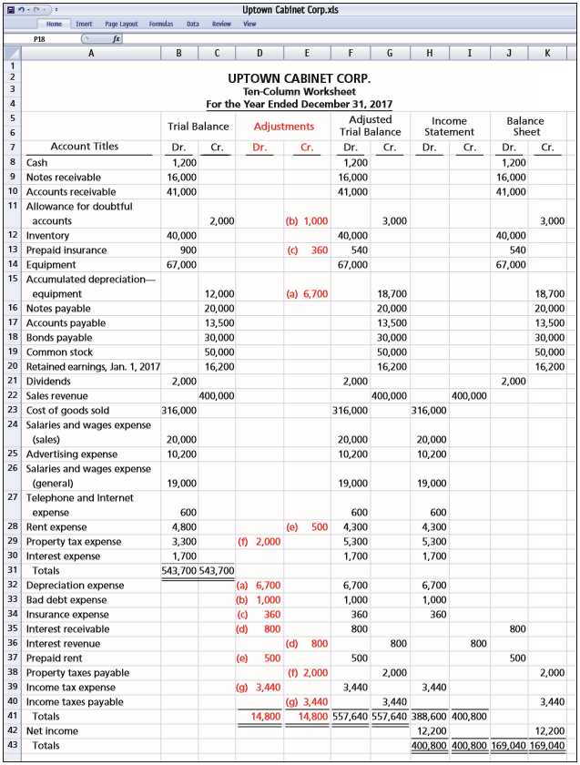
APPENDIX 3C
USING A WORKSHEET: THE ACCOUNTING CYCLE REVISITED
ILLUSTRATION 3C-1
Worksheet

Slide 109
APPENDIX 3C
USING A WORKSHEET: THE ACCOUNTING CYCLE REVISITED
PREPARING FINANCIAL STATEMENTS FROM A WORKSHEET
The Worksheet:
  provides information needed for preparation of the financial statements.
  Sorts data into appropriate columns, which facilitates the preparation of the statements.
LO 9

Slide 110
APPENDIX 3C
USING A WORKSHEET: THE ACCOUNTING CYCLE REVISITED
UPTOWN CABINET CORP.
Income Statement
For the Year Ended December 31, 2017
ILLUSTRATION 3-39
Income Statement for a Merchandising Company
LO 9

Slide 111
APPENDIX 3C
USING A WORKSHEET: THE ACCOUNTING CYCLE REVISITED
UPTOWN CABINET CORP.
Statement of Retained Earnings
For the Year Ended December 31, 2017
ILLUSTRATION 3-40
Statement of Retained Earnings for a Merchandising Company
LO 9

Slide 112
UPTOWN CABINET CORP.
Balance Sheet
As of December 31, 2017
APPENDIX 3C
USING A WORKSHEET: THE ACCOUNTING CYCLE REVISITED
ILLUSTRATION 3-41 Balance Sheet for a Merchandising Company

Slide 113
RELEVANT FACTS
Similarities
  International companies use the same set of procedures and records to keep track of transaction data. Thus, the material in Chapter 3 is the same under both GAAP and IFRS.
  Transaction analysis is the same under IFRS and GAAP but, as you will see in later chapters, different standards sometimes impact how transactions are recorded.
  Both the IASB and FASB go beyond the basic definitions provided in this textbook for the key elements of financial statements, that is, assets, liabilities, equity, revenues, and expenses.
  A trial balance under IFRS follows the same format as shown in the textbook.
LO 10 Compare the accounting information systems under GAAP and IFRS.

Slide 114
RELEVANT FACTS
Differences
  Rules for accounting for specific events sometimes differ across countries. For example, European companies rely less on historical cost and more on fair value than U.S. companies. Despite the differences, the double-entry accounting system is the basis of accounting systems worldwide.
  Internal controls are a system of checks and balances designed to prevent and detect fraud and errors. While most companies have these systems in place, many have never completely documented them nor had an independent auditor attest to their effectiveness. Both of these actions are required under SOX. Enhanced internal control standards apply only to large public companies listed on U.S. exchanges.
LO 10

Slide 115
ON THE HORIZON
The definitional structure of assets, liabilities, equity, revenues, and expenses may change over time as the IASB and FASB evaluate their overall conceptual framework for establishing accounting standards. In addition, high-quality international accounting requires both high-quality accounting standards and high-quality auditing. Similar to the convergence of GAAP and IFRS, there is a movement to improve international auditing standards. The International Auditing and Assurance Standards Board (IAASB) functions as an independent standard-setting body. It works to establish high-quality auditing and assurance and quality-control standards throughout the world. Whether the IAASB adopts internal control provisions similar to those in SOX remains to be seen. You can follow developments in the international audit arena at http://www.ifac.org/iaasb/.
LO 10

Slide 116
IFRS SELF-TEST QUESTION
Information in a company’s first IFRS statements must:
  have a cost that does not exceed the benefits.
  be transparent.
  provide a suitable starting point.
  All the above.
LO 10

Slide 117
IFRS SELF-TEST QUESTION
The transition date is the date:
  when a company no longer reports under its national standards.
  when the company issues its most recent financial statement under IFRS.
  three years prior to the reporting date.
  None of the above.
LO 10

Slide 118
IFRS SELF-TEST QUESTION
When converting to IFRS, a company must:
  recast previously issued financial statements in accordance with IFRS.
  use GAAP in the reporting period but subsequently use IFRS.
  prepare at least three years of comparative statements.
  use GAAP in the transition year but IFRS in the reporting year.
LO 10

Slide 119
COPYRIGHT
“Copyright © 2016 John Wiley & Sons, Inc. All rights reserved. Reproduction or translation of this work beyond that permitted in Section 117 of the 1976 United States Copyright Act without the express written permission of the copyright owner is unlawful. Request for further information should be addressed to the Permissions Department, John Wiley & Sons, Inc. The purchaser may make back-up copies for his/her own use only and not for distribution or resale. The Publisher assumes no responsibility for errors, omissions, or damages, caused by the use of these programs or from the use of the information contained herein.”

