Slide 1
Program Planning

Slide 2
So far we talked about Community Needs Assessment and the 7 steps involved
Community needs assessment: A snapshot of the nutritional problem in our community

Slide 3
Steps in Community Assessment
Define the problem
Set the parameters of the assessment
Collect data
Analyze and interpret data
Share the findings
Set priorities
Choose a plan of action

Slide 4
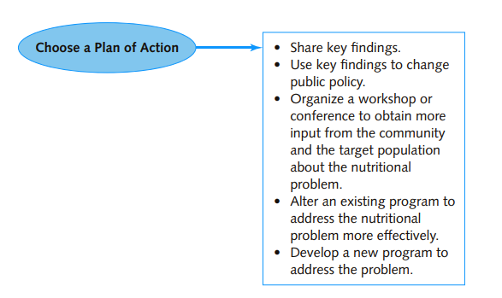
In step 7, we decide a plan of action!
What are we going to do with the data collected from the needs assessment
Today’s activity is program planning

Slide 5
Today we will discuss program planning—the process of designing a program to meet a nutritional need or fill a gap in services. It describes the factors to consider when designing an intervention

Slide 6
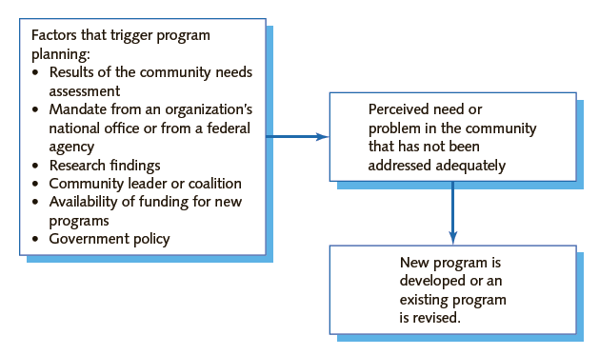
Factors that trigger program planning

Slide 7
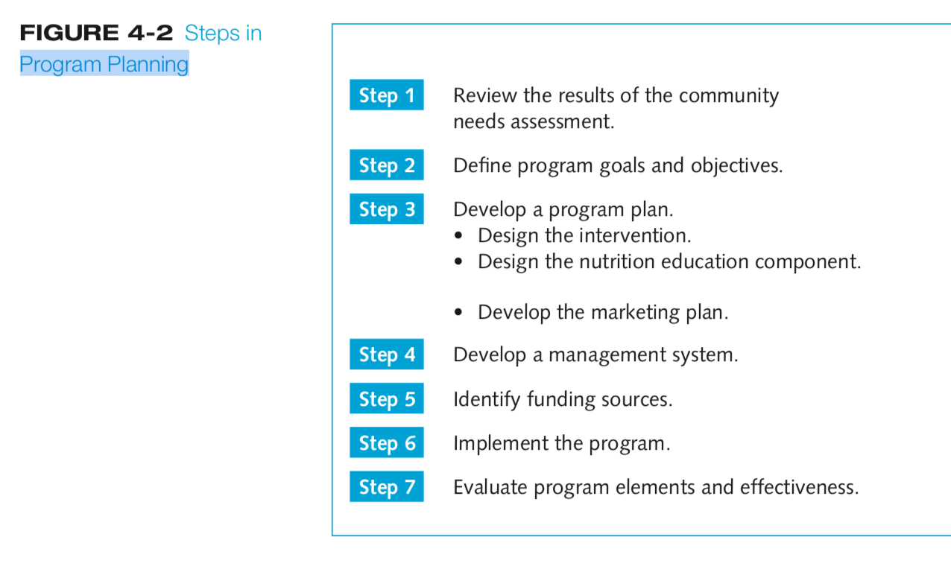
Steps in program planning

Slide 8
Example
When the community assessment identifies a gap in services, a new program may be developed to fill the gap
A needs assessment in the west bank found that 53 % of mothers did not breastfeed their infants
As a result: development of culturally sensitive campaigns that promote breastfeeding
And educate mothers about appropriate times for introducing foods in this population

Slide 9
Step 1: Review the Results of the Community Needs Assessment

Slide 10
Class exercise
You will break up into groups and plan a program for the following cases based on info you collected from community needs assessment

Slide 11
Case study 1
WOMEN AND CHD RISK
INFO from community needs assessment
low level of awareness of CHD risk factors among women: women don’t know mortality rates or risk factors for CHD
“A survey of women aged 18 to 72 years, conducted at five medical clinics in the major metropolitan area, found that about two-thirds (64 percent) do not know that CHD is the leading cause of death among women.
50% of women are smokers
The women show a pattern of low activity levels and
The women eat a diet high in saturated fat
30% of the women surveyed are obese
Weight management programs and classes are available through private health/fitness clubs and dietitians in private practice. nearly two-thirds (64 percent) of women report that they are trying to lose weight, but only 8 percent of women participate in organized classes and programs.
Factors that contribute to CHD risk and could serve as points for intervention

Slide 12
Case study 2 / nutrition status of older adults
20% low Hgb levels
2 %Vitamin A deficiency
64% have hypertension
12 percent of independent older adults reported having difficulty performing two or more personal care activities (for example, bathing, dressing, using the toilet
Majority receive benefits from government
But 32% receive assistance for food ( using food stamps, government assistance to buy food)

Slide 13
Step 2: Define Program Goals and Objectives
Goals are broad statements of desired changes or outcomes. They provide a general direction for the program
Example :Reduce death from CHD among women
Objectives are specific, measurable actions to be completed within a specified time frame
The objective contains
The action or activity to be undertaken
The target population
An indication of how success will be measured or evaluated
The time frame in which the objective will be met.

Slide 14
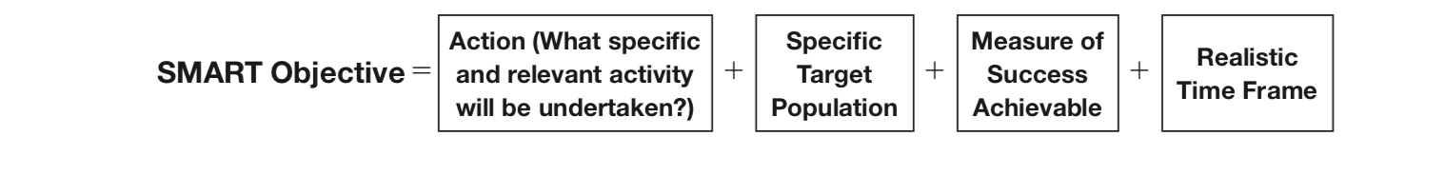
To develop objectives ask yourself
WHAT are we going to do? WHY is it important for us to accomplish this activity?
WHO is going to be responsible for the activities? WHEN do we want this to be completed?
HOW are we going to do these activities?
SMART objectives • Specific, Measurable, Attainable, Relevant, Time‐limited

Slide 15
Structure of objective
Time frame in which objective will be me
Measurable characteristic, behavior, or action
Target population
Indication of how success will be evaluated
Example
By 2017, the incidence of anemia among migrant children in Greece will be reduced by 15%

Slide 16
Outcome objectives ( Health)—measurable changes in a health or nutritional outcome
Example: a decrease in LDL, an increase in serum ferritin concentration,
“By the year 2020, increase calcium intakes so that at least 75 percent of females aged 9 to 19 years consume recommended calcium intakes”
Process objectives—measurable activities carried out by the community nutritionist and other team members in implementing the program.
Example Each community nutritionist will conduct two nutrition lectures per week over the course of the three-month program
Behavioral Objective
“ By 2020, 60% of low income pregnant women living in the west bank will be able to explain the risk of anemia in pregnancy, how iron is related to anemia, and iron rich foods”

Slide 17
In groups : develop your goals and objectives
10-15 minutes

Slide 18
Step 3: Develop a Program Plan
Using the goals and objectives as a guide, develops a program plan
which consists of
Description of the proposed intervention
The nutrition education component
Marketing plan

Slide 19
Things to consider and should be explained in your intervention
the number of clients expected to use the program
Selection criteria for people to be included in the intervention
The staff ( dietitians, doctors, teachers, staff to collect data etc.)
Equipment ( anthropometric tools)
Material resources required to administer the program
The facilities available for staff offices and teaching rooms
the level of staff training required prior to implementing the program
How are you going to convey the nutrition messages
What policies should you consider? Governmental, nation or local regulations must be considered in administering the program
How much money will it cost
How are you going to evaluate the effectiveness of the intervention

Slide 20
When designing an intervention
You can design your intervention to target
Individuals (individuals, families)
Communities (people in social networks such as churches and clubs; entire organizations )
Systems (the large, integrated environments in which all of us live and work. Targeting a system for intervention usually involves changing a public, corporate, or school policy)
city, state, or nation.

Slide 21
The intervention strategy can also encompass one or more levels of intervention
Build awareness
Change lifestyles (quitting smoking, being physically active, eating more fruits and vegetables)
Create a supportive environment -creating environments that support the behavior changes made by individuals
(changing company school policies to provide healthier lunches/ foods in cafeteria)
The intervention strategy INCLUDES one or more levels of intervention

Slide 22
Level 1 Interventions Awareness
Awareness programs can be very successful in helping change attitudes and beliefs and increasing knowledge of risk factors, but they RARELY result in actual behavior changes

Slide 23
Level 2 interventions ( lifestyle )
Help participants make lifestyle changes
Examples: quitting smoking, being physically active, eating more fruits and vegetables and less saturated fat, and managing stress
Use a combination of behavior modification and education

Slide 24
Level III interventions: Supportive Environment
creating environments that support the behavior changes made by individuals
Example: a company’s policy to promote heart- healthy and high-fiber foods in the company cafeteria makes it easier for employees who are trying to lose weight or lower their blood cholesterol concentration to make healthful food choices at work

Slide 25
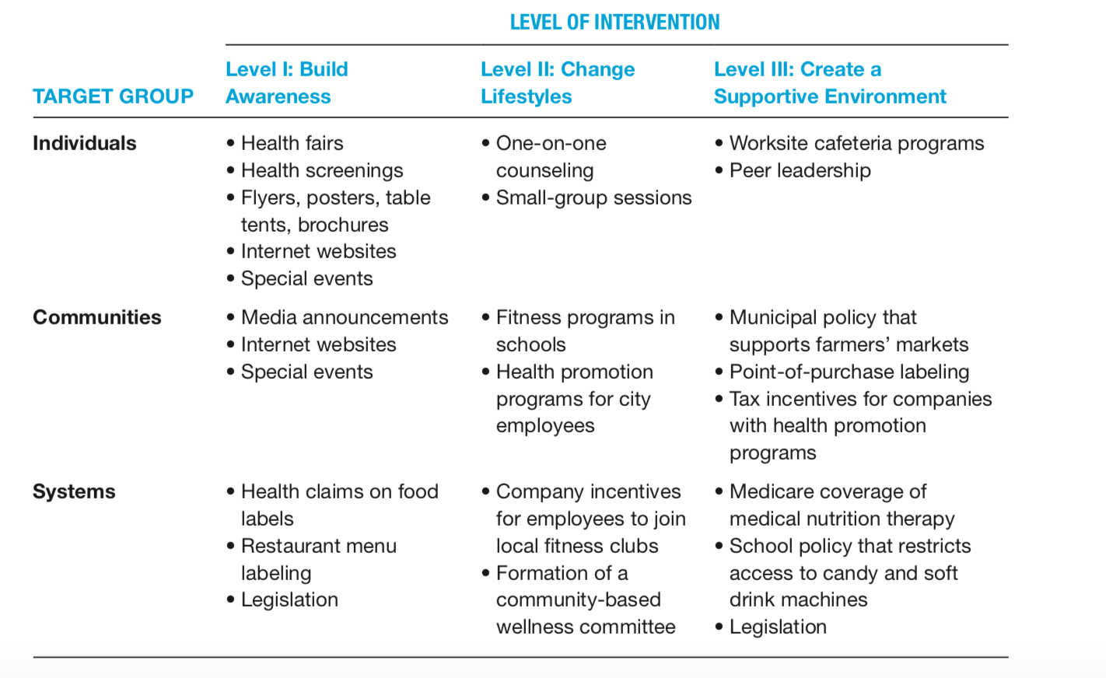
Notes:
Special events: Mother/Daughter Walk sponsored by the Heart and Stroke Foundation
Examples of Level III interventions that target individuals include worksite health promotion and cafeteria programs. Identifying peer leaders who can model behavior change and talk about how they changed their lifestyles is another way of creating a supportive environment.

Slide 26
Design your intervention Your budget?
(20-30 minutes)

Slide 27
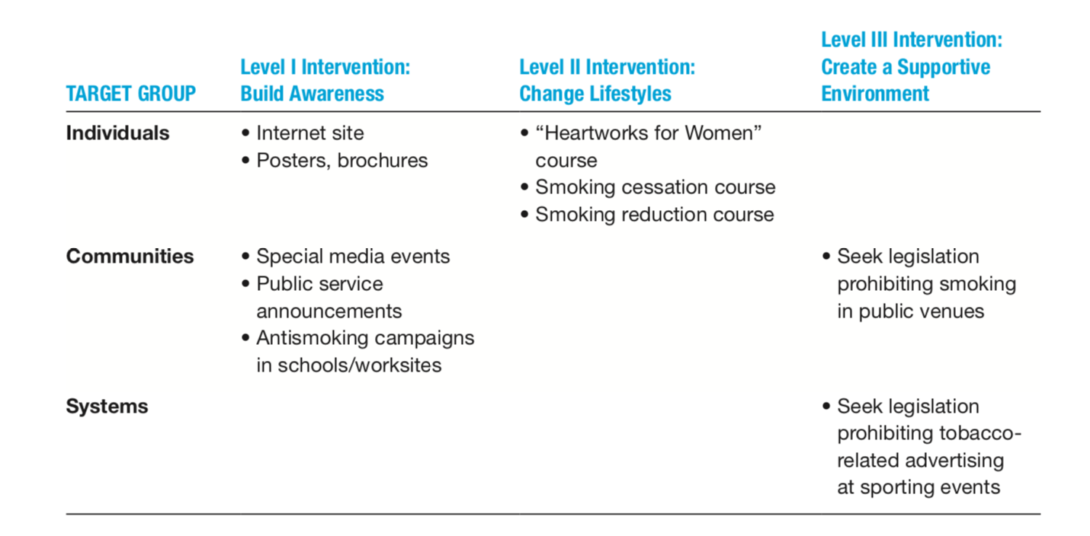

Slide 28
Design the Nutrition Education Component
Each intervention has an educational component. This is delivered after developing an entire nutrition education plan

Slide 29
Steps to be taken When creating the educational component
Assess needs
Set goals and objectives
Specify the format
Develop a lesson plan
Specify nutrition messages
Choose program identifiers
Develop a marketing plan
Specify partnerships
Conduct evaluation research

Slide 30
Educational Component
Assessing Participants’ Needs
Identify the target population’s educational needs
What learning style is best suited for the potential program participants?
What kinds of instructional tools (for example, DVDs or printed handouts) will have the greatest impact with this group?
Will participants be comfortable in group settings?
Should some individual nutrition counseling be provided?

Slide 31
Educational Component
2. Set goals and objectives FOR your educational component
Example Goals
To educate individuals about the contributions of diet to CHD risk
To build skills related to heart-healthy cooking and eating

Slide 32
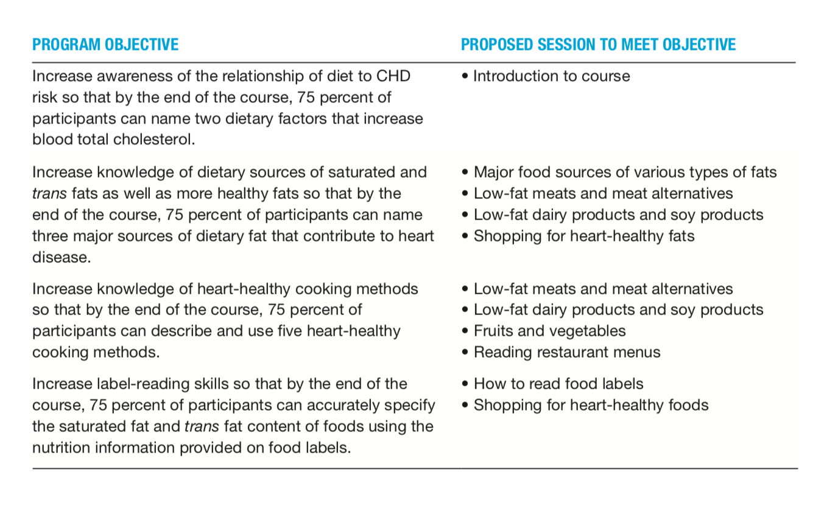
Use objectives as a guide TO sketches a rough outline of the program sessions.
For example: link the program objectives and the individual sessions

Slide 33
Educational Component
3. Specify the Program Format
Example:
Three didactic lectures
Two cooking demonstrations
Choose a format that suits the topic and the amount of information that must be presented

Slide 34
From your community needs assessment you gathered the following information (From the women and CHD risk case study )
Participants have at least a high school education
Many have participated in group classes (for example, weight management classes)
About 75 percent of those surveyed in focus groups have access to the Internet
How would this information effect your format when designing the education component of your intervention???

Slide 35
Educational Component
4. Develop a lesson plan
Who will be teaching? Where? What kind of room? Conference rooms or more private setting? Internet or in person? How long is each session ?

Slide 36
Review the proposed intervention activities
Example
The program has two goals
1) To educate individuals about the contributions of diet to CHD risk
2) To build skills related to heart-healthy cooking and eating

Slide 37
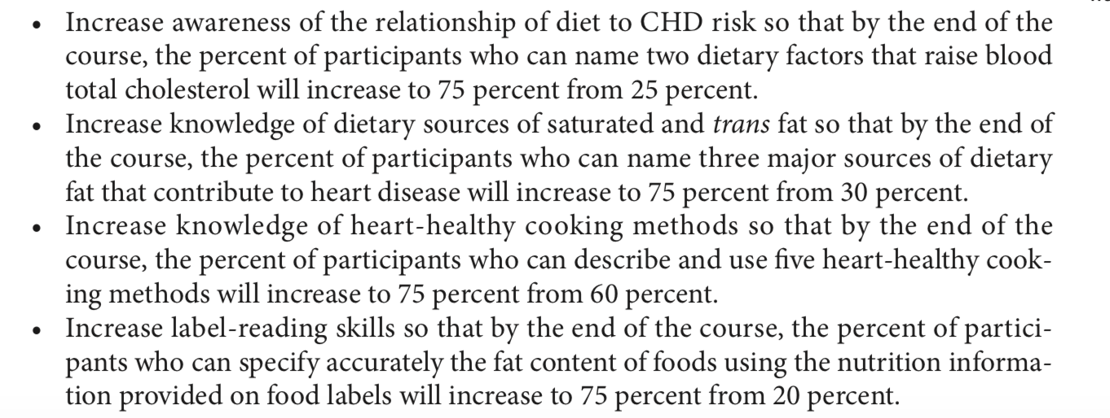
Example
Specific objectives

Slide 38
To meet these educational objectives you decide to conduct 8 Sessions, each session about 90 minutes
The sessions for the program are organized as follows:
Session 1: Getting Started
Session 2: Looking for Fat in All the Right Places
Session 3: Choosing Heart- Healthy Protein Foods
Session 4: Dairy Goes Low-Fat
Session 5: Focus on Fruits and Vegetables
Session 6: Reading Food Labels
Session 7: Grocery Shopping Made Easy
Session 8: Reading Restaurant Menus

Slide 39
Consider the instructional method
group sessions or one-on-one counseling best suited for teaching heart-healthy cooking skills ?? What does your budget allow?
If you choose individual counseling, the facility must have private rooms for this activity
If small-group session: conference rooms or classrooms for teaching groups If cooking facility should have counters, sinks, electrical outlets, and other equipment
Nutrition education material:
Will you create your own materials or use already available brochure, handouts etc.?? Is the available material fitting for your target population?

Slide 40
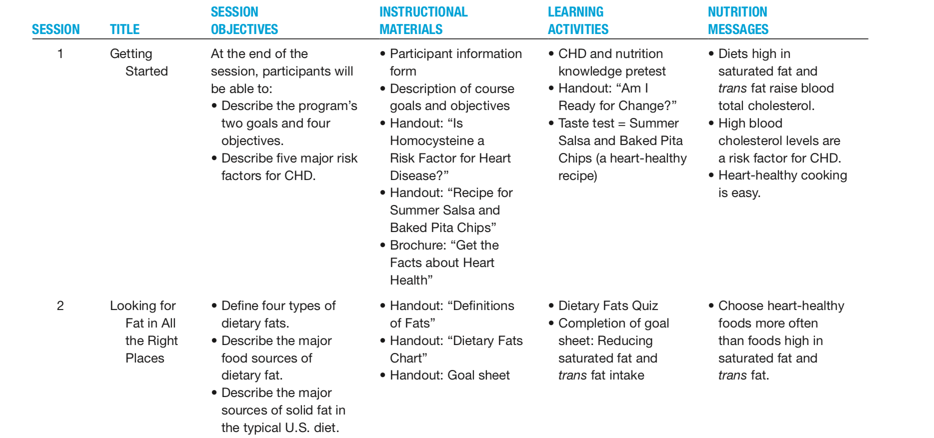

Slide 41
7. Develop a Marketing Plan
developing a marketing plan to promote your intervention for the target population
Social media? Radio? Television ? Advertisement
8. Specify Partnerships
Example: Forming partnerships with grocery stores, local farmers, retail establishments, government agencies, nonprofit organizations
For example to use facility or to receive education material

Slide 42
Example of an Education
Problem: low consumption of milk and calcium by school children (kindergarten through sixth grade)– calcium is crucial for development, gallons of milk are thrown out each day by school cafeteria- Poor acceptance of milk in the cafeteria
Providing students with information alone will not necessarily get them to change their health-related behavior
School-based programs are able to provide children with knowledge and skills and environment to practice (school cafeteria)
Learning should be fun for children

Slide 43

How was the education campaign carried out
The Milk Matters campaign incorporated educational
The nutritionist responsible for the campaign met with teachers to explain activities and educational messages
Each teacher received a packet of materials outlining the daily activities for the week, including classroom presentations by the nutritionist
Photographs of several teachers with “milk mustaches” were taken and posted in the school.
daily milk trivia questions
Art projects
coloring sheets,
video on milk from the Dairy Council
Children were asked, through a newsletter to parents, to bring in an empty fat- free or low-fat carton, as a way to encourage families to try a lower-fat milk.
A contest among classes promoted increased milk consumption at lunch; the winning class was photographed with milk mustaches.

Slide 44
Step 4: Develop a Management System
The personnel structure consists of the employees responsible for overseeing the program
Data management system is the manner in which data about clients, their use of the program, and the outcome measures are recorded and analyzed

Slide 45
Costs:
salaries and wages of program personnel
materials needed
travel expenses, and equipment
indirect costs (such as office space rental, utilities, and janitorial services)

Slide 46
Step 5: Identify Funding Sources
Funding in the form of cash grants or in-kind contributions from partners is possible
Must identify areas where financial support is needed
Determine possible funding sources
prepare and submits a grant application for funding

Slide 47
Step 6: Implement the Program
Two questions arise during this phase
How can program participation be increased?
understand the target population and their needs and interests. use evaluation research to improve the program design
Make the activity enjoyable and relevant to the target population’s needs
Remove barriers to participation
How can the program be improved?

Slide 48
Step 7: Evaluate Program Elements and Effectiveness
Evaluation is the use of scientific methods to judge and improve the planning, monitoring, effectiveness, and efficiency of health, nutrition, and other human service programs
Program evaluations forces community nutritionists to determine whether they are progressing toward their initial goals and whether these goals are still appropriate

Slide 49
Next part of your project
Background
Detailed description of the problem in Palestine (refer to literature)
Nutrition problem and its adverse health effects
Program Aims and Objectives
Process objectives
Health objectives
Behavioral objectives
Due by May 5TH Don’t forget to cite!

Slide 50
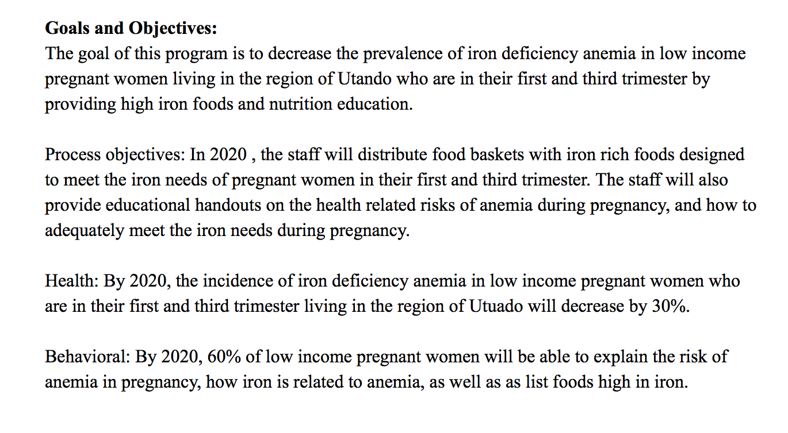
Example of Goals and Objectives

