Slide 1
ADDIE VS SCRUM

Slide 2
How Angry Birds Built a Global Brand?
The success of Angry Birds was not an accident.
The Angry Birds development project was a purposeful project created by an experienced game development company.
Rovio had previously published 52 other games and created 16 original games.
The 12-person team spent 8 months carefully studying the iPhone applications and developing the game.
They refined the game many times before it was released.
It took a great deal of research, engineering, and prototyping to make it success.

Slide 3
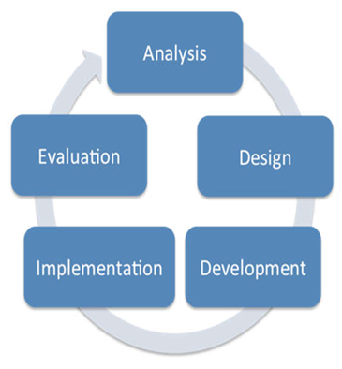
ADDIE Process Model
Used for creating instruction based on five steps:
Analysis
Design
Development
Implementation
Evaluation
Management

Slide 4
Analysis
In this phase:
The type of problem to be solved by the instruction is analyzed.
Takes into account the type of content to be learned:
Declarative knowledge
Problem-solving knowledge
Looks at the learners to see their prerequisite skills.
Looks at the technology available for the delivery of the learning solution.

Slide 5
Design
In this phase
A robust design document is produced
The instructional objectives are written. e.g.:• “The learner will be to identify... “
The appropriate instructional strategies are selected.
Assessment items are created to match objectives.
Storyboards.
Usually, a client signs off on the design document.

Slide 6
Development
In this phase:
The programming and creation of the instruction occurs.
Creating interface items for the instruction.
Creating and loading images and sound files.
At points throughout this phase, a formative evaluation process takes place by learners and stakeholders.
If changes need to be made, the process might go back to the design phase.

Slide 7
Formative Assessment
The goal of formative assessment is to gather feedback that can be used by the instructor and the students to guide improvements in the ongoing teaching and learning context. These are low stakes assessments for students an instructors. Examples:
Asking students to submit one or two sentences identifying the main point of a lecture.
Have students submit an outline for a paper.
Early course evaluations.

Slide 8
Implementation
In this phase
The actually rollout of the instruction to the learners happen.
It involves making sure the instruction can run on any required computer systems or the instructors using the materials understand how they are to be utilized.

Slide 9
Evaluation
Divide into two types:
Formative evaluation: occurs during the design and development.
Materials are reviewed, feedback is presented to the team, and changes are made as needed.
Summative evaluation: occurs at the end when the assessment is made of the utility of the instruction.

Slide 10
Summative Assessment
The goal of summative assessment is to measure the level of success or proficiency that has been obtained at the end of an instructional unit, by comparing it against some standard or benchmark. Examples:
Assigning a grade to a final exam
Critique of a Senior presentation
University Faculty Course Evaluations

Slide 11
Scrum

Slide 12
Product backlog
The scrum process starts when a stakeholder /owner is handed a vision or idea for a new product or update.
From that vision/idea, a list of requirements is created.
Product backlog items is incomplete as emergent requirements appears.
With ADDIE we define all possible requirements in a design document up-front.

Slide 13
Sprints
The project goes in one of the many iterative cycles called sprints.
The product owner is responsible for prioritization ofthe product backlog items.
Sprint can range from 2 to 5 weeks starts with oneday for planning and ends with one day for revision.
Goal of each sprint is to develop finished functionality that can be reviewed by the produced owner.
While in sprint, no changes/modification can be made.

Slide 14
Allows for changes
Upon reviewing the results of the sprint, typically additional emergent requirements are added to the product backlog and reprioritized.
In the next sprint, the modifications can be made if they are of a high enough priority.
This allows for software to be developed quickly and changes to be easily incorporated into the process.
▪ Improves the quality.
▪ Reducing the risk.

Slide 15
Daily Meetings
A daily meetings called Scrums are planned.
These meetings bring the entire team together and address three questions from each member:
1. What have I done since the last meeting?
2. What do I still need to do?
3. What obstacles have I encountered?
Scrum master: to facilitate daily meetings.

Slide 16
Tracking the Progress
Progress of the entire project is tracked with a tool called burn down chart.
Burn down chart visually shows how much work is left to do versus how much time remains.

