Slide 1
Chapter 8
Profitability

Slide 2

Profitability Measures
Profitability refers to the ability of a company to earn income.
Net income is the single most significant measure of profitability. Investors and creditors have a great interest in evaluating the current and prospective profitability of an enterprise.
Profitability ratios have been developed to measure operational performance.
The numerator of the ratios consists of profits according to specified definition (gross margin, operating income, net income); the denominator represents a relevant investment base.

Slide 3
Profitability Measures
Exclude items of income not arising from normal operations
  Discontinued operations

Slide 4
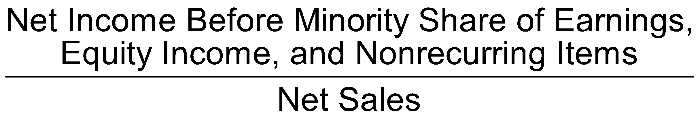
Net Profit Margin
The net profit margin equals the net profit available to common shareholders divided by sales.
Also referred to as return on sales
Reflects net income dollars generated by each dollar of sales
Potential distortion
  Net “other” income or loss

Slide 5
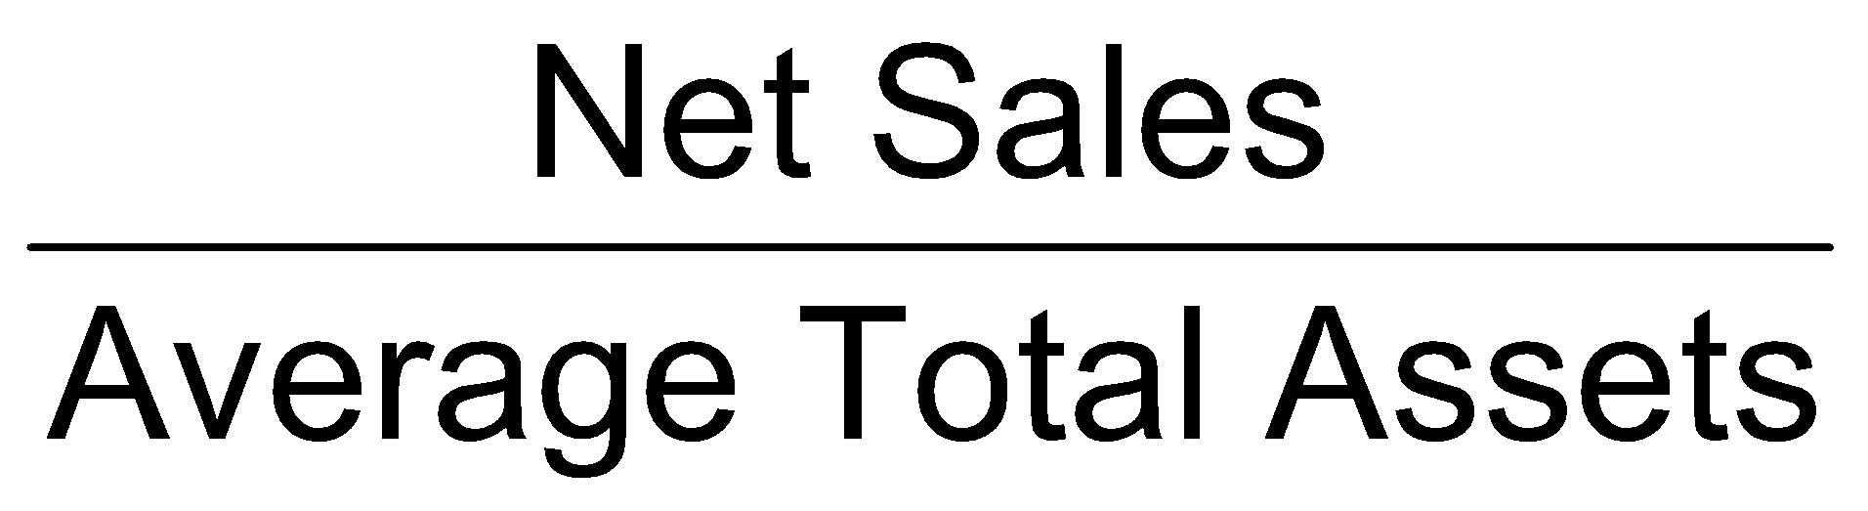
Total Asset Turnover
Asset turnover measures how efficiently assets are used to produce revenues by dividing sales by the average total assets

Slide 6

Return on Assets
Measures the ability to utilize assets to create profits
Average total assets
  Internal analysis: month-end amounts
  External analysis: beginning and ending amounts
  If necessary, consistent use of end-of-year amounts

Slide 7
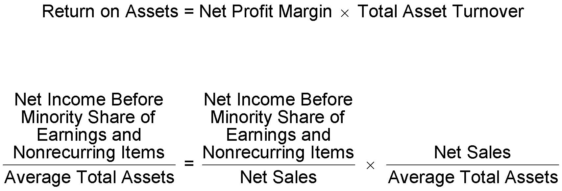
DuPont Return on Assets
Net profit margin, total asset turnover, and return on assets are usually reviewed together because of the direct influence that the net profit margin and the total asset turnover have on return on assets.

Slide 8
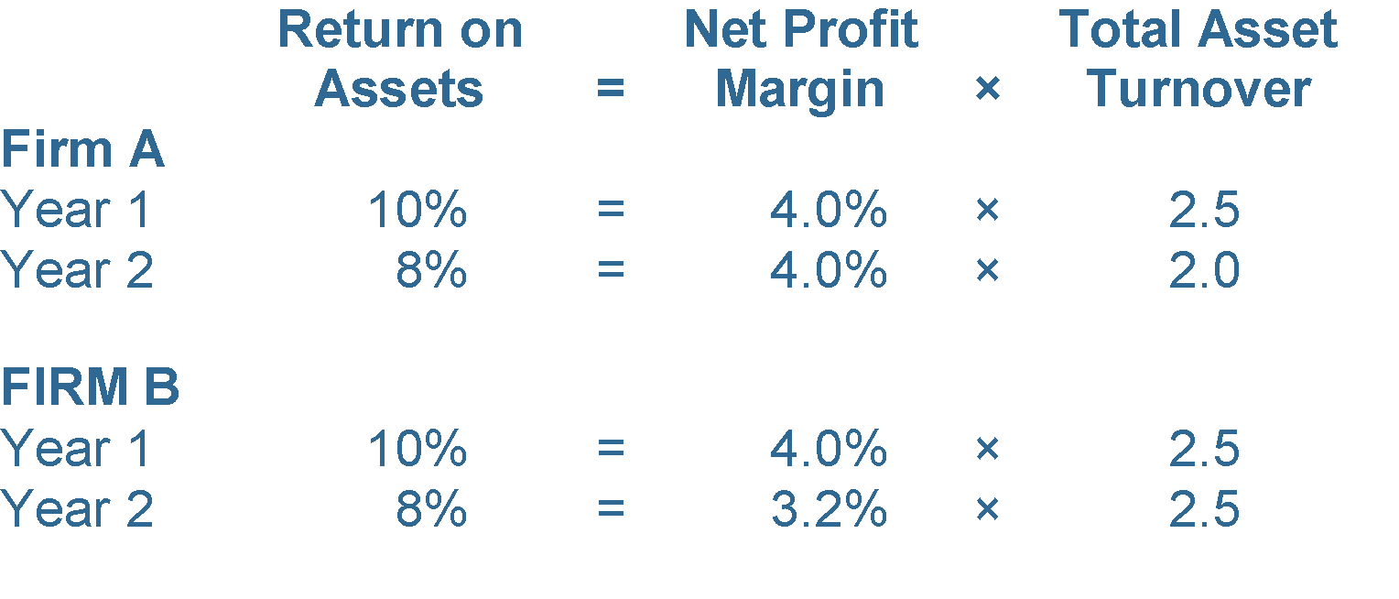
DuPont Return on Assets (cont’d)
DuPont analysis separates return on assets into net profit margin and total asset turnover
Separating the ratio into the two elements allows evaluation of the causes for the change in return on assets

Slide 9
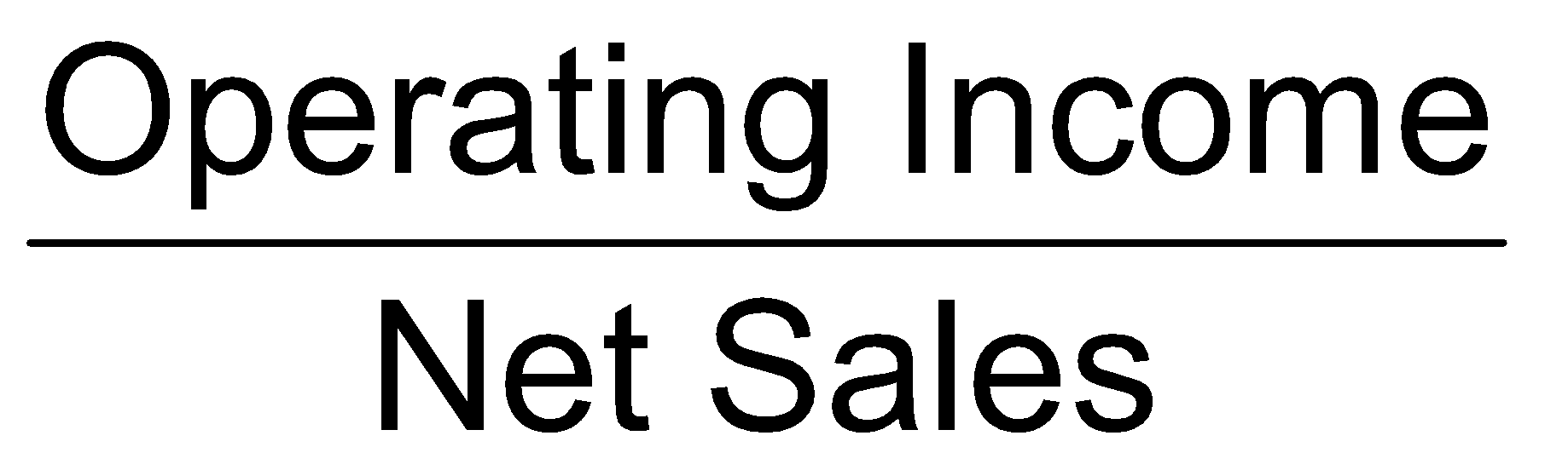
Operating Income Margin
Use operating income in the numerator

Slide 10
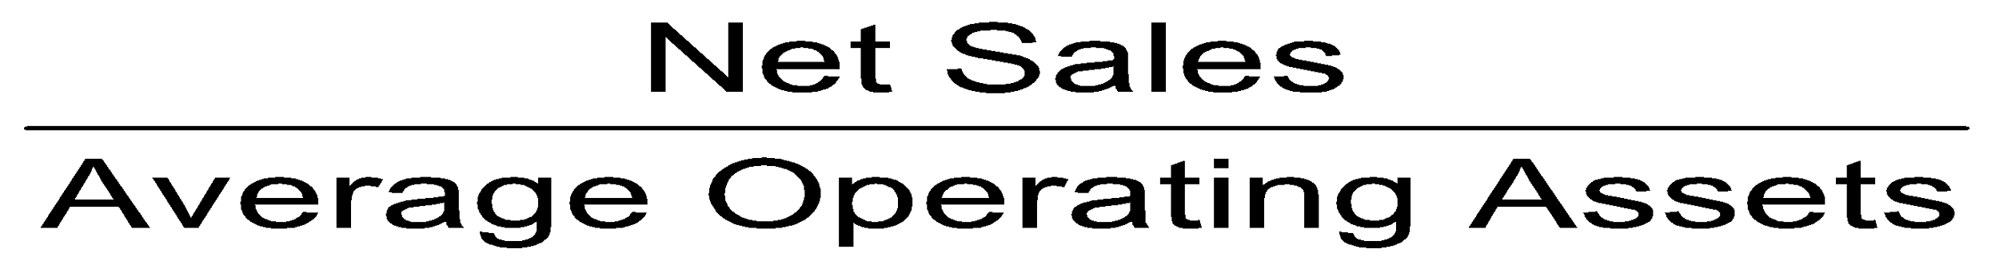
Operating Asset Turnover
Measures the ability of operating assets to generate sales dollars
Operating assets exclude construction in progress, long-term investments, intangibles, and the other assets category from total assets.
Similarly, operating income—the profit generated by manufacturing, merchandising, or service functions—that equals net sales less the cost of sales and operating expenses should also be used instead of net income

Slide 11
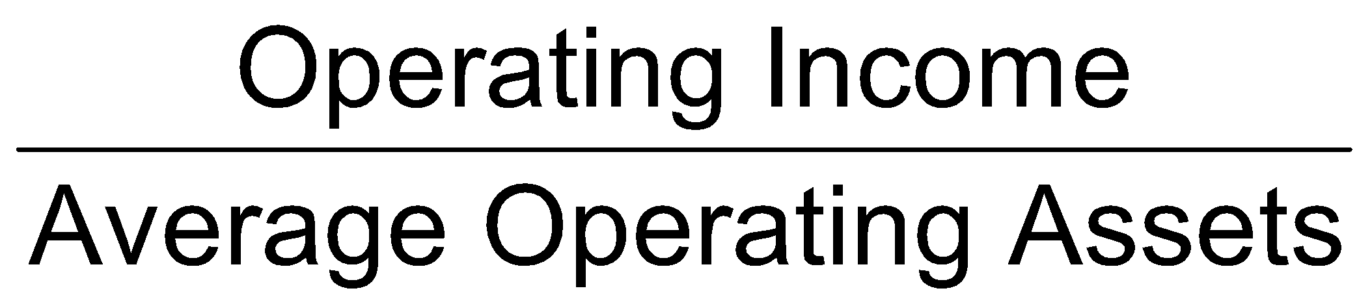
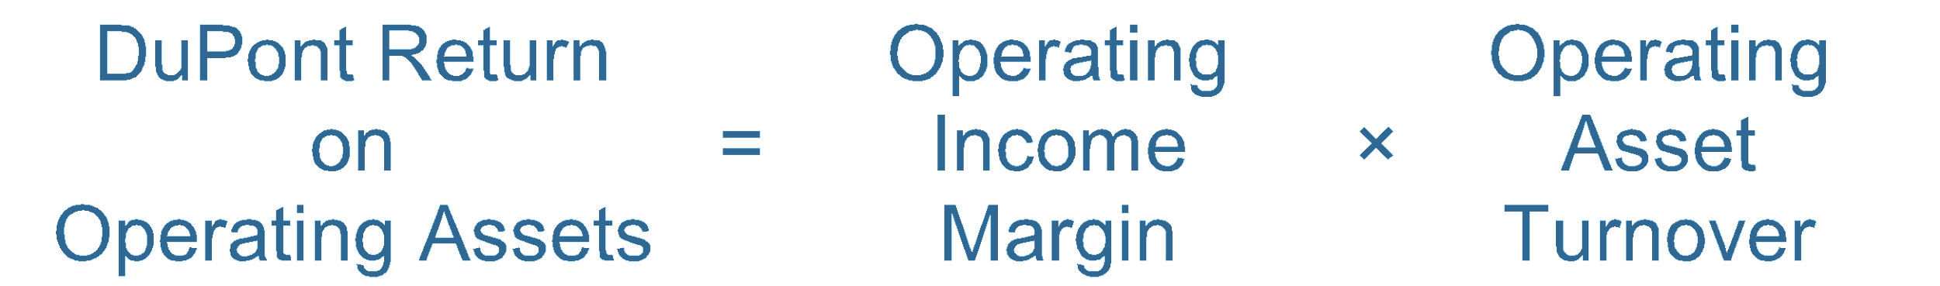
Return on Operating Assets
Measures the ability of operating assets to generate operating income
DuPont analysis of the return on operating assets:

Slide 12
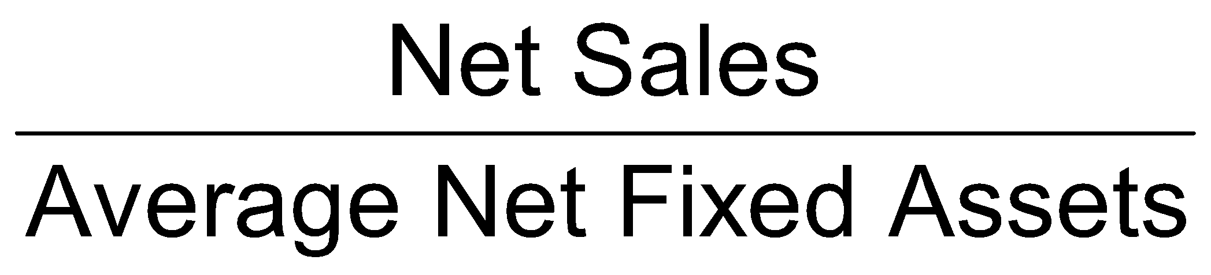
Sales to Fixed Assets
Measures the ability to make productive use of property, plant, and equipment by generating sales dollars
  Exclude construction in progress
Possible distortions
  Old fixed assets
  Labor-intensive industry

Slide 13
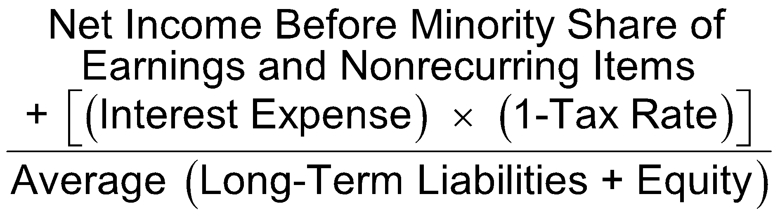
Return on Investment (ROI)
Measures the earnings on investment and indicates how well the firm utilizes its asset base
Evaluates enterprise performance

Slide 14
Return on Investment (ROI) (cont’d)
Measures ability to reward investors and to attract providers of future funds
Evaluates the earnings performance without regard to financing sources

Slide 15
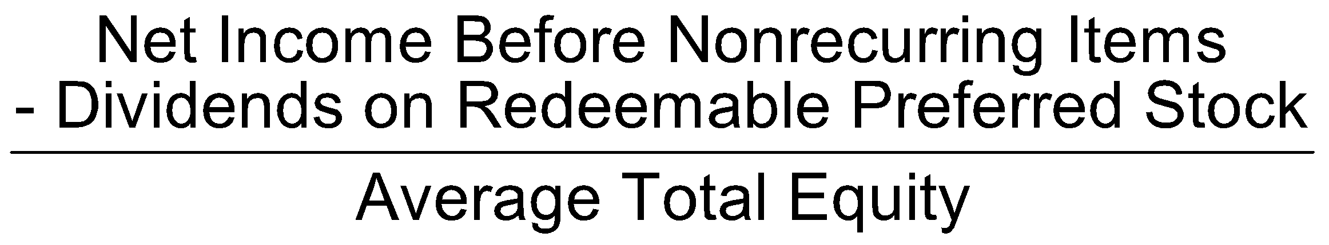
Return on Total Equity
Measures the return to common and preferred stockholders
Adjustments for redeemable preferred stock
  Deduct dividends from net income (numerator)
  Deduct stock value from total equity (denominator)

Slide 16
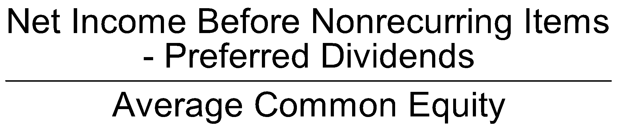
Return on Common Equity
Measures the return to the common stockholder
Common equity:
Total stockholders’ equity
less preferred capital
less minority interest reported as equity

Slide 17
The Relationship Between Profitability Ratios
Rate of return on | Measures return to providers of | Typical result
Assets | All funds | Lowest (includes all assets)
Investment | Long-term funds | Higher than ROA (relative small amount of short-term funds)
Total equity | Equity | Higher than ROI (measures return only to shareholders)
Common equity | Common equity | Highest Common shareholders absorb greatest degree of risk Requires that return to preferred shareholders exceed funds paid to preferred shareholders

Slide 18
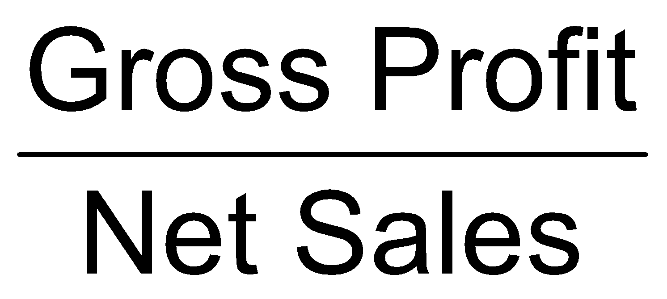
Gross Profit Margin
Sales
– Cost of Goods Sold
= Gross Profit
Beginning Inventory
+ Purchases of Inventory
– Ending Inventory

