Slide 30
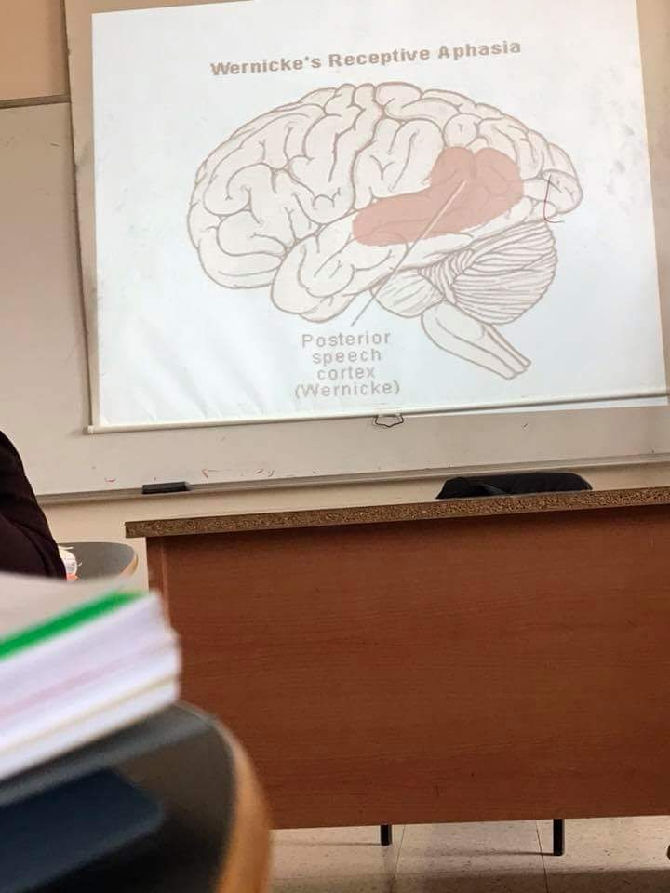

Slide 40
Broca's aphasia

