Slide 1
Firewalls
Hafez Barghouthi

Slide 2
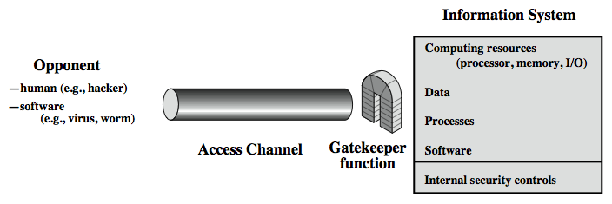
Model for Network Access Security (our concern)

Slide 3
Definition
"Firewall is an information technology security device which is configured to permit, deny or proxy data connections set and configured by the organization's security policy. Firewall can either be hardware or software based.
http://en.wikipedia.org/wiki/firewall_(networking).

Slide 4
In our simple words-1
firewall is a separator between a trusted network area (your company local area network (LAN)) and the UN trusted network area (internet).so it is installed in a point where you protected internal network connects to the internet.
Note:We talk about internet firewall not intranet firewall (within the same site)

Slide 5
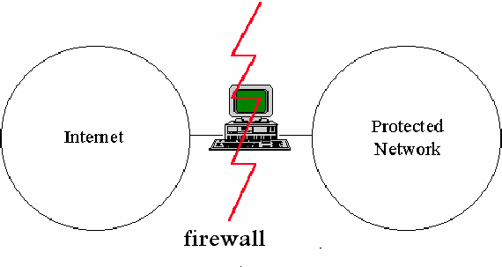
In a simple picture

Slide 6
Firewall Types
Packet filters
Stateful packet filters
Circuit level proxies
Application level proxies
Network address Translator(NAT).
We will talk about 1,4.

Slide 7
Packet filters
The packet filter firewall depends on allowing or blocking packets usually while routing them from one network to another .
set of rules that specify what types of packets to allow and what types of packets to block .

Slide 8
Filtering depends on what
IP src. and dest. address .
restrict which internal network machines have access to the internet and vise versa depending on the possible range of IP addresses.
TCP or UDP src. and dest. port
limit external access to a specific internal services or vise versa.
example mail service SMTP uses TCP port number 25.

Slide 9
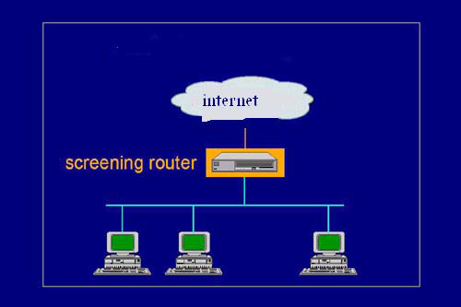
Screening router

Slide 10
Advantages
Widely available in many hardware and
software products.
Easy to install.
Packet filters make use of current network routers. Therefore implementing packet filter is less complicated than other firewall approaches.
Support high speed with simple network condition.

Slide 11
Disadvantages
Packet filters make decisions based on individual packet and not on the context of traffic. This will not provide good security condition.
Creating complex access rules with packet filters can be difficult.
With packet filtering users connect directly from network to network. Direct connection leaves data susceptible to exposure. Hacker can use packet- sniffer to access information such as an external host sniffer can use an internal IP address to access the internal network.

Slide 12
proxies
Instead of working on network and transport layer, proxy services work on the application protocol layer.
It plays as an intermediate blocks between the internal user and the service on the internet (indirect connection).
The major benefit of this approach is called Transparency which means that the proxy server (firewall) presents the illusion that user (internal client) is dealing directly with a real server (external) and the proxy also presents the illusion that the real server is dealing directly with a user on the internal network.

Slide 13
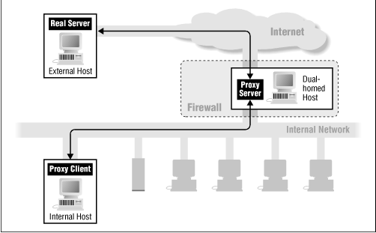
Dual Homed host proxy

Slide 14
Advantages
Transparency
Filtering based on content.
Much better in virus detection than packet Filtering.
ex: A mail proxy could filter viruses,spams and worms

Slide 15
Disadvantages
Cost is higher and performance is lower.
You need a proxy server for each service you want to protect.
Limitation of proxy services (Not available for every service) for example no proxy server available for any of the new audio and video streaming service [3].

Slide 16
In real life
In real firewalls to use a combination between firewall technologies in order to build a reliable firewall and getting the advantages of more than one technique.
Examples
Combination of packet filtering with proxy services . Perimeter security approach.
Combination of packet filtering with Network address translator

Slide 17
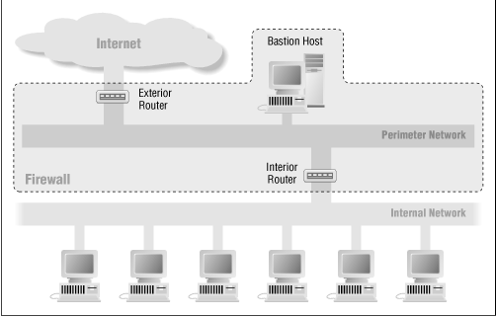
Perimeter Networks(DMZ)

Slide 18
Firewall policies-1
Permissive policies :allow all but block certain dangerous service
Restrictive policies: prevent all but allow only traffic to meet a useful purpose http, pop3,SSH

Slide 19
Rules
Firewall rules can be as following:
Allow from internal network to internet:http,ftp,SSH,DNS
Allow from anywhere to mail server smtp only.
Allow from mail server to internet smtp,DNS.
Allow from inside to mail server smtp,pop3.
Allow reply packets.
Block everything else.

Slide 20
Limitiations
Firewall can't protect against viruses so having a firewall doesn't mean that you don't need any an antivirus program such as MacAfee antivirus or Norton antivirus.
Firewall can't protect against all the software vulnerabilities such as SQL injection. This type of attack is difficult to detect at the network level.[4]
Firewall can't protect against insider threat because firewall is considered as an external defender protection (the inside from the outside) but if the attacker is behind you (on your internal network) firewall can't do anything.
A lot of configuration need to set up a firewall many people have firewalls that are in the end not effective this is because they are not configure the firewall properly.

Slide 21
solutions
Intrusion detection and prevention
Software security
Database security
Again cryptology to provide end to end solution.
Personal firewalls to provide end to end security.

Slide 22
References.
[1] Elizabeth D. Zwicky, Simon Cooper and D. Brent Chapman:'Building Internet Firewalls', O'Reilly and Associates 2000: Second Edition.
[2] S D Hubbard and J C Sager: 'Fire walling the net', BT Technol J, 15, No2, pp 94-106 (April 1997).
[3] Rudkin S et al: ‘Real time applications on the Internet’, BTTechnol 15, No 2, pp 208—224 (April 1997).
[4] Stephen D. Wolthusen: 'SQL injection', lecture slides of session 5, http://www.hig.no/imt/file.php?id=1192.
[5]Firewall(networking)',http://en.wikipedia.org/wiki/firewall_( networking).

