Slide 1

SPAU 328
Principles of Evaluation, Diagnosis, and Report Writing in ComD
Dina Budeiri MSc

Slide 2

Writing Goals and Objectives

Slide 3

SOAP Notes
Four kinds of information are part of the medical record:
  Subjective
  Objective
  Assessment
  Plan
Each type of information is important for understanding the patient/client

Slide 4
S: Subjective
Subjective information is any that is reported to the clinician about the patient OR behavior the clinician observes that impacts the outcome of a session
May be reported by client/patient, caregivers, or family members
Usually, cannot be confirmed by clinician
Ex: “Miral had a cold all week and that affected her performance”

Slide 5
O: Objective
Objective information is the record of what was actually done during the therapy session, including what the client achieved.
Data and activities ONLY – no interpretation
Ex: “The clinician supplied a picture book with no words. Miral created a story based on the picture. Miral generated 9 sentences using correct chronological transitions (first, then, next, so).”

Slide 6
A: Assessment
In the assessment section, the clinician provides comment on client’s progress within the session. Performance goals are specified and new problems may be noted.
Ex: “Miral demonstrated mastery in using transition words between chronological events. She used few descriptions in her narrative.”

Slide 7
P: Plan
The plan section is where the clinician makes specific recommendations for what the client should do next
Use the future tense
Ex: “Miral will start using more descriptive words and more complex sentences.”

Slide 8
Technology changes everything
The advent of technology has changed the classic SOAP note. Clinicians do not need to write the whole thing out. Instead, the Subjective, Objective, and Assessment sections are often entered through checkboxes and/or short phrases.
The writing task falls mostly on writing long and short term goals. The clinician must understand that the other forms of information exist. They are just represented differently.

Slide 9
What are clinical goals?
In a clinical setting, goals (or objectives) refer to the outcomes desired for the client. They may be classified as long-term or short-term.

Slide 10
Long-Term Goals
Long-term goals involve results that will take weeks, months or years to achieve. These might include goals such as raising scores on a standardized achievement test, improving expressive language skills at a level corresponding with age and grade level, or successfully completing a multi-year therapy program.
Example:
Omar will increase his speech intelligibility by producing targeted sounds correctly. Targeted sounds include: /s, l, r/, and /s/ clusters.

Slide 11
Short-Term Goals
A short-term goal is a specific objective the client must master before he or she is able to achieve the long-term goal(s). Short- term goals focus on specific targets, units, tasks, or steps and are usually achieved in a short time period. The short-term goals a client is working on will usually change quickly as he or she masters those and new short-term goals are established.
Example: Omar will produce /s/clusters at the word level when given visual cues with 80% accuracy.

Slide 12
General Guidelines For writing Goals
A well-written goal must be measurable. The goal must be stated in such a way that the clinician can assess whether or not the client has performed the goal.
A well-written goal must pass The Dead Man Rule. If a dead man could do it, it’s not an effective goal. For example, “Sit in a chair” is not a good goal; a dead man could do that. “Attend to a task for 3 minutes without getting up from the chair,” however, is a goal a dead man could not do.

Slide 13
How to Format Short-Term Goals
For an objective to be meaningful, the primary reader and the writer must have identical interpretations of a clients performance.
Well-written goals (have identical interpretations) contain three components:
Performance
Condition
Criterion
Important: Please note that all goals begin with the client’s name and a future tense verb (Jane will + verb).

Slide 14
Performance
Performance refers to what you expect the client to do or perform in order to demonstrate mastery of the objective.
Ex.: Abed will produce voiceless consonants
A question like” Can I count it” could assess whether performance is addressed.

Slide 15
Performance
The verb used should be concrete and one that can be evaluated by the clinician (Examples of appropriate verbs include name, read orally, repeat orally, state, write, match, count, demand, draw, say, reach, remove, etc.)
The verb should not be one that could be interpreted differently by different people (Examples of inappropriate verbs include know, understand, appreciate, enjoy, learn, believe)

Slide 16
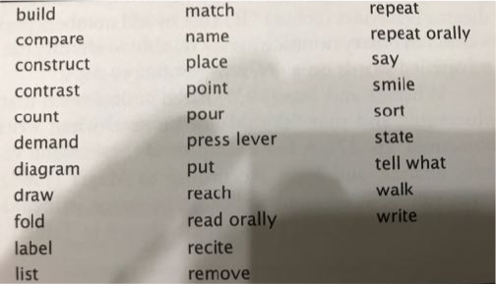
Verbs to use

Slide 17
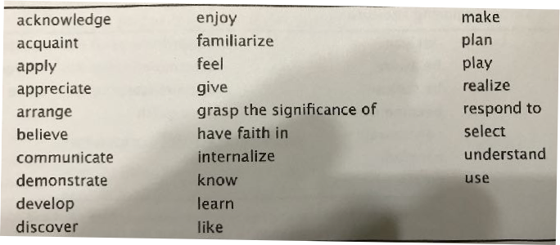
Verbs to avoid

Slide 18
Overt and Covert Verbs
Overt verbs refers to performance that is directly observable through vision or audition.
Covert verbs refer to performance that cannot be directly observed.

Slide 19
Performance Examples
Articulation: correctly produce the /r/ phoneme
Phonology: correctly imitate the consonant cluster /sk/
Language: identify (point to) pics. receptively
Voice: produce easy onset of voice
Fluency: use pullouts
Pragmatics: take turns
Problem in behaviour: sit without kicking
Phonological awareness: provide a rhyming word
Dysphagia: swallow a nectar-consistency liquid
AAC: use eye gaze to request an activity

Slide 20
Condition
This part of the goal refers to the condition under which the performance is to be done.
Ex.: Abed will produce voiceless consonants when preceding vowels
Other examples of conditions include while producing /a/, in disyllabic words, during conversation, during reading, when telling a story, without prompts, within a 2 second period, while talking on the telephone, in every therapy session)

Slide 21
Criterion
This part of the goal refers to how well the client is expected to perform the goal (for example,90% of the time, in 8 out of 10 attempts, for three consecutive trials, in two consecutive sessions)
Ex.: Jane will produce voiceless consonants when preceding vowels in 90% of the appropriate contexts
A criterion of 90% is usually used in speech language therapy. In the case of mentally challenged or very young clients, a criterion of 80% is often used.

Slide 22
Samples of Well-Written Goals
Articulation
- John will correctly imitate /s/ in isolation in 8 out of 10 attempts.
- John will accurately self-correct 90% of the incorrect /s/ productions during reading.
Phonology
- John will produce liquids in 90% of the appropriate contexts.
-John will close syllables on spontaneously produced monosyllabic target words in 90% of his attempts.
Language
- John will spontaneously name 20 of 25 pictures from his surrounding.
- John will appropriately use the pronouns “he” and “she” during conversation in 90% of his attempts.

Slide 23
Samples of Well-Written Goals
Voice
- John will produce appropriate oral resonance on v-c combinations in 90% of his attempts.
- John will use appropriate pitch while producing /a/ in 8 out of 10 trials.
Fluency
- John will speak with less than 0.5 stuttered words per minute during 5 minutes of spontaneous conversation with the clinician.
- John will use pull-outs during all episodes of blocking while speaking on the telephone for 5 minutes.
Pragmatics
- John will request (by pointing or using eye gaze) an object that is out of reach twice during a 10- minute period.
- John will take 3 consecutive turns when a familiar joint action routine is initiated by the clinician.
Behavioral
- John will sit without kicking for 5 minutes after the removal of constraints (clinician’s hands on client’s knees).
- John will follow 8 out 10 directions within 2 seconds of initial presentation.

