Slide 1
Quantum Mechanics in 3-D
Spherical coordinates

Slide 2
Relationship between Spherical and Cartesian Coordinates

Slide 3
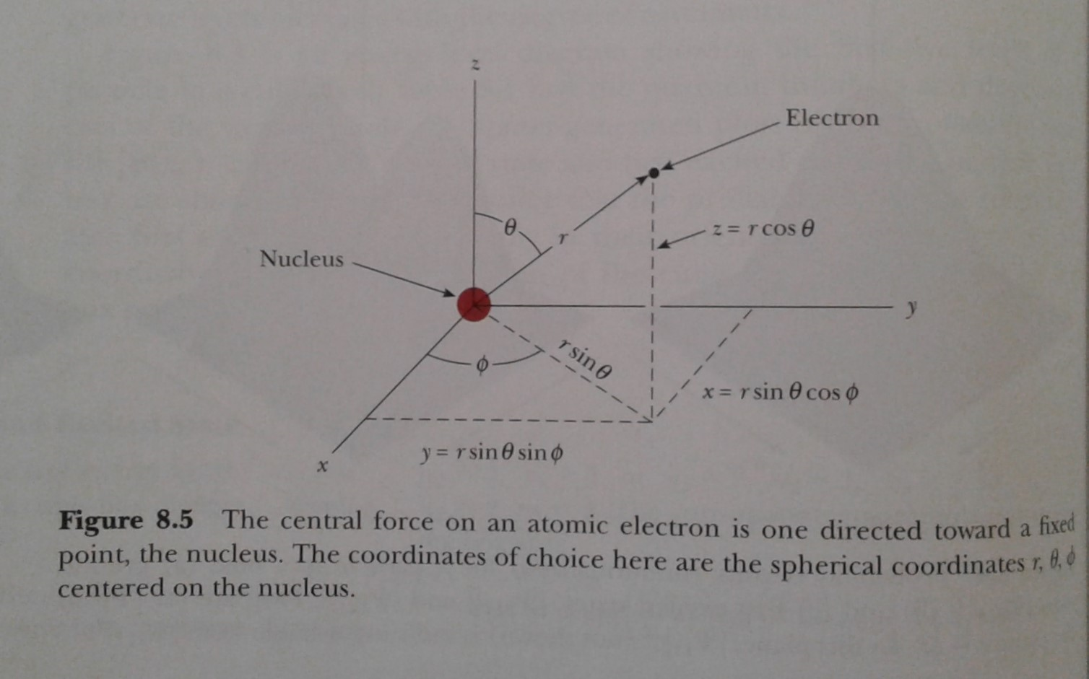

Relationship between Spherical & Cartesian Coordinates
$$0≤θ≤π, 0≤φ≤2π$$

Slide 4
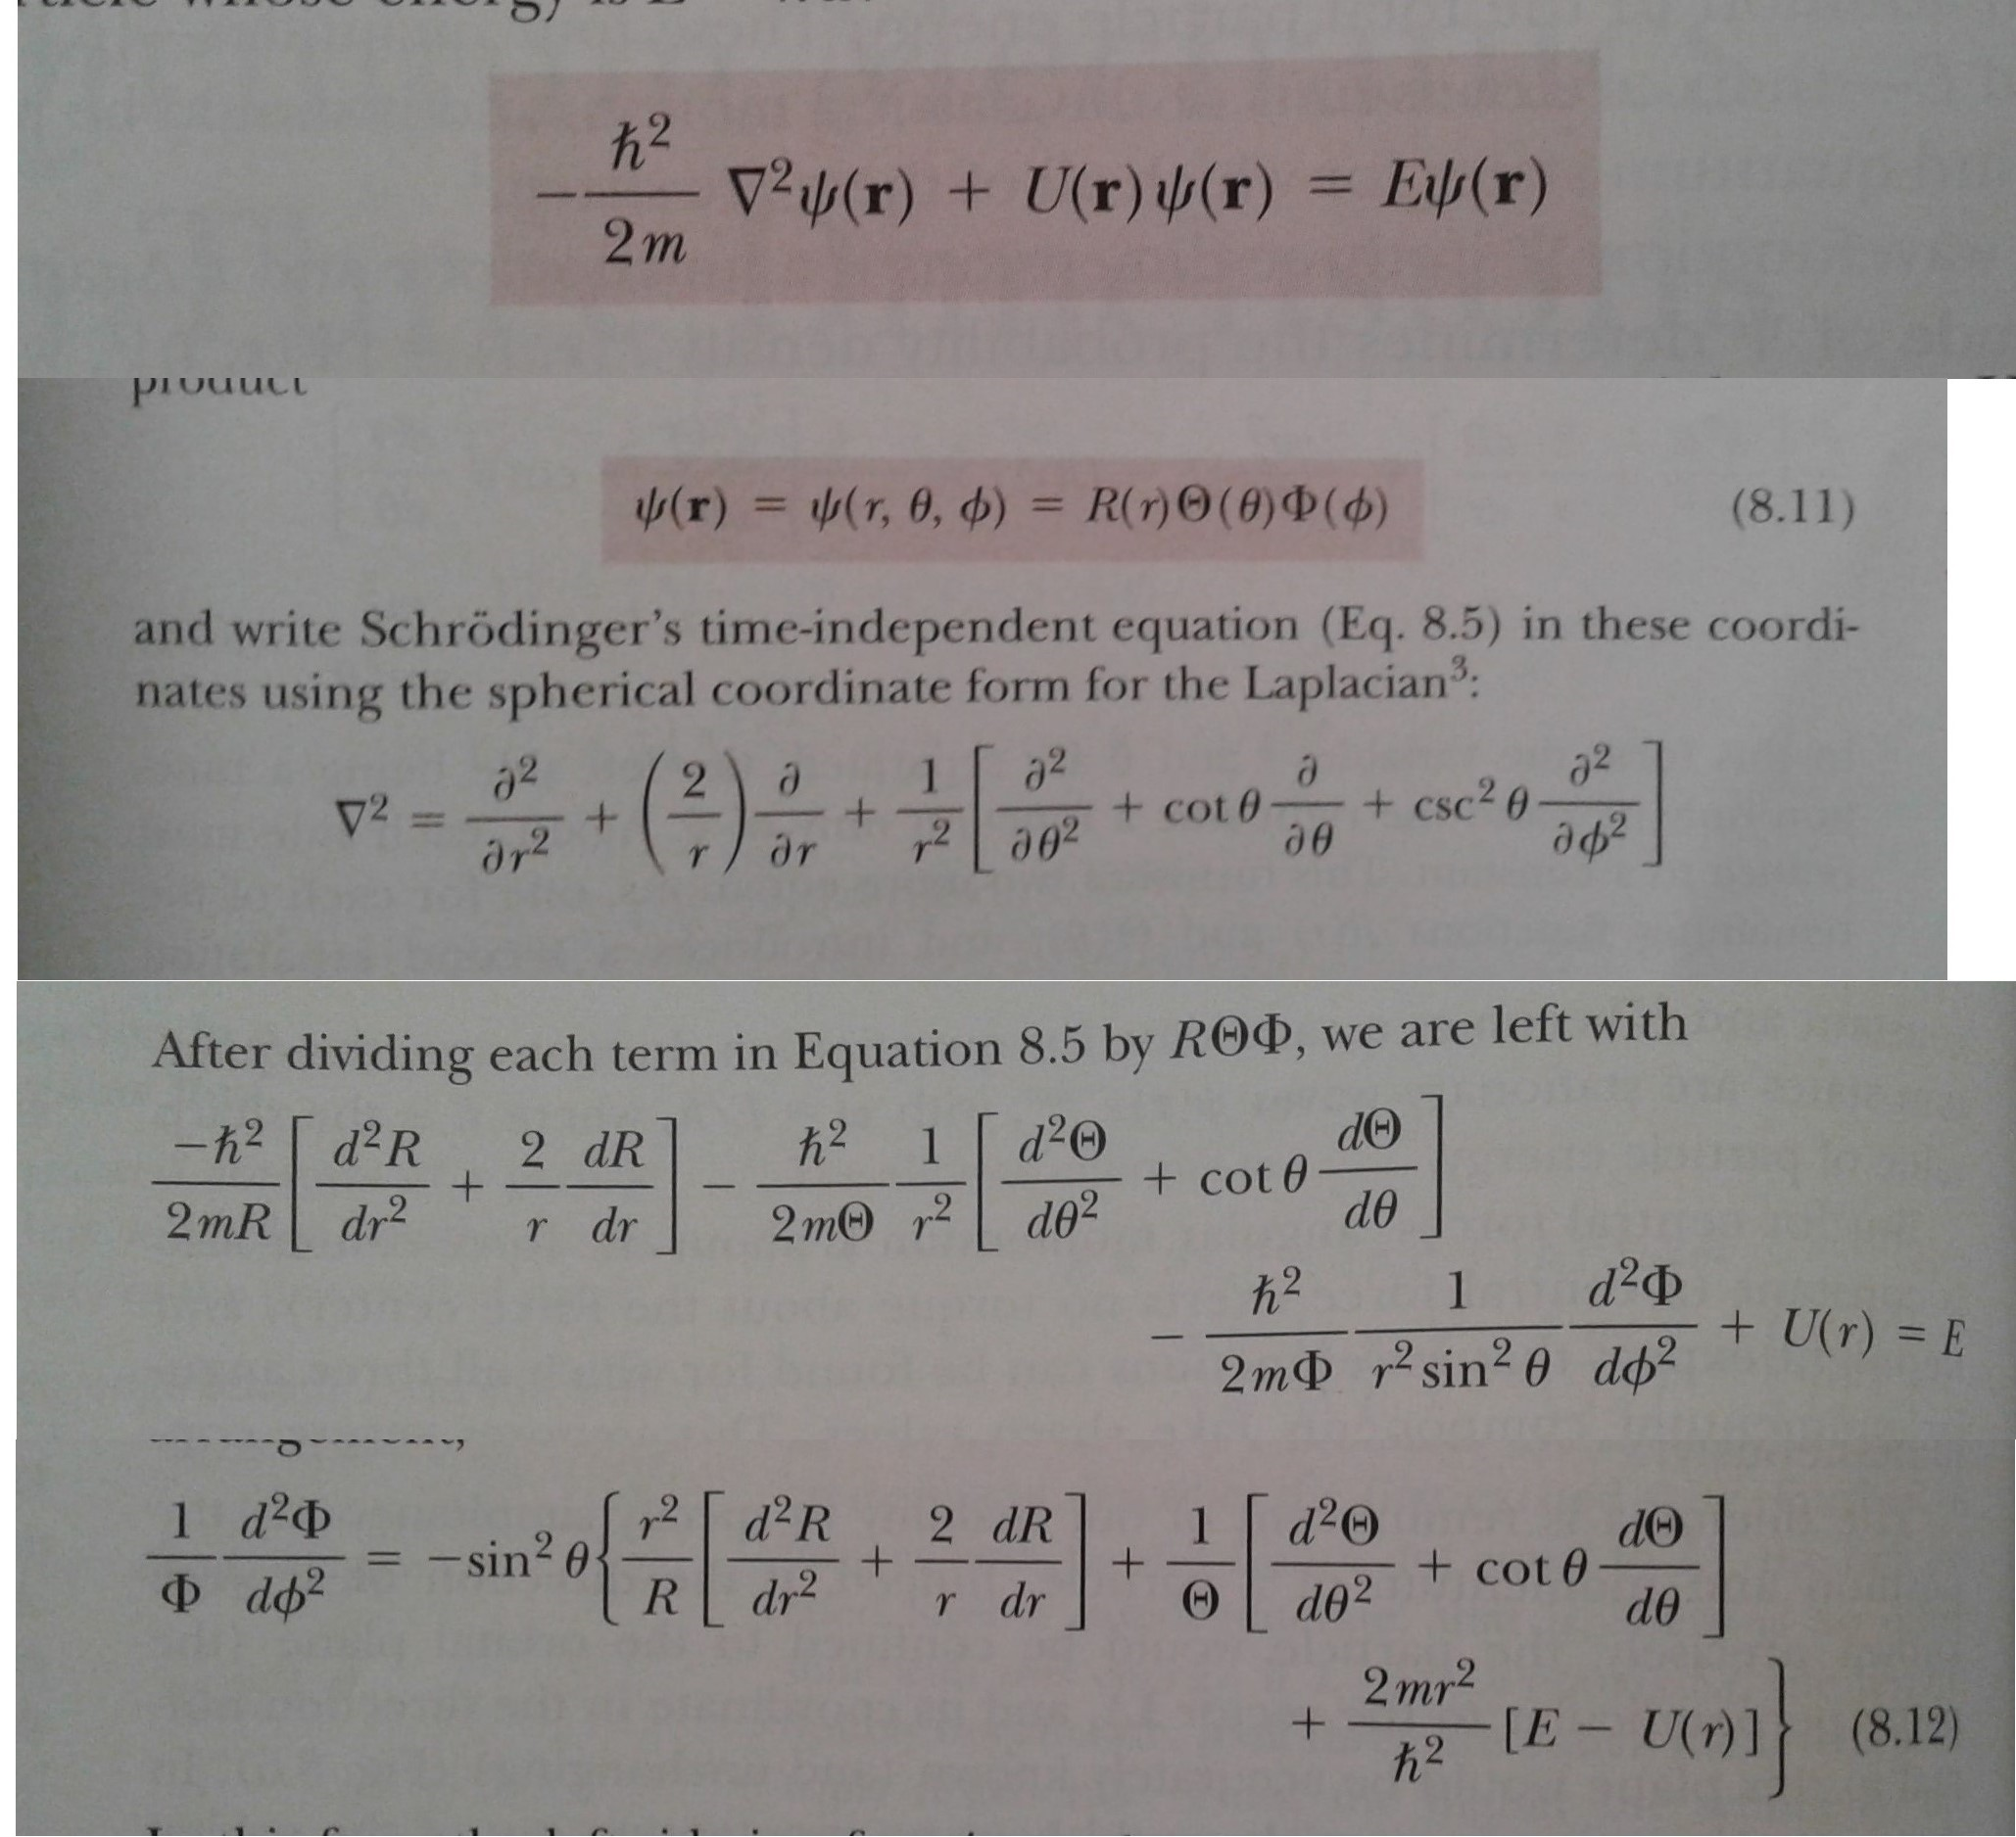
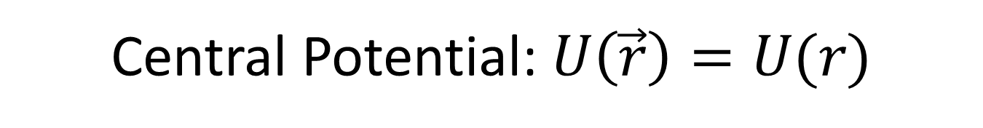
Central Potential: $U\left(\vec{r}\right)=U(r)$

Slide 5
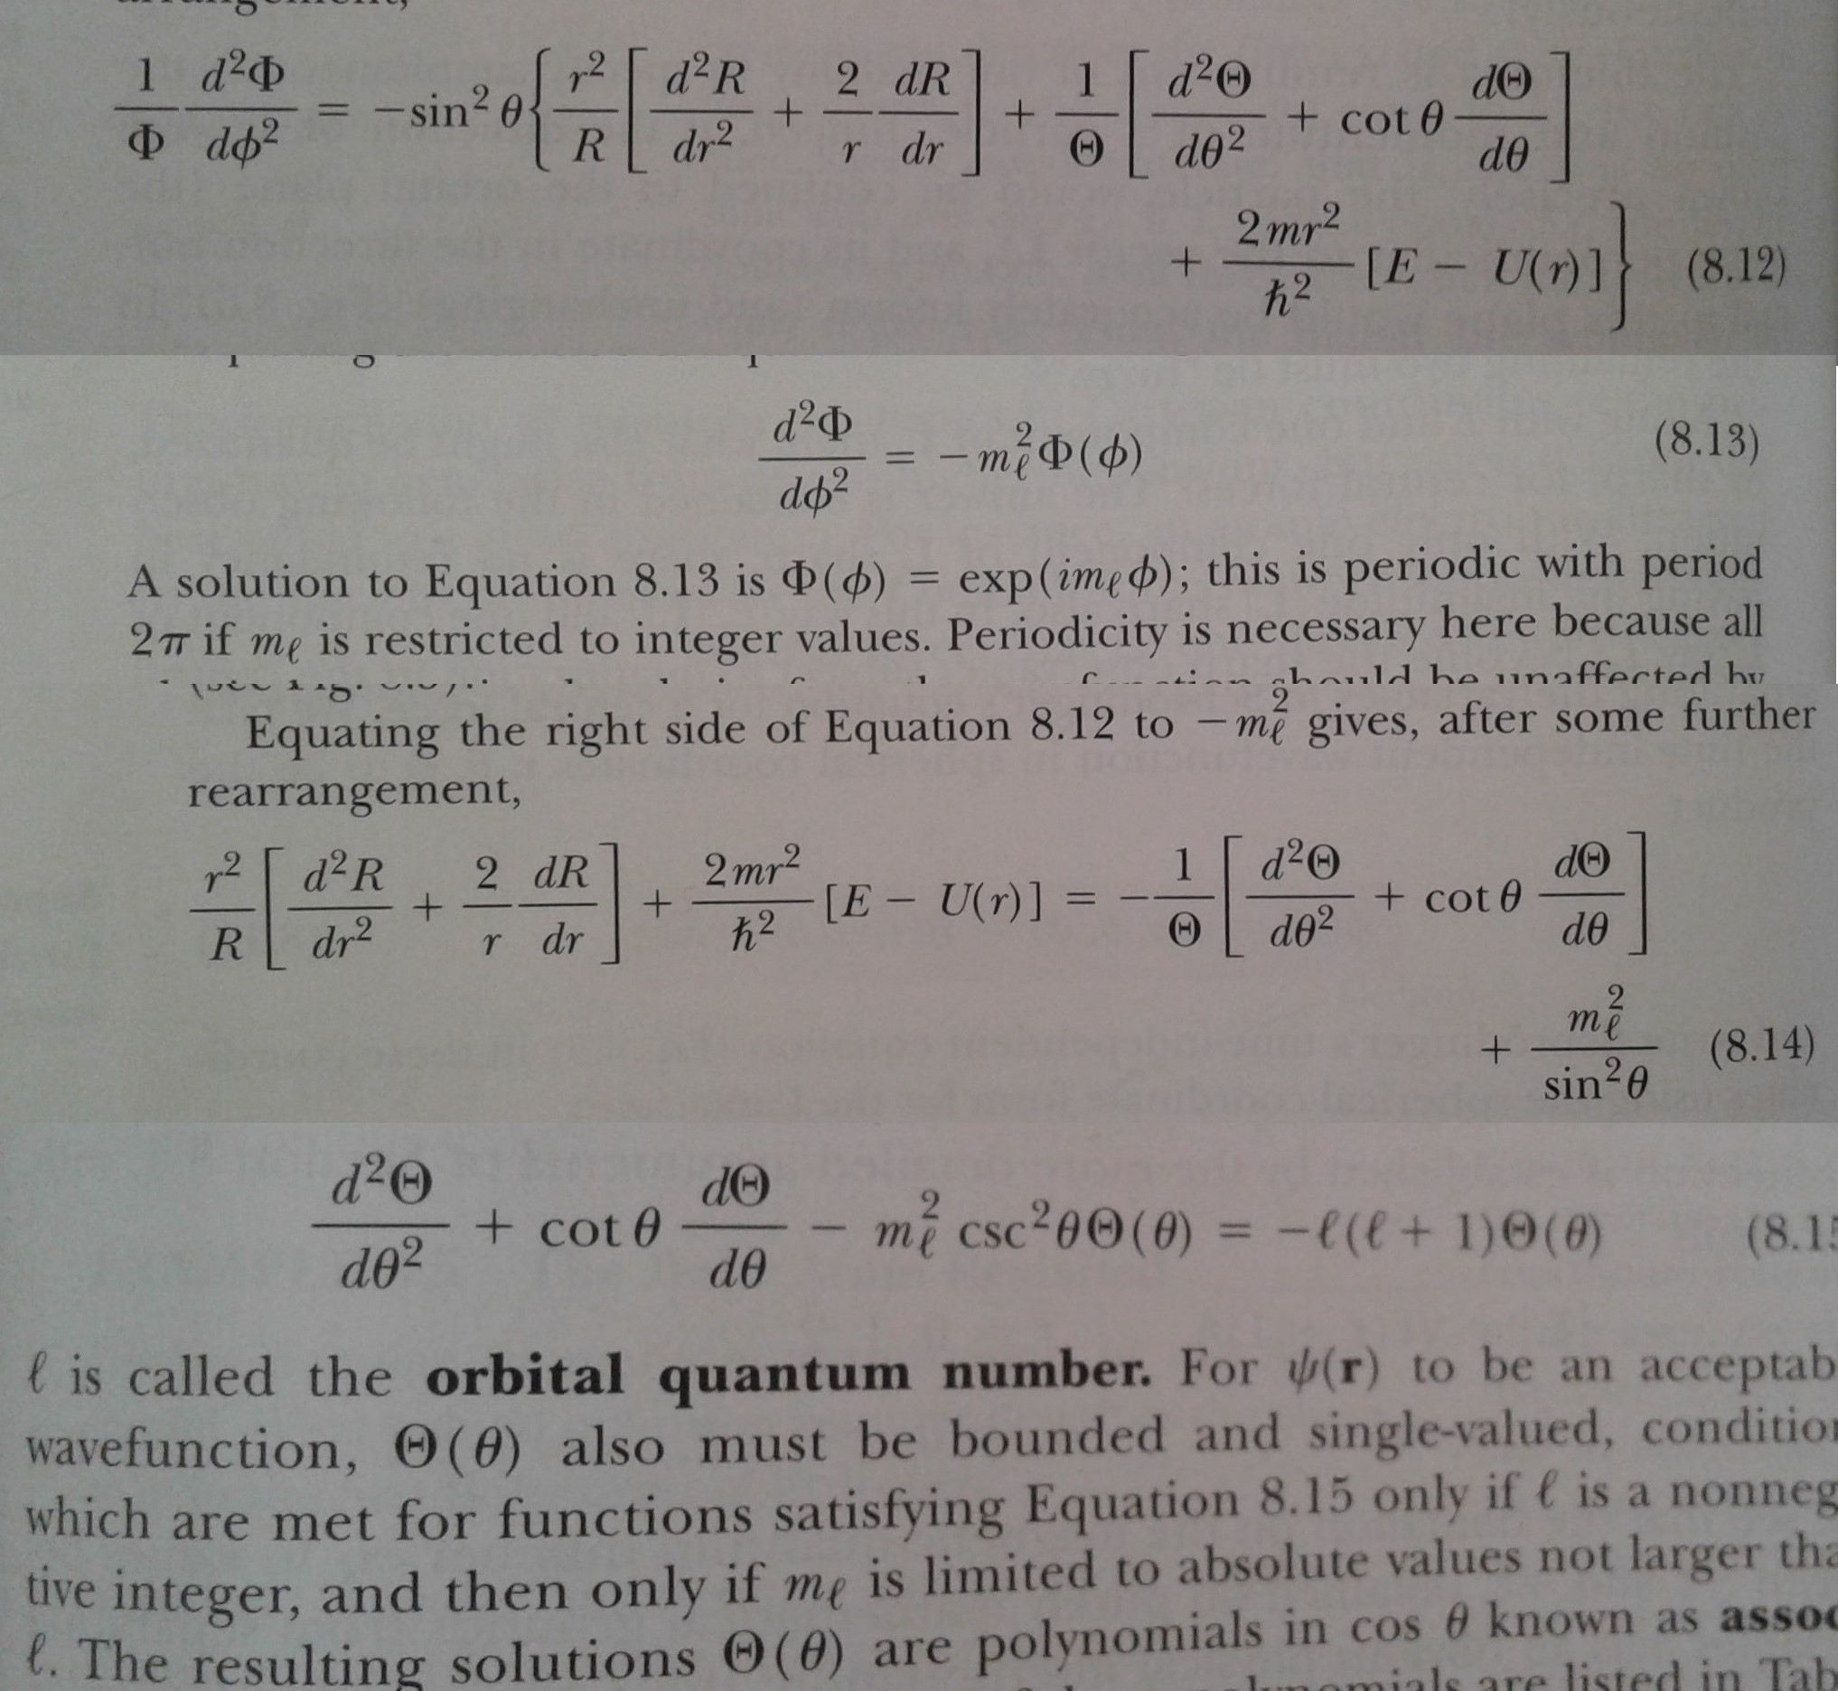
$$Φ\left(φ+2π\right)=Φ\left(φ\right) { →m}_{l}=0, ±1, ±2, ±3, ±4,….$$

Slide 6
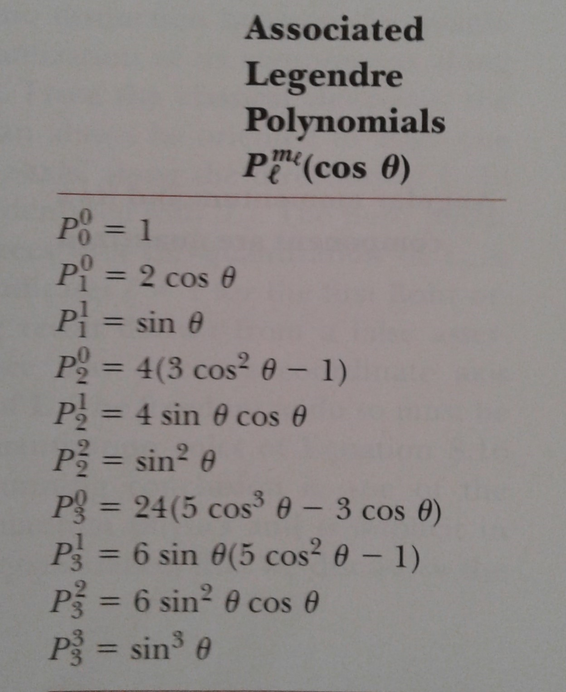
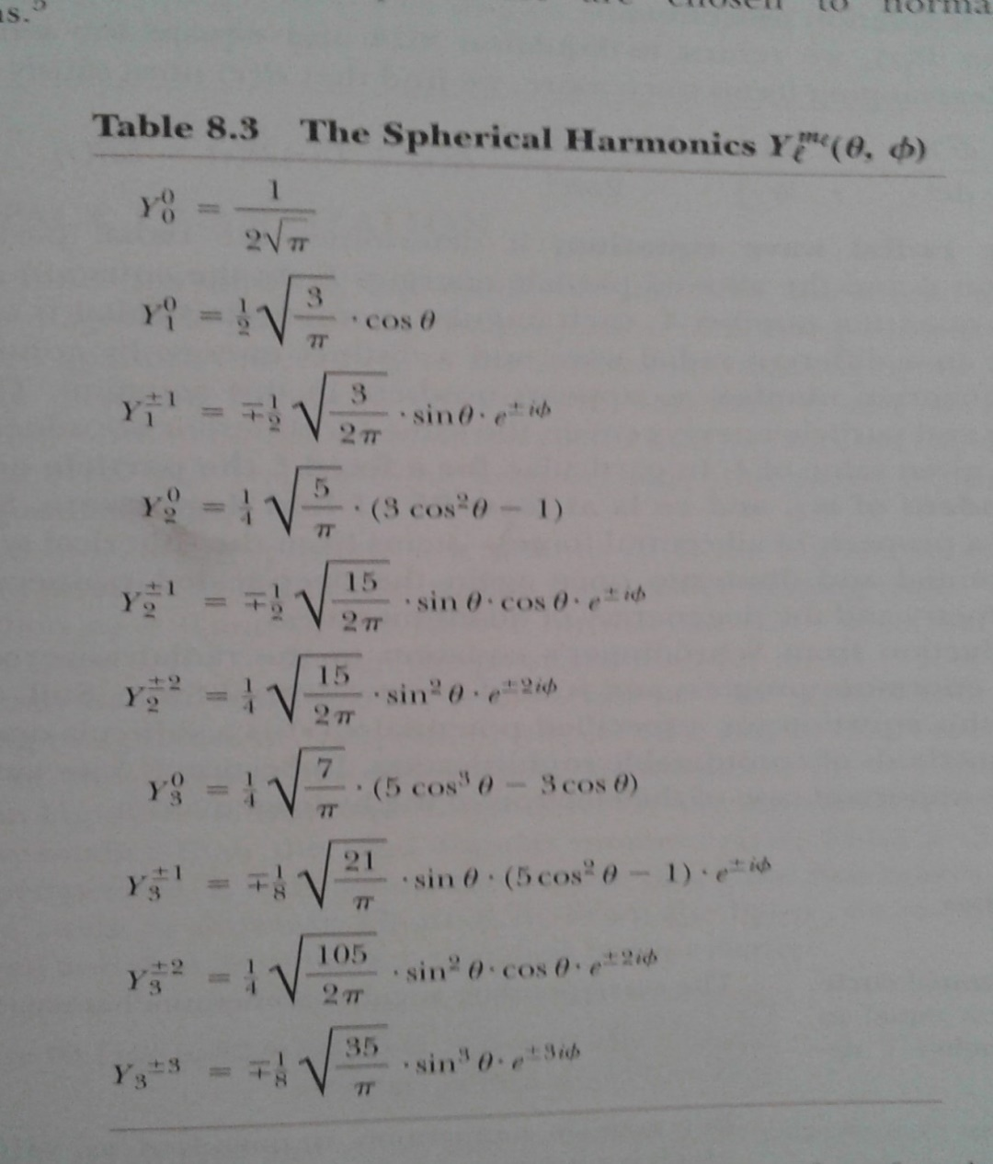
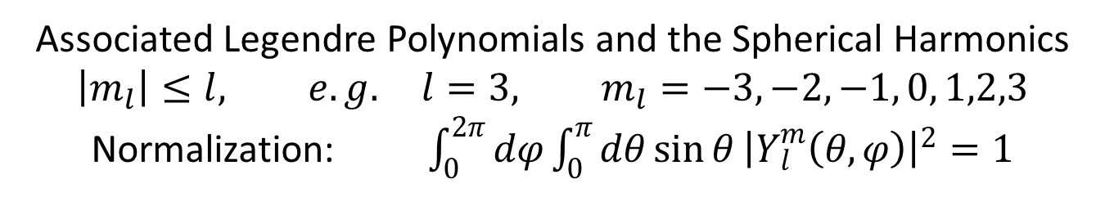
Associated Legendre Polynomials and the Spherical Harmonics
$$\left|m_{l}\right|≤l, e.g. l=3, m_{l}=−3, −2, −1, 0, 1,2,3$$
Normalization: $\int_{0}^{2π}{dφ}\int_{0}^{π}{dθ}{\sin{θ}\left|Y_{l}^{m}\left(θ,φ\right)\right|}^{2}=1$

Slide 7
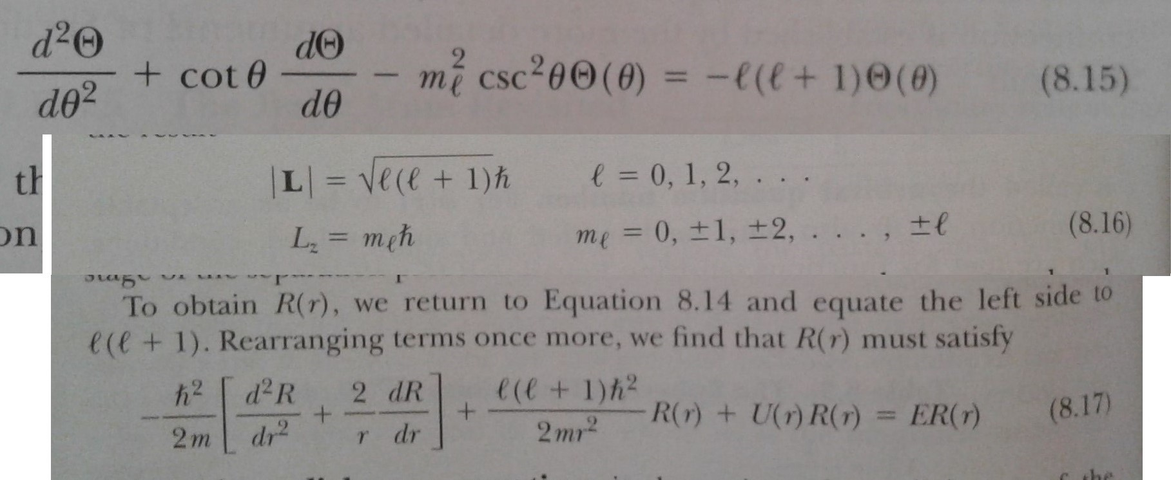
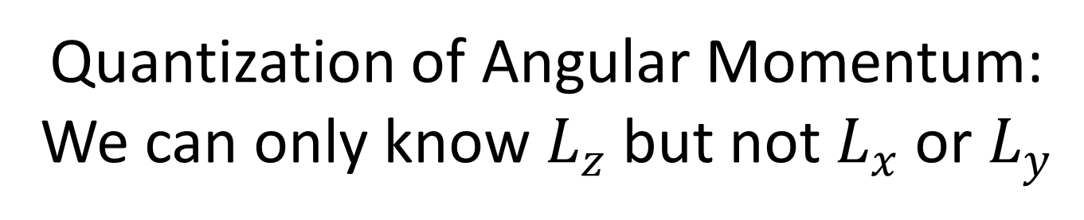
Quantization of Angular Momentum:
We can only know $L_{z}$ but not $L_{x}$ or $L_{y}$

Slide 8
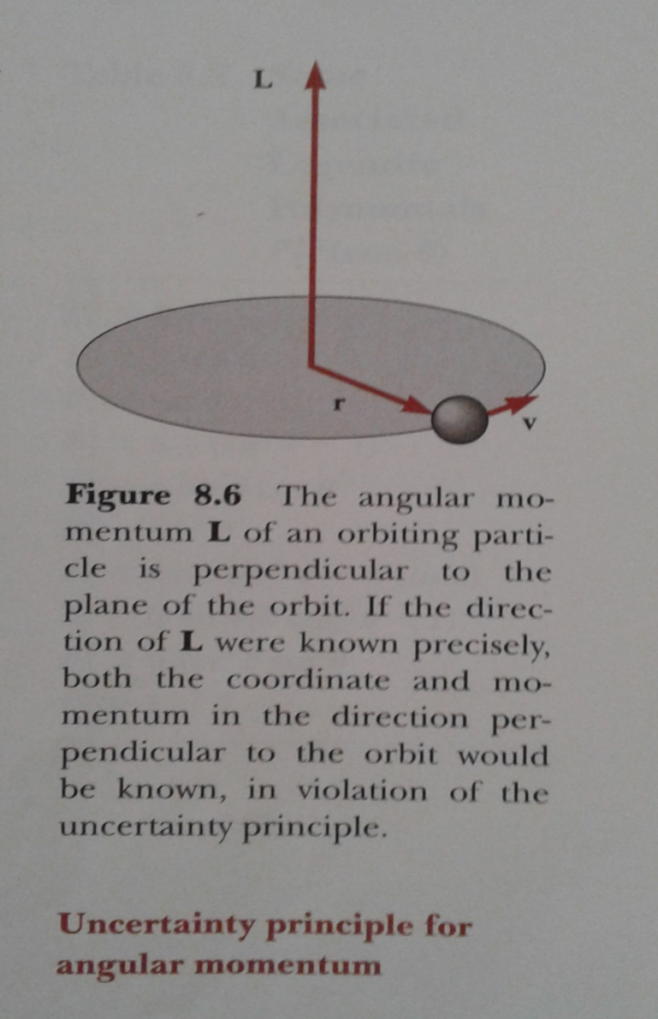
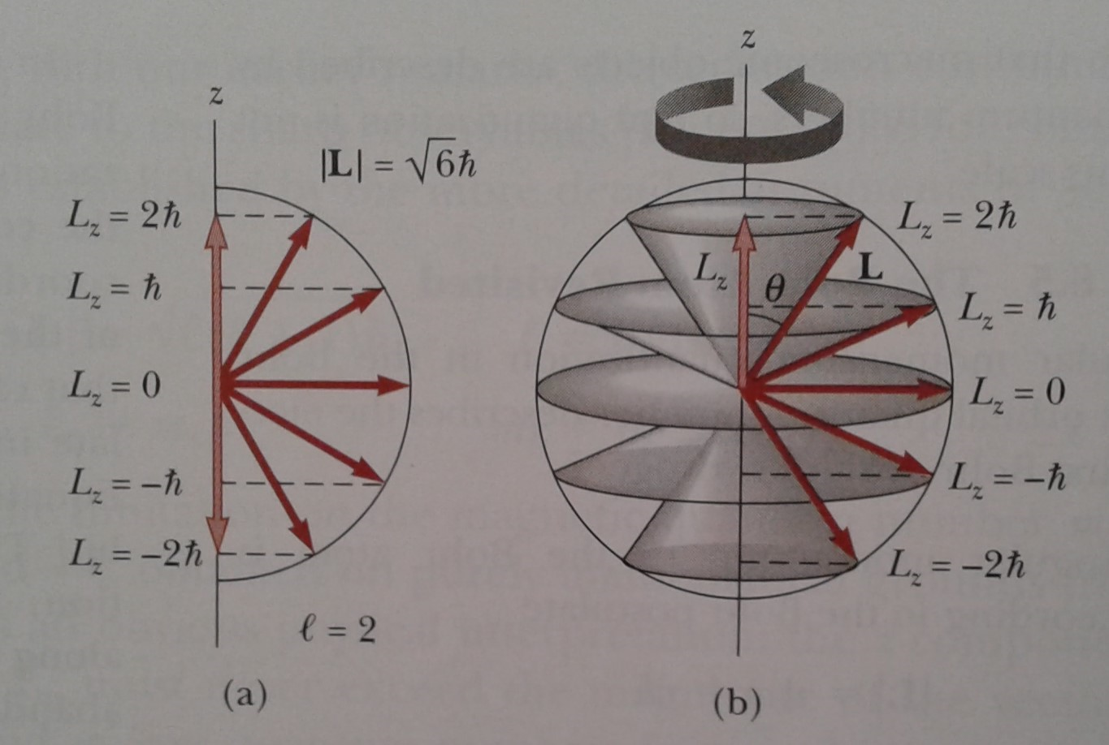
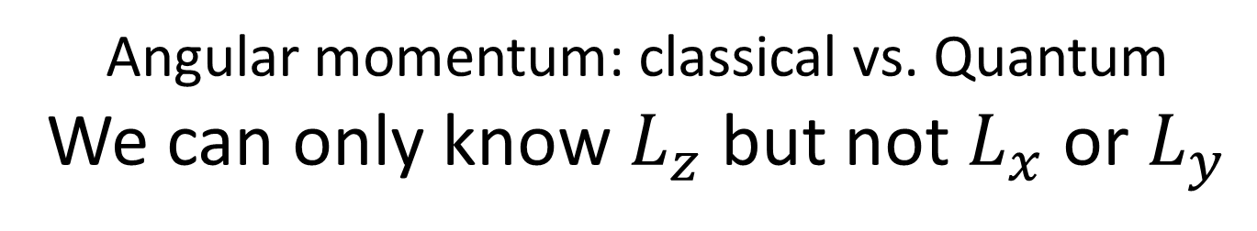
Angular momentum: classical vs. Quantum
We can only know $L_{z}$ but not $L_{x}$ or $L_{y}$

Slide 9
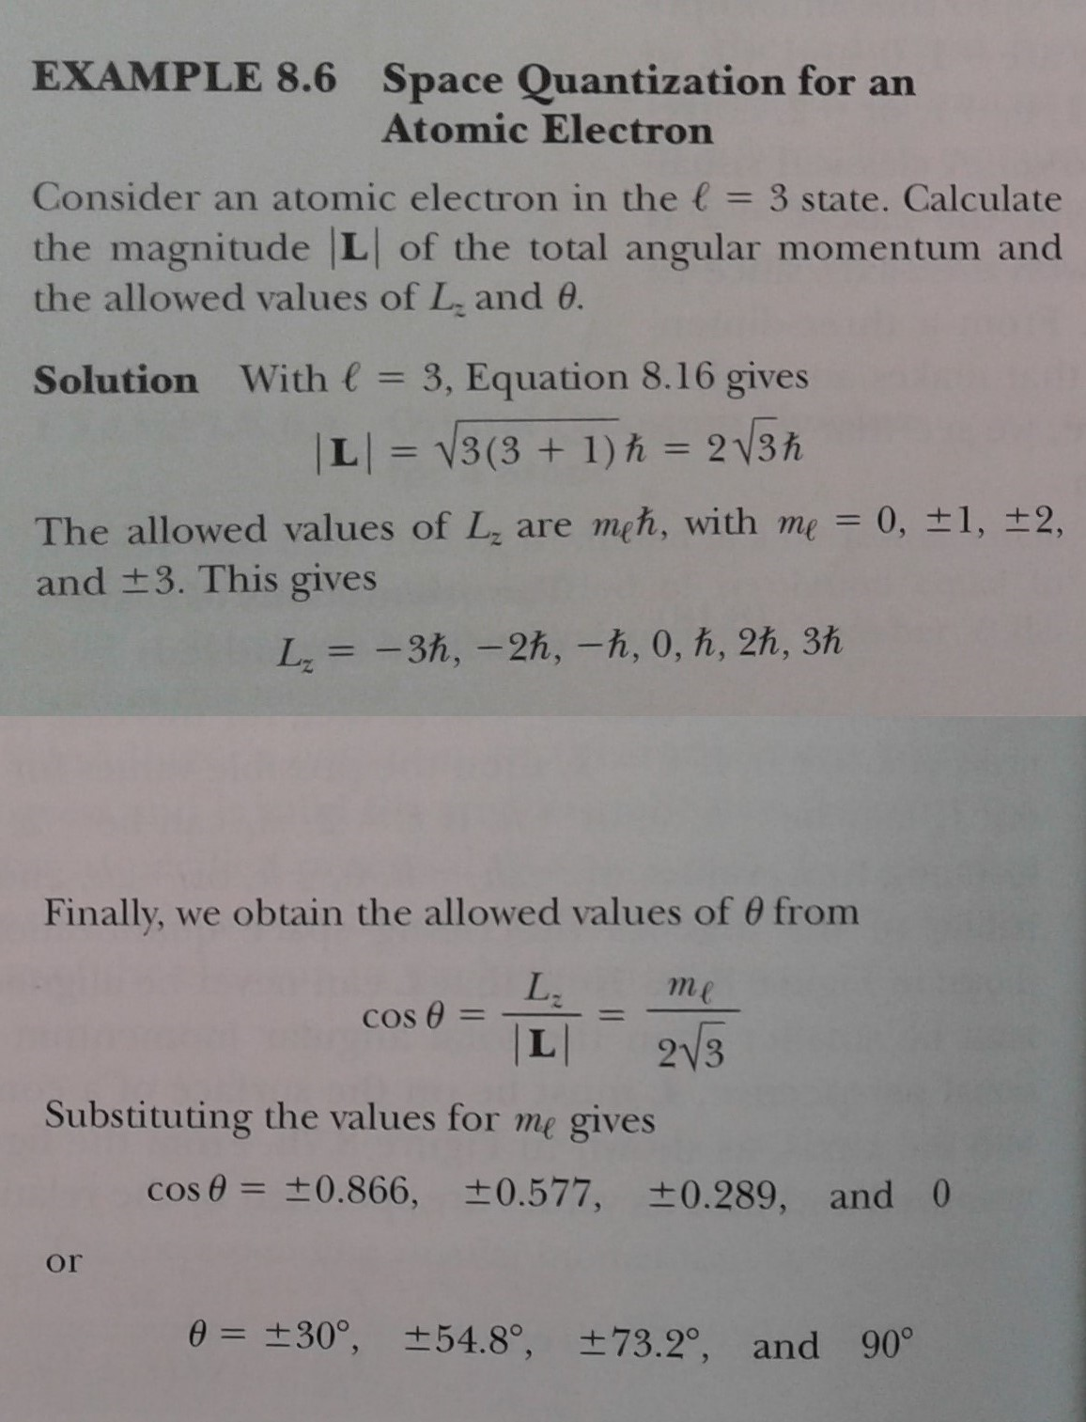
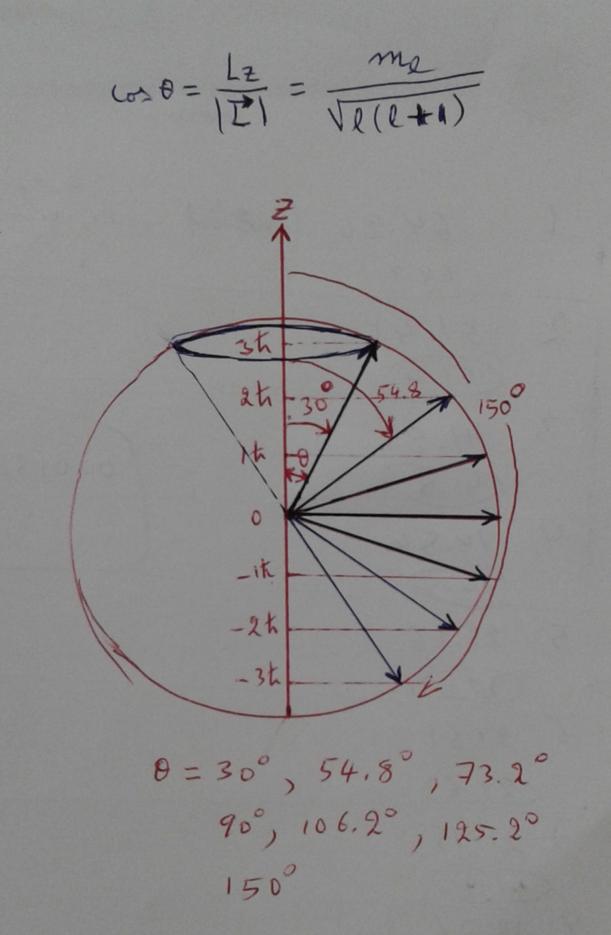
Space Quantization: θ is quantized

Slide 10
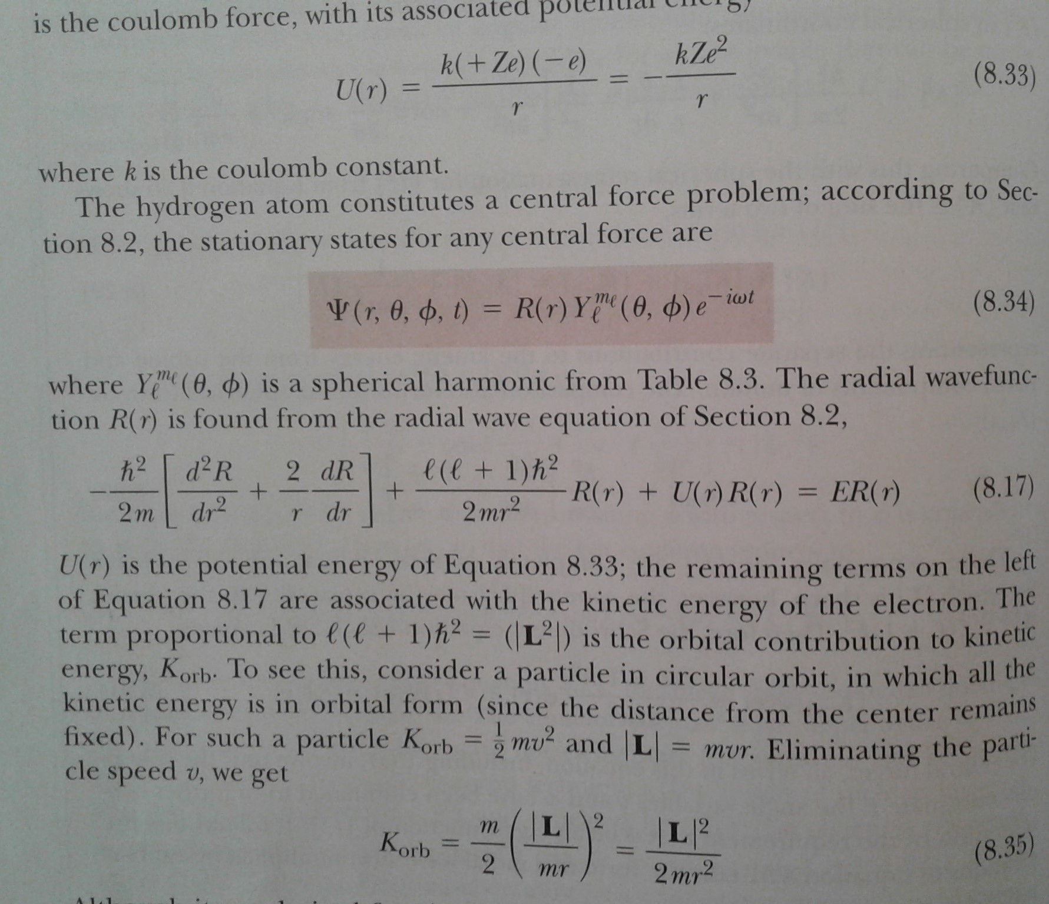
The Hydrogen Atom

Slide 11
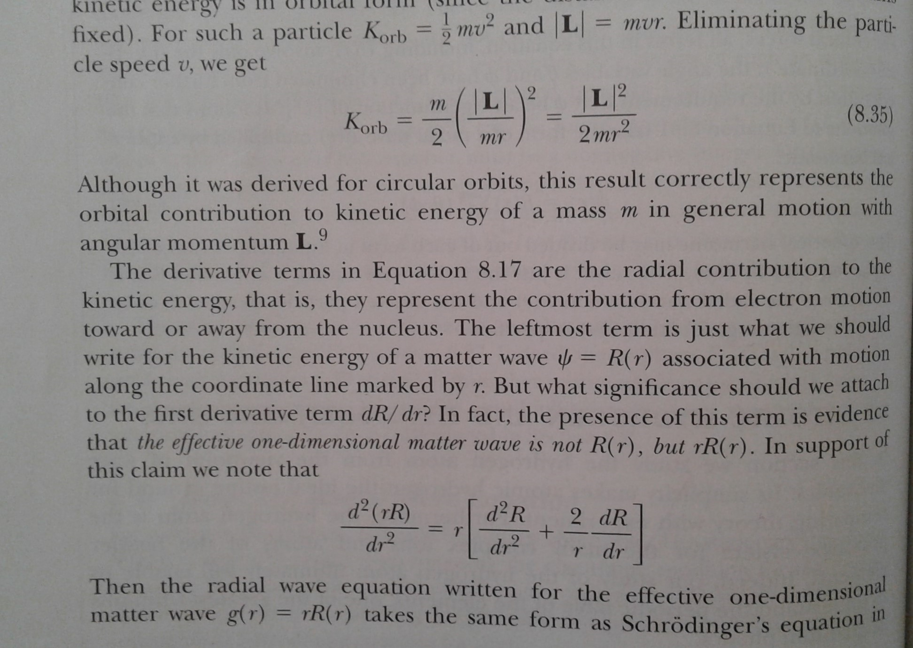
g(r) = rR(r)

Slide 12
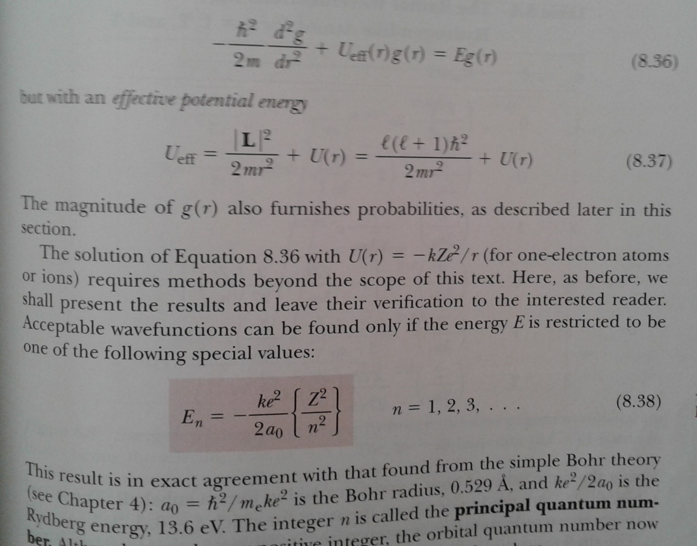
Eqn. for g(r) is similar to 1-D Sch. Eqn.

Slide 13
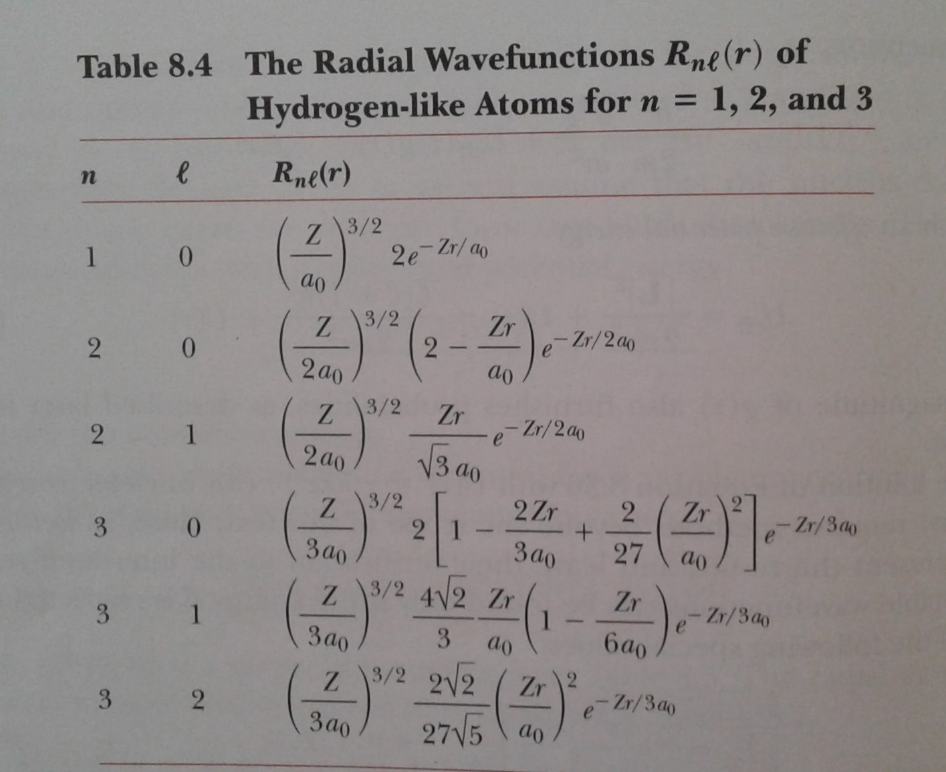

Slide 14
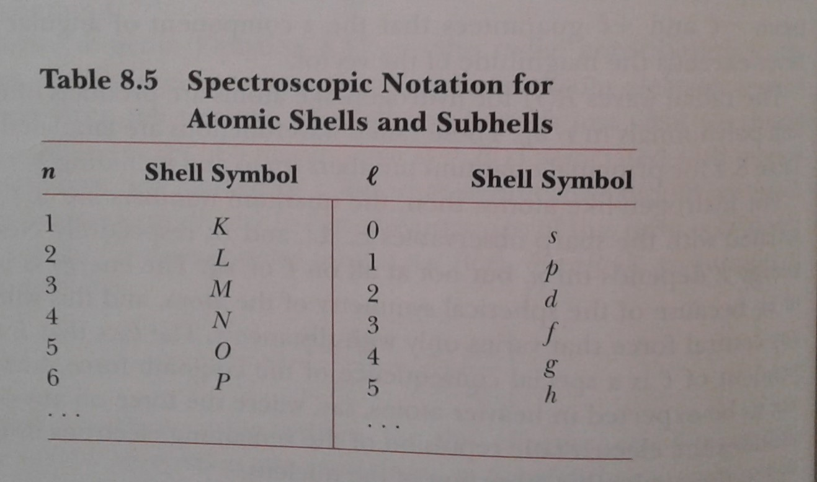
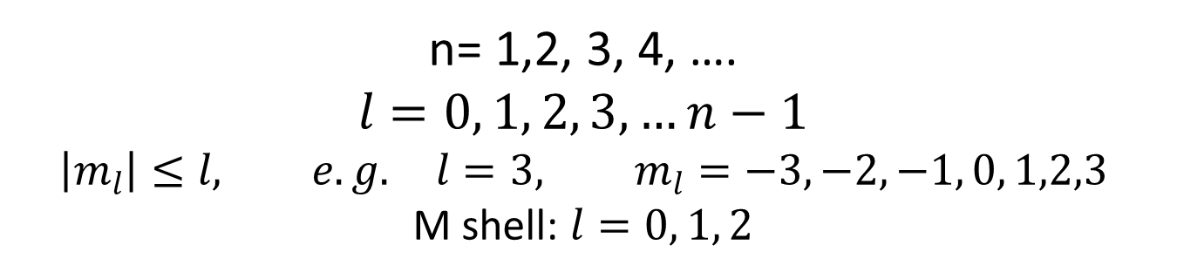
n= 1,2, 3, 4, ….
$$l=0, 1, 2, 3, …n−1 \\ \left|m_{l}\right|≤l, e.g. l=3, m_{l}=−3, −2, −1, 0, 1,2,3$$
M shell: $l=0, 1, 2$

Slide 15
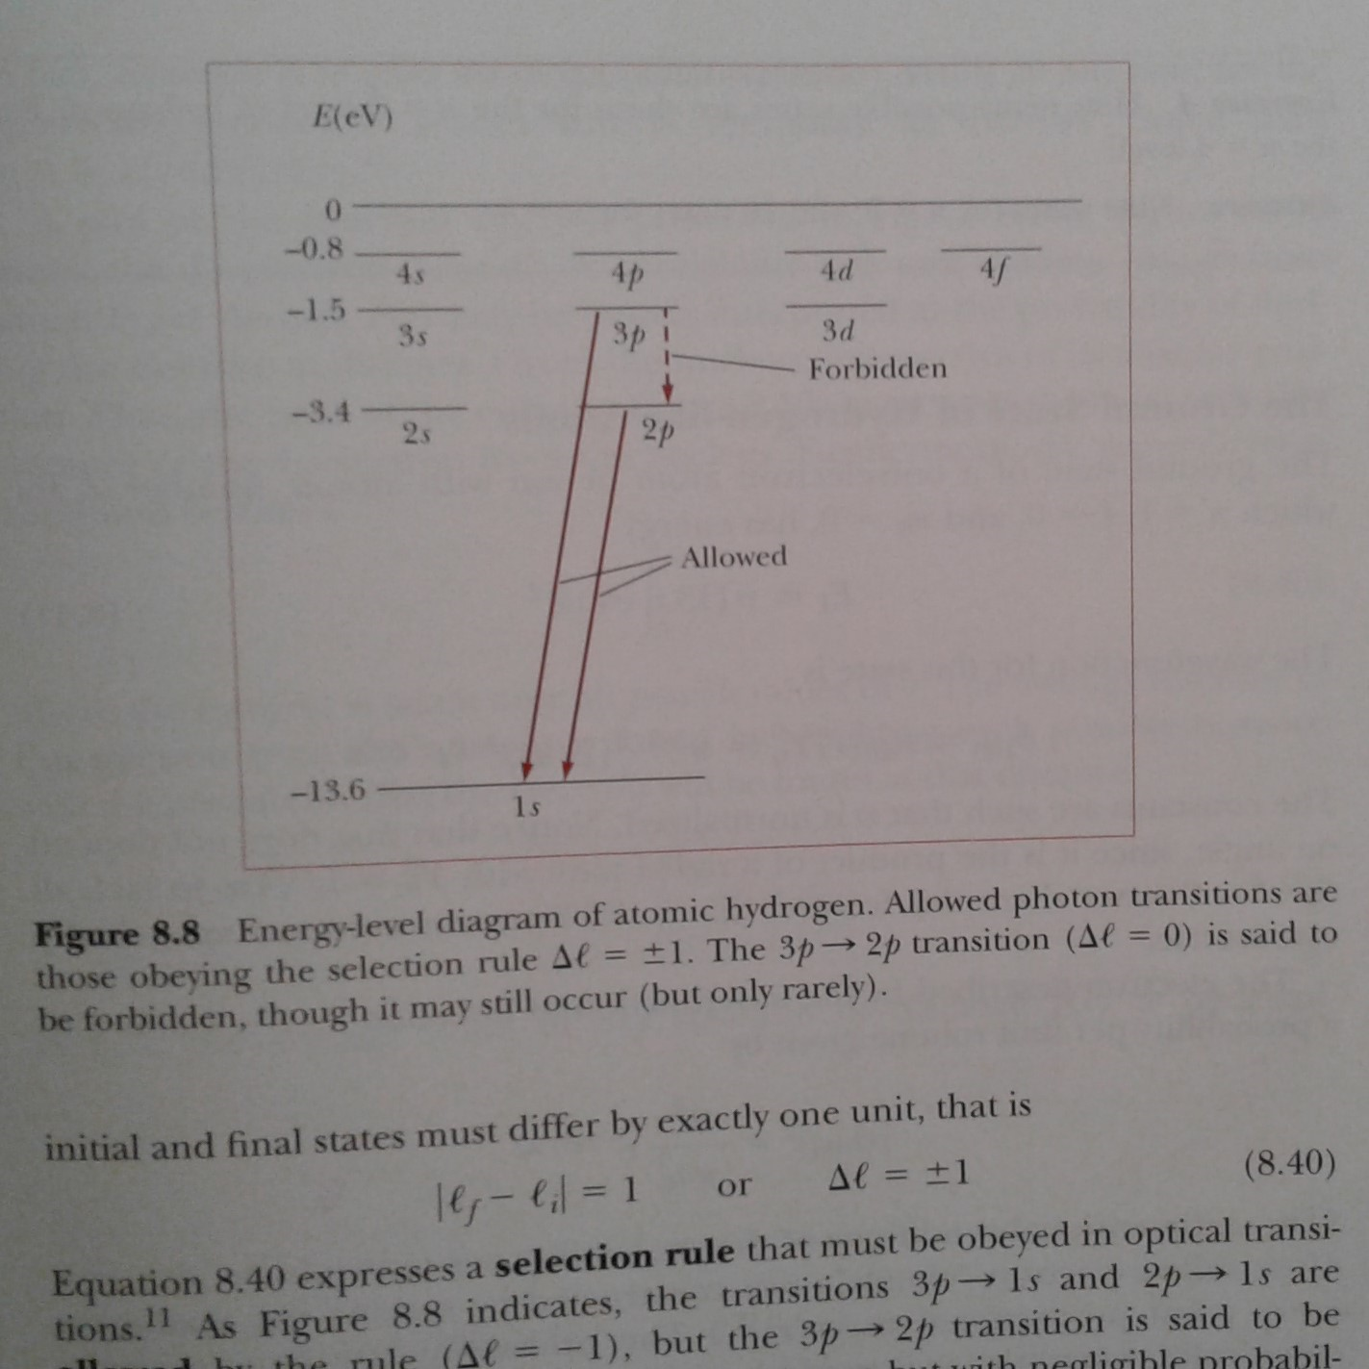
H atom states and selection rules

Slide 16
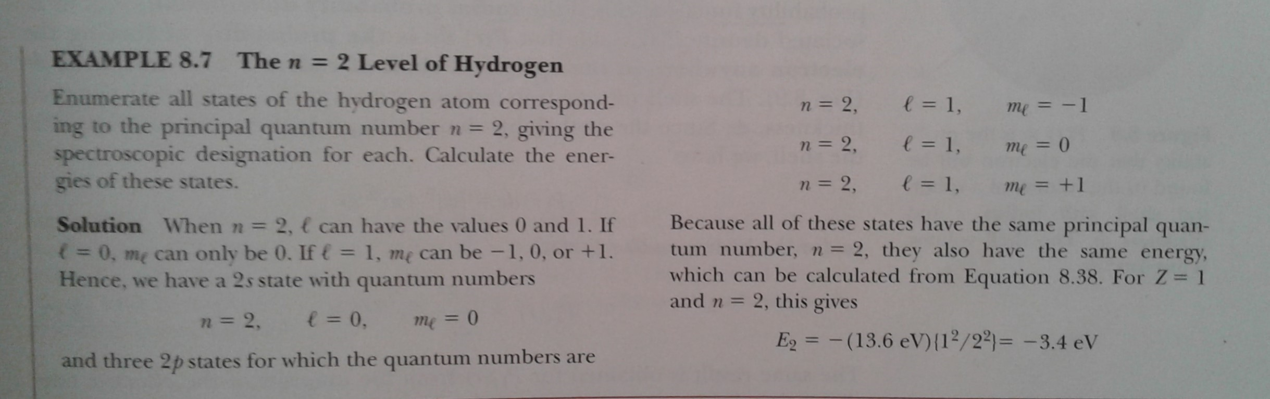
n=2 level has a 4-fold degeneracy
If we include the electron’s spin the degeneracy becomes 8-fold

