Slide 1
Chapter 7, 8 Arrays

Slide 2
Opening Problem
Read one hundred numbers, compute their average, and find out how many numbers are above the average.

Slide 3
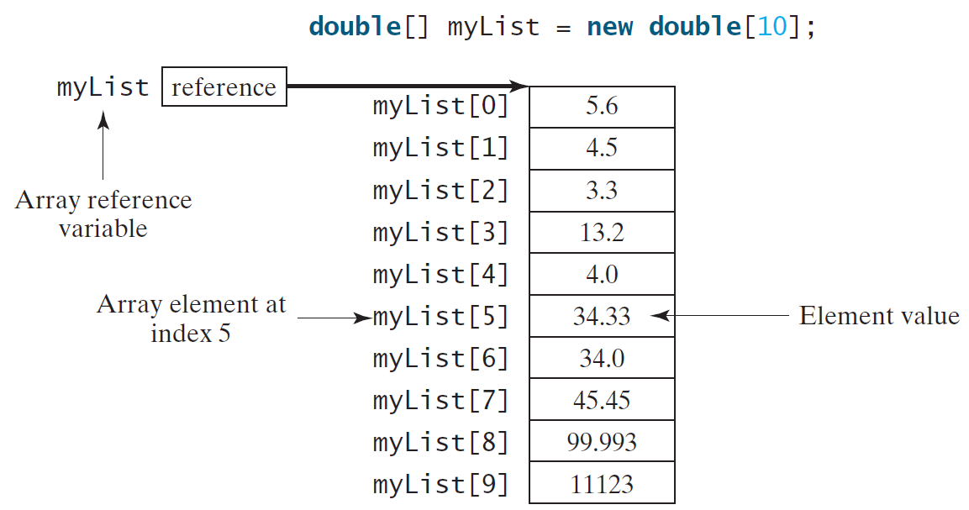
Introducing Arrays
Array is a data structure that represents a collection of the same types of data.

Slide 4
Declaring Array Variables
datatype[] arrayRefVar;
double[] myList;
  datatype arrayRefVar[]; // This style is allowed, but not preferred
  double myList[];
arrayRefVar = new datatype[arraySize];
myList = new double[10];
myList[0] references the first element in the array.
datatype[] arrayRefVar = new
datatype[arraySize];
double[] myList = new double[10];
myList.length returns 10

Slide 5
More on Arrays
When an array is created, its elements are assigned the default value of
  0 for the numeric primitive data types,
  '\u0000' for char types, and
  false for boolean types.
The array elements are accessed through the index. The array indices are 0-based, i.e., it starts from 0 to arrayRefVar.length-1.
myList[2] = myList[0] + myList[1];

Slide 6
Declaring, creating, initializing Using the Shorthand Notation
double[] myList = {1.9, 2.9, 3.4, 3.5};
This shorthand notation is equivalent to the following statements:
double[] myList = new double[4];
myList[0] = 1.9;
myList[1] = 2.9;
myList[2] = 3.4;
myList[3] = 3.5;

Slide 7
CAUTION
Using the shorthand notation, you have to declare, create, and initialize the array all in one statement. Splitting it would cause a syntax error. For example, the following is wrong:
  double[] myList;
  myList = {1.9, 2.9, 3.4, 3.5};

Slide 8
Trace Program with Arrays
animation
Declare array variable values, create an array, and assign its reference to values
public class Test {
public static void main(String[] args) {
int[] values = new int[5];
for (int i = 1; i < 5; i++) {
values[i] = i + values[i-1];
}
values[0] = values[1] + values[4];
}
}

Slide 9
Trace Program with Arrays
animation
After this line, values[0] is 11 (1 + 10)
public class Test {
public static void main(String[] args) {
int[] values = new int[5];
for (int i = 1; i < 5; i++) {
values[i] = i + values[i-1];
}
values[0] = values[1] + values[4];
}
}

Slide 10
Initializing arrays
With input values
    java.util.Scanner input = new java.util.Scanner(System.in);
    System.out.print("Enter " + myList.length + " values: ");
    for (int i = 0; i < myList.length; i++)
    myList[i] = input.nextDouble();
With Random numbers
    for (int i = 0; i < myList.length; i++) {
    myList[i] = Math.random() * 100;
    }
Printing:
    for (int i = 0; i < myList.length; i++) {
    System.out.print(myList[i] + " ");
    }

Slide 11
Array Processing
Summing
      for (int i = 0; i < myList.length; i++) {
      total += myList[i];
      }
Largest Element
      double max = myList[0];
      for (int i = 1; i < myList.length; i++) {
      if (myList[i] > max) max = myList[i];
      }

Slide 12
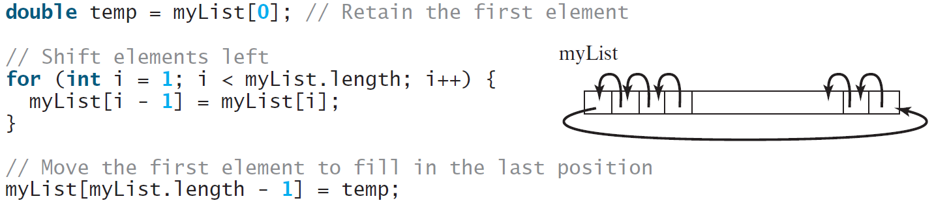
Shuffling & Shifting

Slide 13
Enhanced for Loop (for-each loop)
JDK 1.5 introduced a new for loop that enables you to traverse the complete array sequentially without using an index variable. For example, the following code displays all elements in the array myList:
  for (double value: myList)
  System.out.println(value);
In general, the syntax is
  for (elementType value: arrayRefVar) {
  // Process the value
  }
You still have to use an index variable if you wish to traverse the array in a different order or change the elements in the array.

Slide 14
Analyze Numbers
Read one hundred numbers, compute their average, and find out how many numbers are above the average.
AnalyzeNumbers
Run

Slide 15
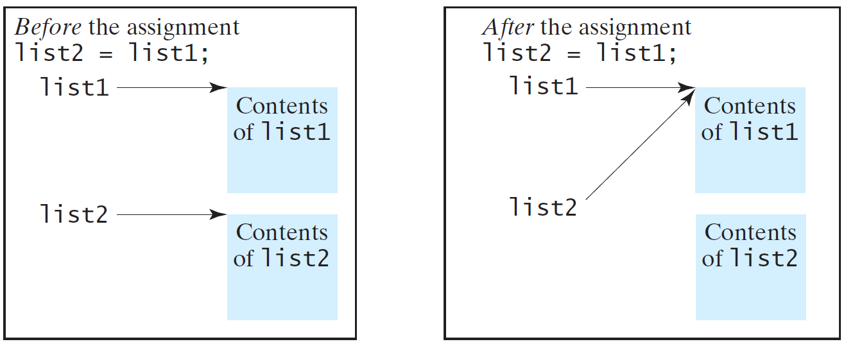
Copying Arrays
Often, in a program, you need to duplicate an array or a part of an array. In such cases you could attempt to use the assignment statement (=), as follows:
list2 = list1;

Slide 16
Copying Arrays
Using a loop:
int[] sourceArray = {2, 3, 1, 5, 10};
int[] targetArray = new int[sourceArray.length];
for (int i = 0; i < sourceArrays.length; i++)
targetArray[i] = sourceArray[i];

Slide 17
The arraycopy Utility
arraycopy(sourceArray, src_pos, targetArray, tar_pos, length);
Example:
System.arraycopy(sourceArray, 0, targetArray, 0, sourceArray.length);

Slide 18
Passing Arrays to Methods
public static void printArray(int[] array) {
for (int i = 0; i < array.length; i++) {
System.out.print(array[i] + " ");
}
}
Invoke the method
int[] list = {3, 1, 2, 6, 4, 2};
printArray(list);
Invoke the method
printArray(new int[]{3, 1, 2, 6, 4, 2});
Anonymous array

Slide 19
Anonymous Array
  The statement
    printArray(new int[]{3, 1, 2, 6, 4, 2});
  creates an array using the following syntax:
    new dataType[]{literal0, literal1, ..., literalk};
  There is no explicit reference variable for the array. Such array is called an anonymous array.

Slide 20
Pass by Reference vs. By Value
Java uses pass by value to pass arguments to a method. There are important differences between passing a value of variables of primitive data types and passing arrays.
For a parameter of a primitive type value, the actual value is passed. Changing the value of the local parameter inside the method does not affect the value of the variable outside the method.
For a parameter of an array type, the value of the parameter contains a reference to an array; this reference is passed to the method. Any changes to the array that occur inside the method body will affect the original array that was passed as the argument.

Slide 21
Simple Example
public class Test {
public static void main(String[] args) {
int x = 1; // x represents an int value
int[] y = new int[10]; // y represents an array of int values
m(x, y); // Invoke m with arguments x and y
System.out.println("x is " + x);
System.out.println("y[0] is " + y[0]);
}
public static void m(int number, int[] numbers) {
number = 1001; // Assign a new value to number
numbers[0] = 5555; // Assign a new value to numbers[0]
}
}

Slide 22
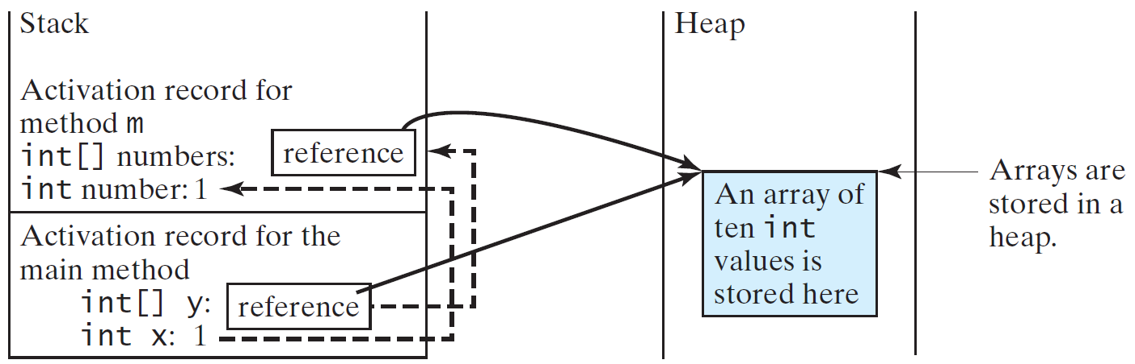
Call Stack
When invoking m(x, y), the values of x and y are passed to number and numbers. Since y contains the reference value to the array, numbers now contains the same reference value to the same array.

Slide 23
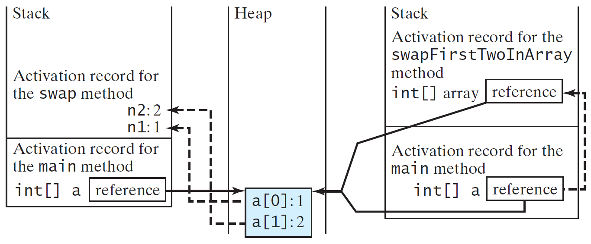
Call Stack
When invoking m(x, y), the values of x and y are passed to number and numbers. Since y contains the reference value to the array, numbers now contains the same reference value to the same array.

Slide 24
Heap
The JVM stores the array in an area of memory, called heap, which is used for dynamic memory allocation where blocks of memory are allocated and freed in an arbitrary order.

Slide 25
Passing Arrays as Arguments
Objective: Demonstrate differences of passing primitive data type variables and array variables.
TestPassArray
Run

Slide 26
Example, cont.

Slide 27
Returning an Array from a Method
public static int[] reverse(int[] list) {
int[] result = new int[list.length];
for (int i = 0, j = result.length - 1;
i < list.length; i++, j--) {
result[j] = list[i];
}
return result;
}
list
result
int[] list1 = {1, 2, 3, 4, 5, 6};
int[] list2 = reverse(list1);

Slide 28
Trace the reverse Method, cont.
animation
int[] list1 = {1, 2, 3, 4, 5, 6};
int[] list2 = reverse(list1);
Return result
public static int[] reverse(int[] list) {
int[] result = new int[list.length];
for (int i = 0, j = result.length - 1;
i < list.length; i++, j--) {
result[j] = list[i];
}
return result;
}
list
1
2
3
4
5
6
list2
result
6
5
4
3
2
1

Slide 29
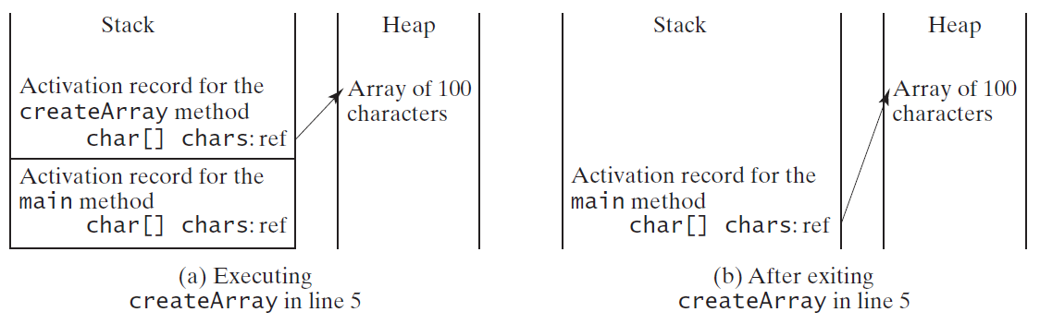
Problem: Counting Occurrence of Each Letter
Generate 100 lowercase letters randomly and assign to an array of characters.
Count the occurrence of each letter in the array.
CountLettersInArray
Run

Slide 30
Variable-Length Arguments
You can pass a variable number of arguments of the same type to a method.
public class VarArgsDemo {
public static void main(String[] args) {
    printMax(34, 3, 3, 2, 56.5);
    printMax(new double[]{1, 2, 3});
    }
public static void printMax(double... numbers) {
if (numbers.length == 0) {
System.out.println("No argument passed");
return;
}
double result = numbers[0];
for (int i = 1; i < numbers.length; i++)
if (numbers[i] > result) result = numbers[i];
System.out.println("The max value is " + result);
}
}
VarArgsDemo
Run

Slide 31
Searching Arrays
Searching is the process of looking for a specific element in an array; for example, discovering whether a certain score is included in a list of scores. Searching is a common task in computer programming. There are many algorithms and data structures devoted to searching. In this section, two commonly used approaches are discussed, linear search and binary search.

Slide 32
Linear Search
The linear search approach compares the key element, key, sequentially with each element in the array list. The method continues to do so until the key matches an element in the list or the list is exhausted without a match being found. If a match is made, the linear search returns the index of the element in the array that matches the key. If no match is found, the search returns -1.

Slide 33
From Idea to Solution
/** The method for finding a key in the list */
public static int linearSearch(int[] list, int key) {
for (int i = 0; i < list.length; i++)
if (key == list[i])
return i;
return -1;
}
Trace the method
int[] list = {1, 4, 4, 2, 5, -3, 6, 2};
int i = linearSearch(list, 4); // returns 1
int j = linearSearch(list, -4); // returns -1
int k = linearSearch(list, -3); // returns 5

Slide 34
Binary Search
For binary search to work, the elements in the array must already be ordered. Without loss of generality, assume that the array is in ascending order.
  e.g., 2 4 7 10 11 45 50 59 60 66 69 70 79
The binary search first compares the key with the element in the middle of the array.

Slide 35
Binary Search, cont.
Consider the following three cases:
If the key is less than the middle element, you only need to search the key in the first half of the array.
If the key is equal to the middle element, the search ends with a match.
If the key is greater than the middle element, you only need to search the key in the second half of the array.

Slide 36
From Idea to Soluton
/** Use binary search to find the key in the list */
public static int binarySearch(int[] list, int key) {
int low = 0;
int high = list.length - 1;
while (high >= low) {
int mid = (low + high) / 2;
if (key < list[mid])
high = mid - 1;
else if (key == list[mid])
return mid;
else
low = mid + 1;
}
return -1 - low;
}

Slide 37
The Arrays.binarySearch Method
Since binary search is frequently used in programming, Java provides several overloaded binarySearch methods for searching a key in an array of int, double, char, short, long, and float in the java.util.Arrays class. For example, the following code searches the keys in an array of numbers and an array of characters.
  int[] list = {2, 4, 7, 10, 11, 45, 50, 59, 60, 66, 69, 70, 79};
  System.out.println("Index is " +
  java.util.Arrays.binarySearch(list, 11));
  char[] chars = {'a', 'c', 'g', 'x', 'y', 'z'};
  System.out.println("Index is " +
  java.util.Arrays.binarySearch(chars, 't'));
For the binarySearch method to work, the array must be pre-sorted in increasing order.
Return is 4
Return is –4 (insertion point is 3, so return is -3-1)

Slide 38
Sorting Arrays
Sorting, like searching, is also a common task in computer programming. Many different algorithms have been developed for sorting. This section introduces a simple, intuitive sorting algorithms: selection sort.

Slide 39
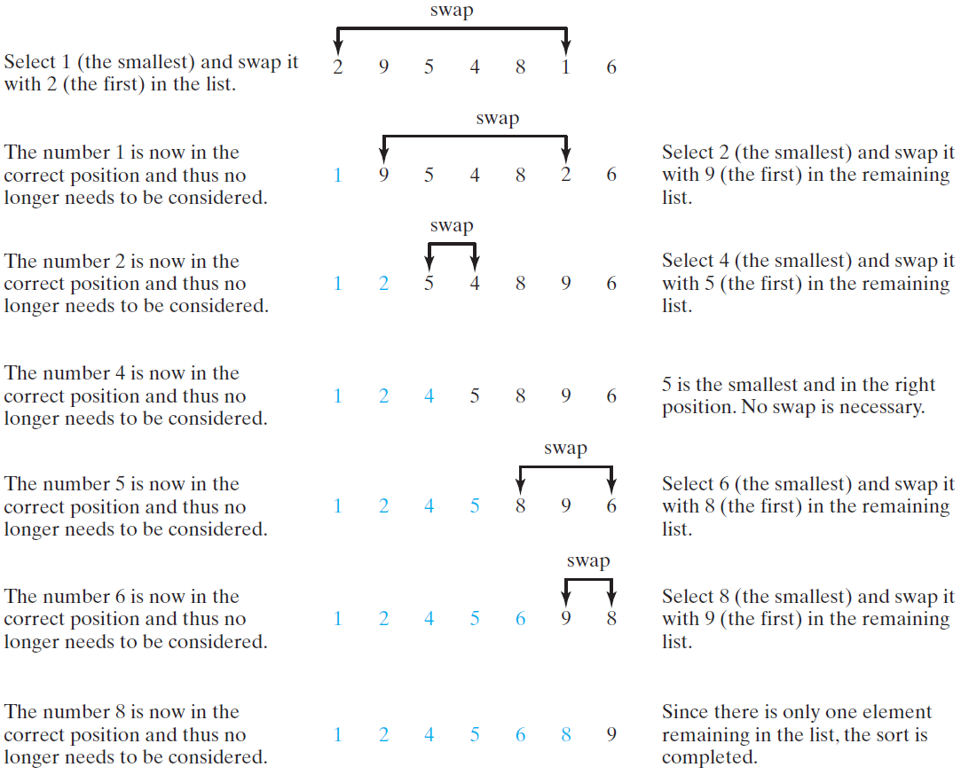
Selection Sort
Selection sort finds the smallest number in the list and places it first. It then finds the smallest number remaining and places it second, and so on until the list contains only a single number.

Slide 40
The Code
/** The method for sorting the numbers */
public static void selectionSort(double[] list) {
for (int i = 0; i < list.length; i++) {
// Find the minimum in the list[i..list.length-1]
double currentMin = list[i];
int currentMinIndex = i;
for (int j = i + 1; j < list.length; j++) {
if (currentMin > list[j]) {
currentMin = list[j];
currentMinIndex = j;
}
}
// Swap list[i] with list[currentMinIndex] if necessary;
if (currentMinIndex != i) {
list[currentMinIndex] = list[i];
list[i] = currentMin;
}
}
}
Invoke it
selectionSort(yourList)

Slide 41
The Arrays.sort Method
Since sorting is frequently used in programming, Java provides several overloaded sort methods for sorting an array of int, double, char, short, long, and float in the java.util.Arrays class. For example, the following code sorts an array of numbers and an array of characters.
  double[] numbers = {6.0, 4.4, 1.9, 2.9, 3.4, 3.5};
  java.util.Arrays.sort(numbers);
  char[] chars = {'a', 'A', '4', 'F', 'D', 'P'};
  java.util.Arrays.sort(chars);
Java 8 now provides Arrays.parallelSort(list) that utilizes the multicore for fast sorting.

Slide 42
The Arrays.toString(list) Method
The Arrays.toString(list) method can be used to return a string representation for the list.

Slide 43
Main Method Is Just a Regular Method
You can call a regular method by passing actual parameters. Can you pass arguments to main? Of course, yes. For example, the main method in class B is invoked by a method in A, as shown below:

Slide 44
Command-Line Parameters
class TestMain {
public static void main(String[] args) {
...
}
}
java TestMain arg0 arg1 arg2 ... argn

Slide 45
Processing
Command-Line Parameters
In the main method, get the arguments from args[0], args[1], ..., args[n], which corresponds to arg0, arg1, ..., argn in the command line.
Notes:
Example 12.4

Slide 46
Problem: Calculator
Objective: Write a program that will perform binary operations on integers. The program receives three parameters: an operator and two integers.
java Calculator 2 + 3
java Calculator 2 - 3
Calculator
java Calculator 2 / 3
Run
java Calculator 2 . 3

Slide 47
public class Calculator
  public static void main(String[] args) {
    if (args.length != 3) {
    System.out.println( "Usage: java Calculator operand1 operator operand2"); System.exit(1);
  }
    int result = 0;
    switch (args[1].charAt(0)) {
      case '+': result = Integer.parseInt(args[0]) + Integer.parseInt(args[2]); break;
      case '-': result = Integer.parseInt(args[0]) - Integer.parseInt(args[2]); break;
      case '.': result = Integer.parseInt(args[0]) * Integer.parseInt(args[2]); break;
      case '/': result = Integer.parseInt(args[0]) / Integer.parseInt(args[2]);
    } // Display result
    System.out.println(args[0] + ' ' + args[1] + ' ' + args[2] + " = " + result);
  }
}

Slide 48
Declaring Variables of Two-dimensional Arrays and Creating Two-dimensional Arrays
int[][] matrix = new int[10][10];
or
int matrix[][] = new int[10][10];
matrix[0][0] = 3;
for (int i = 0; i < matrix.length; i++)
for (int j = 0; j < matrix[i].length; j++)
matrix[i][j] = (int)(Math.random() * 1000);
double[][] x;

Slide 49
Declaring, Creating, and Initializing Using Shorthand Notations
You can also use an array initializer to declare, create and initialize a two-dimensional array. For example,
int[][] array = {
{1, 2, 3},
{4, 5, 6},
{7, 8, 9},
{10, 11, 12}
};
int[][] array = new int[4][3];
array[0][0] = 1; array[0][1] = 2; array[0][2] = 3;
array[1][0] = 4; array[1][1] = 5; array[1][2] = 6;
array[2][0] = 7; array[2][1] = 8; array[2][2] = 9;
array[3][0] = 10; array[3][1] = 11; array[3][2] = 12;
Same as

Slide 50
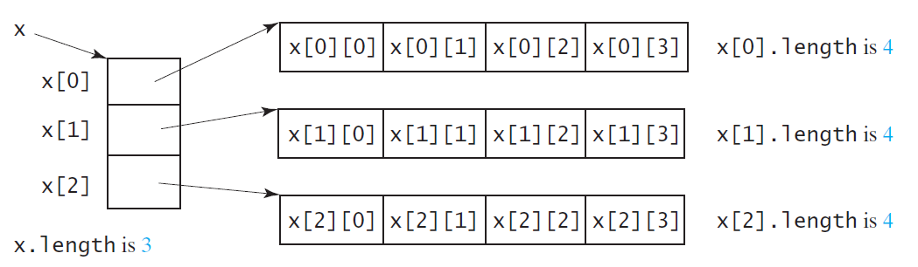
Lengths of Two-dimensional Arrays
int[][] x = new int[3][4];

Slide 51
Lengths of Two-dimensional Arrays, cont.
int[][] array = {
{1, 2, 3},
{4, 5, 6},
{7, 8, 9},
{10, 11, 12}
};
array.length
array[0].length
array[1].length
array[2].length
array[3].length
array[4].length ArrayIndexOutOfBoundsException

Slide 52
Ragged Arrays
Each row in a two-dimensional array is itself an array. So, the rows can have different lengths. Such an array is known as a ragged array. For example,
int[][] matrix = {
{1, 2, 3, 4, 5},
{2, 3, 4, 5},
{3, 4, 5},
{4, 5},
{5}
};
matrix.length is 5
matrix[0].length is 5
matrix[1].length is 4
matrix[2].length is 3
matrix[3].length is 2
matrix[4].length is 1

Slide 53
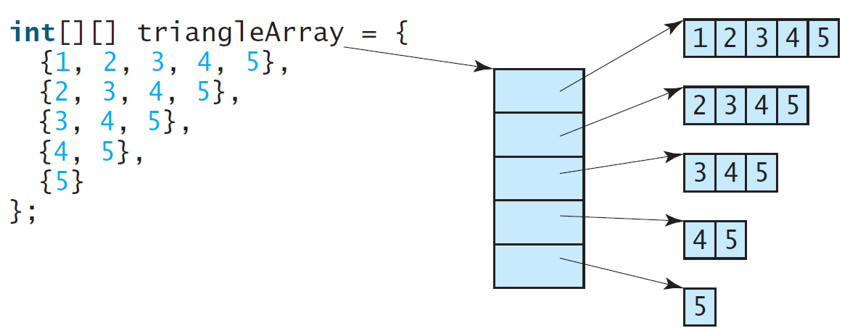
Ragged Arrays, cont.

Slide 54
Initializing arrays with input values
java.util.Scanner input = new Scanner(System.in);
System.out.println("Enter " + matrix.length + " rows and " +
matrix[0].length + " columns: ");
for (int row = 0; row < matrix.length; row++) {
for (int column = 0; column < matrix[row].length; column++) {
matrix[row][column] = input.nextInt();
}
}

Slide 55
Initializing arrays with random values
for (int row = 0; row < matrix.length; row++) {
for (int column = 0; column < matrix[row].length; column++) {
matrix[row][column] = (int)(Math.random() * 100);
}
}

Slide 56
Printing arrays
for (int row = 0; row < matrix.length; row++) {
for (int column = 0; column < matrix[row].length; column++) {
System.out.print(matrix[row][column] + " ");
}
System.out.println();
}

Slide 57
Passing Arrays to Methods
public class PassTwoDimensionalArray {
public static void main(String[] args) {
int[][] m = getArray(); // Get an array // Display sum of elements
System.out.println("\nSum of all elements is " + sum(m));
}
public static int[][] getArray() { // Create a Scanner
Scanner input = new Scanner(System.in); // Enter array values
int[][] m = new int[3][4];
System.out.println("Enter " + m.length + " rows and " +
m[0].length + " columns: ");
for (int i = 0; i < m.length; i++)
for (int j = 0; j < m[i].length; j++)
m[i][j] = input.nextInt();
return m;
}
public static int sum(int[][] m) {
int total = 0;
for (int row = 0; row < m.length; row++) {
for (int column = 0; column < m[row].length; column++) {
total += m[row][column];
}
}
return total;
}
}
Run
PassTwoDimensionalArray

Slide 58
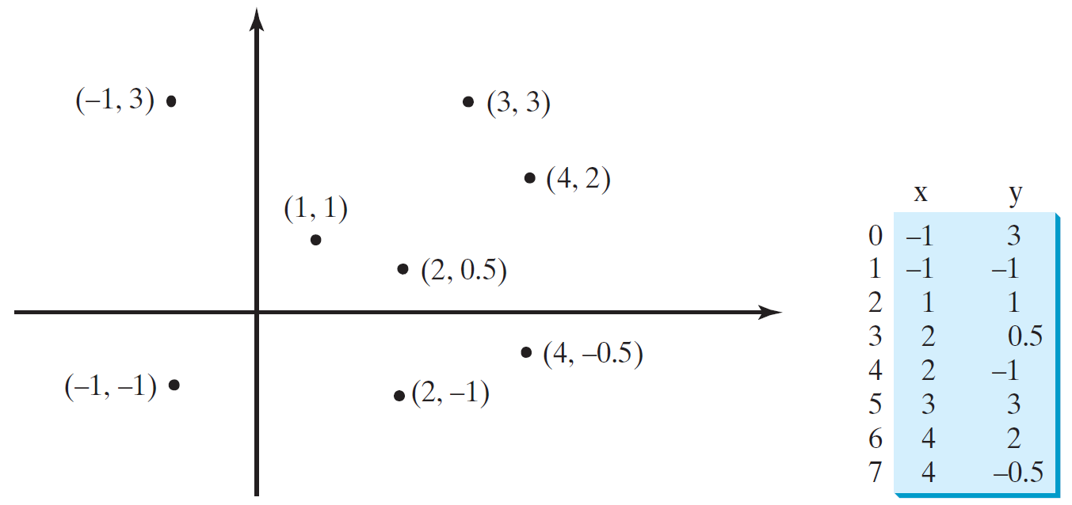
Problem: Finding Two Points Nearest to Each Other
https://liveexample.pearsoncmg.com/dsanimation/ClosestPaireBook.html
PassTwoDimensionalArray
Run

Slide 59
Multidimensional Arrays
Occasionally, you will need to represent n-dimensional data structures. In Java, you can create n-dimensional arrays for any integer n.
The way to declare two-dimensional array variables and create two-dimensional arrays can be generalized to declare n-dimensional array variables and create n-dimensional arrays for n >= 3.

Slide 60
Multidimensional Arrays
double[][][] scores = {
{{7.5, 20.5}, {9.0, 22.5}, {15, 33.5}, {13, 21.5}, {15, 2.5}},
{{4.5, 21.5}, {9.0, 22.5}, {15, 34.5}, {12, 20.5}, {14, 9.5}},
{{6.5, 30.5}, {9.4, 10.5}, {11, 33.5}, {11, 23.5}, {10, 2.5}},
{{6.5, 23.5}, {9.4, 32.5}, {13, 34.5}, {11, 20.5}, {16, 7.5}},
{{8.5, 26.5}, {9.4, 52.5}, {13, 36.5}, {13, 24.5}, {16, 2.5}},
{{9.5, 20.5}, {9.4, 42.5}, {13, 31.5}, {12, 20.5}, {16, 6.5}}
};

Slide 61
Problem: Calculating Total Scores
Objective: write a program that calculates the total score for students in a class. Suppose the scores are stored in a three-dimensional array named scores. The first index in scores refers to a student, the second refers to an exam, and the third refers to the part of the exam. Suppose there are 7 students, 5 exams, and each exam has two parts--the multiple-choice part and the programming part. So, scores[i][j][0] represents the score on the multiple-choice part for the i’s student on the j’s exam. Your program displays the total score for each student.
TotalScore
Run

Slide 62
public class TotalScore { /** Main method */
public static void main(String[] args) {
double[][][] scores =
{ {{7.5, 20.5}, {9.0, 22.5}, {15, 33.5}, {13, 21.5}, {15, 2.5}},
{{4.5, 21.5}, {9.0, 22.5}, {15, 34.5}, {12, 20.5}, {14, 9.5}},
{{6.5, 30.5}, {9.4, 10.5}, {11, 33.5}, {11, 23.5}, {10, 2.5}},
{{6.5, 23.5}, {9.4, 32.5}, {13, 34.5}, {11, 20.5}, {16, 7.5}},
{{8.5, 26.5}, {9.4, 52.5}, {13, 36.5}, {13, 24.5}, {16, 2.5}},
{{9.5, 20.5}, {9.4, 42.5}, {13, 31.5}, {12, 20.5}, {16, 6.5}},
{{1.5, 29.5}, {6.4, 22.5}, {14, 30.5}, {10, 30.5}, {16, 6.0}}};
// Calculate and display total score for each student
for (int i = 0; i < scores.length; i++) {
double totalScore = 0;
for (int j = 0; j < scores[i].length; j++)
for (int k = 0; k < scores[i][j].length; k++)
totalScore += scores[i][j][k];
System.out.println("Student " + i + "'s score is " + totalScore);
}
}
}

