Slide 1
Chapter 6
Problem Solutions

Slide 2
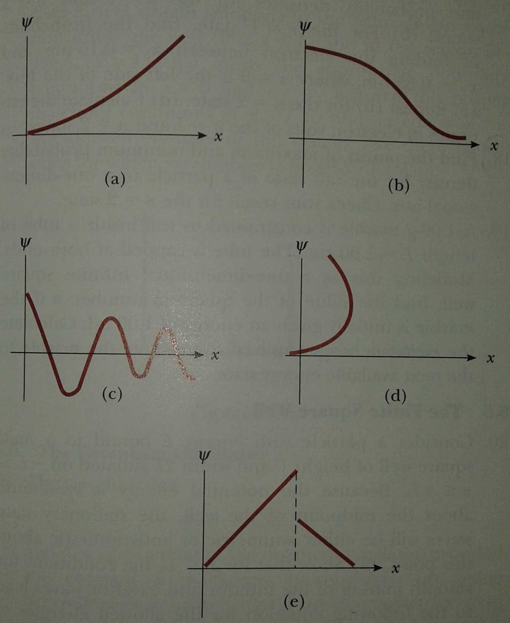
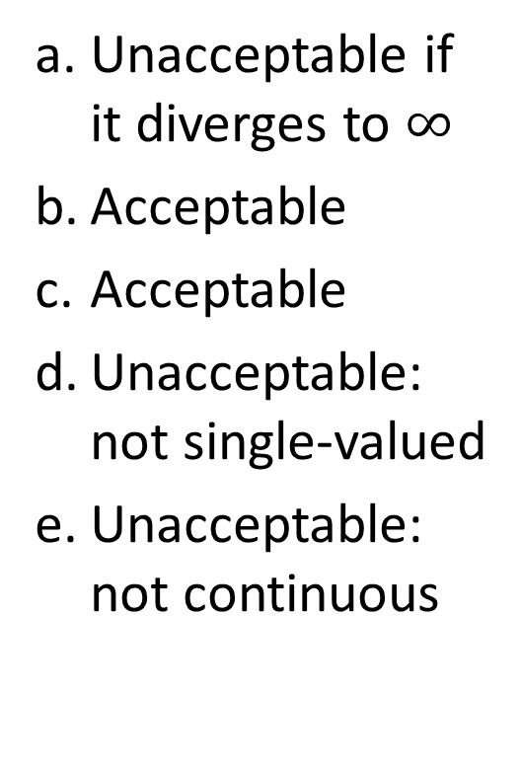
Problem 1
Unacceptable Wavefunctions
Unacceptable if it diverges to $∞$
Acceptable
Acceptable
Unacceptable: not single-valued
Unacceptable: not continuous

Slide 3
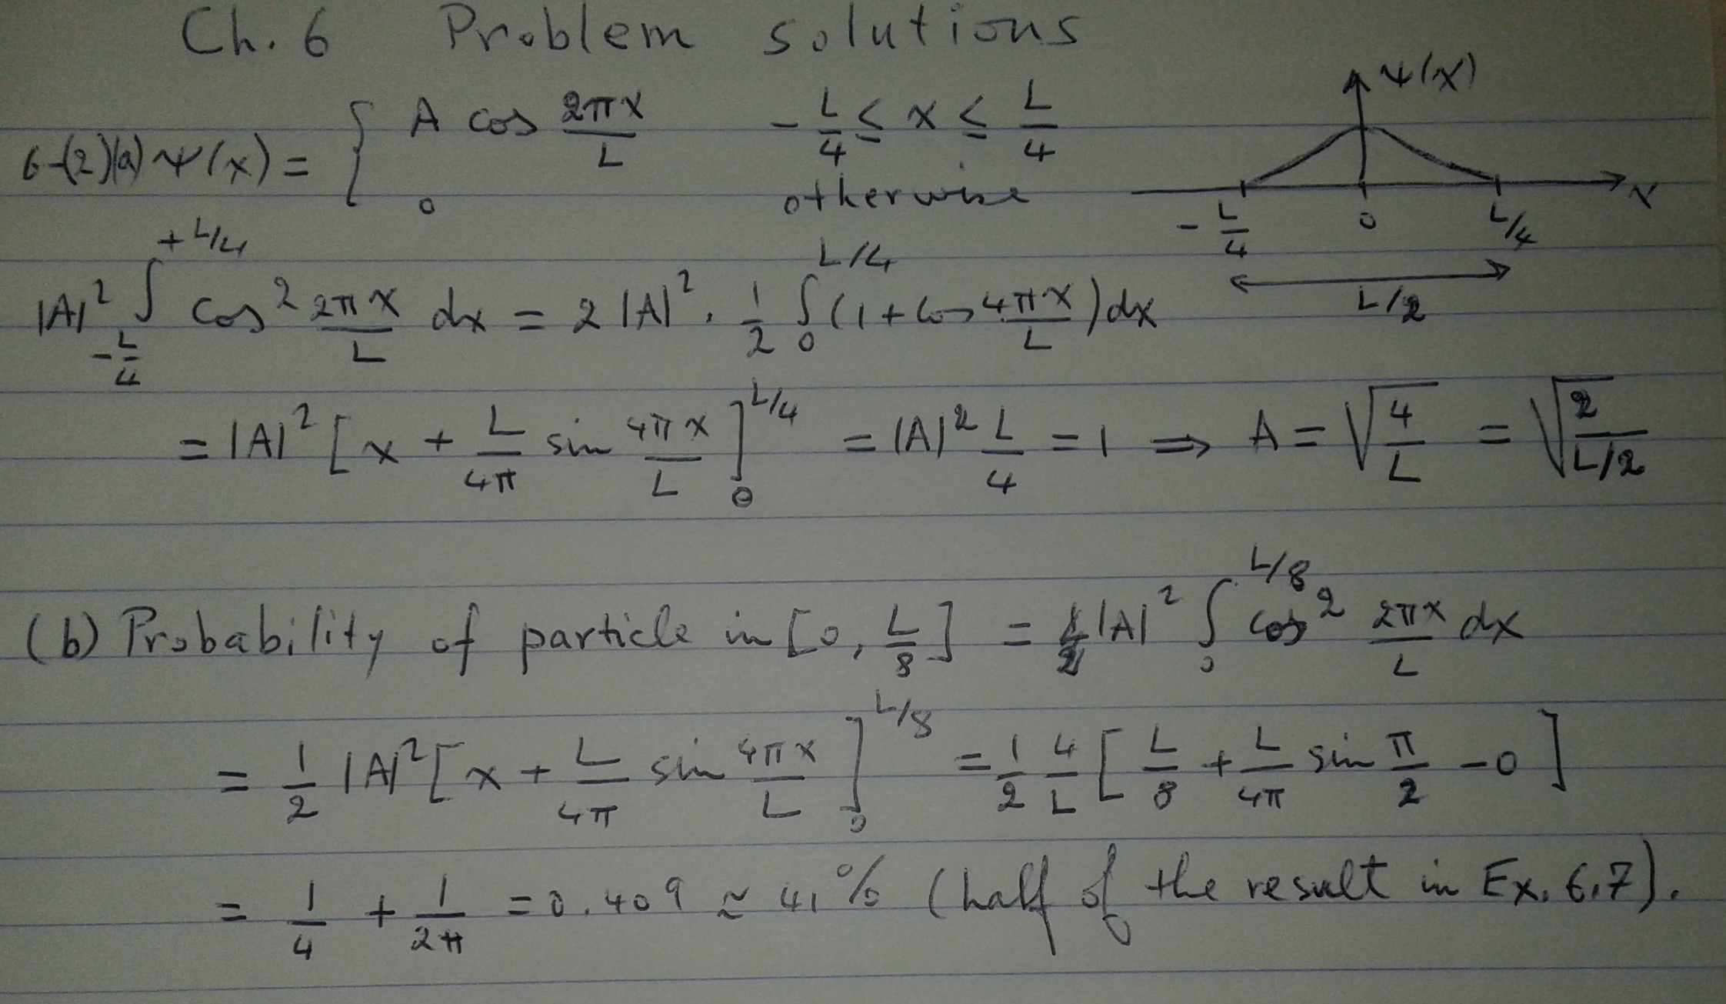

Slide 4
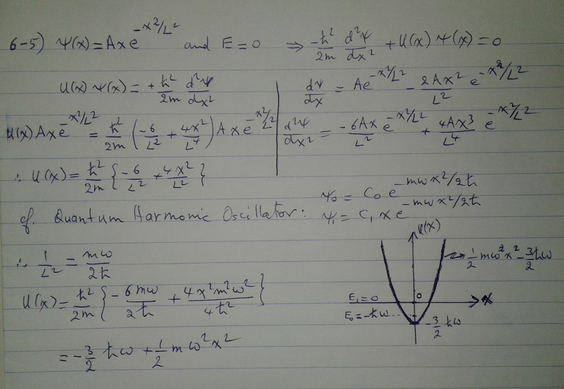

Slide 5
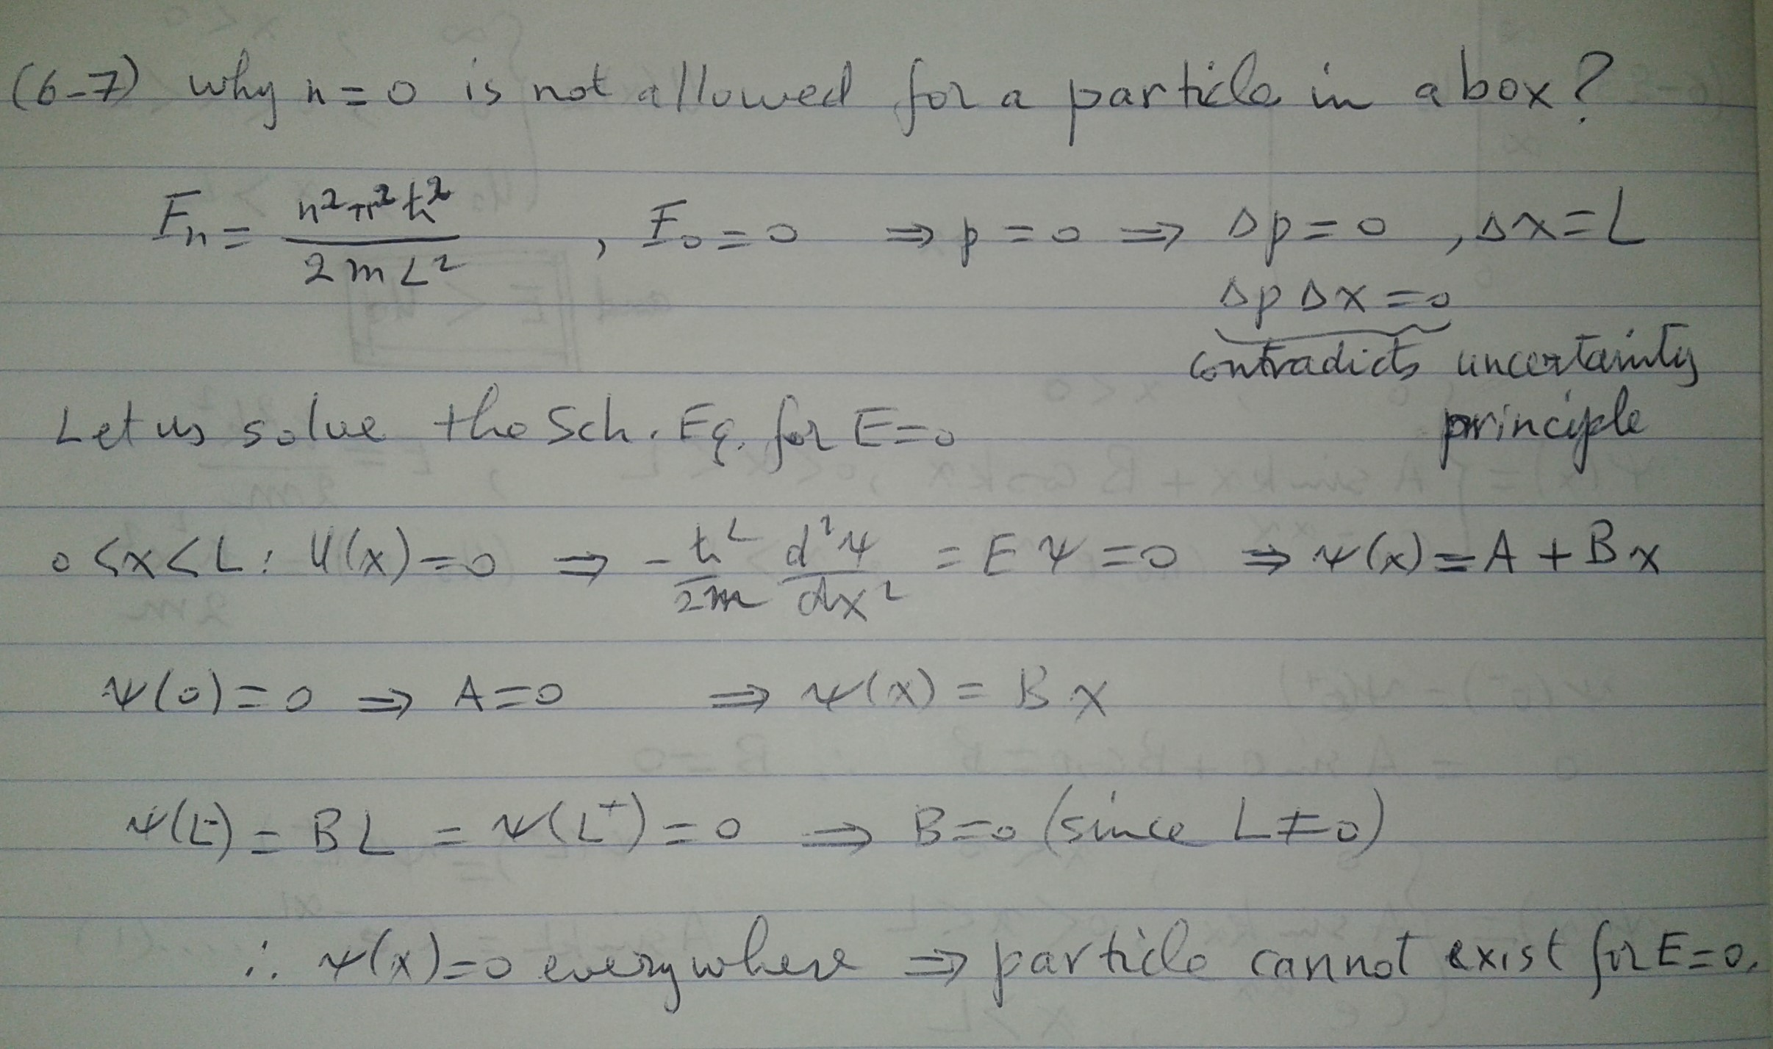

Slide 6
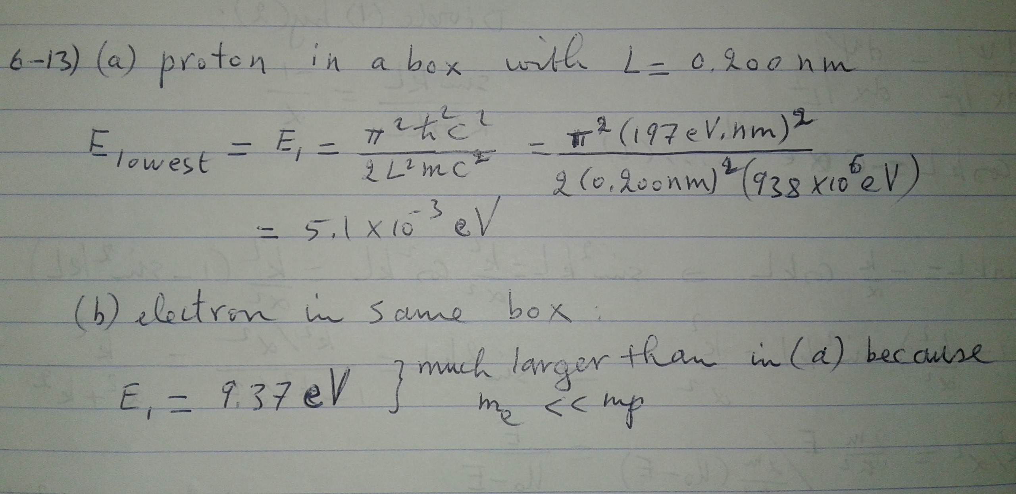

Slide 7
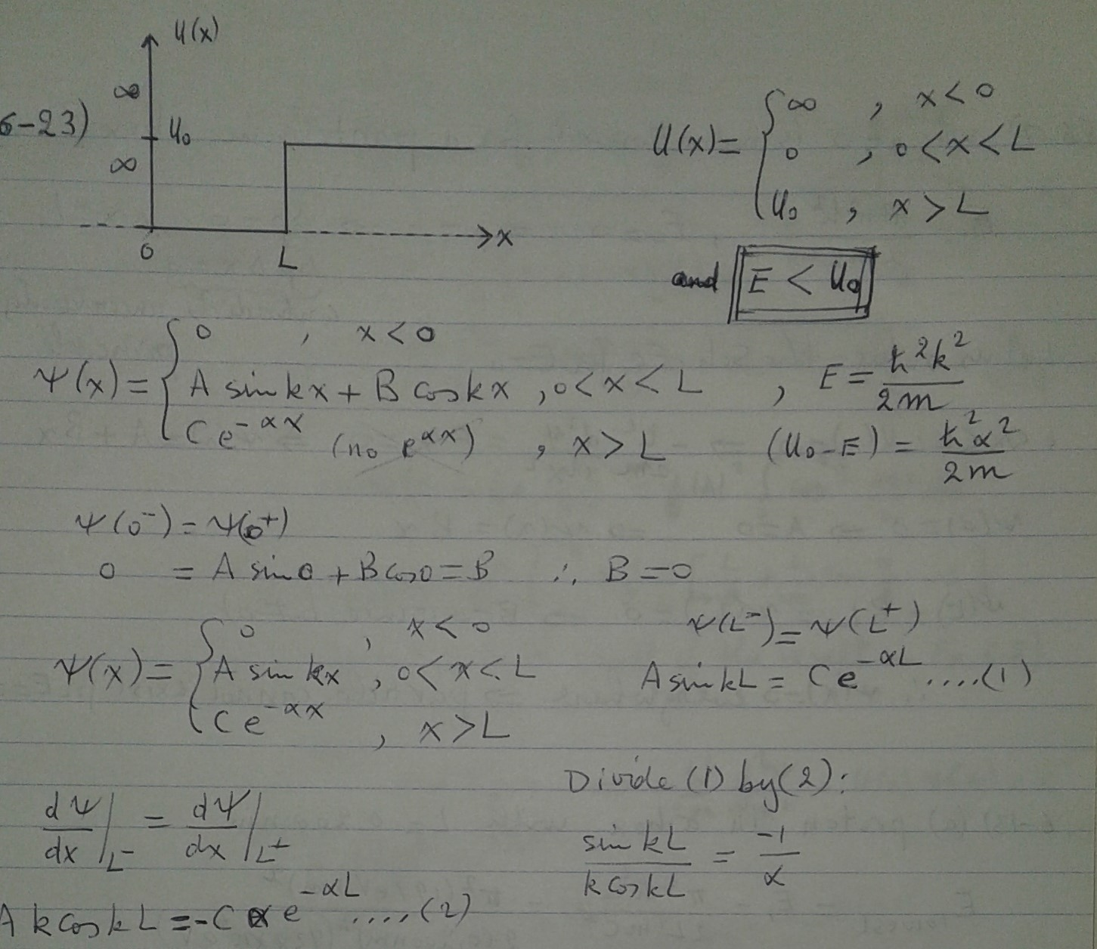

Slide 8
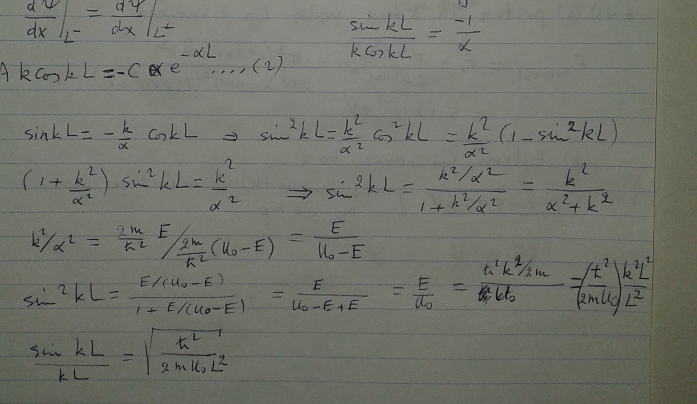
Problem 6-23 continued

Slide 9
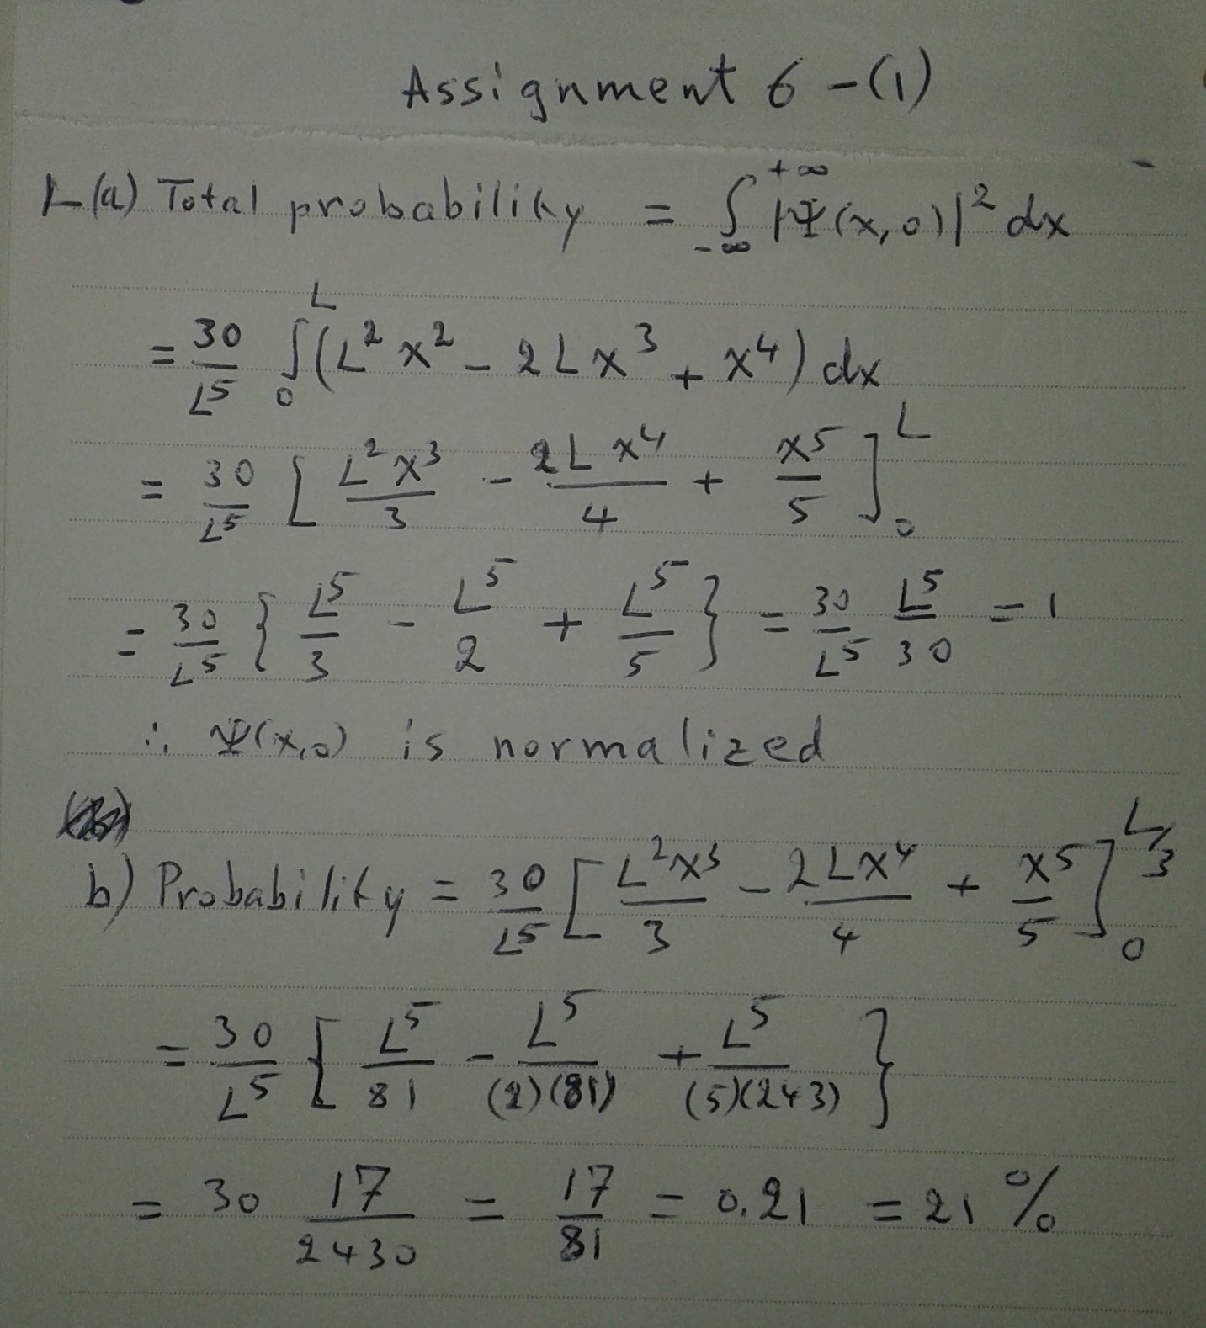

Assignment 6 -1 Ψ(x, 0) = $\left\{\begin{aligned}0 , x<0 \\ \sqrt{\frac{30}{L^{5}}}x\left(L−x\right) , 0<x<L \\ 0 , x>L\end{aligned}\right.$

Slide 10
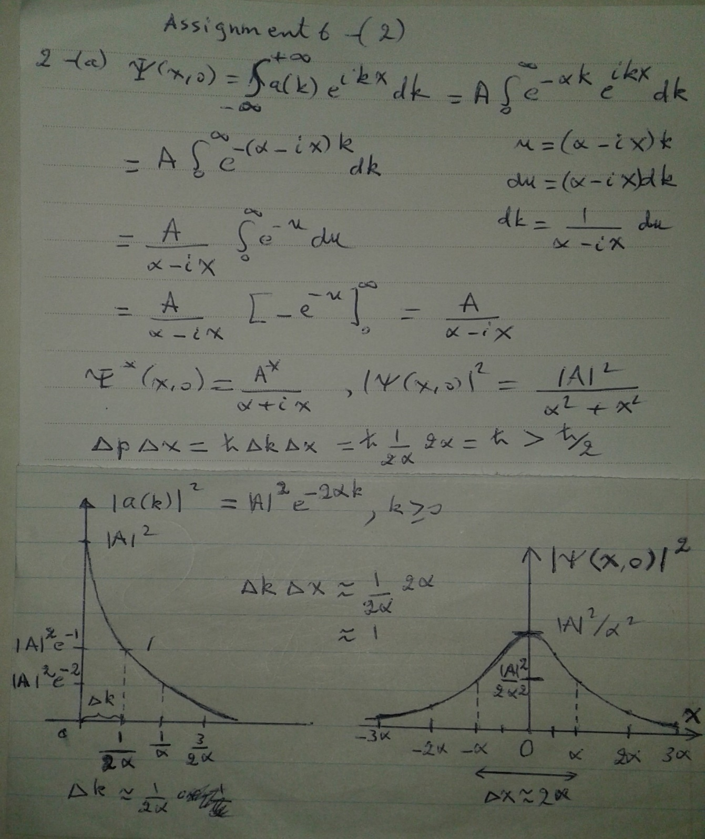

Assignment 6-2
$$a\left(k\right)=$$
$$\left\{\begin{matrix}0 ,k<0 \\ A e^{−αk} ,k≥0\end{matrix}\right\}$$

Slide 11
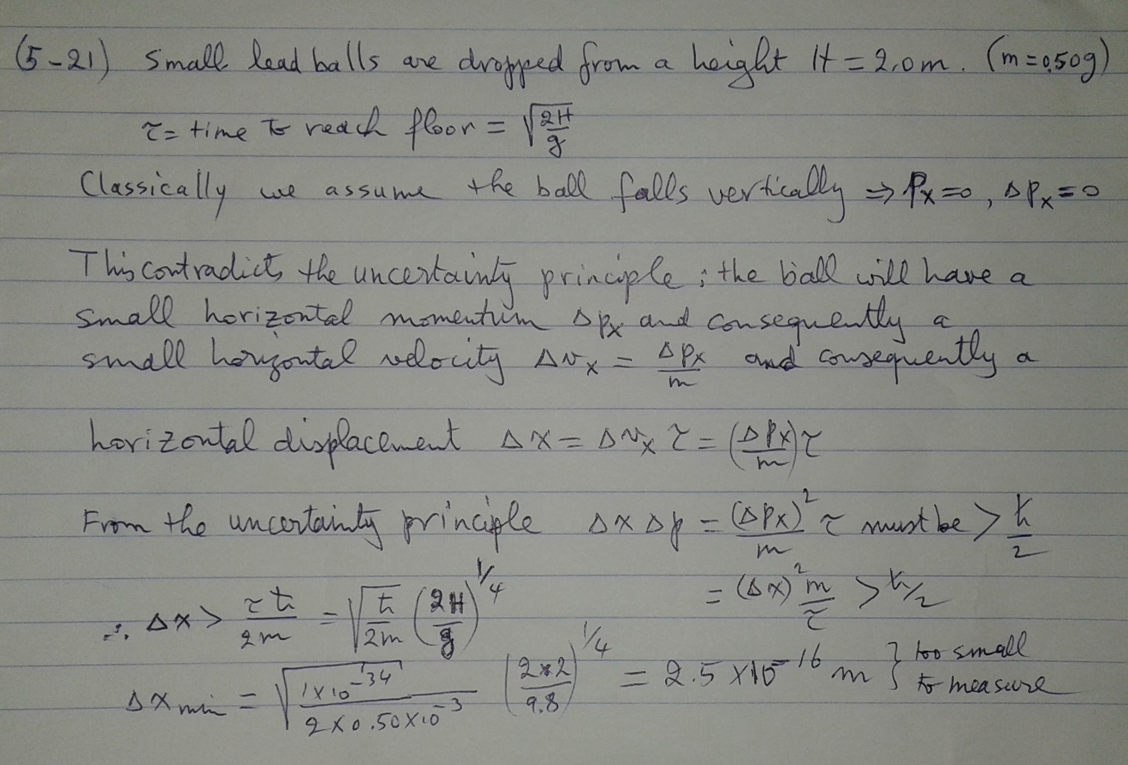
Problem 5-21

