Slide 1

Fundamental of nursing lab
Diabetes
Rania Soboh
1200101

Slide 2
Outline
Diabetes definition
Diabetes signs and symptoms
Diabetes causes
Diabetes diagnosis
Diabetes a treatment
The care plan
References

Slide 3
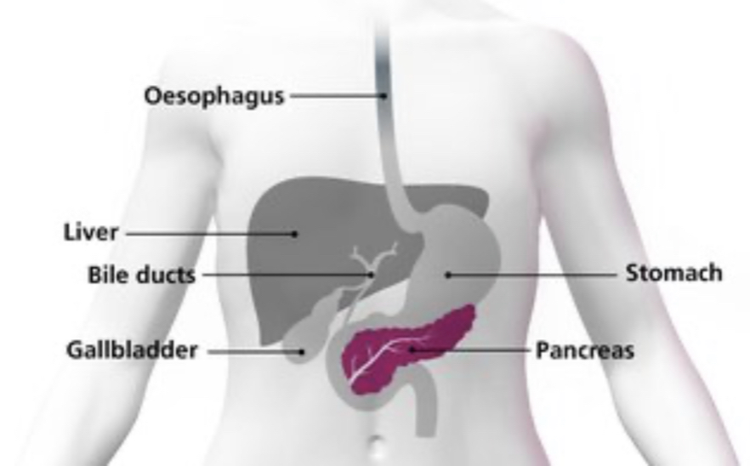
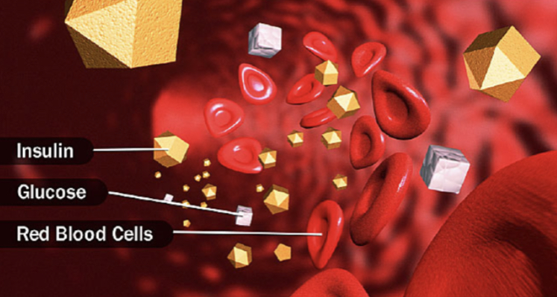
Diabetes definition
Diabetes: is a number of diseases that involve problems with the hormone insulin, which is secreted by the pancreas.

Slide 4
Types of diabetes
Diabetes(type_1) Diabetes(type_2) Gestational diabetes

Slide 5
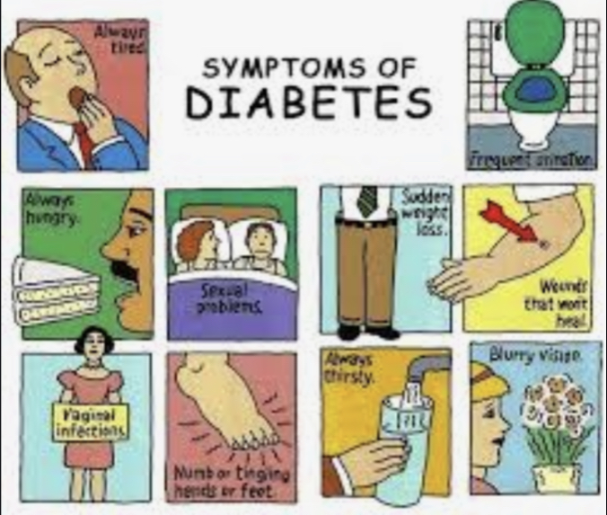
Signs and symptoms
Some signs and symptoms for type 1and2 of diabetes:
Increased thirst
Frequent urination
Unexplained weight loss
Fatigue
Blurred vision
Slow-healing sores
Frequent infections

Slide 6
Diabetes causes
Causes of type 1 diabetes
The exact cause of type 1 diabetes is unknown. The immune system attacks and destroys your insulin-producing cells in the pancreas. This leaves the body with little or no insulin.
Weight is not believed to be a factor in type 1 diabetes.

Slide 7
Diabetes causes
Causes of type 2 diabetes :
The cells become resistant to the action of insulin, and the pancreas is unable to make enough insulin to overcome this resistance.
The reason of that resistance is unknown.
Being overweight is strongly linked to the development of type 2 diabetes.

Slide 8
Diabetes causes
Causes of gestational diabetes:
During pregnancy, the placenta produces hormones to sustain the pregnancy. These hormones make your cells more resistant to insulin.
weight before pregnancy often plays a role.

Slide 9
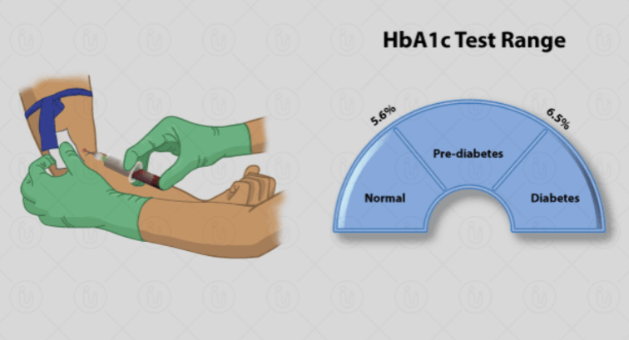
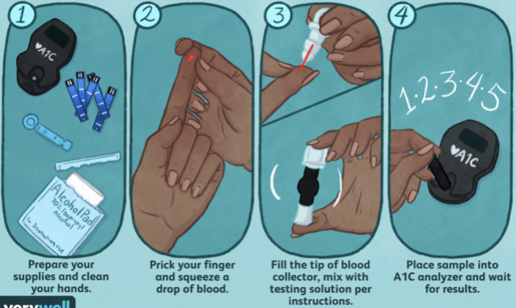
Diabetes diagnosis
Tests for type 1 and type 2 diabetes and prediabetes:
The essential test:
is Glycated hemoglobin (A1C) test
It doesn’t require fasting.
Indicates the average blood sugar level for the past two to three months.
It measures the percentage of blood sugar attached to hemoglobin.

Slide 10
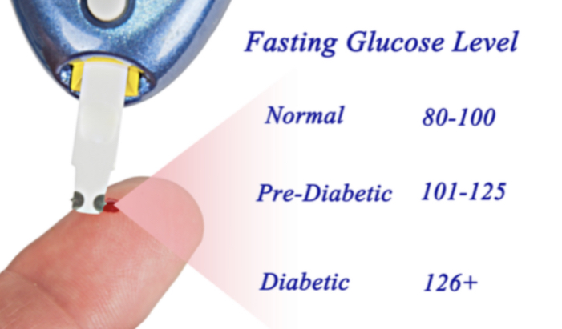
Diabetes diagnosis
Tests for type 1 and type 2 diabetes and prediabetes:
Another tests:
Random blood sugar test:
taken at a random time. Regardless of when you last ate, a blood sugar level of 200 (mg/dL)or higher suggests diabetes.
Fasting blood sugar test:
A blood sample will be taken after an overnight fast.

Slide 11
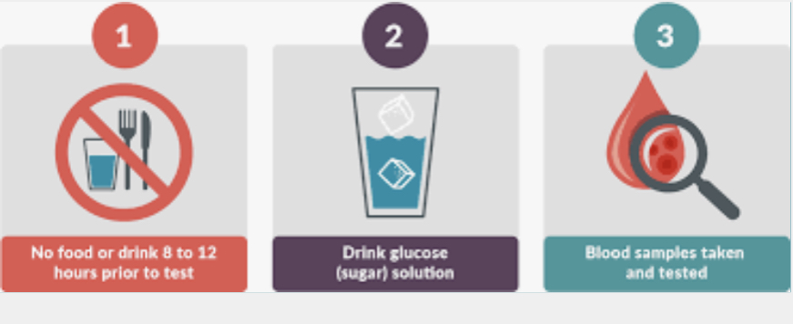
Diabetes diagnosis
Tests for type 1 and type 2 diabetes and prediabetes:
Another tests:
Oral glucose tolerance test:
For this test, you fast overnight, and the fasting blood sugar level is measured. Then you drink a sugary liquid, and blood sugar levels are tested periodically for the next two hours.

Slide 12
Diabetes diagnosis
Tests for gestational diabetes:
Initial glucose challenge test:
For this test the pregnant woman drinks a syrupy glucose solution. One hour later, she'll have a blood test. blood sugar level below 140 mg/dL considered normal. And if it was higher than normal that means that she has higher risk of gestational diabetes. And her doctor will order a follow-up test to determine if you have gestational diabetes.
Follow-up glucose tolerance testing:
If at least two of the blood sugar readings are higher than the normal. She'll be diagnosed with gestational diabetes.

Slide 13
Diabetes treatment
Generally for all types:
Healthy eating
By cutting down saturated fats, decreasing fat and calories, And focusing on fiber.
Physical activities
Exercises lowers blood sugar level by moving it into the cells, so it decreases the need of insulin in the body.

Slide 14
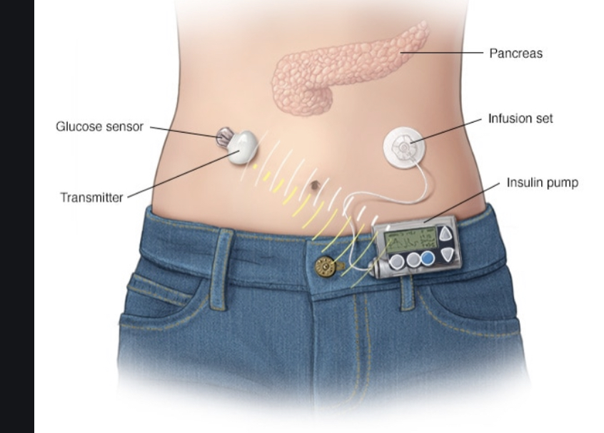
Diabetes treatment
Treatment for type1 and 2 of diabetes:
1)Monitoring blood sugar levels
*For type 1(4 times a day)and for type 2 less frequently
2)Insulin
*Incident cannot be taking orally to lower your blood sugar, because stomach enzymes interfere with insulin action.
*Often Insulin is injected using fine needle and syringe or an insulin pen.
*Artificial pancreas(closed_loop insulin delivery) for people with type 1.

Slide 15
Diabetes treatment
Treatment for type1 and 2 of diabetes:
3)Oral or other medication
*Metformin: The first medication prescribed for type two diabetes.
*SGLT2 inhibitors: Preventing the kidneys from reabsorbing sugar into the blood, so the sugar excreted in the urine.
4)Transplantation (for type 1)
*I didn’t always successful.
*With successful transplant the client wouldn’t longer need insulin therapy.

Slide 16
Diabetes treatment
Treatment for gestational diabetes:
Exercises
Healthy diet
Monitoring blood sugar level
Insulin or oral medications

Slide 17
Diabetes care plan
Risks
1)Cardiovascular diseases:
The cause: High blood sugar can damage blood vessels and nerves that control the heart (high blood sugar that increases the first of blood through the arteries and can damage artery walls).
Can lead to: Heart attack, stroke, atherosclerosis.

Slide 18
Diabetes care plan
Risks
2)Nerve damage (neuropathy):
The cause: excess sugar can injure the walls of tiny blood vessels that nourish the nerves.
Can lead to: *Lose all sense of feeling in affected limbs.
*Damage the nerve related to the digestion which cause a problem with nausea, vomiting, diarrhea or constipation.
*for men it may lead to erectile dysfunction.

Slide 19
diabetes care plan
Risks
3)Foot damage:
The cause: Nerve damage or low blood flow to the feet.
can lead to: If there is any cuts it can develop to infections(Which often heal poorly) this infections may require toe, foot, leg amputation.

Slide 20
diabetes care plan
Risks
4)Kidney damage (nephropathy):
The cause: excess sugar can damage blood vessels clusters that filtered waste from the blood in kidneys.
Can lead to: *Kidney failure.
*Kidney irreversible end, which required to kidney dialysis, or transplant.

Slide 21
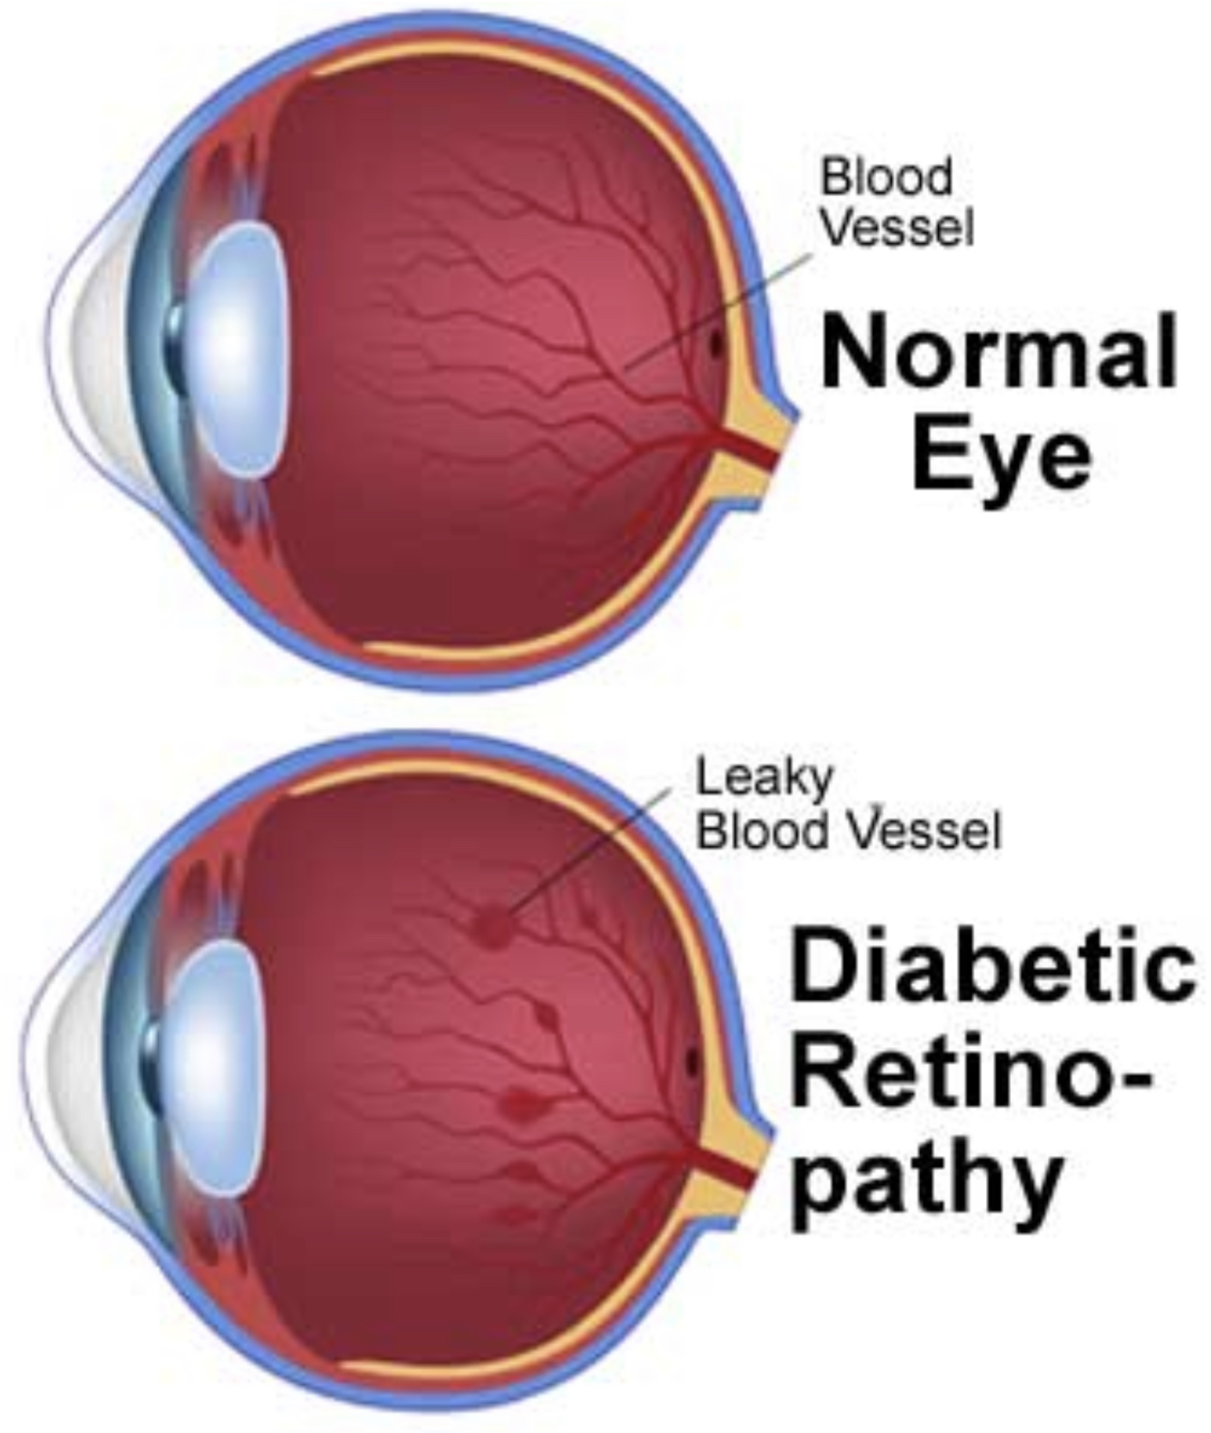
diabetes care plan
Risks
5)Eye damage (retinopathy):
The cause: damage the blood vessels of the retina.
Can lead to:
*Diabetic retinopathy, potentially leading to blindness.
*Cataracts, glaucoma.

Slide 22
Nursing interventions | Rationales
Assess for signs of hyperglycemia or hypoglycemia. | To determine the appropriate treatment in maintaining target blood glucose levels. Symptoms of Hyperglycemia: 3P’s (polyphagia, polyuria, and polydipsia), fatigue or blurred vision Hypogylcemia: dizziness, headache, fatigue, diaphoresis, and tachycardia
Monitor blood glucose levels. (Frequency of blood glucose checks depends on the treatment plan.) | To ensure that the blood glucose level is within target range.
Administer diabetic medication (oral and/or insulin therapy) as prescribed. | To keep the glucose levels within normal range, effectively controlling diabetes and reducing the risk for blood vessel damage, nerve damage, kidney injury, and other complications of diabetes.
Encourage the patient to adhere to his/her dietary plan. | Low fat, low calories, and high fiber foods are ideal for diabetic patients.
Encourage the patient to increase physical activity, particularly aerobic exercise. | Exercises lowers blood sugar level by moving it into the cells, so it decreases the need of insulin in the body.

Slide 23
references
Mayo Clinic
Webmed
Health line
Nurse study

