Slide 1
Exp #1
Introduction to Android Programming
SLIDES BY: Tarek Zidan and Mohamad Balawi

Slide 2
Welcome to
ADVANCED COMPUTER SYSTEMS ENGINEERING LABORATORY ENCS5150

Slide 3
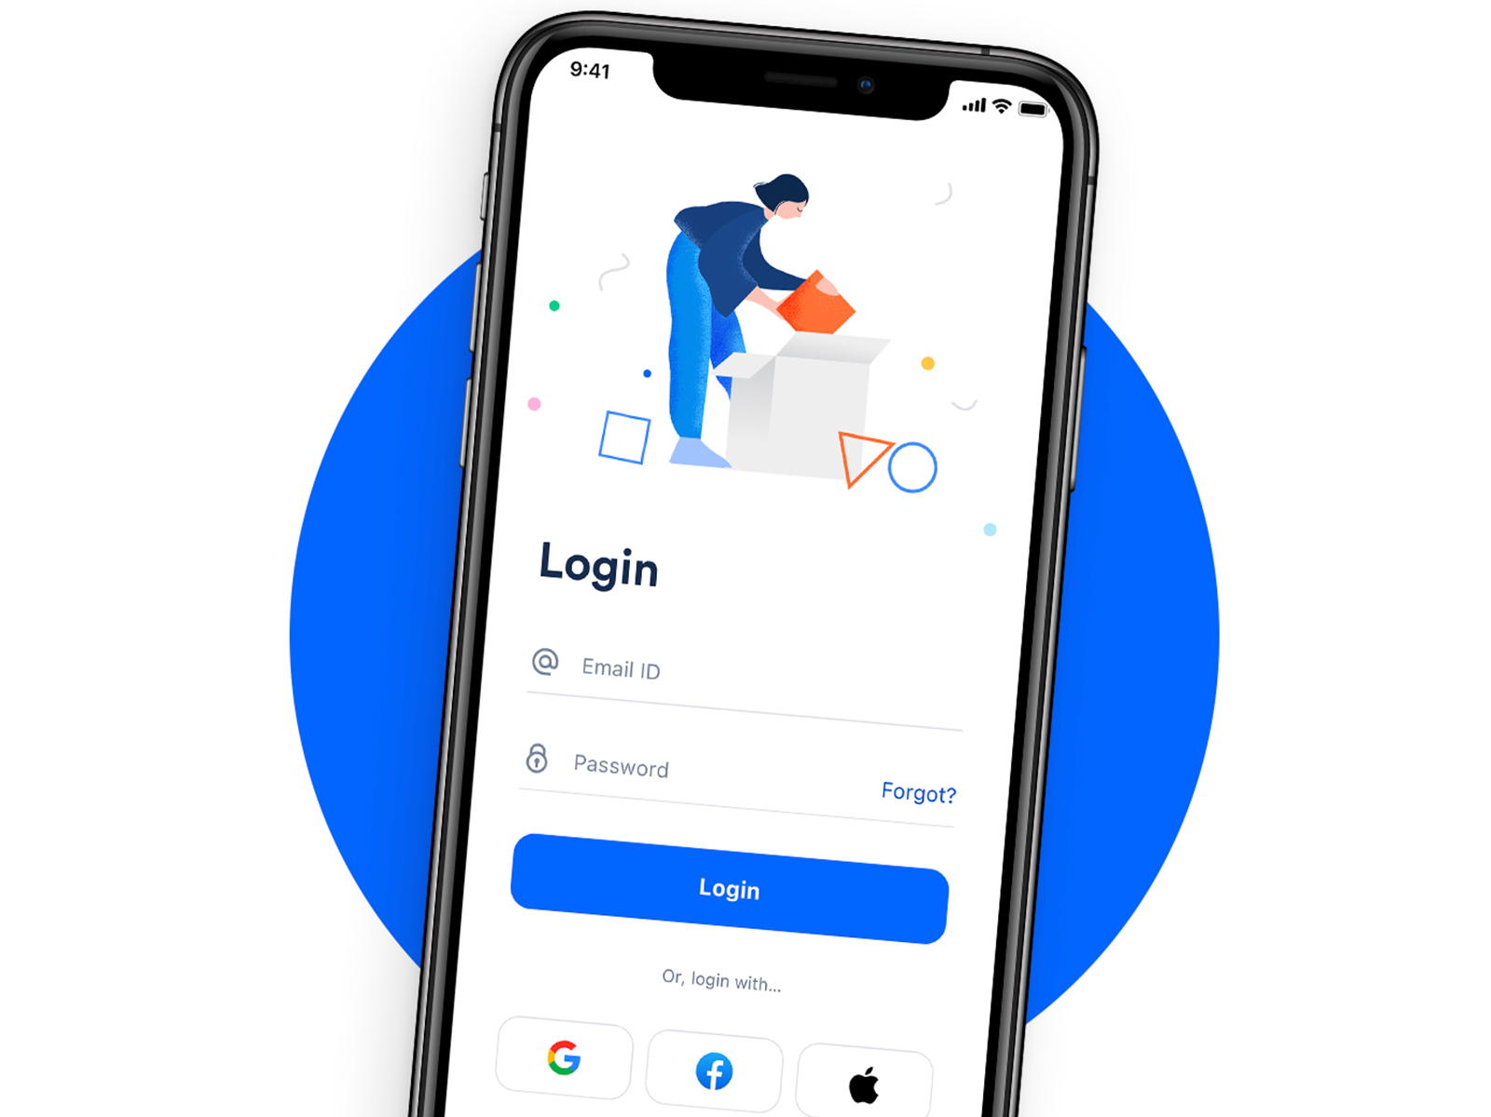
Android Components
Android has 4 main component types:
1. Activity
  Represents a single screen with a user interface.
  (Example: a login screen).

Slide 4


2. Service
  Runs in the background to perform long-running operations or to handle network transactions.
  (Example: playing music in background.)
  (Example: downloading files while the app is in the background.)

Slide 5
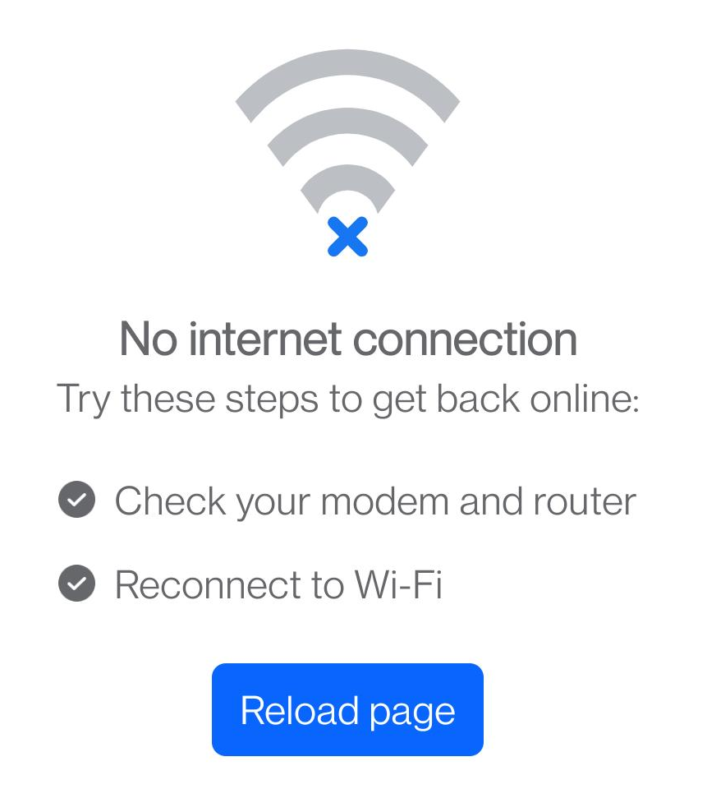
3. Broadcast Receiver
  Listens for system-wide broadcast announcements, such as notifications or device state changes.
  (Example: Detecting network issue.)

Slide 6

4. Content Provider
  Presents data to external applications as one or more tables that are similar to the tables found in a relational database.
  (Example: A maps application can provide access to location data, to be used by other applications, for example, a delivery application).

Slide 7
Android Manifest file
The Android Manifest file (AndroidManifest.xml) is a crucial component of any Android application. It provides essential information about the app to the Android system, which the system must have before it can run any of the app's code.
It contains:
  Package Name: The unique identifier for the application, defined by the package attribute.
  Components: Declares the components (Activities, Services ...).
  Permissions: e.g. Internet Usage permission, access to local files.
  Application Icon.
  And much more.

Slide 8
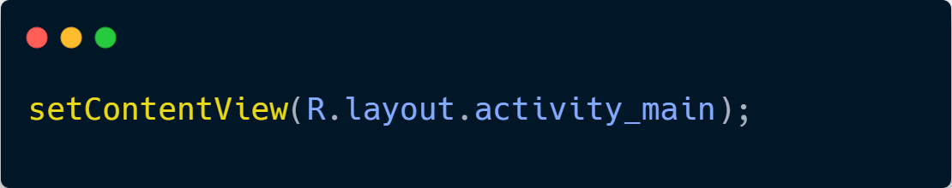
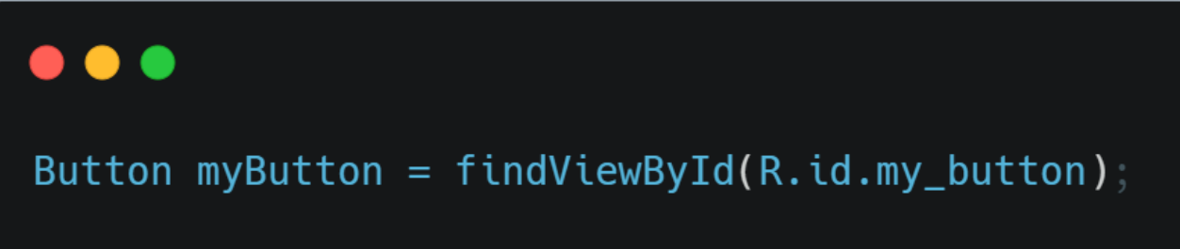
R.java class
The R.java file, often called the R class, is an auto-generated class containing references to all
Resources (such as layouts, strings, images, and IDs) used within an Android application.
The R class is dynamically linked to res folder which contains the resources.
In this experiment, you will notice the following line in your Java code:

Slide 9
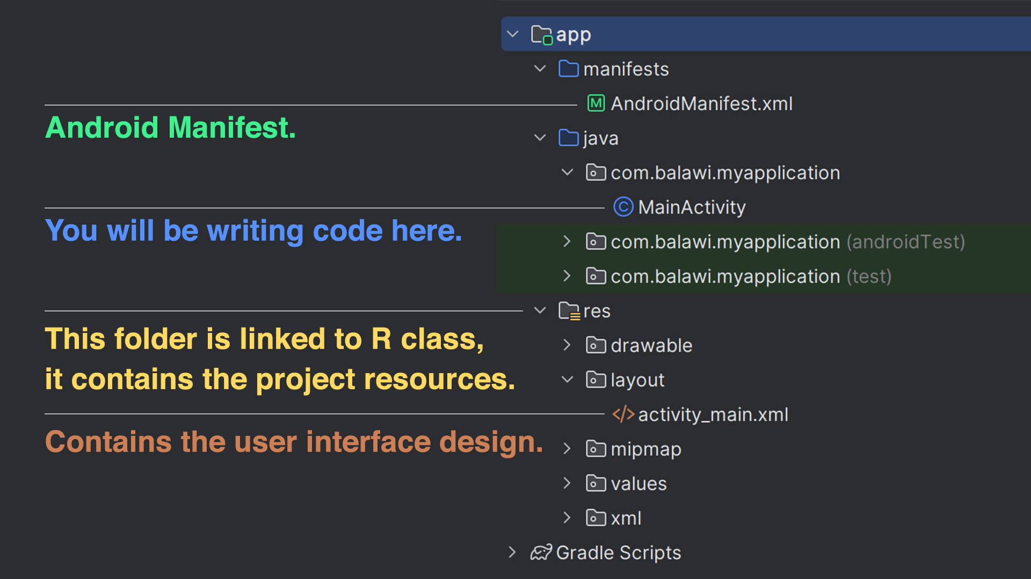

Slide 10
Lab Conventions (Compulsory)
The following is a list of conventions that must be followed when using Android Studio.
Failure to comply may result in grade deductions, and your to-dos may not be graded.
If you are not sure what are these or where to choose them, please ask the TA.
1. Device
Pixel 3a XL device with API Level 26 (Graphic=Software).
2. Minimum SDK
API Level 26.

