Slide 1
How to read X-Ray

Slide 2
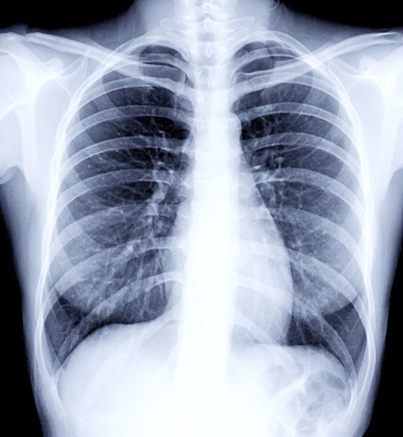

Slide 3
Chest X-ray
what do we have to do with the chest X-ray?
What are the landmarks that we have to consider when analyzing chest X-ray?
What are the ABCDEF of the chest X-ray?

Slide 4
A: Air way
Ensure trachea is visible and in midline
Trachea gets pushed away from abnormality, eg pleural effusion or tension pneumothorax
Trachea gets pulled towards abnormality, eg atelectasis
Trachea normally narrows at the vocal cords
If an endotracheal tube is in place, check the positioning, the distal tip of the tube should be 3-4cm above the carina

Slide 6
B: Bones
Check the vertebral bodies and the sternum for fractures or other osteolytic changes
check the clavicles and shoulders

Slide 8
C: Cardiac
Look at the heart and vessels (systemic and pulmonary).
check the cardiac position
is 1/3 to the right and 2/3 to the left?

Slide 10
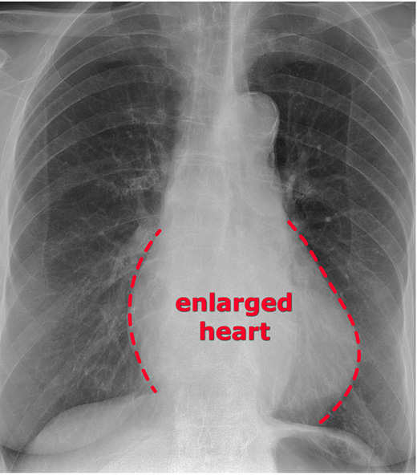

Slide 11
D: Diaphragm
The normal diaphragm appears as a dome-shaped structure separating the thoracic and abdominal cavities
The right hemidiaphragm is slightly higher than the left.
The liver is located inferior to the right hemidiaphragm.
The stomach and spleen are located inferior to the left hemidiaphragm.

Slide 13
E: Equal lung fields

Slide 14
F: Foreign bodies

Slide 15
Abnormal findings in chest X-Ray

Slide 16
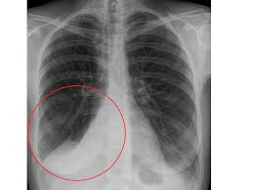
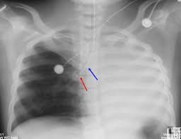
Atelectasis
obstruction of air flow lead to collapsed of alveoli or an entire lung

Slide 17
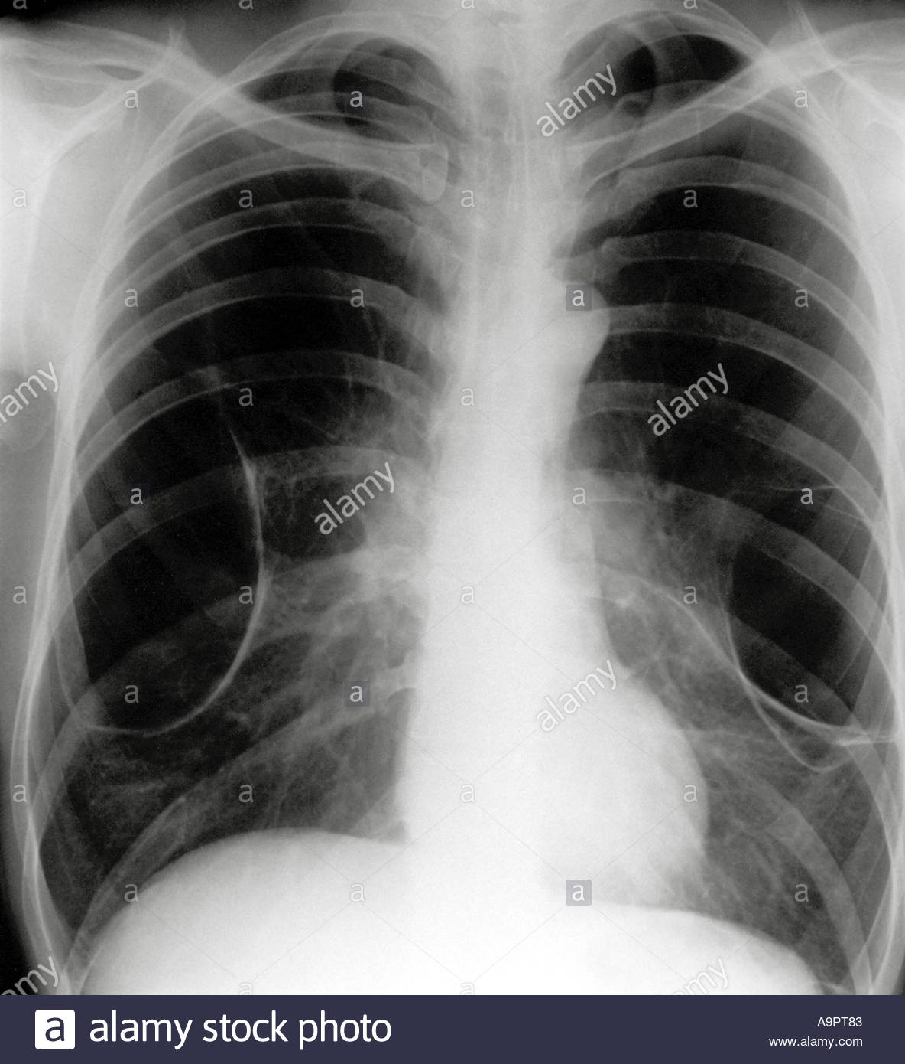
Emphysema
chronic inflammation of the lungs leads to destruction of alveoli and decreased elasticity of the lungs ,hyperinflated lungs

Slide 18
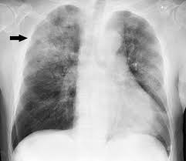
Pneumonia
is an infection that inflames the air sacs in one or both lungs. The air sacs may fill with fluid or pus (purulent material)

Slide 19
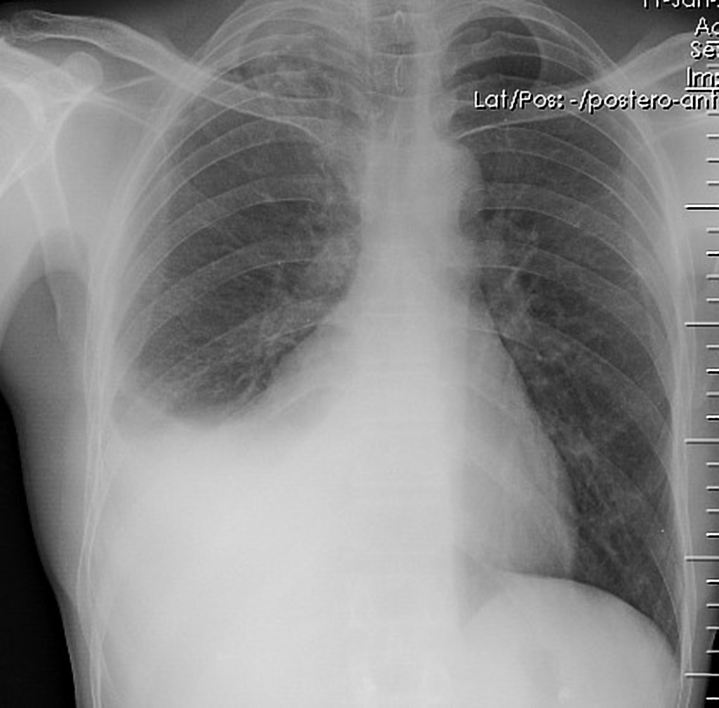
Pleural effusion
sometimes referred to as “water on the lungs,” is the build-up of excess fluid between the layers of the pleura outside the lungs

Slide 20
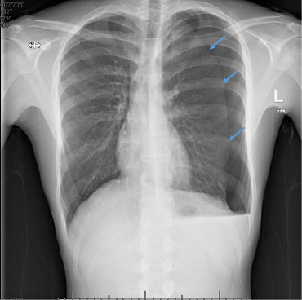
Pneumothorax
a condition in which air moves into the plural space and cause collapse of lung

Slide 21
