Slide 1
Vitamin K
NUTD 334

Slide 2
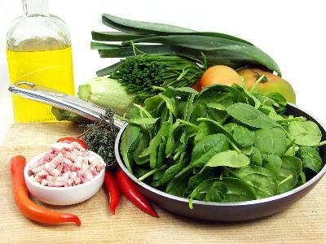
Sources
Green leafy vegetables
Soya bean oil
Eggs
Meats
Dairy products
Gut bacteria

Slide 3
Vitamin K
Two groups
  Phylloquinone (K1)
    Plant based
  Menaquinone (K2) (source?
    Animal based
  What is menadione (K3)?
    Supplement based
Stable in heat processing (canning), sterilization, unstable in light

Slide 4
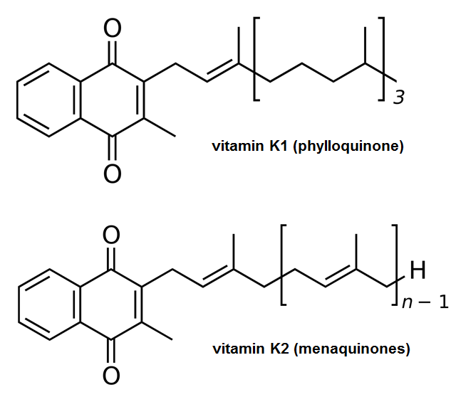
structure

Slide 5
Needs
0-6 months 2 mcg/day
7-12 month 2.5 mcg/day
1-3 years 30 mcg/day
4-8 years 55 mcg/day
9-13 years60 mcg/day 14-18 years 75
19-50 years 120 mcg/day (males) 90 mcg/day females
51+ years120 mcg/day males, 80 mcg/day (females)
Pregnant and lactating 90 mcg/day

Slide 6
Absorption
Absorbed in jejenum + ileum
  Delivered to the liver incorporated in chylomircons
  Associated with LDL, HDL, and VLDL (mainly)
  Catabolized Vit K in the liver is excreted via bile (some in urine)
    Oxidative degradation of the phytl side chain
Function
  Cofactor for dependent carboxylases increasing affinity to calcisum and sometimes phosphorus

Slide 7
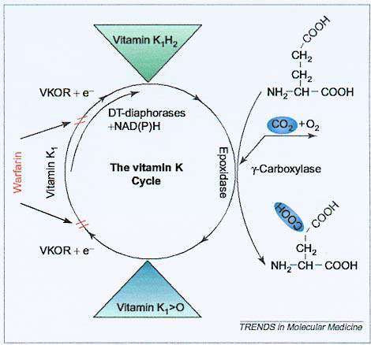
The vitamin K cycle
Figure 1. The vitamin K-dependent γ-carboxylation system. The γ-carboxylase converts vitamin K-dependent proteins to γ-carboxyglutamic acid (Gla) containing proteins by adding CO2 to glutamic acid (Glu) residues in newly synthesized proteins. The γ-carboxylase requires reduced vitamin K1 (vitamin K1H2) as a cofactor for this post-translational modification reaction.Concomitant with γ-carboxylation, vitamin K1H2 is converted to vitamin K1 2,3-epoxide (vitamin K1>O). The epoxide is reduced by the warfarin-sensitive enzyme vitamin K1 2,3-epoxide reductase
(VKOR) to the vitamin K1H2 cofactor. This cyclic interconversion of vitamin K metabolites constitutes the vitamin K cycle. At high tissue concentrations, vitamin K1 quinone (vitamin K1) can be reduced to vitamin K1H2 by the alternative pathway of the cycle. This pathway is catalyzed by NAD(P)H dehydrogenases (DTdiaphorases), which are not inhibited by warfarin.
Wallin R and Hutson SM. Trends Mol Med. 2004;10(7):299-302.

Slide 8
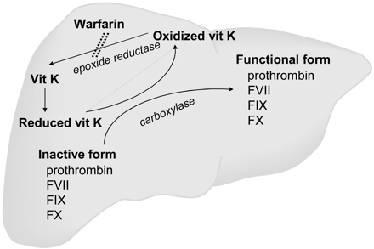
Main functions
Source: http://crashingpatient.com/medical-surgical/neurology/reversal-of-anticoagulation-antiplatelet.htm/

Slide 9
Main functions
Vitamin K-dependent bone proteins.
  Osteocalcin
    Most abundant noncollagenous bone proteins and synthesized in osteoblasts and odontoblast. The synthesis of osteocalcin is regulated by the active form of vitamin D (calcitriol).
    Osteocalcin contains three Gla residues that give this protein a high affinity for hydroxyapatite.
    A role for hydroxyaptite has as yet to be discovered, but it is thought to be related to bone mineralization.

Slide 10
Vitamin K
Deficiency
  Infants
    Injection at birth with Vitamin K
  Adults
    Warfarin block Vitamin K recycling in the liver
    Warfarin action can also be inhibited by vitamin K consumption
Toxicity
  Rare

