Slide 1

Exp3-Presentation
Newton's Law Of Motion
Mr.Nihad Abu Awwad
Students:
Abdallah Zatare-1151769
Ibrahim Bani Owda-1180539
Hamza AlHasan-1181636
Date:27/11/2019

Slide 2
Contents
The aim of the experiment
The method used: Air track
Part I: Theory, Procedure and Data
Part II-A: Theory, Procedure, Data and Graph
Part II-B: Theory, Procedure, Data and Graph
Conclusion

Slide 3
The aim of the experiment
To verify the Newton’s first and second laws of motion.
Newton’s first law of motion: Every object continues in its state of rest, or of uniform velocity in a straight line, as long as no net force acts on it.
Newton’s second law of motion: The acceleration of an object is directly proportional to the net force acting on it, and its inversely proportional to its mass. The direction of the acceleration is in the direction of the net force acting on the object(F=ma) .[1]
---------------------------------------------------------------
[1]Physics: Principles With Applications-page 74

Slide 4
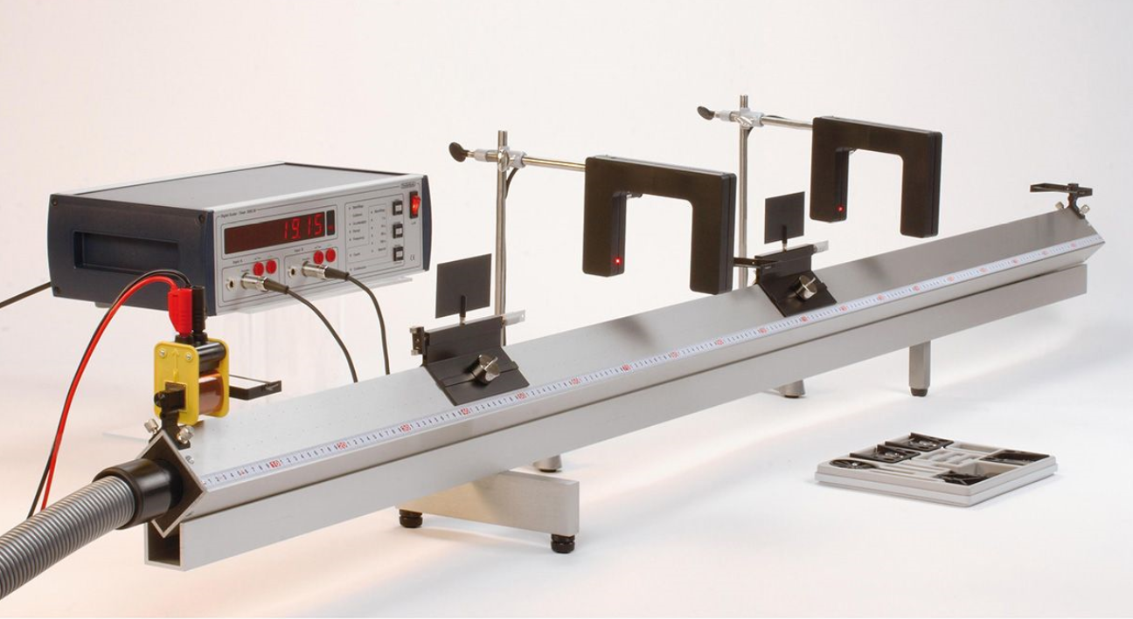
Air Track
Photocell
Device to measure the time
Mass M’
Cart(mass M)
Track
Air Blower

Slide 5
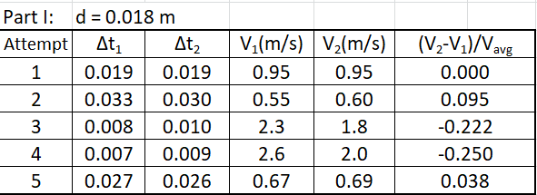
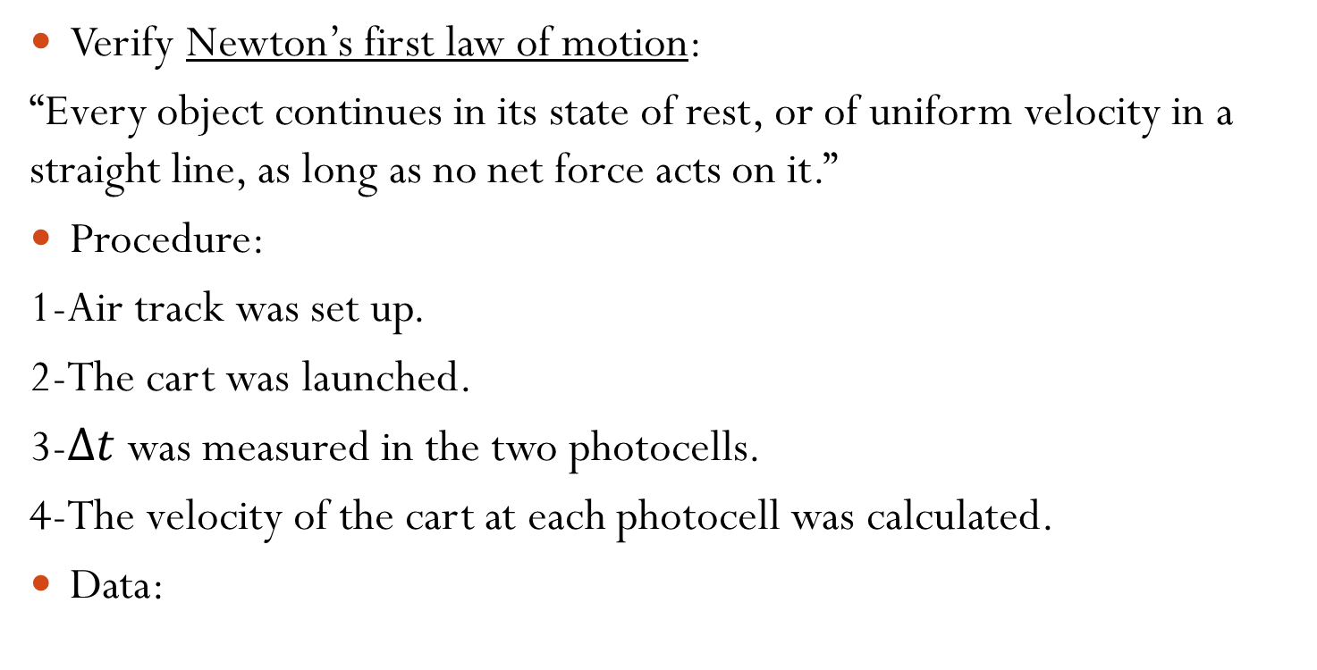
Part I
Verify Newton’s first law of motion:
“Every object continues in its state of rest, or of uniform velocity in a straight line, as long as no net force acts on it.”
Procedure:
1-Air track was set up.
2-The cart was launched.
3-$Δt$was measured in the two photocells.
4-The velocity of the cart at each photocell was calculated.
Data:

Slide 6
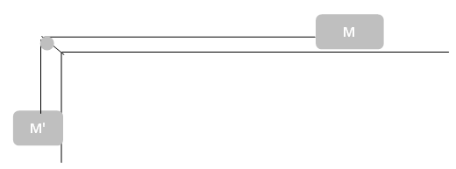

Part II
Verify Newton’s second law of motion:
The cart was experienced a constant force, and hence, a constant acceleration as following:
F = ma
M'g = (M+M')a
$$a=\frac{M^{′}g}{M+M′}$$

Slide 7

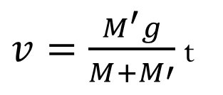

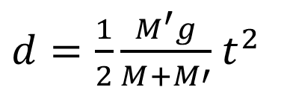
And we know that: $v_{f}=v_{i}+at$
we assume $v_{i}$ to be zero
➔
by integrating the both side with respect to t :
➔
Where d is the distance between the cart and the first photocell.
$v=\frac{M^{′}g}{M+M′}$ t
$d=\frac{1}{2}\frac{M^{′}g}{M+M′}$ $t^{2}$
d

Slide 8
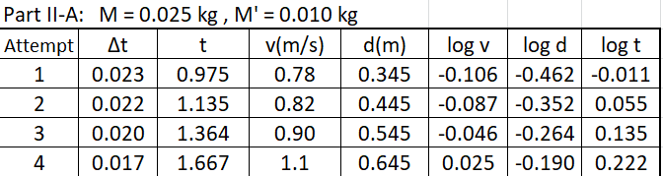
Part II-A: Fixed M, M’, variable d
Procedure:
1-One timer was set up to measure t and the other to measure Δt.
2-Some mass (M’) was hanged with the cart(M).
3-The position of the first photocell(d) has been changed five times.
4-t and Δt were obtained of each time (d) is changed.
Data

Slide 9
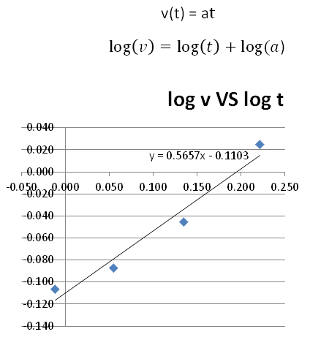
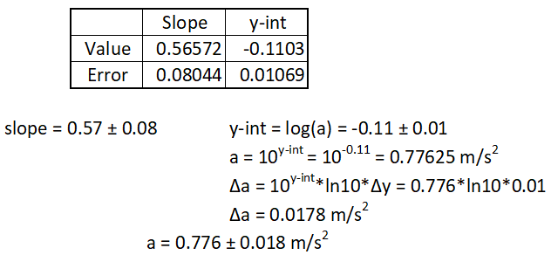
Graph 1:

Slide 10
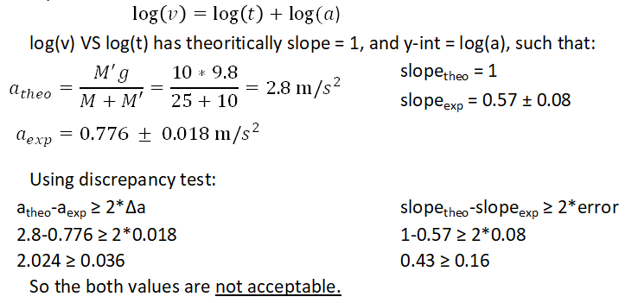
Analysis-graph 1:

Slide 11
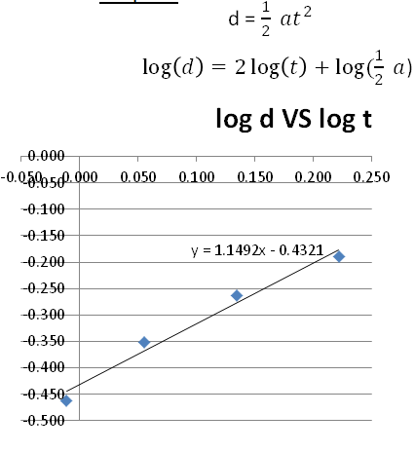
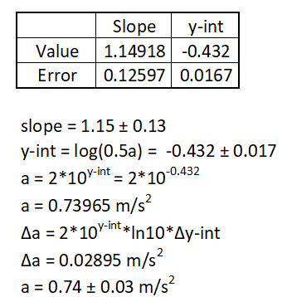
Graph 2:

Slide 12
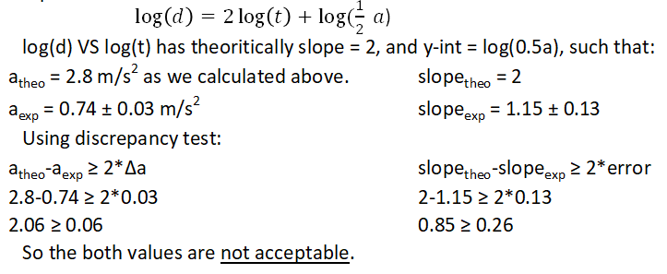
Analysis-graph 2:

Slide 13
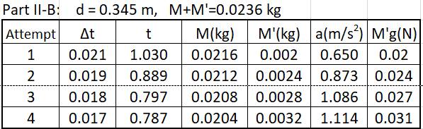
Part II-B: Fixed (M+M’), variable M and M’
Procedure:
By keeping (d) constant, t and Δt were obtained of each time (M) is decreased and (M’) is increased.
Data:

Slide 14
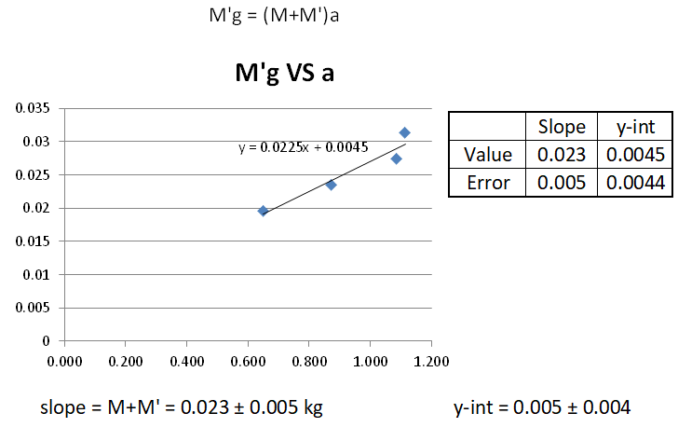
Graph

Slide 15
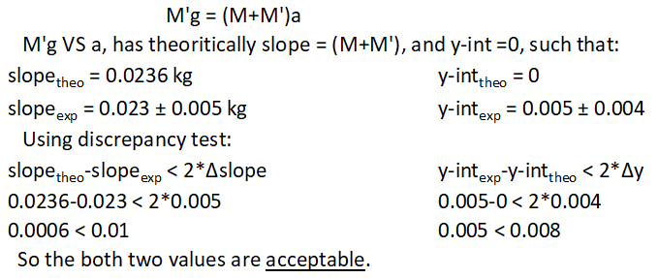
Analysis

Slide 16
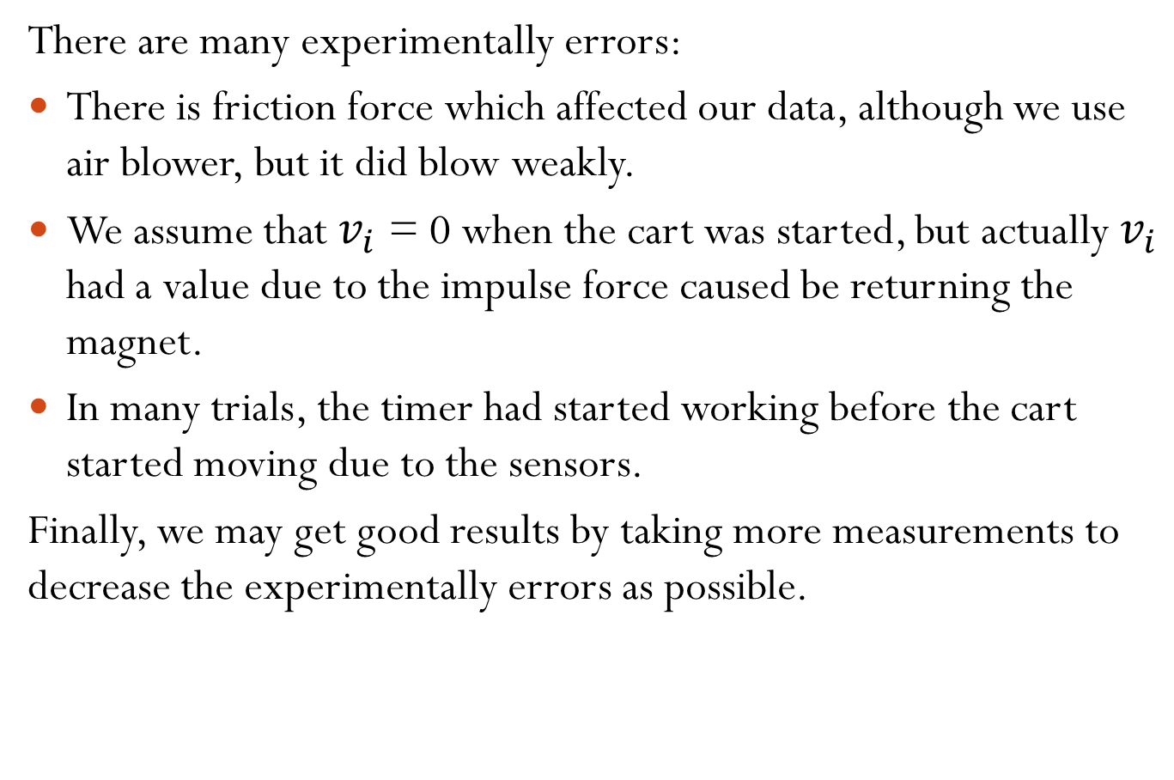
Conclusion
There are many experimentally errors:
There is friction force which affected our data, although we use air blower, but it did blow weakly.
We assume that $v_{i}$ = 0 when the cart was started, but actually $v_{i}$ had a value due to the impulse force caused be returning the magnet.
In many trials, the timer had started working before the cart started moving due to the sensors.
Finally, we may get good results by taking more measurements to decrease the experimentally errors as possible.

