Slide 1
Chapter Eight
DC Motors
aabdo@birzeit.edu Electrical Machine & Power Electronics ENEE 4301

Slide 2
Introduction
Why were dc motors so common, when dc power systems themselves were fairly rare?
DC power systems are still common in cars, trucks, and aircraft. When a vehicle has a dc power system, it makes sense to consider using dc motors.
Another application for dc motors was a situation in which wide variations in speed are needed. Before the widespread use of power electronic rectifier-inverters, dc motors were unexcelled in speed control applications. Even if no dc power source were available, solid-state rectifier and chopper circuits were used to create the necessary dc power, and dc motors were used to provide the desired speed control
Today, induction motors with solid-state drive packages are the preferred choice over dc motors for most speed control applications. However, there are still some applications where dc motors are preferred.
aabdo@birzeit.edu DC Motors

Slide 3
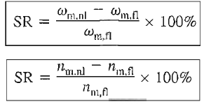
Introduction
DC motors are often compared by their speed regulations. The speed regulation (SR) of a motor is defined by
It is a rough measure of the shape of a motor's torque- speed characteristic:
A positive speed regulation means that a motor's speed drops with increasing load, and
A negative speed regulation means a motor's speed increases with increasing load.
The magnitude- of the speed regulation tells approximately how steep the slope of the torque-speed curve is.
aabdo@birzeit.edu DC Motors

Slide 4
Introduction
There are five major types of dc motors in general use:
1) The separately excited dc motor
2) The shunt dc motor
3) The permanent-magnet dc motor
4) The series dc motor
5) The compounded dc motor
aabdo@birzeit.edu DC Motors

Slide 5
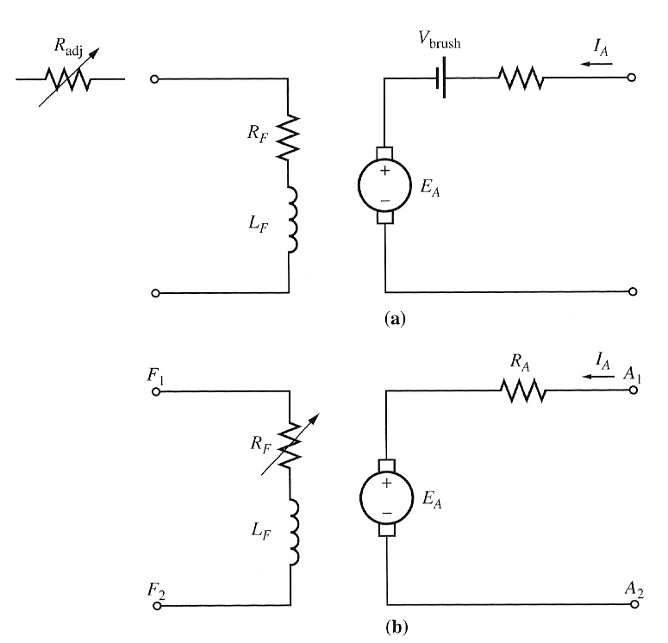
The Equivalent Circuit of a DC Motor
the simplified equivalent circuit of a dc motor:
aabdo@birzeit.edu DC Motors

Slide 6
The Equivalent Circuit of a DC Motor
The internal generated voltage is given by:
E_{A} = Kφω
and the torque induced is
τ_{ind} = KφI_{A}
The tools necessary to analyse the behaviour and performance of a dc motor are:
Equations for E_{A} and τ_{ind}
Kirchoff’s voltage law (KVL) equation of the armature circuit
3) The machine’s magnetisation curve
aabdo@birzeit.edu DC Motors

Slide 7
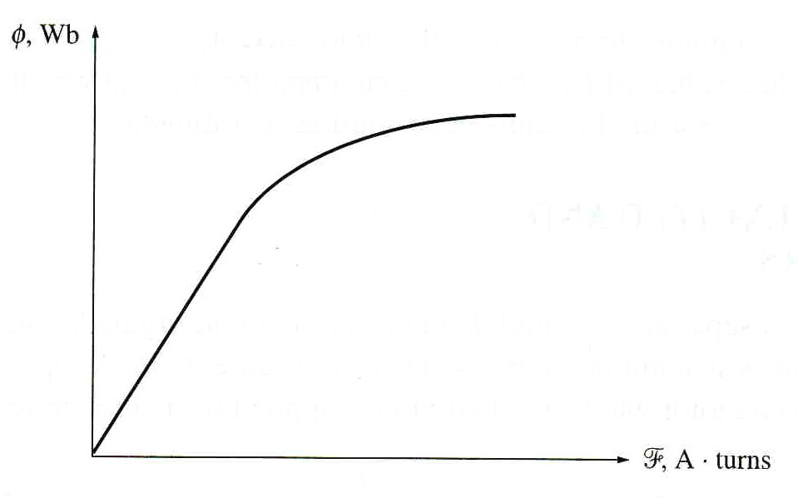
The Magnetisation Curve of a DC Machine
E_{A} is directly proportional to the flux in the machine and the speed of rotation of the machine.
How is the internal generated voltage related to the field current in the machine?
The field current I_{F} produces a field magnetomotive force (mmf) given by
F = N_{F}I_{F}
This mmf produces a flux in the machine in accordance with its magnetisation curve shown below.
The magnetization curve of a ferromagnetic material (φ vs. F)
aabdo@birzeit.edu DC Motors

Slide 8
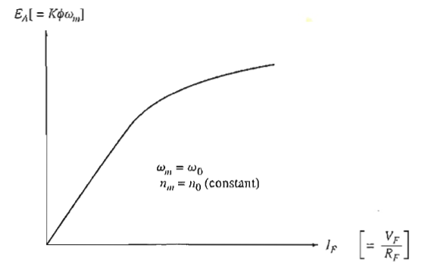
The Magnetisation Curve of a DC Machine
Note: Most machines are designed to operate near the saturation point on the magnetisation curve (at the knee of the curve).
This implies that a fairly large increase in field current is often necessary to get a small increase in E_{A} when operation is near full load.
aabdo@birzeit.edu DC Motors

Slide 9
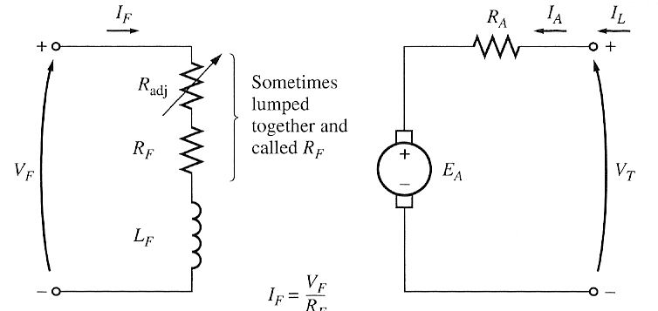
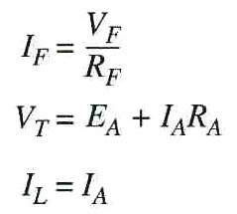
Separately Excited and Shunt DC Motors
A separately excited dc motor is a motor whose field circuit is supplied from a separate constant-voltage power supply.
The equivalent circuit of a separately excited dc motor.
aabdo@birzeit.edu DC Motors

Slide 10
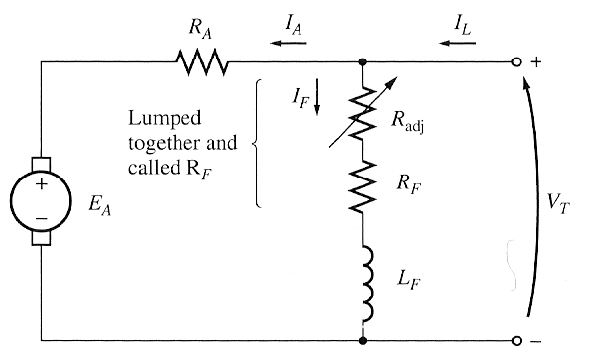
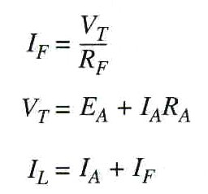
Separately Excited and Shunt DC Motors
While a shunt dc motor is a motor whose field circuit gets its power directly across the armature terminals of the motor
The equivalent circuit of a shunt dc motor.
aabdo@birzeit.edu DC Motors

Slide 11
The Terminal Characteristic of a Shunt DC Motor
aabdo@birzeit.edu DC Motors

Slide 12
The Terminal Characteristic of a Shunt DC Motor
aabdo@birzeit.edu DC Motors

Slide 13
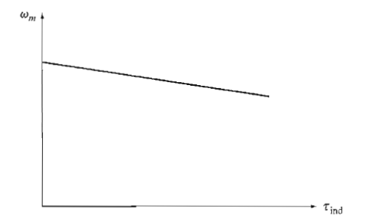
The Terminal Characteristic of a Shunt DC Motor
Torque-speed characteristic of a shunt or separately excited dc motor with compensating windings to eliminate armature reaction.
aabdo@birzeit.edu DC Motors

Slide 14
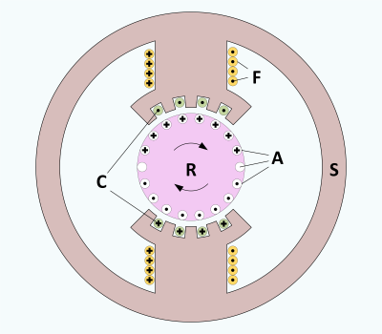
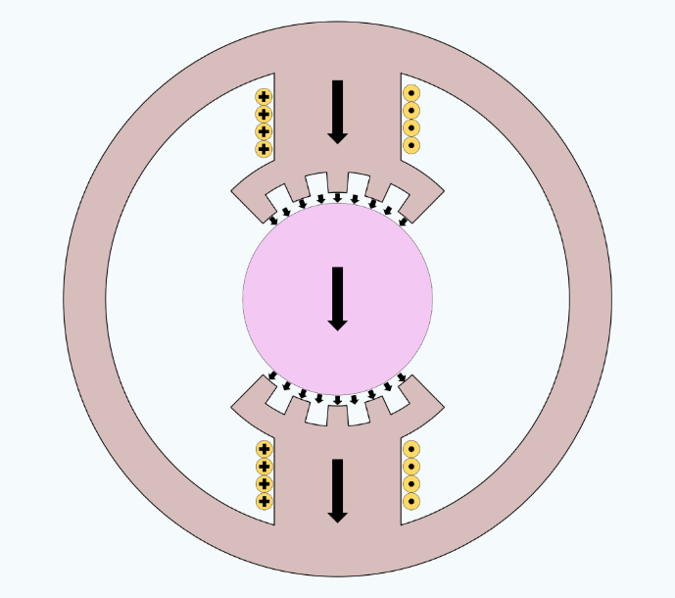
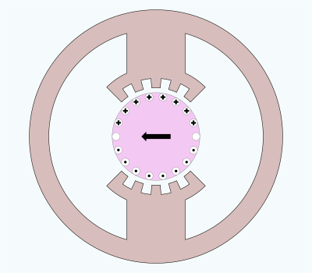
The Terminal Characteristic of a Shunt DC Motor
If a motor has compensating windings, there will be no flux weakening problems and the flux in the motor will be constant.
If a shunt dc motor has compensating windings so that flux is constant regardless of load, and the motor’s speed and armature current are known at any one value of load, then it is possible to calculate its speed at any other value of load, as long as the armature current at that load is known or can be determined.
aabdo@birzeit.edu DC Motors

Slide 15
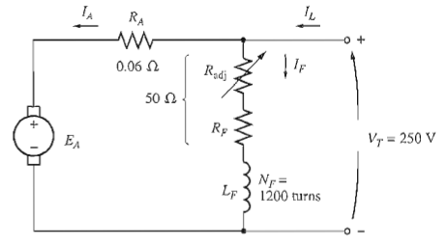
Example 8-1
A 50HP, 250V, 1200 r/min DC shunt motor with compensating windings has an armature resistance (including the brushes, compensating windings, and interpoles) of 0.06 Ω. Its field circuit has a total resistance R_{adj} + R_{F} of 50 Ω, which produces a no-load speed of 1200r/min. There are 1200 turns per pole on the shunt field winding (Figure below)
(a) Find the speed of this motor when its input current is 100A.
(b) Find the speed of this motor when its input current is 200A.
(c) Find the speed of this motor when its input current is 300A.
aabdo@birzeit.edu DC Motors

Slide 16
Speed Control of Shunt DC Motors
Adjusting the field resistance R_{F}
Adjusting the terminal voltage applied to the armature
Inserting a resistance in series with the armature circuit - less common method.
aabdo@birzeit.edu DC Motors

Slide 17
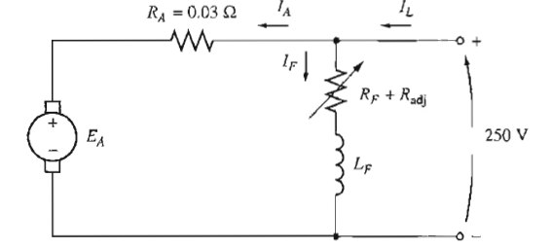
Example 8-3
The following figure shows a 100-hp, 250-V, 1200 rpm shunt de motor with an armature resistance of 0.03 Ω and a field resistance of 41.67 Ω. The motor has compensating windings, so armature reaction can be ignored. Mechanical and core losses may be assumed to be negligible for the purposes of this problem. The motor is assumed to be driving a load with a line current of 126 A and an initial speed of 1103 rpm . To simplify the problem, assume that the amount of armature current drawn by the motor remains constant.
If the machine's magnetization curve is shown in Figure 8- 9, what is the motor's
speed if the field resistance is raised to 50Ω?
2. Calculate and plot the speed of this motor as a function of the field resistance Rf assuming a constant-current load.
Solve it by your Self
aabdo@birzeit.edu DC Motors

Slide 18
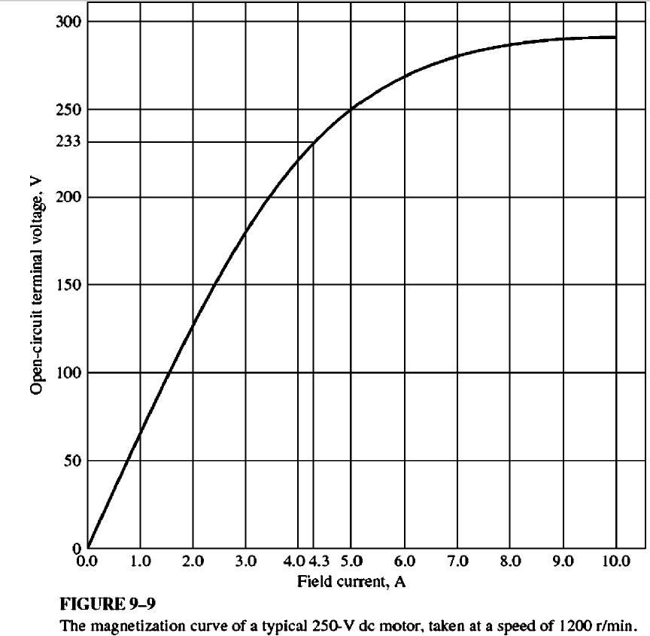
Example 8-3
aabdo@birzeit.edu DC Motors

Slide 19
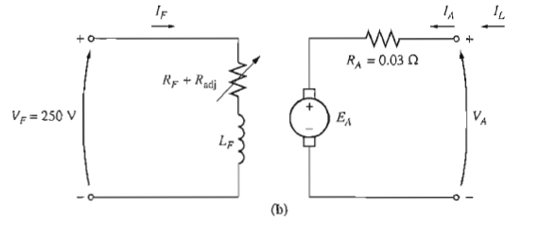
Example 8-4
The motor in Example 8- 3 is now connected separately excited, as shown in Figure 8-17b. The motor is initially running with VA = 250 V, IA = 120 A, and n = 1103 r/min, while supplying a constant-torque load. What will the speed of this motor be if VA is reduced to 200 V?
Solve it by your Self
aabdo@birzeit.edu DC Motors

Slide 20
The Effect of an Open Field Circuit
As R_{F} is increased, the motor speed increases.
What happens if the field circuit were actually opened while the motor is running?
The flux in the machine would drop drastically (i.e. all the way down to φ_{res}).
Hence, E_{A} (= Kφω) also drops.
This causes really enormous increase in I_{A}.
Since t_{ind} ∝ I_{A}, the induced torque would be quite a bit higher than load torque in the motor.
Therefore, motor’s speed rises and keeps going up.
Therefore, in a shunt dc motor operating with light fields, armature reaction can be severe such that increase in loads can weaken its flux enough to cause motor’s speed to rise.
However, most loads have torque-speed curves whose torque increases with speed.
aabdo@birzeit.edu DC Motors

Slide 21
Runaway of DC Motors
aabdo@birzeit.edu DC Motors

Slide 22
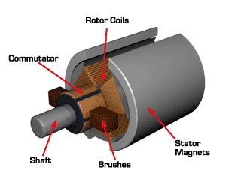
The Permanent Magnet DC Motor (PMDC)
PMDC is a dc motor whose poles are made of permanent magnets.
Advantage (compared to shunt dc motor):
1) No external field circuit is required, no field circuit copper losses
2) Smaller than shunt dc motors – because of no field circuit
Disadvantages:
1) Cannot produce high flux density as an externally supplied shunt dc motor – lower induced torque per ampere of armature current compared to a shunt motor of same size.
aabdo@birzeit.edu DC Motors

Slide 23
The Permanent Magnet DC Motor (PMDC)
2) Runs the risk of demagnetisation due to armature reaction or excessive heating during prolonged periods of overload.
The PMDC is basically the same machine as a shunt dc motor except the flux in the PMDC motor is fixed.
Speed control through varying the field current or flux is not possible.
Hence, speed control methods for PMDC motors are:
Armature voltage control
Armature resistance control
aabdo@birzeit.edu DC Motors

Slide 24
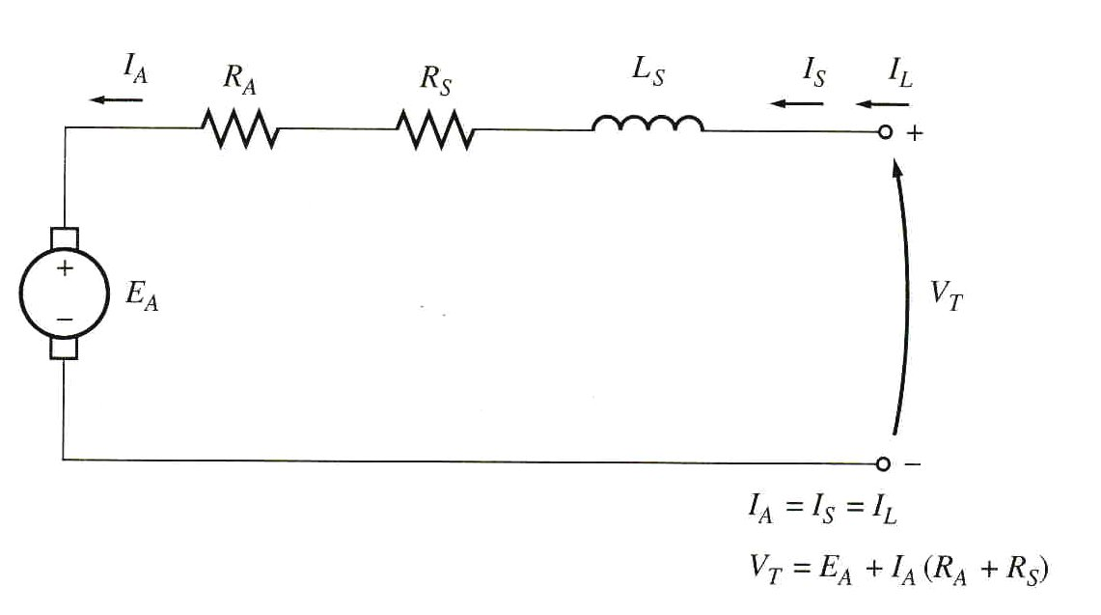
The Series DC Motor
A series dc motor contains field windings of relatively few turns connected in series with the armature circuit.
The equivalent circuit:
aabdo@birzeit.edu DC Motors

Slide 25
The Series DC Motor
aabdo@birzeit.edu DC Motors

Slide 26
Induced Torque in a Series DC Motor
aabdo@birzeit.edu DC Motors

Slide 27
Induced Torque in a Series DC Motor
aabdo@birzeit.edu DC Motors

Slide 28
The Terminal Characteristic of a Series DC Motor
aabdo@birzeit.edu DC Motors

Slide 29
The Terminal Characteristic of a Series DC Motor
aabdo@birzeit.edu DC Motors

Slide 30
Speed Control of Series DC Motors
aabdo@birzeit.edu DC Motors

Slide 31
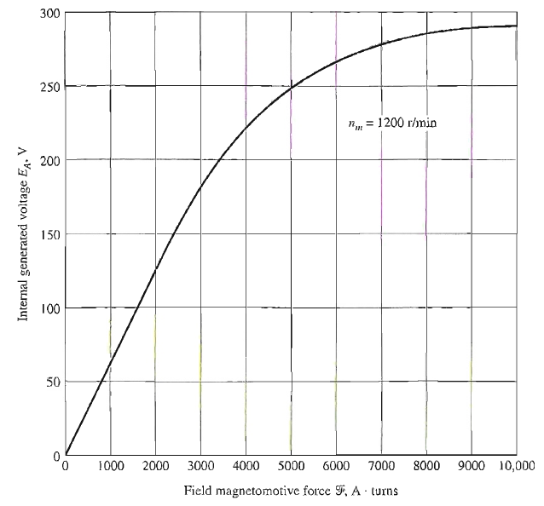
Example 8-5
A series dc motor with V_{T}=250V , total R_{A}+R_{s}=0.08 ohm , field circuit consists of 25 turns per pole. Magnetizing curve is given in Fig. 8-22
a) Find the speed and induced torque of this motor for when the armature current is 50A
aabdo@birzeit.edu DC Motors

Slide 32
Example 8-5
aabdo@birzeit.edu DC Motors

Slide 33
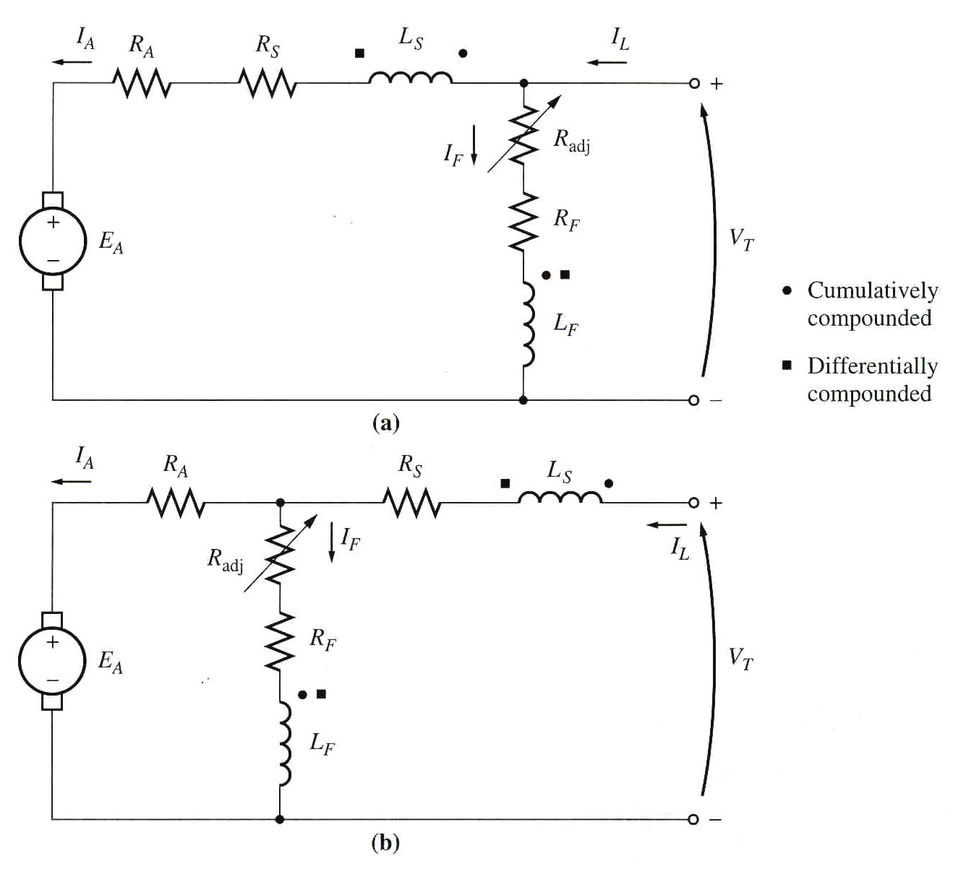
The Compounded DC Motor
A compounded dc motor is a motor with both a shunt and a series field. The equivalent circuit of the compounded motor is shown below:
Current flowing into a dot produced positive mmf.
aabdo@birzeit.edu DC Motors

Slide 34
The Compounded DC Motor
Cumulative compounding – current flows into dots on both field coils. Hence, resulting mmfs add to give a larger total mmf.
Differential compounding – current flows into dot on one field coil and out of the dot on the other. Hence, resulting mmfs subtract
There are two components of flux:
one is constant and
another which is proportional to I_{A} (and hence to the load)
aabdo@birzeit.edu DC Motors

Slide 35
The Compounded DC Motor
aabdo@birzeit.edu DC Motors

Slide 36
The Compounded DC Motor
aabdo@birzeit.edu DC Motors

Slide 37
The Compounded DC Motor
aabdo@birzeit.edu DC Motors

Slide 38
Speed Control in the Cumulatively Compounded DC Motor
aabdo@birzeit.edu DC Motors

Slide 39
DC Generators
DC generators are dc machines used as generators.
There is no real difference between a generator and a motor except for the direction of power flow.
There are five major types of dc generators, classified according to the manner in which their field flux is produced:
1. Separately excited generator. In a separately excited generator, the field flux
is derived from a separate power source independent of the generator itself.
2. Shunt generator. In a shunt generator, the field flux is derived by connecting
the field circuit directly across the terminals of the generator.
aabdo@birzeit.edu DC Motors

Slide 40
DC Generators
3. Series generator. In a series generator, the field flux is produced by connecting
the field circuit in series with the armature of the generator.
4. Cumulatively compounded generator. In a cumulatively compounded generator,
both a shunt and a series field are present, and their effects are additive.
5. Differentially compounded generator. In a differentially compounded generator,
both a shunt and a series field are present, but their effects are subtractive.
These various types of dc generators differ in their terminal (voltage/current) characteristics, and therefore in the applications to which they are suited.
aabdo@birzeit.edu DC Motors

Slide 41
DC Generators
DC generators are compared by their voltages. power ratings, efficiencies, and voltage regulations.
Voltage regulation (VR) is defined by the equation
It is a rough measure of the shape of the generator's voltage/current characteristic.
a positive voltage regulation means a drooping characteristic, and
a negative voltage regulation means a rising characteristic.
aabdo@birzeit.edu DC Motors

Slide 42
DC Generators
DC generators are quite rare in modem power systems.
Even dc power systems such as those in automobiles now use ac generators plus rectifiers to produce dc power.
The equivalent circuit of a dc generator is similar to the equivalent circuits of a dc motor, except that the direction of current flow
aabdo@birzeit.edu DC Motors

Slide 43
Separately Excited DC Generators
A separately excited de generator is a generator whose field current is supplied by a separate external dc voltage source.
It is clear that the armature current is equal to the line current in a separately excited generator:
aabdo@birzeit.edu DC Motors

Slide 44
Separately Excited DC Generators
The terminal characteristic of a separately excited generator is a plot of VT versus IL for a constant speed w. By Kirchhoff's voltage law, the terminal voltage is:
What happens in a generator of this sort when the load is increased?
When the load supplied by the generator is increased, IL (and therefore IA) increases.
As the armature current increases, the lARA drop increases, so the terminal vo1tage
of the generator falls.
aabdo@birzeit.edu DC Motors

Slide 45
Separately Excited DC Generators
Control of Terminal Voltage
The terminal voltage of a separately excited dc generator can be controlled by changing the internal generated voltage EA of the machine. By Kirchhoff's voltage law VT = EA – lARA so if EA increases, VT will increase, and if EA decreases, VT will decrease. Since the intemal generated voltage EA is given by the equation EA = Kɸω there are two possible ways to control the voltage of this generator:
1. Change the speed of rotation. If w increases, then EA = Kɸω increases, so VT = EA - lARA increases as well.
2. Change the field current. If RF is decreased, then the field current increases
(IF = VF/ RF). Therefore, the fluxɸ, in the machine increases. As the flux rises, EA = Kɸ ω must rise too, so VT = EA – lARA increases.
aabdo@birzeit.edu DC Motors

Slide 46
Shunt DC Generators
A shunt dc generator is a dc generator that supplies its own field current by having its field connected directly across the terminals of the machine.
The armature current of the machine supplies both the field circuit and the load attached to the machine:
aabdo@birzeit.edu DC Motors

Slide 47
Shunt DC Generators
This type of generator has a distinct advantage over the separately excited dc generator in that no external power supply is required for the field circuit.
But that leaves an important question unanswered: If the generator supplies its own
field current, how does it get the initial field flux to start when it is first turned on?
Voltage Buildup in a Shunt Generator
Assume that the generator has no load connected to it and that the prime mover starts to turn the shaft of the generator. How does an initial voltage appear at the terminals of the machine?
The voltage buildup in a dc generator depends on the presence of a residual flux in the poles of the generator. When a generator first starts to turn, an internal voltage will be generated, which is given by
aabdo@birzeit.edu DC Motors

Slide 48
Shunt DC Generators
aabdo@birzeit.edu DC Motors

Slide 49
Shunt DC Generators
What if a shunt generator is started and no voltage builds up? What could be wrong? There are several possible causes for the voltage to fail to build up during starting. Among them are:
1. There may be no residual magnetic flux in the generator to start the process going. If the residual flux ɸ= 0, then EA = 0, and the voltage never builds up. If this problem occurs, disconnect the field from the armature circuit and connect it directly to an external dc source, such as a battery. The current flow from this external dc source will leave a residual flux in the poles, which will then allow normal starting. This procedure is known as "flashing the field.
aabdo@birzeit.edu DC Motors

Slide 50
Shunt DC Generators
aabdo@birzeit.edu DC Motors

Slide 51
Shunt DC Generators
Voltage Control for a Shunt DC Generator
As with the separately excited generator, there are two ways to control the voltage
of a shunt generator:
1. Change the shaft speed Wm of the generator.
2. Change the field resistor of the generator, thus changing the field current.
aabdo@birzeit.edu DC Motors

Slide 52
Series DC Generators
A series dc generator is a generator whose field is connected in series with its armature.
Since the armature has a much higher current than a shunt field, the series field in a generator of this sort will have only a very few turns of wire, and the wire used will be much thicker than the wire in a shunt field.
aabdo@birzeit.edu DC Motors

Slide 53
Series DC Generators
aabdo@birzeit.edu DC Motors

Slide 54
Series DC Generators
The Terminal Characteristic of a Series Generator
The magnetization curve of a series dc generator looks very much like the magnetization curve of any other generator.
aabdo@birzeit.edu DC Motors

Slide 55
Cumulatively Compounded DC Generators
A cumulatively compounded de generator is a DC generator with both series and
shunt fields, connected so that the magnetomotive forces from the two fields are
additive.
aabdo@birzeit.edu DC Motors

Slide 56
Cumulatively Compounded DC Generators
aabdo@birzeit.edu DC Motors

Slide 57
Cumulatively Compounded DC Generators
Voltage Control of Cumulatively Compounded
DC Generators
The techniques available for controlling the terminal voltage of a cumulatively
compounded de generator are exactly the same as the techniques for controlling
the voltage of a shunt dc generator:
Change the speed of rotation.
2. Change the field current.
aabdo@birzeit.edu DC Motors

Slide 58
Suggested Problems
From our text book try to solve the following problems:
8-1, 8-2, 8-3, 8-4, 8-5, 8-6, 8-8, 8-9, 8-13
aabdo@birzeit.edu DC Motors

