Slide 1
Requirements Engineering

Slide 2
Introduction
The requirements for a system are the descriptions of what the system should do, the services that it provides and the constraints on its operation.
These requirements reflect the needs of customers for a system that serves a certain purpose such as controlling a device, placing an order, or finding information
Birzeit University- CS Dept - Samer Zein (Ph.D). Refs Ian Sommerville 10th edt

Slide 3
Requirements During Initial Phase
The requirements are first written in high-level.
This provides a chance for other software companies to provide detailed solutions for the customer organization.
Later on, a detailed description of the system requirements should be generated.
These detailed requirements serve as a contract between development company and customer.
During the RFP, the customer may write the requirements in high level format. This is to allow contractors to specify different solutions.
Later on, when the customer contracts with software vendor, the requirements are written in more detailed format.
Birzeit University- CS Dept - Samer Zein (Ph.D). Refs Ian Sommerville 10th edt

Slide 4
Requirements’ Levels
Requirements are usually written in two levels
System Requirements
User Requirements

Slide 5
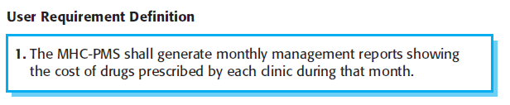
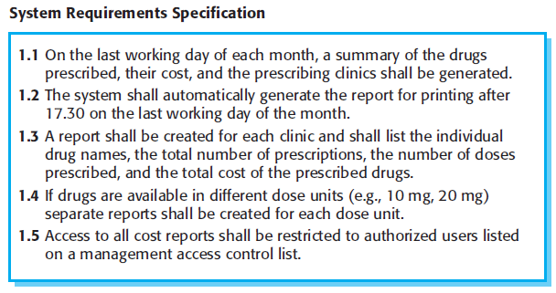
Example: User vs. System Requirements

Slide 6
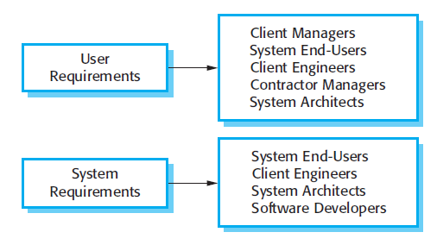

Slide 7
Functional and Non-Functional Requirements
Functional Requirements: These are statements of services the system should provide, how the system should react to particular inputs, and how the system should behave in particular situations.
Non-Functional Requirements: These are constraints on the services or functions offered by the system.

Slide 8
Functional and Non-Functional Requirements..2
In reality, the distinction between different types of requirement is not as clear-cut as these simple definitions suggest.
Sometimes, a non-functional requirement can generate several functional requirements.

Slide 9
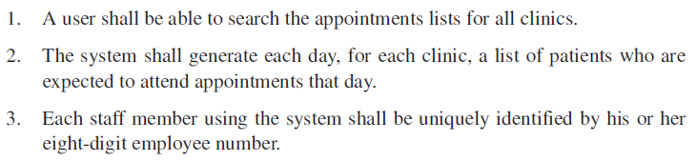
Examples on Functional Requirements:
Imprecision in the requirements specification is the cause of many software engineering problems.
It is natural for a system developer to interpret an ambiguous requirement in a way that simplifies its implementation

Slide 10
Requirements Properties
In general, the system requirements should be
Correct
Consistent
Complete
This however will not be easy in large and complex systems with many stakeholders

Slide 11
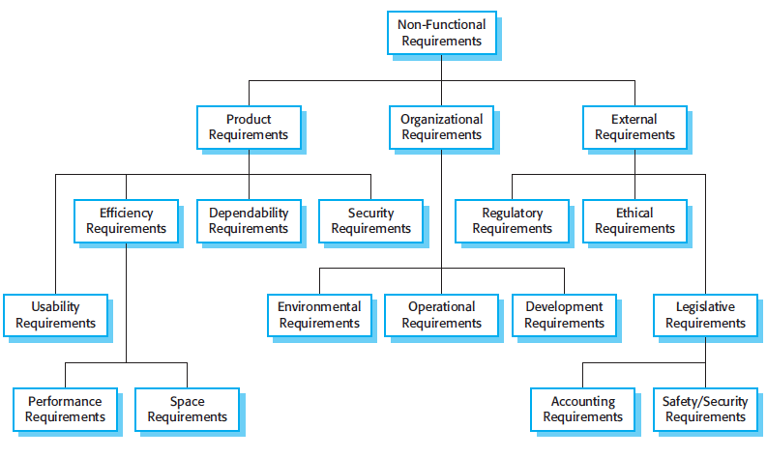

Slide 12


Non-Functional Requirements Should be Quantifiable

Slide 13
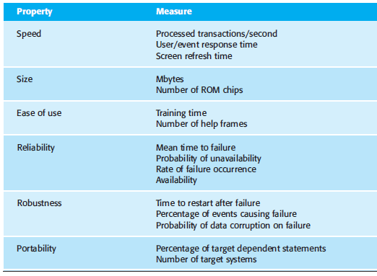
Metrics for Specifying Non-functional Requirements
Keep in mind that some NFR cannot be quantified, e.x. maintainability.
NFR can contradict with other functional or non-functional requirements.

Slide 14
The Software Requirements Document (SRS)
It is an official statement of what the system developers should implement.
It should include both the user requirements for a system and a detailed specification of the system requirements
Agile methods do not use official SRS, instead they use User Stories
Critical and Outsourcing Projects needs detailed SRS document

Slide 15
Level of Details When Writing Requirements
The level of detail depends on the type of system that is being developed and the development process used.
Critical systems need to have detailed requirements because safety and security have to be analyzed in detail.
When the system is to be developed by a separate company the system specifications need to be detailed and precise.
If an in-house, iterative development process is used, the requirements document can be much less detailed and any ambiguities can be resolved during development of the system.

Slide 16
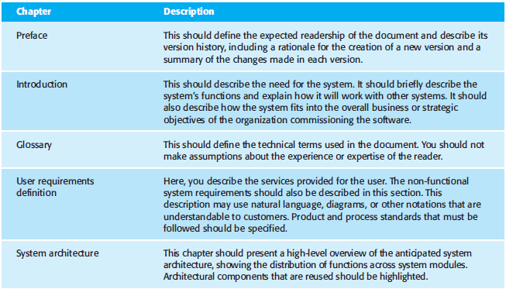
What Should Be Included in the SRS?

Slide 17
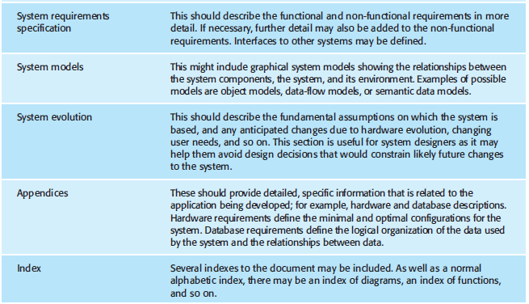

Slide 18
Requirements Specification
Requirements specification is the process of writing down the user and system requirements in a requirements document.
At this stage, focus on what the system should do, not how the system will do it (design)
User requirements should be simple natural language who don’t have technical background.
User requirements can have some intuitive diagrams such as use case diagram.

Slide 19
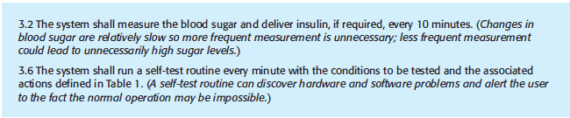
Requirements Specification: Natural language

Slide 20
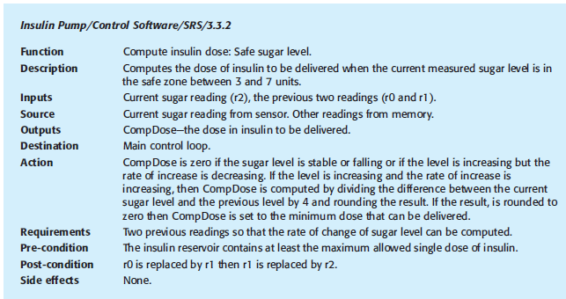
Requirements Specification: Structured Format

Slide 21
Guidelines when writing requirements specification:
You should have standard format for requirements specification.
Use language consistently to distinguish between mandatory (shall) and desirable (should) requirements.
Use text highlights (bold, italic) to highlight parts of req.
Do not use technical language.
It can be excellent to include a rationale with each user requirement (why this req. has been included?)

Slide 22
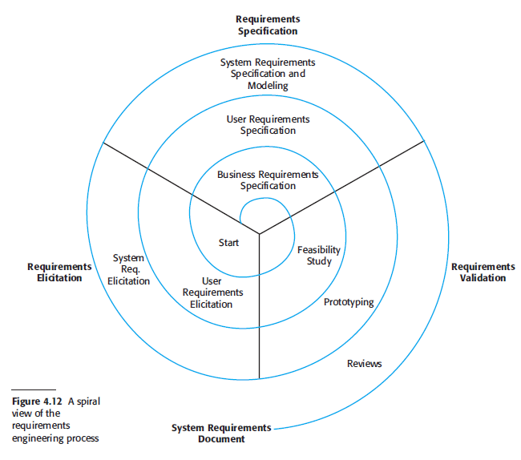

Slide 23
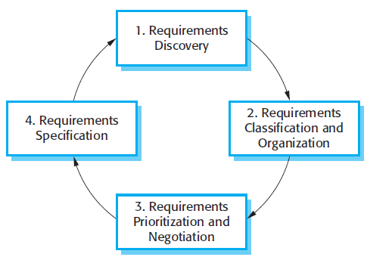
Requirements Elicitation & Analysis Process
Using Interviews
Writing down requirements
Define subsystems
Negotiate with stakeholders

Slide 24
Requirement Analysis
The process of understanding customer requirements and their implications. It comes after requirements discovery
It involves technical staff working on the discovered requirements, iteratively with customers, to understand their technical implication and importance.
It includes the processes of classifying and organising requirements, negotiating (with customers) and prioritizing them in the order of their importance to the customers.
The output of this process is the requirement specification document (SRS) negotiated and accepted with customers.

Slide 25
Problems of requirements analysis
Stakeholders don’t know what they really want.
Stakeholders express requirements in their own terms.
Different stakeholders may have conflicting requirements.
The requirements change during
the analysis process
Political factors
Stages include:
Requirements discovery,
Requirements classification and organization,
Requirements prioritization and negotiation,
Requirements specification.

Slide 26
Stakeholders in the MHC-PMS
Patients whose information is recorded in the system.
Doctors who are responsible for assessing and treating patients.
Nurses who coordinate the consultations with doctors and administer some treatments.
Medical receptionists who manage patients’ appointments.
IT staff who are responsible for installing and maintaining the system.
etc

Slide 27
Techniques
There are many requirement engineering techniques for requirement elicitation and analysis, some of the often used ones:
Interviewing
Scenario generation
Use case analysis
Ethnography

Slide 28
Interviewing
Formal or informal interviews with stakeholders are part of most RE processes.
Types of interview
Closed interviews based on pre-determined list of questions
Open interviews where various issues are explored with stakeholders.
Focused interviews, with clusters of stakeholders
Effective interviewing
Be open-minded, avoid pre-conceived ideas about the requirements and are willing to listen to stakeholders.
Prompt the interviewee to get discussions going using a springboard question, a requirements proposal, or by working together on a prototype system.

Slide 29
Interviews
Meeting introductory protocol
Ensure cultural introduction protocols are followed
First meeting
Aim: to understand the business and its context with a clear aim to understand business processes and services.
Effective meetings:
Ensure a chair is assigned at the beginning, to keep time-controlled progress
Ensure an agenda is defined with clear objectives of the target outcome of the meeting
Ensure a timescale is set for each agenda item and is kept/controlled by the chair
Ensure clear actions and decisions (and who is responsible for and by when) are identified and reached by the end of the meeting
Ensure the actions and decisions are summarised at the end of the meeting

Slide 30
Scenarios
Scenarios are real-life examples of how a system can be used.
They should include
A description of the starting situation;
A description of the normal flow of events;
A description of what can go wrong;
Information about other concurrent activities;
A description of the state when the scenario finishes.

Slide 31
Scenario for collecting medical history: Example

Slide 32
Scenario for collecting medical history: Example
Successful
output?
Yes
Yes
No?

Slide 33
Use cases
Use-cases are a scenario based technique, in the UML, which identifies the actors in an interaction and describes the interaction itself.
A set of use cases should describe all possible interactions with the system.
High-level graphical model supplemented by more detailed structured or tabular description.
Sequence diagrams may be used to add detail to use-cases by showing the sequence of event processing in the system.

Slide 34
Use case diagrams
Used during inception, requirements elicitation and requirements analysis
Describe the functionality of the system
Use cases focus on the behavior of the system from an external point of view.
A use case describes a function provided by the system that yields a visible result for an actor

Slide 35
A Use Case diagram shows you some of the use cases in your system, some of the actors in your system, and the relationships between them.
use case is a high−level piece of functionality that the system will provide.
An actor is anyone or anything that interacts with the system being built.

Slide 36
Use cases for the MHC-PMS

Slide 37
Ethnography
A social scientist spends a considerable time observing and analysing how people actually work.
People do not have to explain or articulate their work.
Social and organisational factors of importance may be observed.
Ethnographic studies have shown that work is usually richer and more complex than suggested by simple system models.

Slide 38
Requirements validation
Concerned with demonstrating that the requirements define the system the customer really wants.
Requirements error costs are high so validation is very important
Fixing a requirements error after delivery may cost up to 100 times the cost of fixing an implementation error.

Slide 39
Requirements Validation Check list
Validity Checks: sometimes additional requirements are needed.
Consistency Checks: no conflicts.
Completeness Checks: nothing is missing.
Realism Checks: can such requirements be done using current knowledge and technology?
Verifiability: requirements should be verifiable

Slide 40
Requirements Validation Techniques
Requirements reviews: systematic analysis of requirements by a team of reviewers.
Prototyping: executable model of system is developed and presented to stakeholders.
Test-case generation: requirements should be testable

