Slide 1
ENCS 2110
Digital Electronics and Computer Organization Lab
Experiment No. 9
A Simple Security System Using FPGA

Slide 2
Basic Idea
The main goal of this experiment is to build a simple security system.
The system has a password of two digits.
The password is: “22”.
The entered password is shown on two 7-Segment displays.
If the correct password was entered, a GREEN LED will turn on.
If a wrong password was entered, a RED LED will turn on.

Slide 3
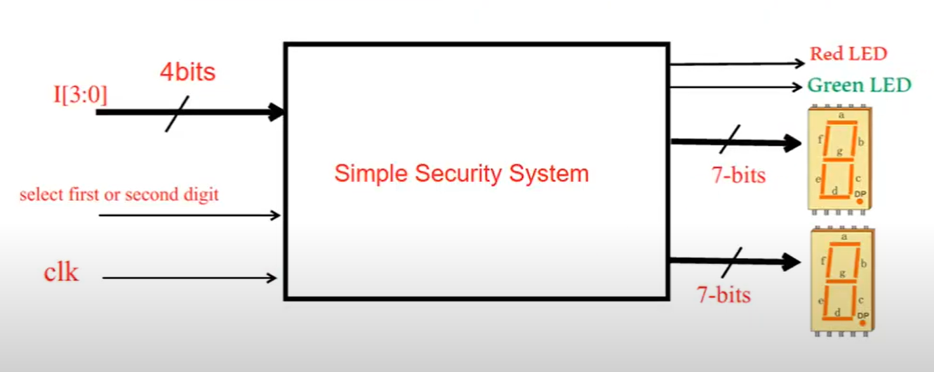
Top level diagram

Slide 4
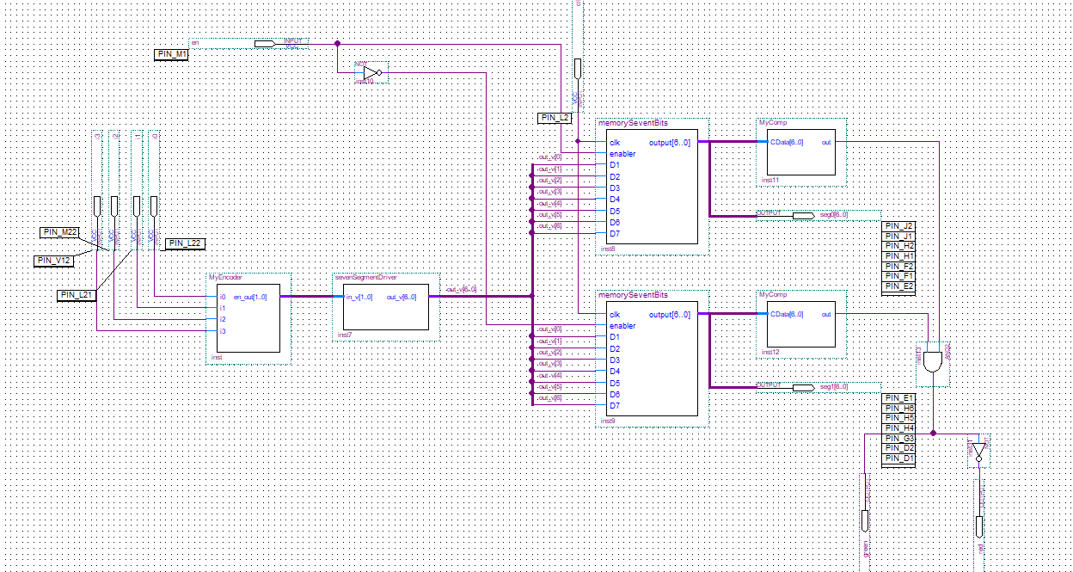
Block diagram

Slide 5
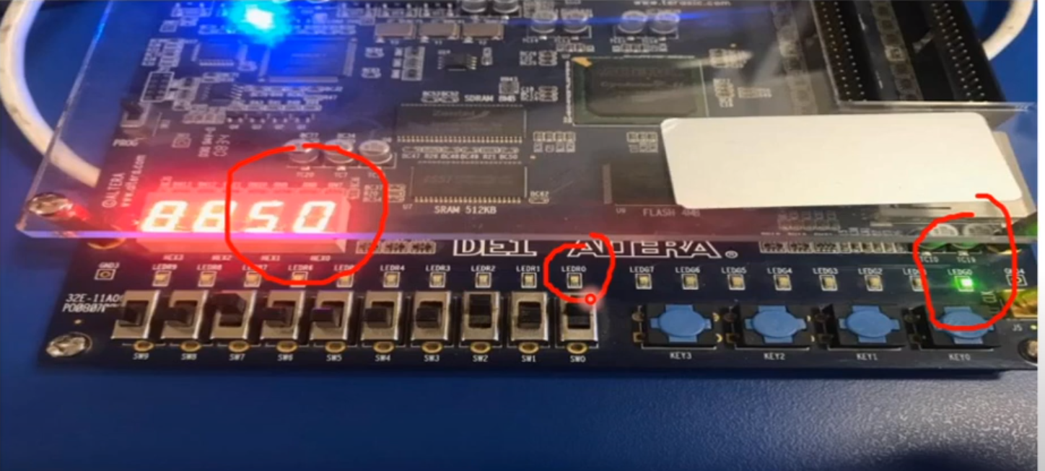

Slide 6
Question
How do we build this?
→Let us break it into smaller stages

Slide 7
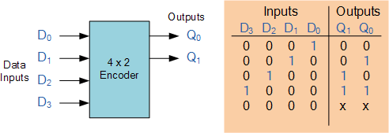
Stage 1: Priority encoder

Slide 8
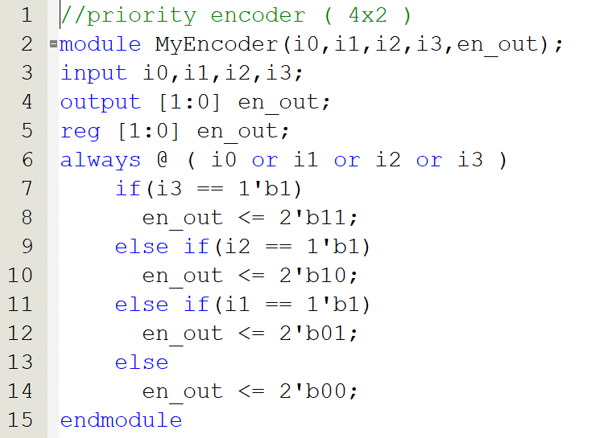
Stage 1: Priority encoder

Slide 9
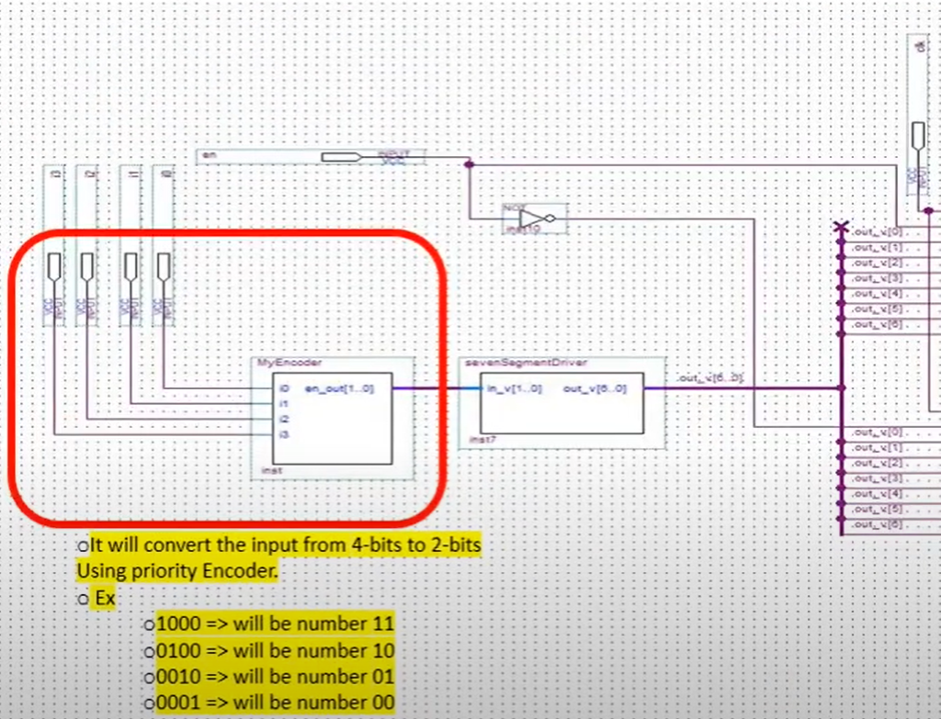

Slide 10
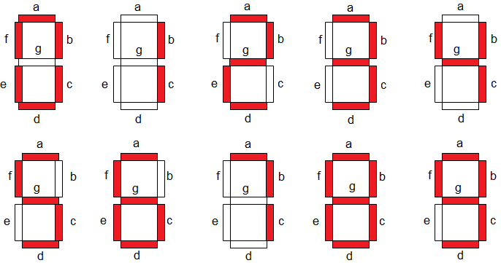
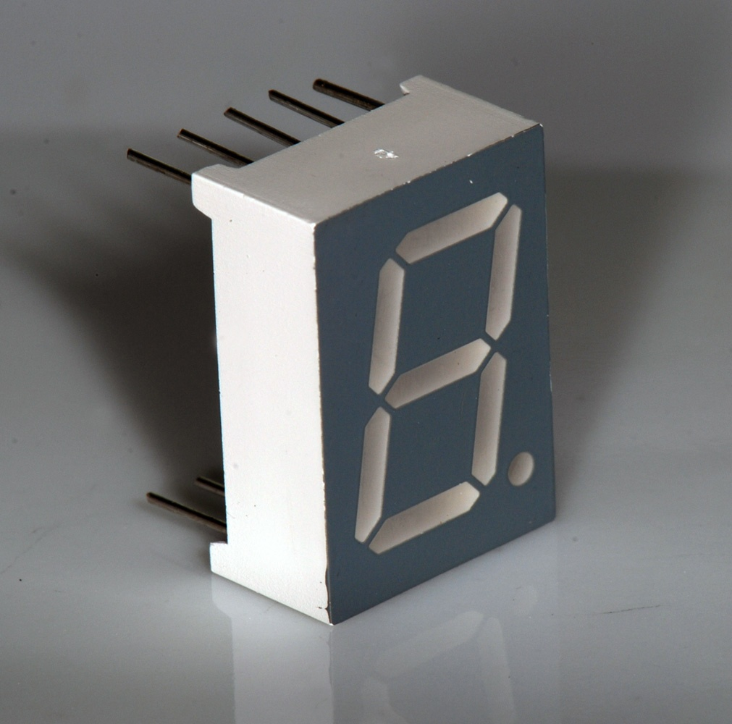
7-Segments
7-segments are components used to display numbers or alphabets by turning on a sequence of LEDS.
Each segment is just a LED, and it has a unique name from (a-g).

Slide 11
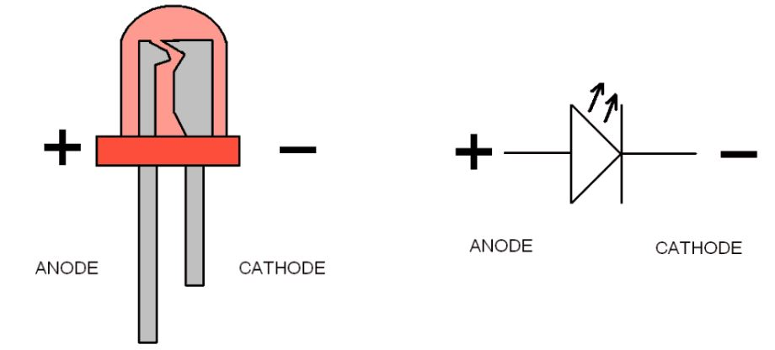
LEDS
Anode | Cathode | LED
0 | 0 | OFF
0 | 1 | OFF
1 | 0 | ON
1 | 1 | OFF

Slide 12
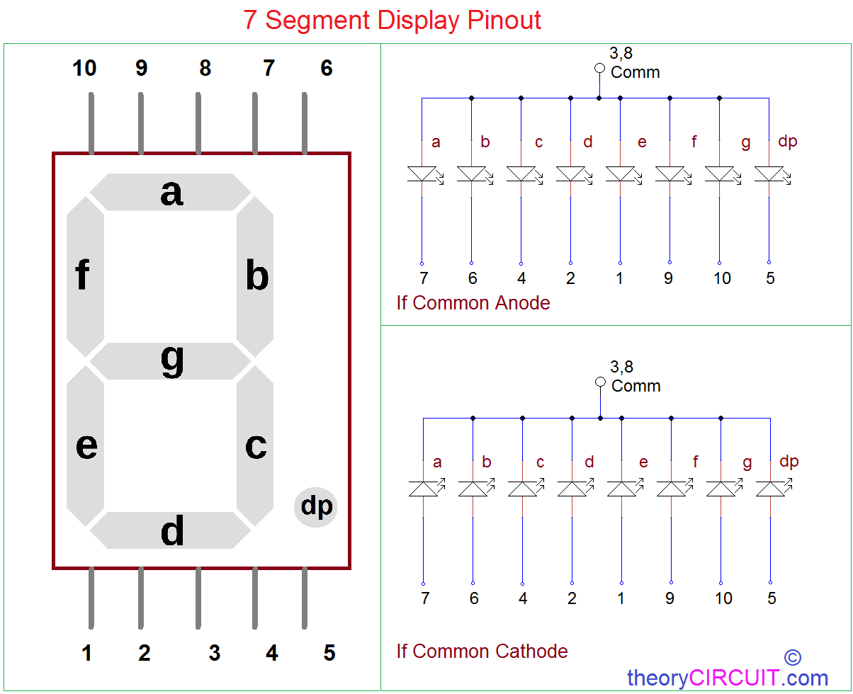
Common Anode vs Common Cathode

Slide 13
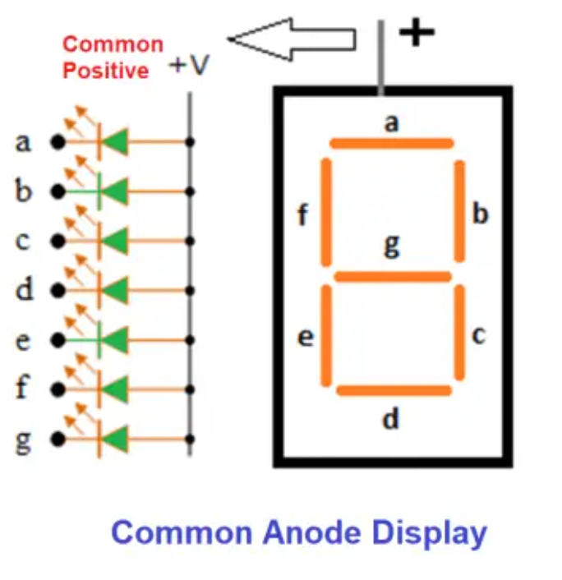
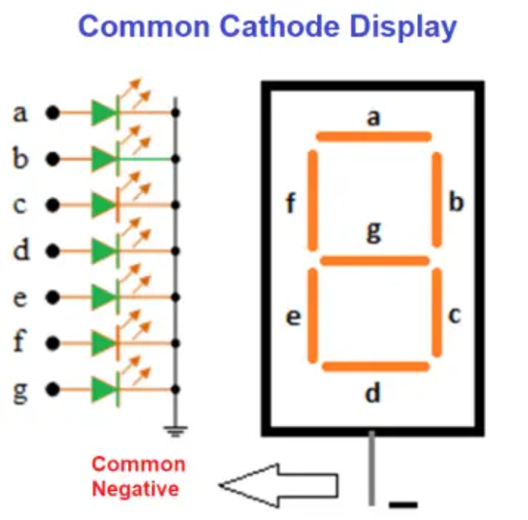
Common Anode vs Common Cathode
Active LOW
Active HIGH

Slide 14
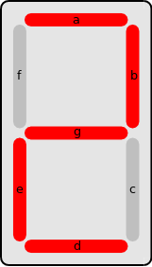
Example
Method | a | b | c | d | e | f | g
Active low | 0 | 0 | 1 | 0 | 0 | 1 | 0
Active high | 1 | 1 | 0 | 1 | 1 | 0 | 1

Slide 15
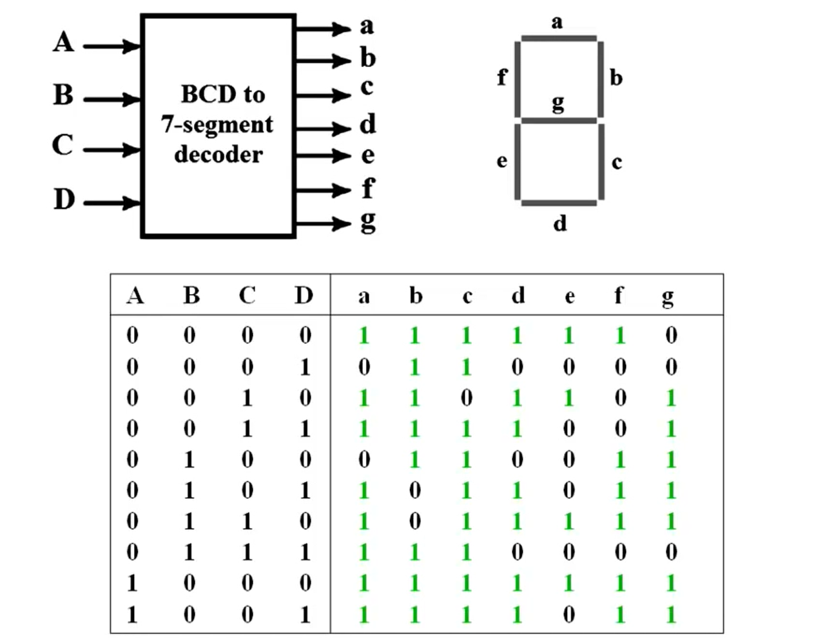
Stage 2: 7-Segment Decoder
The main idea of this component
is to map between 4 digit inputs
to 7 digit inputs so that it can
be displayed on the 7-segment
correctly.

Slide 16
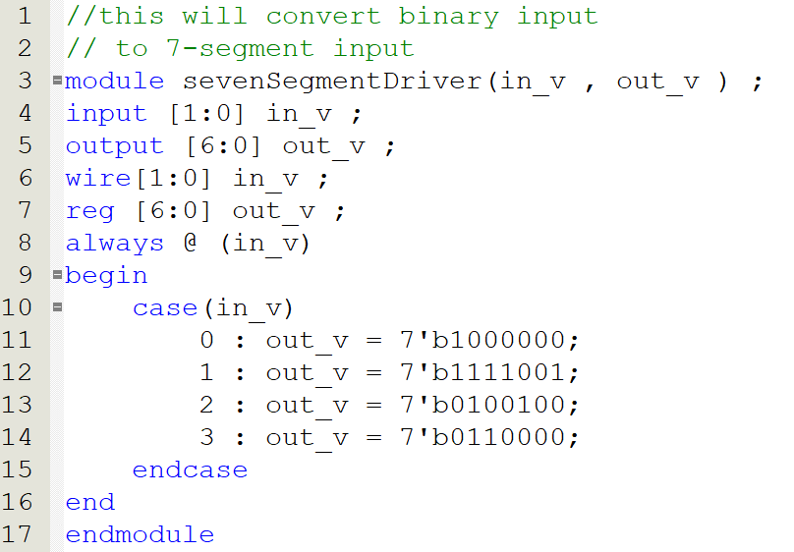
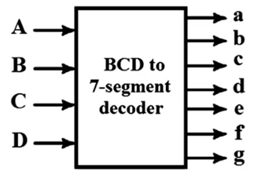
Stage 2: 7-Segment Decoder

Slide 17
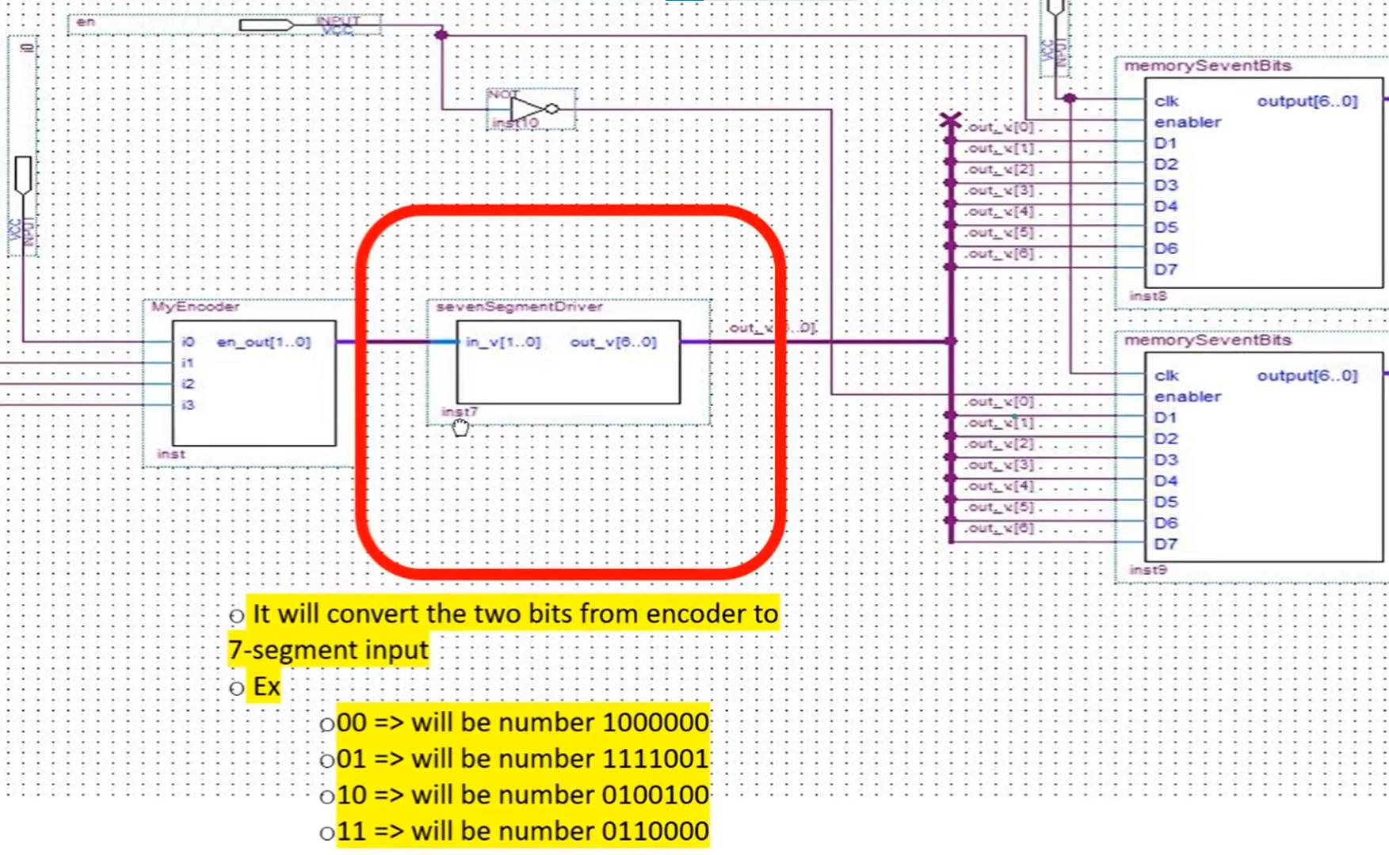

Slide 18
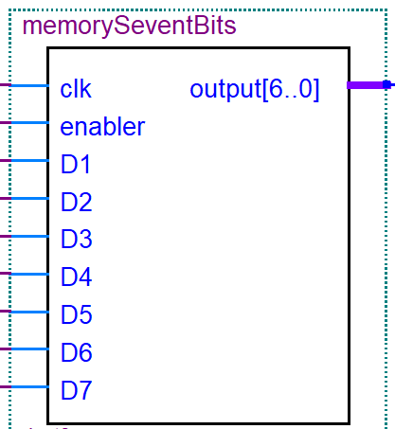
Stage 3: Memory
It is used to store/retrieve data.
In our experiment, we have a 7-bits memory
(output from 7-seg decoder).
To store each bit, we need:
  Flip-Flop
  MUX
It is synchronous, which means it
stores data based on clock pulse.
It has an enable pin, to turn it on/off.

Slide 19
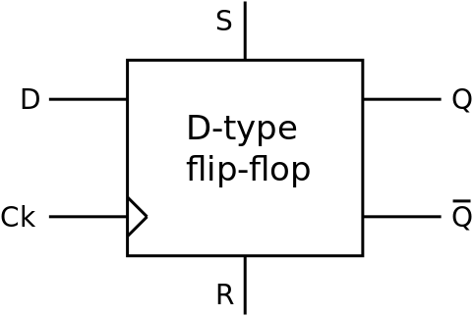
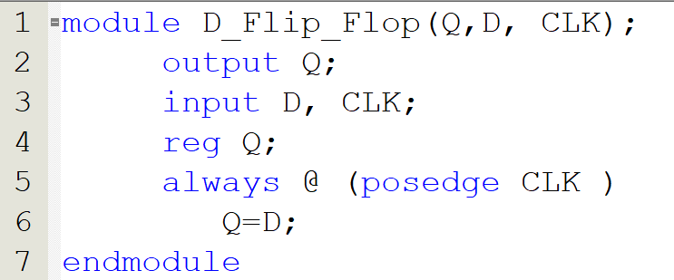
Flip-Flop

Slide 20
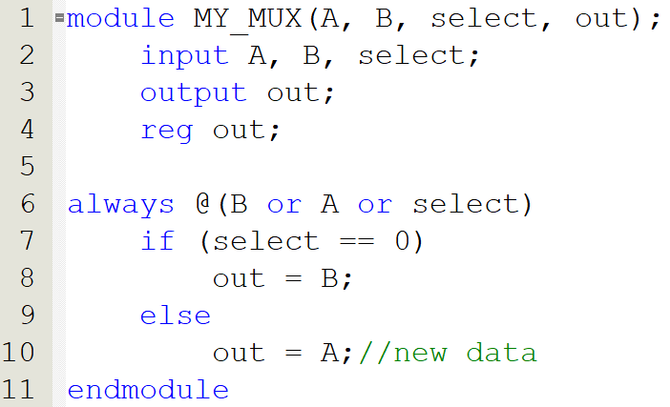
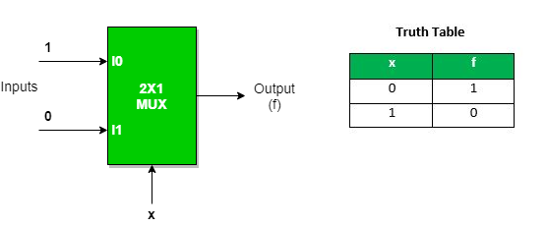
MUX

Slide 21
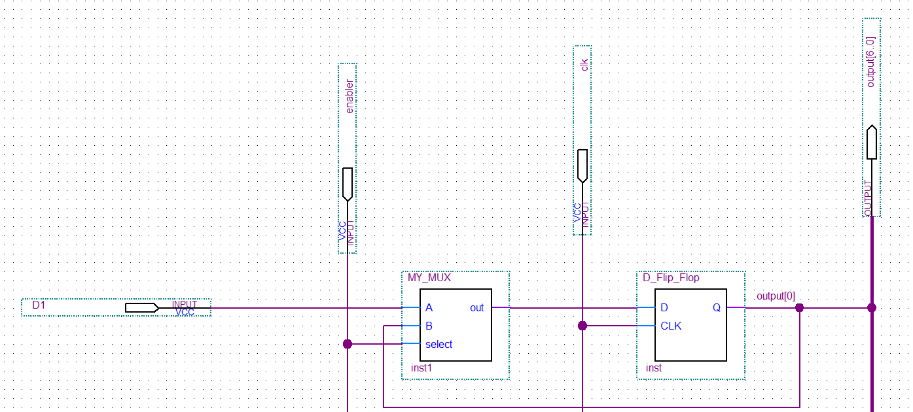
1-bit memory

Slide 22
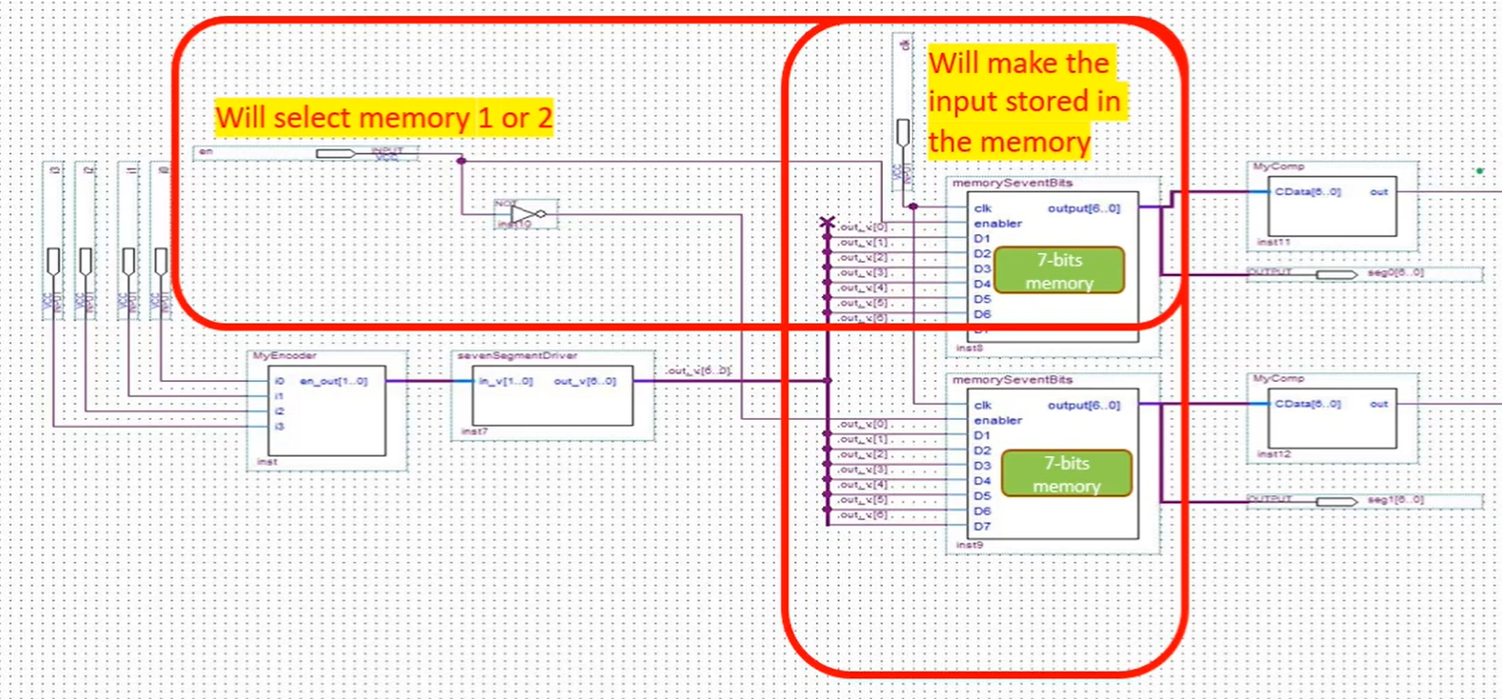

Slide 23
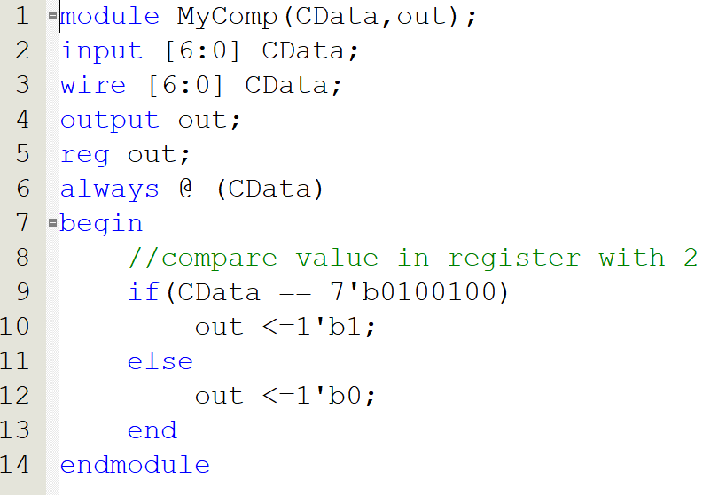
Stage 4: Comparator
gfedcba

Slide 24
Stage 5: Red/Green light
If the two digits are the number 2, then the GREEN LED will turn on.
Any other case, the RED LED will turn on.
Logic: AND gate.

Slide 25
Simulation

Slide 26
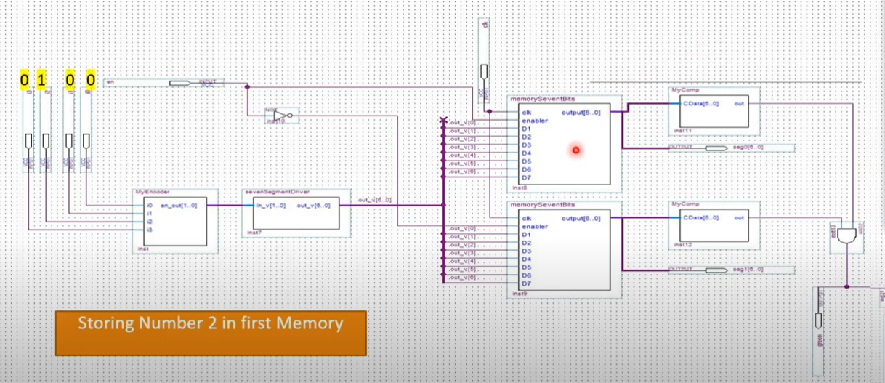

Slide 27
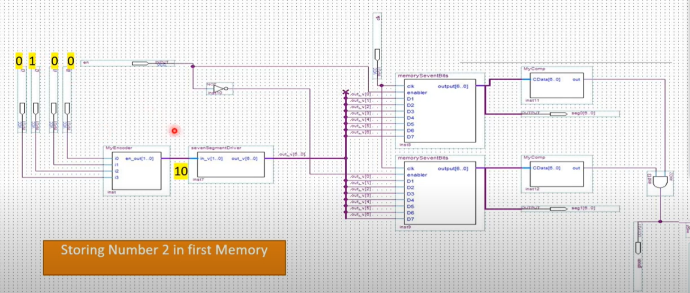

Slide 28
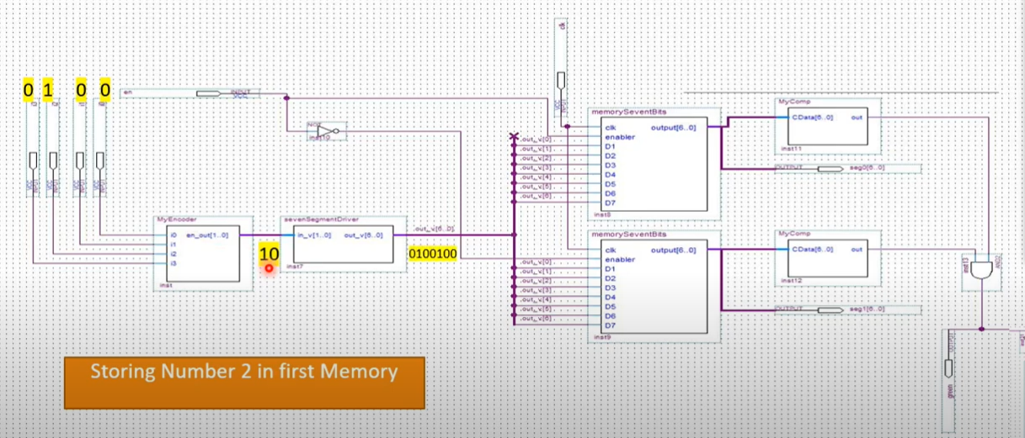

Slide 29
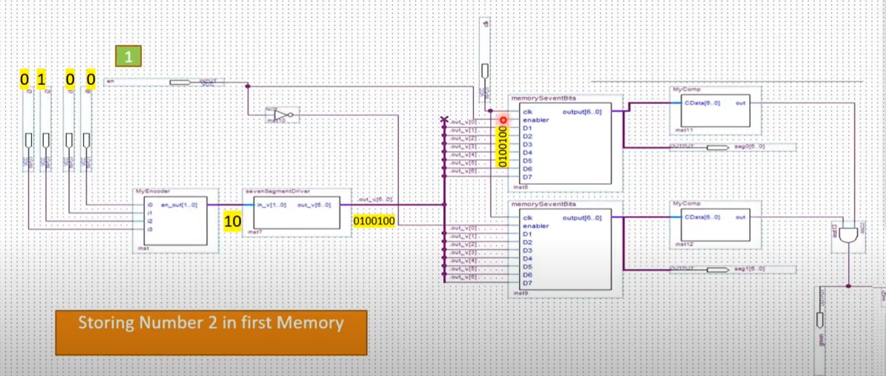

Slide 30
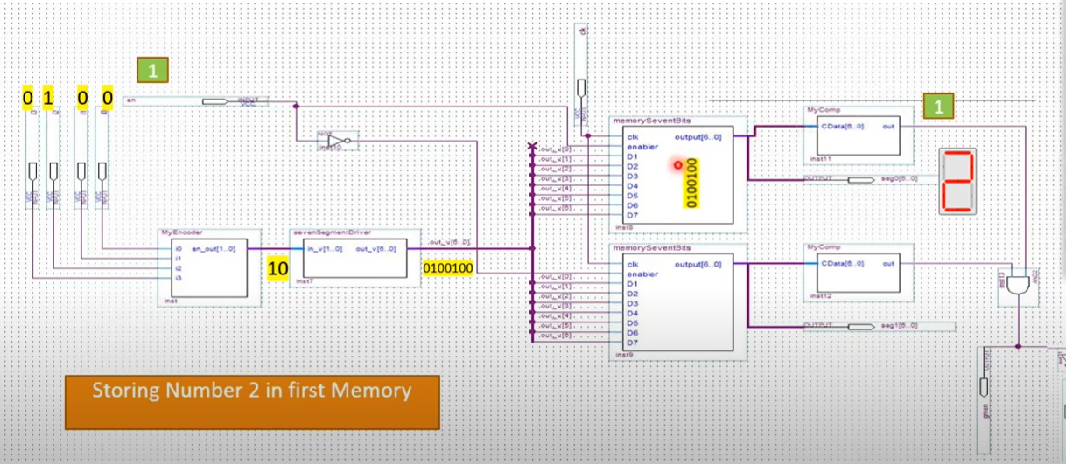

Slide 31
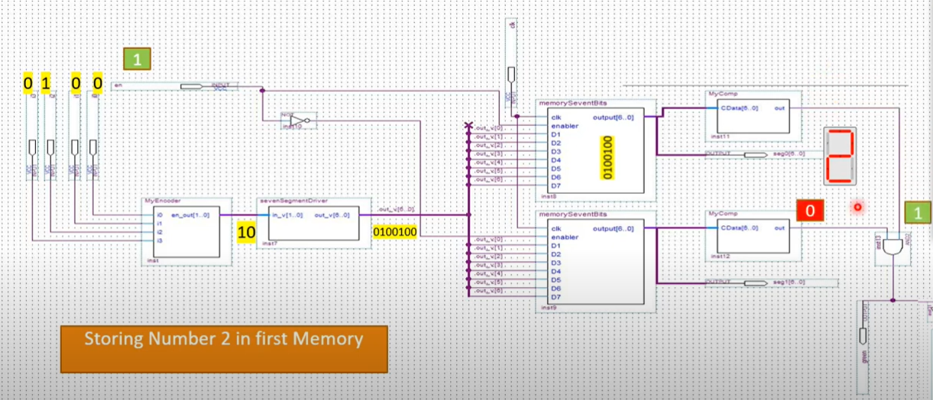

Slide 32
