Slide 1
Exp #10
Spring Boot Part 2
SLIDES BY: Tarek Zidan and Mohamad Balawi

Slide 2
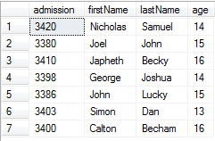
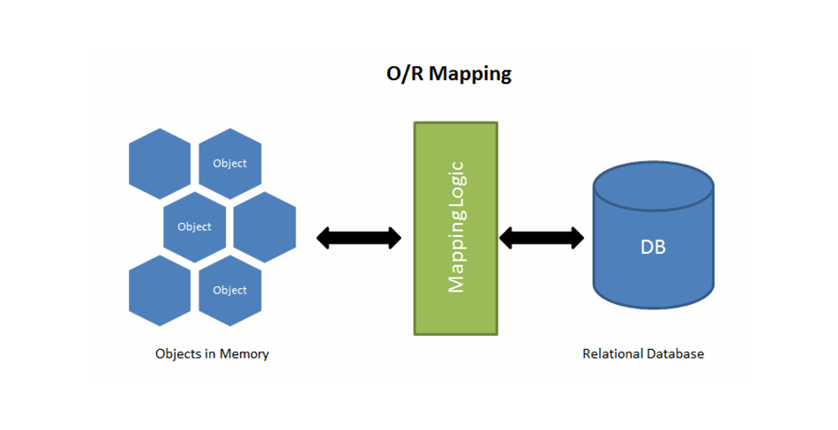
ORM (Object relational mapping)
A technique to convert data between models within object-oriented languages to serialized data to be stored (In relational database in our case).
ORM models present many advantages. The main advantage is the decoupling from the database connector.
As database queries vary among different databases. Therefore, ORM takes care of this difference.
Student student = new Student();

Slide 3
JPA (Java Persistence API)
A specification of Java.
It is used to persist data between Java object and relational database.
JPA acts as a bridge between object-oriented domain models and relational database systems.
Spring Data JPA
Implementation of Java Persistence API (JPA) specification.
is built on top of Hibernate, hibernate is a very commonly used framework for ORM in java.

Slide 4

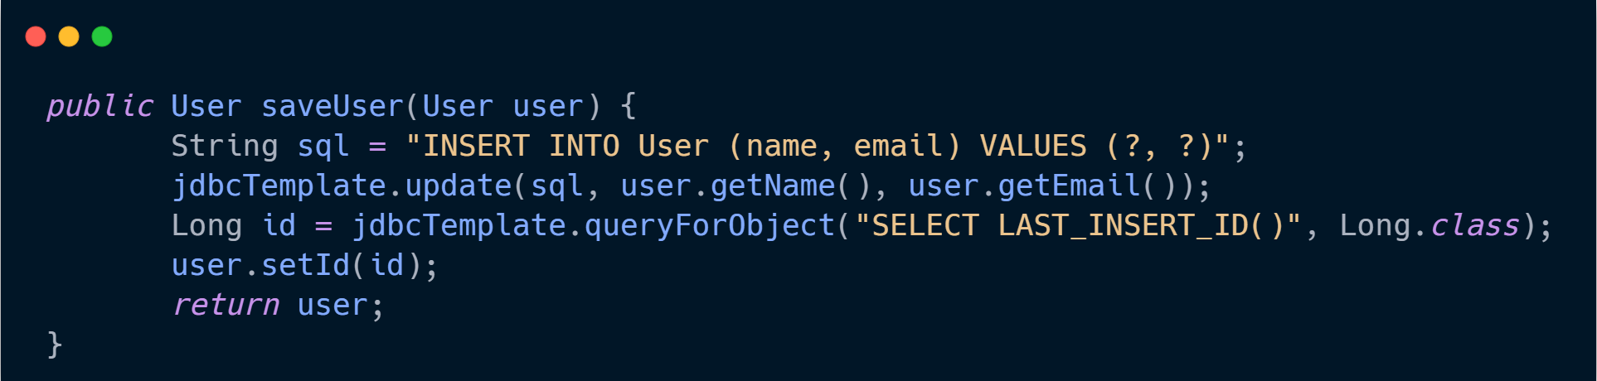
ORM vs Normal Queries
ORM
Query

Slide 5
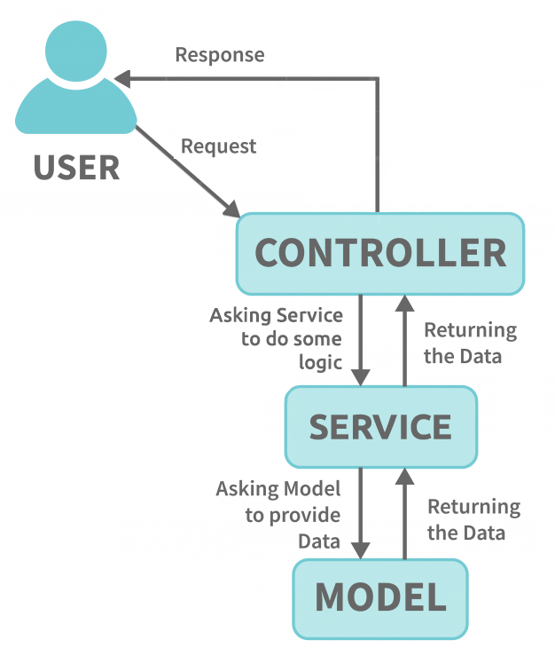
Our MVC Architecture (in exp 9)

Slide 6
What we expect afrer adding a DB

Slide 7
Our architechture in experiment 10

Slide 8
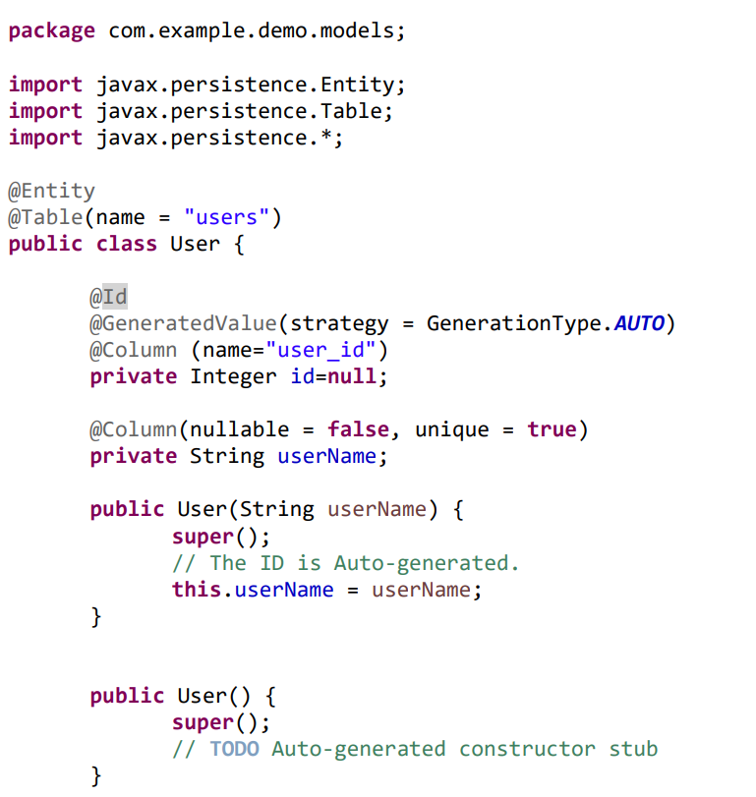
How to use JPA annotations
@Entity Defines a database table.
@Table Define table name.
@Id Primary key.
@GeneratedValue Primary key generation method.
@Column Specifies column properties.

Slide 9
How to Setup exp10:
Download & install MySQL Server from here. (use the following username and password):
  Username: root
  Password: 1234
Download & install intelliJ Community Edition from here.
Open Spring Initializr and create a new application with the following settings and dependencies:

Slide 10
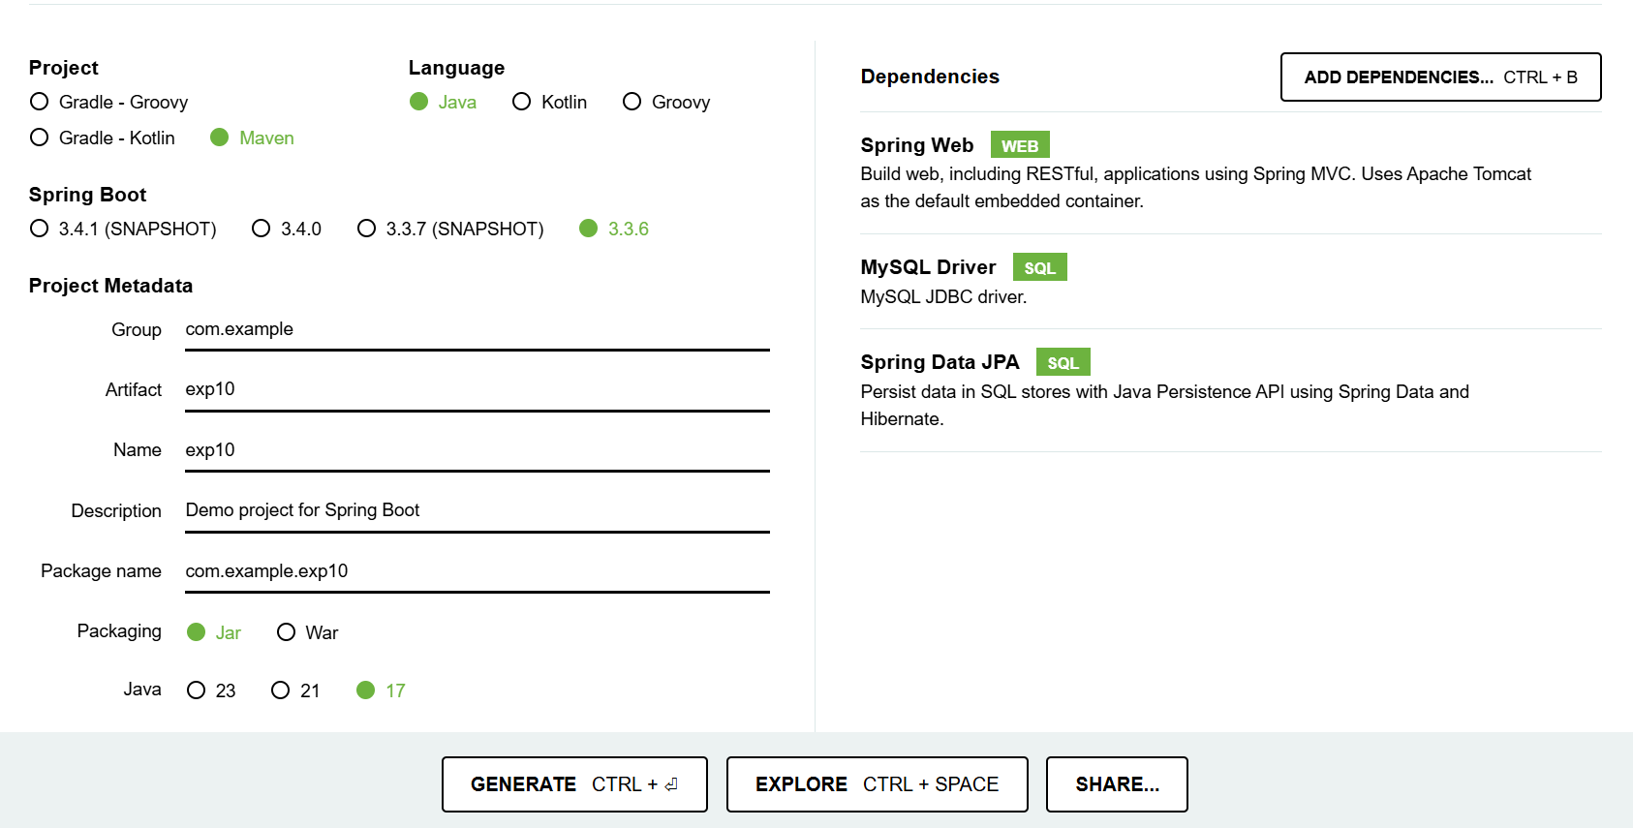

Slide 11


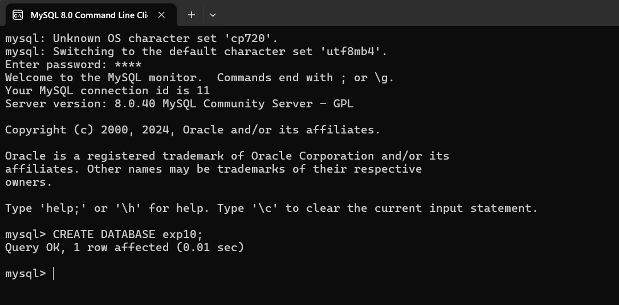
Open MySQL command line (or workbench) using the shortcut or by executing the following command:
  cd "C:\Program Files\MySQL\MySQL Server 8.0\bin" && mysql -u root –p
Execute the following command to create a new database:
  CREATE DATABASE exp10;

Slide 12
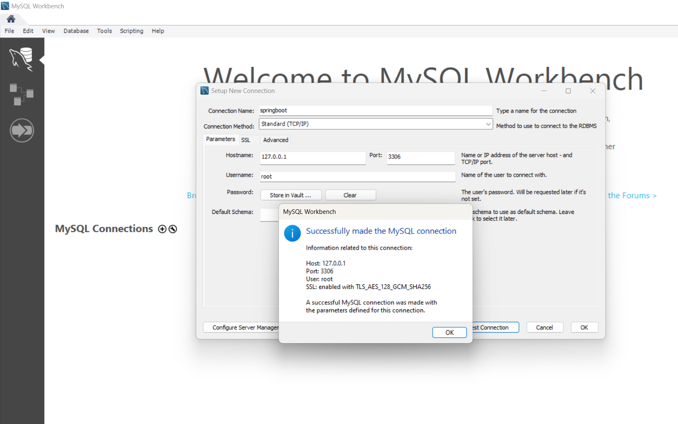
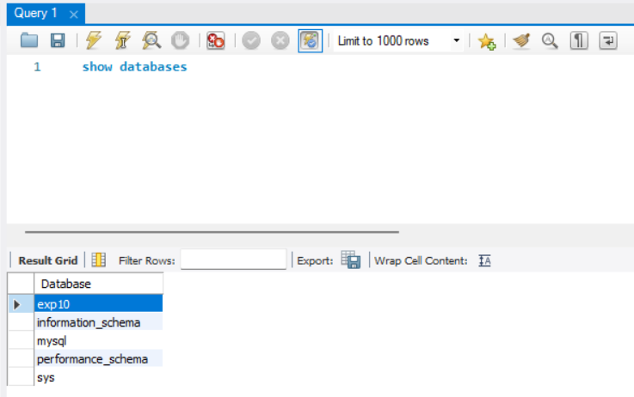
If you are using workbench

Slide 13
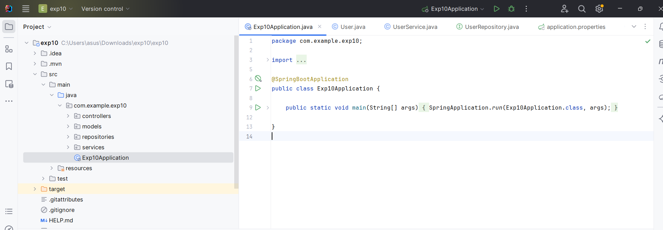
Extract the zip file downloaded from Spring Initializr.
Open the project folder in IntelliJ.

Slide 14
Copy the following DB configurations into \src\main\resources\application.properties file.
(If your port 8080 is busy, then use 8081)
  server.port=8080
  spring.datasource.url=jdbc:mysql://localhost:3306/exp10?allowPublicKeyRetrieval=true&useSSL=false
  spring.datasource.username=root
  spring.datasource.password=1234
  spring.jpa.hibernate.ddl-auto=update
  spring.jpa.hibernate.naming-strategy=org.hibernate.cfg.ImprovedNamingStrategy
  spring.jpa.properties.hibernate.dialect=org.hibernate.dialect.MySQL8Dialect

Slide 15
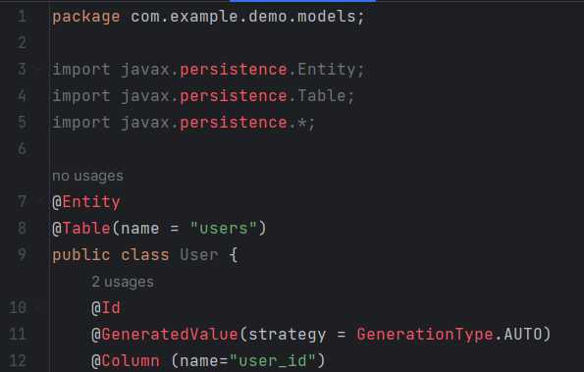
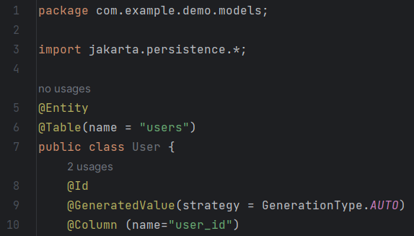
If you face the importing error shown below, it can be solved by removing all import statements that begin with “import javax.persistence...” and replacing them with the following line:
import jakarta.persistence.*;

Slide 16
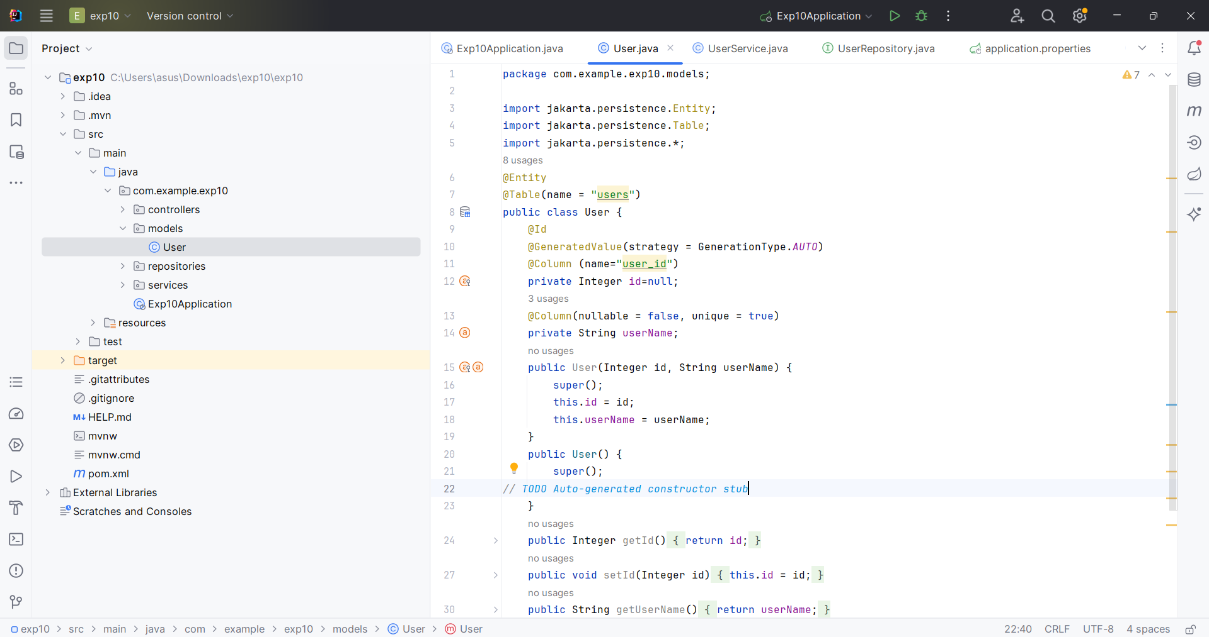
Go to lab manual page 124
Create a User class

Slide 17
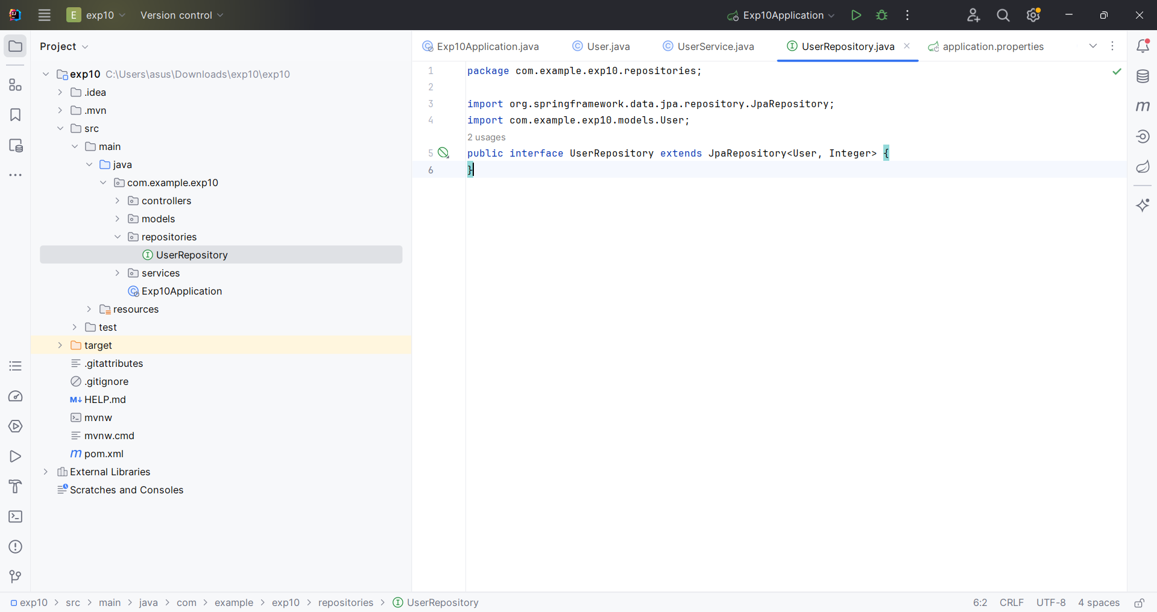
Create a UserRepository interface

Slide 18
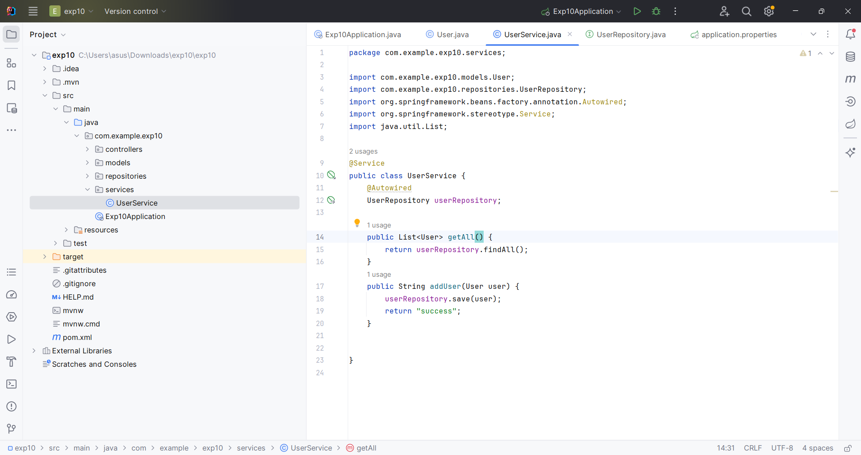
Create a UserService class

Slide 19
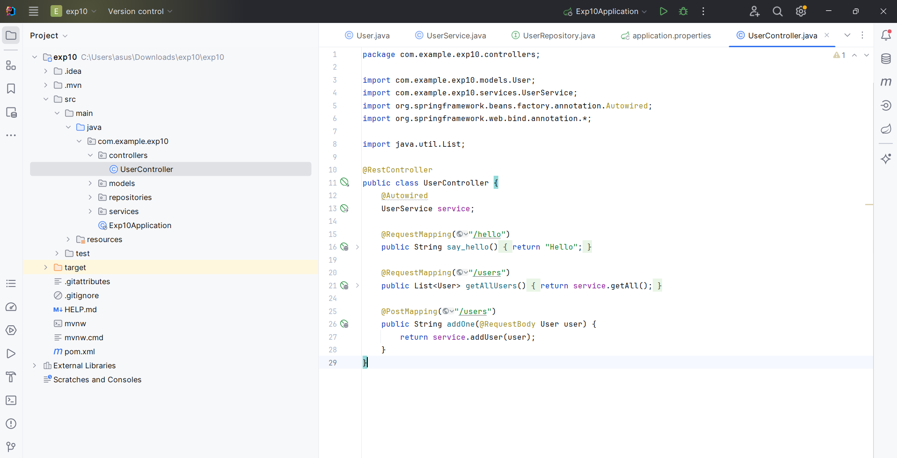
Create a UserController class with HTTP methods

Slide 20
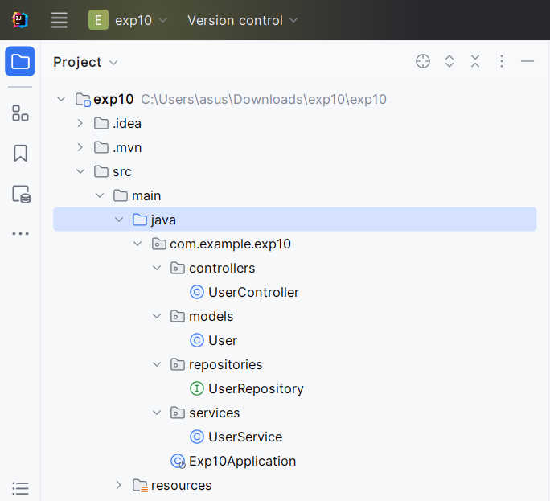
Notice the folders

Slide 21
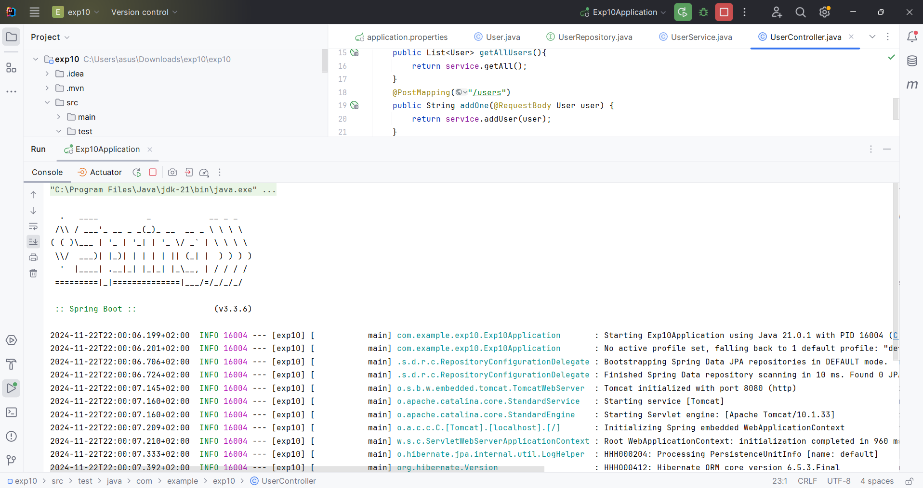
Run the spring boot while the MYSQL is running

Slide 22
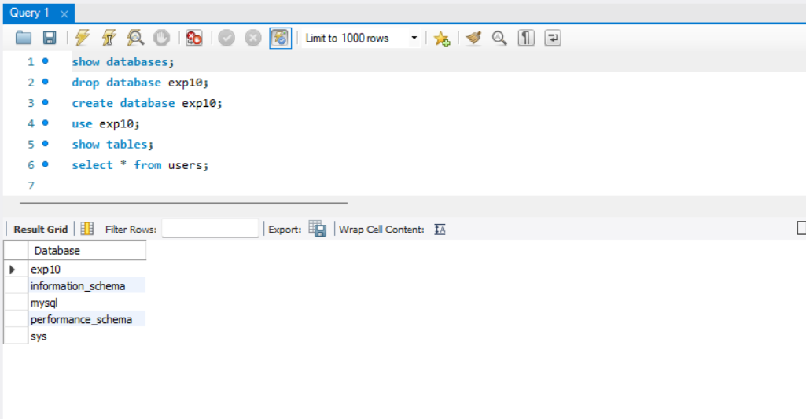
Workbench is running and has the exp10 database

Slide 23
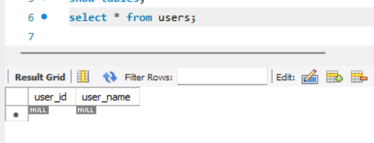
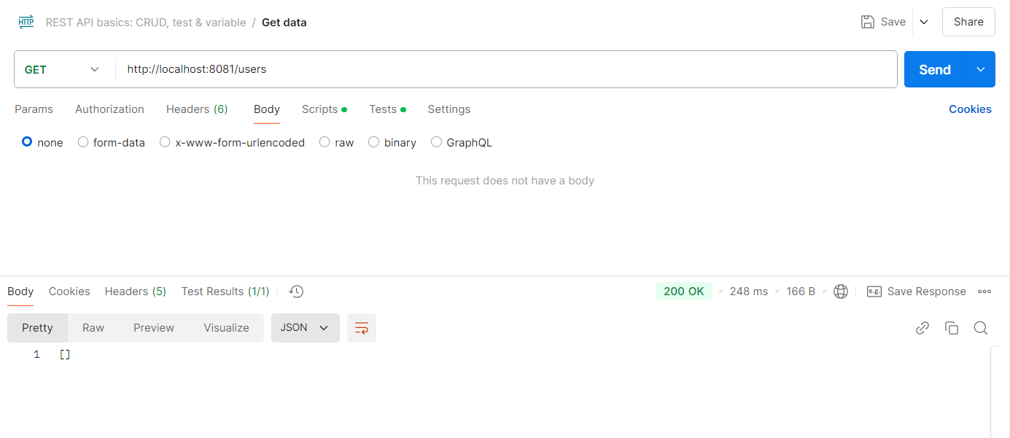
Running: the table was created but it is empty

Slide 24
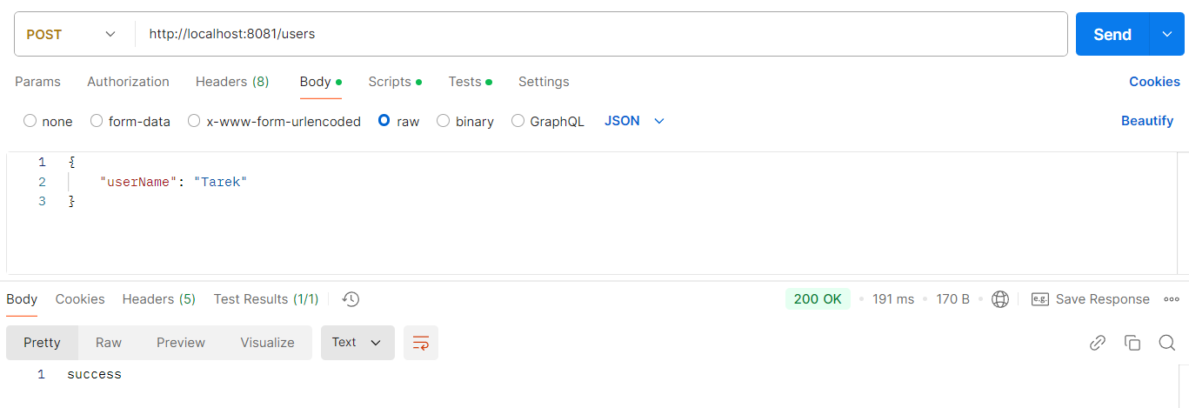
Adding a user by giving just a username

Slide 25
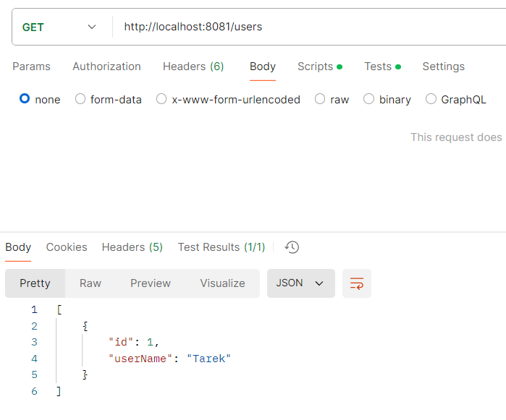
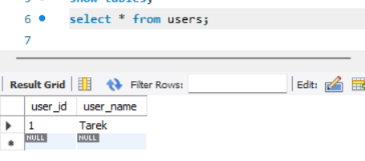
Result

Slide 26
MySQL Command Line
Some useful commands:
  To find the DB server port: SHOW VARIABLES LIKE 'port';
  To create ad DB: CREATE DATABASE exp10;
  To use a DB: USE exp10;
  To find database username: SELECT user();
  Find who uses port 8080: netstat -ano | findstr :8080
  Kill a process: tasklist /FI "PID eq 1234"

