Slide 1
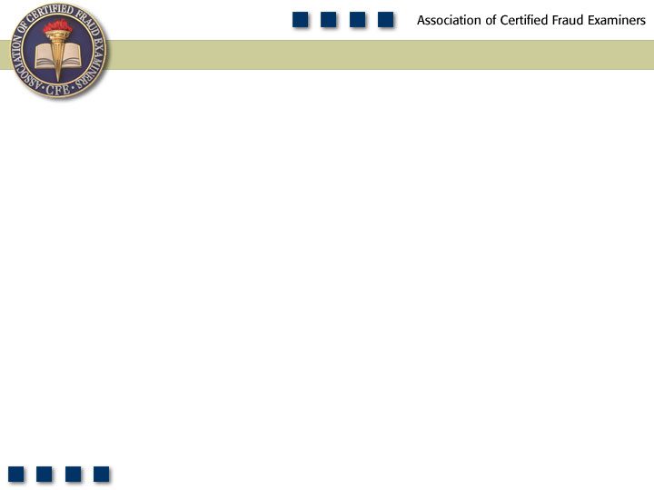
Chapter 9
Non-Cash Assets

Slide 2
Learning Objectives
List the five categories of tangible non-cash misappropriations discussed in this chapter.
Discuss the data on non-cash misappropriations from the 2011 Global Fraud Survey.
Explain how misuse of non-cash assets can negatively affect organizations.
Understand how and why unconcealed larceny of non-cash assets occurs.
Be familiar with internal controls and tests that can be used to prevent and detect non-cash larceny.
Understand how weaknesses in internal asset requisition and transfer procedures can lead to the misappropriation of non-cash assets.

Slide 3
Learning Objectives
Explain how purchasing and receiving schemes are used to misappropriate non-cash assets.
Understand how the theft of non-cash assets through the use of fraudulent shipments is accomplished.
Define the term “shrinkage.”
Describe how fraudsters conceal the theft of non-cash assets on the victim organization’s books.
Understand how fraudsters misappropriate intangible assets and how companies can protect themselves.
Be familiar with proactive audit tests that can be used to detect misappropriations of non-cash assets.

Slide 4
Inventory and All
Other Assets
Misuse
Larceny
Asset Req. &
Transfers
False Sales
& Shipping
Purchasing &
Receiving
Unconcealed
Larceny

Slide 5
Cash vs. Non-Cash Schemes
2011 Global Fraud Survey
Scheme Type | % of Asset Misappropriation Cases | Median Loss
Cash Misappropriations | 82.1% | $100,000
Non-Cash Misappropriations | 19.9% | $58,000

Slide 6
Non-Cash Cases by Type of
Asset Misappropriated

Slide 7
Median Loss by Type of Asset in Non-Cash Schemes

Slide 8
Non-Cash Tangible Asset Misappropriations
Misuse
Unconcealed larceny
Asset requisitions and transfers
Purchasing and receiving schemes
Fraudulent shipments

Slide 9
Misuse of Non-Cash Tangible Assets
Typical misuse
  Company vehicles
  Company supplies
  Computers
  Other office equipment
Doing personal work on company time
Running side businesses

Slide 10
The Costs of Inventory Misuse
Loss of productivity
Need to hire additional employees to compensate
Lost business if employee’s business competes
Unauthorized use of equipment can mean additional wear and tear sooner or more often

Slide 11
Unconcealed Larceny Schemes
Greater concern than misuse of assets
Most schemes are not complex
Some employees know their co-workers are stealing but refrain from reporting it
Many of the employees who steal company property are highly trusted
Assets misappropriated after-hours or mailed to perpetrator

Slide 12
The Fake Sale
Needs an accomplice
Sale is not rung up but the accomplice takes the merchandise
Accomplice may return merchandise for cash

Slide 13
Preventing and Detecting Unconcealed Larceny of Non-Cash Tangible Assets
Segregate the duties of requisitioning, purchasing, and receiving
Segregate the duties of payables, purchasing, and receiving
Maintain physical security of merchandise
Track those who enter secure areas through access logs
Install security cameras and let their presence be known

Slide 14
Preventing and Detecting Unconcealed Larceny of Non-Cash Tangible Assets
Conduct inventory counts on a periodic basis by someone independent of the purchasing and warehousing functions
Suspend shipping and receiving activities during physical counts
Investigate significant discrepancies
Independently follow-up on customer complaints

Slide 15
Asset Requisitions and Transfers
Documentation enables non-cash assets to be moved from one location to another
Internal documents can be used to fraudulently gain access to merchandise
Basic scheme is to requisition materials to complete a work-related project, then steal the materials
Inventory stored in multiple locations creates opportunities

Slide 16
Purchasing and Receiving Schemes
Assets were intentionally purchased by the company but misappropriated
Falsifying incoming shipments
  May also reject portion of the shipment as being substandard
  Perpetrator keeps the “substandard” merchandise

Slide 17
False Shipments of Inventory and Other Assets
False shipping and sales documents are created to make it appear that the inventory was sold
False packing slips can allow the inventory to be delivered to fraudster or accomplice
To hide the theft a false sale is created
Receivable is aged and written off
Legitimate sale is understated

Slide 18
Other Schemes
Assets are written off in order to make them available for theft
Assets are declared as scrap and given to the employee
New equipment is ordered for the company to replace old – new equipment is sent to employee’s home leaving old equipment in place

Slide 19
Concealing Inventory Theft
Key concealment issue is shrinkage
Inventory shrinkage is the unaccounted-for reduction in the company’s inventory due to theft
Since shrinkage signals fraud, the fraudster must prevent anyone from looking for the missing assets
Physical count of inventory detects shrinkage

Slide 20
Concealing Inventory Theft
Altered inventory records
  Forced reconciliation
  Deleting or covering up the correct totals and entering new totals
Fictitious sales and accounts receivable
  Charge sale to existing account
  Write-off to discounts and allowances or bad debt expense

Slide 21
Concealing Inventory Theft
Write off inventory and other assets
  Eliminates the problem of shrinkage
Physical padding
  Make it appear that there are more assets present that there actually are

Slide 22
Preventing and Detecting Thefts of Non-Cash Tangible Assets
Separate the duties of:
  Ordering goods
  Receiving goods
  Maintaining perpetual inventory records
  Issuing payments
Match the invoices to receiving reports before payments are issued
Match the packing slip to an approved purchase order

Slide 23
Preventing and Detecting Thefts of Non-Cash Tangible Assets
Match outgoing shipments to sales orders before merchandise goes out
Periodically match inventory shipments to sales records
Investigate shipments that cannot be traced to a sale
Check out unexplained increases in bad debt expense

Slide 24
Preventing and Detecting Thefts of Non-Cash Tangible Assets
Compare shipping addresses to employee addresses
Review unexplained entries in perpetual inventory records
Reconcile materials ordered for specific projects with actual work done
Perform trend analysis on scrap inventory
Check to make sure that inventory removed from inventory is properly approved

Slide 25
Misappropriation of Intangible Assets
Misappropriation of information
  Includes theft of competitively sensitive information, (e.g., trade secrets, customer lists, marketing strategies)
  Can undermine value, reputation, and competitive advantage
  Can result in legal liabilities
  Identify most valuable information and take steps to protect it
Misappropriation of securities
  Proper internal controls over investment portfolio

