Slide 1
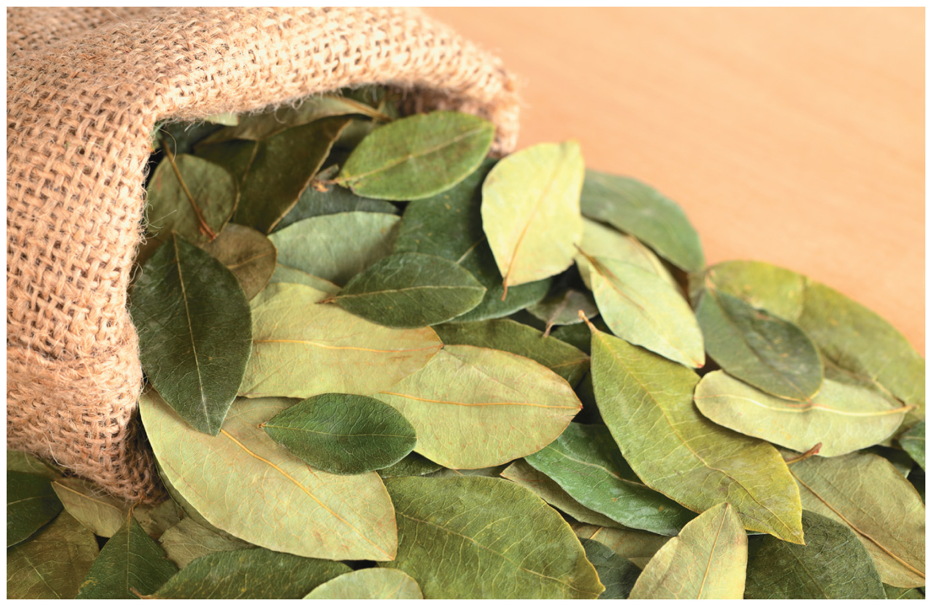
Chapter 9
Reactions of Alcohols, Ethers, Epoxides, Amines, and Thiols
Paula Yurkanis Bruice
University of California,
Santa Barbara

Slide 2
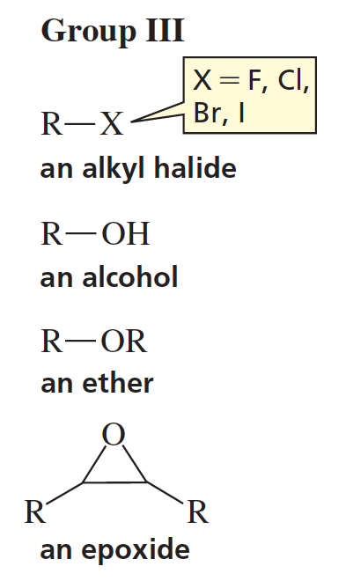
More About the Families in Group III
The families in Group III all have an electronegative atom or group that is attached to an sp³ carbon.

Slide 3
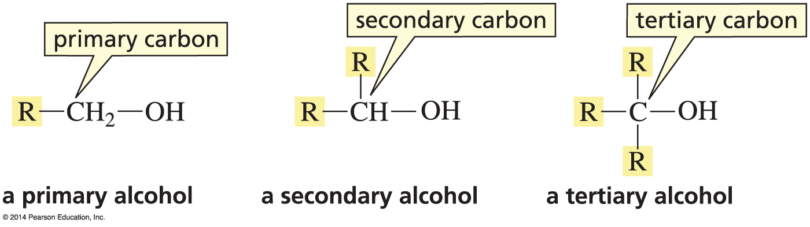
Classification of Alcohols
Primary alcohol = OH is on a primary carbon.
Secondary alcohol = OH is on a secondary carbon.
Tertiary alcohol = OH in on a tertiary carbon.

Slide 4
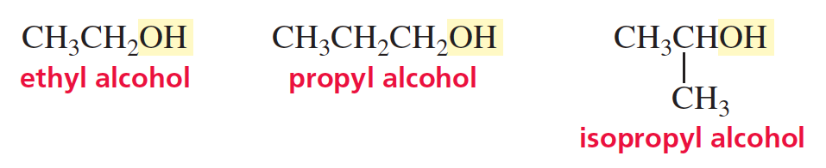
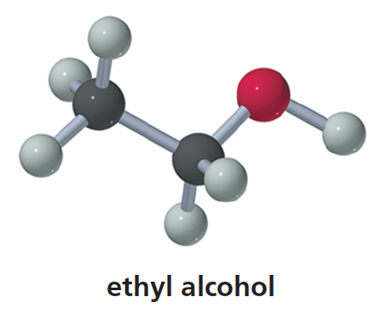
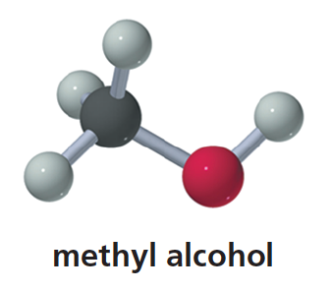
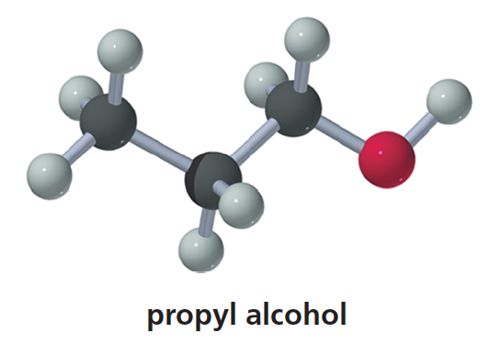
Common Names of Alcohols

Slide 5
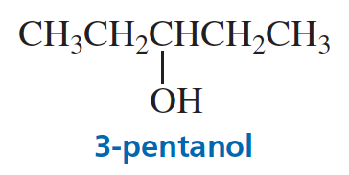
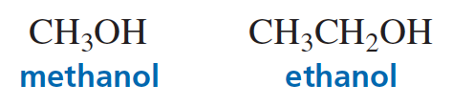
Systematic Names of Alcohols
The OH is the “functional group.”
Systematic nomenclature uses a suffix to denote a functional group.
Alcohols are named by replacing the “e” at the end of the parent hydrocarbon with the suffix “ol.”

Slide 6
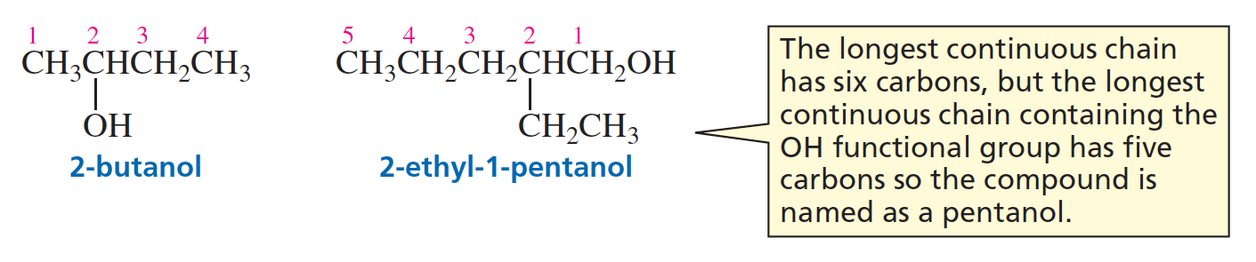
Systematic Names of Alcohols
The parent hydrocarbon is the longest chain containing the functional group.

Slide 7
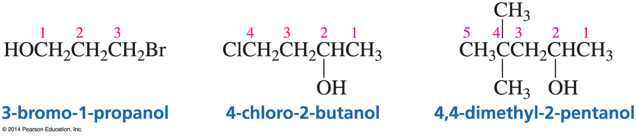
Systematic Names of Alcohols
When there is both a functional group and a substituent, the functional group gets the lowest number.

Slide 8
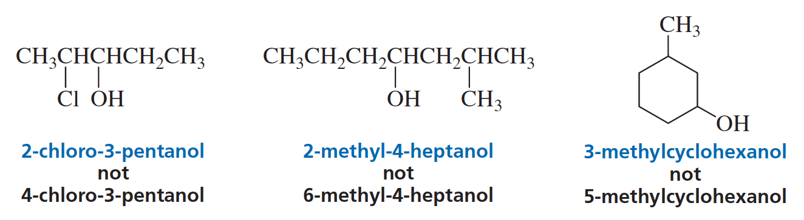
Systematic Names of Alcohols

Slide 9
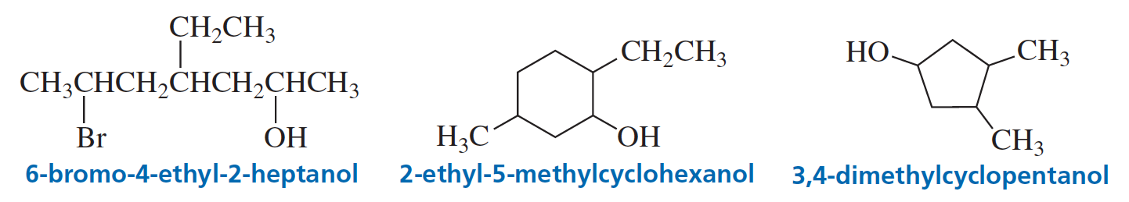
Systematic Names of Alcohols

Slide 10
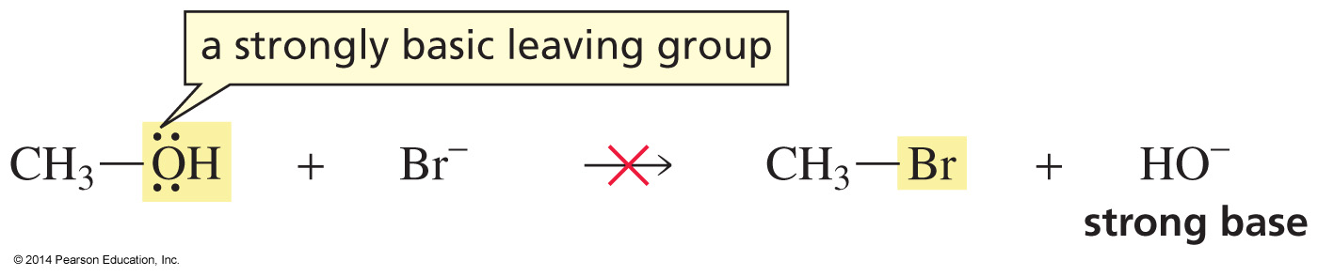
Strongly Basic Leaving Groups
cannot be displaced

Slide 11
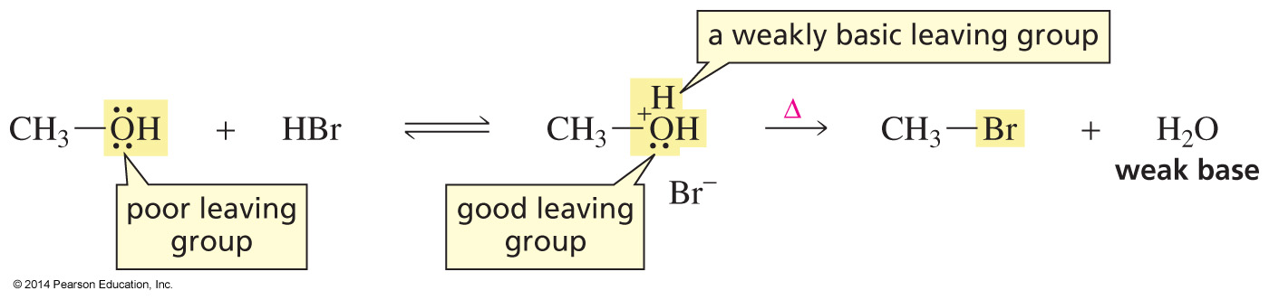
Acid converts the Poor Leaving Group
into a Good Leaving Group
Alcohols have to be “activated” before they can react.
Only weakly basic nucleophiles can be used.
Strongly basic nucleophiles would react with the proton.

Slide 12
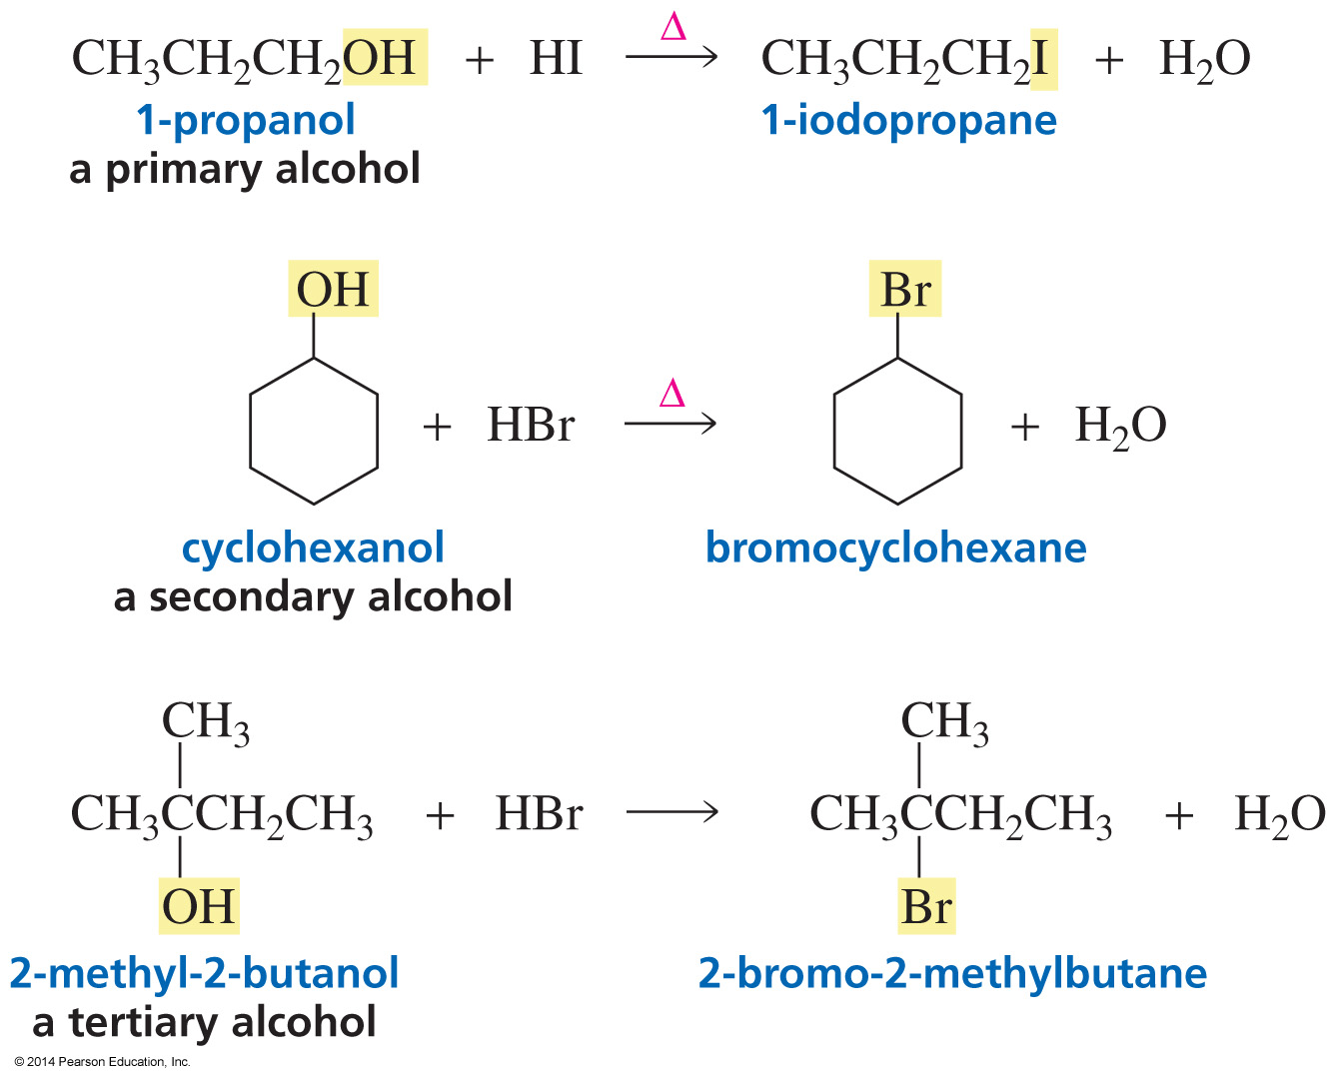
Converting Alcohols to Alkyl Halides
Primary and secondary alcohols require heat for this reaction.
Tertiary alcohols do not.

Slide 13
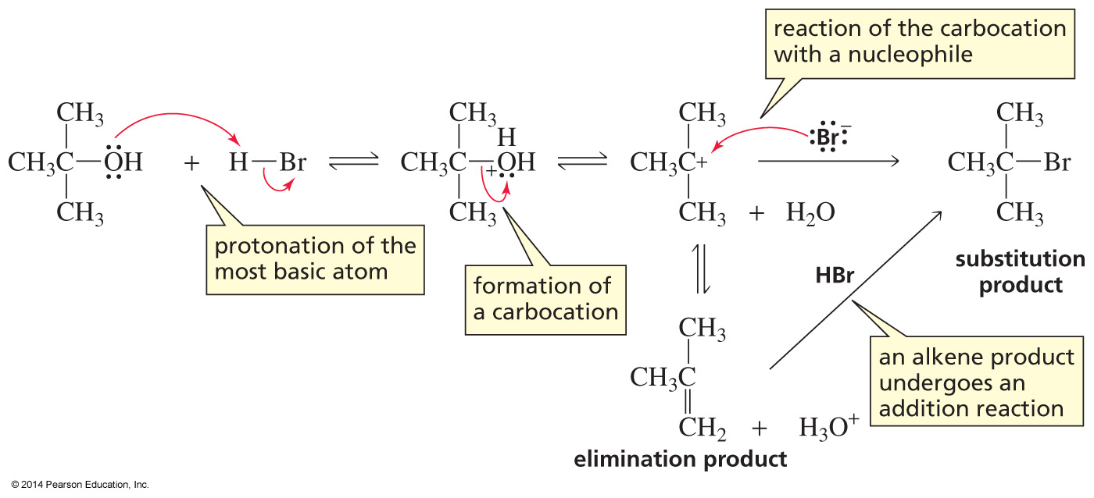
The Reactions of Secondary and Tertiary Alcohols with Hydrogen Halides are S_{N}1 Reactions

Slide 14
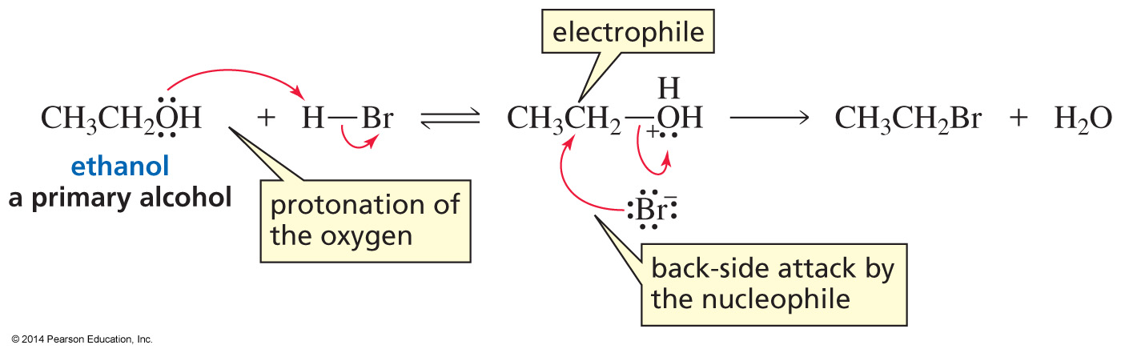
The Reactions of Primary Alcohols with Hydrogen Halides are S_{N}2 Reactions
Alcohols undergo S_{N}1 reactions unless they would have to form a primary carbocation.

Slide 15
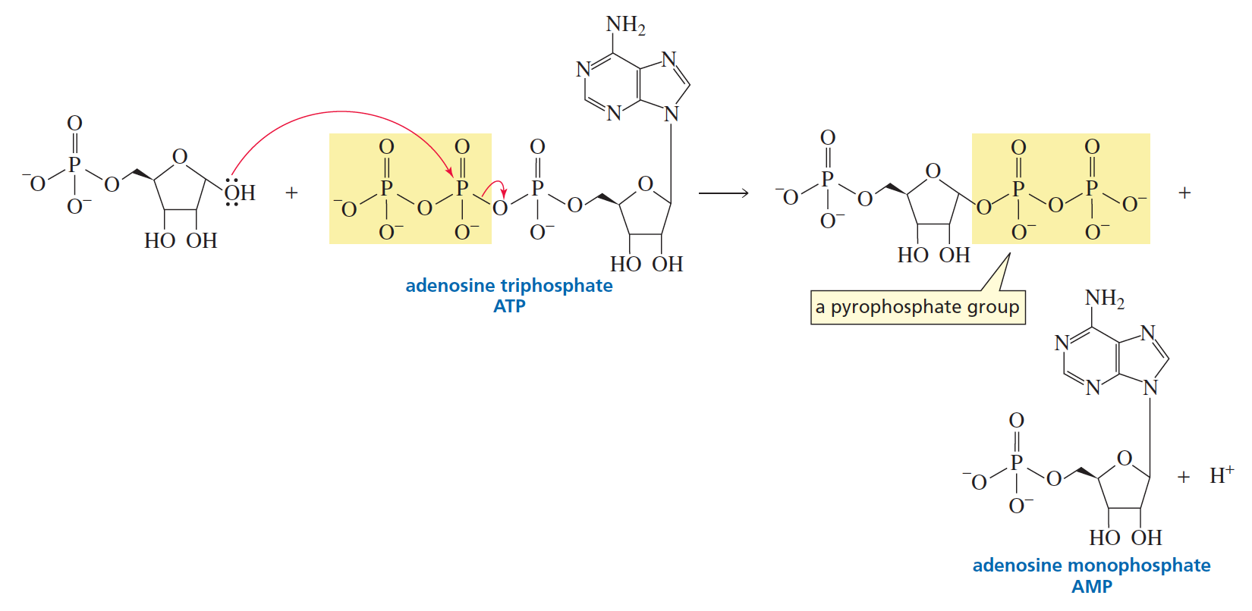
Activating an OH Group for Nucleophilic Substitution in a Cell

Slide 16
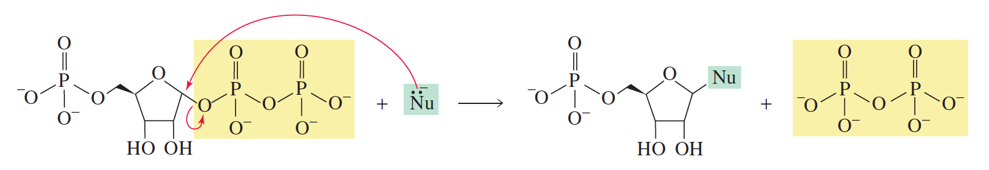
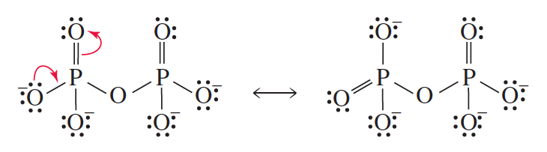
Activating an OH Group for Nucleophilic Substitution in a Cell
Pyrophosphate is a good leaving group (weak base).

Slide 17
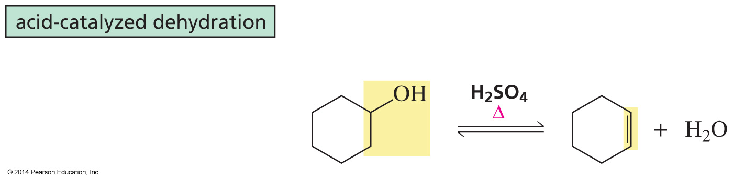
Dehydration of an Alcohol
Dehydration of an alcohol is an elimination reaction.

Slide 18
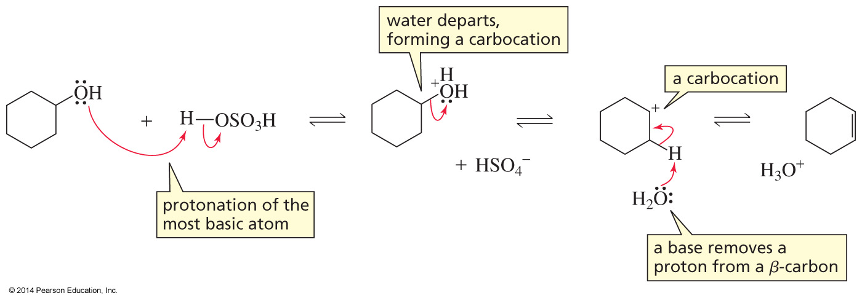
Dehydration of Secondary and Tertiary Alcohols are E1 Reactions

Slide 19
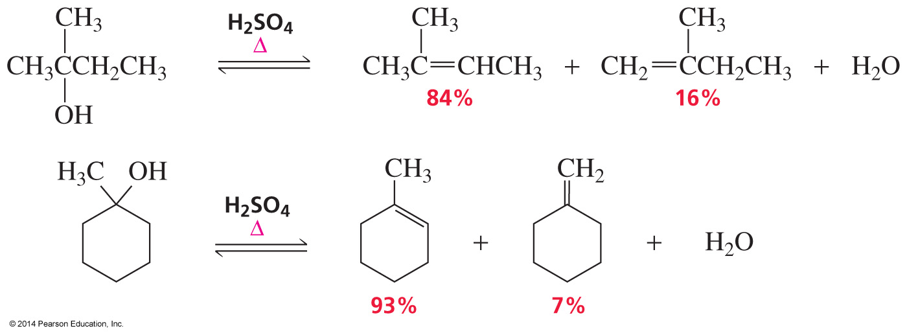
Dehydration is a
Regioselective Reaction
The major product is the more stable alkene.

Slide 20
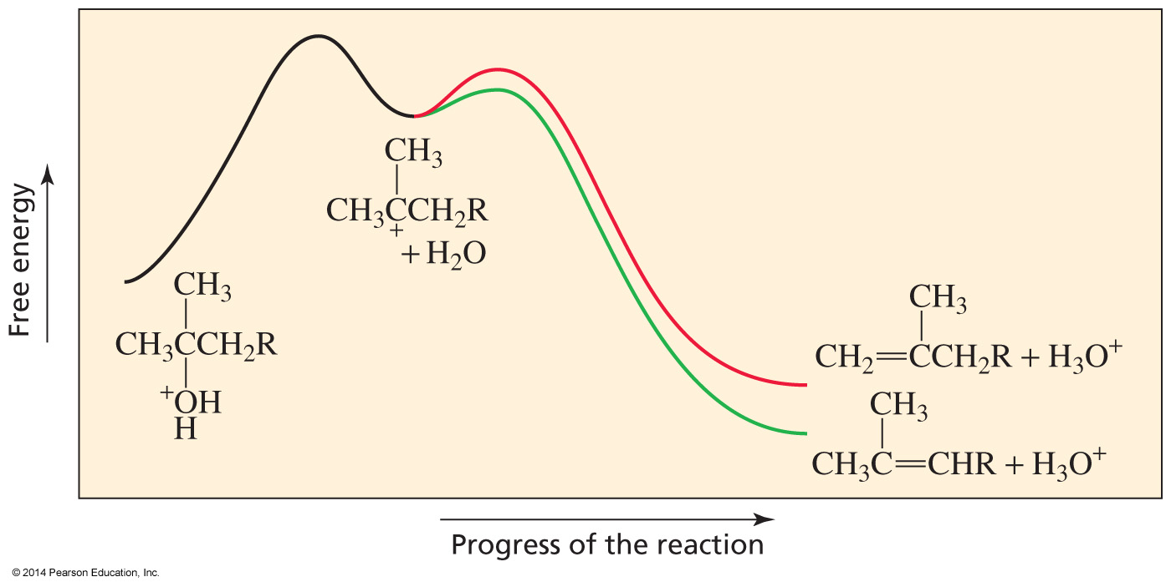
The more stable Alkene has the more stable Transition State leading to its formation

Slide 21
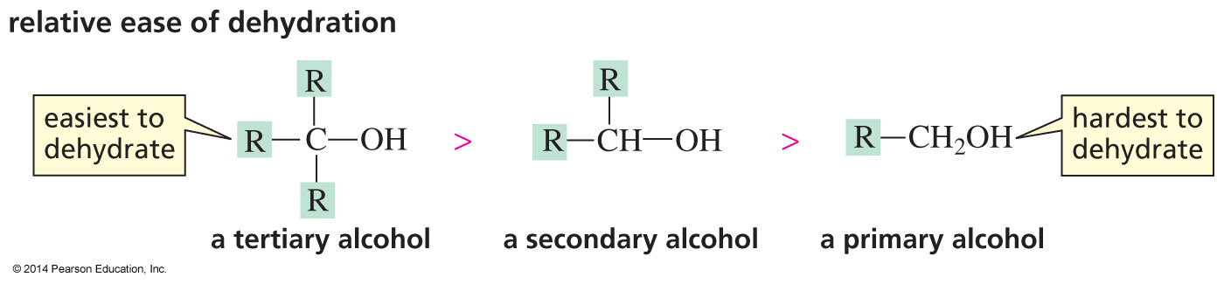
Tertiary Alcohols are the Easiest to Dehydrate
The rate of dehydration reflects the ease of carbocation formation.

Slide 22
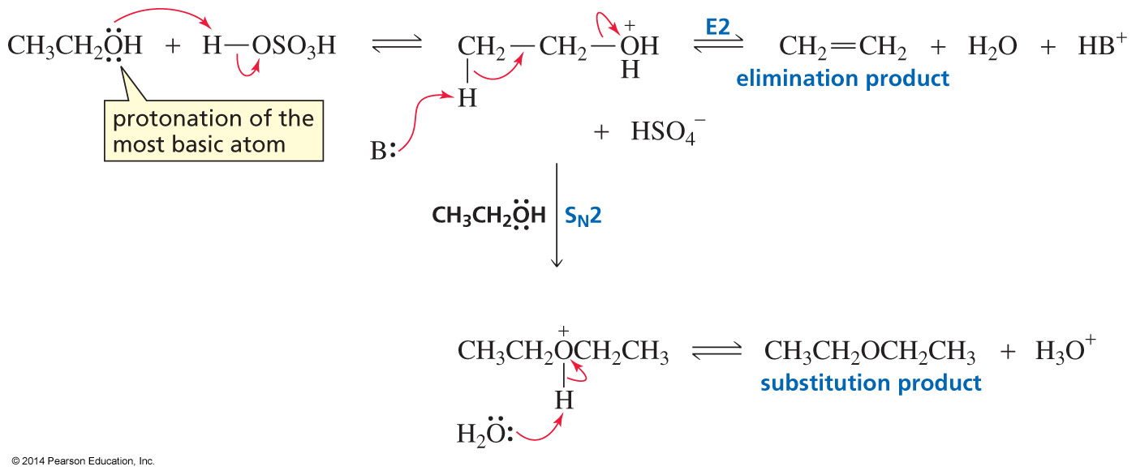
Dehydration of a Primary Alcohol
is an E2 Reaction
Both E2 and S_{N}2 products are obtained.
Alcohols undergo E1 reactions unless they would have to form a primary carbocation.

Slide 23
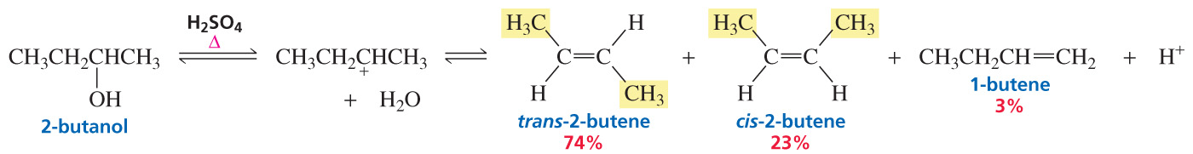
The major product is the Stereoisomer with the largest groups on opposite sides of the Double Bond
The major product has the CH₃ groups on opposites sides of the double bond.

Slide 24
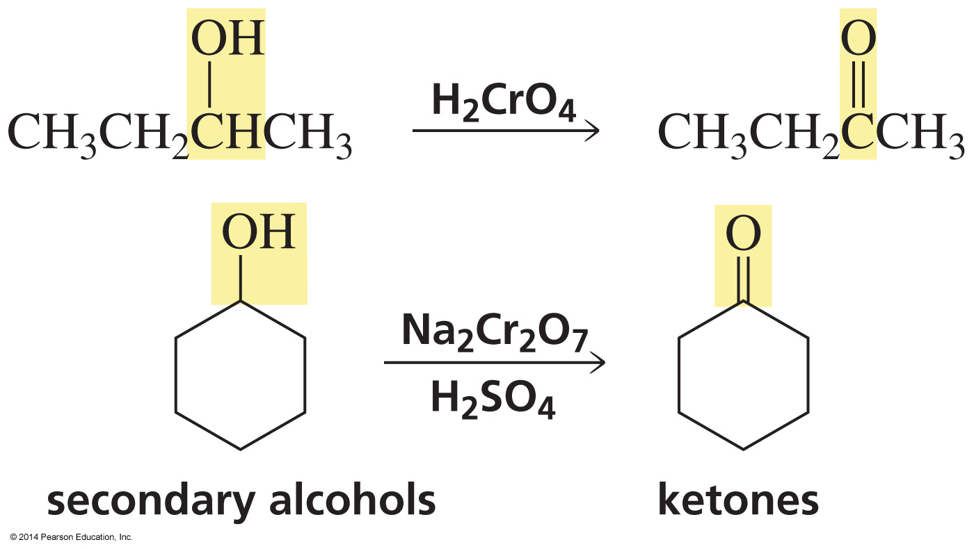
Oxidation of Secondary Alcohols

Slide 25
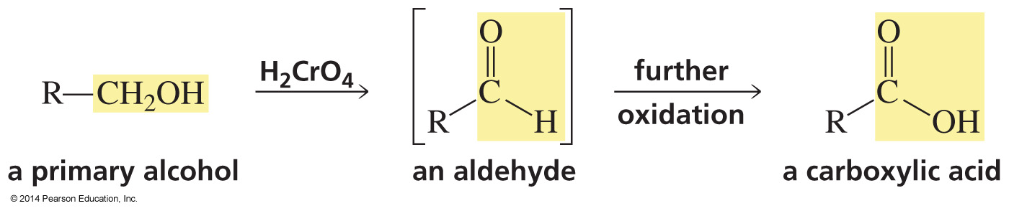
Oxidation of Primary Alcohols

Slide 26
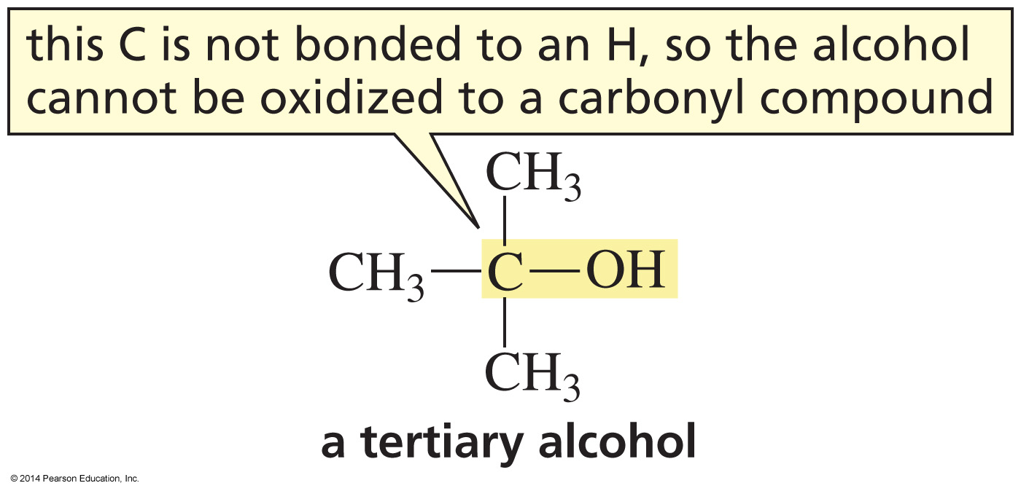
Tertiary Alcohols cannot be Oxidized to a Carbonyl Compound

Slide 27
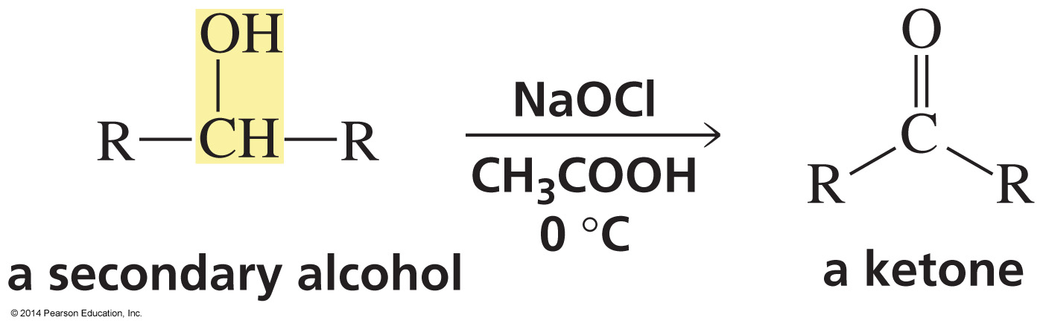
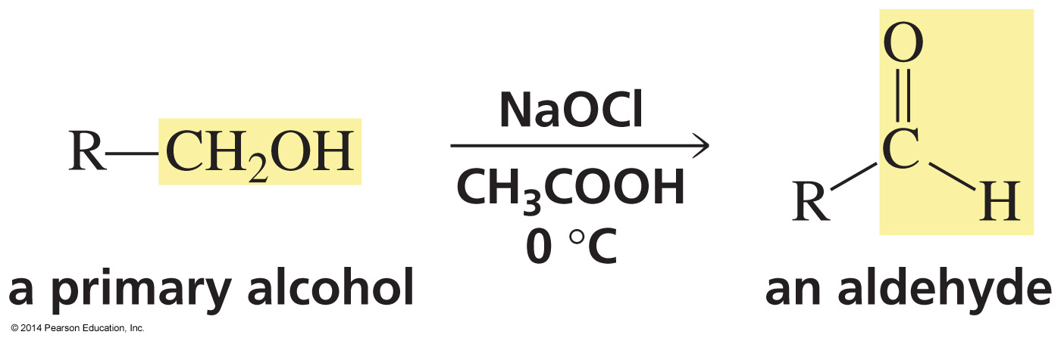
Oxidation by Hypochlorous Acid (HOCl)

Slide 28
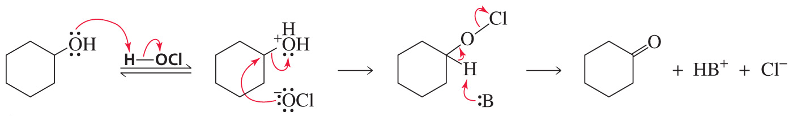
The Mechanism

Slide 29
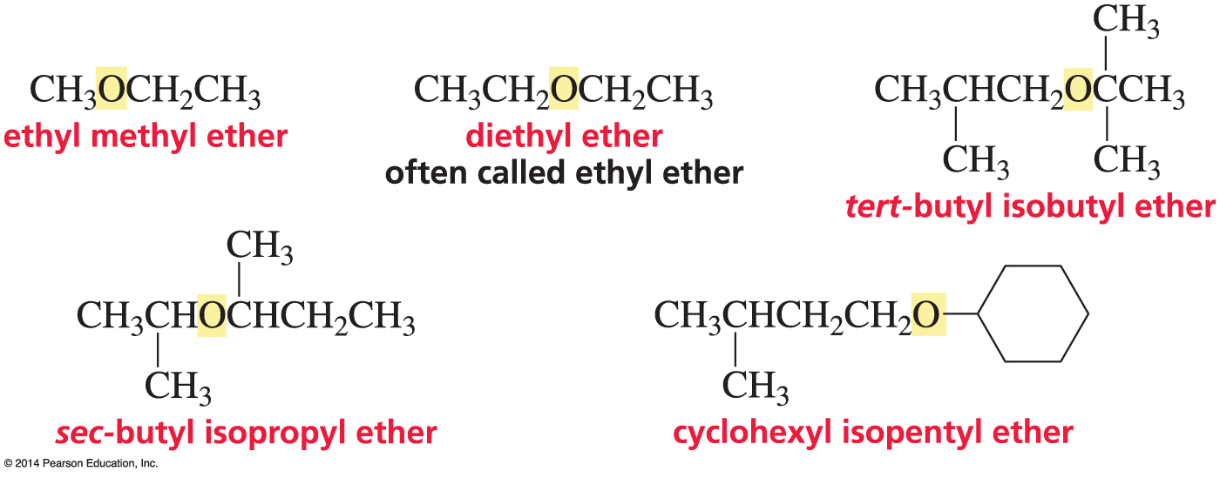
Nomenclature of Ethers
The substituents are listed in alphabetical order.

Slide 30
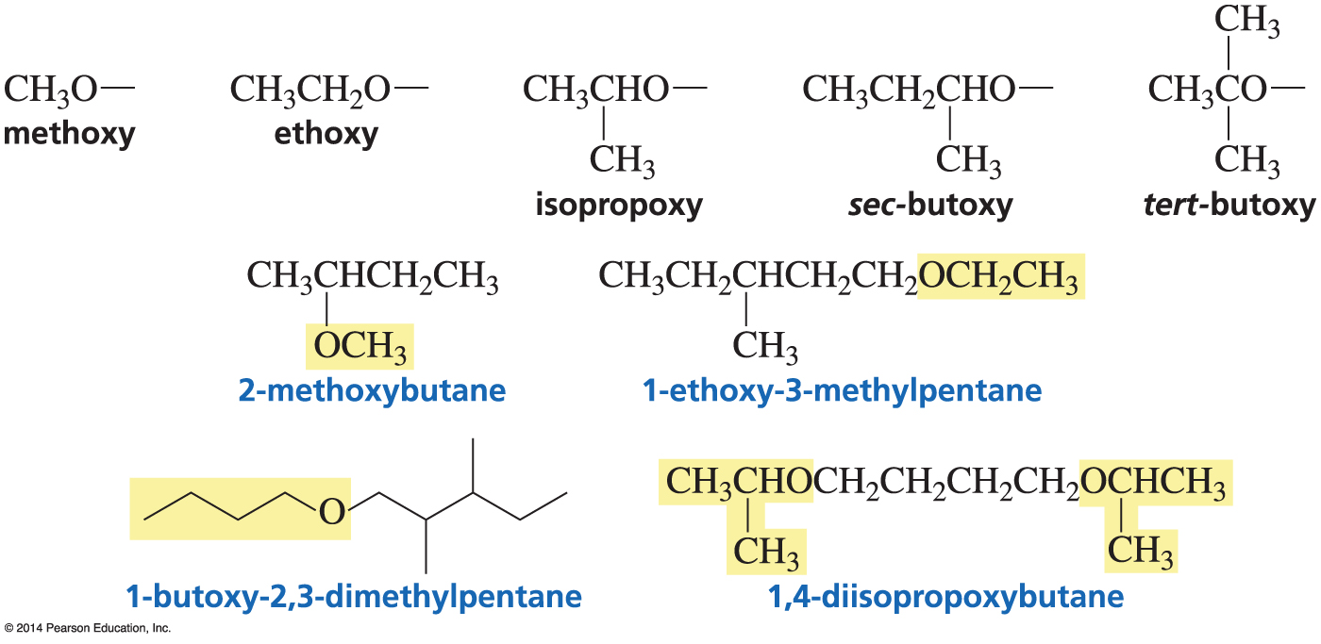
Systematic Names of Ethers

Slide 31
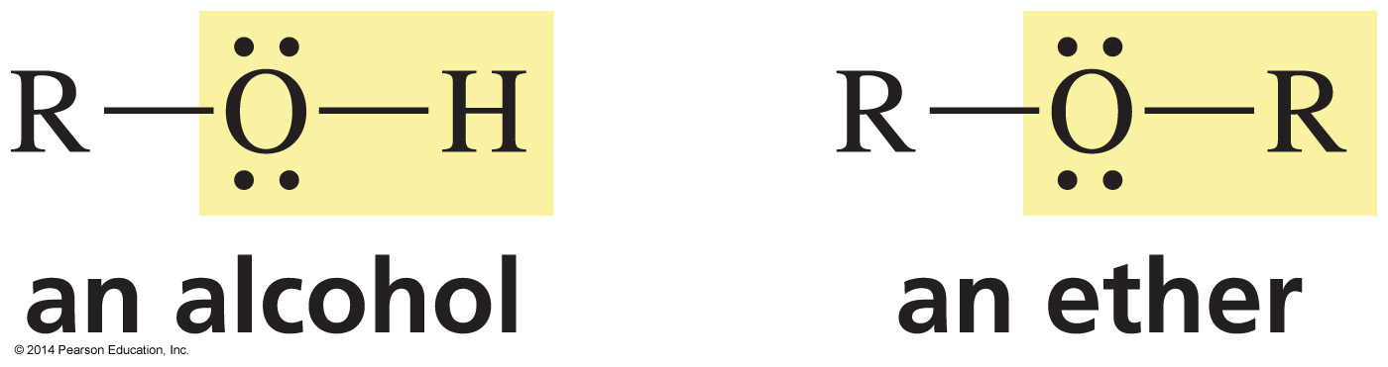
Alcohols and Ethers have
similar Leaving Groups
Alcohols and ethers have to be “activated” before the compounds can react.

Slide 32
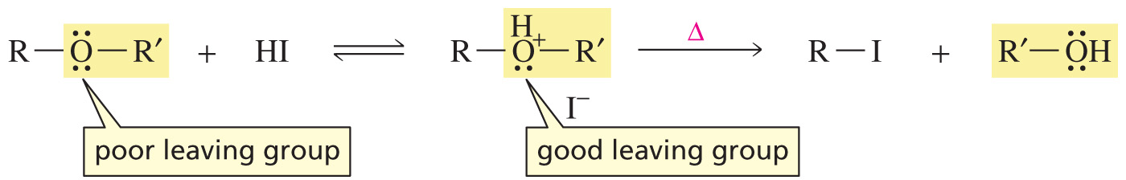
The Leaving Group of an Ether can be activated by Protonation

Slide 33
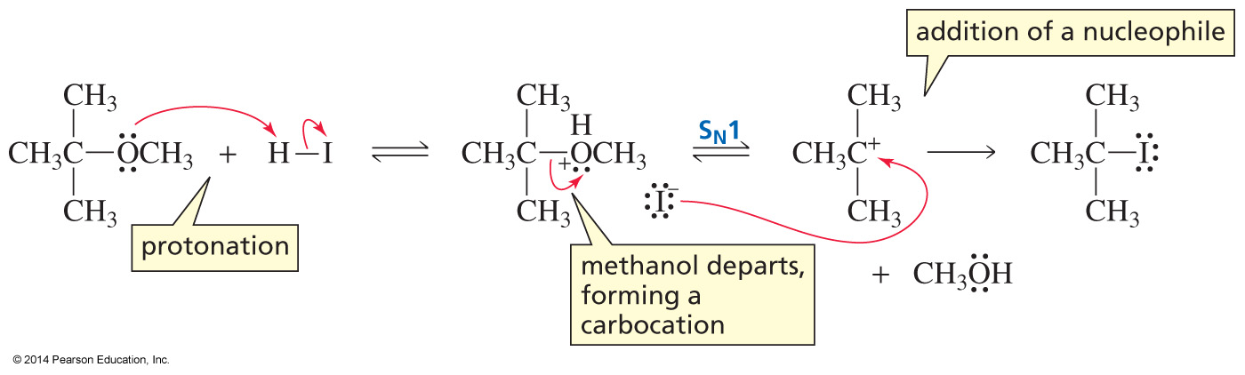
The Mechanism
If a relatively stable carbocation will be formed when ROH leaves, it will be an S_{N}1 reaction.

Slide 34
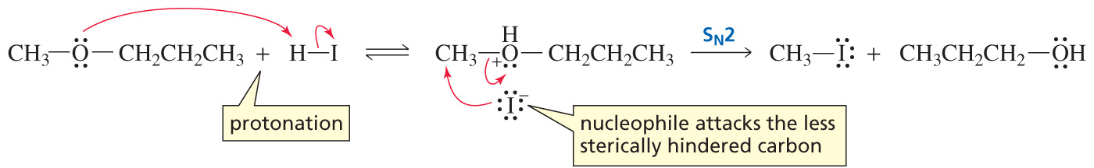
The Mechanism
If a relatively stable carbocation would not be formed when ROH leaves, it will be an S_{N}2 reaction.
Ethers undergo S_{N}1 reactions unless they would have to form a primary carbocation.

Slide 35
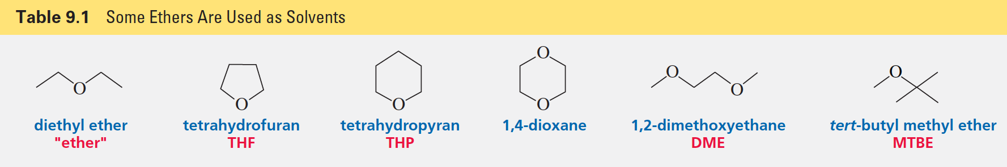
Ethers are common Solvents because they react only with Hydrogen Halides

Slide 36
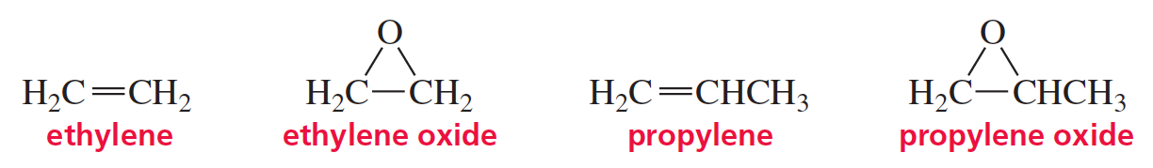
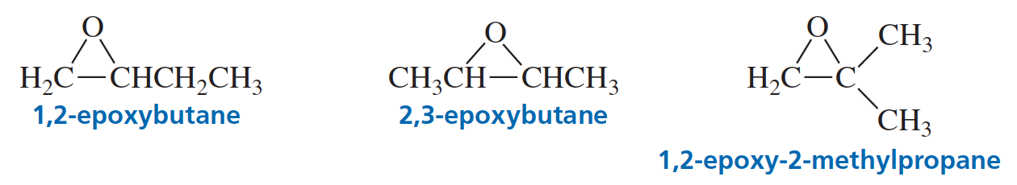
Nomenclature of Epoxides

Slide 37
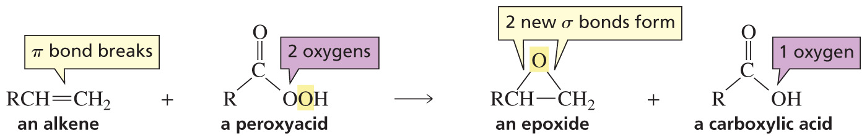
Synthesis of an Epoxide

Slide 38
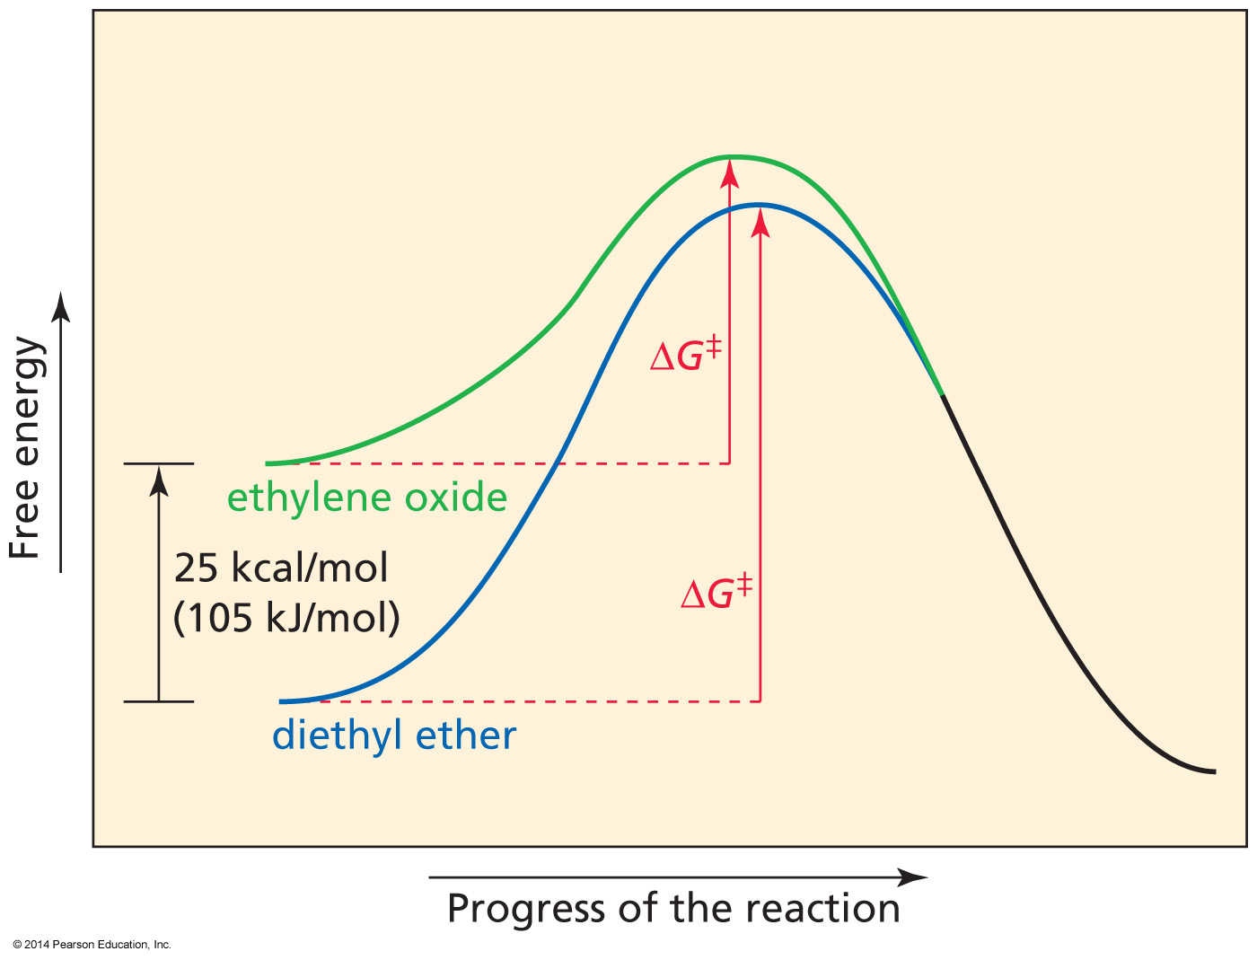
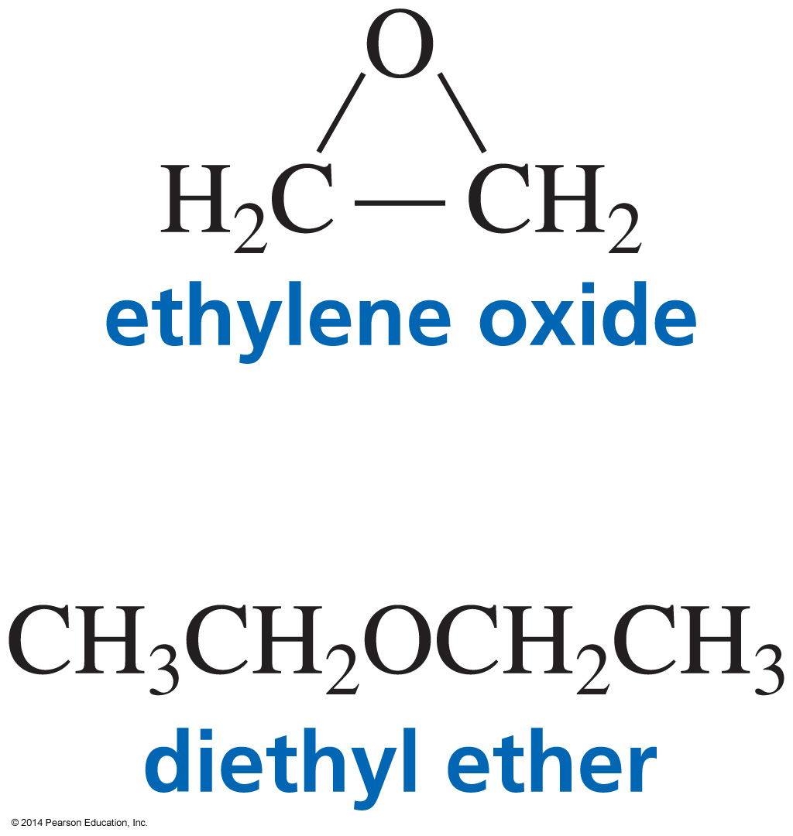
Epoxides are more reactive than Ethers because of Ring Strain

Slide 39
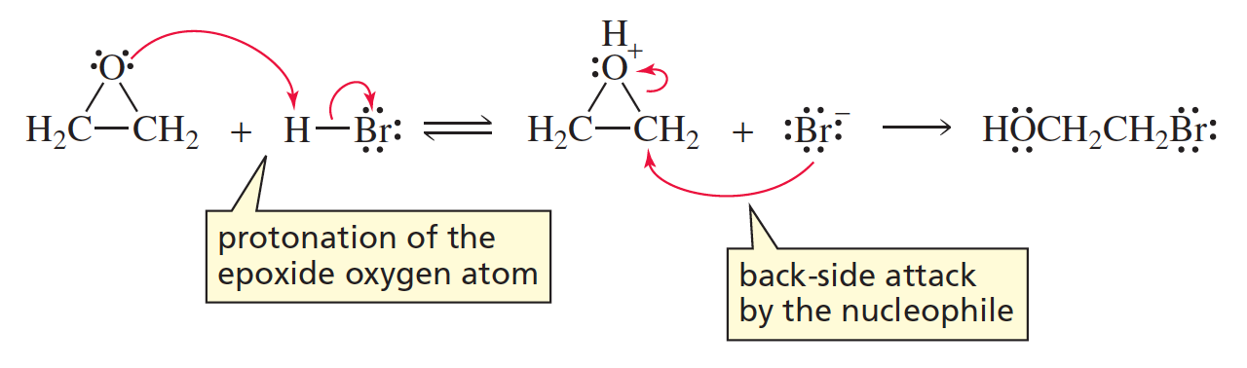
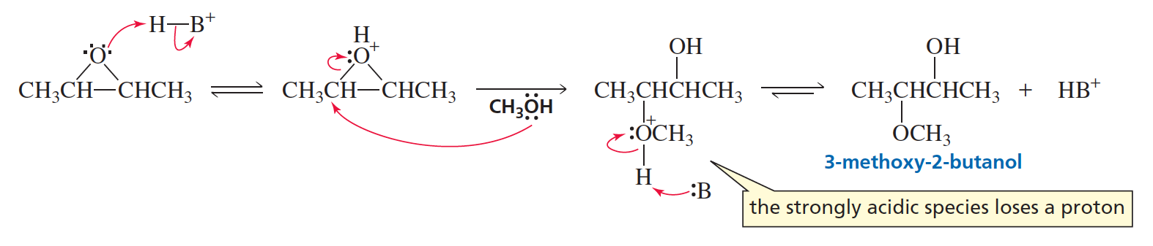
Nucleophilic Substitution of Epoxides:
The Acid-Catalyzed Mechanism

Slide 40
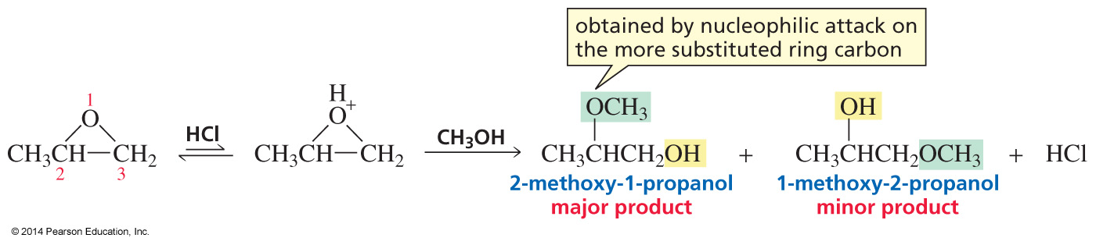
Under acidic conditions, the Nucleophile attacks the more substituted Ring Carbon

Slide 41
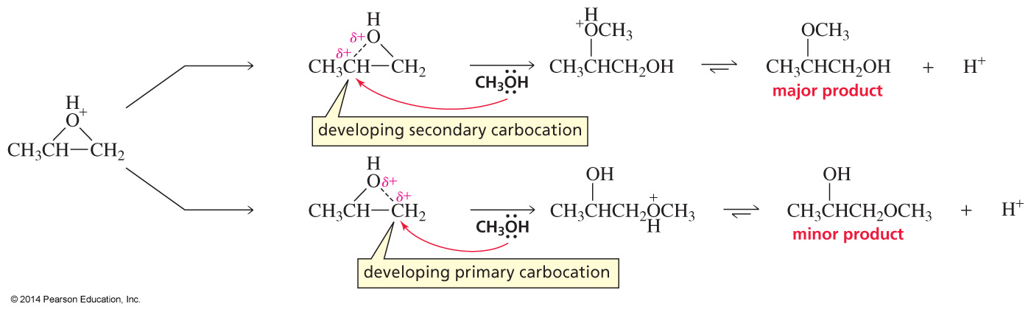
Why the more Substituted Ring Carbon is attacked under acidic conditions
The nucleophile attacks the more substituted ring carbon.

Slide 42

Under neutral or basic conditions, the Nucleophile attacks the less substituted Carbon
The nucleophile attacks the less substituted ring carbon.

Slide 43

The conditions determine
the Site of Nucleophilic Attack

Slide 44

Using Epoxides in Synthesis

Slide 45


Carbocation Stability determines the Carcinogenicity of an Arene Oxide

Slide 46

The more stable the Carbocation, the more likely the Phenolic Product will be formed

Slide 47

Addition Products can be Carcinogenic
If formation of the addition products is faster than formation of the phenol, the arene oxide can be carcinogenic.

Slide 48

Relative Reactivity of Amines

Slide 49

Protonating an Amine does not form a Compound with a Good Leaving Group
Amines cannot undergo substitution and elimination reactions.

Slide 50

Amines are common Organic Bases

Slide 51

Amines are common Nucleophiles

Slide 52

Thiols
Thiols used to be called mercaptans because they capture mercury.

Slide 53

Nomenclature of Thiols

Slide 54

Thiols are good Nucleophiles
in a Protic Solvent
Thiolate ions are better nucleophiles because they are less solvated than are alkoxide ions.
The product is a sulfur analogue of an ether
(thioether or a disulfide).

Slide 55

Thioethers are also Nucleophiles

Slide 56

A Sulfonium Ion is an Alkylating Agent

Slide 57

Methylation by a Chemist

Slide 58

Methylation by a Cell

Slide 59

Noradrenaline to Adrenaline

Slide 60

The Families in Group III

