Slide 1
Chapter 4 Mathematical Functions, Characters, and Strings

Slide 2
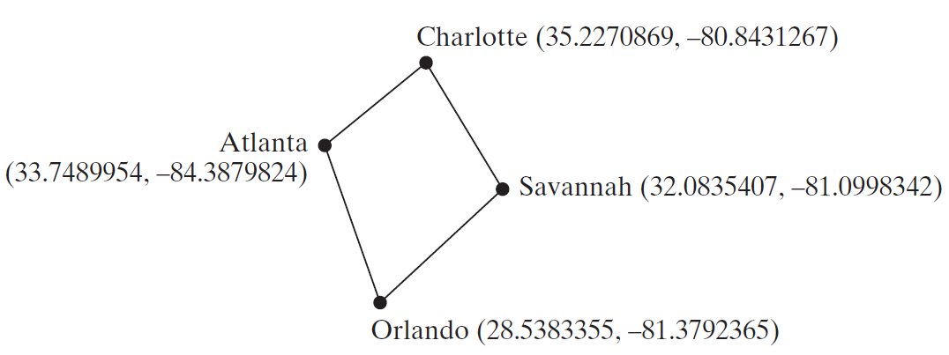
Motivations
Suppose you need to estimate the area enclosed by four cities, given the GPS locations (latitude and longitude) of these cities, as shown in the following diagram. How would you write a program to solve this problem? You will be able to write such a program after completing this chapter.

Slide 3
Objectives
To solve mathematics problems by using the methods in the Math class (§4.2).
To represent characters using the char type (§4.3).
To encode characters using ASCII and Unicode (§4.3.1).
To represent special characters using the escape sequences (§4.4.2).
To cast a numeric value to a character and cast a character to an integer (§4.3.3).
To compare and test characters using the static methods in the Character class (§4.3.4).
To introduce objects and instance methods (§4.4).
To represent strings using the String objects (§4.4).
To return the string length using the length() method (§4.4.1).
To return a character in the string using the charAt(i) method (§4.4.2).
To use the + operator to concatenate strings (§4.4.3).
To read strings from the console (§4.4.4).
To read a character from the console (§4.4.5).
To compare strings using the equals method and the compareTo methods (§4.4.6).
To obtain substrings (§4.4.7).
To find a character or a substring in a string using the indexOf method (§4.4.8).
To program using characters and strings (GuessBirthday) (§4.5.1).
To convert a hexadecimal character to a decimal value (HexDigit2Dec) (§4.5.2).
To revise the lottery program using strings (LotteryUsingStrings) (§4.5.3).
To format output using the System.out.printf method (§4.6).

Slide 4
Mathematical Functions
Java provides many useful methods in the Math class for performing common mathematical functions.

Slide 5
The Math Class
Class constants:
PI
E
Class methods:
Trigonometric Methods
Exponent Methods
Rounding Methods
min, max, abs, and random Methods

Slide 6
Trigonometric Methods
sin(double a)
cos(double a)
tan(double a)
acos(double a)
asin(double a)
atan(double a)
Examples:
Math.sin(0) returns 0.0
Math.sin(Math.PI / 6) returns 0.5
Math.sin(Math.PI / 2) returns 1.0
Math.cos(0) returns 1.0
Math.cos(Math.PI / 6) returns 0.866
Math.cos(Math.PI / 2) returns 0
Radians
toRadians(90)

Slide 7
Exponent Methods
exp(double a)
Returns e raised to the power of a.
log(double a)
Returns the natural logarithm of a.
log10(double a)
Returns the 10-based logarithm of a.
pow(double a, double b)
Returns a raised to the power of b.
sqrt(double a)
Returns the square root of a.
Examples:
Math.exp(1) returns 2.71
Math.log(2.71) returns 1.0
Math.pow(2, 3) returns 8.0
Math.pow(3, 2) returns 9.0
Math.pow(3.5, 2.5) returns 22.91765
Math.sqrt(4) returns 2.0
Math.sqrt(10.5) returns 3.24

Slide 8
Rounding Methods
double ceil(double x)
x rounded up to its nearest integer. This integer is returned as a double value.
double floor(double x)
x is rounded down to its nearest integer. This integer is returned as a double value.
double rint(double x)
x is rounded to its nearest integer. If x is equally close to two integers, the even one is returned as a double.
int round(float x)
Return (int)Math.floor(x+0.5).
long round(double x)
Return (long)Math.floor(x+0.5).

Slide 9
Rounding Methods Examples
Math.ceil(2.1) returns 3.0
Math.ceil(2.0) returns 2.0
Math.ceil(-2.0) returns –2.0
Math.ceil(-2.1) returns -2.0
Math.floor(2.1) returns 2.0
Math.floor(2.0) returns 2.0
Math.floor(-2.0) returns –2.0
Math.floor(-2.1) returns -3.0
Math.rint(2.1) returns 2.0
Math.rint(2.0) returns 2.0
Math.rint(-2.0) returns –2.0
Math.rint(-2.1) returns -2.0
Math.rint(2.5) returns 2.0
Math.rint(-2.5) returns -2.0
Math.round(2.6f) returns 3
Math.round(2.0) returns 2
Math.round(-2.0f) returns -2
Math.round(-2.6) returns -3

Slide 10
min, max, and abs
max(a, b)and min(a, b)
Returns the maximum or minimum of two parameters.
abs(a)
Returns the absolute value of the parameter.
random()
Returns a random double value in the range [0.0, 1.0).
Examples:
Math.max(2, 3) returns 3
Math.max(2.5, 3) returns 3.0
Math.min(2.5, 3.6) returns 2.5
Math.abs(-2) returns 2
Math.abs(-2.1) returns 2.1

Slide 11
The random Method
Generates a random double value greater than or equal to 0.0 and less than 1.0 (0 <= Math.random() < 1.0).
Examples:
In general,

Slide 12
Case Study: Computing Angles of a Triangle
Write a program that prompts the user to enter the x- and y-coordinates of the three corner points in a triangle and then displays the triangle’s angles.
ComputeAngles

Slide 13
Character Data Type
Four hexadecimal digits.
char letter = 'A'; (ASCII)
char numChar = '4'; (ASCII)
char letter = '\u0041'; (Unicode)
char numChar = '\u0034'; (Unicode)
NOTE: The increment and decrement operators can also be used on char variables to get the next or preceding Unicode character. For example, the following statements display character b.
char ch = 'a';
System.out.println(++ch);

Slide 14
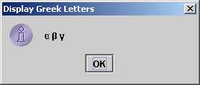
Unicode Format
Java characters use Unicode, a 16-bit encoding scheme established by the Unicode Consortium to support the interchange, processing, and display of written texts in the world’s diverse languages. Unicode takes two bytes, preceded by \u, expressed in four hexadecimal numbers that run from '\u0000' to '\uFFFF'. So, Unicode can represent 65535 + 1 characters.
Unicode \u03b1 \u03b2 \u03b3 for three Greek letters

Slide 15
ASCII Code for Commonly Used Characters

Slide 16
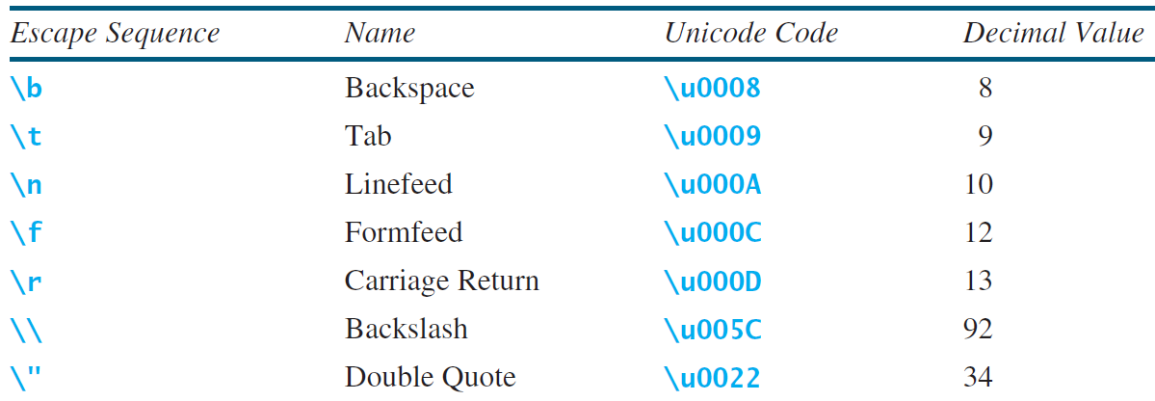
Escape Sequences for Special Characters

Slide 17
Appendix B: ASCII Character Set
ASCII Character Set is a subset of the Unicode from \u0000 to \u007f

Slide 18
ASCII Character Set, cont.
ASCII Character Set is a subset of the Unicode from \u0000 to \u007f

Slide 19
Casting between char and Numeric Types
int i = 'a'; // Same as int i = (int)'a';
char c = 97; // Same as char c = (char)97;

Slide 20
Comparing and Testing Characters
if (ch >= 'A' && ch <= 'Z')
System.out.println(ch + " is an uppercase letter");
else if (ch >= 'a' && ch <= 'z')
System.out.println(ch + " is a lowercase letter");
else if (ch >= '0' && ch <= '9')
System.out.println(ch + " is a numeric character");

Slide 21
Methods in the Character Class

Slide 22
Formatting Output
Use the printf statement.
System.out.printf(format, items);
Where format is a string that may consist of substrings and format specifiers. A format specifier specifies how an item should be displayed. An item may be a numeric value, character, boolean value, or a string. Each specifier begins with a percent sign.

Slide 23
Frequently-Used Specifiers
Specifier Output Example
%b a boolean value true or false
%c a character 'a'
%d a decimal integer 200
%f a floating-point number 45.460000
%e a number in standard scientific notation 4.556000e+01
%s a string "Java is cool"

Slide 24
FormatDemo
The example gives a program that uses printf to display a table.
FormatDemo

