Slide 1

Internal Audit (ACCT 337)
Chapter 1
Introduction to Internal Audit

Slide 2

Course outline
Welcome
Course Prerequisite
Lectures
Exams, Assignments and Quizzes
Course Objectives

Slide 3
Professional certificates
Field | Applicable standards | Board/Institute | Certificate
Financial ACCT | GAAP/IFRS | FASB/IASB | CPA/CMA
Managerial ACCT | - | IMA | CMA
External Audit | GAAS/ISA | AICPA/IAASB | CPA
Internal Audit | IIA Standards | IIA | CIA

Slide 4

Introduction
Listed entities: IAF
Misperception: police function?
What is internal audit??!!
Key terms:
  Institute of IAs (www.theiia.org)
  IAF (IAD)
  CAE
  BOD
  AC

Slide 5
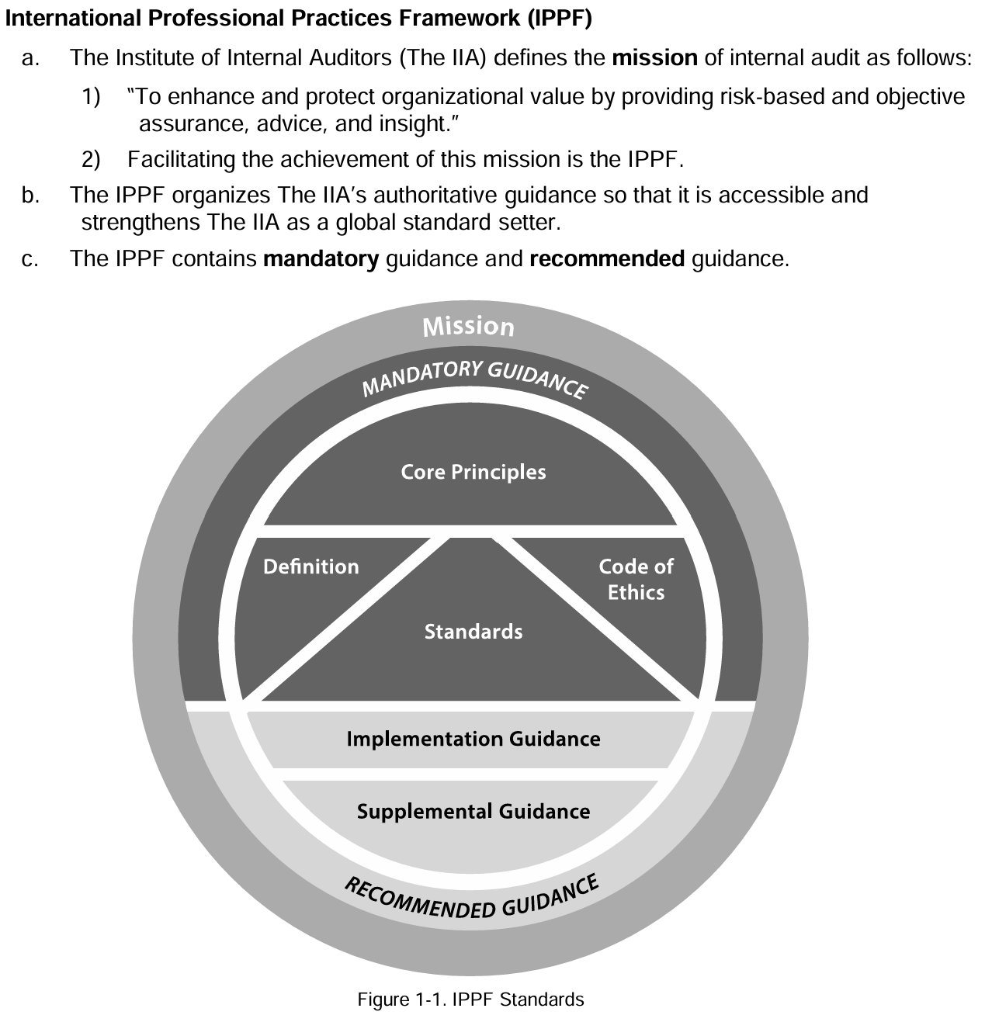
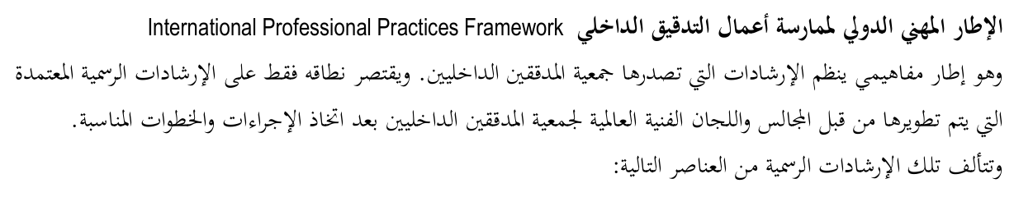
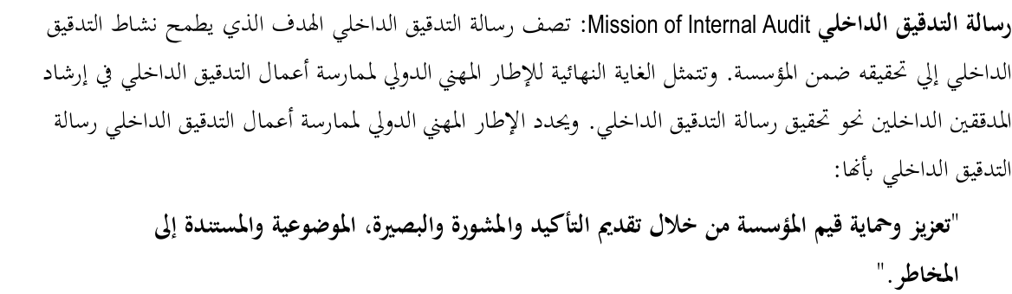

Slide 6
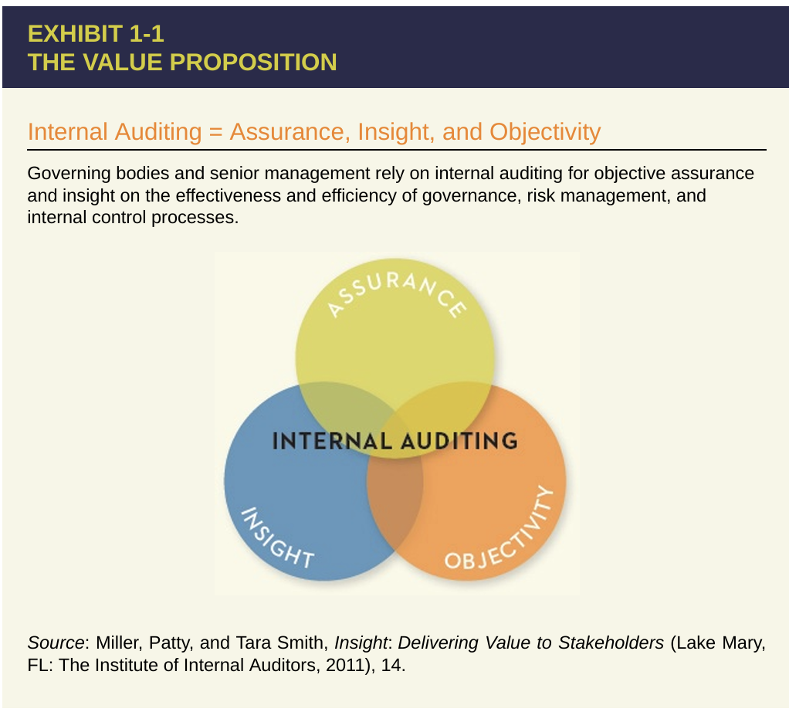
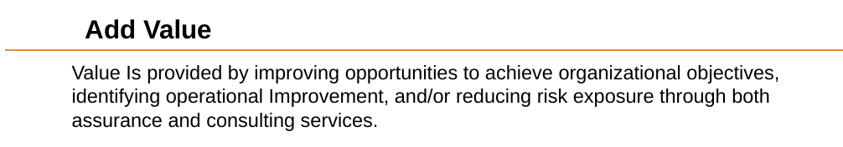
Internal Audit Value Proposition

Slide 7
Internal Audit Value Proposition
The IIA formed a task force in 2008 “to explore and develop a clear and concise description of internal audit’s value proposition…” In 2010, the IIA Global Board of Directors, The IIA’s governing body, endorsed the outcomes of the task force’s work.
The three components of the value proposition are defined below:
1- Assurance = Governance, Risk, and Control.
Internal audit provides assurance on the organization’s governance, risk management, and control processes to help the organization achieve its strategic, operational, financial, and compliance objectives.
2- Insight = Catalyst, Analyses, and Assessments.
Internal audit is a catalyst for improving an organization’s effectiveness and efficiency by providing insight and recommendations based on analyses and assessments of data and business process.
3- Objectivity = Integrity, Accountability, and Independence.
With commitment to integrity and accountability, internal audit provides value to governing bodies and senior management as an objective source of independent advice

Slide 8
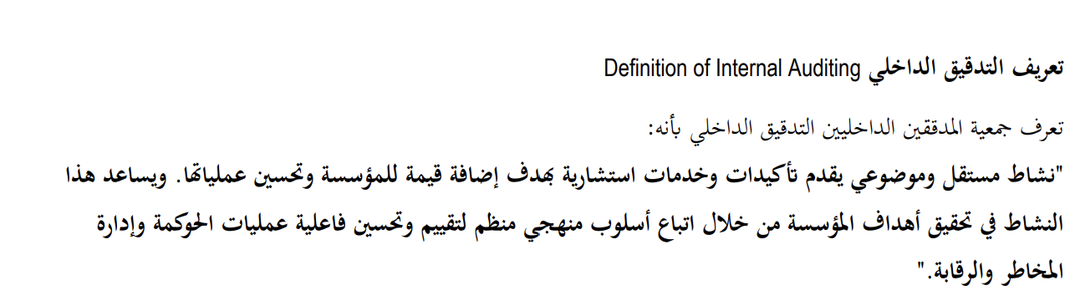
Definition of Internal Auditing
The IIA’s Board of Directors adopted the current definition of internal
auditing in 1999:
“Internal auditing is an independent, objective assurance and consulting activity designed to add value and improve an organization's operations. It helps an organization accomplish its objectives by bringing a systematic, disciplined approach to evaluate and improve the effectiveness of risk management, control, and governance processes”.
KEY TOPICS
T1- it helps an organization accomplish its objectives
T2- evaluate and improve the effectiveness of risk management, control, and governance processes
T3- assurance and consulting activity
T4- independent, objective
T5- a systematic, disciplined approach

Slide 9
T1: It helps an organization accomplish its objectives (1 of 3)
Objective: what the organization wants to achieve.
COSO:
  Committee of Sponsoring Organizations of the Treadway Commission
  Joint initiative of 5 organizations: for the development of framework for risk management and internal controls.
    AAA: American Accounting Association
    AICPA: American Institute of Certified Public Accountants
    FEI: Financial Executives International
    IMA: Institute of Management Accountants
    IIA: Institute of Internal Auditors
COSO report: 4 types of objectives

Slide 10
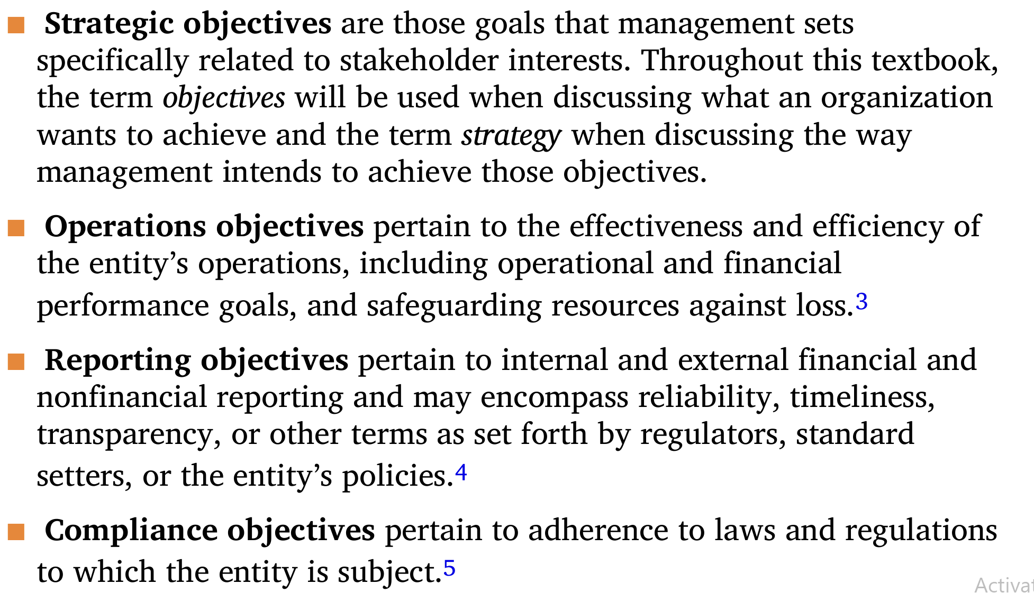
It helps an organization accomplish its objectives (2 of 3)
Types of Objectives:
Strategic Objectives: long term
Operations Objectives: efficiency and effectiveness of operations
Reporting Objectives: Reliability of internal/external reporting of financial/nonfinancial information
Compliance Objectives: with applicable law and regulations

Slide 11
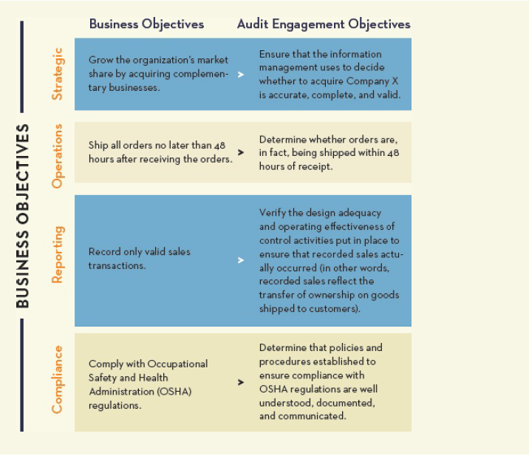
It helps an organization accomplish its objectives (3 of 3)
Business objectives is the foundation for defining internal audit engagement objectives (what the IA wants to achieve).

Slide 12
T2: Evaluate and improve the effectiveness of risk management, control, and governance processes.
Governance :
  Process conducted by BOD
  To authorize, direct and oversee management toward the achievement of the organization’s objectives
Risk Management :
  Process conducted by Management
  To understand and deal with risks (negatively affect the entity ability to achieve its objectives.
Internal Control:
  Process conducted by Management
  To mitigate risks to acceptable levels.

Slide 13
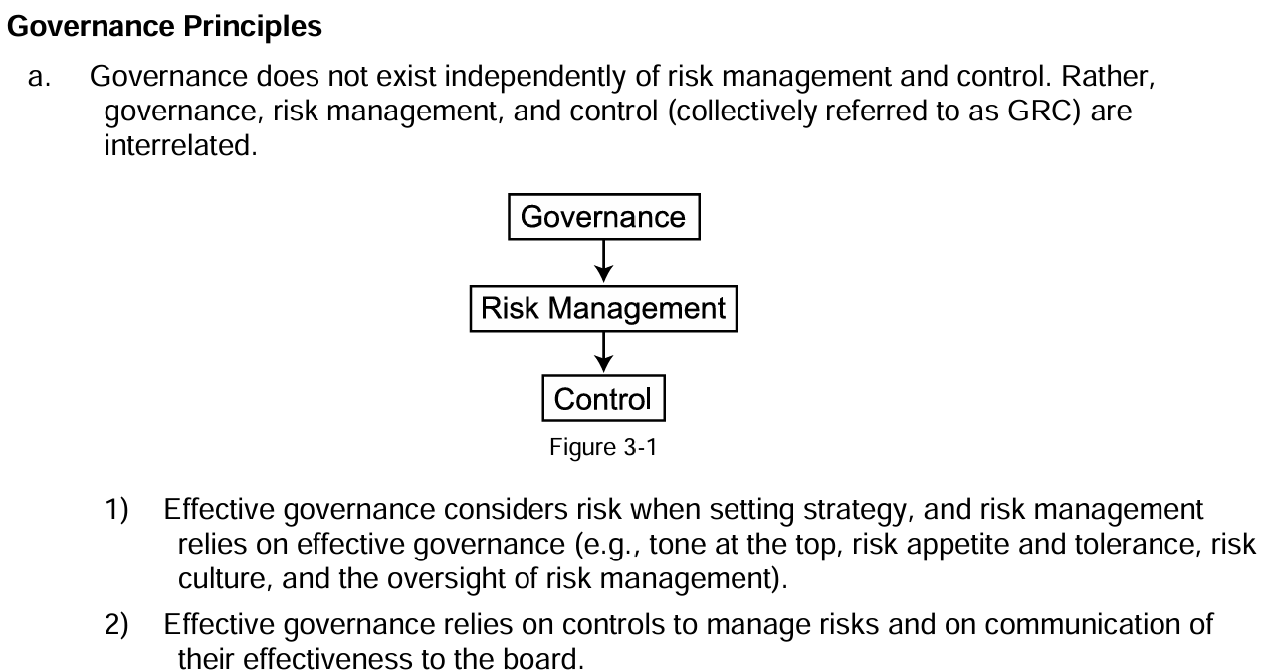
T2: Understanding GRC

Slide 14

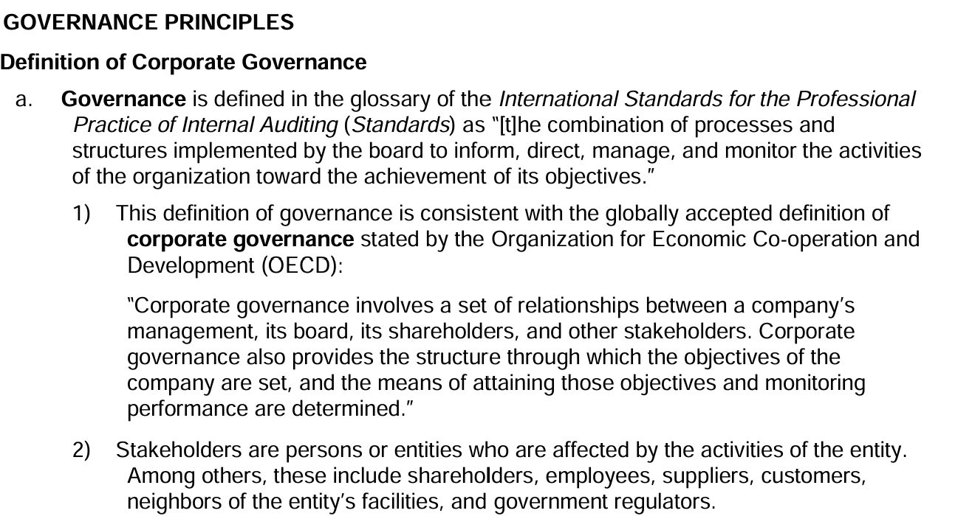
T2: GOVERNANCE (1/2)

Slide 15
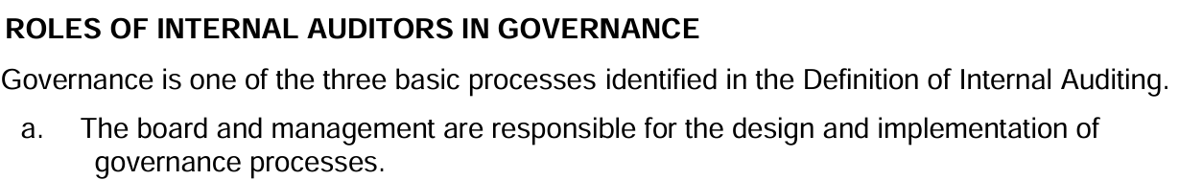
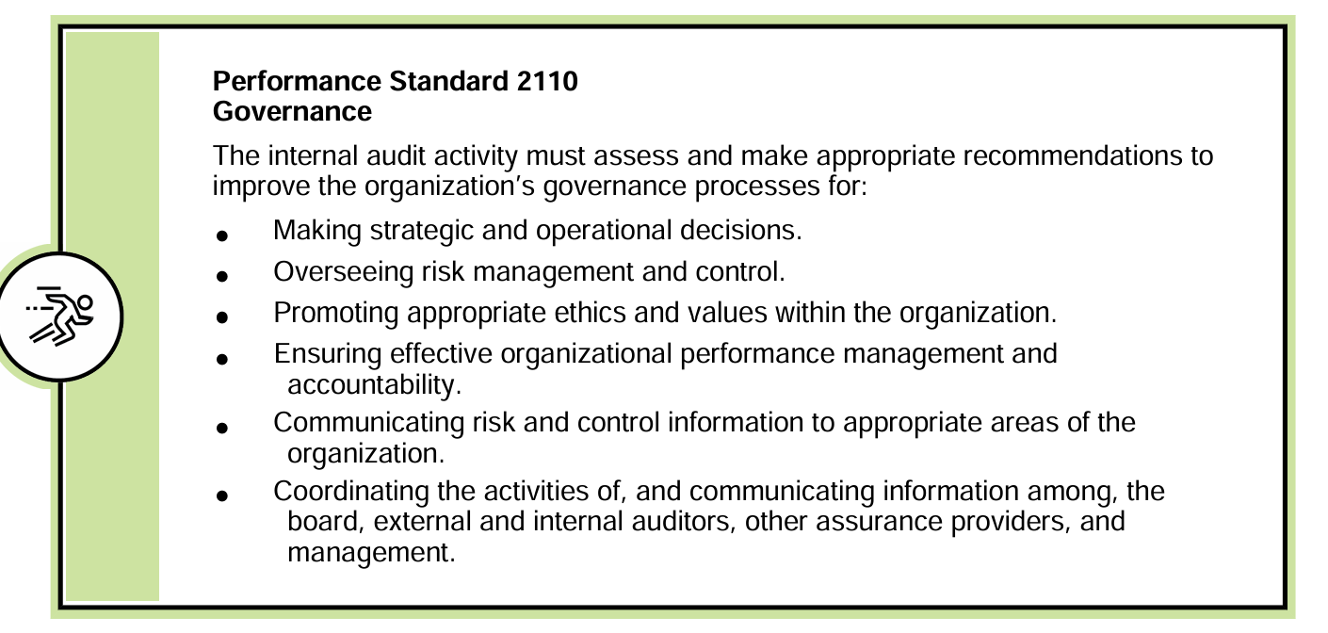
T2: GOVERNANCE (2/2)

Slide 16

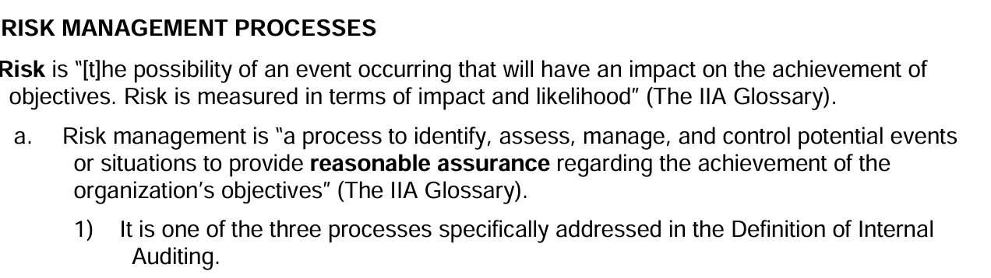
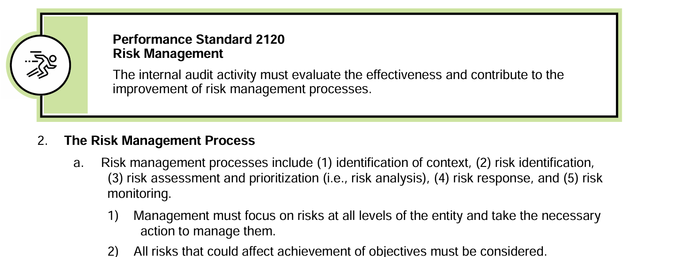
T2: RISK MANAGEMENT (1/2)

Slide 17

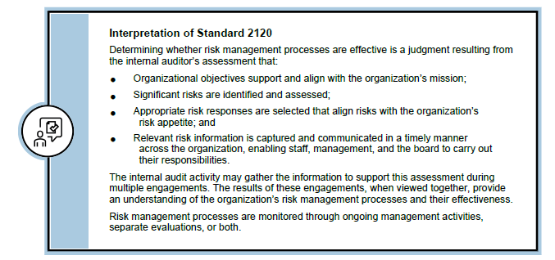
T2: RISK MANAGEMENT (2/2)

Slide 18

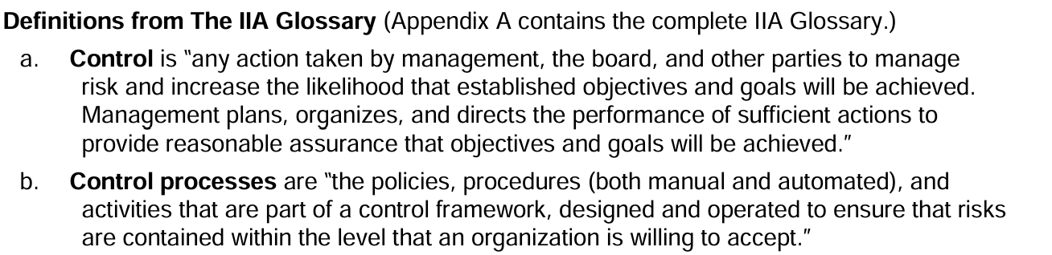
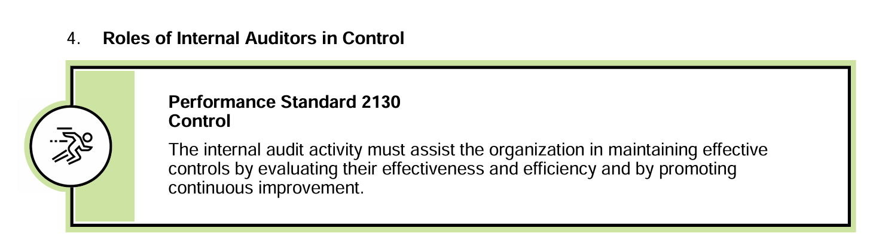
T2: CONTROL

Slide 19
T2: Example for Governance, Risk Management, and Control (GRC)
Scenario: University Course Registration System
1. Governance: The university’s Academic Council oversees the policies and procedures for course registration. They establish guidelines on how students can register for courses, how many credits they can take, and the deadlines for registration. The council ensures that the registration process aligns with the university’s academic goals, such as maintaining a balanced student workload and ensuring that required courses are available to students.
2. Risk Management: The university’s IT department identifies risks related to the course registration system, such as the risk of system overload during peak registration times, potential data breaches, or errors in course enrollment. To manage these risks, the IT department implements a risk management plan that includes stress-testing the system, enhancing cybersecurity measures, and creating a backup system in case the main system fails.
3. Control: To enforce the policies and mitigate risks, the university implements controls within the registration system. These controls include requiring students to log in with secure credentials, limiting the number of course credits they can register for based on academic policies, and setting system alerts for any anomalies, such as a student trying to register for more credits than allowed. Additionally, the system is monitored in real-time to detect and address any issues immediately. The controls within the registration system ensure that the rules set by the Academic Council are followed and that the risks identified by the IT department are managed effectively. This helps maintain the integrity of the registration process.
How is GRC Connected:
Governance establishes the policies and framework for the course registration process.
Risk Management identifies potential threats to the registration process and plans ways to mitigate them.
Controls are the mechanisms put in place to ensure the registration process adheres to the governance framework and that risks are minimized.
Where Internal Audit Falls in the GRC Framework:
Internal audit intersects with Governance, Risk Management, and Control by providing an independent evaluation of each component:
In Governance, internal audit assesses whether the governance structures are aligned with the university's goals and if they are being adhered to.
In Risk Management, internal audit evaluates how well risks are identified and managed, ensuring that risk management practices are both effective and efficient.
In Control, internal audit tests and confirms that controls are working as intended to mitigate risks and ensure compliance with policies.

Slide 20

T3: Assurance and consulting activity (1/3)
Assurance Engagement: Auditee
Consulting Engagement: Customer
Differences:
Primary purpose
Assurance:
assess evidence and provide conclusions
Consulting:
provide advice
Who determines nature and scope:
Assurance:
IAF
Consulting: Customer/Client and IAF
Parties involved:
Assurance:
Three (Auditee/IA/Users)
Consulting:
Two (Customer or Client/IA)

Slide 21
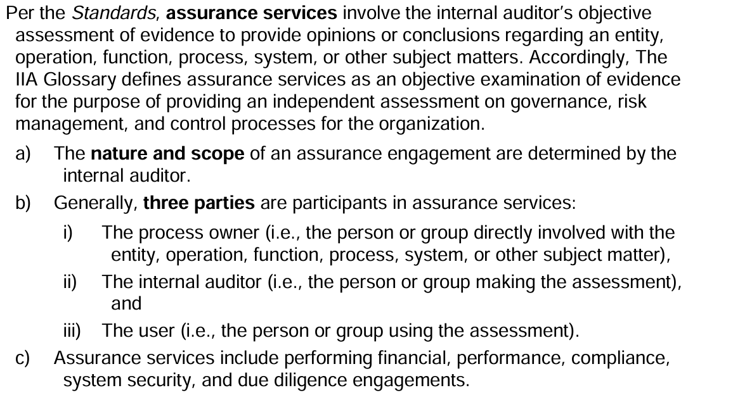
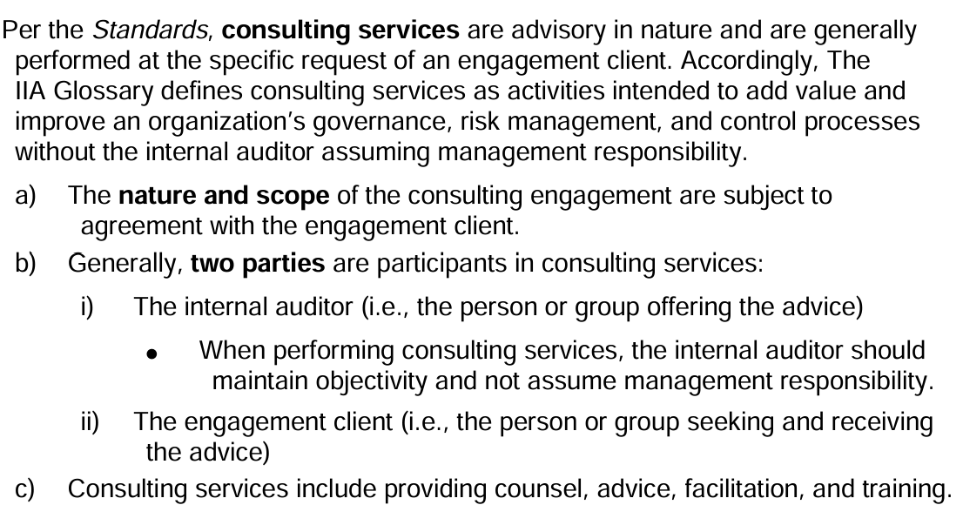
T3: Assurance vs. Consulting (2/3)

Slide 22
T3: Assurance vs. Consulting Example (3/3)
Scenario: Your company wants to ensure that its payroll process is accurate and secure.
Assurance Service Example:
What It Is: The company asks the internal auditor to review the current payroll process. The auditor examines how payroll is being managed—whether employees are paid the correct amounts on time, and if the payroll records are accurate. The auditor provides a report on whether the payroll system is functioning correctly, identifying any errors or weaknesses.
Key Participants:
  Process Owner: The HR or Payroll department responsible for managing payroll.
  Internal Auditor: The one evaluating the payroll process.
  User: The company’s management, who will use the auditor’s report to ensure that payroll is being handled properly.
Consulting Service Example:
What It Is: The company is considering switching to a new payroll software and asks the internal auditor for advice. The auditor provides suggestions on how to transition to the new system smoothly, identifies potential risks (like data migration issues), and recommends best practices for setting up the new system. The focus is on providing guidance to improve the payroll process.
Key Participants:
  Internal Auditor: The one offering advice on the new payroll system.
  Client: The HR or IT department responsible for implementing the new payroll software, seeking guidance on the transition.
Key Difference:
Assurance is about the internal auditor checking the existing payroll process to make sure it’s accurate and secure.
Consulting is about the internal auditor advising on how to improve or set up a new payroll system.

Slide 23

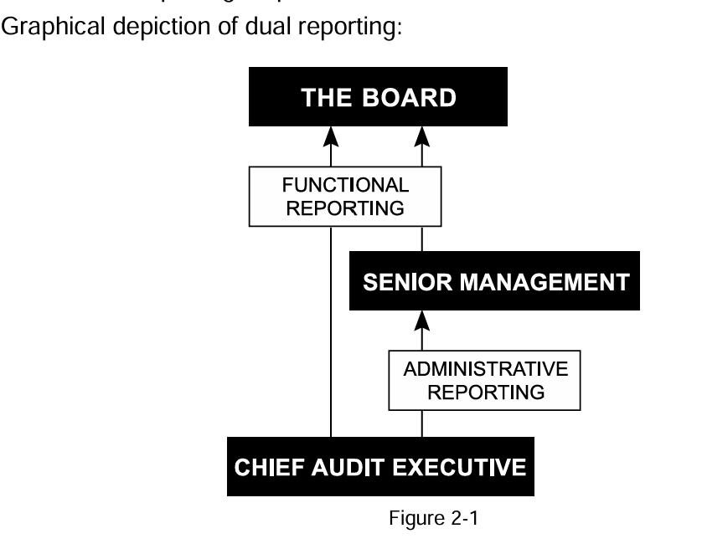
T4: Independence and Objectivity
Independence:
  Achieved throughout the organizational status of the Internal Audit Function (IAF)
  CAE reports functionally to BOD or Audit Committee (AC) and administratively to CEO
Objectivity:
  Mental attitude of individual IAs
  Should not
    Involve themselves in day to day operations
    make management decisions
    avoid conflict of interest (12 months must elapse)

Slide 24
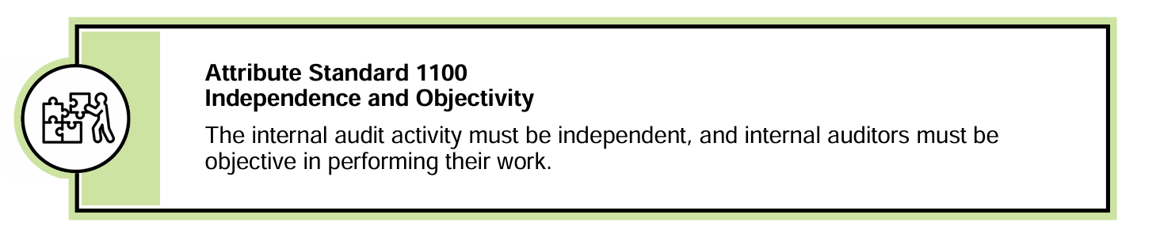
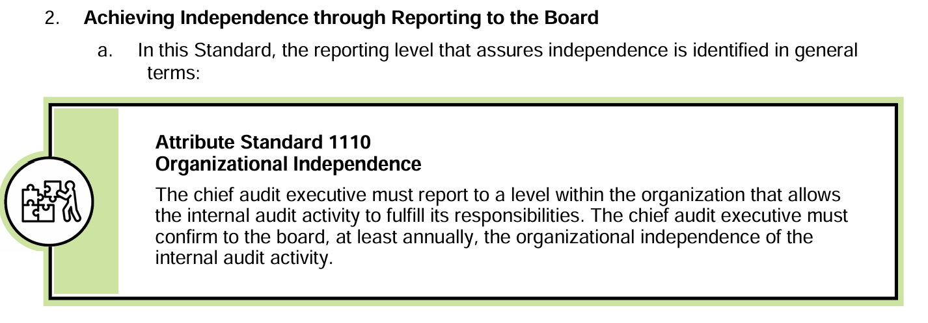
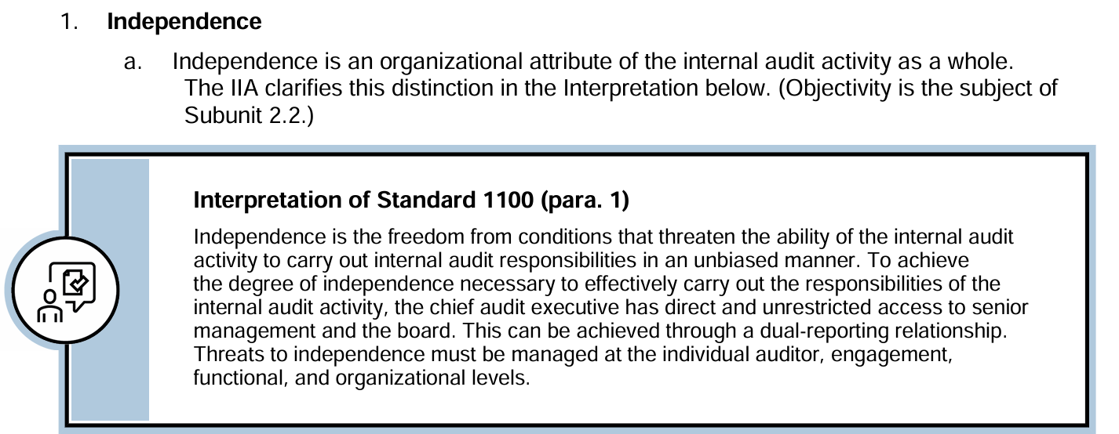
T4: Independence and Objectivity (IIA standards)-Independence

Slide 25
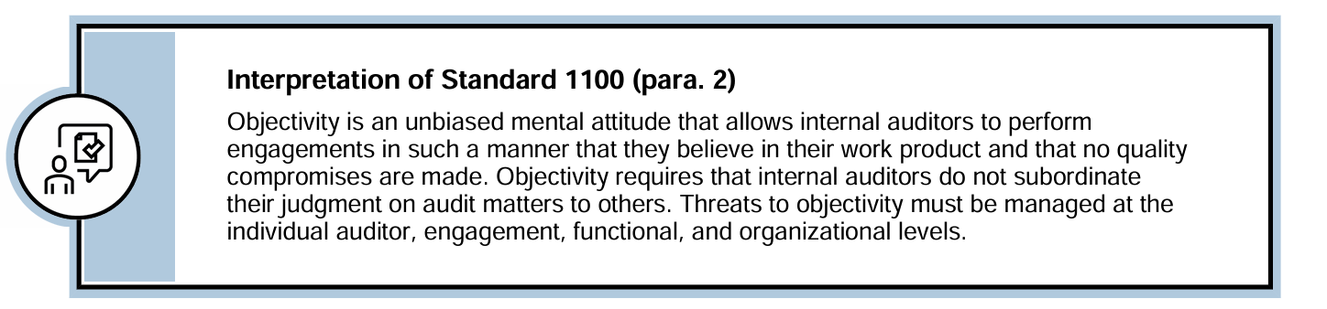
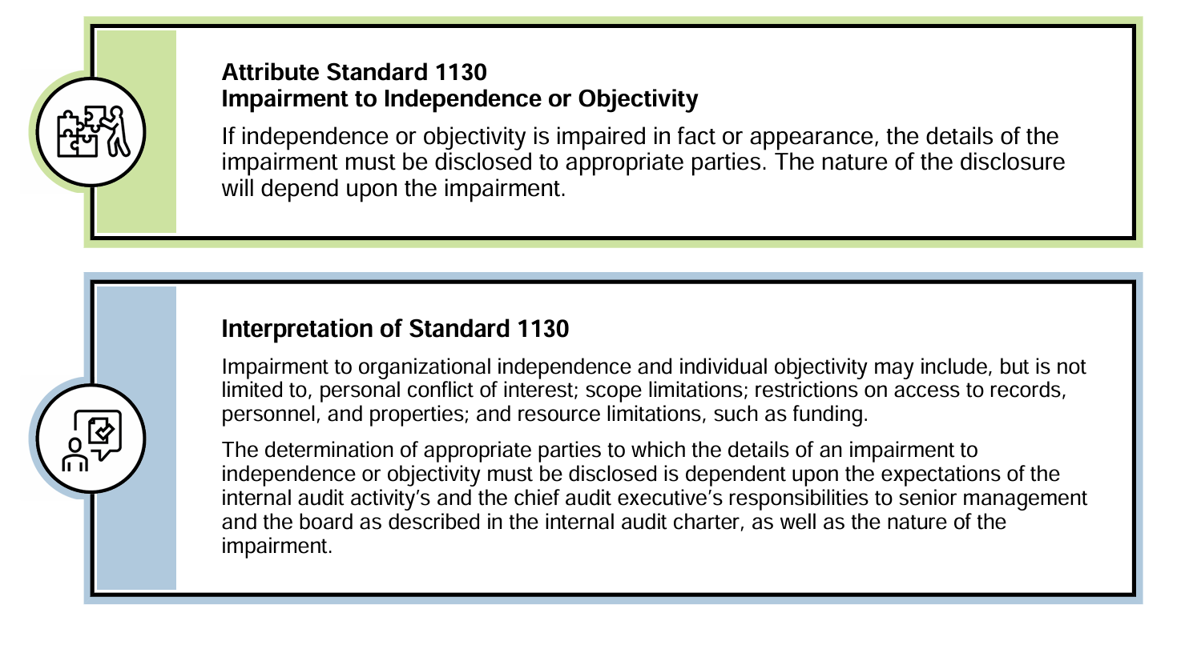
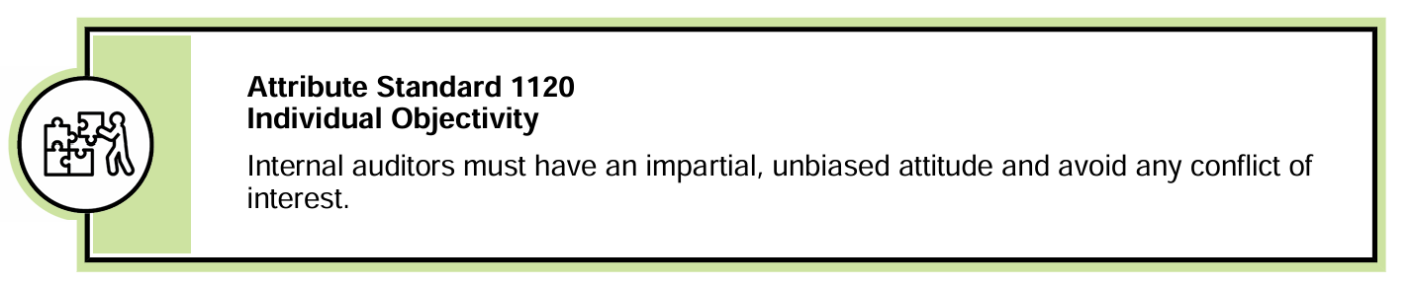
T4: Independence and Objectivity (IIA standards)-Objectivity

Slide 26
T4: Independence and Objectivity-Example 1
Example of an Independence Violation
Scenario: The internal audit department is scheduled to audit the company's financial reporting process. However, the Chief Audit Executive (CAE) reports directly to the Chief Financial Officer (CFO), who is responsible for the financial reports being audited. The CFO subtly implies that a negative audit report could lead to budget cuts for the audit department, which could affect the CAE's team and resources.
Why This Is an Independence Violation: In this scenario, the CAE’s independence is compromised because the person to whom they report (the CFO) is the same person responsible for the area being audited. This creates a conflict of interest where the CAE may feel pressured to avoid reporting issues within the financial reporting process to protect the audit department’s budget and their own position. This structural relationship impairs the CAE's ability to conduct an unbiased and objective audit.

Slide 27
T4: Independence and Objectivity-Example 2
Example of an Objectivity Violation
Scenario: An internal auditor is reviewing the procurement process within the organization. During the audit, the procurement manager, who is also a close friend of the auditor, asks the auditor to overlook a minor issue in the process to avoid any potential scrutiny. The auditor, not wanting to harm the friendship, decides to downplay the issue in the audit report.
Why This Is an Objectivity Violation: The auditor’s personal relationship with the procurement manager has compromised their ability to remain impartial. The auditor should evaluate and report all findings based on the evidence, without letting personal relationships influence their judgment. Here, the auditor’s mental attitude and decision-making have been biased due to the friendship.

Slide 28

T5: Systematic and Disciplined Approach
The Engagement Process
To truly add value and improve operations, internal assurance and consulting engagements must be performed in a systematic and disciplined manner.
An Engagement is a specific internal audit assignment or project that includes multiple tasks or activities designed to accomplish a specific set of objectives.
The 3 fundamental phases in the internal audit engagement process are:
  1- Planning the engagement (objectives)
  2- Performing the engagement (testing)
  3- Communicating engagement outcomes. (reporting)

Slide 29

Accounting vs. Auditing
The relationship of auditing to accounting is close, yet their natures are very different; they are business associates, not parent and child.
Accounting includes the collection, classification, summarization, and communication of financial data; it involves the measurement and communication of business events and conditions as they affect and represent a given enterprise or other entity.
Auditing must consider business events and conditions too, but it does not have the task of measuring or communicating them. Its task is to review the measurements and communications of accounting for propriety.
Auditing is analytical, critical, investigative, concerned with the basis for accounting measurements and assertions (evidence).
Internal assurance and consulting services are also analytical and investigative; they are based on logic, which involves reasoning and drawing inferences

Slide 30

Differences between Internal Audit and External Audit
Opinion
Primary users

Slide 31

External vs. Internal Auditing
External Auditing:
A financial statement audit is a form of assurance service in which the firm issues a written attestation report that expresses an opinion about whether the financial statements are fairly stated in accordance with Generally Accepted Accounting Principles (GAAP).
It also attests to the effectiveness of the company’s internal control over financial reporting as of the balance sheet date.
Both the CPA firm’s financial statement audit report and the firm’s report on the effectiveness of internal control over financial reporting are public documents—they are included in the company’s annual report and submitted to the U.S. Securities and Exchange Commission (SEC).
Internal Auditing:
Internal auditors also provide financial reporting assurance services. The primary difference between internal and external financial reporting assurance services is the audience. Internal auditors provide their financial reporting assurance services primarily for the benefit of management and the board of directors.

Slide 32
Nature and Scope of IA Services (1/2)
Help achieving objectives
Evaluate and improve effectiveness of GRC
Test Design adequacy and operating effectiveness
Testing procedures
1- Inquiry
2- Observation
3- Inspection of documents
4- Re-performing control activities
5- Confirmations
6- Trend & Ratio analysis
7- Data analysis using computer- assisted audit techniques
8- Direct test of transactions and events

Slide 33
Nature and Scope of IA Services (2/2)
In-house IAF
Outsourcing
  Full outsourcing (Outside audit firm providing internal audit services)
  Co-sourcing (in-house IAF and outside audit firm)

Slide 34
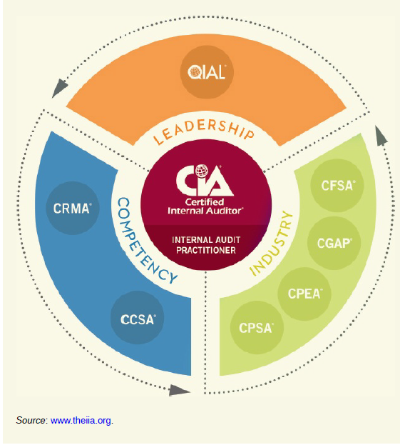
The IIA & Professional Certification in IA
The IIA, headquartered in the USA, is recognized around the world as “the internal audit profession’s global voice, standard-setter, and resource for professional development and certification.”
The IIA offers several professional certifications for Internal Auditors; The premier certification sponsored by The IIA is the Certified Internal Auditor (CIA), the only globally accepted certification for internal auditors.
Certified Internal Auditor, 3 parts exam:
  Part 1 – Essentials of Internal Auditing
  Part 2 – Practice of Internal Auditing
  Part 3 – Business Knowledge for Internal Auditing

Slide 35
END OF CHAPTER 1

