Slide 1
Summarizing, paraphrasing
Adapted from owl.purdue.edu and They Say, I Say

Slide 2
Why bother with secondary references?
Provide support for claims or add credibility to your writing
Refer to work that leads up to the work you are now doing
Give examples of several points of view on a subject
Call attention to a position that you wish to agree or disagree with
Highlight a particularly striking phrase, sentence, or passage by quoting the original
Expand the depth of your writing

Slide 3
Paraphrasing
Paraphrasing is rewriting or rewording a particular piece of text or content in which the same idea, meaning, and context are maintained, but the wording is different from the original.
It has nothing to do with shortening the volume of a text.
Keeping the same words from the original text would be considered quoting and not paraphrasing.

Slide 4
How to paraphrase
1. Reread the original passage.
2. Rewrite each sentence (or point) in your own words.
3. Use quotation marks to identify any borrowed words or phrases.
4. Cite the source (including the page).

Slide 5
Paraphrasing
Original: A lot of people enjoy oranges.
Incorrect paraphrase: A lot of people like oranges.
Correct paraphrase: Oranges are popular.
Original: Cats are entertaining pets.
Incorrect paraphrase: Cats are entertaining.
Correct paraphrase: Feline pets can be playful.

Slide 6
Paraphrasing
Original:
Some argue that the approximately 11 million undocumented immigrants in the United States ought to receive a path to US citizenship, while others claim that these immigrants need to be deported back to their home countries.
Incorrect paraphrase
Some say that the 11 million undocumented immigrants in the United States ought to receive a way for citizenship, while other people say that the immigrants should go back to their countries.
Correct paraphrase
Although some individuals maintain that undocumented immigrants should go back to their countries, others defend these immigrants’ right for a path to citizenship.

Slide 7
pARAPHRASING
Original:
  “Not only does the Disney version provide visual images for the fairy tale it is depicting, these images and the relative value of group membership associated with the images are then translated into beliefs children hold about status in particular group membership, in relation to notions of good, bad, pretty, and ugly as reflected in the films.”
  Incorrect paraphrase:
  Disney provides visual images for fairy tales. The children translate these images into beliefs they hold about status in particular group, which is related to notions of good, bad, pretty, and ugly.
  Correct paraphrase:
Disney’s depiction of fairy tales is internalised by children, in which they start associating certain images of beautiful or detestable looks with high or low ranks, and even evil or good behaviours.

Slide 8
Paraphrasing exercise
1.The student requested that the professor excuses her absence, but the professor refused.
2.International Center is hosting English Conversation classes. They help non-native speakers of English practice their English speaking skills.
3.“Illiteracy is a problem in many of the world’s poorest countries. Even in wealthier nations like the United States, many children struggle with reading and writing. But in 19 cities across the country [United States], the volunteers of Experience Corps are helping youngsters learn to read. The volunteers, all over 50, work with students in low-income areas.” (Older Volunteers Help Children Learn to Read, Voice of America, voanews.com)

Slide 9
Summarizing
A summary is an objective short version of a longer original text. It only presents the most important ideas of the original text.
It has no specific details.
A summary can use main keywords or terms used in the original text.

Slide 10
What not to include in a summary
Your opinion
Exact sentences or phrases from the original text
Rearrangement of exact words from the original text
Specific details, such as examples or irrelevant information
A conclusion, unless there is a main claim in the original conclusion

Slide 11
Summarizing
Original:
“The movement toward education by computer is developing fast. Massive Open Online Courses, called MOOCs, are changing how people learn in many places. For years, people could receive study materials from colleges or universities and take part in online classes. But such classes were not designed for many thousands of students at one time, as MOOCs are.” (MOOCS Are Moving Forward , Voice of America, learningenglish.voanews.com)
Incorrect summary:
Voice of America website:
“Computer education is growing fast. MOOCs are influencing how we study. People received materials from universities for a long time to be able to take classes online. MOOCs are the only ones thousands can take at a time.”
Correct summary:
According to a Voice of America article, a fast-growing MOOCs movement allows thousands to take online classes at once, changing how we learn.

Slide 12
Summarizing exercise
“Women entrepreneurs in the developing world often face challenges that limit their chances for success and growth. They often have less access to education than men and have difficulty getting financing on their own. But with an understanding of the essential aspects of doing business – such as planning, financing, networking and marketing – they can overcome those obstacles. That's where the 10,000 Women Initiative comes in. As Faiza Elmasry tells us, it's an investment in education with dividends that benefit the businesswomen, their local communities and their national economies.” (Goldman Sachs invests in Educating Women in Business, Voice of America, voanews.com)

Slide 13
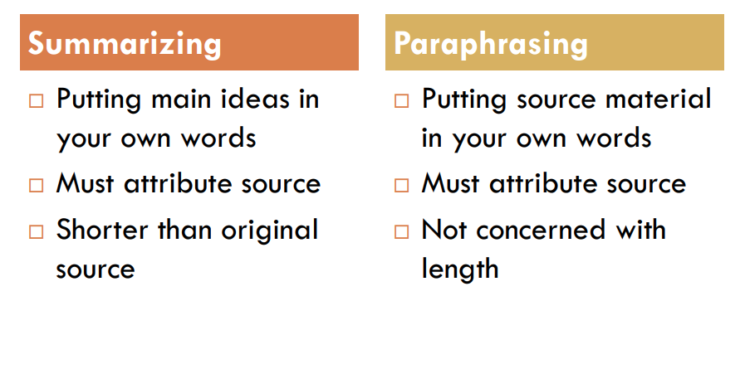

Slide 14
Sample text with summary, quote and paraphrase
In his famous and influential work The Interpretation of Dreams, Sigmund Freud argues that dreams are the "royal road to the unconscious" (3), expressing in coded imagery the dreamer's unfulfilled wishes through a process known as the "dream-work" (4). According to Freud, actual but unacceptable desires are censored internally and subjected to coding through layers of condensation and displacement before emerging in a kind of rebus puzzle in the dream itself (10-11).

