Slide 1
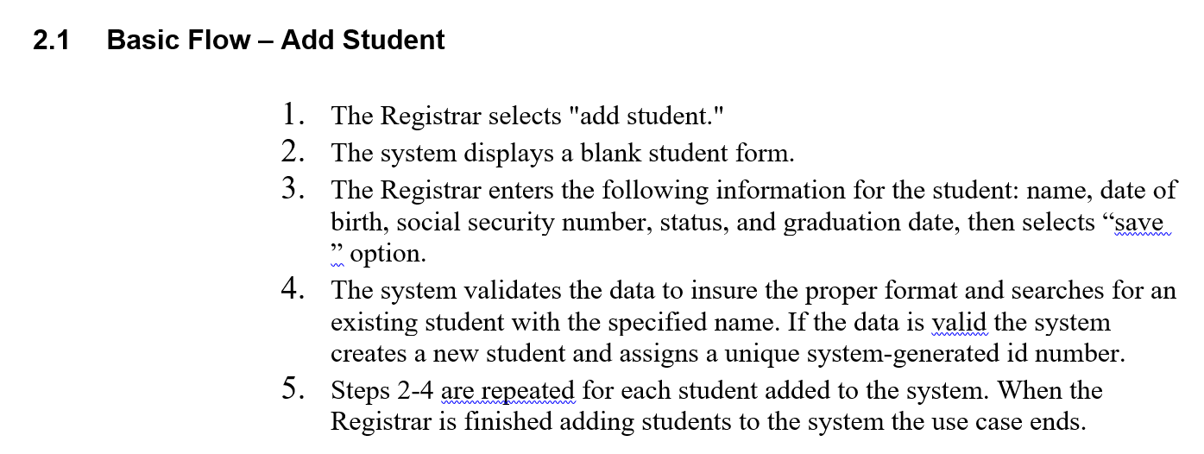
Suppose that we want to convert the following use case flow to a sequence diagram:

Slide 2
Sequence diagram: shows the participating objects in the run time for certain scenario.
Actor: Registrar
Boundary Objects (UI) (Views) :
Maintian student
Student Form
Entities (Model): Student
Controller: AddStudentCtrl
Service: StudentDa for database read/write for student table.

Slide 3
<<boundary>>
:MaintainStudent
Registrar
<<controller>>
:AddStudentCtrl
Add student
create
<<boundary>>
:StudentForm
Time🡪
Fill information
save
validate
<<Entity>>
:Student
addStudent()
<<service>>
:StudentDa
saveStudent()

