Slide 1
Vitamin A

Slide 2
Vitamins
Do not provide energy.
  but are needed for the metabolism of energy
Are needed in microgram or milligram quantities, not gram quantities → “micronutrients

Slide 3
The absorption rates of natural and synthetic vitamins sometimes differ because of different chemical forms of the same vitamin
  (e.g., synthetic folic acid is better absorbed than natural folate in foods)
or because the synthetic vitamins are “free,” not “bound” to other components in food
  (e.g., synthetic vitamin B12 is not bound to small peptides as natural vitamin B12 is)

Slide 4
The fat-soluble vitamins A, D, E, and K differ from the water-soluble vitamins in several significant
Being insoluble in the watery juices of the GI tract, the fat-soluble vitamins require bile for their digestion and absorption
Upon absorption, fat-soluble vitamins travel through the lymphatic system within chylomicrons before entering the bloodstream, where many of them require protein carriers for transport.

Slide 5
Excesses of fat soluble vitamins are stored primarily in the liver and adipose tissue
The body maintains blood concentrations by retrieving these vitamins from storage as needed; thus people can eat less than their daily need for days, weeks, or even months or years without ill effects.

Slide 6
Vitamin A
In Ancient Egypt, Liver was prescribed for night blindness
Vitamin A was the first fat-soluble vitamin to be recognized.
Vitamin A is the generic term used to includes
Retinol and related structures with 20 carbon atoms
pro-vitamin A carotenoids with 40 carbon atoms.

Slide 7
Three different forms of vitamin A are active in the body: retinol, retinal, and retinoic acid
Collectively known as retinoids ( these are derived from animal sources)
Foods derived from plants provide carotenoids, some of which can be converted to vitamin A
The most studied of the carotenoids with vitamin A activity is beta-carotene, which can be split to form retinol in the intestine and liver

Slide 8
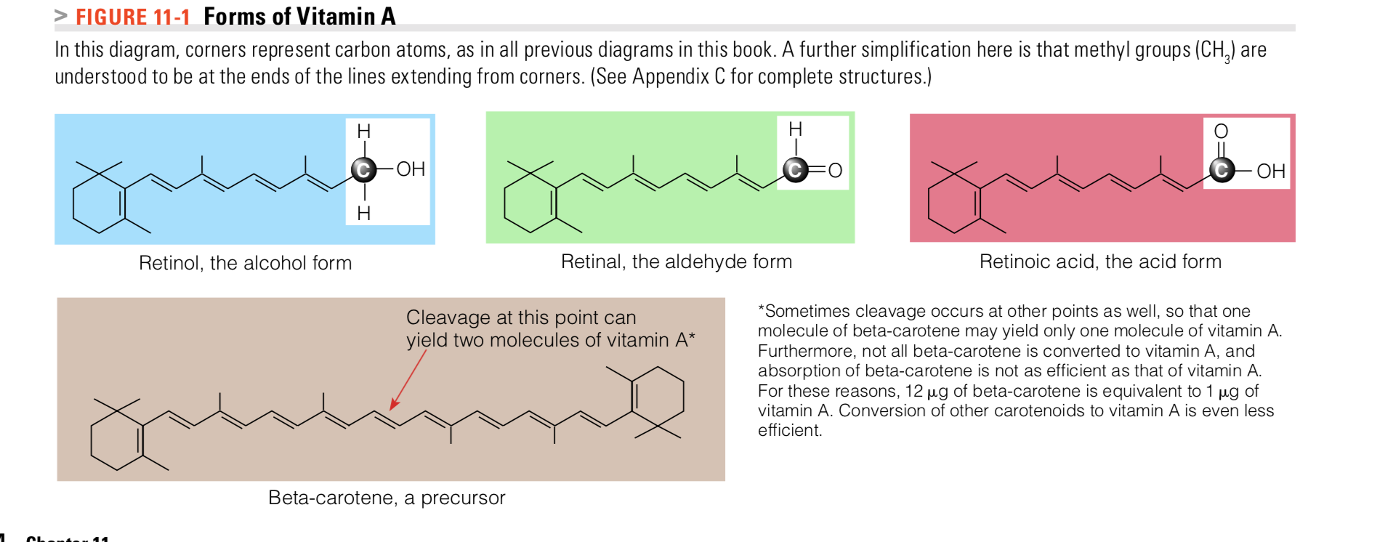

Slide 9
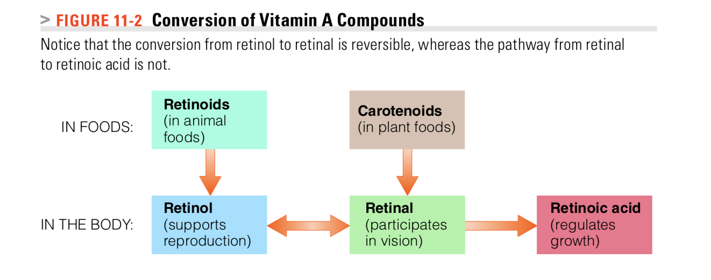
The cells can convert retinol and retinal to the other active forms of vitamin A as needed. The conversion of retinol to retinal is reversible, but the further conversion of retinal to retinoic acid is irreversible
Why does it matter ?
Because each form of vitamin A performs a specific function that the others cannot

Slide 10
Roles in the Body
Regulate the expression of several hundred genes. Its major roles include:
Promoting vision
Participating in protein synthesis and cell differentiation, thereby maintaining the health of epithelial tissues and skin
Supporting reproduction and regulating growth

Slide 11
Retinol supports reproduction and is the major transport and storage form of the vitamin.
Retinal is active in vision and is also an intermediate in the conversion of retinol to retinoic acid
Retinoic acid acts like a hormone, regulating cell differentiation, growth, and embryonic development.
Only retinol can fully support vision and reproduction?

Slide 12
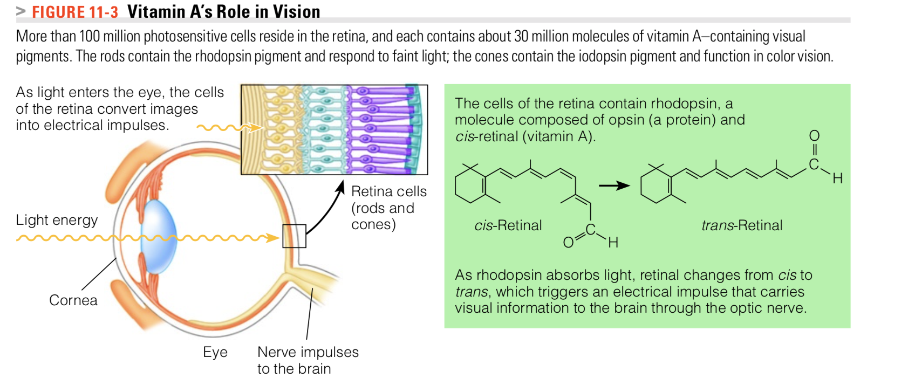
Vision
Vitamin A plays two indispensable roles in the eye: it helps maintain a crystal-clear outer window, the cornea
Participates in the conversion of light energy into nerve impulses at the retina

Slide 13
The retina contain pigment molecules called rhodopsin
Each rhodopsin molecule is composed of a protein called opsin bonded to a molecule of retinal
When light passes through the cornea of the eye and strikes the retina, rhodopsin responds. As it does, opsin is released and retinal shifts from a cis to a trans configuration
These changes generate an electrical impulse that conveys the message to the brain. Much of the retinal is then converted back to its active cis form and combined with the opsin protein to regenerate rhodopsin

Slide 14
Retinol is needed for the visual process and one of the earliest signs of vitamin A deficiency is a failure to see in dim light known as night blindness.
Because vitamin A is also involved in maintaining the coverings and linings of the eyes (the cornea) deficiency can cause dysfunction of the linings and coverings of the eye, causing dryness of the eyes, a condition called xerophthalmia. This condition can progress, causing ulceration of the cornea and eventually blindness.

Slide 15
Vitamin A in Protein Synthesis and Cell Differentiation
Vitamin A participates in protein synthesis and cell differentiation, a process by which each type of cell develops to perform a specific function.
All body surfaces, both inside and out, are covered by layers of cells known as epithelial cells
The epithelial tissue on the outside of the body is the skin
  Vitamin A and beta-carotene help to protect against skin damage from sunlight
The epithelial tissues that line the inside of the body are the mucous membranes: the linings of the mouth, stomach etc.
vitamin A helps to maintain their integrity

Slide 16
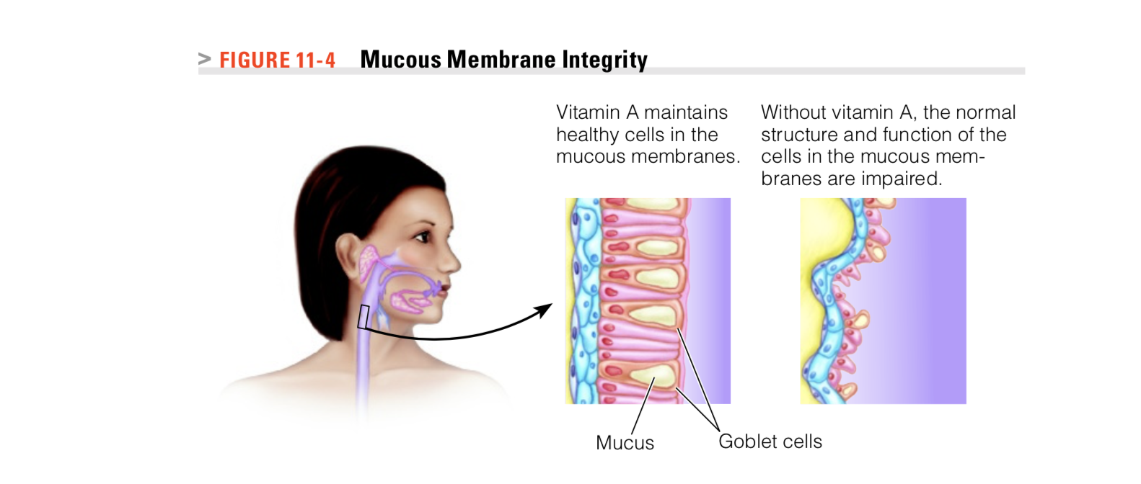

Slide 17
Vitamin A in Reproduction and Growth
In men, retinol participates in sperm development, and in women, vitamin A supports normal fetal development during pregnancy
Children lacking vitamin A fail to grow; given vitamin A supplements, these children gain weight and grow taller.

Slide 18
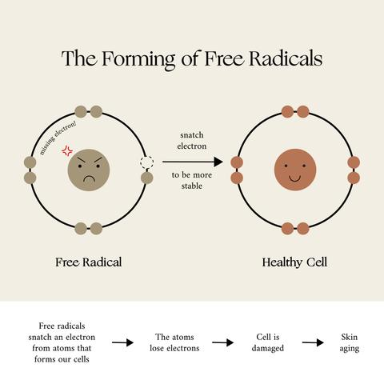

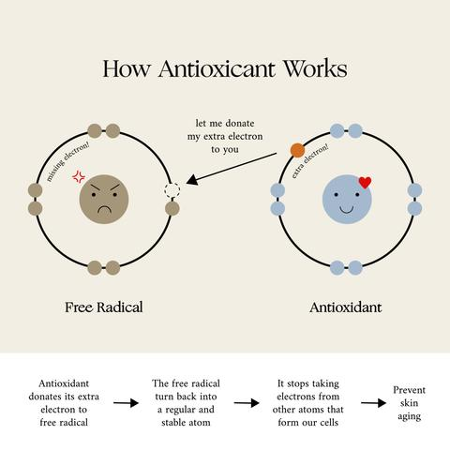
Beta-Carotene as a Precursor and an Antioxidant Beta-carotene plays two primary roles in the body. First, it serves as a vitamin A precursor. Second, some beta-carotene acts as an antioxidant capable of protecting the body against disease.

Slide 19
Vitamin A Deficiency
Vitamin A status depends mostly on the adequacy of vitamin A stores
90 percent of Vit A are in the liver
Vitamin A status also depends on a person’s protein status because retinol-binding protein serves as the vitamin’s transport carrier inside the body.
If a person were to stop eating vitamin A–containing foods, deficiency symptoms would not begin to appear until after stores were depleted—1 to 2 years for a healthy adult but much sooner for a growing child.

Slide 20
Vitamin A : Deficiency
Vitamin A deficiency is not common in the developed world
But a major nutrition problem in many developing countries- responsible for a million or more unnecessary deaths and cases of blindness each year.
Routine vitamin A supplementation and food fortification can be a life saving intervention

Slide 21
Vitamin A : Deficiency
Susceptible to Infectious Diseases : Vitamin A is important for immunity and resistance to infections
NightBlindness
Blindness (Xerophthalmia) : Total blindness—failure to see at all. Night blindness is caused by a lack of vitamin A at the back of the eye, the retina; total blindness is caused by a lack of vitamin A at the front of the eye, the cornea.
Decreased mucous secretion of the stomach and intestines → impaired digestion and absorption

Slide 22
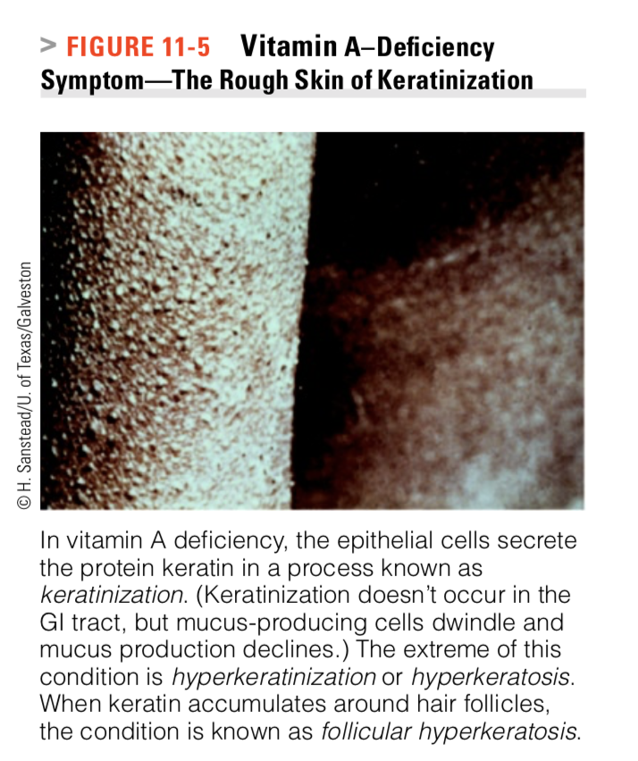
Keratinization: In vitamin A deficiency, the epithelial cells secrete the protein keratin in a process known as keratinization.
symptoms are dryness and scaling of the skin.

Slide 23
Vitamin A Toxicity
Symptoms of toxicity begin to develop when all the binding proteins are loaded, and vitamin A is free to damage cells
Headaches, vomiting
hair loss, bone defects
liver damage
Can cause birth defects during pregnancy

Slide 24
Vitamin A Recommendations
Because the body can derive vitamin A from both retinoids and carotenoids, its content in foods and its recommendations are expressed as retinol activity equivalents (RAE)
One microgram of retinol counts as 1 RAE
12 micrograms of dietary beta-carotene = 1 RAE
Beta-carotene’s absorption and conversion are significantly less efficient than those of the retinoids

Slide 25
Vitamin A in Foods
The richest sources of the retinoids are foods derived from animals
liver, fish liver oils, milk and milk products, butter, and eggs. Because vitamin A is fat-soluble, it is lost when milk is skimmed.
To compensate, reduced-fat, low-fat, and fat-free milks are fortified so as to provide the amount found in whole milk. Margarine is usually fortified to provide the same amount of vitamin A as butter.

Slide 26

Plants contain no retinoids, but many vegetables and some fruits contain vitamin A precursors—the carotenoids. Only a few carotenoids have vitamin A activity; the carotenoid with the greatest vitamin A activity is beta- carotene. Beta-carotene is a rich, deep yellow, almost orange, compound.
The beta-carotene in dark green, leafy vegetables is abundant, but masked by large amounts of the green pigment chlorophyll.

Slide 27
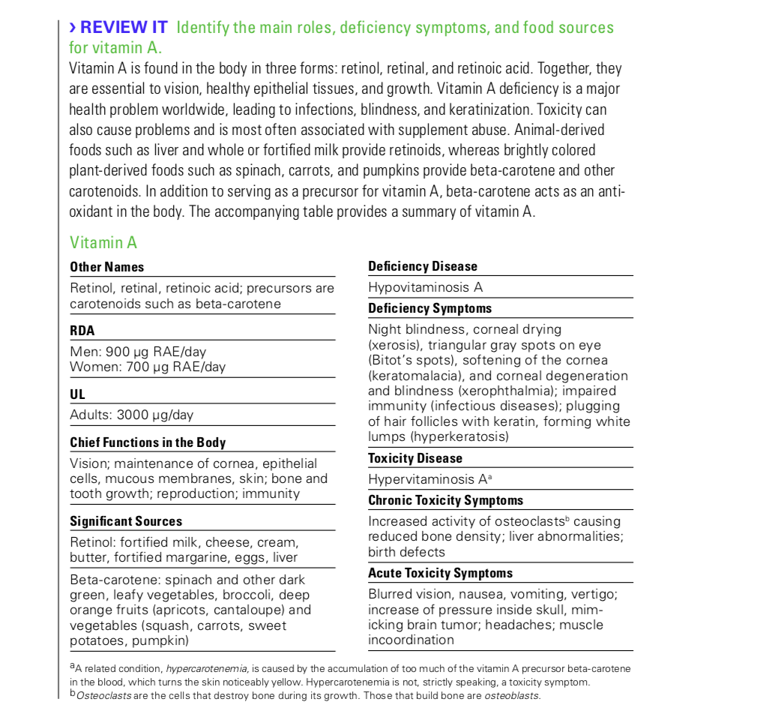
RDA

Slide 28
The Water-Soluble Vitamins: B Vitamins and Vitamin C

Slide 29
The vitamins ARE DIFFERENT from carbohydrates, fats, and proteins in the following ways:
Structure: Vitamins are individual units; they are not linked together (as are molecules of glucose or amino acids
Function: Vitamins do not yield energy when metabolized
They assist the enzymes that participate in the release of energy from carbohydrates, fats, and proteins.
Food contents: The amounts of vitamins people ingest from foods and the amounts they require daily are measured in micrograms (μg) or milligrams (mg), rather than grams (g).*

Slide 30
Some water-soluble vitamins are synthesized by GI tract bacteria and absorbed by the large intestine, but not in quantities great enough to meet the body’s needs
Foods must supply these essential nutrients

Slide 31
Bioavailability= The amount of vitamins available from foods depends not only on the quantity provided by a food but also on the amount absorbed and used by the body

Slide 32
Bioavailability can be influenced by
Efficiency of digestion and time of transit through the GI tract
Previous nutrient intake and nutrition status= if a person is deficient or has adequate stores of a certain vitamin/nutrient
Method of food preparation (raw, cooked, or processed)
Heat/ acid/ light can destroy some vitamin
synthetic, fortified, or naturally occurring)- Absorption can sometimes differ
Other foods consumed at the same time
vitamins that are available from foods in inactive forms known as precursors, or provitamins.

