Slide 1
Hematopoietic Function

Slide 2
Hematopoietic and Lymphoid Tissues
The hematopoietic system consists of the different types of blood cells generated from the pluripotent stem cells in the bone marrow.
These stem cells differentiate into committed cell lines that develop into red blood cells, platelets, and leukocytes.
The development of the different types of blood cells is supported by chemical messengers, called colony-stimulating factors, other growth factors, and chemical mediators.

Slide 3
Hematopoietic and Lymphoid Tissues
White blood cells (leukocytes) development begins with myeloid stem cells that develop into granulocyte and monocyte cell lines, and lymphoid stem cells that develop into the lymphocyte cell line.
The immature precursor cells for each of the cell lines are called blast cells.
The blast cells progress through various maturational stages before becoming mature granulocytes, monocytes, or lymphocytes.

Slide 4
Hematopoietic and Lymphoid Tissues
The life span of white blood cells is relatively short so that constant renewal is necessary to maintain normal blood levels.
Any conditions that decrease the availability of stem cells or hematopoietic growth factors produce a decrease in white blood cells.

Slide 5
The Lymphatic System
The lymphatic system consists of a network of lymphatic vessels, nodes, and tissues where B and T lymphocytes complete their differentiation.
Lymphnodes, which are the site where many lymphomas originate, exhibit an outer cortex and an inner medulla.

Slide 6
The Lymphatic System
The cortex contains well-defined B-cell and T-cell domains.
The B-cell–dependent superficial cortex consists of two types of follicles: immunologically inactive follicles, called primary follicles, and active follicles that contain germinal centers, called secondary follicles.
Most of the T cells are contained in the paracortex, the area between the medullary and outer superficial cortices.

Slide 7
Neutropenia
Neutropenia, which represents a marked reduction in neutrophils, can occur as a congenital or acquired disorder.
Because the neutrophil is essential to host defenses against bacterial and fungal infections, severe and often life-threatening infections are common in persons with neutropenia.

Slide 8
Neutropenia
Congenital neutropenia consists primarily of cyclic neutropenia, which is characterized by cyclic oscillations of peripheral neutrophils, and severe congenital neutropenia or Kostmann syndrome, which is associated with severe bacterial infections.
The acquired neutropenias encompass a wide spectrum of etiologies, including immunologically mediated bone marrow suppression, neutrophil injury and destruction, infection-related processes, and drug-induced mechanisms—particularly those related to cancer chemotherapeutic agents.

Slide 9
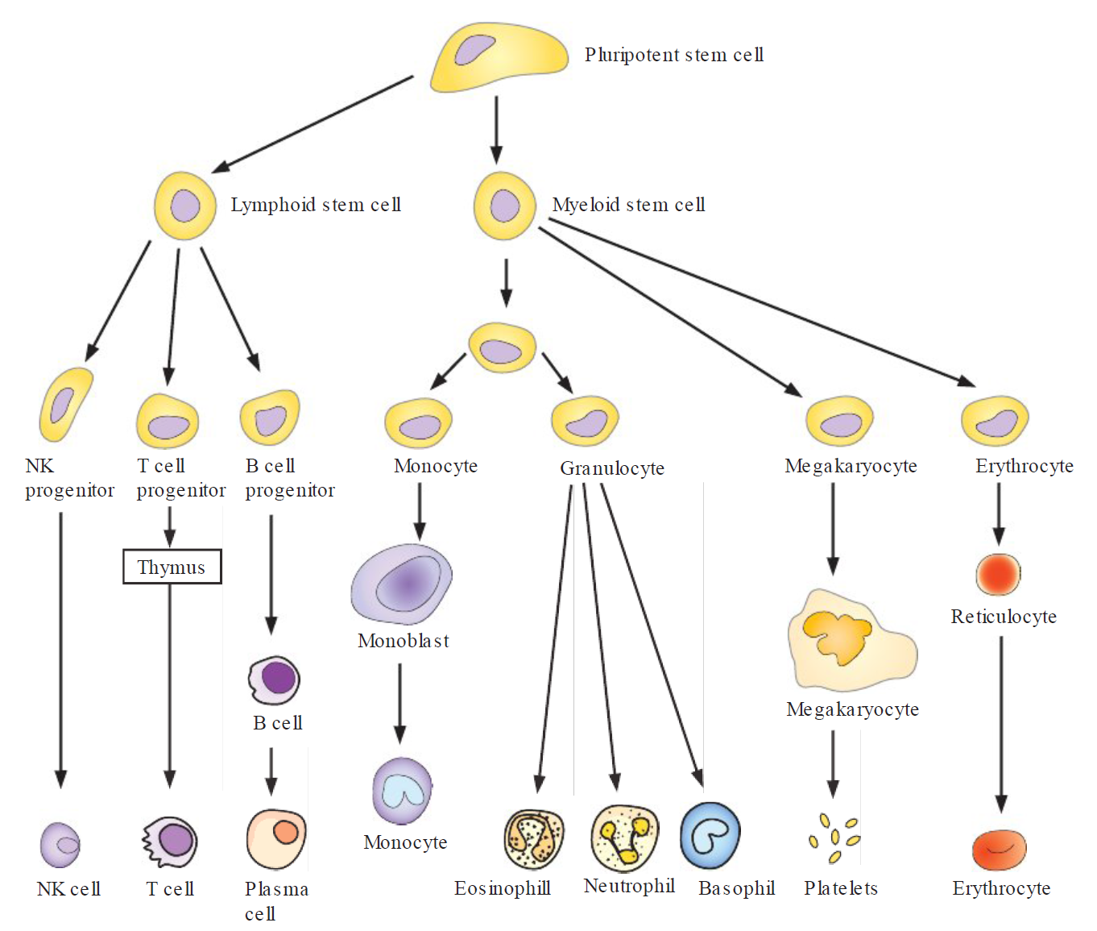
Major Developmental Stages of Blood Cells

Slide 10
Infectious Mononucleosis
Infectious mononucleosis is a self-limited lymphoproliferative disorder caused by the B-lymphotropic Epstein-Barr virus that is usually transmitted in the saliva.
The disease is characterized by fever, sore throat, generalized lymphadenopathy, and the appearance of atypical lymphocytes and several antibodies in the blood.
Treatment is largely symptomatic and supportive and most people recover without incident.

Slide 11
Neoplastic Disorders
The neoplastic disorders of hematopoietic and lymphoid origin include the leukemias, lymphomas, and multiple myeloma.

Slide 12
Leukemias
The leukemias are malignant neoplasms arising from the transformation of a single blood cell line derived from hematopoietic stem cells in the bone marrow.
Because leukemic cells are immature and poorly differentiated, they proliferate rapidly and have a long life span, they do not function normally, they interfere with the maturation of normal blood cells, and they circulate in the bloodstream, cross the blood– brain barrier, and infiltrate many body organs.

Slide 13
Leukemias
Leukemias are classified according to cell type (i.e., lymphocytic or myelocytic) and whether the disease is acute or chronic.
The lymphocytic leukemias involve immature lymphocytes and their progenitors that originate in the bone marrow but infiltrate the spleen, lymph nodes, CNS, and other tissues.
The myelogenous leukemias involve the pluripotent myeloid stem cells in the bone marrow and interfere with the maturation of all blood cells, including the granulocytes, erythrocytes, and thrombocytes.

Slide 14
Leukemias
The acute leukemias (i.e ., ALL, which primarily affects children, and AML, which primarily affects adults) have a sudden and stormy onset with symptoms of depressed bone marrow function (anemia, fatigue, bleeding, and infections); bone pain; and generalized lymphadenopathy, splenomegaly, and hepatomegaly.

Slide 15
Leukemias
The chronic leukemias, which largely affect adults, have a more insidious onset.
Chronic lymphocytic leukemia often has the most favorable clinical course, with many persons living long enough to die of other, unrelated causes.
The course of CML is slow and progressive, with transformation to a course resembling that of AML.

Slide 16
Lymphoma
The lymphomas (non-Hodgkin [NHL] and Hodgkin lymphoma) represent malignant neoplasms that arise in the peripheral lymphoid tissues.
The NHLs, which usually originate in the lymph nodes, are multicentric in origin and spread early to various lymphoid tissues throughout the body, especially the liver, spleen, and bone marrow.

Slide 17
Lymphoma
Hodgkin lymphoma is a group of cancers characterized by Reed-Sternberg cells that begins as a malignancy in a single lymph node and then spreads to contiguous lymph nodes.
Both types of lymphomas are characterized by manifestations related to uncontrolled lymph node and lymphoid tissue growth, bone marrow involvement, and constitutional symptoms (fever, fatigue, weight loss) related to the rapid growth of abnormal lymphoid cells and tissues.

Slide 18
Multiple Myeloma
Multiple myeloma is a plasma cell dyscrasia characterized by expansion of a single clone of immunoglobulin-producing plasma cells and a resultant increase in serum levels of a single monoclonal immunoglobulin (paraprotein) or its fragments.
The main sites involved in multiple myeloma are the bones and bone marrow.

Slide 19
Multiple Myeloma
In addition to the abnormal proliferation of marrow plasma cells, there is proliferation and activation of osteoclasts, which leads to bone resorption and destruction and increased risk for pathologic fractures and development of hypercalcemia.
Paraproteins secreted by the plasma cells may cause hyperviscosity of body fluids and may break down into amyloid, a proteinaceous substance deposited between cells that can cause heart failure and neuropathy.

Slide 20
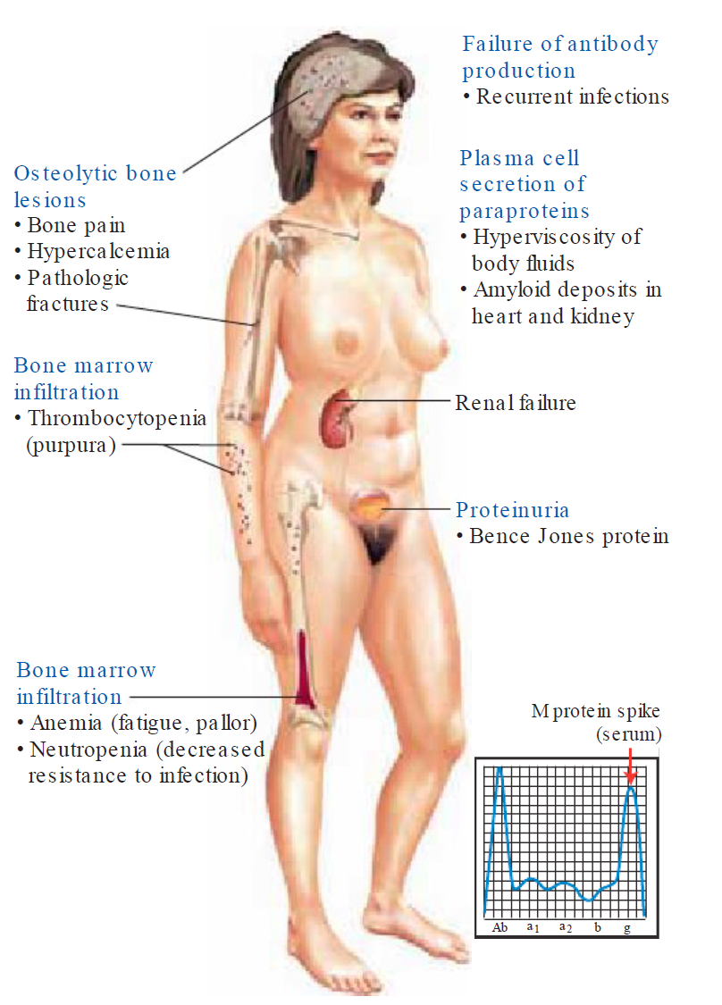
Clinical Features of Multiple Myeloma

Slide 21
Disorders of Hemostasis

Slide 22
Hemostasis
Hemostasis is an orderly multistep physiological process that preserves vascular integrity by balancing the processes that maintain blood in a fluid state and prevent excessive bleeding following injury.

Slide 23
Hemostasis
Hemostasis involves platelets, plasma clotting factors, naturally occurring anticoagulants, and the endothelial cells that line blood vessels, in order to transform blood into a semisolid clot with erythrocytes trapped in its fibrin meshwork.

Slide 24
Hemostasis
The process of hemostasis begins when a loss of endothelial integrity causes platelet activation.
Upon activation, platelets undergo adhesion, granule release, and aggregation to form a primary platelet plug.

Slide 25
Hemostasis
The formation of the secondary hemostatic plug cements the platelet plug, forming an insoluble hemostatic clot.
To occur, the formation of the definitive clot requires activation of the coagulation cascade, which terminates with thrombin converting fibrinogen into insoluble fibrin.

Slide 26
Hemostasis
The final step of the process involves fibrinolysis or clot dissolution, which involves the action of plasmin to dissolve the clot and allow blood flow to be reestablished and tissue healing to take place.

Slide 27
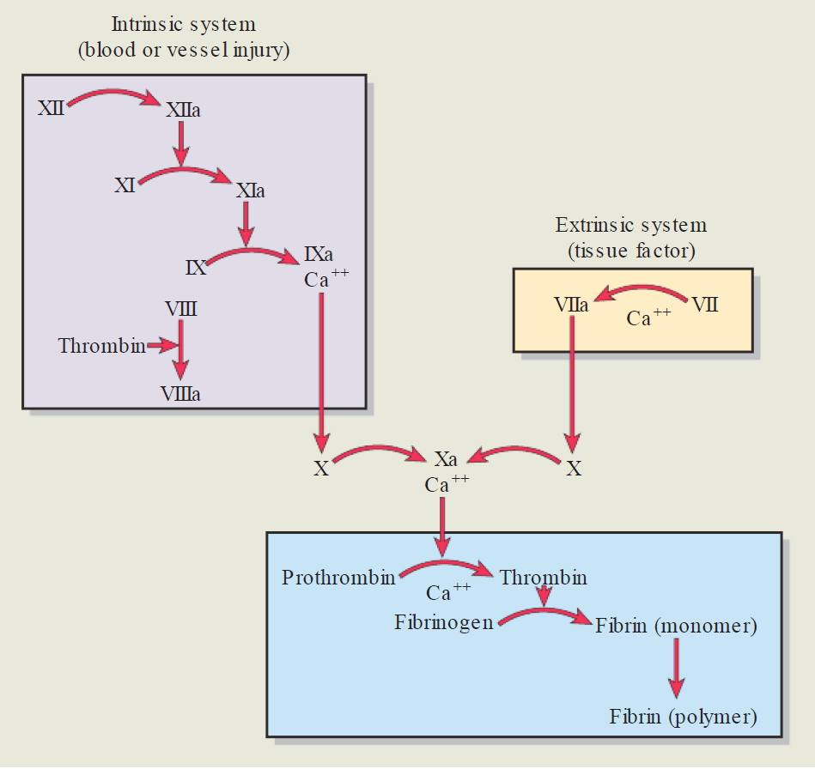
The Intrinsic & Extrinsic Coagulation Pathway

Slide 28
Hypercoagulability
Hypercoagulability states increase the risk of clot or thrombus formation in either the arterial or venous circulations.
Arterial thrombi are associated with conditions that produce an increase in platelet numbers or turbulence in blood flow with platelet adhesion.

Slide 29
Venous Thrombi
Venous thrombi are associated with inherited or acquired conditions that cause a decrease in anticoagulation factors or produce a stasis of blood, thereby causing an increase in procoagulation factors.

Slide 30
Hypercoagulability
Increased platelet function usually results from disorders such as atherosclerosis that damage the vascular endothelium and disturb blood flow, or from conditions such as smoking that increase sensitivity of platelets to factors that promote adhesiveness and aggregation.

Slide 31
Hypercoagulability
Increased activity of the coagulation system results from hereditary (factor V Leiden mutation) or acquired disorders (immobility, hyperviscosity syndromes) causing alterations in the components of the coagulation system (i.e., an increase in procoagulation factors or a decrease in anticoagulation factors).

Slide 32
Thrombocytosis
Thrombocytosis refers to an increase in the platelet count that can occur as an essential (primary thrombocytosis) or are active process (secondary thrombocytosis).
The antiphospholipid syndrome, another cause of venous and arterial clotting, manifests as a primary or a secondary disorder associated with systemic lupus erythematosus. It is associated with antiphospholipid antibodies, which promote thrombosis throughout the body.

Slide 33
Bleeding Disorders
Bleeding disorders or impairment of blood coagulation can result from defects in any of the factors that contribute to hemostasis: platelets, coagulation factors, or vascular integrity.

Slide 34
Disorders of Platelet Plug
Disorders of platelet plug formation include an decrease in platelet numbers due to inadequate platelet production (bone marrow dysfunction), excess pooling of platelets in the spleen, excess platelet destruction (thrombocytopenia), abnormal platelet function (thrombocytopathia), or defects in von Willebrand factor.

Slide 35
Bleeding Disorders
Impairment of blood coagulation can result from deficiencies of one or more of the known clotting factors.
Deficiencies can arise because of acquired disorders (i.e., liver disease or vitamin K deficiency) or inherited disorders (i.e., hemophilia A or von Willebrand disease).

Slide 36
Bleeding Disorders
Bleeding may also occur from structurally weak vessels that result from impaired synthesis of vessel wall components (i.e ., vitamin C deficiency, excessive cortisol levels as in Cushing disease, or the aging process) or from damage by genetic mechanisms (i.e., hemorrhagic telangiectasia) or the presence of microthrombi.

Slide 37
DIC
Disseminated intravascular coagulation (DIC) is characterized by widespread coagulation and bleeding in the vascular compartment.
It begins with massive activation of the coagulation cascade and generation of microthrombi that cause vessel occlusion and tissue ischemia.
Clot formation consumes all available coagulation proteins and platelets, and severe hemorrhage may occur.

Slide 38
Disorders of Red Blood Cells

Slide 39
RBCs
The function of red blood cells (RBC), facilitated by the iron-containing hemoglobin molecule, is to transport oxygen from the lungs to the tissues.
The biconcave shape of the red cell increases the surface area for diffusion of oxygen across the thin cell membrane.

Slide 40
Erythropoiesis
Erythropoiesis, or production of RBC, occurs in the bone marrow and requires iron, vitamin B12, and folate.
RBC production is governed by tissue oxygen needs. The decrease in oxygen content in blood is sensed by the kidneys, which then produce a hormone called erythropoietin.
Erythropoietin, in turn, stimulates the bone marrow to increase RBC production.

Slide 41
RBCs
The red blood cell has a life span of approximately 120 days and is broken down in the spleen, liver, or bone marrow.
In the process of destruction, the heme portion of the hemoglobin molecule is converted to bilirubin.
Bilirubin, which is insoluble in plasma, attaches to plasma proteins for transport in the blood. It is removed from the blood by the liver and conjugated to a water-soluble form so that it can be excreted in the bile.

Slide 42
RBCs
In the laboratory, automated blood cell counters rapidly provide accurate measurements of red blood cell count and cell indices.
A stained blood smear provides information about the size, color, and shape of red cells and the presence of immature or abnormal cells.
If blood smear results are abnormal, examination of the bone marrow may be indicated.

Slide 43
Anemia
Anemia, which is a deficiency of red cells or hemoglobin, results from excessive loss (blood loss anemia), increased destruction (hemolytic anemia), or impaired production of red blood cells (iron-deficiency, megaloblastic due to a Vitamin B12 deficiency, and aplastic anemias).

Slide 44
Anemia
Blood loss anemia can be a cute or chronic.
With bleeding, iron and other components of the erythrocyte are lost from the body.

Slide 45
Hemolytic Anemia
Hemolytic anemia is characterized by the premature destruction of red cells, with body retention of iron and the other products of red cell destruction.
It can be caused by defects in the red cell membrane, hemoglobinopathies (sickle cell disease or thalassemia), or inherited enzyme defects (G6PD deficiency).
Acquired forms of hemolytic anemia are caused by agents extrinsic to the red blood cell, such as medications , bacterial and other toxins, antibodies, and physical trauma.

Slide 46
Aplastic Anemia
Aplastic anemia is caused by bone marrow suppression and usually results in a reduction of white blood cells and platelets, as well as red blood cells.

Slide 47
Anemia
Chronic diseases such as inflammatory disorders (rheumatoid arthritis), cancers, and renal failure cause anemia through the production of inflammatory cytokines that interfere with erythropoietin production or response.

Slide 48
Anemia
The manifestations of anemia are caused by the decreased hemoglobin in the blood (pallor), tissue hypoxia due to deficient oxygen transport (weakness and fatigue), and recruitment of compensatory mechanisms (tachycardia and palpitations) designed to increase oxygen delivery to the tissues.

Slide 49
Polycythemia
Polycythemia describes a condition of increased red blood cell (RBC) mass.
It can present as a relative or absolute disorder, with the latter subcategorized as primary or secondary.
Relative polycythemia results from a loss of vascular volume (i.e., diuretic use) and is corrected by fluid replacement.

Slide 50
Polycythemia
Primary polycythemia, or polycythemia vera, is a proliferative disease of the bone marrow with an absolute increase in total RBC mass accompanied by elevated white cell and platelet counts.
Secondary polycythemia results from increased erythropoietin levels caused by hypoxic conditions such as chronic heart and lung disease.

Slide 51
Polycythemia
Many of the manifestations of polycythemia are related to increased blood volume and viscosity that lead to hypertension and stagnation of blood flow.

Slide 52
Alert
The red blood count a long with hemoglobin concentration changes from being high at birth, reflecting the in-utero need for oxygen, to declining in the elderly due to a decrease in the replacement ability of red cells.

Slide 53
Alert
During the early neonatal period, there is a shift from fetal to adult hemoglobin.
Many infants have physiologic jaundice because of hyperbilirubinemia during the 1st week of life, related to the increase in red blood cell breakdown and the inability of the infant’s liver to conjugate bilirubin.

Slide 54
Alert
Hemolytic disease of the newborn occurs in Rh-positive infants of Rh-negative mothers who have been sensitized.
It involves hemolysis of an infant's red cells in response to maternal Rh antibodies that have crossed the placenta.

Slide 55
Alert
Anemia is an increasingly common health problem in the elderly.
Although most elderly persons are able to maintain their hemoglobin and hematocrit levels within a normal range, they are unable to replace their red cells as promptly as their younger counterparts during a stress situation such as bleeding.

