Slide 1
CONSTITUTIONAL FACTORS IN STUTTERING P.P.T

Slide 2
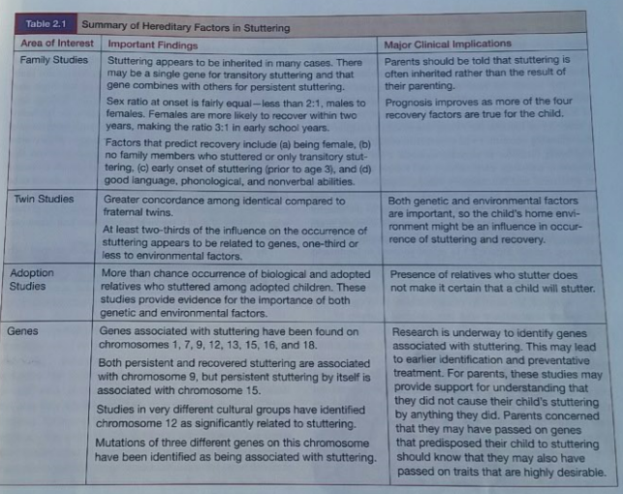
Heredity Factors

Slide 3
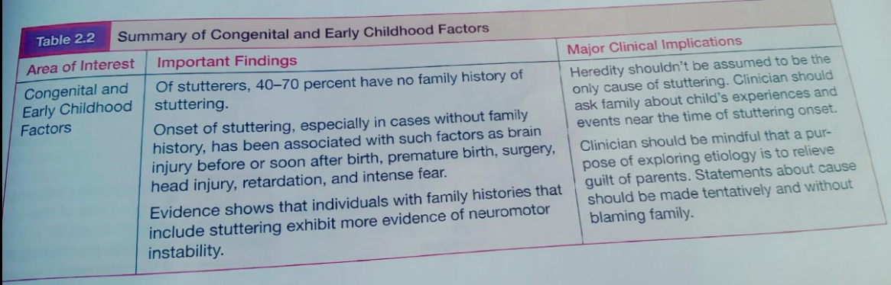
Congenital Factors

Slide 4
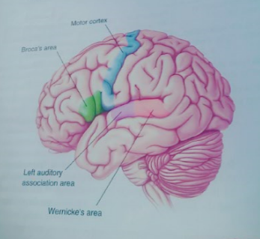
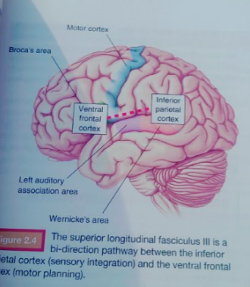
Brain Structure and Function

Slide 5
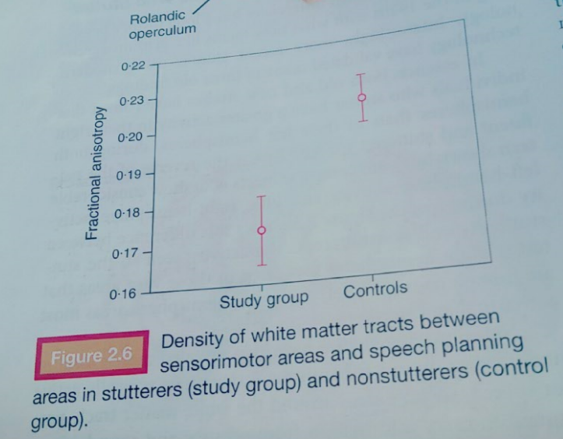
Density of White Matter

Slide 6
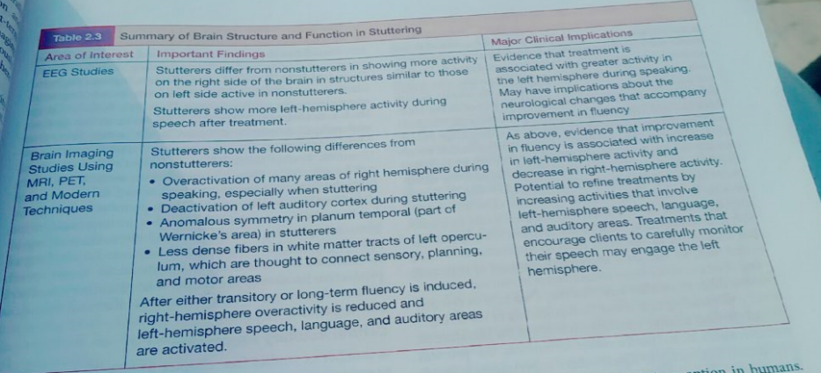
Brain Structure and Function

Slide 7
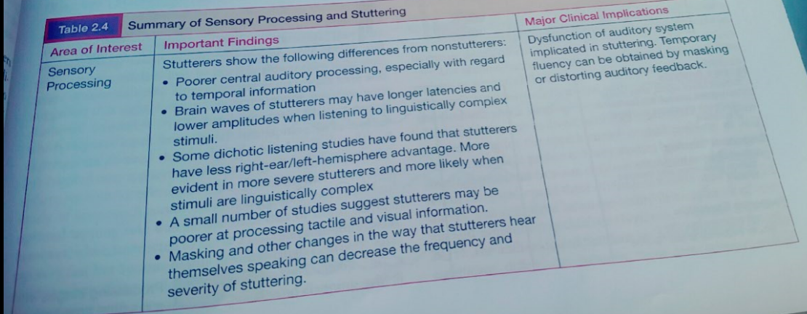
Sensory Processing

Slide 8
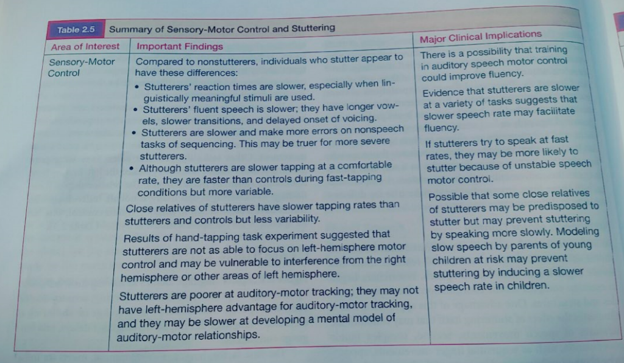
Sensory Motor control

Slide 9
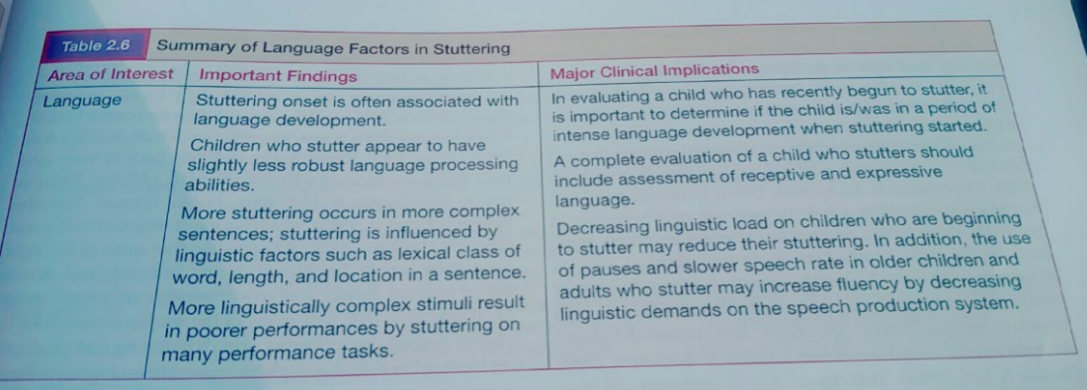
Language Factors

Slide 10
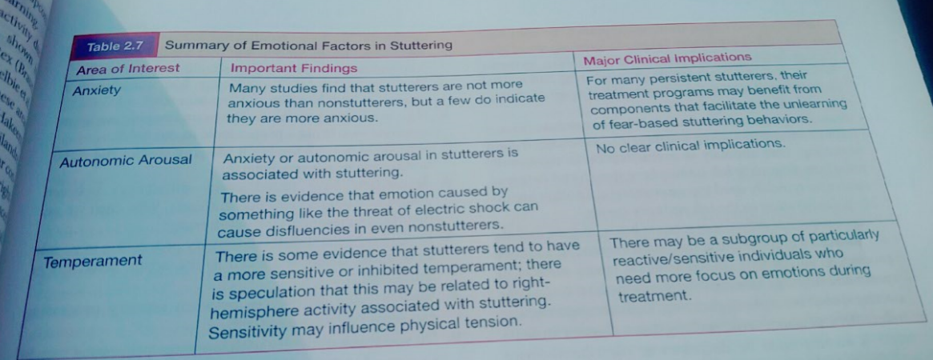
Emotional Factors

Slide 11
THEORIES ABOUT CONSTITUTIONAL FACTORS

Slide 12
STUTTERING AS ADISORDER OF BRAIN ORGANIZATION
ORTON-TRAVIS THEORY –(HEMISPHERIC DOMINANCE).(1920s-30s)
The Left-Brain hemisphere is dominant for language in most people.
Many stutterers seemed to be Left-handers, whose parents changed them into being Right-handed.
Conflicts in speech control,neither hemisphere in fully charge.
Neuromotor disorganization and mistiming of speech production resulting in stuttering.

Slide 13
Cont.
Gechwind & Galaburda(1985):
Many disorders resulting from delays in left hemisphere growth during fetal period ,leading to right-hemisphere dominance for language.
Various L-H stuctures during embryonic development are suited for speech and language functions.
Some of the cells that are genetically programmed to sprout the function of speech and language, migrates to the left hemisphere which is developmentally delayed.
In stead they receive signals from the more developed right hemisphere.

Slide 14
Cont.
William Webster(1993):
Stuttering results from anomalous cerebral organization.
SMA(supplementary motoric area in left frontal lobe that adjusted very close to emotional centers) which is responsible for planning and sequencing speech movements is vulnerable to disruption by activities in other areas of the brain (corpus callosum).
Stutterers have overactive right- hemisphere, activation from right-hemisphere regulated emotions would disrupt SMA functions.

Slide 15
STUTTERING AS a DISORDER OF TIMING
Van Riper (1982):
Temporal disruption of the successive programming of the muscular movements required to produce speech.
Kent (1984):
Inappropriate localization of speech and language in the right hemisphere results in an inability to create the precise timing patterns needed for speech perceiving and production.
Or not well-developed left hemisphere.
Right hemisphere activity during increased emotions interfere left hemisphere timing abilities during speech production.

Slide 16
STUTTERING AS a REDUCED CAPACITY FOR INTERNAL MODELING
Megan & Peter Neilson(1987):
Deficits in the ability to create and use the
(INVERSE INTERNAL MODELS OF THE SPEECH PRODUCTION SYSTEM.
How children learn to speak:
Perception of speech sound stored
Play with speech sounds ,trying to imitate what they hear.
Gradually children learn how to make these sounds accurately.
Too much of brain resources would be required if the child has to remember and produce every movement/s for every speech sound.

Slide 17
Cont.
Children develop a mental model of the relationship between the speech movement and the sound they hear and try to produce.
Children develop a mental model of the relationship between the speech sounds and the motor command called:
( sensory-motor model for speech) Neilsons
called( inverse internal model) of how speech
produced.
Inverse: transforms sensory targets into motor commands.

Slide 18
Cont.
Children plan a word in terms of what it should sound like.
Their sensory- motor model generate the motor movement commands that will produce the speech sound targets.
These components of speech production process are involved in the corticocerebllar structures and pathways.
Stutterers were poorer than non stutterers in tracking tone differences in different ears.
They have difficulties in sensory-to-motor and motor-to-sensory transformation(SENSORY TARGETS) transformation.

Slide 19
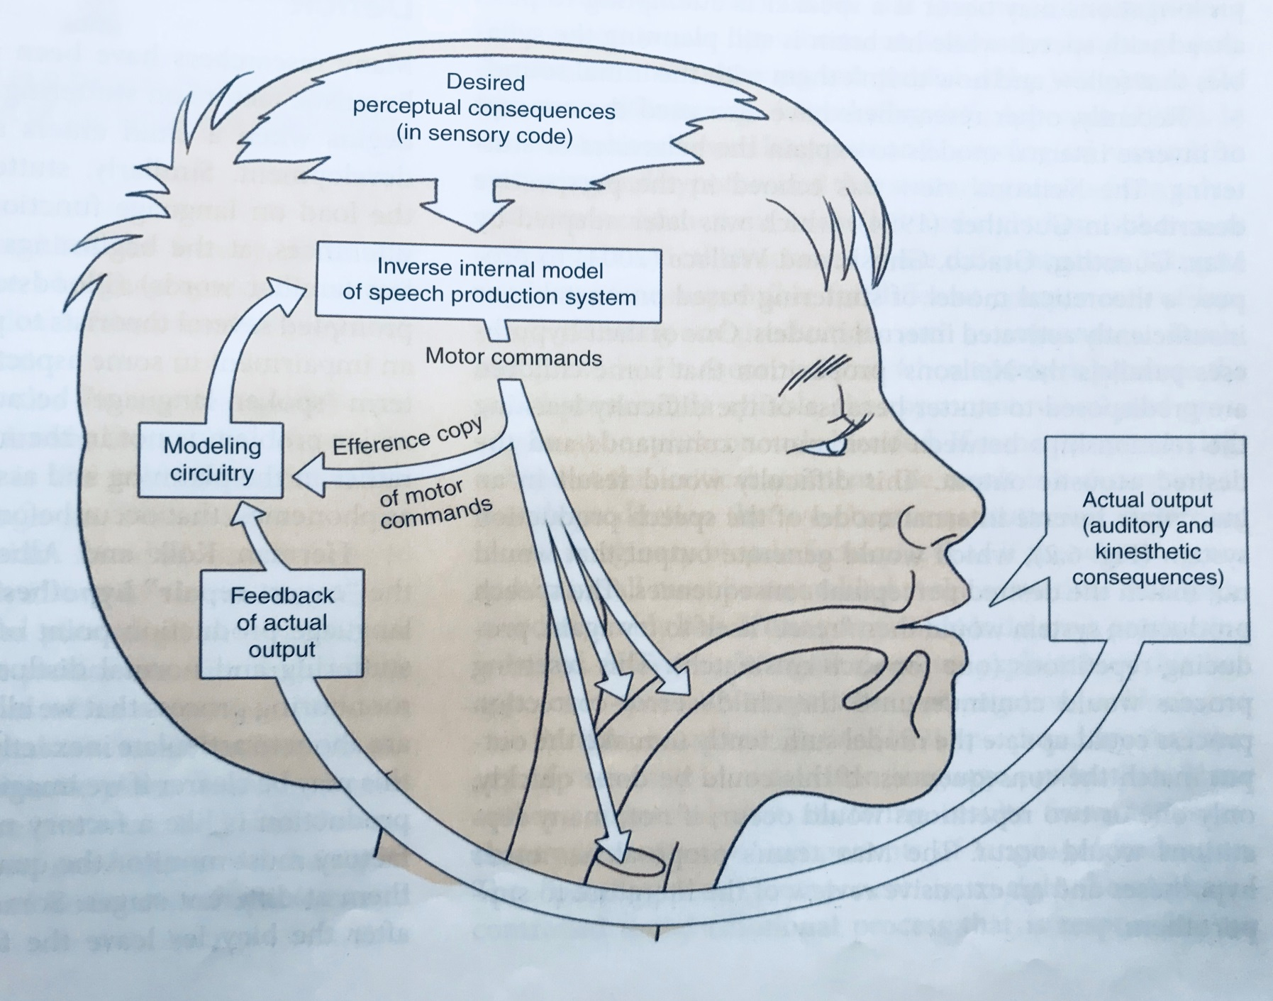
Cont.

Slide 20
STUTTERING AS a LANGUAGE PRODUCTION DEFICIT
Stuttering begins when a child enters a period of intensive language acquisition.
Stuttering is most frequent when the load on language function is heavier.
Stuttering problem is not in the motor execution of speech but rather in the planning and assembly of language units.

Slide 21
Cont.
KOLK AND POSTMA( 1997):(COVERT REPAIR HYPOTHESIS).
We do check the phonetic plan(Internal monitoring) for what we are about to say before we articulate it.
When our internal monitor detects an error, speech production is interrupted and repairs need to be made before production continue.
Halting of production and the repair process cause the disfluencies.

Slide 22
STUTTERING AS a MULTIFACTORIAL DYNAMIC DISORDER
ANN SMITH:(1999)
The core of stuttering is a motor speech disorder.
The appearance and severity of stuttering is influenced by a multitude of factors.
Instead of searching for a single cause ,look for which factors interact in stuttering and how they interact.

Slide 23
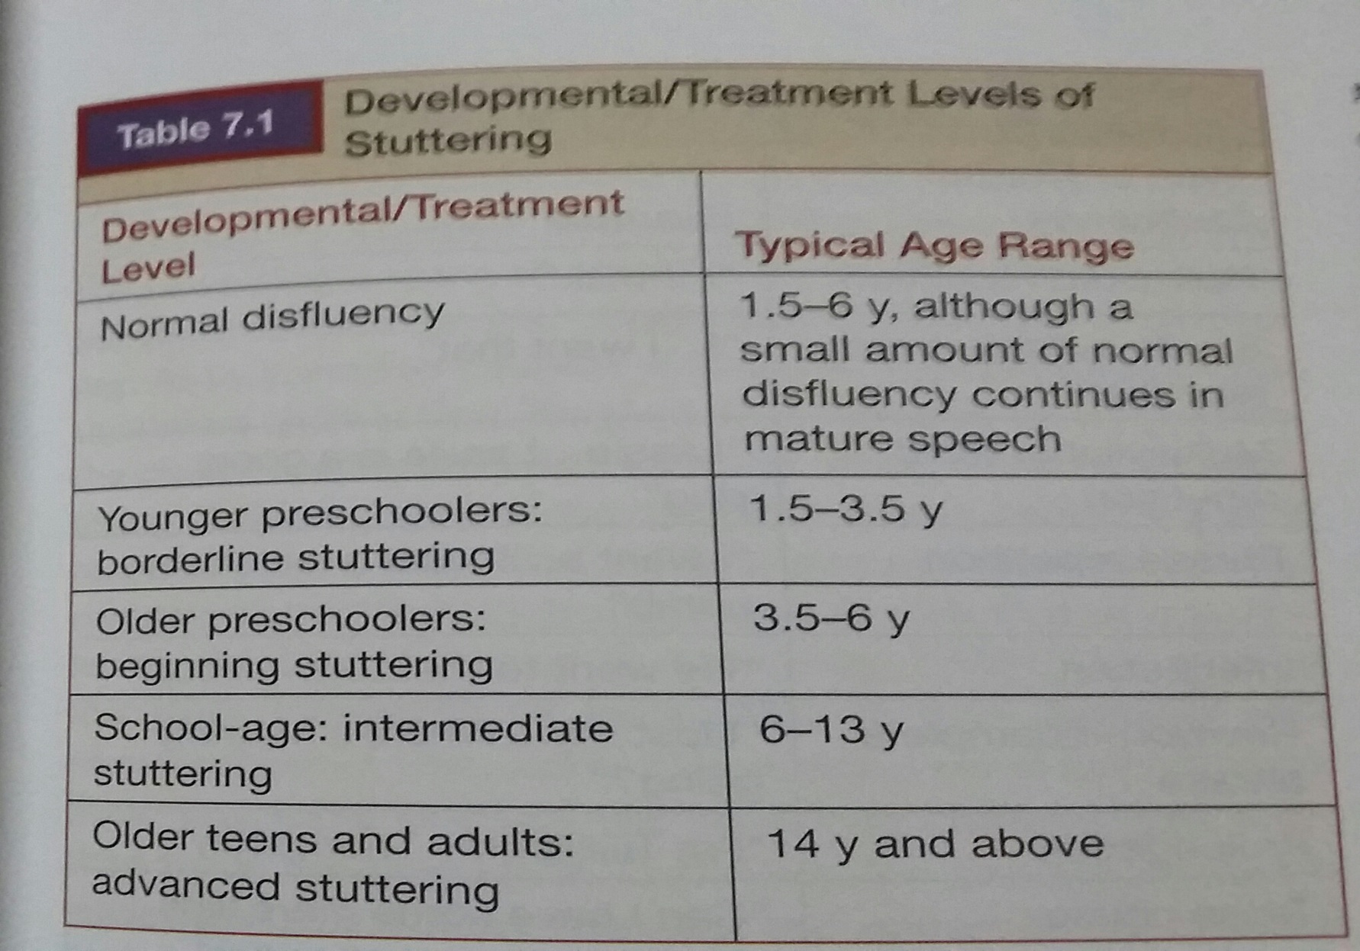

Slide 24
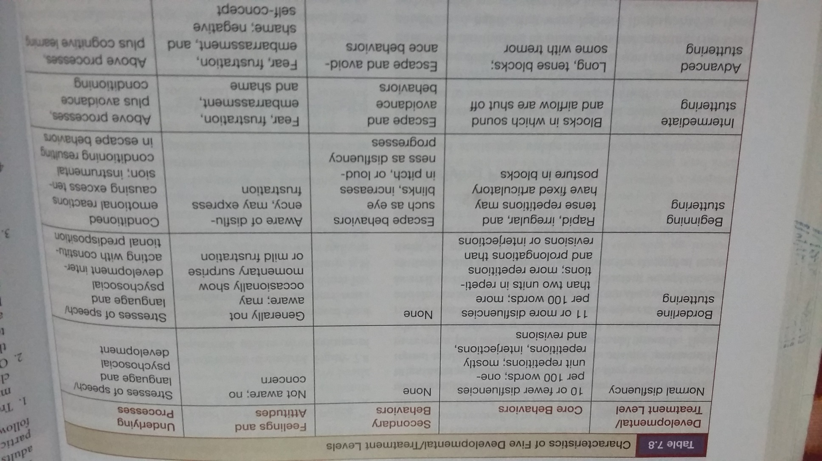

Slide 25
PRELIMINARIES TO ASSESSMENT

Slide 26
Assessment
Assessment took place at different levels:
Information Gathering.
-case history.
-questionnairs.
-parental interview.
-measuring and test implemintation.
Personal encounter.
Knowing the client and his family.

Slide 27
Assessment has to fulfill the following needs
Client’s Needs.
Client’s right to privacy.
-Health Insurance Portability and Accountability
Act 1996(HIPAA).
Clinician expertise.
-Empathy.
-Mastery.
-Statements and questions.
-Understand client and family needs.
-Understand the stuttering problem.

Slide 28
Cont.
Cultural considerations.(multicultural perspectives).
-Eye contact.
-Physical contact.
-Nature of reinforcers.
-Family interaction.
-Intentional stuttering.
-Conversational style.
-Modes of address.

Slide 29
Assessment of Stuttering Behavior
Frequency.
Type.
Duration
Severity.
Speech naturalness.
Speech rate.
Concomitant or associated behaviors.

Slide 30
Behaviors Counted as Stutters
Part word repetitions.
Monosyllabic whole word repetitions.
Sound prolongations.
Blockages of sound or air flow.
Successful avoidance behavior(equivocally).

Slide 31
Assessment Procedures
Speech Sample:
-Tow speech samples: one at home or school, one at the clinic.
-May be audiorecorded.
-obtaining samples when stuttering varies.
Sample size:
Conversational speech:200-265 words=300-400 syllables.
Reading passage:at or below the level of the client reading level -130 words=200 syllables.
-Transcripe.

Slide 32
Cont.
Assessing Frequency:
-Percentage of syllables stuttered.
-Each syllable can be stuttered only once.
-Posponements are not counted when we have a stuttered word,if not we count them as one disfluency.
-Successful unequivocal avoidance is counted even if the word is not stuttered.
Stuttering is greater in reading tasks than in speaking task.

Slide 33
Cont.
Assessing Types of Stuttering:
-Count the total number of disfluencies:
Stutter-like(types of stutters).
Normal disfluencies(not stutter-like).
-We can use the proportion.
-Child who stutter has more than 10 stutter-like disfluencies per 100 words.
-If a child shows a plateau or increase in part-word repetition in later preschool years ,child is showing stuttering rather than normal disfluency.

Slide 34
Cont.
Assessing Duration:
-Measures of duration of the longest stutters.
-Average of the duration of the 3 longest stutters (disfluencies) in the speech sample to the nearest half asecond.
Assessing Secondary Behaviors:
Referred to as ‘concomitant’, ’associated’,
‘accessory’ behaviors.
-They are escape or avoidance behaviors.
-An important diagnostic sign between normally disfluent from those who are real stutterer.

Slide 35
ASSESSING SEVERITY
The most clinically relevant stuttering behaviors.
Most commonly used measure of severity is SSI-3,SSI-4(Riley,first published 1972).
1- Frequency:percentage of syllables stuttered on both speaking and reading tasks.
-in non readers speaking task is doubled.
2-Duration: the mean of the 3 longest disfluencies.
3-Physical concomitants.

Slide 36
Assessing Speech Naturalness
Speech sounds Normal.
Judgment :subjectively(intuitive).
objectively( rates).
SSI-4 incorporates naturalness rating as part of the assessment.
Speaking and Reading Rate:number of words/syllables per minute.
Count the non stuttered words.
Avoidance and postponement words not calculated.

Slide 37
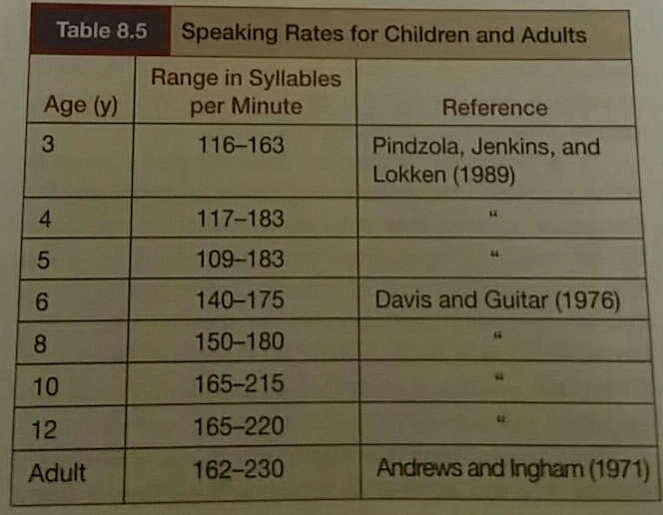
Cont.

Slide 38
Assessing Feelings and Attitudes
Preschool Children:Kiddy CAT,ISPP,BSQ.
School-Age Children:A-19 Scale,CAT,OASES, TASCC.
Adolescents and Adults:S-24,SSRSS,PSI,Locus of Control,OASES

Slide 39
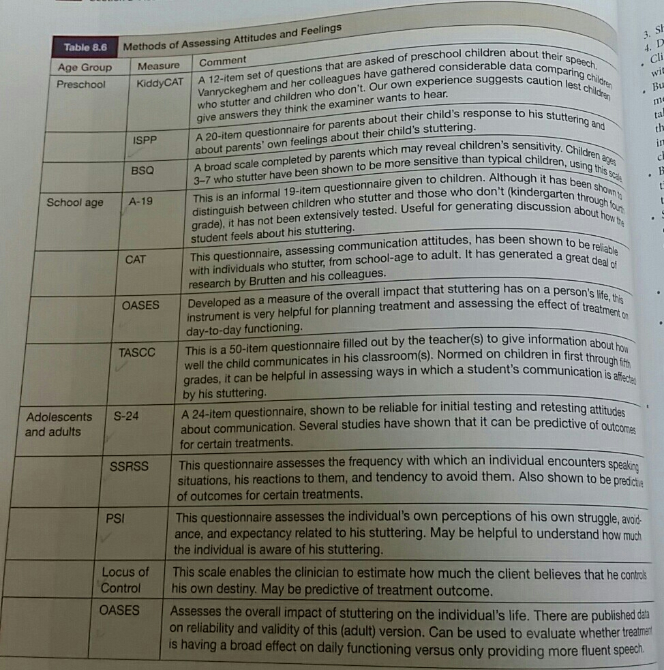

Slide 40
Assessment and Diagnosis

Slide 41
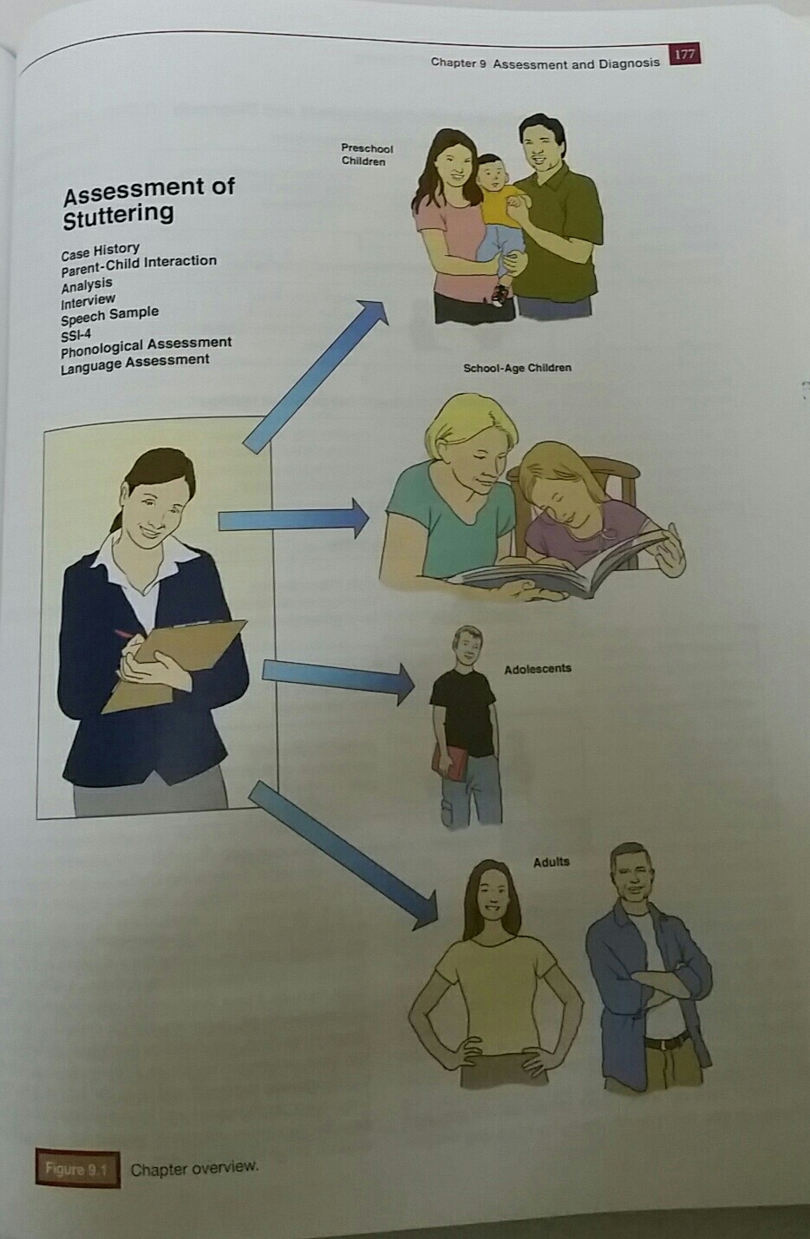
Assessment and Diagnosis

Slide 42
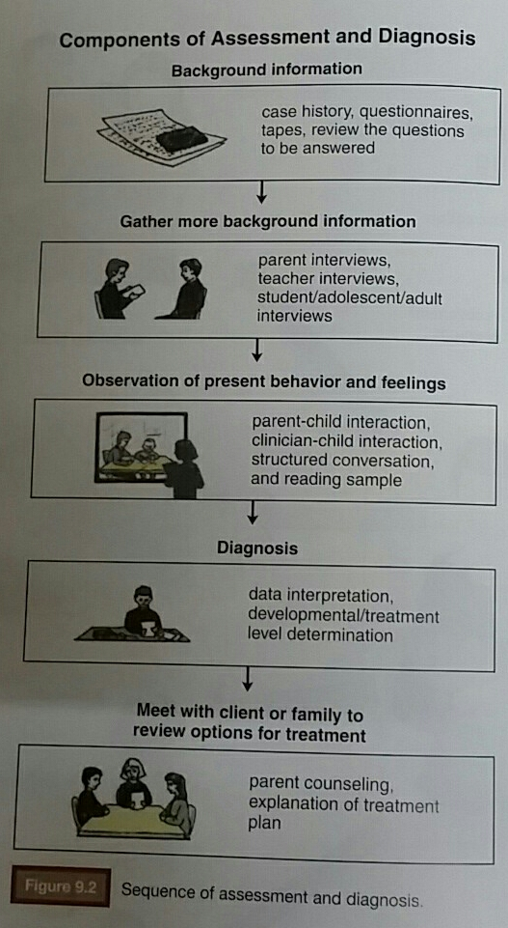

Slide 43
Preschool Child
Preassessment:
Clinical Quistions.
Initial Contact with the family.
Case history form.(pages 180-184)
Audio/Video recording.
Assessment:
Parent-Child interaction.(formally or in formally).
-parents affected/not by my point of view about stuttering.
-see the actual child stuttering.
-see the parents interaction.
-I can get a larger sample of speech.

Slide 44
Cont.
Parent interview:
-talk more freely about stuttering with child and parents.
-several questions are asked to the parents(pages 185-188).
Clinician-Child interaction:
-talking about stuttering with the child/parents.
-A child who won’t talk.
-A child who is entirely fluent. Use parents record, or rescheduled the client, change the environment for a new record.

Slide 45
Cont.
Speech Sample
Pattern of disfluencies:
-SSI-3/SSI-4
-Test of Chlidhood Stuttering(TOCS).
-Speech Rate.
Feelings and Attitudes:
1-the child is unaware.
2-occasionally aware.
3-aware and frustrated.
4-highly aware frustrated and afraid.

Slide 46
Cont.
Speech and Language behaviors.
Speech and Language environment.
Physical Development.
Cognitive Development. referral
Social-Emotional Development.

Slide 47
DIAGNOSIS
Normally(Typically) Disfluent:
Less than 10 disfluencies/100words or syllables.
Multisyllable word repetitions,phrase repetitions,revesions ,interjections,pauses.
Two or less repetitions.
Stuttering-like disfluencies/total disfluencies less than 50%.
All disfluencies are relaxed.

Slide 48
Cont.
Border Line Stuttering:
1.5-3 years
More than 10 disfluencies/100words or syllables.
Disfluencies are loose and relaxed.
Part word repetitions, single-syllable word repetitions, prolongations.
More than tow repetitions.
Stuttering-like disfluencies/total disfluencies more than 50%.

Slide 49
Cont.
Beginning Stuttering:
Between 3.5 years old and 6.
Tension and hurry in the child’s stuttering.
Rapid, abrupt repetitions, pitch rising during repetitions, prolongations,
Difficulty starting airflow or phonation(blocks)
Signs of facial tension.
Aware of his stuttering.
Frustrated .
Use a variety of escape behaviors.
Avoidance may occure.

Slide 50
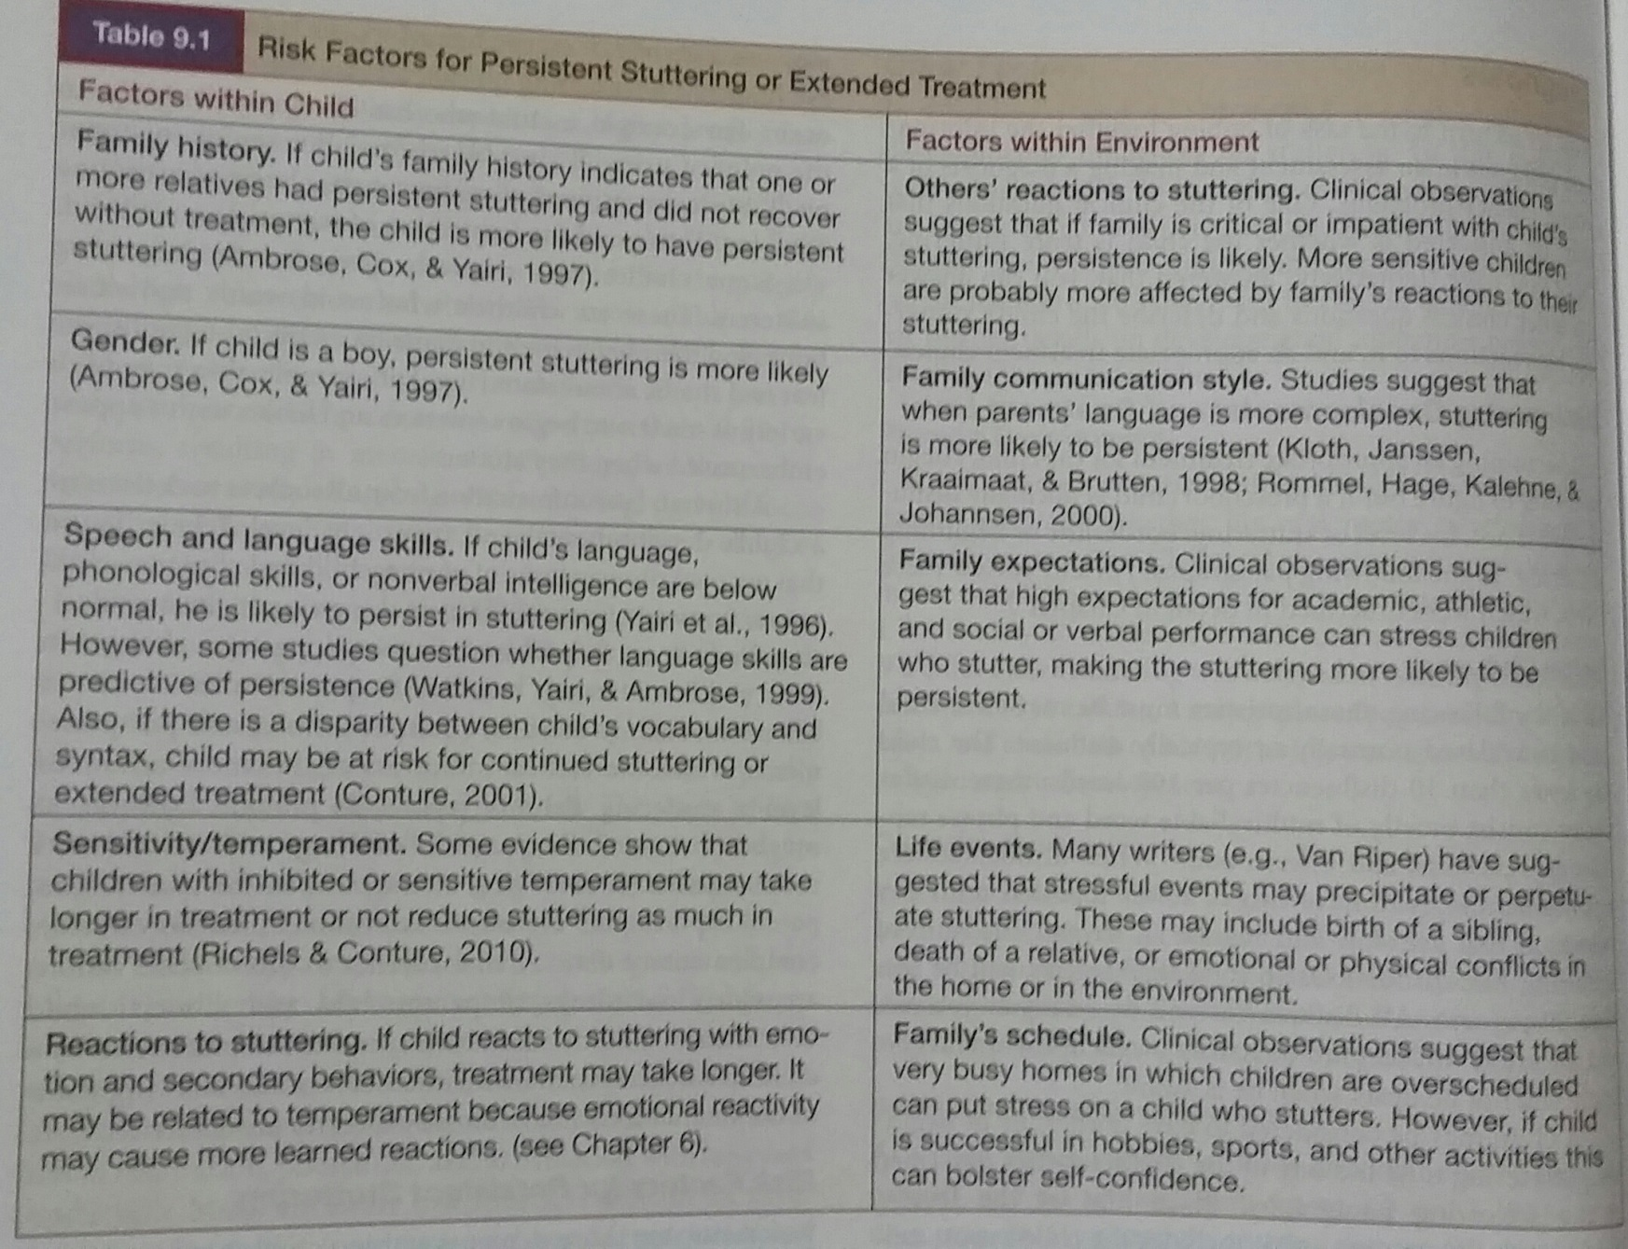
Risk Factors for Persistent Stuttering

Slide 51
Drawing Information Together
Closing Interview:
Discuss assessment findings.
Discuss family desires.
Write my summary and recommendations.
Recommendations for children with normal disfluency.

Slide 52
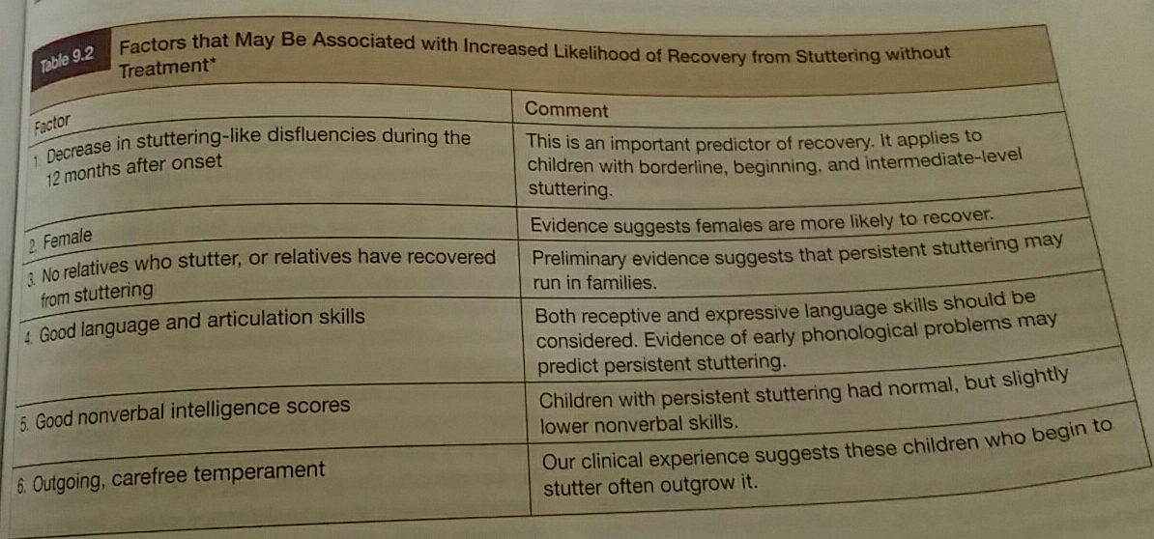
Recommendations for Children with Borderline or Beginning Stuttering

Slide 54
SCHOOL-AGE CHILD
Preassessment:
Clinical Quistions.
Public School Consideration(IDEA,97 ,2004).
Initial Contact with the family.
Case history form.(pages 180-184)
Audio/Video recording.

Slide 55
Cont.
Assessment:
Parent interview:
-talk more freely about stuttering with child and parents.
-several questions are asked to the parents(pages 185-188).
Teacher interview.
Classroom observation.
Child/student interview-accepting environment.
Questionnaire for the client (page200).

Slide 56
Cont.
Speech Sample
Pattern of disfluencies:
-SSI-3/SSI-4
--Speech Rate.
-Trial Therapy.(fluency skills)
Feelings and Attitudes.

Slide 57
Cont.
Speech and Language behaviors.
Speech and Language environment.
Physical Development.
Cognitive Development.
Social-Emotional Development.
Academic Adjustment.

Slide 58
Cont.
Diagnosis.
Closing Interview:
Discuss assessment findings.
Discuss family desires.
Write my summary and recommendations.
Public School settings.

Slide 59
ADOLESCENTS and ADULTS
PREASSESSMENT:
Clinic versus School Assessment.
Case History Form.(pages 205-208)
Attitude Questionnaires.
Audio/Video recording.

Slide 60
Cont.
ASSESSMENT:
Client Interview.(questions pages 209-210).
Parents Interview.
Speech Sample
Pattern of disfluencies:
-SSI-3/SSI-4
--Speech Rate.
-Trial Therapy.(fluency skills)
Feelings and Attitudes.

Slide 61
Cont.
Speech and Language behaviors.
Speech and Language environment.
Physical Development.
Cognitive Development.
Social-Emotional Development.
Diagnosis and recommendations.
Closing interview.

Slide 62
PRELIMINARIES TO TREATMENT

Slide 63
Clinician’s Attributes(Characteristics):
Empathy:The ability to understand the feelings,thoughts,perspectives and beliefs.
Warmth(Unconditional positive regard):feeling of positive regard for another person which is conveyed by voice tone,facial exoression and body language.
Genuineness(congruence):Honesty and self-acceptance.
A Preference for Evidence-Based Practice.
A Commitment to Continuing Education.
Critical Thinking and Creativity.

Slide 64
Clinician’s Beliefs
Clinician’s Beliefs about the causes ,etiology and development of stuttering direct clinical practice in:
ASSESSMENT.
INTERVENTION.
PARENT COUNCELLING.

Slide 65
TREATMENT GOALS
Treatment goals vary according to different variables.
Reduce the Frequency of Stuttering.
Reduce the Abnormality of Stuttering.
Reduce Negative Feelings about Stuttering and about Speaking.
Reduce Negative Thoughts and Attitudes about Stuttering and about Speaking.
Reduce avoidance.
Increase Overall Communication Abilities.
Create an Environment that Facilitates Frequency: Fluency -Facilitating Environment.

Slide 66
THERAPY PROCEDURES

Slide 67
Procedures to Help Clients and Families Deal with Their Emotions Associated with stuttering
Called counseling or working with emotions related to stuttering.
Empathy,Warmth and Genuineness.
Family must develop faith in the clinician abilities and in understanding and acceptance of their feelings.
Listen carefully to parents description of stuttering, responses to it ,feelings.
Share information about recovery,help parents realize positive changes.
In older clients direct work with the clients rather than the family.
Teaching certain techniques(cancellations,pull-outs, preparatory sets .

Slide 68
Procedures to Reduce the Frequency of Stuttering
Operant conditioning.
Rewards: may be verbal,tangible(tokens).
Mild punishment:drawing attention to stuttering moment, ask the client to try the word again.
Fluency Shaping techniques is used.
Mostly SLOW AND PROLONGED SPEECH.
Then progressing to more and more normal-sounding speech.

Slide 69
Procedures to Reduce the Abnormality of Stuttering
Appropriate for clients who developed struggle,tension, escape and avoidance.
Reward and mild punishment is used to:
-change long tense stutters to briefer and more relaxed ones.
-diminish use of escape and avoidance behaviors.
Reducing negative emotions.
These techniques called(STUTTERING MODIFICATION).VAN RIPER
FLUENCY SHAPING TECHNIQUES some times used.

Slide 70
Procedures to Reduce Negative Thoughts and Attitudes about Stuttering and Speaking
Cognitive Behavior Therapy.
Helping clients to think and feel more positively about their speech,listener reactions,and situations of negative emotions.
Thoughts influence Feelings and Actions.
Muscular tension and maladaptive behaviors leads to more stuttering.

Slide 71
Procedures to Reduce Avoidance
Reducing negative emotions(fears of stuttering and listener reaction).
Fear of stutter:rewarding catching a stutter moment and holding onto it.
Fear of listener:stuttering voluntarily make client feeling in control during stutter.
Learn client preparatory sets (stuttering modification) .
Shifting to slower rate(fluency shaping).
Situation avoidance: help client to construct a hierarchy of easy-to- difficult situations.

Slide 72
Procedures to Increase Overall Communication Abilities
Reduce fears of stuttering and listener reaction.
Reduce avoidance speaking situations.
Observe and report the overall communication style of the client in different contexts.
Eye contact,turn taking,topic maintainance, clarifying,repairing communication breakdown,willingness to initate and maintain communicative interaction.

Slide 73
Procedures to Create an Environment that Facilitates Fluency
Parent counseling.
Parent child interaction is an important key element for environment that can facilitate fluency.
Coaching parents how to communicate with their child.
Home communication style to be changed.
Make school a(fluency-friendly) environment.
Openness about stuttering can create supportive environment.

Slide 74
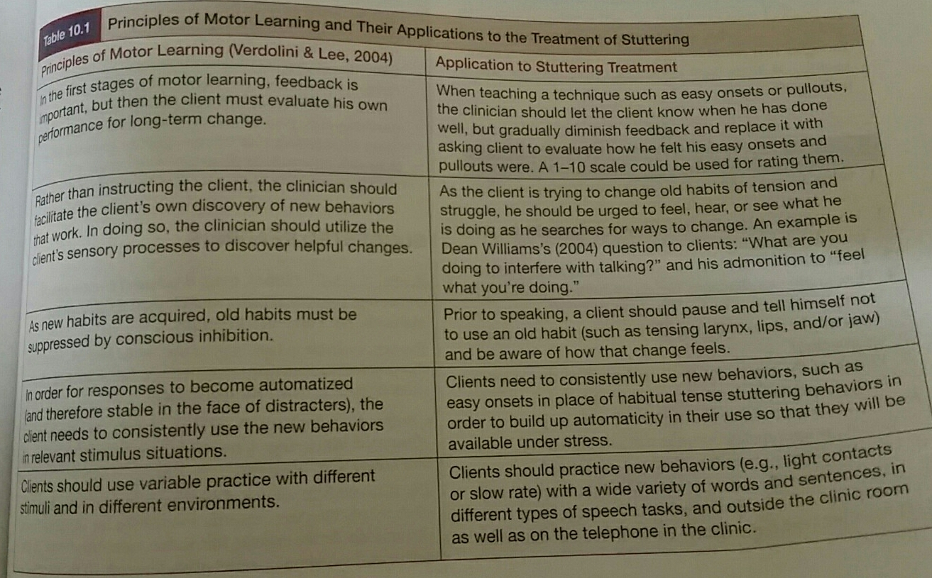
Motor Learning Principles for Treatment Generalization.

Slide 75
STUTTERING INTERVENTION
(THERAPY)

Slide 76
TOW MAJOR THERAPY APPROACHES
1-STUTTERING MODIFICATION.
2-FLUENCY SHAPING .

Slide 77
Stuttering Modification
The main goal of stuttering modification is not to speak more fluently but to stutter easily.
Two key elements:
  Modification of stuttering moments to reduce severity.
  Elimination of avoidance and covert behaviors to reduce the fear of stuttering

Slide 78
STUTTERING MODIFICATION
VAN RIPER’s approach.
Major focus on Attitudes, speech fears, avoidances.
Major focus on Modification of stuttering moments.
Major focus on analysis of stuttering behaviors.
Major emphasis on Development of self-monitoring skills.

Slide 79
Four Phases ( Stages)
Identification Phase
Desensitization Phase
Modification Phase
Stabilization Phase

Slide 80
Identification Phase
To improve the understanding of each individual’s stuttering and to have client understand the basic concepts of speech production.
Therapy strategies used to identify behaviors are oral reading, discussion, modeling stuttered behaviors, and self observation.

Slide 81
Desensetization
Deliberate (or Voluntary) Stuttering:
( Toughening the Stutterer to his Stuttering )
What is it?
The child stutters “on purpose”.
Why use it?
  Assists in building awareness of stuttering moments
  Decreases fear and avoidance of stuttering
  Desensitizes to listener reactions
  Creates a feeling of confidence in the ability to say feared words
  Confront what might otherwise be avoided
When and how to use it?
  -Begin teaching at the single word level with unfeared sounds or words
  Begin using it in unfeared situations
  Build to use on feared words or in feared situations.

Slide 82
Modification Phase
A-Cancellation:
What is it?
  Finishing a stuttered word then
  Pausing for a moment to plan (e.g. pantomime or silently revisit the word) then
  Stuttering on the word again in an easier way
Why use it?
  The child learns to “cancel out” or replace hard stuttering with a looser, more controlled form of stuttering
  Cancellation discourages avoidance behaviors such as recoiling, changing words, stopping in a block and backing up
  Cancellation reinforces easier stuttering and build confidence

Slide 83
Cont.
  When and how to use it?
    - Child MUST complete the hard stutter before pausing and making it easier
    - Typically used in the therapy room only as a way of learning a strategy, not in the outside world

Slide 84
Cont.
B-Pullout:
What is it?
  “Holding on” to the stuttering moment and “staying with it”
  Helps to focus in on site of physical tension and cessation of movement so as to
  Change the stuttering moment through reducing or “easing off” tension and slowly moving ahead into the next sound or word
Why use it?
  Confront the stuttering moment and “take charge” (desensitization)
  Release tension and keep speech moving forward
  Reinforce a looser or “easier” way of stuttering

Slide 85
Cont.
When and how to use it?
  When the child experiences a high degree of emotionality or feels “stuck” in a moment of stuttering
  After the child has learned to “hold onto” a moment of stuttering and tolerate it
  Start with deliberate or “fake” stuttering at the single word level

Slide 86
Cont.
  C--Preparatory Sets:
  -when the person anticipates a word to be difficult, they are encouraged to work through all sounds of the word slowly and calmly.
  -Preparatory set is used prior to the production of an upcoming word that the pws anticipates will be stuttered.
  -Using a slower rate and light articulatory contacts the pws begins the first sound of the word slowly, smoothly, and easily.
  - The word is completed in a slow, relaxed, smooth manner.

Slide 87
Stabilization Phase
Individual becomes a confident communicator and possesses the skills to act as their own clinician.
Generalization and maintenance are addressed during the stabilization phase

Slide 88
Generalization & Maintenance
Generalization
  The client is able to use strategies learned in therapy in more natural contexts.
  The client is encouraged to face situations that were feared and avoided prior therapy.
  Dismissal occurs when the client becomes more confident and feels that stuttering moments in every day situations are manageable.
Maintenance
  The strategies learned during therapy are maintained by the client during the stabilization phase and after dismissal.
  If stuttering behaviors reoccur and become problematic, it is encouraged to go over the phases of therapy with a pseudo stutter.

Slide 89
Disclosure
What is it?
  Child chooses to openly acknowledges own stuttering to listeners
Why use it?
  Allows the child to take control of the situation
  It promotes openness about using techniques
  Helps listeners know what to expect
  Informs listeners what the client wants them to do
When to use it?
  Like other tools, it should occur in a hierarchy (e.g., family, friends, group therapy, teachers/co-workers, strangers)
  At the beginning of a conversation or presentation

Slide 90
Fluency Shaping
Fluency shaping techniques are designed to reduce the frequency of disfluencies.
All of them modify speech in some manner.
It is important to remember that there is a tradeoff between naturalness and fluency benefits: the more the child modifies her speech, the less likely she is to be disfluent, BUT the more unnatural she will sound

Slide 91
Fluency Shaping
Stuttering is viewed as physical phenomenon.
If the speaker follows the rules of speech mechanics, his speech will be fluent.
if he violates these rules, his speech will not be fluent.
As incorrect and distorted muscle movements are altered, the speaker is able to achieve fluent speech.
The client is carefully taken through gradations of muscle movements associated with speech production.

Slide 92
Cont.
Full Breath Target:
-Teach the client to inhale through the mouth in a relaxed manner.
-particular attention to relaxation of the throat and a smooth downward movement of the diaphragm.
-The diaphragm must move smoothly during the inhalation and the vocal tract including the articulators must stay relaxed.
-At the top of the full inhalation, the client must not tighten and needs to begin speaking without hesitation.
-Air and voice must begin at the same time.

Slide 93
Cont.
Gentle Onset:
-Addresses the abrupt initiation of phonation.
-Full breath must occur first before gentle onset is effective.
-Gentle onset is taught by exaggerating the initiation of sounds/words.
-First the client demonstrates very low amplitude vibration of the vocal cords, followed by a gradual increase in the loudness of phonation.
- Finally a decrease in loudness to the initial amplitude level.

Slide 94
Cont.
Easy Starts/Easy Speech:
-The child/teen is generally instructed to begin speech a little slower, with less tightness, and slightly softer.
-Complexity of responses increased in a hierarchy manner.
-Carryover and self-monitoring are taught to the children.

Slide 95
Cont.
Stretching:
-The child/teen can also be taught to slightly stretch the beginning sound to ease into production.
Light Contacts:
The child/teen is taught to “touch” the articulators together lightly and softly.
Light contacts are used on sounds that involve more contacts such a plosives and labials.
Chunking:
- The child/teen practices forward moving speech by grouping words together.

Slide 96
Slow-Prolonged Speech
DAF:DELAYED AUDITORY FEEDBACK
  optimum is 500-millisecond delay
Rhythmic Speech:
- Metronome-timed speech
  pacing boards
  miniature electronic metronome worn behind the ear
  (one word or syllable per beat

Slide 97
Cont.
Masking:
-Speaking while listening to loud masking noise
-Turned on when person begins to phonate
-Turned off when phonation ceases

