Slide 1
Organizational Behavior 15th Ed
Chapter 4
Robbins and Judge
Emotions and Moods

Slide 2
Chapter 4 Learning Objectives
After studying this chapter you should be able to:
Differentiate emotions from moods and list the basic emotions and moods.
Discuss whether emotions are rational and what functions they serve.
Identify the sources of emotions and moods.
Show the impact emotional labor has on employees.
Describe affective events theory and identify its applications.
Contrast the evidence for and against the existence of emotional intelligence.
Be able to identify strategies for emotion regulation and their likely effects.
Apply concepts about emotions and moods to specific OB issues.

Slide 3
Differentiate Emotions from Moods, List the Basic Emotions and Moods
LO 1
Why Were Emotions Ignored in OB?
The “Myth of Rationality”
Emotions were seen as irrational
Managers worked to make emotion-free environments
View of Emotionality
Emotions were believed to be disruptive
Emotions interfered with productivity
Only negative emotions were observed
Now we know emotions can’t be separated from the workplace

Slide 4
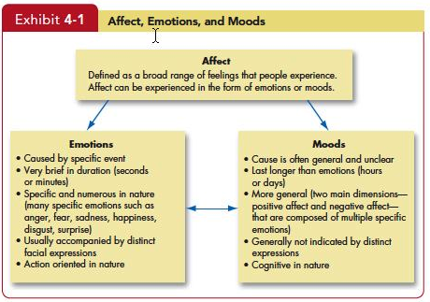
Differentiate Emotions from Moods, List the Basic Emotions and Moods
LO 1
Insert Exhibit 4-1

Slide 5
Differentiate Emotions from Moods, List the Basic Emotions and Moods
LO 1
While not universally accepted, there appear to be six basic emotions:
Anger
Fear
Sadness
Happiness
Disgust
Surprise

Slide 6
Differentiate Emotions from Moods, List the Basic Emotions and Moods
LO 1
May even be placed in a spectrum of emotion:
Happiness
Surprise
Fear
Sadness
Anger
Disgust

Slide 7
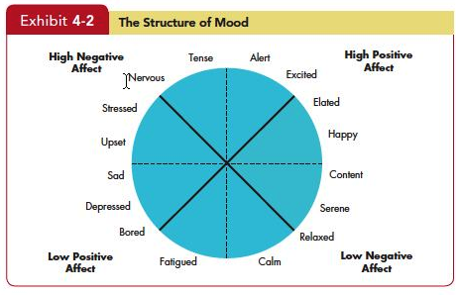
Discuss Whether Emotions Are Rational and What Functions They Serve
LO 2
Insert Exhibit 4-2

Slide 8
Discuss Whether Emotions Are Rational and What Functions They Serve
LO 2
Decision-Making
Thinking
Feeling

Slide 9
Identify the Sources of Emotions and Moods
LO 3
Personality
There is a trait component – affect intensity
Day and Time of the Week
There is a common pattern for all of us
Happier in the midpoint of the daily awake period
Happier toward the end of the week

Slide 10
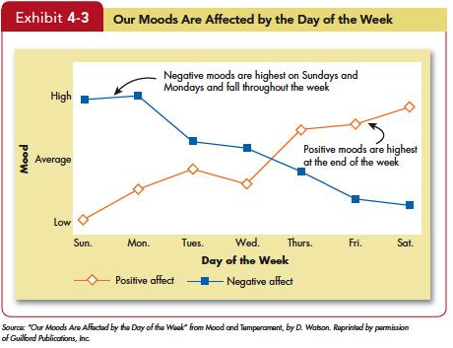
Identify the Sources of Emotions and Moods
LO 3
Insert Exhibit 4-3

Slide 11
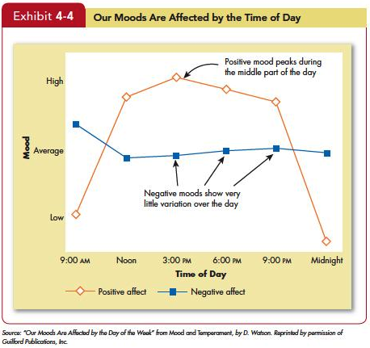
Identify the Sources of Emotions and Moods
LO 3
Insert Exhibit 4-4

Slide 12
Identify the Sources of Emotions and Moods
LO 3
Weather
Illusory correlation – no effect
Stress
Even low levels of constant stress can worsen moods
Social Activities
Physical, informal, and dining activities increase positive moods

Slide 13
Identify the Sources of Emotions and Moods
LO 3
Sleep
Poor sleep quality increases negative affect
Exercise
Does somewhat improve mood, especially for depressed people

Slide 14
Identify the Sources of Emotions and Moods
LO 3
Age
Older folks experience fewer negative emotions
Sex
Women tend to be more emotionally expressive, feel emotions more intensely, have longer-lasting moods, and express emotions more frequently than do men
Due more to socialization than to biology

Slide 15
Show the Impact Emotional Labor Has on Employees
LO 4
Emotional Labor-An employee’s expression of organizationally desired emotions during interpersonal transactions at work.
Emotional Dissonance:
Employees have to project one emotion while simultaneously feeling another
Can be very damaging and lead to burnout

Slide 16
Show the Impact Emotional Labor Has on Employees
LO 4
Types of Emotions:
Felt: the individual’s actual emotions
Displayed: required or appropriate emotions
Surface Acting: Hiding one’s inner feelings and forgoing emotional expressions in response to display rules.
Deep Acting: Trying to modify one’s true inner feelings based on display rules.

Slide 17
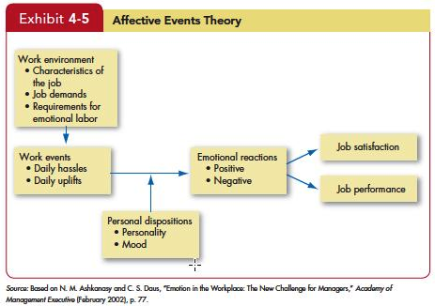
Describe Affective Events Theory and Identify Its Applications
LO 5
Insert Exhibit 4-5

Slide 18
Describe Affective Events Theory and Identify Its Applications
LO 5
An emotional episode is actually the result of a series of emotional experiences triggered by a single event
Current and past emotions affect job satisfaction
Emotional fluctuations over time create variations in job performance
Emotion-driven behaviors are typically brief and variable
Both negative and positive emotions can distract workers and reduce job performance

Slide 19
Describe Affective Events Theory and Identify Its Applications
LO 5
Emotions provide valuable insights about behavior
Emotions, and the events that cause them, should not be ignored at work; they accumulate
Notes:
In summary, emotions do provide very valuable information and predict factors about behavior. In addition, it is important not to ignore minor events as they will accumulate over time.

Slide 20
Contrast the Evidence For and Against the Existence of Emotional Intelligence
LO 6
Emotional Intelligence is a person’s ability to:
Be self-aware
Recognizing own emotions when experienced
Detect emotions in others
Manage emotional cues and information

Slide 21
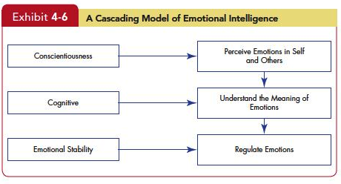
Contrast the Evidence For and Against the Existence of Emotional Intelligence
LO 6
Insert Exhibit 4-6
Notes:
Exhibit 4-6 illustrates the “Cascading Model of Emotional Intelligence” Here we see the suggested relationship between Conscientiousness. Cognitive, and Emotional Affects and the outcomes of detecting others’ emotions, understanding what they mean, and regulating the emotions successfully.

Slide 22
Contrast the Evidence For and Against the Existence of Emotional Intelligence
LO 6
EI is controversial and not wholly accepted
Case for EI:
Intuitive appeal;
Predicts criteria that matter;
Is biologically-based.

Slide 23
Contrast the Evidence For and Against the Existence of Emotional Intelligence
LO 6
EI is controversial and not wholly accepted
Case against EI:
Too vague a concept;
Can’t be measured;
Its personality by a different name.

Slide 24
Be Able to Identify Strategies for Emotion Regulation and Their Likely Effects
LO 6
Emotion regulation is to identify and modify the emotions you feel.
Strategies to change your emotions include thinking about more pleasant things, suppressing negative thoughts, distracting yourself, reappraising the situation, or engaging in relaxation techniques.

Slide 25
Apply Concepts About Emotions and Moods to Specific OB Issue
LO 7
Selection
EI should be a hiring factor, especially for social jobs.
Decision Making
Positive emotions can lead to better decisions.
Creativity
Positive mood increases flexibility, openness, and creativity.

Slide 26
Apply Concepts About Emotions and Moods to Specific OB Issue
LO 7
Motivation
Positive mood affects expectations of success; feedback amplifies this effect.
Leadership
Emotions are important to acceptance of messages from organizational leaders.

Slide 27
Apply Concepts About Emotions and Moods to Specific OB Issue
LO 7
Negotiation
Emotions, skillfully displayed, can affect negotiations
Customer Services
Emotions affect service quality delivered to customers which affects customer relationships
Emotional Contagion: “catching” emotions
Job Attitudes
Can carry over to home, but dissipate overnight

Slide 28
Apply Concepts About Emotions and Moods to Specific OB Issue
LO 7
Deviant Workplace Behaviors
Negative emotions lead to employee deviance (actions that violate norms and threaten the organization)
Safety and Injury at Work
Don’t do dangerous work when in a bad mood
Manager’s Influence
Leaders who are in a good mood, use humor,
and praise employees increase positive moods

Slide 29
Managerial Implications
Emotions and moods are a natural part of an individual’s makeup.
Ignoring co-workers’ and employees’ emotions and assessing others’ behavior as if they were completely rational is wrong.
“You can’t divorce emotions from the workplace because you can’t divorce emotions from people.”
Managers who understand the roles of emotions and moods will significantly improve their ability to explain co-workers’ and employees’ behaviors.

Slide 30
All rights reserved. No part of this publication may be reproduced, stored in a retrieval system, or transmitted, in any form or by any means, electronic, mechanical, photocopying, recording, or otherwise, without the prior written permission of the publisher. Printed in the United States of America.
Copyright © 2013 Pearson Education, Inc. publishing as Prentice Hall
Notes:
All rights reserved. No part of this publication may be reproduced, stored in a retrieval system, or transmitted, in any form or by any means, electronic, mechanical, photocopying, recording, or otherwise, without the prior written permission of the publisher. Printed in the United States of America.

