Slide 1




Musculoskeletal Assessment

Slide 2
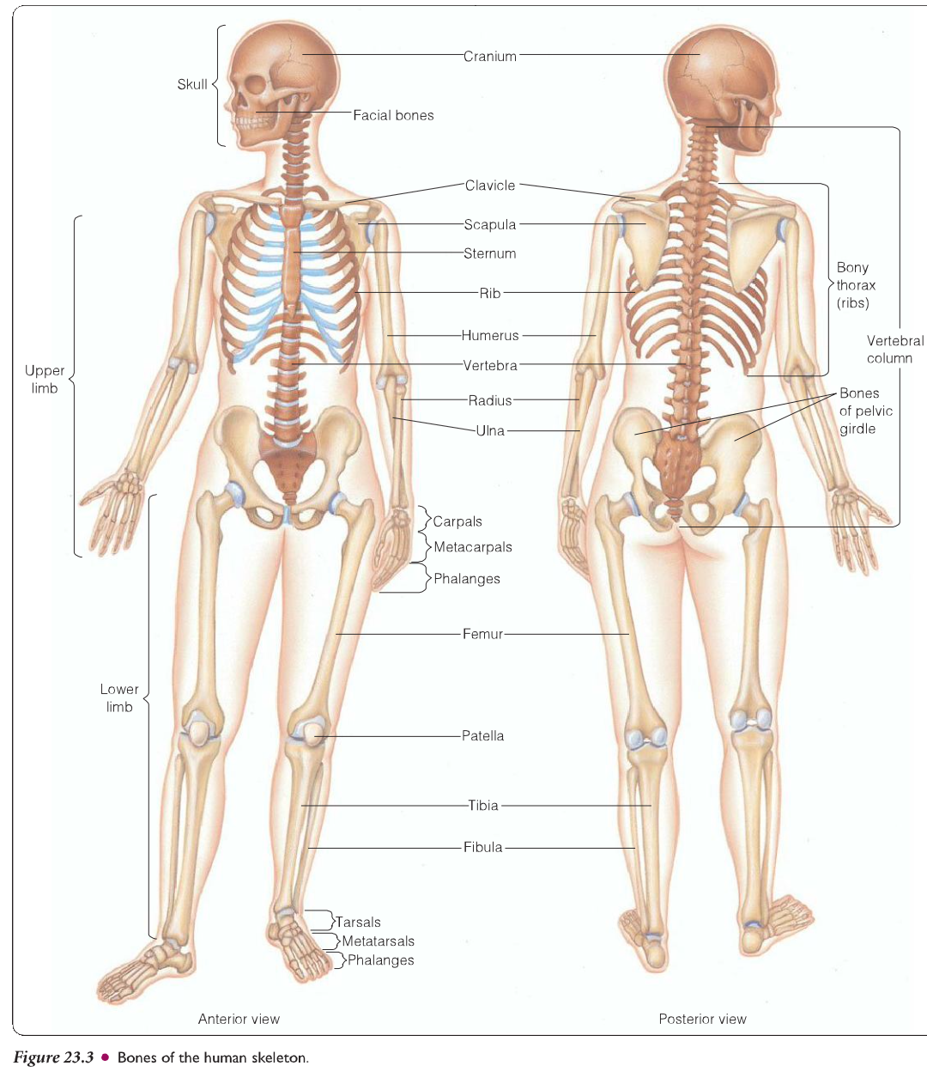

Slide 3
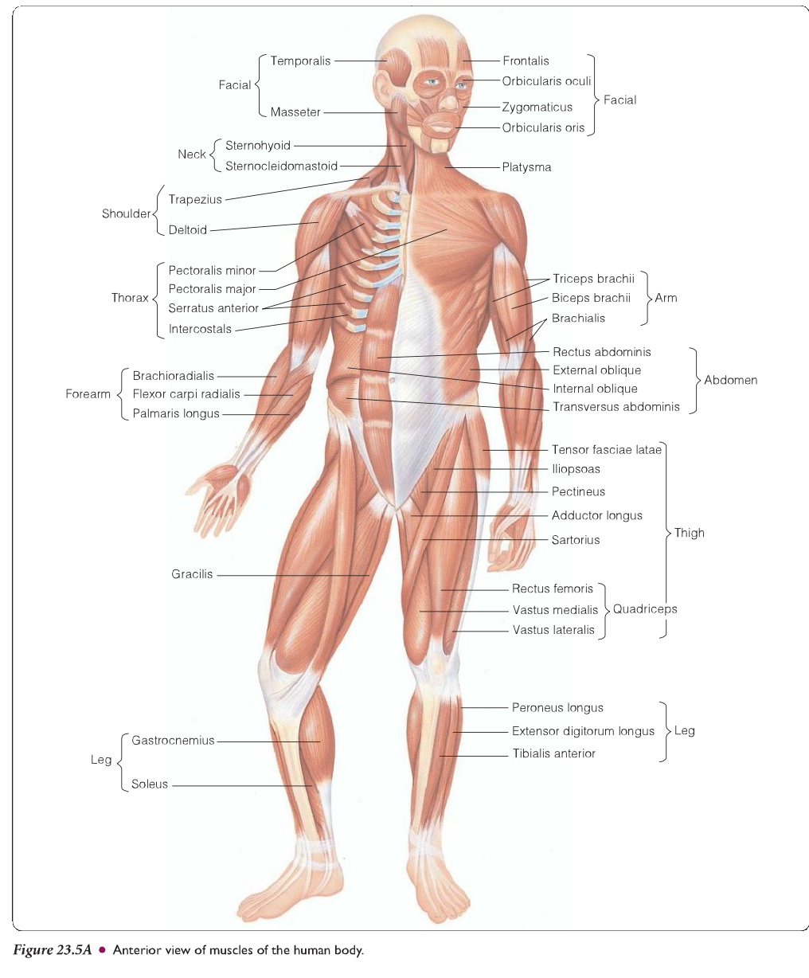

Slide 4
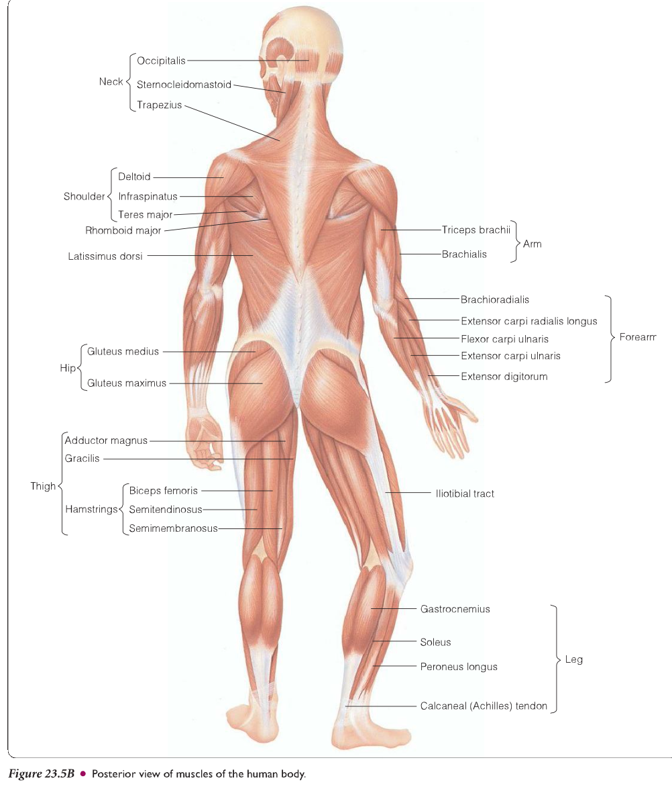

Slide 5
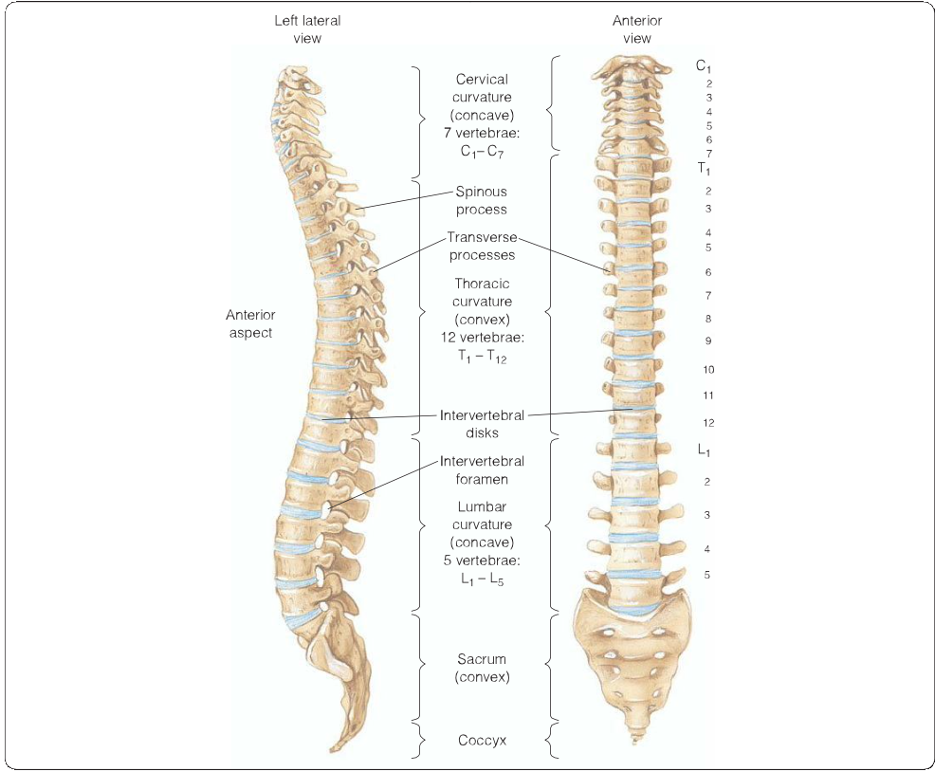

Slide 6
JOINTS
Inspect temporomandibular joint
palpate temporomandibular muscles
Test for range of motion of the TMJ
Test for muscle strength and motor function of cranial nerve V (Trigeminal )
( temporalis and masseter muscle )
inspect and palpate for Symmetry , Erythema, Edema, Nodules, Deformities
Masses, Skin atrophy, Skin breakdown

Slide 7
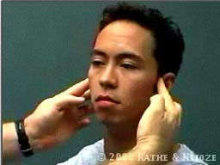
Palpation: Temperomandibular Joint
Place the tips of your index fingers directly in front of the tragus of each ear
Ask the person to open and close the mouth
Note any decreased range of motion, tenderness, or swelling

Slide 8
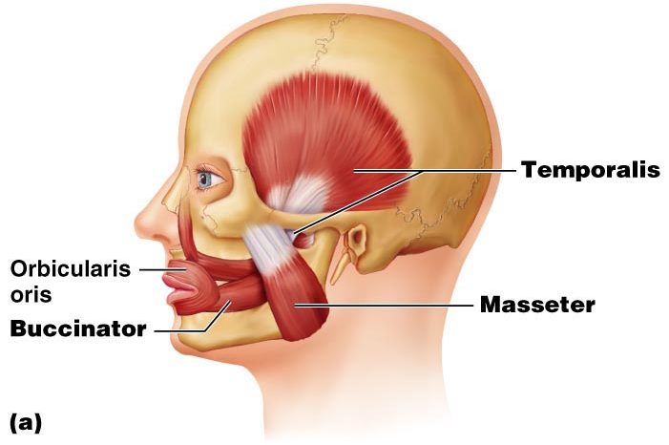
Joints
TMJ dysfunction should be suspected if facial pain and limited jaw movement accompany clicking sounds as the jaw opens and closes

Slide 9
Shoulders
Inspect and palpate the shoulders and the surrounding tissue
Test range of motion of the shoulders
1-flexion and extension of shoulders
2-internal and external rotation of the shoulder
3-abduction and adduction of the shoulder
Test for strength of the shoulder muscles

Slide 10
Rating muscle strength
Rating | Description of function | Classification
5 | Full Range of Motion (ROM)against gravity with full resistance | Normal
4 | Full R.O.M against gravity with moderate resistance | Good
3 | Full R.O.M with gravity | Fair
2 | Full R.O.M without gravity (passive motion ) | poor
1 | Palpable muscle contraction but no movement | Trace
0 | No muscle contraction | Zero

Slide 11
Grading Muscle Strength
5 Normal 100% Complete ROM against full
resistance
4 Good 75% Complete ROM against
moderate resistance
3 Fair 50% Complete ROM without
resistance
2 Poor 25% Complete ROM only if joint
fully supported
1 Trace 10% Muscle contraction visible
but insufficient to move joint
0 None 0% No visible or palpable muscle
contraction

Slide 12
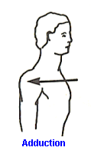
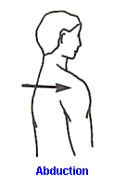
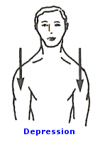
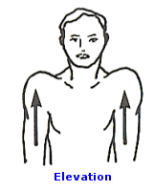
Shoulder Girdle

Slide 13
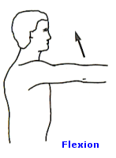
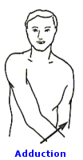
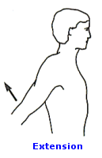
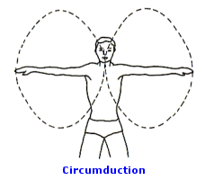
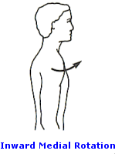
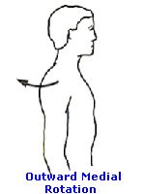
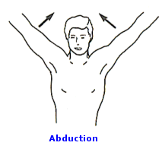
Shoulder Joint

Slide 14
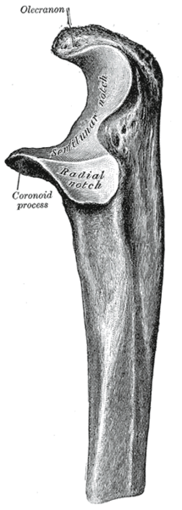
Elbows
Palpate the lateral and medial aspects of the olecranon process
Test range of motion of each elbow
Test muscle strength
Use a Goniometer to determine exact ROM in joints with limited ROM

Slide 15
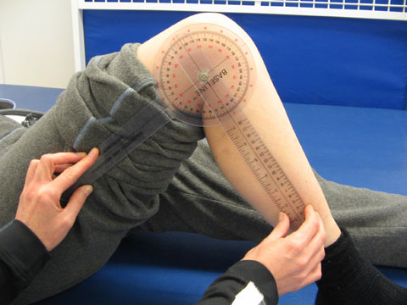
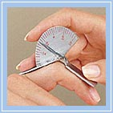

Slide 16


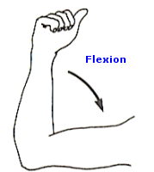


Slide 17
Wrists and hands
Inspect the wrists and dorsum of the hands for size ,shape ,symmetry ,and color
Inspect the palms of the hands
Palpate the wrists and hands for temperature and texture
Palpate each joint of wrists and hands

Slide 18
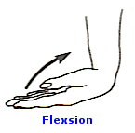
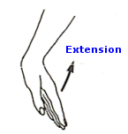
Test the range of motion of the wrist
The wrist should hyperextended to 70 degree and flex to 90 degree

Slide 19
Turn the palms down ,move the hand laterally toward the fifth finger ,then medially toward the thumb ( movement of the wrist and not the elbow )
Ulnar deviation should reach as mush as 55 degree and radial deviation 20 degree

Slide 20
Perform phalens test
Bend the wrists downward and press the backs of both hands together ( flexion of wrist 90 degree ) -CARPAL TUNNEL SYNDROME
Tinels sign :percussing lightly over the median nerve

Slide 21
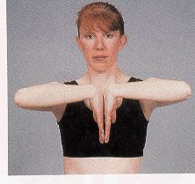
Phelan’s Sign

Slide 22
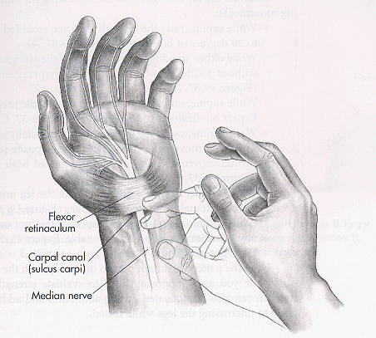
Tunnel Sign

Slide 23
Test R.O.M of the hands and fingers
Fingers should flex to 90 degree and hyperextend to 30 degree
Test for muscle strength of hands and fingers

Slide 24
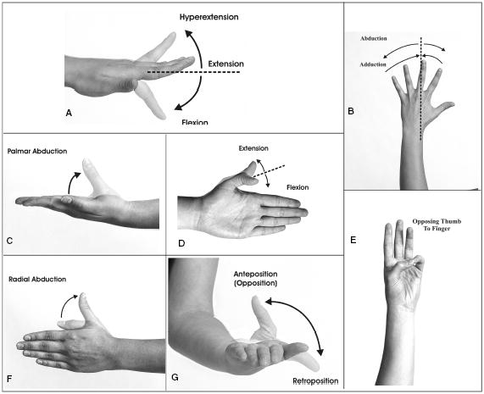

Slide 25
Hips
Inspect the position of each hip and leg with the client in a supine position
Palpate each hip joint and the upper thighs
Test R.O.M of the hips
-hip flexion to 90 degree with straight knee
-hip flexion to 120 degree with flexed knee
-internal hip rotation to 40 degree and external rotation to 45 degree
-adduction to 30 degree and abduction to 45 degree
-hyper extension to 15 degree
Test for muscle strength of the hip

Slide 26
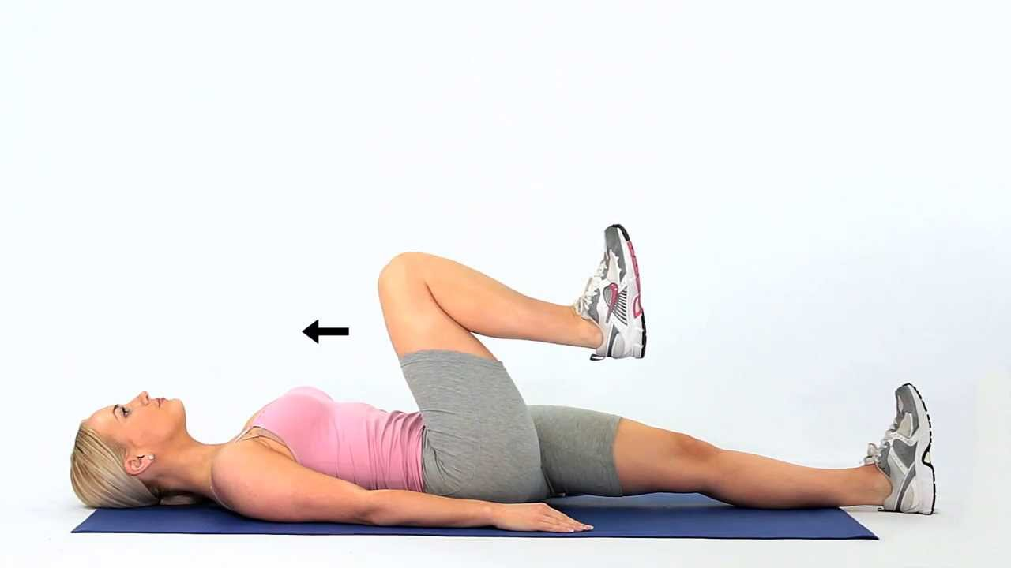
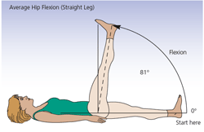

Slide 27
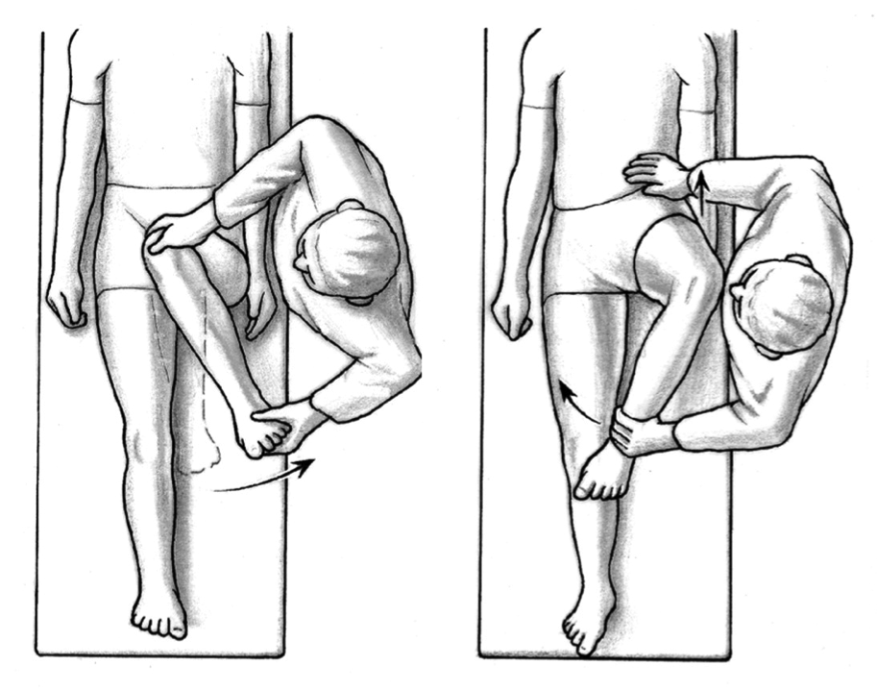

Slide 28
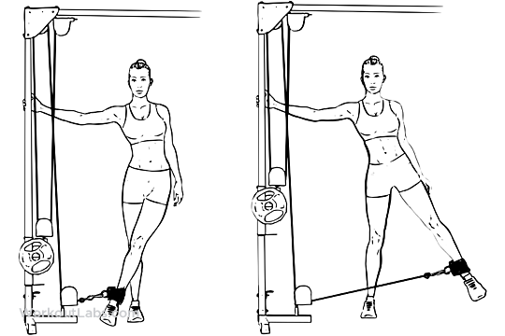

Slide 29
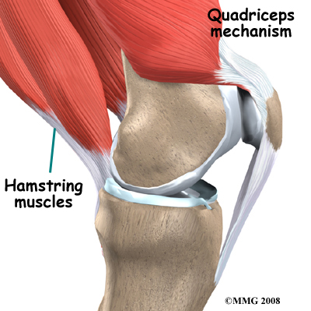
Knees
Inspect the knees, quadriceps muscle
Palpate the knee
Palpate the tibiofemoral joint
Test for the bulge sign –this procedure detect the presence of small amounts of fluid (4 to 8 ml ) –apply pressure to the lateral side of the knee while observing the medial side ,normally no fluid is present

Slide 30
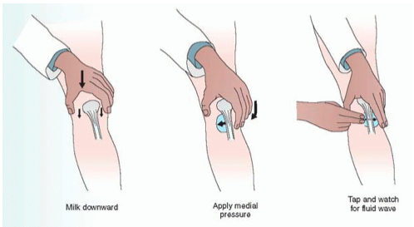

Slide 31
Perform ballottement
-used to detect fluid ,grasp the thigh just above the knee to milk fluid behind patella the tap patella ,if it rebounds against your fingers ,fluid is present
https://www.youtube.com/watch?v=r18O50lzMGw
-Test the R.O.M of each knee
-Test for muscle strength
-Inspect the knee while the client is standing

Slide 32
Ankles and feet
Inspect the ankles and feet with the client sitting ,standing ,and walking
Palpate the ankle
Palpate achilles tendon ,metatarsopharyngeal joints and interphalangeal joint
Test R.O.M of the ankles and feet
-dorsiflexion reach 20 degree
-planter flexion 45 degree
-inversion to 30 degree and eversion to 20 degree
-test muscle strength of the ankle and foot

Slide 33
Spine
Inspect the spine
Palpate each vertebral process with your thumb
Palpate the muscles on both sides of the neck and back
Test R.O.M of the cervical spine
Test R.O.M of the thoracic and lumbar spine

Slide 34
Lateral flexion of the spine -35 degree
Forward flexion of the spine reach 90 degree and extension reach 35
Rotation of the spine reach 30 degree

Slide 35
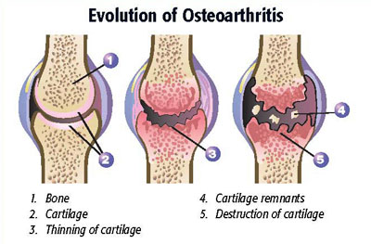
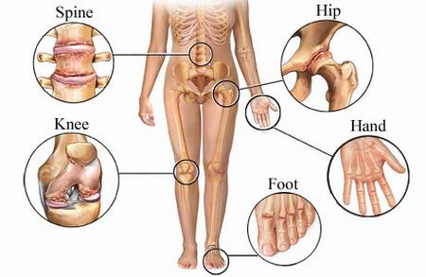
Rheumatic disease
Osteoarthritis :joint cartilage erodes, resulting in pain ,stiffness and disability

Slide 36
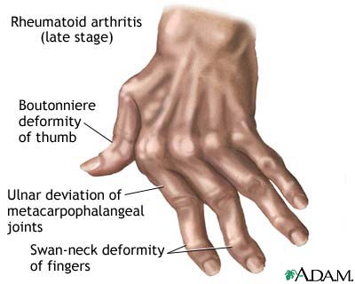
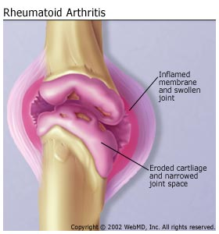
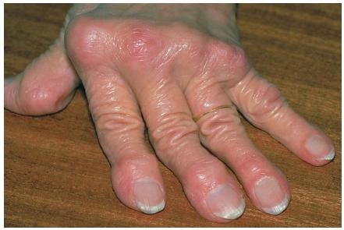
Rheumatoid arthritis : inflammation of the synovium of the joint leads to pain ,swelling ,damage to the joint ,and loss of function

Slide 37
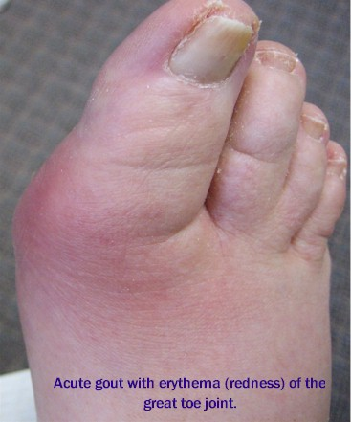
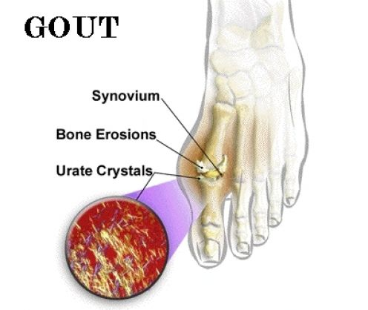
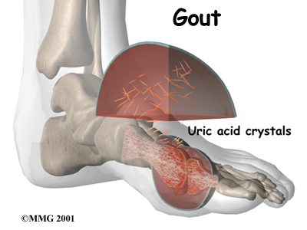
Gout :type of arthritis caused by uric acid crystal deposits in the joints. Manifested by erythema, pain and edema

Slide 38
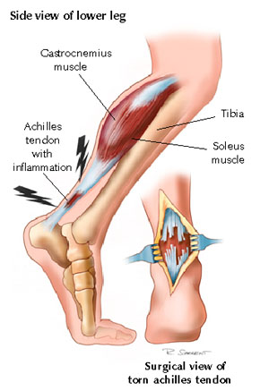
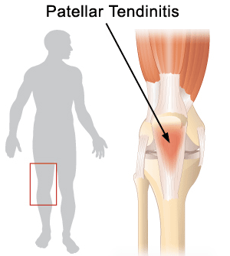
Tendinitis –inflammation of tendon
Polymyositis :inflammation and weakness in skeletal muscles

Slide 39
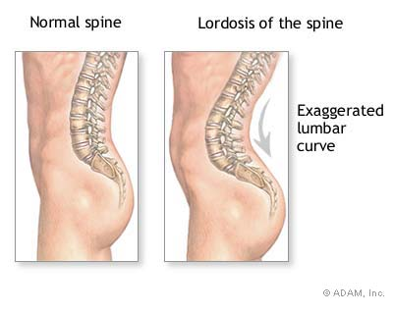
Abnormal of spine
Kyphosis ,Scoliosis
Lordosis :exaggeration of the normal lumbar curve , occurs in pregnancy and in obesity to compensate for the protuberance of the abdomen

Slide 40
Joint disorders
TMJ syndrome
Inflammation or Trauma lead to swelling and crepitus or pain in the joint

Slide 41
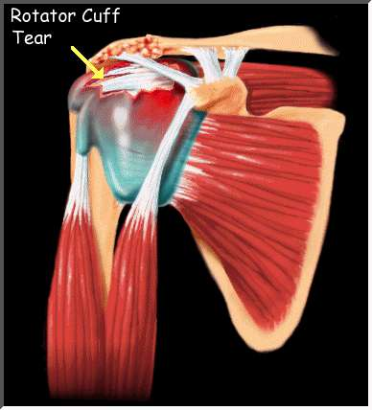
Rotator cuff tear
are tears of one, or more, of the four tendons of the rotator cuff muscles
- Happens due to repeated impingement, injury or falls.

Slide 42
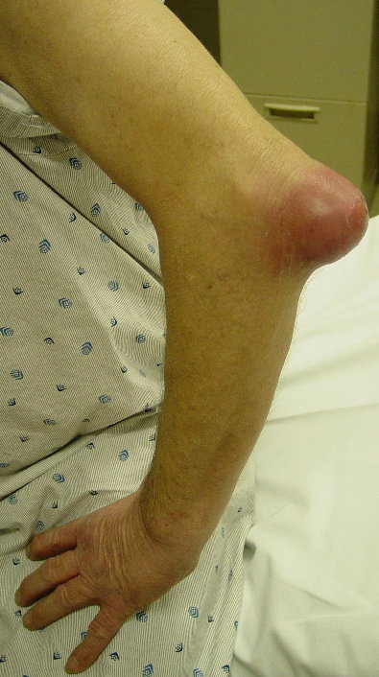
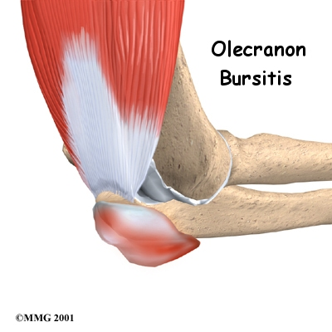
Olecranon bursitis
is a condition characterized by pain, swelling and inflammation of the olecranon bursa located in the elbow

Slide 43
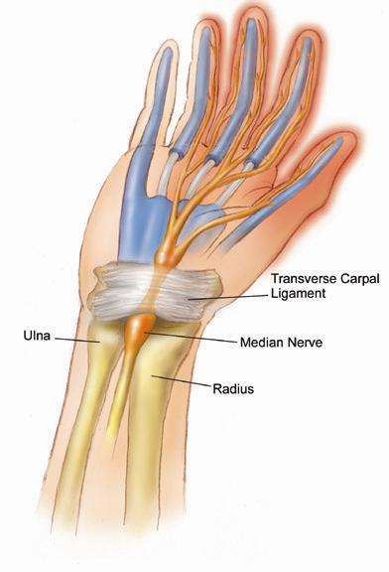
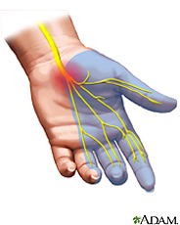
Carpal tunnel syndrome
-The carpal tunnel is a narrow passageway of ligament and bones at the base of hand. It contains nerve and tendons
-Chronic repetitive motion results in compression of the medial nerve
- Findings include: Positive Phalen's test, pain and numbness.

Slide 44
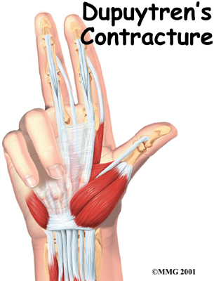
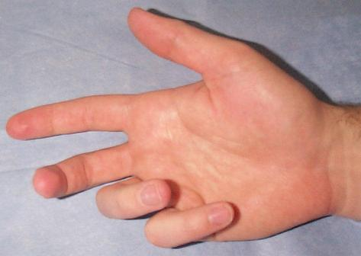
Dupuytrens contracture
is a fixed flexion contracture of the hand where the fingers bend towards the palm and cannot be fully extended (straightened)

Slide 45


Hallux valgus
If the big toe starts to deviate inward in the direction of other toe

Slide 46

Hammer toe
is a deformity of the proximal interphalangeal joint of the second, third, or fourth toe causing it to be permanently bent, resembling a hammer

