Slide 1
Lecture 7
NUTD 343
Dr. Emilia Rappocciolo

Slide 2
Foodborne pathogens
Definition: Foodborne pathogens (e.g. viruses, bacteria, parasites) are biological agents that can cause a foodborne illness event. A foodborne disease outbreak is defined as the occurrence of two or more cases of similar illness resulting from the ingestion of a common food.
foodborne infection: occurs when a pathogen is ingested with food and establishes itself (and usually multiplies) in the human host. Requires an incubation period. Time from ingestion to symptoms can be long.
foodborne intoxication: occurs when a toxigenic pathogens establishes itself in a food product and produces a toxin, which is then ingested by the human host.
Except for botulinal toxins, the mycotoxins, and the phytoplankton toxins, just about all of the foodborne agents may be contracted via the fecal–oral route

Slide 3
Fecal oral route

Slide 4
pathogenesis
To cause disease microorganisms need to be able to do the following:
Invasion: overcome (mostly) acidity of stomach
Colonization: attachment to intestinal wall and multiplication
Avoidance of immune system
Production of toxins or ability to cross the intestinal wall
Different pathogens have different behaviour
  Flat and round worms: go to muscle, liver, or stay in the GI tract
  Protozoa: stay in the gut with the exception of Toxoplasma gondii that can cross the placenta
  Phytoplankton toxins: ingested preformed
  Bacteria: much diversity and complexity

Slide 5
Bacteria pathogenesis
Gram positive bacteria produce extracellular substances that account for most if not all the disease causing processes. Toxins such as enterotoxins, and exotoxins like botulinum toxin.
Not all Gram positive bacteria cause disease through toxins. An example is Listeria monocytogenes which is an intracellular parasite.
Gram negative bacteria have more complex mechanisms of pathogenesis.
Salmonella: All S. enterica serovars carry pathogenicity islands 1 and 2 (SPI-1, SPI-2), which were acquired via horizontal transfer either by plasmids or phages. In S. Typhimurium, at least 60 genes are required for virulence, and the two SPIs are known to contain at least 42 of these genes.
A 29-kDa polypeptide enterotoxin has been demonstrated in S. Typhimurium that cross-reacts with cholera toxin and activates adenylate cyclase and could be involved in the diarrheal part of the syndrome.

Slide 6
Bacteria pathogenesis
Virulent strains of S. enterica initiate infection in nonphagocytic cells by attaching to the intestinal mucosa with the aid of fimbrial adhesins encoded by a gene on SPI-1. This is followed by the penetration of the intestinal mucosa.
Once inside, they invade the M cells of Peyer’s patches, multiply inside vacuoles causing the cell to burst and pathogen spread.
Escherichia coli: EPEC and EHEC. The pathogenicity island on the chromosome of EHEC and EPEC contains the eae gene that encodes the intimin protein that is essential for attachment–effacement (A/E).
The pathogenicity of EHEC is due to the possession of Stx toxins, endotoxins, and host-derived cytokines such as tumor necrosis factor alpha (TNF-a) and interleukin-1β. Stx1 and Stx2 toxins inhibit protein synthesis in endothelial cells.

Slide 7
Bacteria pathogenesis
Yersinia enterocolitica: Yersinia outer proteins (YOPs). Type III secretion system injects YopB and YopD into the cell and induce apoptosis
Shigellae. Invade macrophages in colonic and rectal tract and induce apoptosis. Acute inflammatory disease with dysentery. Blood and mucus are secreted. Shiga toxin inhibits protein synthesis.
Vibrios. O1 Vibrio cholerae colonizes epithelium of small intestine (M cells in particular). Toxin is coregulated with the expression of pili that mediate attachment. Cholera toxin causes great loss of water by dysregulation of Cl/Na channels (activation of cAMP).

Slide 8
Examples of Some Gram-Negative Bacteria that possess at least one virulence factor often associated with established Foodborne Pathogens
Organism | Virulence Factor Demonstrated
Aeromonas caviae | Enterotoxin
A. hydrophila | Cytotoxic enterotoxin
Bacteroides fragilis | Loop-positive enterotoxin
Citrobacter freundii | Heat-stable enterotoxin; A/E lesions
Enterobacter cloacae | Heat-stable enterotoxin
Hafnia alvei | Produce A/E lesions
Klebsiella pneumoniae | Heat-stable enterotoxin
Plesiomonas shigelloides | Heat-stable enterotoxin

Slide 9
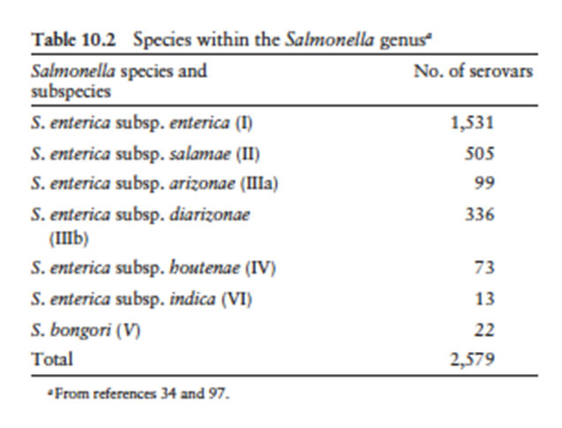
salmonellosis
The genus Salmonella consists of two species, contains multiple serovars (>2500). The two species are: S. enterica and S. bongori. S. enterica is divided into six subspecies, which are referred to by a Roman numeral and a name.

Slide 10
Samonella enterica subspecies typhimurium
In gastrointestinal tracts of a broad range of animals, mammals, reptiles, birds and insects
Causes gastroenteritis
Transferred animal-to-person, through certain food products: fresh meat, poultry, eggs, milk,fruits, vegetables, seafood
House pets - contamination through contact with their feces.

Slide 11
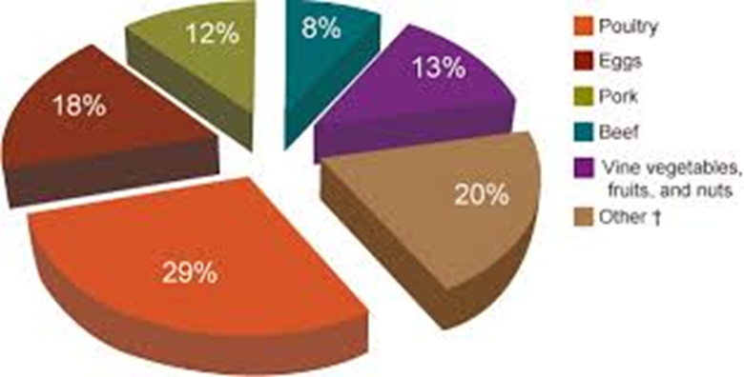
Foods associated with salmonella outbreaks

Slide 12
Virulence and infectivity
Sequence of steps:
Ingestion of Salmonella spp., survival in the stomach, adherence to small intestine epithelial cells, overcome defense mechanisms, initiate infection
virulence factors:
  length and structure of the O side chains of lipopolysaccharide.
  resistance to the action of complement is related to the length of the O side chain.
  presence and type of fimbriae - related to the ability to attachment
  expression of genes (on pathogenicity islands SPI, SP-1,SP-2) responsible for invasion into cells

Slide 13
VIRULENCE
Production of toxins
  heat labile enterotoxin cause loss of intestinal fluids, diarrhea
  heat labile cytotoxin cause damage to intestinal mucosal surface and results in enteric symptoms and inflammation
Intracellular survival in phagocytes is associated with the presence of virulence plasmids which also result in spreading from the small intestine to the spleen and liver.
Multiple antibiotic resistant strains of Salmonella have emerged
Example: S. Typhimurium definitive phage type 104 (DT104)
Multi-resistant S. Typhimurium DT104 infects both humans and animals (cattle and sheep)
it is a significant health problem in Europe, North America, Middle East, South Africa and South-East Asia.

Slide 14
CLINICAL SIGNS
Most frequent:
Mild to fulminant diarrhea (severe and sudden) with low grade fever, nausea and vomiting
Bacteremia and septicemia with high fever and positive blood cultures
Severe dehydration: infants, elderly
In most cases symptoms resolve in 1 to 7 days
Deaths are rare except in very young, very old, debilitated or immunocompromised persons
Reiter’s syndrome: Reactive Arthritis: a debilitating group of symptoms that follow gastrointestinal infection

Slide 15
transmission
Transmission by fecal-oral route
  by consumption of contaminated food or water
  person-to-person contact
  direct contact with infected animals (cats, dogs), poultry,
Reptiles – turtles carry the most virulent strains
Incidence of illness and outbreak data
  Salmonellosis is one of the most commonly reported enteric illnesses worldwide
  Children between 0–4 years had the highest notification rate
Outbreaks are associated with:
  animal products: eggs, poultry, raw meat, milk and dairy products
  fresh produce, salad dressing, fruit juice, peanut butter and chocolate

Slide 16
temperature
Resistance to heat and cold temperatures
Can grow in foods heated at 54 °C (serovar Typhimurium)
Heat resistance is inversely correlated with the Aw
Adaptation to heat
Exposure to sub lethal T causes -
  Increased concentration of saturated FA in the plasma membrane
  Results in less fluidity, lower Aw and higher resistance to heat
  Able to grow in foods stored at 2 – 4 C
Resist drying – can survive on dry beans surfaces (chocolate) – when processed, the low heat used to melt the chocolate is not high enough to eliminate the organism

Slide 17
ph
Can grow in a wide pH range: 4.5 – 9.5
Concerns about fermented foods are raised, because salmonella can survive and contaminate fermented foods
Acid Tolerance response is enhanced when the organism is briefly pre-exposed to pH 5.5, result in survival at lower pH of 4.5
Due to the synthesis of many pH shock proteins

Slide 18
salt
High salt concentration inhibits growth and is used to extend shelf life of foods
Salmonella is inhibited in the presence of 3% - 4% salt
Salmonella can grow at low pH, high salt >2% with increasing temperature
Presence of salt in acidified foods can reduce the antibacterial action of acids
Salmonella can survive in packaged refrigerated foods under vacuum modified atmosphere (adopted to prolong shelf life) gas mix of 60-80% CO₂ with N₂ and/or O₂ can inhibit the growth of aerobic spoilage organisms (Pseudomonas) and does not promote the growth of Salmonella

Slide 19
Selected major outbreaks associated with Salmonella infections (>50 cases and at least one fatality)
year | serovar | No. cases | Food | Country | Comments
2010 | S. Typhimurium PT9 | 170 | Aioli - Oil, garlic | Australia | Made with raw eggs
2009 | S. Montevideo | 272 | Salami with red/black pepper | US | Pepper added at the end, contained Salmonella
2007 | S. Tennessee | 628 | Peanut butter | Us | Raw material tested positive
2006 | S. Oranienburg | 126 | Peanut butter | Australia | Cross contamination with alfalfa
2005 | S. Typhimurium PT135 | 63 | Eggs in bakery products | Australia | Inadequate hygiene, eggs were externally dirty
2002 | S. Oranienburg | >439 | chocolate | Germany | Hi fat content caused salm. resistance to heat
1999 | S. Typhimurium PT135a | 507 | Fruit juice | Australia | Unpasteurized, found on oranges and in storage tank
1985 | S. Typhimurium | 16,284 (7) | Pasteurized milk | US | Cross contamination with the unpasteurized tank

