Slide 1
Activity diagram

Slide 2
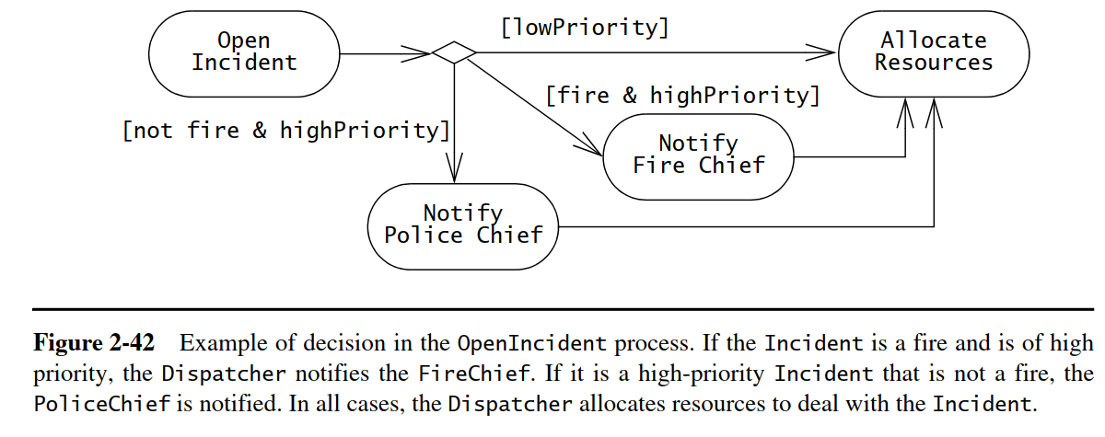

Slide 3
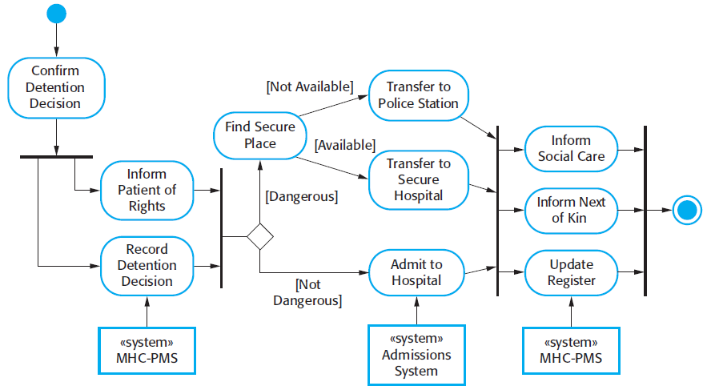
Activity Diagrams

Slide 4
Head of Department
Dean
Kader Committee
Check detailed interviews report
Call for meeting of faculty kader committee
Form a committee for interviews
Study interviews report
Notify applicants for interview dates
Forward report to Kader committee
Results are convincing?
Conduct interviews and write down scores
yes
Approve new candidates
No
Ask for new job interviews
Create a detailed interviews report
Send meeting minutes to Dean

Slide 5
State Chart for Book object
Order online
Pending
Book has arrived
Reserved online
Reserved
Available
Reservation cancelled
Rented by member
lost
Rented by member
Returned by member
Rented
Deleted
lost

