Slide 1
Chapter 7
Long-Term Debt-Paying Ability

Slide 2

Long-Term Debt-Paying Ability
The capital structure of an enterprise consists of debt and equity funds.
The sources and composition of the two types of capital determine the financial stability and long-term solvency of the firm.
Equity capital is risk capital, and the return on investment to an investor is subject to many uncertainties.
Debt capital must be paid on a specified date, usually with interest, if the firm is to survive.
There is no ideal capital structure common to all firms. In general, a firm should not have a heavy amount of long-term debt and preferred stock in relation to common stock and retained earnings.

Slide 3
Long-Term Debt-Paying Ability
Senior security holders should be well protected, and the common stock should not be burdened by excessive debt.
A company’s capitalization usually depends on the industry, the financial position of the company, and the philosophy of management.
Generally, relatively stable industries, such as utilities, have a higher debt to equity structure than industrial companies.
Companies with only common stock capitalization can be attractive to both investors and creditors because there are no prior claims ahead of the common.
However, long-term debt and preferred stock can provide leverage to a company’s capital structure and can possibly enhance the return to the common stockholders

Slide 4
Solvency (Leverage and Debt Service)
Solvency is the company's ability to satisfy long-term debt as it becomes due.
An important consideration is the size of debt in the firm's capital structure, which is referred to as financial leverage.
Solvency depends on earning power; in the long run a company will not satisfy its debts unless it earns profits.
A leveraged capital structure subjects the company to fixed interest charges, which contributes to earnings instability. Excessive debt may also make it difficult for the firm to borrow funds at reasonable rates during tight money markets.

Slide 5
Capital Structure Ratios
Solvency is the company's ability to satisfy long-term debt as it becomes due.
An important consideration is the size of debt in the firm's capital structure, which is referred to as financial leverage.
Solvency depends on earning power; in the long run a company will not satisfy its debts unless it earns profits.
A leveraged capital structure subjects the company to fixed interest charges, which contributes to earnings instability. Excessive debt may also make it difficult for the firm to borrow funds at reasonable rates during tight money markets.

Slide 6
Balance Sheet Consideration When Determining Long-Term Debt-Paying Ability
The firm’s ability to carry debt, as indicated by the balance sheet, can be viewed by considering the:
debt ratio and
debt/equity ratio

Slide 7
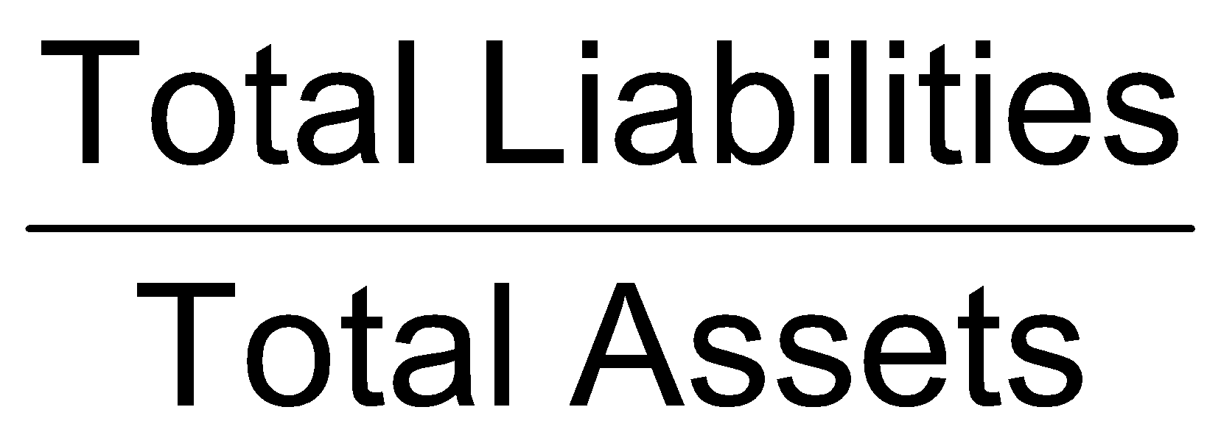
Debt Ratio
Indicates the percentage of assets financed by creditors
it helps to determine how well creditors are protected in case of insolvency. If creditors are not well protected, the company is not in a position to issue additional long-term debt.
From the perspective of long-term debt-paying ability, the lower this ratio, the better the company’s position

Slide 8
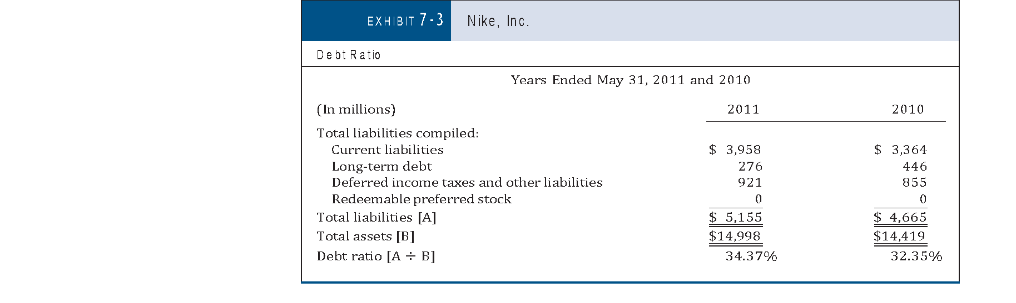
Debt Ratio
Substantially less than one-half of the Nike assets were financed by out- siders in both 2011 and 2010.
This debt ratio is a conservative computation because all of the liabilities and near liabilities have been included. At the same time, the assets are under- stated because no adjustments have been made for assets that have a fair market value greater than book value.

Slide 9
Debt Ratio
The debt ratio should be compared with competitors and industry averages.
Industries that have stable earnings can handle more debt than industries that have cyclical earnings.
Comparison can be misleading if one firm has substantial hidden assets, or liabilities that other firms do not (such as substantial land carried at historical cost).

Slide 10
Debt Ratio
Variations in application: substantial disagreement occurs on the details of the formula to compute the debt ratio
Whether short-term liabilities should be included??
Not part of long-term source of funds: exclude
Part of the total source of funds: include
Whether certain other items should be included in liabilities??
some liabilities clearly represent a commitment to pay out funds in the future,
other items may never result in a future payment.
Items that present particular problems as to a future payment of funds include: reserves, deferred taxes, noncontrolling interests, and redeemable preferred stock.

Slide 11
Debt Ratio and Certain Liabilities
Deferred Income Taxes
Difference between income tax expense based on financial statement income and income taxes payable based on the tax return. This difference is recorded as deferred income taxes.
The concept that results in deferred income taxes is called interperiod tax allocation.
Recognized as a liability by GAAP; include in ratio

Slide 12
Debt Ratio and Certain Liabilities
Deferred Income Taxes
consider the following facts related to a machinery purchase for $100,000:
Three-year write-off for tax purposes:
1st year $ 25,000
2nd year 38,000
3rd year 37,000
$100,000
Five-year write-off for financial statements:
1st year $ 20,000
2nd year 20,000
3rd year 20,000
4th year 20,000
5th year 20,000
$100,000

Slide 13
Debt Ratio and Certain Liabilities
Deferred Income Taxes
For both tax and financial statement purposes, $100,000 was written off for the equipment. The write-off on the tax return was three years, while the write-off on the financial statements was five years.
The faster write-off on the tax return resulted in lower taxable income than the income reported on the income statement during the first three years.
During the last two years, the income statement income was lower than the tax return income.

Slide 14
Debt Ratio and Certain Liabilities
Minority Shareholders’ Interest
Noncontrolling interest, results when the firm has consolidated another company of which it owns less than 100%. The proportion of the consolidated company that is not owned appears on the balance sheet as part of shareholders’ equity.
Some firms exclude the noncontrolling interest when computing debt ratios because this amount does not represent a commitment to pay funds to outsiders.
Other firms include the noncontrolling interest when computing debt ratios because these funds came from outsiders and are part of the total funds that the firm uses.
This book takes the conservative position of including noncontrolling interest in the primary computation of debt ratios.

Slide 15
Debt Ratio and Certain Liabilities (cont’d)
Redeemable Preferred Stock
Redeemable preferred stock is subject to mandatory redemption requirements or has a redemption feature outside the issuer’s control.
When computing debt ratios: Two views:
Exclude from ratio; does not present a normal debt relationship
Include in ratio for conservative application (adopted in this book).

Slide 16

Debt/Equity Ratio
Also determines the entity’s long-term debt- paying ability.
The debt/equity ratio also helps determine how well creditors are protected in case of insolvency.
From the perspective of long-term debt-paying ability, the lower this ratio is, the better the company’s debt position.
This ratio should also be compared with industry averages and competitors

Slide 17
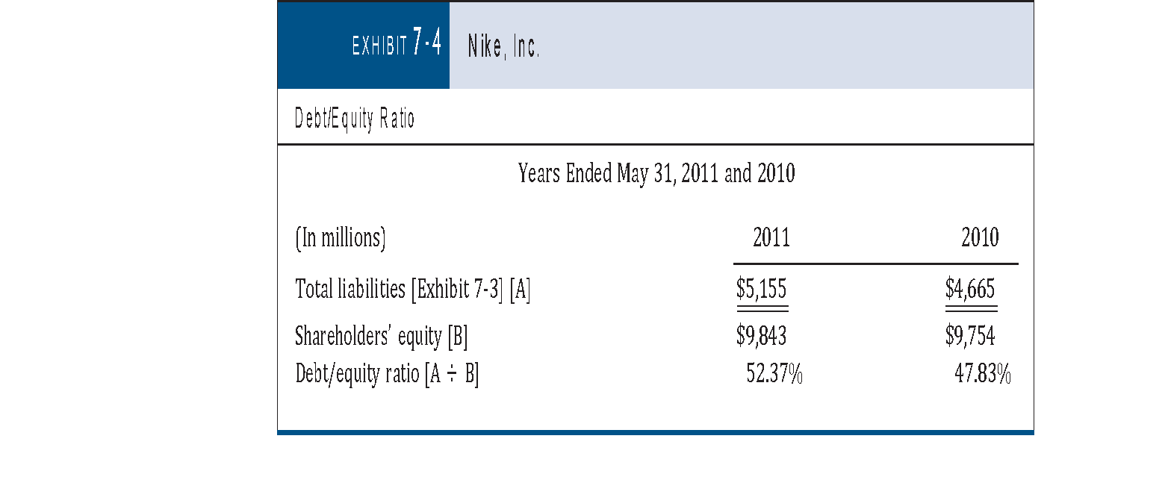
Debt/Equity Ratio
Debt/ equity ratio was 52.37% at the end of 2011, down from 47.83% at the end of 2010.

Slide 18

Debt to Tangible Net Worth Ratio
Determines the entity’s long-term debt payment ability
Indicates how well creditors are protected in case of the firm’s insolvency
More conservative than debt ratio or debt/equity ratio due to exclusion of intangibles because they do not provide resources to pay creditors

Slide 19
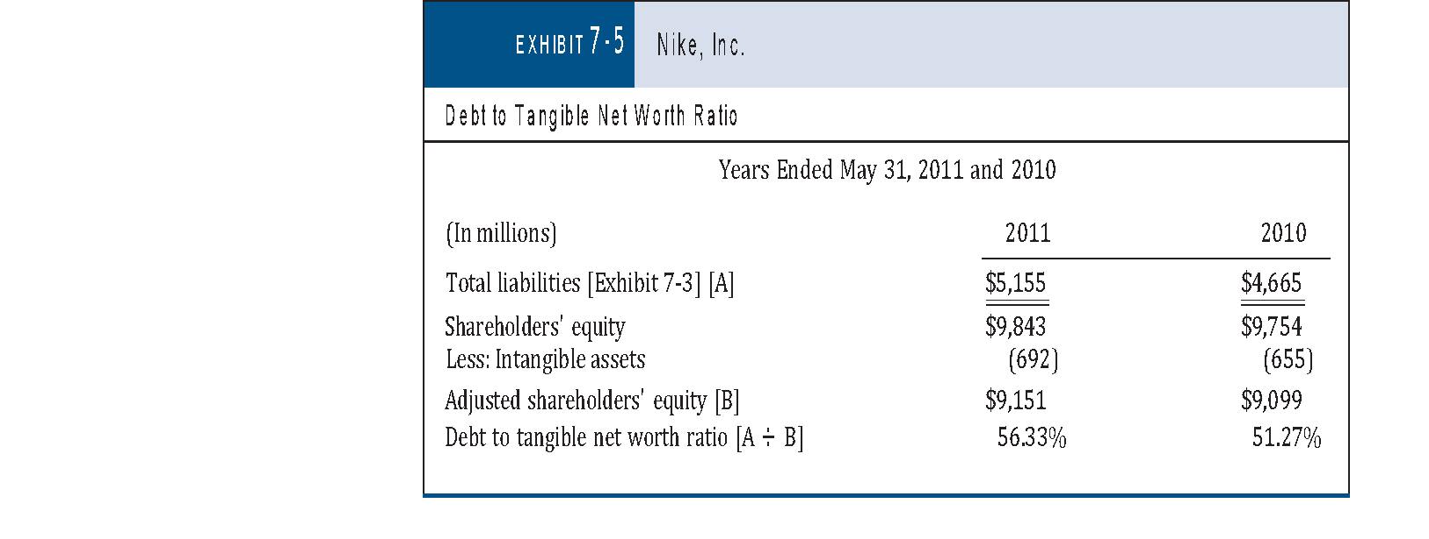
Debt to Tangible Net Worth Ratio

Slide 20
Income Statement Consideration When Determining Long-Term Debt-Paying Ability
The firm’s ability to carry debt, as indicated by the income statement, can be viewed by considering the:
times interest earned and
fixed charge coverage.

Slide 21

Times Interest Earned
The times interest earned ratio indicates a firm’s long-term debt-paying ability from the income statement view.
If the times interest earned is adequate:
little danger exists that the firm will not be able to meet its interest obligation.
it should be able to refinance the principal when it comes due

Slide 22
Times Interest Earned (cont’d)
In general, the primary analysis of the firm’s ability to carry the debt as indicated by the income statement should include only income expected to occur in subsequent periods. Thus, the following nonrecurring items should be excluded:
Exclude discontinued operations
Exclude extraordinary items
Exclude (add back) to income:
Interest expense
Income tax expense
Equity losses (earnings) of nonconsolidated subsidiaries
Minority loss (income)
Include interest capitalized

Slide 23
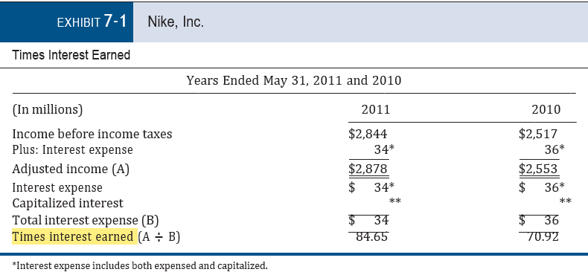
Times Interest Earned (cont’d)

Slide 24
Times Interest Earned (cont’d)
Comparisons
To evaluate the adequacy of coverage, the times interest earned ratio should be computed for a period of three to five years (provides insight on the stability of the interest coverage).
Compared to competitors and the industry average
Secondary analysis
Interest coverage on long-term debt
Use only interest on long-term debt
Not practical for external analysis

Slide 25
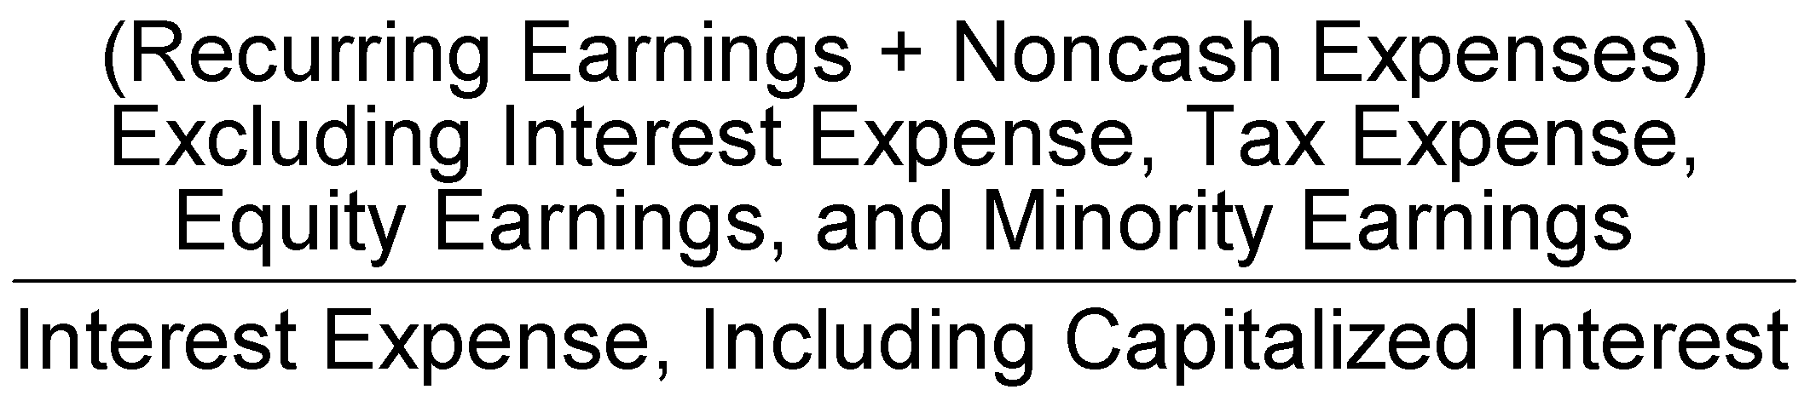
Cash basis times interest earned.
Useful for evaluating the firm in the short run
Noncash expenses such as depreciation, depletion, and amortization can be added back to the numerator of the times interest earned ratio
Less conservative

Slide 26
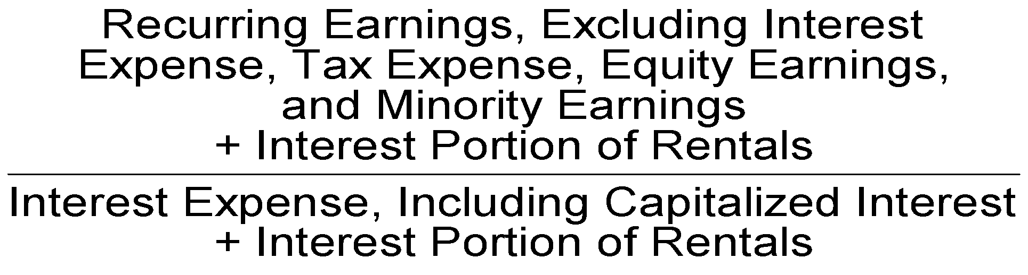
Fixed Charge Coverage
Extension of the times interest earned ratio.
Indicates a firm’s long-term debt-paying ability from the income statement view.
Indicates a firm’s ability to cover fixed charges

Slide 27
Fixed Charge Coverage
What should be included in the fixed charges??
Lessee classifies leases as capital leases or operating leases.
In capital lease, lessee includes the leased asset in fixed assets and the related obligation in liabilities. Part of the lease payment is considered to be interest expense. Therefore, the interest expense on the income statement includes interest related to capital leases.
Operating leases are reflected on the income statement in the rent expense.
An operating lease for a relatively long term is a type of long-term financing, so part of the lease payment is really interest.
When a portion of operating lease payments is included in fixed charges, it is an effort to recognize the true total interest that the firm pays.

Slide 28
Fixed Charge Coverage
Accounting for Leases
A capital lease is a lease in which the lessor only finances the leased asset, and all other rights of ownership transfer to the lessee.
This results in the recording of the leased asset as the lessee's books as a fixed asset. The lessee can only record the interest portion of a capital lease payment as expense, as opposed to the amount of the entire lease payment in the case of operating lease.

Slide 29
Fixed Charge Coverage
Capital Lease Criteria: any one of the following four alternatives:
Ownership. The ownership of the asset is shifted from the lessor to the lessee by the end of the lease period; or
Bargain purchase option. The lessee can buy the asset from the lessor at the end of the lease term for a below-market price; or
Lease term. The period of the lease encompasses at least 75% of the useful life of the asset (and the lease is noncancellable during that time); or
Present value. The present value of the minimum lease payments is at least 90% of the fair value of the asset at the inception of the lease.

Slide 30
Long-Term Leasing
Capital leases
Asset and liability are reported on the balance sheet
Operating leases
Reported as expense on the income statement
Supplemental analysis using future payments
One-third can be estimated as interest
Two-thirds can be added to the fixed assets and long-term liabilities for debt ratio analyses

Slide 31
Fixed Charge Coverage
Usually, one-third of the operating leases’ rental charges is included in the fixed charges because this is an approximation of the proportion of lease payment that is interest.
Two-thirds can be added to the fixed assets and long-term liabilities for debt ratio analyses
SEC requires specific calculation using lease terms
Fixed charge may also include:
Depreciation, depletion, and amortization
Debt principal payments
Pension payments
Substantial preferred stock dividends
The more items included as “fixed charges,” the more conservative the ratio

Slide 32
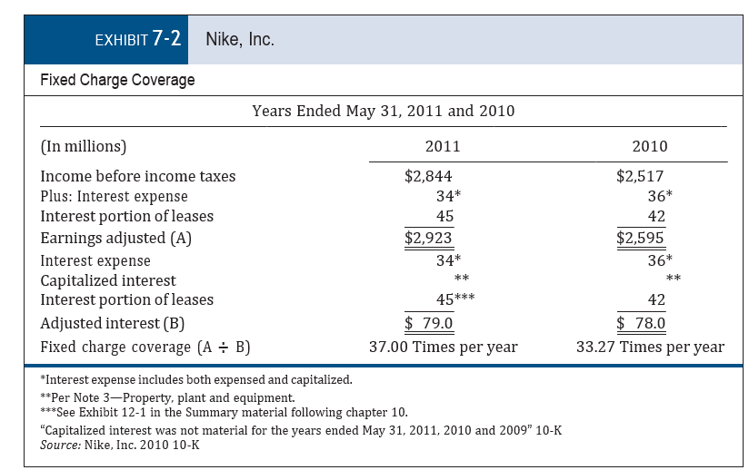
Fixed Charge Coverage

Slide 33
Long-Term Assets vs. Long-Term Debt
Consider the assets of the firm when determining the long-term debt-paying ability
Ability for analysis is limited
Financial statements do not disclose market or liquidation value
Certain assets may have market value significantly greater then carrying value
Certain assets may have earnings potential in the future

