Slide 1
Chapters 4, 10 Strings

Slide 2
Character Data Type
char letter = 'A'; (ASCII)
char numChar = '4'; (ASCII)
char letter = '\u0041'; (Unicode)
char numChar = '\u0034'; (Unicode)
NOTE: The increment and decrement operators can also be used on char variables to get the next or preceding Unicode character. For example, the following statements display character b.
char ch = 'a';
System.out.println(++ch);

Slide 3
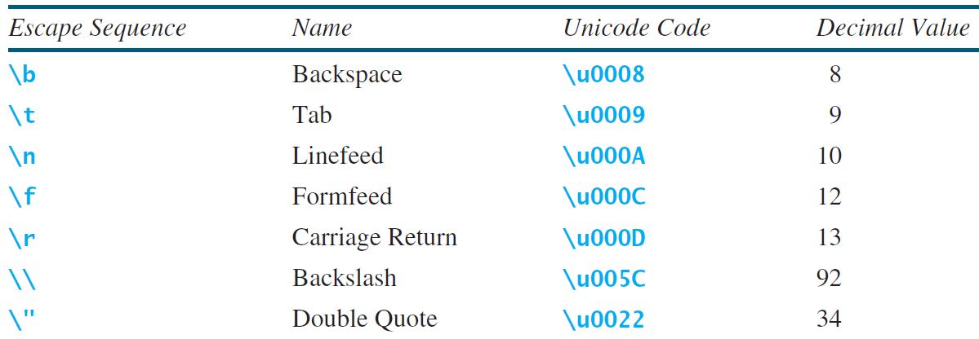
Escape Sequences for Special Characters

Slide 4
Casting between char and Numeric Types
int i = 'a'; // Same as int i = (int)'a';
char c = 97; // Same as char c = (char)97;

Slide 5
Comparing and Testing Characters
if (ch >= 'A' && ch <= 'Z')
System.out.println(ch + " is an uppercase letter");
else if (ch >= 'a' && ch <= 'z')
System.out.println(ch + " is a lowercase letter");
else if (ch >= '0' && ch <= '9')
System.out.println(ch + " is a numeric character");

Slide 6
Methods in the Character Class

Slide 7
The String Type
The char type only represents one character. To represent a string of characters, use the data type called String. For example,
String message = "Welcome to Java";
String is actually a predefined class in the Java library just like the System class and Scanner class. The String type is not a primitive type. It is known as a reference type. Any Java class can be used as a reference type for a variable. Reference data types will be thoroughly discussed in Chapter 9, “Objects and Classes.” For the time being, you just need to know how to declare a String variable, how to assign a string to the variable, how to concatenate strings, and to perform simple operations for strings.

Slide 8
Simple Methods for String Objects

Slide 9
Simple Methods for String Objects
Strings are objects in Java. The methods in the preceding table can only be invoked from a specific string instance. For this reason, these methods are called instance methods. A non-instance method is called a static method. A static method can be invoked without using an object. All the methods defined in the Math class are static methods. They are not tied to a specific object instance. The syntax to invoke an instance method is
referenceVariable.methodName(arguments).

Slide 10
Getting String Length
String message = "Welcome to Java";
System.out.println("The length of " + message + " is "
+ message.length());

Slide 11
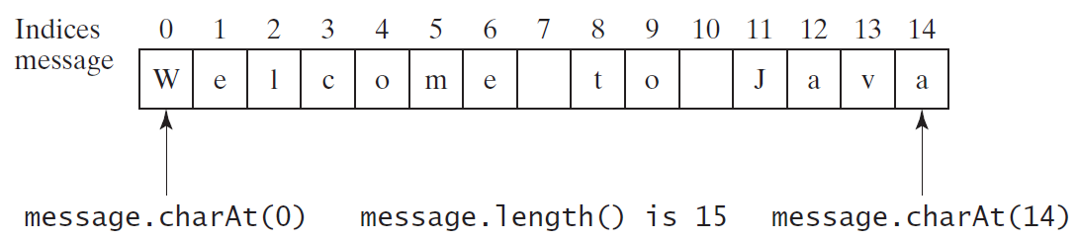
Getting Characters from a String
String message = "Welcome to Java";
System.out.println("The first character in message is "
+ message.charAt(0));

Slide 12
Converting Strings
"Welcome".toLowerCase() returns a new string, welcome.
"Welcome".toUpperCase() returns a new string, WELCOME.
" Welcome ".trim() returns a new string, Welcome.

Slide 13
String Concatenation
String s3 = s1.concat(s2); or String s3 = s1 + s2;
// Three strings are concatenated
String message = "Welcome " + "to " + "Java";
// String Chapter is concatenated with number 2
String s = "Chapter" + 2; // s becomes Chapter2
// String Supplement is concatenated with character B
String s1 = "Supplement" + 'B'; // s1 becomes SupplementB

Slide 14
Reading a String from the Console
Scanner input = new Scanner(System.in);
System.out.print("Enter three words separated by spaces: ");
String s1 = input.next();
String s2 = input.next();
String s3 = input.next();
System.out.println("s1 is " + s1);
System.out.println("s2 is " + s2);
System.out.println("s3 is " + s3);

Slide 15
Reading a Character from the Console
Scanner input = new Scanner(System.in);
System.out.print("Enter a character: ");
String s = input.nextLine();
char ch = s.charAt(0);
System.out.println("The character entered is " + ch);

Slide 16
Comparing Strings
OrderTwoCities
Run

Slide 17
import java.util.Scanner;
public class OrderTwoCities {
public static void main(String[] args) {
Scanner input = new Scanner(System.in);
// Prompt the user to enter two cities
System.out.print("Enter the first city: ");
String city1 = input.nextLine();
System.out.print("Enter the second city: ");
String city2 = input.nextLine();
if (city1.compareTo(city2) < 0)
System.out.println("The cities in alphabetical order are " +
city1 + " " + city2);
else
System.out.println("The cities in alphabetical order are " +
city2 + " " + city1);
}
}

Slide 18
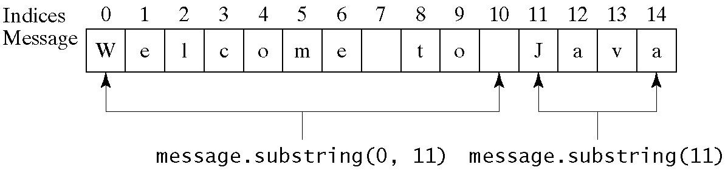
Obtaining Substrings

Slide 19
Finding a Character or a Substring in a String

Slide 20
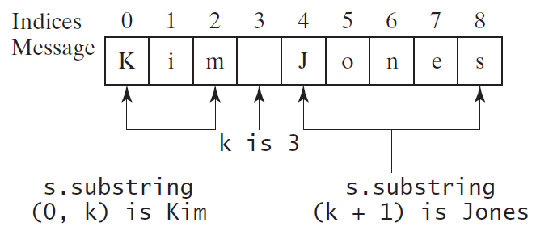
Finding a Character or a Substring in a String
int k = s.indexOf(' ');
String firstName = s.substring(0, k);
String lastName = s.substring(k + 1);

Slide 21
Conversion between Strings and Numbers
int intValue = Integer.parseInt(intString);
double doubleValue = Double.parseDouble(doubleString);
String s = number + "";

Slide 22
Formatting Output
Use the printf statement.
System.out.printf(format, items);
Where format is a string that may consist of substrings and format specifiers. A format specifier specifies how an item should be displayed. An item may be a numeric value, character, boolean value, or a string. Each specifier begins with a percent sign.

Slide 23
Frequently-Used Specifiers
Specifier Output Example
%b a boolean value true or false
%c a character 'a'
%d a decimal integer 200
%f a floating-point number 45.460000
%e a number in standard scientific notation 4.556000e+01
%s a string "Java is cool"

Slide 24
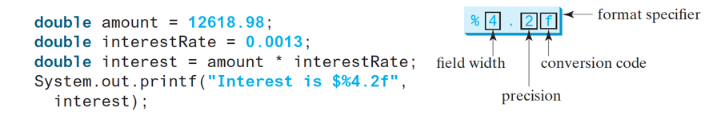
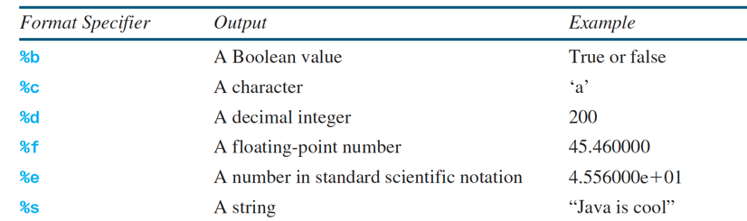
Formatting Data types

Slide 25
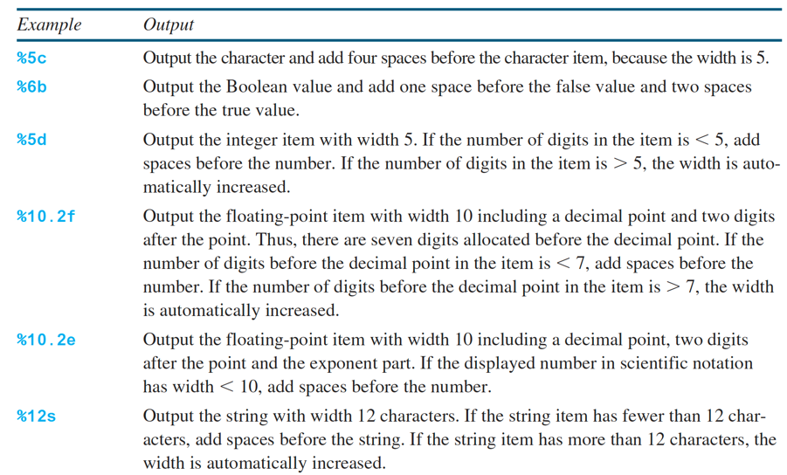
Formatting: widths

Slide 26
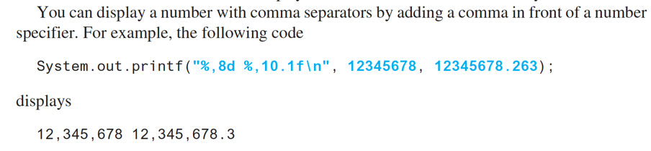
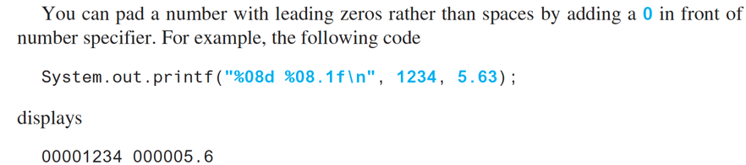
Formatting: comma, zeros

Slide 27
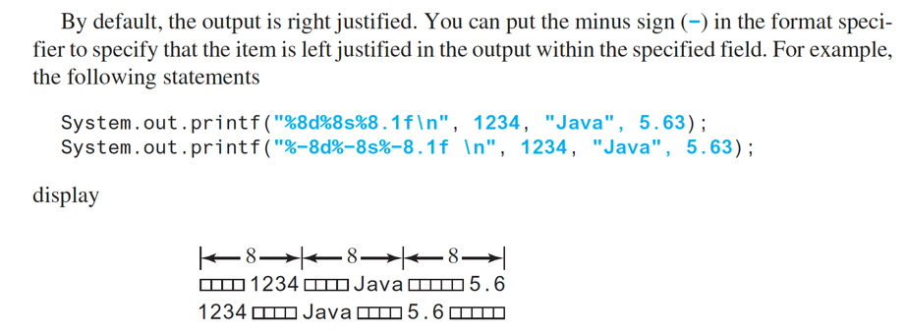
Formatting: Justification

Slide 28
Constructing Strings
String newString = new String(stringLiteral);
String message = new String("Welcome to Java");
Since strings are used frequently, Java provides a shorthand initializer for creating a string:
String message = "Welcome to Java";

Slide 29
Strings Are Immutable
A String object is immutable; its contents cannot be changed. Does the following code change the contents of the string?
String s = "Java";
s = "HTML";

Slide 30
Trace Code
animation
String s = "Java";
s = "HTML";

Slide 31
Trace Code
animation
String s = "Java";
s = "HTML";

Slide 32
Interned Strings
Since strings are immutable and are frequently used, to improve efficiency and save memory, the JVM uses a unique instance for string literals with the same character sequence. Such an instance is called interned. For example, the following statements:

Slide 33
Examples
display
s1 == s is false
s1 == s3 is true
A new object is created if you use the new operator.
If you use the string initializer, no new object is created if the interned object is already created.

Slide 34
Trace Code
animation

Slide 35
Trace Code

Slide 36
Trace Code

Slide 37
Replacing and Splitting Strings

Slide 38
Examples
"Welcome".replace('e', 'A') returns a new string, WAlcomA.
"Welcome".replaceFirst("e", "AB") returns a new string, WABlcome.
"Welcome".replace("e", "AB") returns a new string, WABlcomAB.
"Welcome".replace("el", "AB") returns a new string, WABcome.

Slide 39
Splitting a String
String[] tokens = "Java#HTML#Perl".split("#”,0);
for (int i = 0; i < tokens.length; i++)
System.out.print(tokens[i] + " ");
displays
Java HTML Perl

Slide 40
Matching, Replacing and Splitting by Patterns
You can match, replace, or split a string by specifying a pattern. This is an extremely useful and powerful feature, commonly known as regular expression. Regular expression is complex to beginning students. For this reason, two simple patterns are used in this section. Please refer to Supplement III.F, “Regular Expressions,” for further studies.
"Java".matches("Java");
"Java".equals("Java");
"Java is fun".matches("Java.*");
"Java is cool".matches("Java.*");

Slide 41
Matching, Replacing and Splitting by Patterns
The replaceAll, replaceFirst, and split methods can be used with a regular expression. For example, the following statement returns a new string that replaces $, +, or # in "a+b$#c" by the string NNN.
String s = "a+b$#c".replaceAll("[$+#]", "NNN");
System.out.println(s);
Here the regular expression [$+#] specifies a pattern that matches $, +, or #. So, the output is aNNNbNNNNNNc.

Slide 42
Matching, Replacing and Splitting by Patterns
The following statement splits the string into an array of strings delimited by some punctuation marks.
String[] tokens = "Java,C?C#,C++".split("[.,:;?]");
for (int i = 0; i < tokens.length; i++)
System.out.println(tokens[i]);

Slide 43
Convert Character and Numbers to Strings
The String class provides several static valueOf methods for converting a character, an array of characters, and numeric values to strings. These methods have the same name valueOf with different argument types char, char[], double, long, int, and float. For example, to convert a double value to a string, use String.valueOf(5.44). The return value is string consists of characters ‘5’, ‘.’, ‘4’, and ‘4’.

Slide 44
StringBuilder and StringBuffer
The StringBuilder/StringBuffer class is an alternative to the String class. In general, a StringBuilder/StringBuffer can be used wherever a string is used. StringBuilder/StringBuffer is more flexible than String. You can add, insert, or append new contents into a string buffer, whereas the value of a String object is fixed once the string is created.

Slide 45
StringBuilder Constructors

Slide 46
Modifying Strings in the Builder

Slide 47
Examples
stringBuilder.append("Java");
stringBuilder.insert(11, "HTML and ");
stringBuilder.delete(8, 11) changes the builder to Welcome Java.
stringBuilder.deleteCharAt(8) changes the builder to Welcome o Java.
stringBuilder.reverse() changes the builder to avaJ ot emocleW.
stringBuilder.replace(11, 15, "HTML")
changes the builder to Welcome to HTML.
stringBuilder.setCharAt(0, 'w') sets the builder to welcome to Java.

Slide 48
The toString, capacity, length, setLength, and charAt Methods

Slide 49
Problem: Checking Palindromes Ignoring Non-alphanumeric Characters
This example gives a program that counts the number of occurrence of each letter in a string. Assume the letters are not case-sensitive.
PalindromeIgnoreNonAlphanumeric
Run

Slide 50
Regular Expressions
Appendix H
A regular expression (abbreviated regex) is a string that describes a pattern for matching a set of strings. Regular expression is a powerful tool for string manipulations. You can use regular expressions for matching, replacing, and splitting strings.

Slide 51
Matching Strings
Appendix H
"Java".matches("Java");
"Java".equals("Java");
"Java is fun".matches("Java.*")
"Java is cool".matches("Java.*")
"Java is powerful".matches("Java.*")

Slide 52
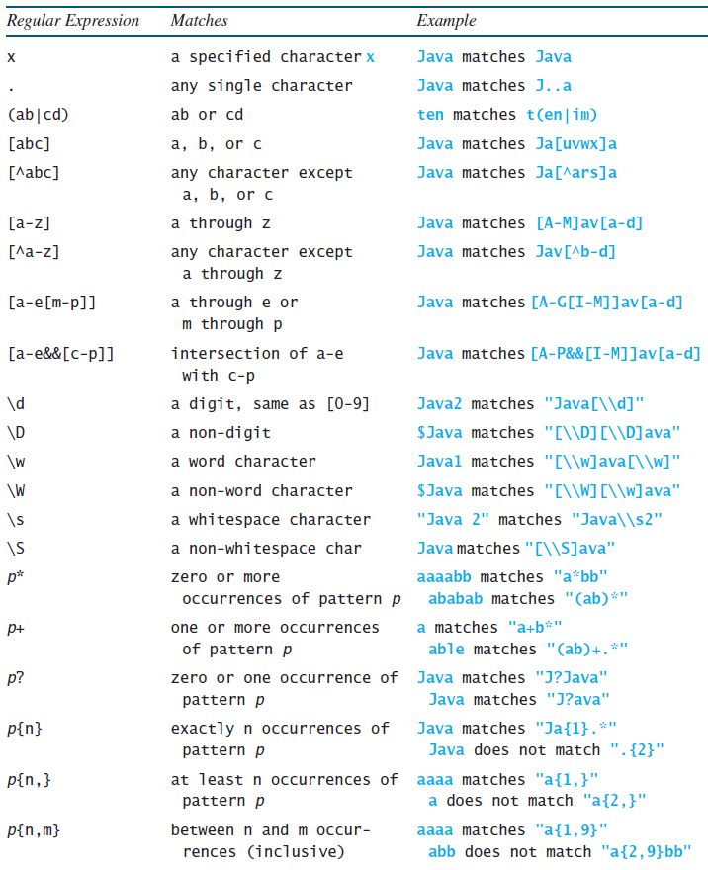
Regular Expression Syntax
Appendix H

Slide 53
Replacing and Splitting Strings
Appendix H

Slide 54
Examples
Appendix H
String s = "Java Java Java".replaceAll("v\\w", "wi") ;
String s = "Java Java Java".replaceFirst("v\\w", "wi") ;
String[] s = "Java1HTML2Perl".split("\\d");

