Slide 1
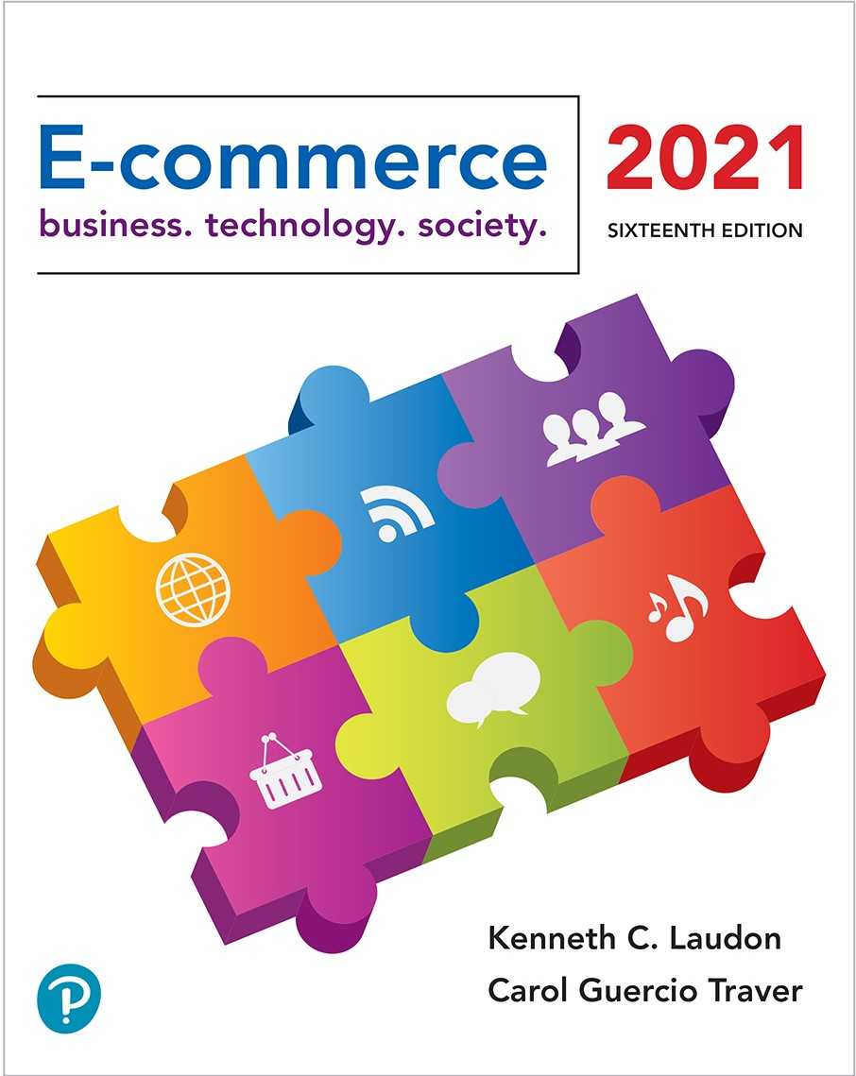

E-commerce 2021: Business. Technology. Society.
Sixteenth Edition
Chapter 9
Online Retail and Services
Copyright © 2022, 2019, 2018 Pearson Education, Inc. All Rights Reserved
Notes:
If this PowerPoint presentation contains mathematical equations, you may need to check that your computer has the following installed:
1) MathType Plugin
2) Math Player (free versions available)
3) NVDA Reader (free versions available)

Slide 2
Learning Objectives
9.1 Understand the environment in which the online retail sector operates today.
9.2 Explain how to analyze the economic viability of an online firm.
9.3 Identify the challenges faced by the different types of online retailers.
9.4 Describe the major features of the online service sector.
9.5 Discuss the trends taking place in the online financial services industry.
9.6 Describe the major trends in the online travel services industry today.
9.7 Identify current trends in the online career services industry.
9.8 Understand the business models of on-demand service companies.

Slide 3
Blue Nile Sparkles for Your Cleopatra
Class Discussion
  Why is selling (or buying) diamonds over the Internet difficult?
  How has Blue Nile developed its supply chain to keep costs low?
  How has Blue Nile reduced consumer anxiety over online diamond purchases?
  What are some vulnerabilities facing Blue Nile?
  Would you buy a $5,000 engagement ring at Blue Nile?

Slide 4
What’s New in Online Retail
Covid-19 pandemic increases e-commerce retail spending
Retail mobile e-commerce continues to accelerate
Social e-commerce starts to gain serious traction
Local e-commerce continues to grow
Selection of goods available online increases
Virtual merchants increasingly embrace subscription-based revenue model
Big data and analytics power increased use of predictive marketing

Slide 5
The Online Retail Sector
Most important theme in online retailing is effort to integrate online and offline operations
U.S. retail market
  Personal consumption of goods accounted for $4.5 trillion (about 20%) of total G D P (gross domestic product)

Slide 6
The Retail Industry
7 segments (clothing, durable goods, etc.)
  For each, uses of Internet may differ
    Information versus direct purchasing
Mail order/telephone order (M O T O) sector
  Most similar to online retail sector
  Sophisticated order entry, delivery, inventory control systems

Slide 7
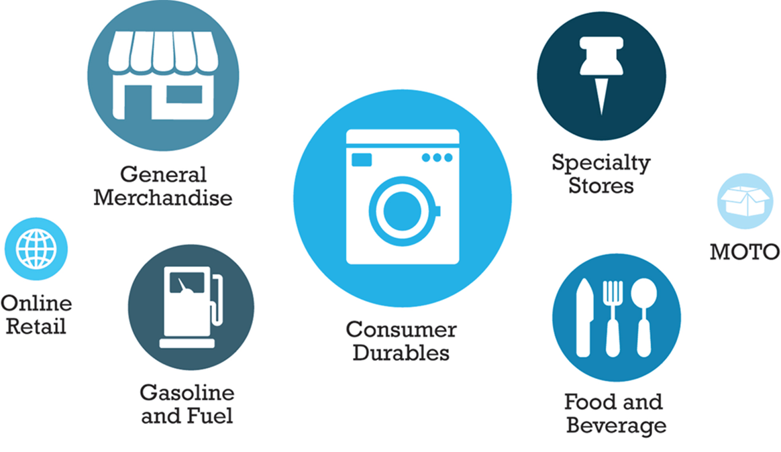
Figure 9.1 Composition of the U.S. Retail Industry
Notes:
Figure 9.1, Page 606.
The retail industry can be grouped into seven major segments.
SOURCE: Based on data from U.S. Census Bureau, 2012.

Slide 8
E-commerce Retail: The Vision
The Vision
  Reduced search and transaction costs; customers able to find lowest prices
  Lowered market entry costs, lower operating costs, higher efficiency
  Traditional physical store merchants forced out of business
  Some industries would be disintermediated
Few of these assumptions were correct-structure of retail marketplace has not been revolutionized
Internet has created new venues for omni-channel firms and supported a few pure-play merchants

Slide 9
The Online Retail Sector Today (1 of 2)
On of the smallest segment of retail industry (about 11%)
Growing at faster rate than offline segments
Computers and consumer electronics generated highest percentage of revenue in 2019, followed by the apparel and accessories category
Over 80% of Internet users will buy online in 2020
Primary beneficiaries:
  Established offline retailers with online presence (e.g., Staples)
  Pure-play online retailers (e.g., Amazon)

Slide 10
The Online Retail Sector Today (2 of 2)
Omni-channel integration: retailers that sell products through a variety of channels and integrate their physical stores with their website and mobile platform
  Integrating web operations with physical store operations
    Leverage value of physical store
    Types of integration, e.g., online order, in-store pickup
Social e-commerce growth
Location-based marketing of local goods and services
Rapidly growing mobile platform

Slide 11
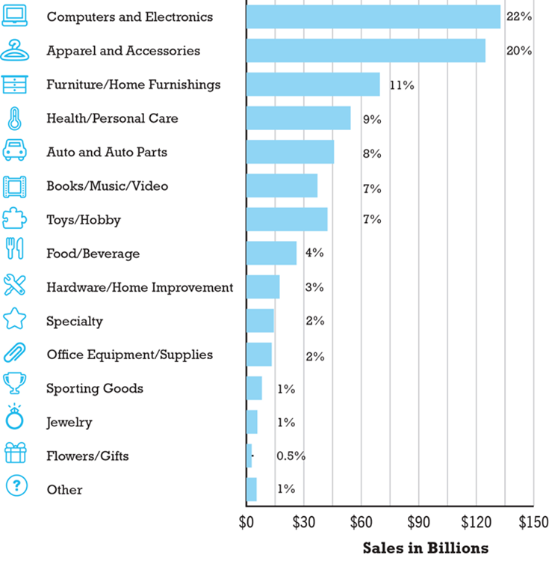
Figure 9.2 Online Retail Revenues by Category, 2019
Notes:
Figure 9.2, Page 609.
Computers and electronics is the leading online purchase category in terms of revenue generated, accounting for 22% of all online retail revenues.
SOURCES: Based on data from eMarketer, Inc., 2020a, 2020b; Digital Commerce 360 Research, 2020; Berthene, 2019;
Cassidy, 2019a; authors’ estimates..
Alt Text
Long description: A bar graph depicts online retail revenues by category in 20 19 in terms of billions of dollars and as a percentage of total online retail revenue, as follows: Computers and electronics are 135 billion dollars and 22 percent. Apparel and accessories are 130 billion dollars and 20 percent. Furniture and Home Furnishings are 70 billion dollars and 11 percent. Health and personal care are 55 billion and 9 percent. Auto and auto parts are 50 billion dollars and 8 percent. Books and music and video are 40 billion dollars and 7 percent. Toys and hobby are 40 billion dollars and 7 percent. Food and beverage are 29 billion dollars and 4 percent. Hardware and home improvement are 21 billion dollars and 3 percent. Specialty are 20 billion dollars and 2 percent. Office equipment and supplies are 19 billion dollars and 2 percent. Sporting goods are 10 billion dollars and 1 percent. Jewelry are 9 billion dollars and 1 percent. Flowers and gifts are 2 billion dollars and 0.5 percent. Other is 5 billion dollars and 1 percent. All values are estimated.

Slide 12
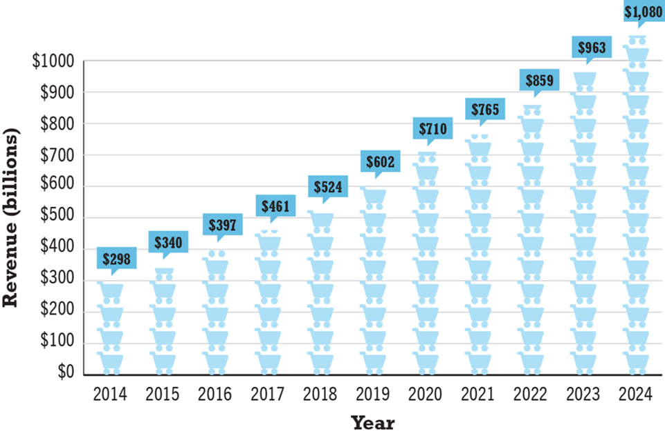
Figure 9.3 The Growth of Online Retail in the United States
Notes:
Figure 9.3, Page 610.
Online retail revenues will be an estimated $710 billion in 2020 and are expected to increase to about $1.1 trillion by 2024, almost doubling since 2019.
SOURCES: Based on data from eMarketer, Inc., 2020.
Alt Text
Long description: A pictograph shows the growth of online retail revenues in the United States in billions of dollars from 20 14 to 20 24, as follows: Online retail revenue grows steadily from 300 billion dollars in 20 14 to a projected 1080 billion dollars in 20 24.

Slide 13
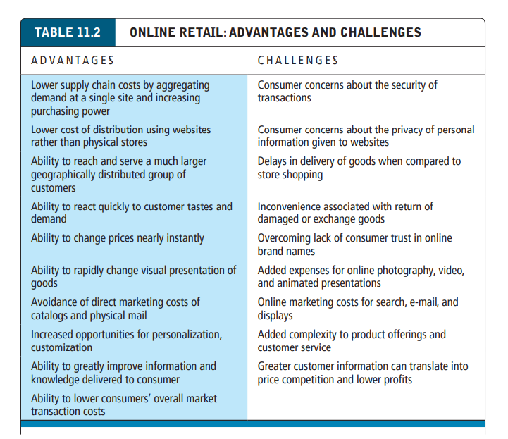
Figure 9.3 The Growth of Online Retail in the United States

Slide 14
Analyzing the Viability of Online Firms
Economic viability:
  Ability of firms to survive as profitable business firms during specified period (i.e., 1-3 years)
Two business analysis approaches:
  Strategic analysis
    Focuses on both industry and firm itself
  Financial analysis
    How firm is performing

Slide 15
Strategic Analysis Factors (1 of 2)
Key industry strategic factors
  Barriers to entry
  Power of suppliers
  Power of customers
  Existence of substitute products
  Industry value chain: Is the chain of production and distribution in the industry changing in ways that benefit or harm the firm?
  Nature of intra-industry competition: Is the basis of competition within the industry based on differentiated products and services, price, scope of offerings, or focus of offerings? How is the nature of competition changing? Will these changes benefit the firm?

Slide 16
Strategic Analysis Factors (2 of 2)
  Firm value chain: Has the firm adopted business processes and methods of operation that allow it to achieve the most efficient operations in its industry? Will changes in technology force the firm to realign its business processes?
  Core competencies: Does the firm have unique competencies and skills that cannot be easily duplicated by other firms? Will changes in technology invalidate the firm’s competencies or strengthen them?
  Synergies: Does the firm have access to the competencies and assets of related firms either owned outright or through strategic partnerships and alliances?
  Technology: Has the firm developed proprietary technologies that allow it to scale with demand? Has the firm developed the operational technologies (e.g., customer relationship management, fulfillment, supply chain management, inventory control, and human resource systems) to survive?
  Social and legal challenges: Has the firm put in place policies to address consumer trust issues (privacy and security of personal information)? Is the firm the subject of lawsuits challenging its business model, such as intellectual property ownership issues? Will the firm be affected by changes in Internet taxation laws or other foreseeable statutory developments

Slide 17
Financial Analysis Factors (1 of 2)
Statements of Operations
  Revenues
  Cost of sales: Cost of sales typically includes the cost of the products sold and related costs. The lower the cost of sales compared to revenue, the higher the gross profit.
  Gross margin: calculated by dividing gross profit by net sales revenues. Gross margin can tell you if the firm is gaining or losing market power
  Operating expenses: typically include the cost of marketing, technology, and administrative overhead
  Operating margin: calculated by dividing operating income or loss by net sales revenue, What did the firm earn from its current operations.
  Net margin: tells us the percentage of its gross sales revenue the firm was able to retain after all expenses are deducted. Net margin is calculated by dividing net income or loss by net sales revenue

Slide 18
Financial Analysis Factors (2 of 2)
Balance sheet: provides a financial snapshot of a company on a given date and shows its financial assets and liabilities
  Assets: refers to stored value
  Current assets: assets such as cash, securities, accounts receivable, inventory, or other investments that are likely to be able to be converted to cash within one year
  Liabilities: outstanding obligations of the firm
  Current liabilities: debts of the firm that will be due within one year
  Long-term debt: liabilities that are not due until the passage of a year or more
  Working capital: firm’s current assets minus current liabilities

Slide 19
E-commerce in Action: E-Tailing Business Models
Four main types
  Virtual merchants
  Omni-channel merchants (bricks-and-clicks)
  Catalog merchants
  Manufacturer-direct
Each type faces different strategic environments and different industry and firm economics

Slide 20
E-tailing Business Models: Virtual Merchants
Single-channel e-commerce firms that generate almost all revenue from online sales
Examples: Amazon, Wayfair, Overstock, Blue Nile
Challenges
  Building business and brand name quickly
  Low barriers to entry invite many competitors
  Substantial costs to build and maintain website presence
  Steep learning curve

Slide 21
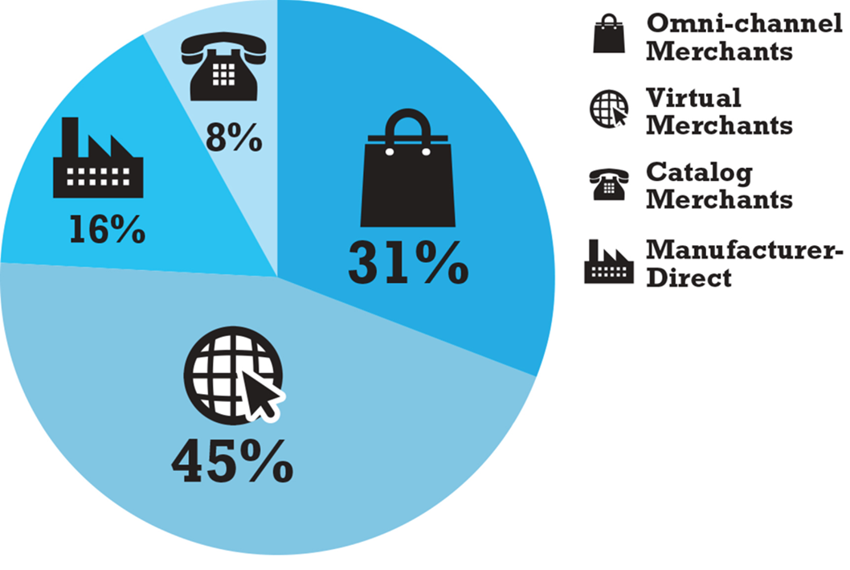
Figure 9.4 Share of Online Retail Sales by Type of Company
Notes:
Figure 9.4, Page 617.
Virtual merchants account for 45% of online retail sales, although this percentage is heavily skewed by the dominance of Amazon, which by itself accounts for over 37%.
SOURCES: Based on data from Digital Commerce 360 Research, 2020; Davis 2019; Davis, 2018a, 2018b; eMarketer, Inc., 2016; authors’ estimates.
Alt Text
Long description: A pie chart depicts the share of online retail sales for specific types of companies, as follows: Omni channel merchants have a 31 percent share. Virtual merchants have a 45 percent share. Catalog merchants have an 8 percent share. Manufacturer direct firms have a 16 percent share.

Slide 22
E-commerce in Action: Amazon (1 of 3)
Vision:
  Lowest prices, best selection, most customer-centric
Business model:
  Retail, third-party merchants, and Amazon Web Services
Financial analysis:
  Challenged by Covid-19 pandemic, but showed continued explosive revenue growth, profitable
Strategic analysis/business strategy:
  Maximize sales volume, lower costs and prices, acquisitions, mobile shopping, new products and services

Slide 23
E-commerce in Action: Amazon (2 of 3)
Strategic analysis/competition:
  Online and offline general and catalog merchandisers, web services
Strategic analysis/technology:
  Largest, most sophisticated collection of online retailing technologies available
Strategic analysis/social and legal challenges:
  Covid-19 pandemic; government investigations based on antitrust concerns

Slide 24
E-commerce in Action: Amazon (3 of 3)
Future prospects:
  Amazon has turned corner to sustainable profitability
  Increased profits from Amazon Web Services
  Amazon Prime
  Continues to invest in future products and services

Slide 25
E-tailing Business Models: Omni-channel Merchants (Bricks-and-Clicks)
Have network of physical stores as primary retail channel but also have online operations
Challenges:
  High cost of physical buildings and staff
  Need to coordinate prices across channels
  Need to develop methods of handling cross-channel operations
  Building credible e-commerce presence
Examples: Walmart, Macy’s, Target, Staples

Slide 26
E-tailing Business Models: Catalog Merchants
Established companies that have a national offline catalog operation as their largest retail channel, but who also have online capabilities
Challenges:
  High costs for printing and mailing
  Need to leverage existing assets and competencies to new technology environment
  Need to develop cross-channel operations
  Building credible e-commerce presence
Examples: Lands’ End, L.L. Bean, C D W Corp, Cabela’s

Slide 27
E-Tailing Business Models: Manufacturer-Direct
Single or multi-channel manufacturers who sell to consumers online without intervention of retailers
Challenges
  Channel conflict
  Switching from supply-push model to demand-pull model
  Developing credible e-commerce presence
Examples
  Apple, Dell, Sony
  Digital native verticals: Warby Parker, Everlane

Slide 28
Common Themes in Online Retailing
Online retail fastest growing channel in retail commerce
  Profits for startup ventures have been difficult to achieve
Disintermediation has not occurred
Established merchants need to create integrated shopping experience to succeed online
Growth of online specialty merchants (e.g., Blue Nile)
Extraordinary growth of social, local, and mobile e-commerce
Increasing use of big data analytics by retailers

Slide 29
Insight on Technology: Stitch Fix Builds a Business on Big Data and Predictive Marketing
Class Discussion
  How does big data enable predictive marketing?
  Are there any drawbacks to the increasing use of predictive marketing?
  Have you experienced predictive marketing in your own shopping? If so, what was the experience like - were suggestions accurate and helpful?
  How has the Covid-19 pandemic impacted Stitch Fix?

Slide 30
The Service Sector: Offline and Online
Service sector:
  Largest and most rapidly expanding part of economies of advanced industrial nations
  Concerned with performing tasks in and around households, business firms, and institutions
    Includes doctors, lawyers, accountants, business consultants, and so on
  Employs 4 out of 5 U.S. workers
  About 80% of U.S. G D P

Slide 31
Service Industries
Major service industry groups:
  Finance
  Insurance
  Real estate
  Travel
  Professional services-legal, accounting
  Business services-consulting, advertising, marketing, and so on
  Health services
  Educational services

Slide 32

Copyright
This work is protected by United States copyright laws and is provided solely for the use of instructors in teaching their courses and assessing student learning. Dissemination or sale of any part of this work (including on the World Wide Web) will destroy the integrity of the work and is not permitted. The work and materials from it should never be made available to students except by instructors using the accompanying text in their classes. All recipients of this work are expected to abide by these restrictions and to honor the intended pedagogical purposes and the needs of other instructors who rely on these materials.

