Slide 1
Chapter 7
Tunneling Phenomena
Unbound particles

Slide 2
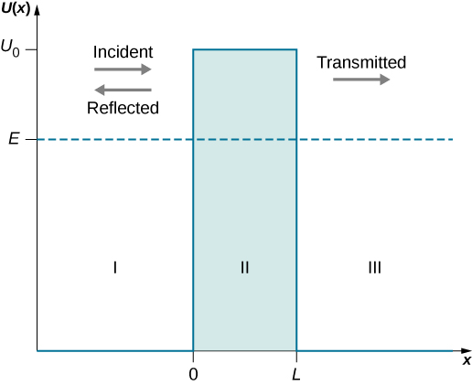
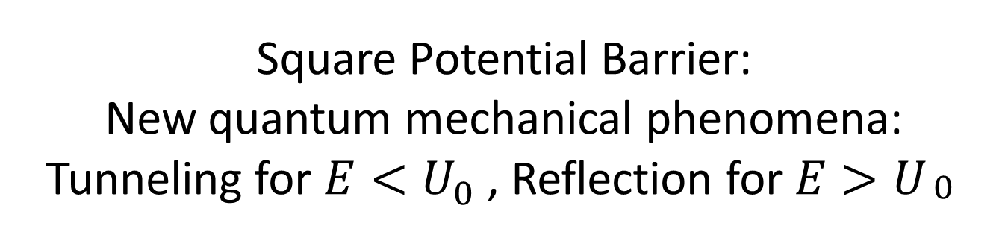
Square Potential Barrier:
New quantum mechanical phenomena: Tunneling for $E<U_{0}$ , Reflection for $E>U_{\begin{aligned}0 \\ \end{aligned}}$

Slide 3
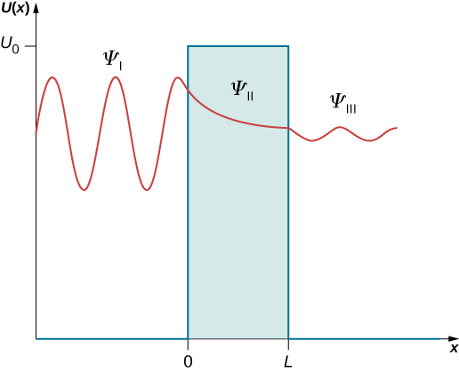
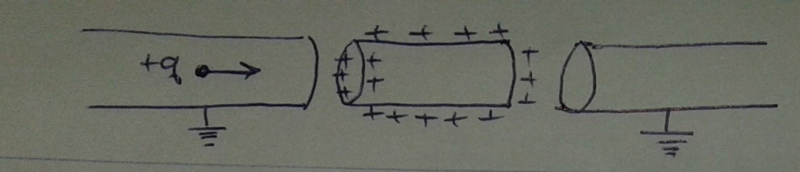
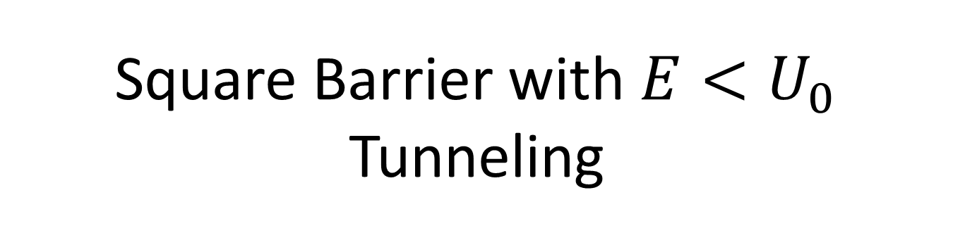
Square Barrier with $E<U_{0}$
Tunneling

Slide 4
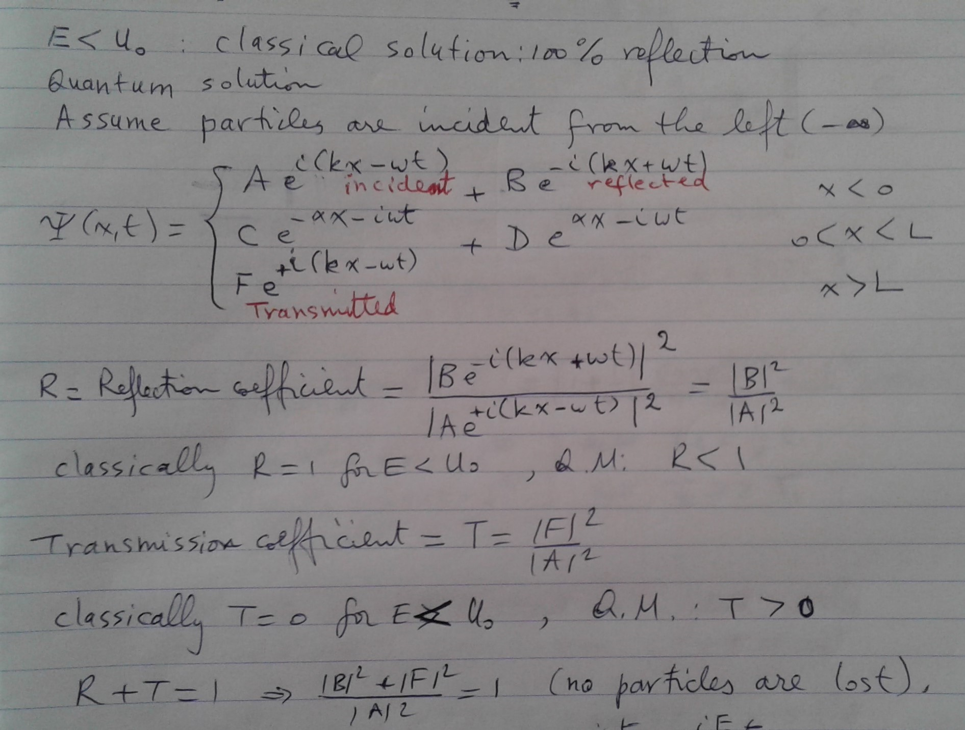
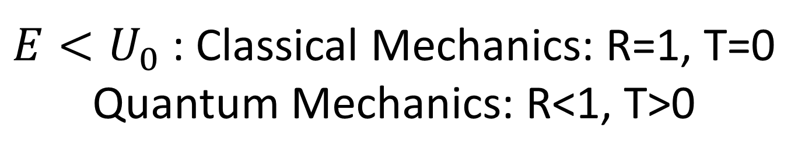
$E<U_{0}$: Classical Mechanics: R=1, T=0
Quantum Mechanics: R<1, T>0

Slide 5
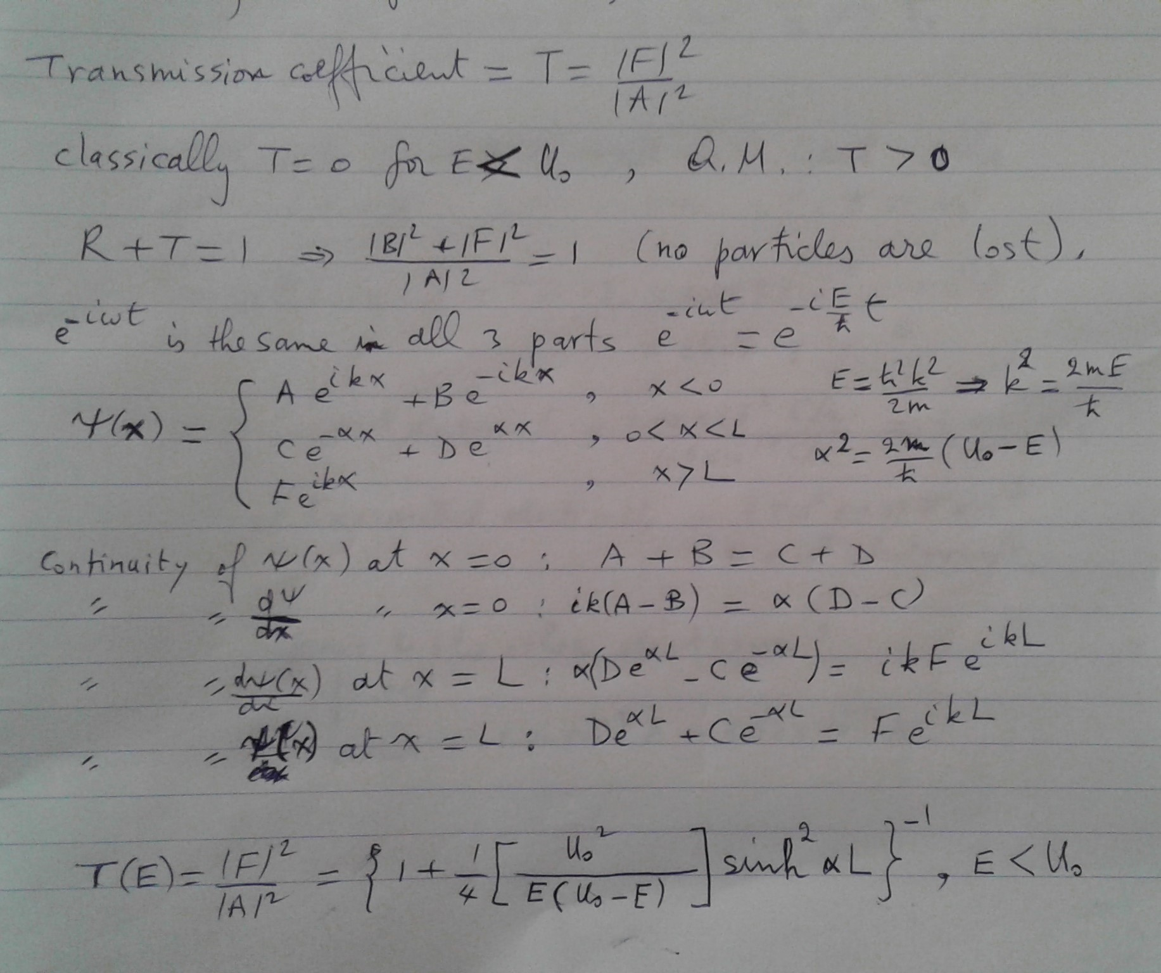
QM: T>0

Slide 6
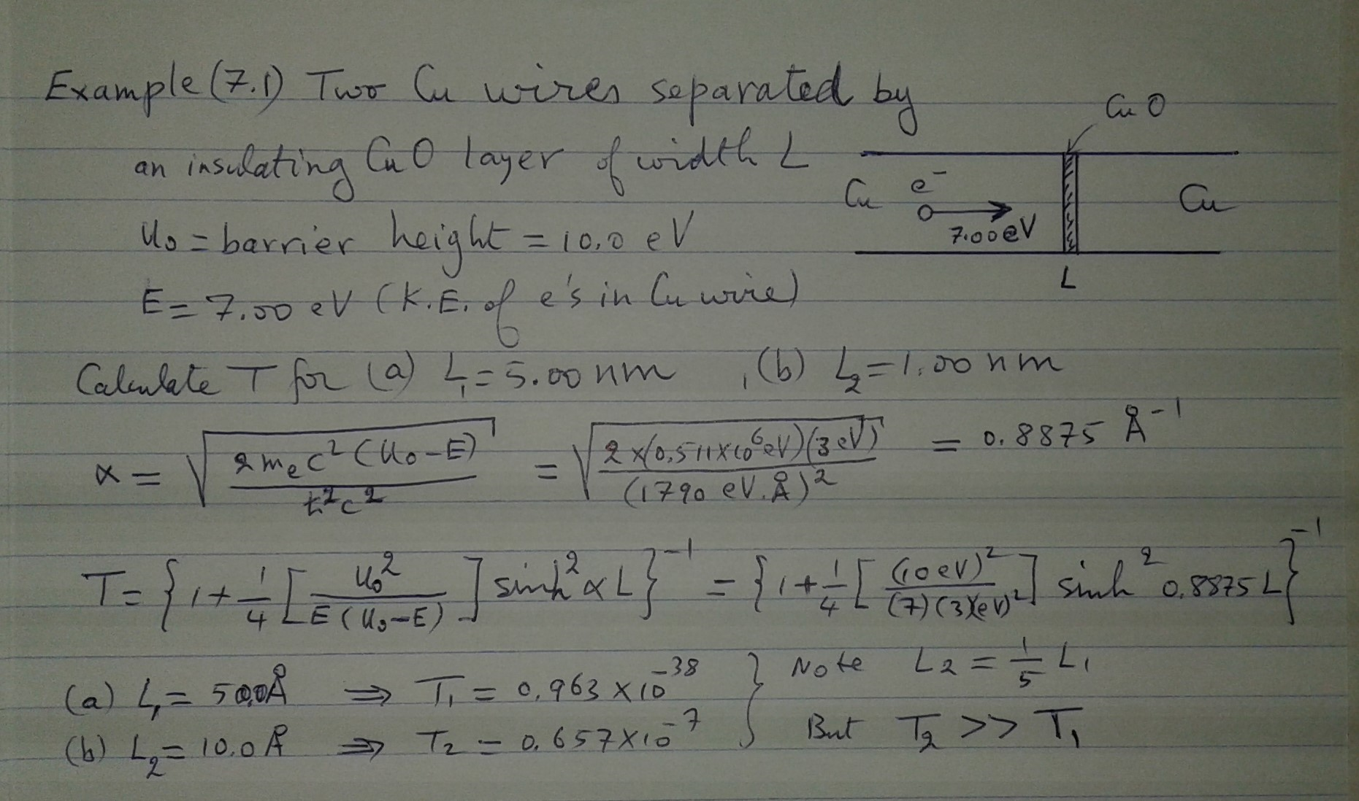
Ex 7.1: Tunneling across a CuO layer

Slide 7
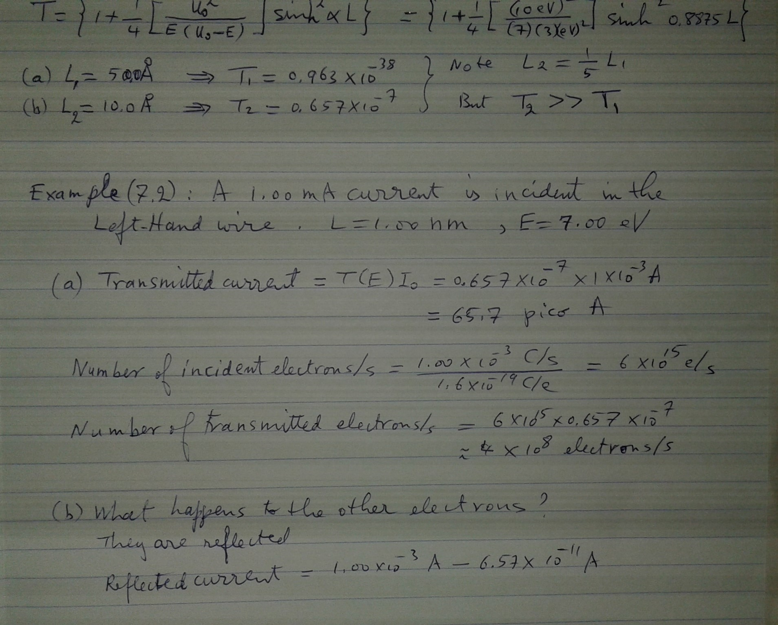
Ex 7.2 continuation of Ex 7.1

Slide 8
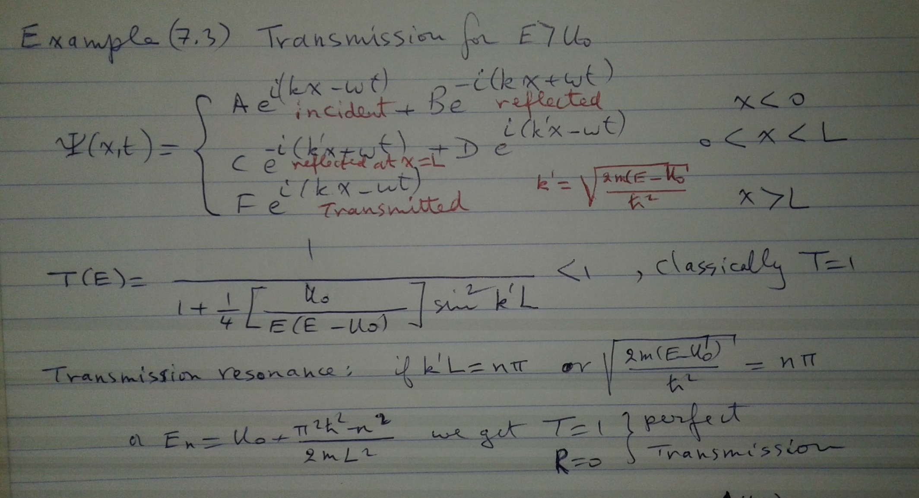
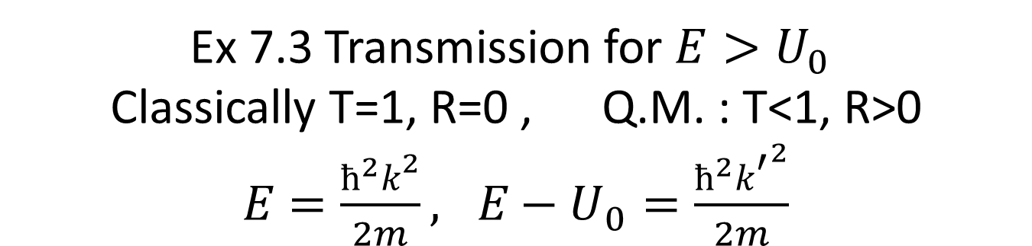
Ex 7.3 Transmission for $E>U_{0}$
Classically T=1, R=0 , Q.M. : T<1, R>0
$E=\frac{ħ^{2}k^{2}}{2m}, E−U_{0}=\frac{ħ^{2}{k^{′}}^{2}}{2m}$

Slide 9
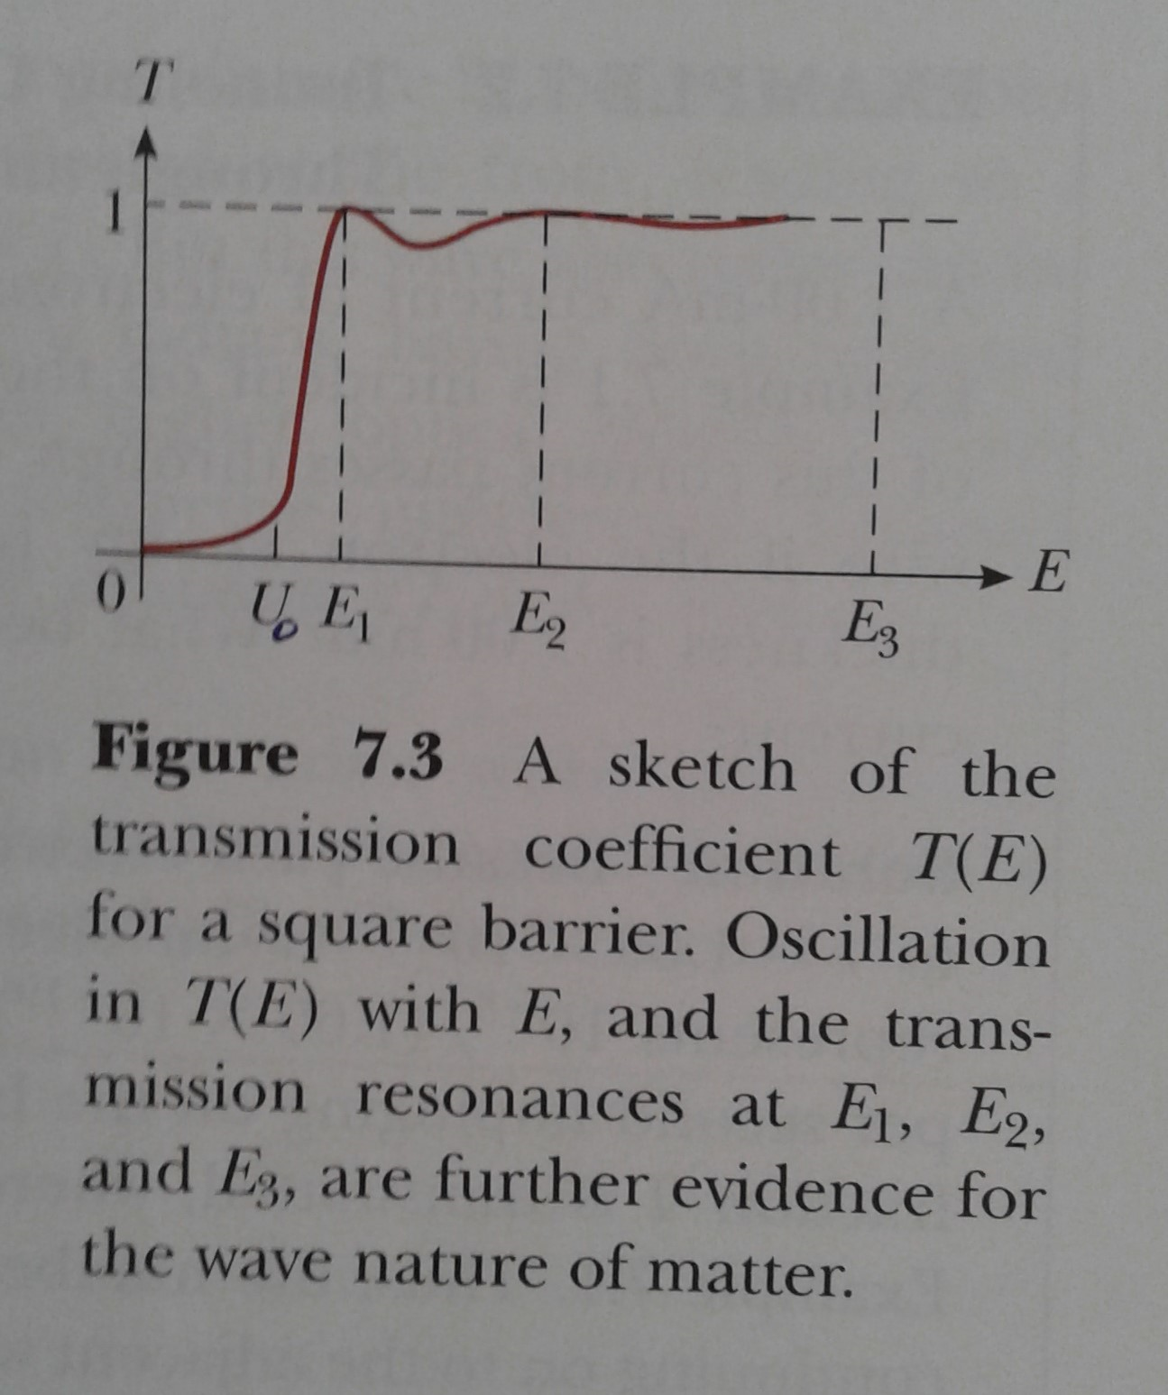
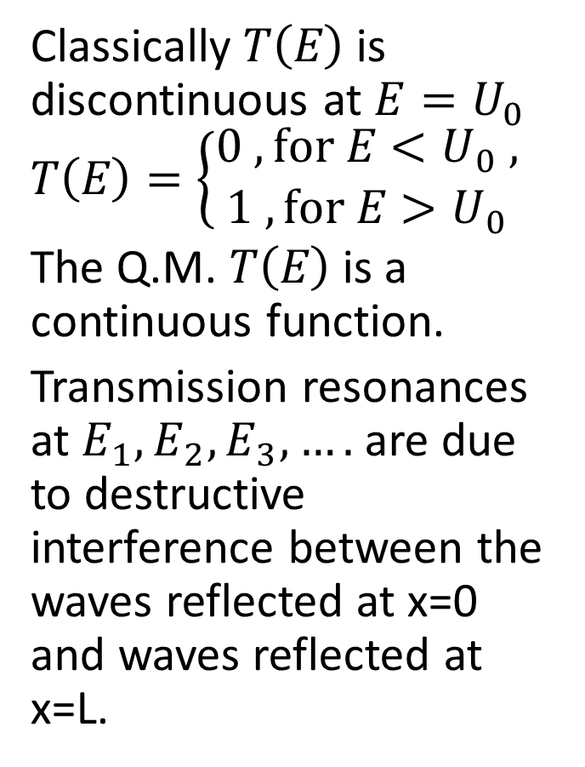
T(E) for all energies
Classically $T\left(E\right)$ is discontinuous at $E=U_{0}$ $T\left(E\right)=\left\{\begin{matrix}0 , for E<U_{0} , \\ 1 , for E>U_{0} \end{matrix}\right.$
The Q.M. $T\left(E\right)$ is a continuous function.
Transmission resonances at $E_{1}, E_{2}, E_{3},….$ are due to destructive interference between the waves reflected at x=0 and waves reflected at x=L.

Slide 10
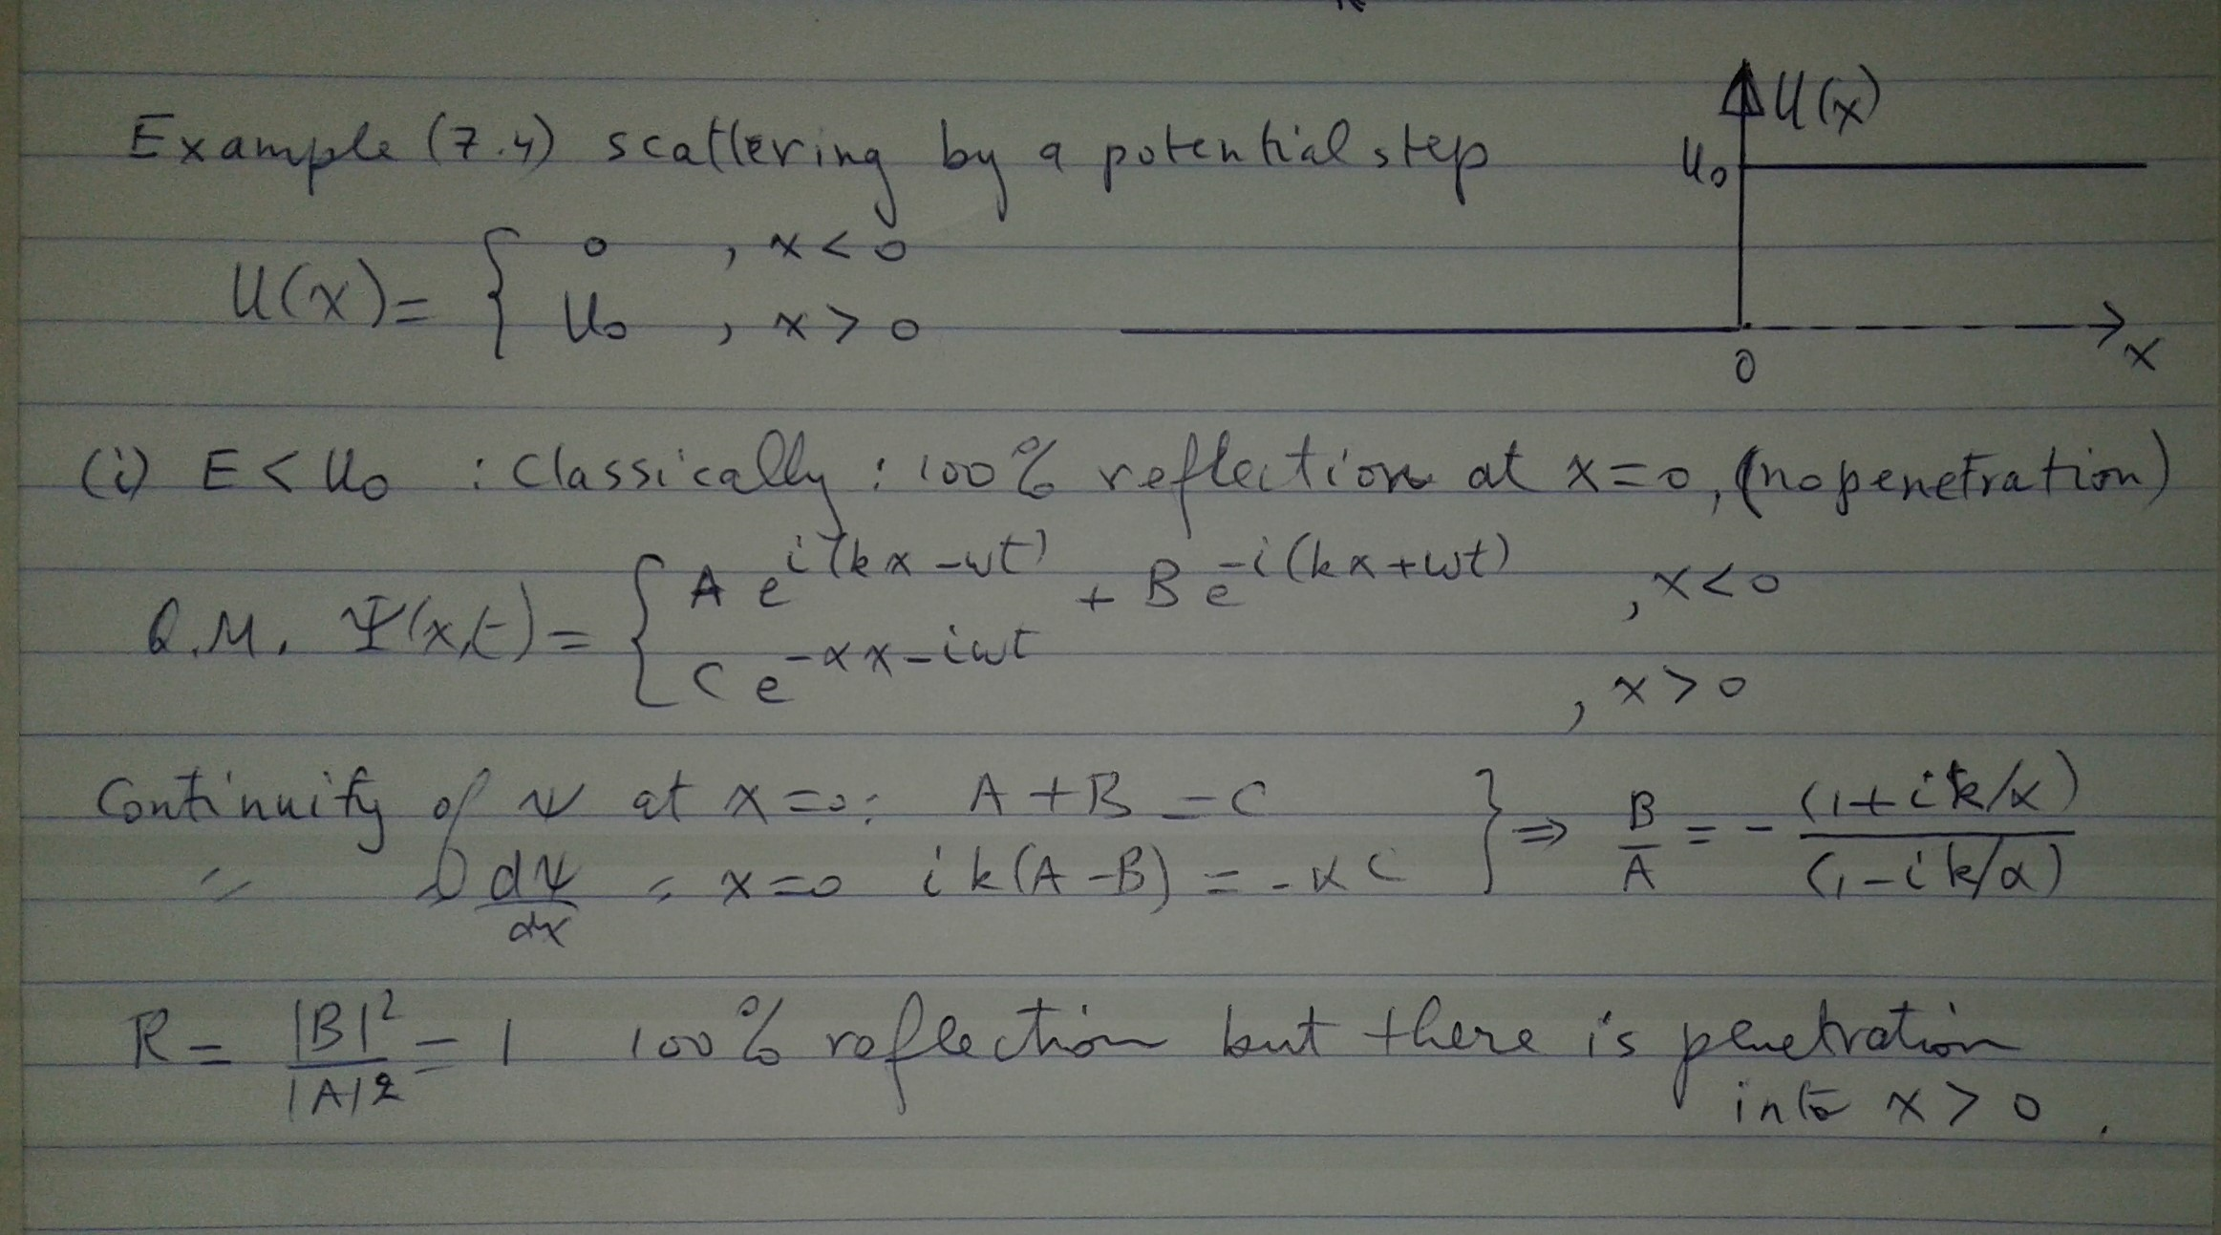
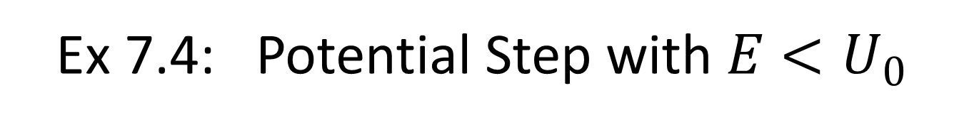
Ex 7.4: Potential Step with $E<U_{0}$

Slide 11
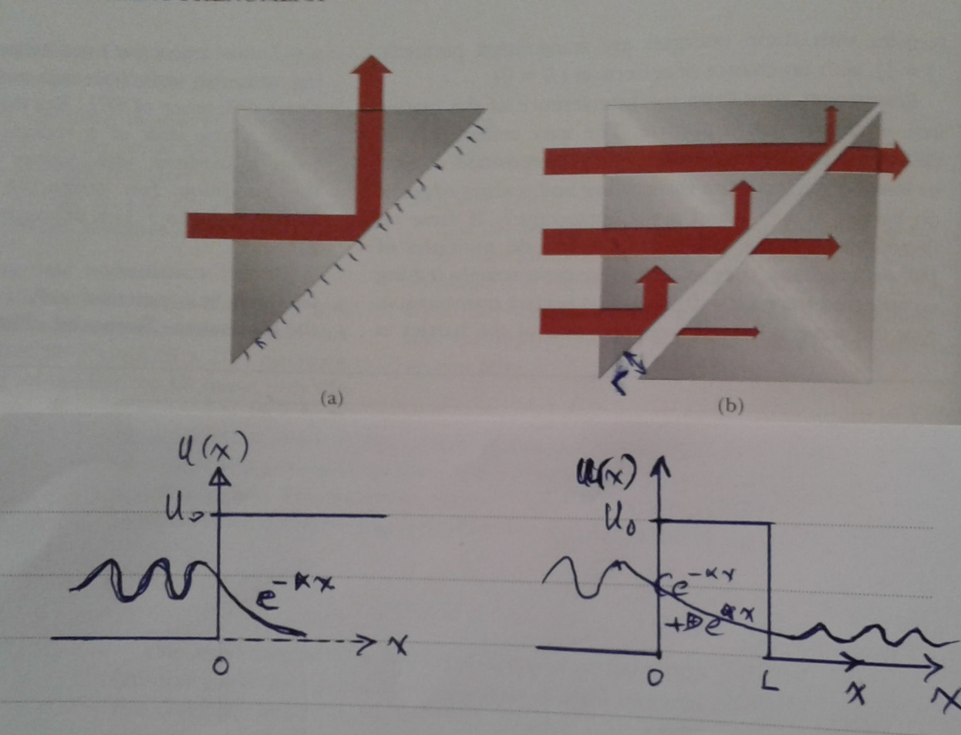
Tunneling & Frustrated Total Internal Reflection

Slide 12
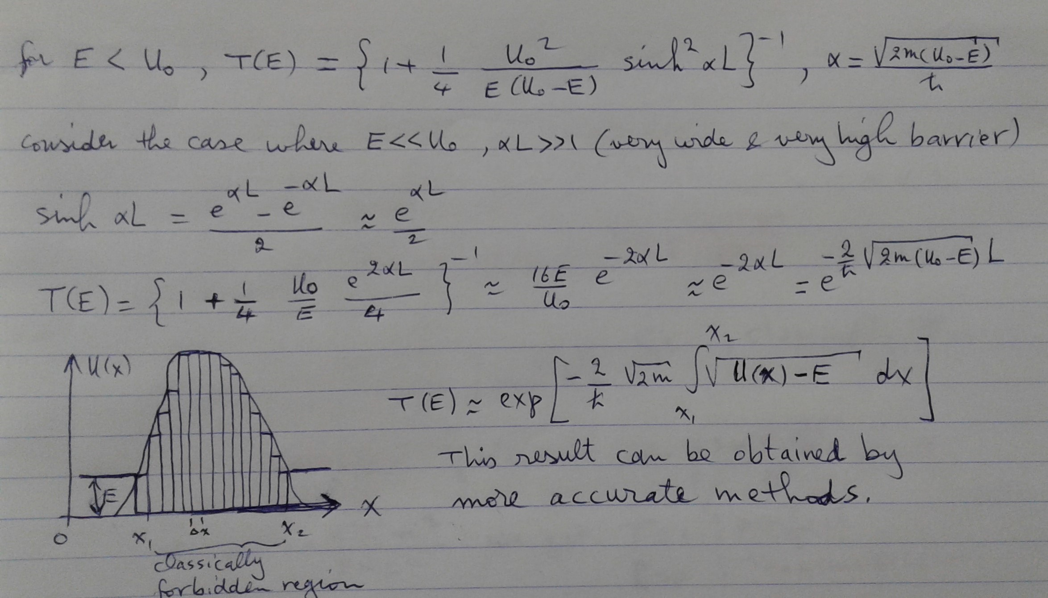
Penetration of an irregular barrier

Slide 13
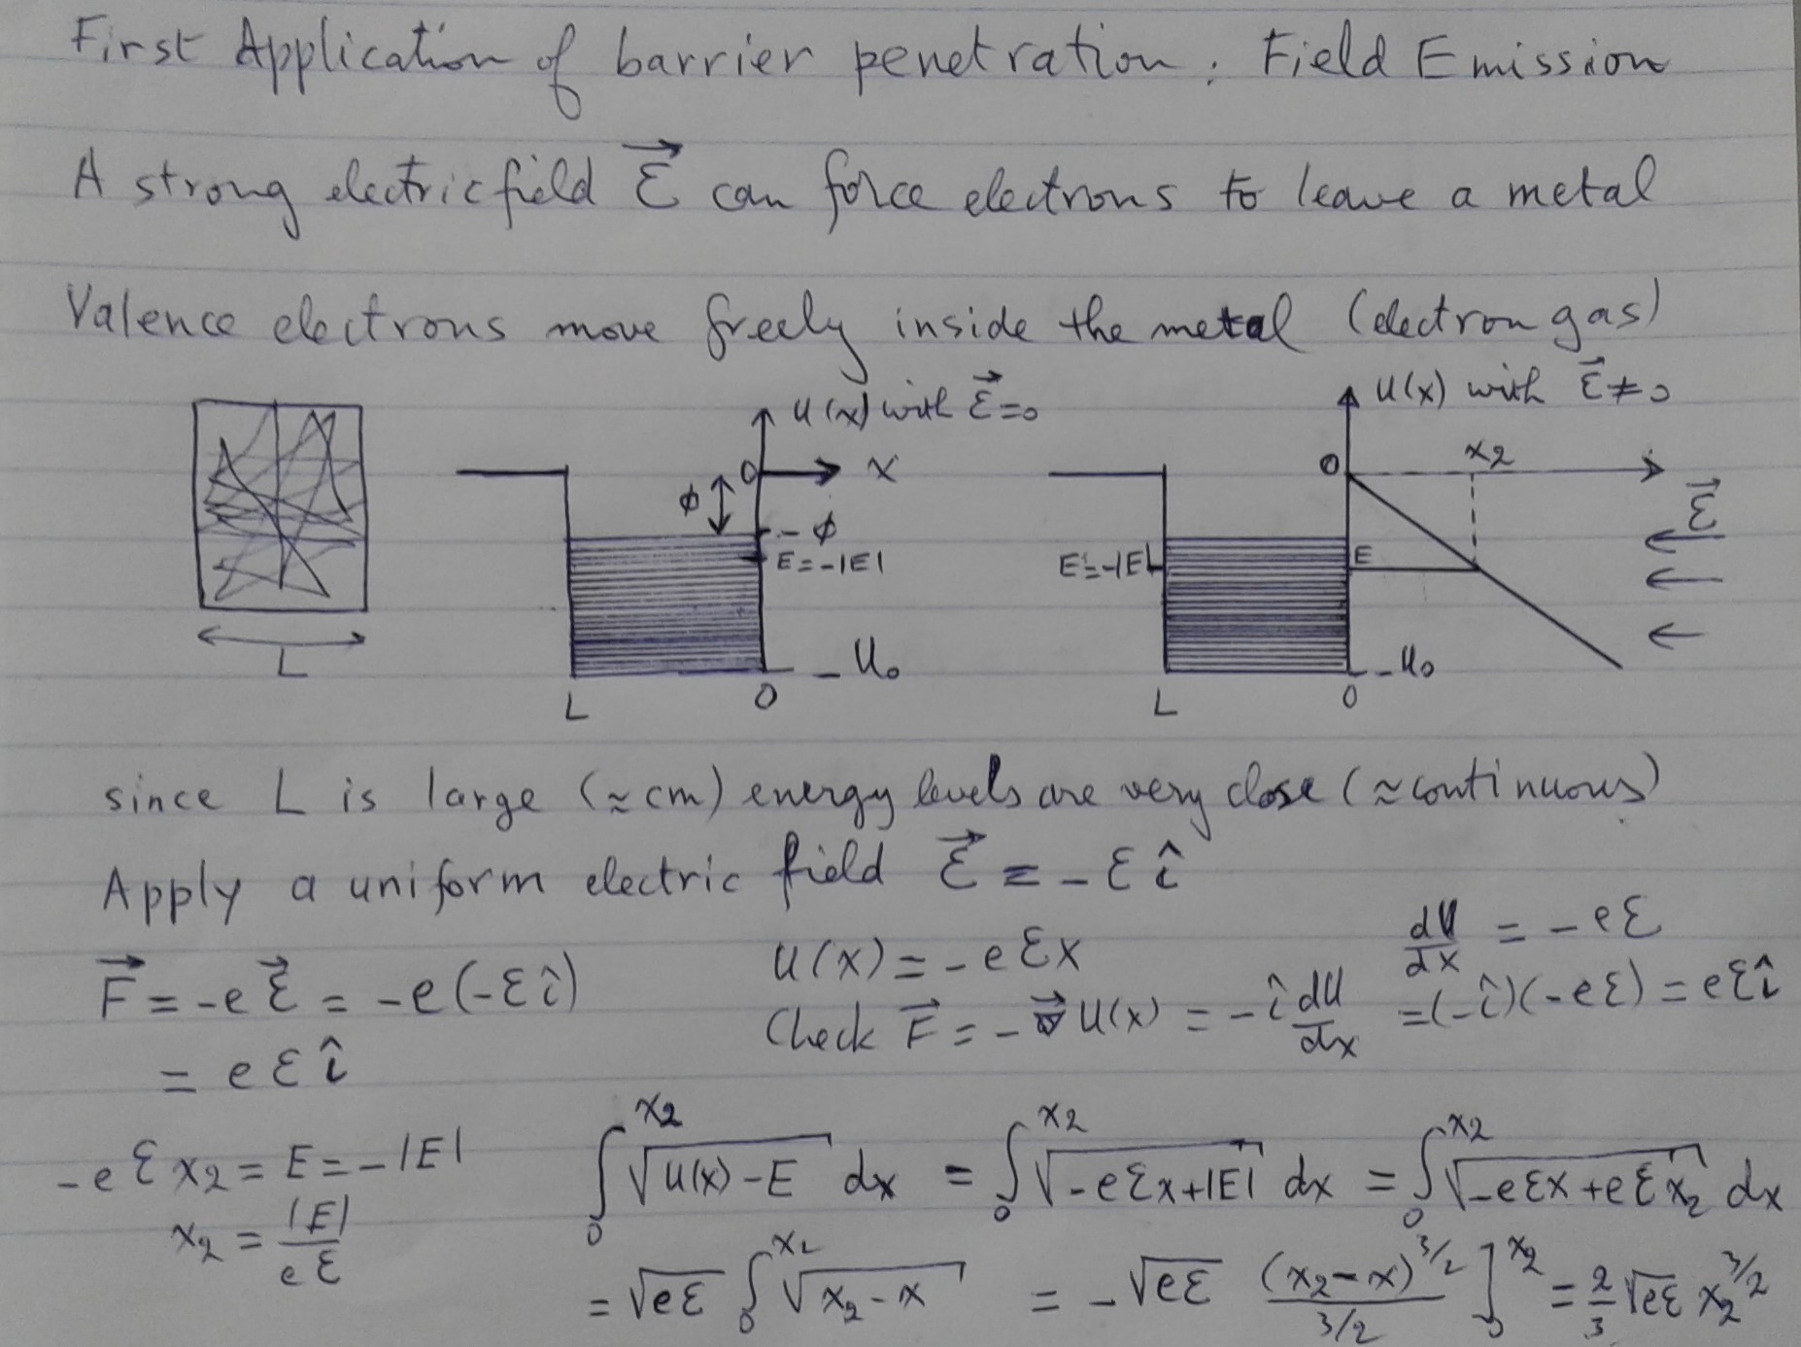
$T\left(E\right)=exp\left\{−\frac{2}{ħ}\sqrt{2m}\int_{x_{1}}^{x_{2}}{\sqrt{U(x)−E}dx}\right\}$ : 1. Field Emission

Slide 14
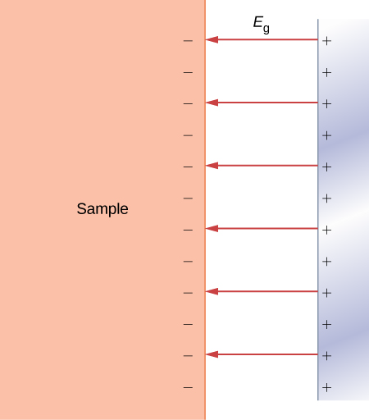
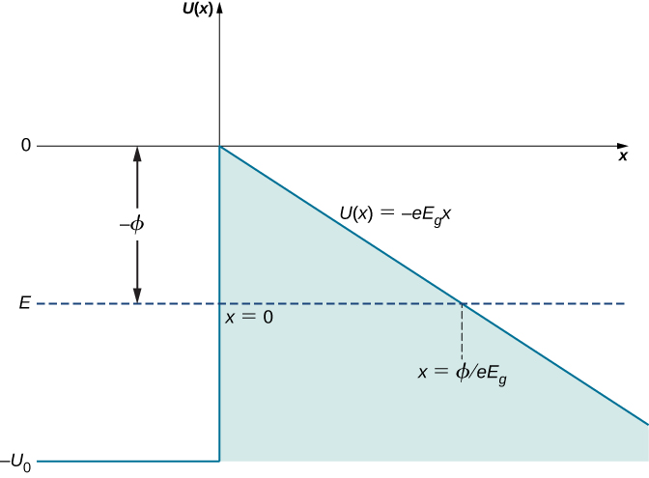

Slide 15
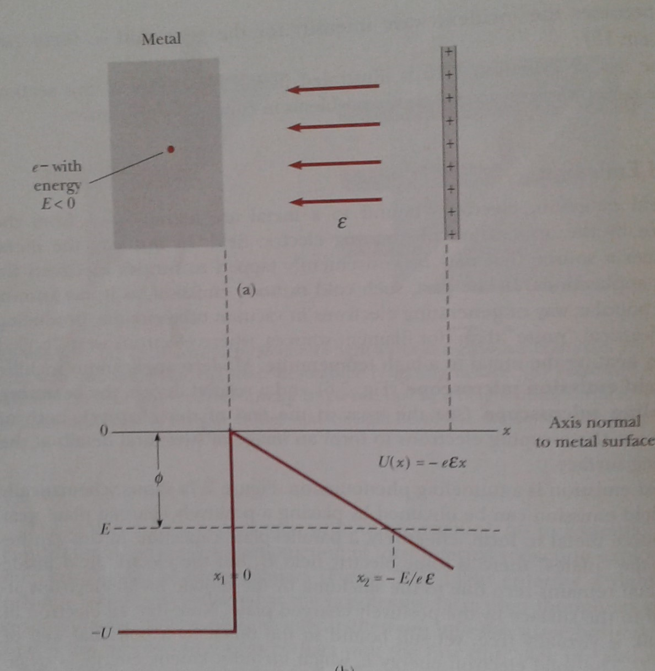
Field Emission
Electrons escape from the metal by tunneling under the barrier. The lower the energy the thicker is the barrier. The most likely electrons to escape are those with E=-φ

Slide 16
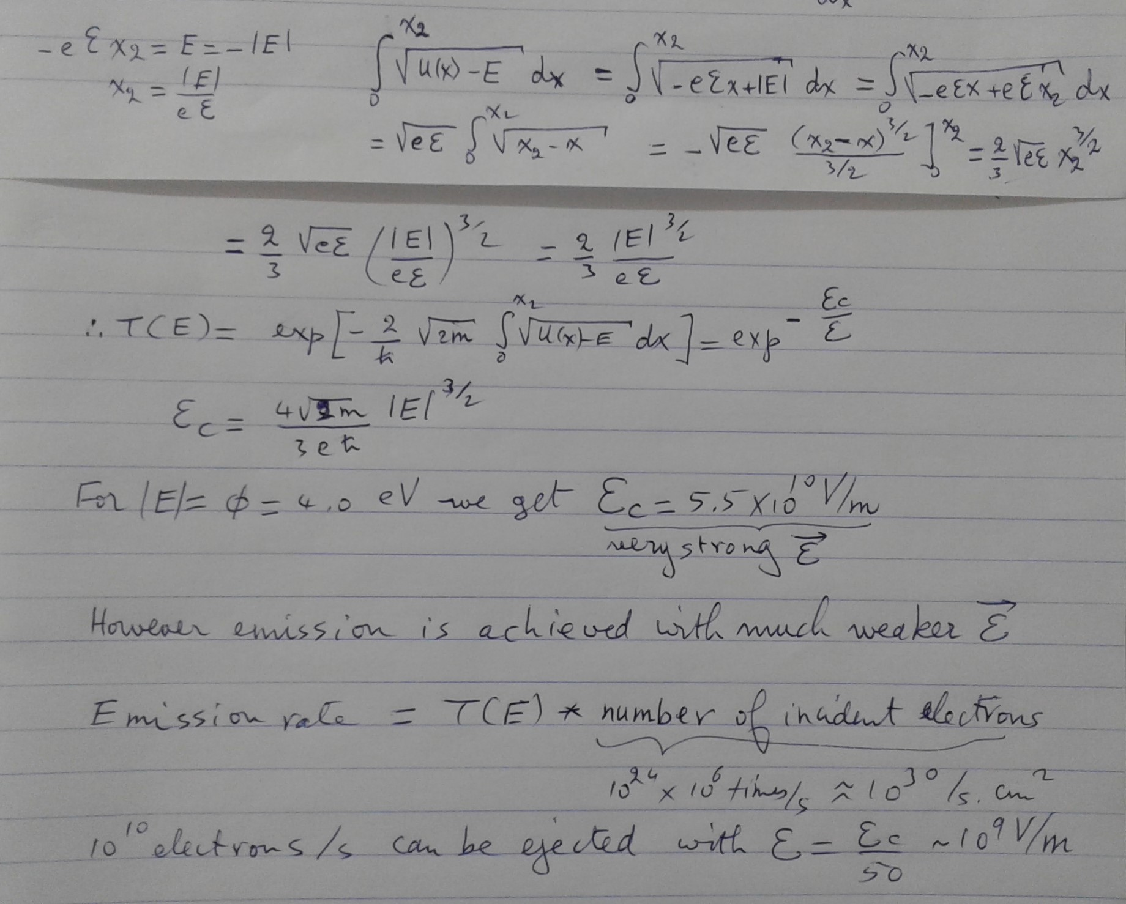

Slide 17
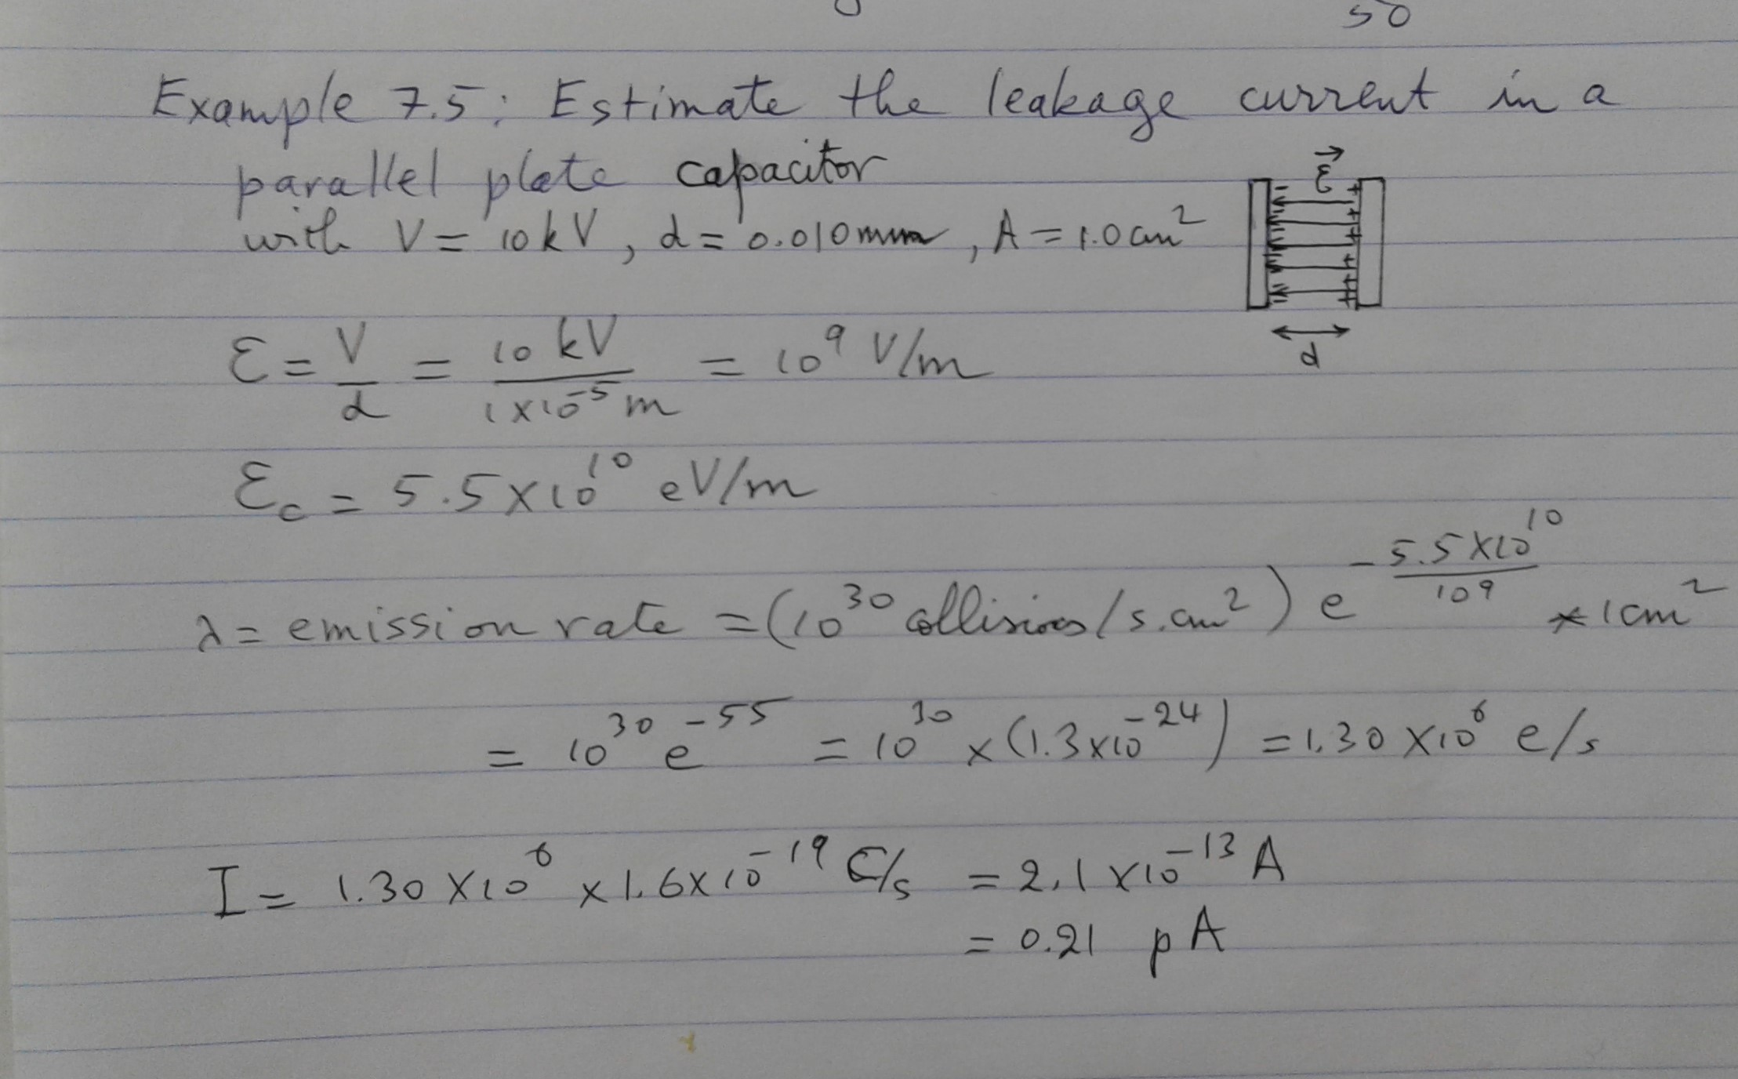
Leakage in a parallel plate capacitor

Slide 18
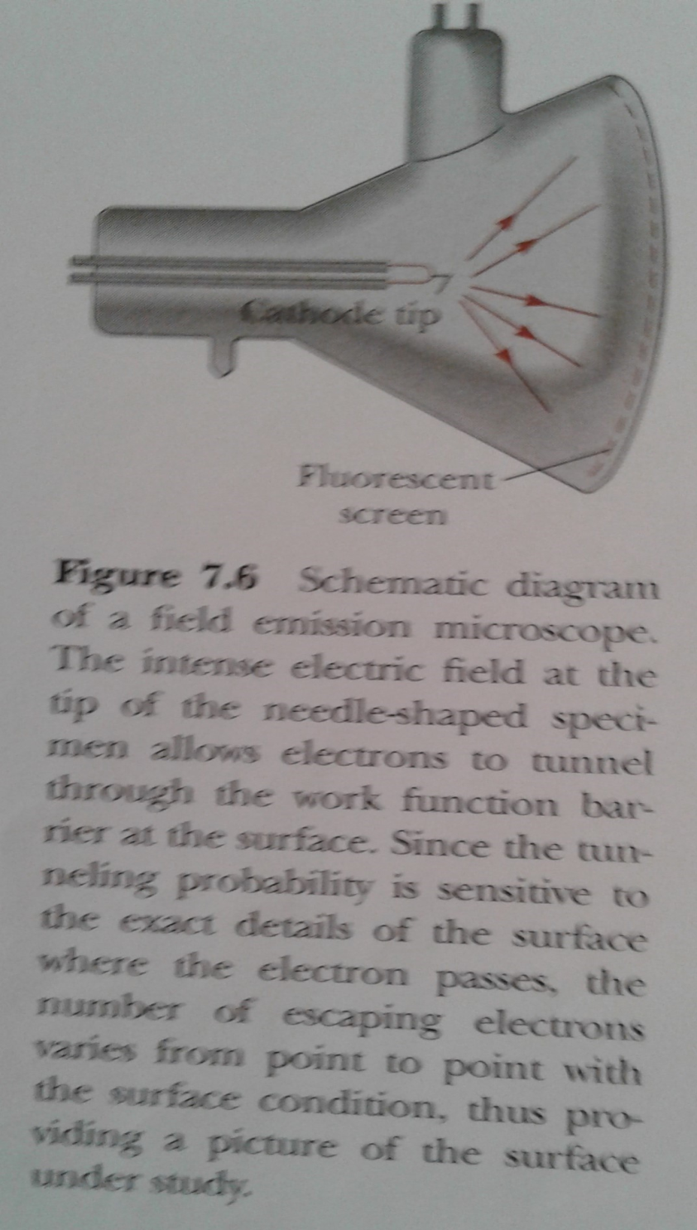
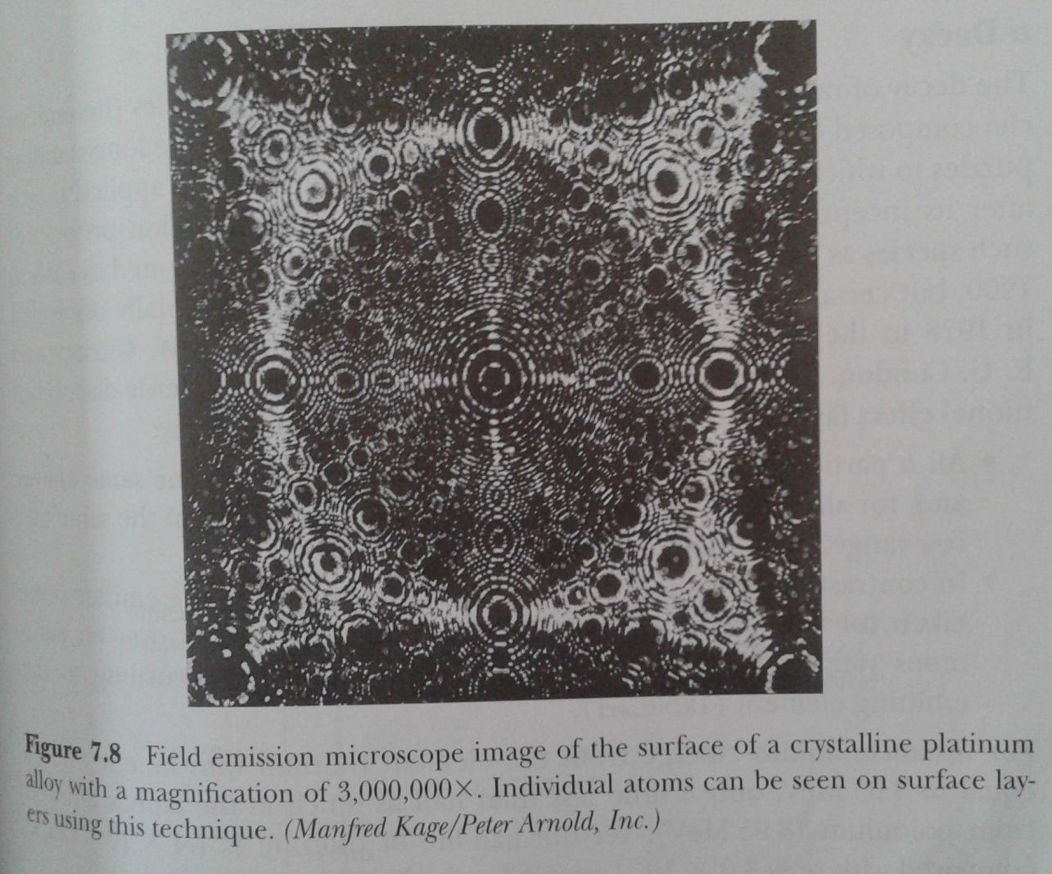

Slide 19
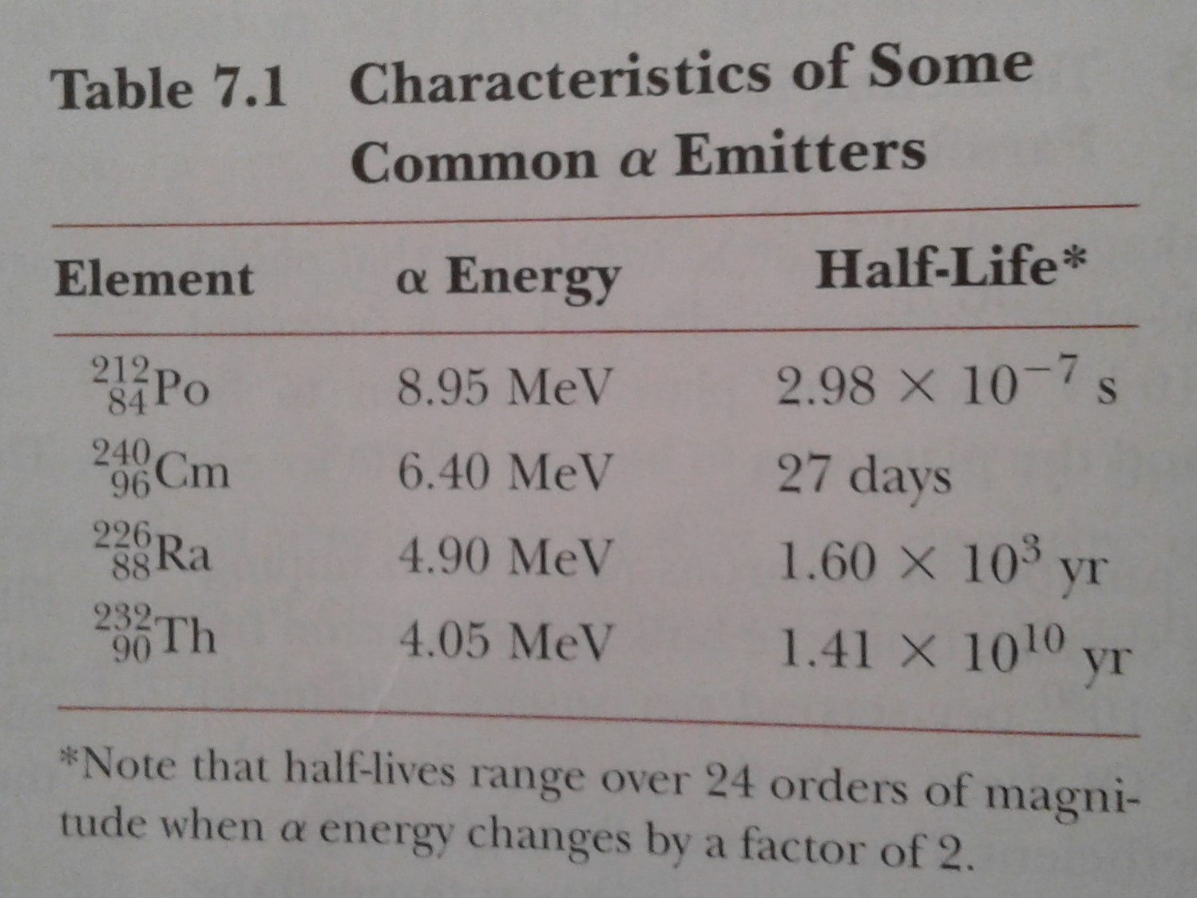
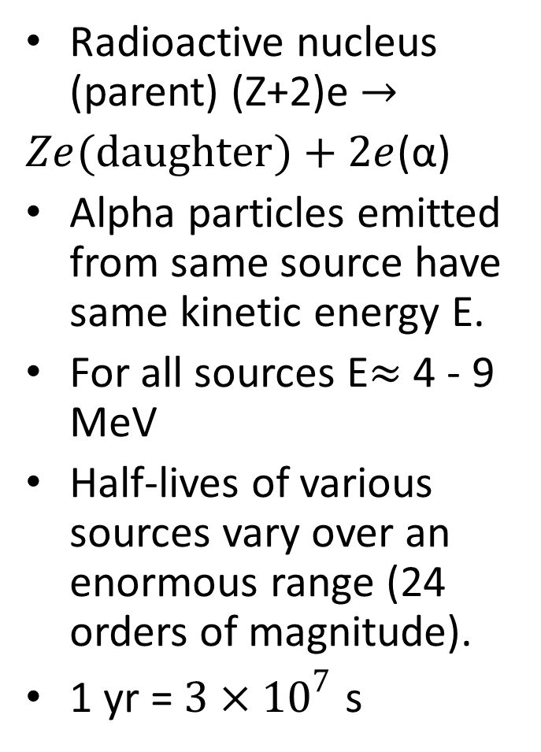
2nd Application: Alpha decay (Gamow 1928)
Radioactive nucleus (parent) (Z+2)e $→$
$Ze(daughter)+2e$(α)
Αlpha particles emitted from same source have same kinetic energy E.
For all sources E$≈$ 4 - 9 MeV
Half-lives of various sources vary over an enormous range (24 orders of magnitude).
1 yr = $3×{10}^{7}$ s

Slide 20
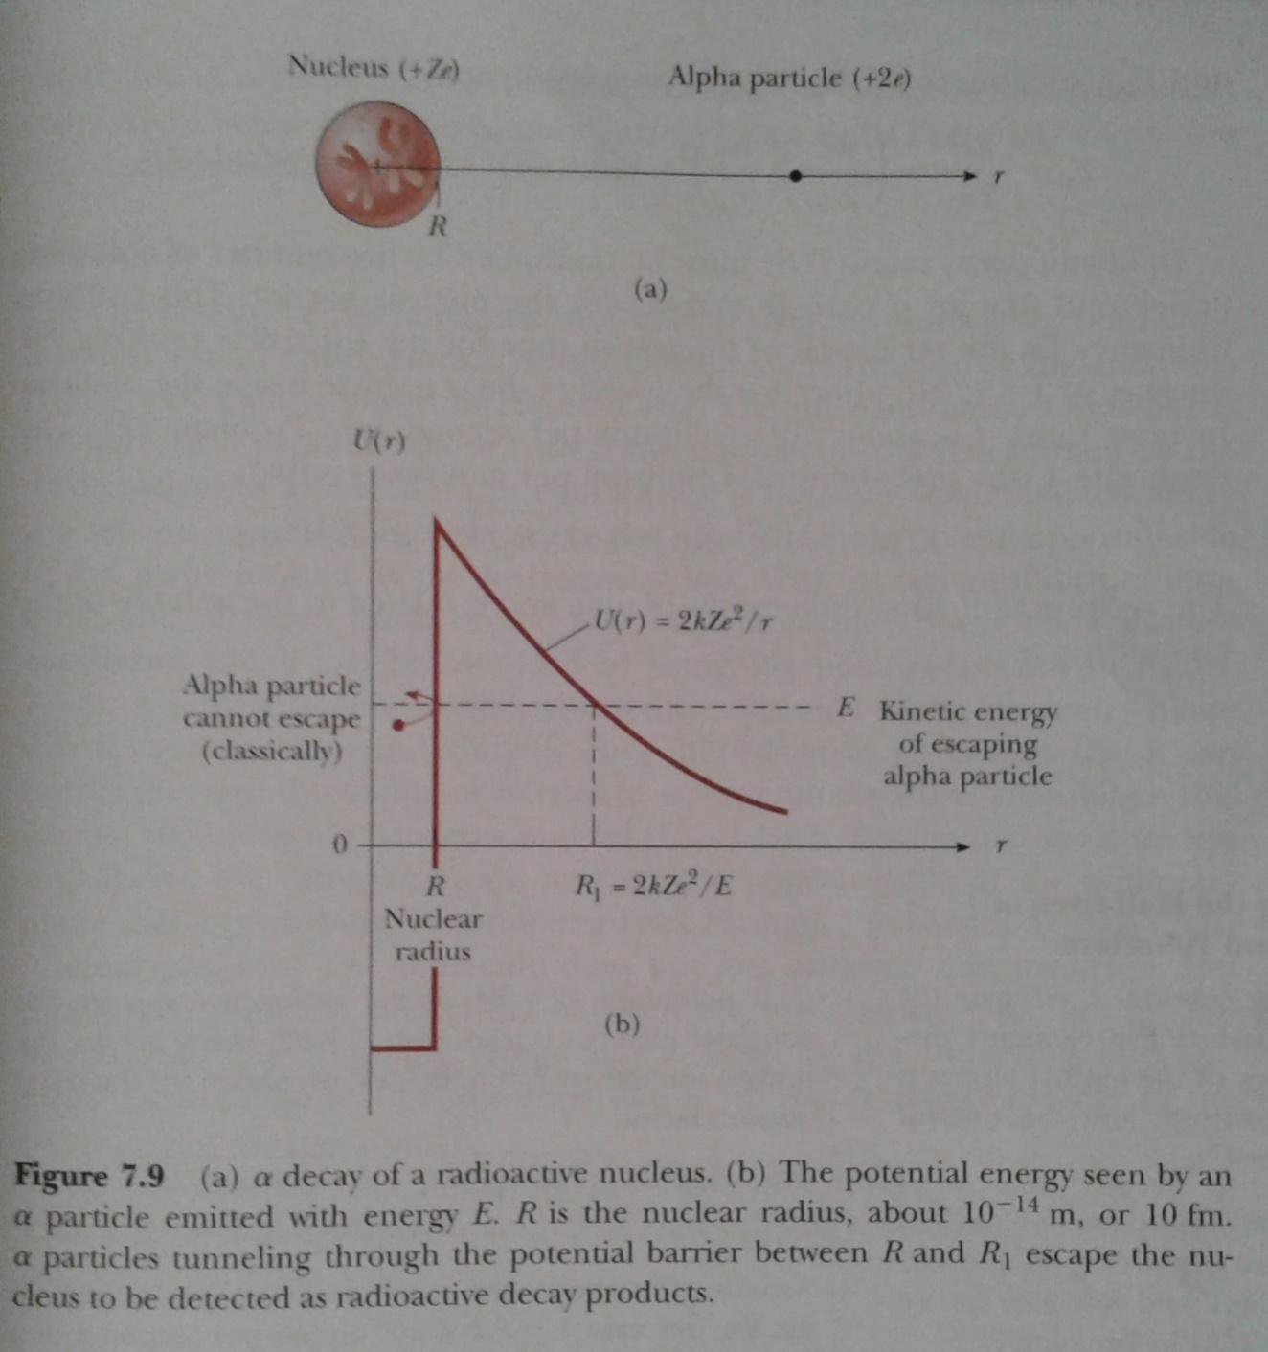
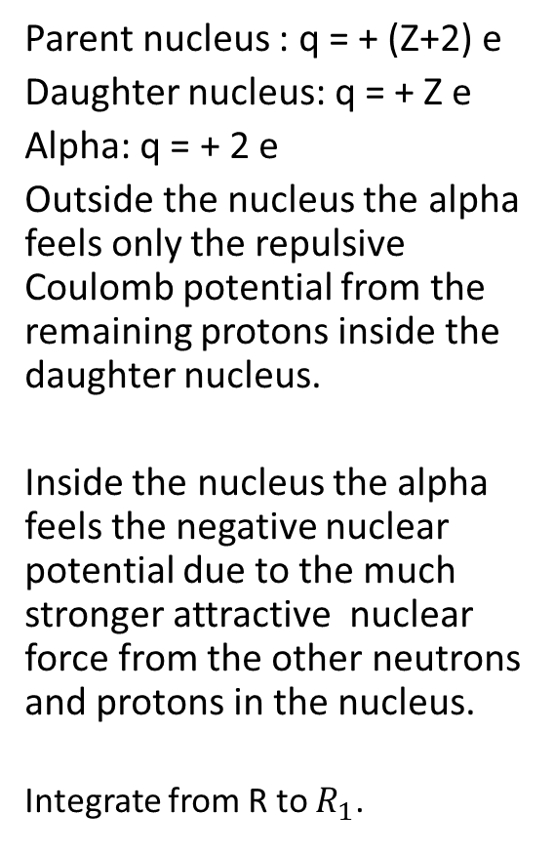
Potential felt by the Alpha Particle
Parent nucleus : q = + (Z+2) e
Daughter nucleus: q = + Z e
Alpha: q = + 2 e
Outside the nucleus the alpha feels only the repulsive Coulomb potential from the remaining protons inside the daughter nucleus.
Inside the nucleus the alpha feels the negative nuclear potential due to the much stronger attractive nuclear force from the other neutrons and protons in the nucleus.
Integrate from R to $R_{1}$.

Slide 21
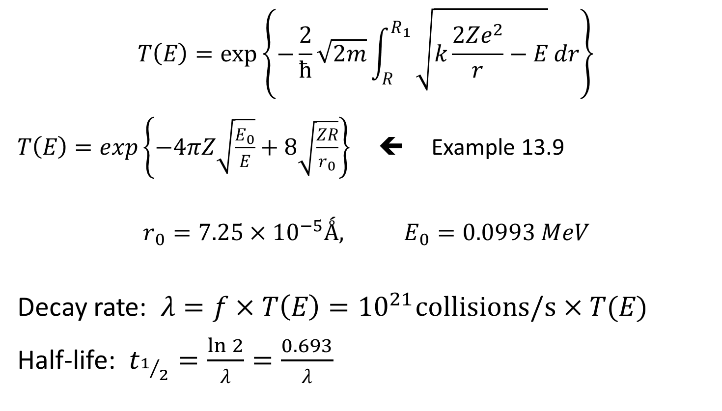

$$T\left(E\right)=exp\left\{−\frac{2}{ħ}\sqrt{2m}\int_{R}^{R_{1}}{\sqrt{U(r)−E} dr}\right\}$$
$$T\left(E\right)=exp\left\{−\frac{2}{ħ}\sqrt{2m}\int_{R}^{R_{1}}{\sqrt{k\frac{2Ze^{2}}{r}−E} dr}\right\}$$
$T\left(E\right)=exp\left\{−4πZ\sqrt{\frac{E_{0}}{E}}+8\sqrt{\frac{ZR}{r_{0}}}\right\}$ ⬅ Example 13.9
$$r_{0}=7.25×{10}^{−5}Ǻ, E_{0}=0.0993 MeV$$
Decay rate: $λ=f×T\left(E\right)={10}^{21}collisions/s×T(E)$
Half-life: $t_{1/2}=\frac{\ln{2}}{λ}=\frac{0.693}{λ}$

Slide 22
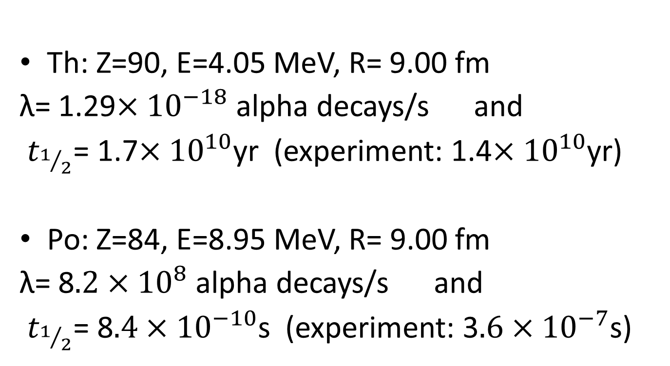

Example 7.8: Estimate $t_{1/2}$ for Th and Po
Th: Z=90, E=4.05 MeV, R= 9.00 fm
λ= 1.29$×{10}^{−18}$ alpha decays/s and
$t_{1/2}$= 1.7$×{10}^{10}$yr (experiment: 1.4$×{10}^{10}$yr)
Po: Z=84, E=8.95 MeV, R= 9.00 fm
λ= 8$.2×{10}^{8}$ alpha decays/s and
$t_{1/2}$= 8$.4×{10}^{−10}$s (experiment: 3$.6×{10}^{−7}$s)

Slide 23
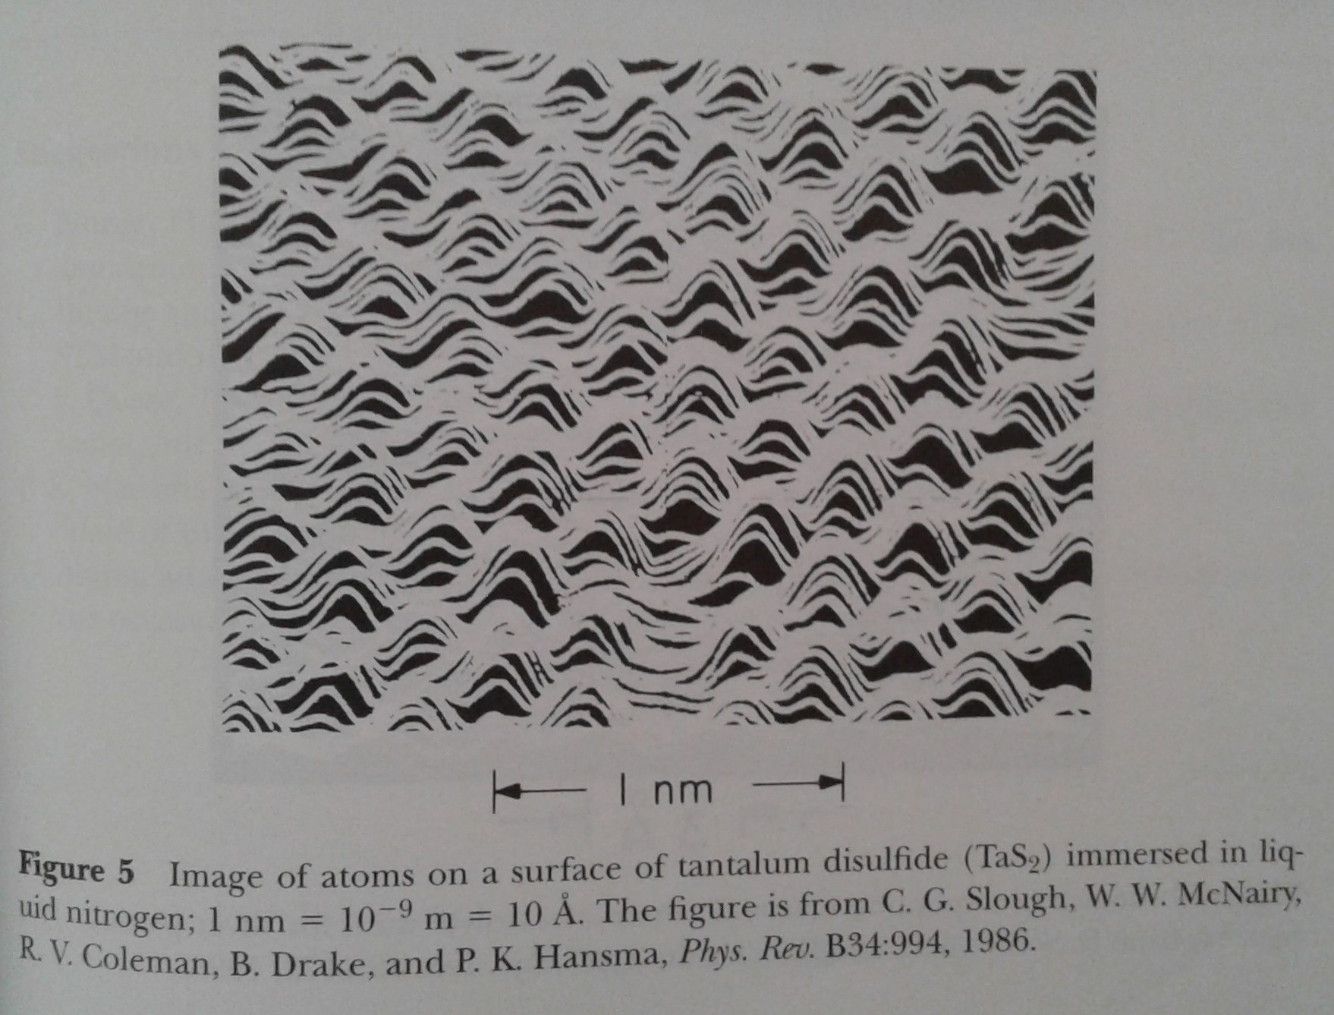
Scanning Tunneling Microscope (STM) pp 253-259

