Slide 1
NUTD 338 Nutrient metabolism
Hind Eliyan

Slide 2
Metabolism
Sum of all biochemical reactions occurring in a cell
the set of life-sustaining chemical processes that enables organisms to transform the chemical energy stored in molecules into energy that can be used for cellular processes

Slide 3
Catabolic vs. Anabolic reactions
Breakdown of complex organic molecules which will usually lead to the release of energy
example: polymers such as proteins, nucleic acids, and polysaccharides are reduced to their constituent parts: amino acids, nucleotides, and sugars.
anabolic pathways: the synthesis of new macromolecules which requires input of energy
Cells must balance their catabolic and anabolic pathways in order to control their levels of critical metabolites
Example: in starvation – little glucose so cells synthesize glucose from other metabolites or use fat to generate ATP

Slide 4
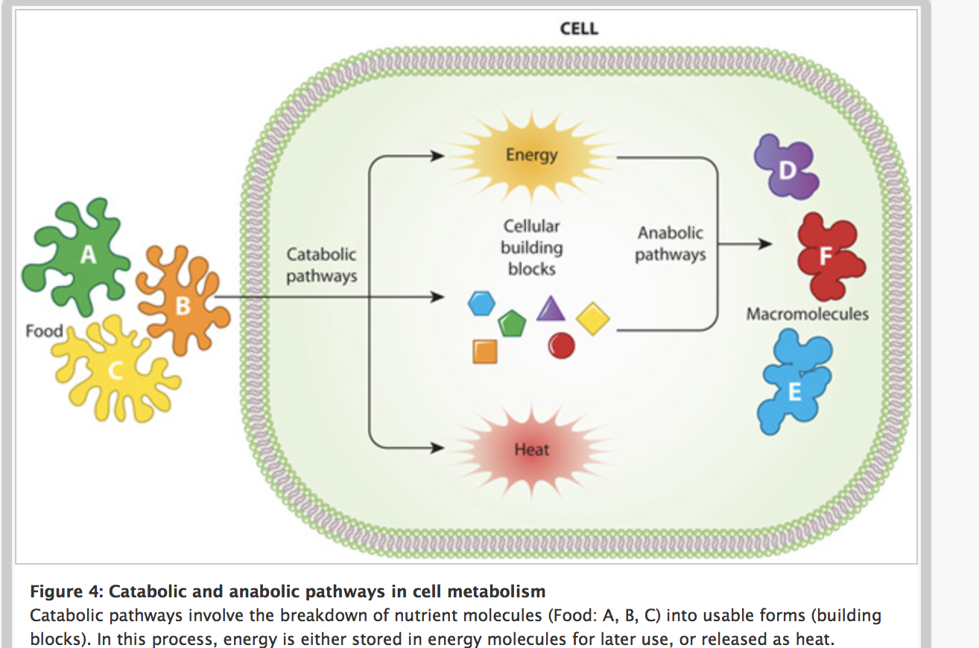

Slide 5
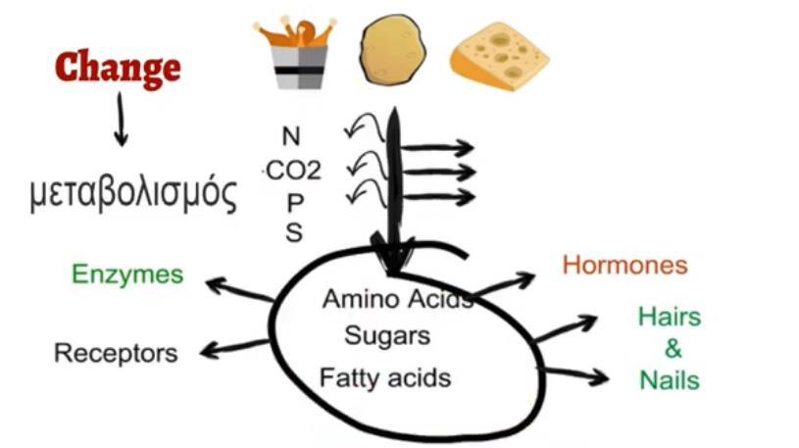
Photo credit: Sajid Sheikh, https://www.youtube.com/watch?v=HrYRMknYHrk&t=190s

Slide 6
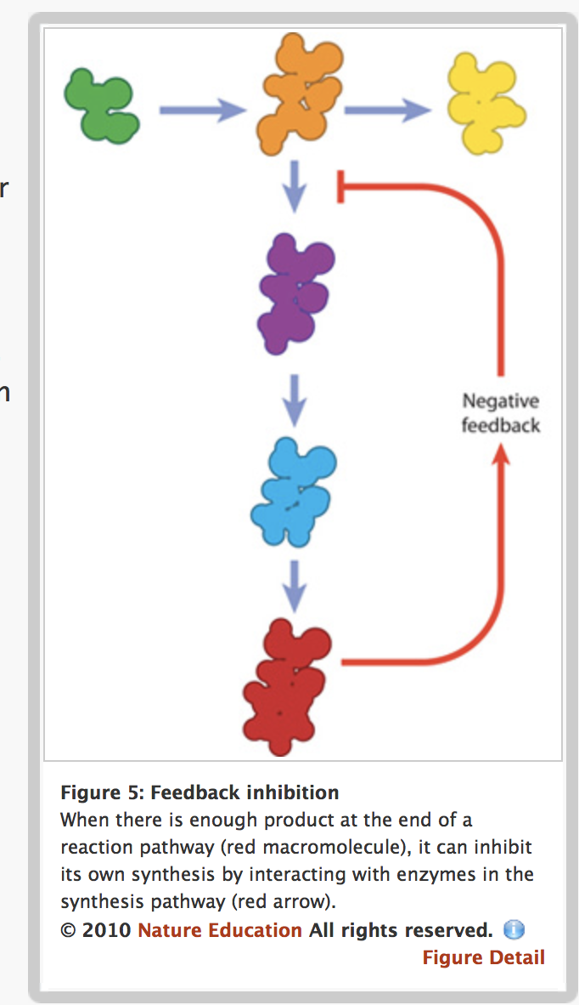
REGULATION OF METABOLIC PATHWAYS
must also monitor the needs and excess of all their different metabolic pathways
Example: to strengthen a specific pathway , cells can increase the amount of a (rate-limiting) enzyme or use activators to convert that enzyme into an active conformation
To slow down or halt a pathway, cells can decrease the amount of an enzyme or use inhibitors to make the enzyme inactive
An, Cell Metabolism. Nature news. Available at: https://www.nature.com/scitable/topicpage/cell-metabolism-14026182on

Slide 7
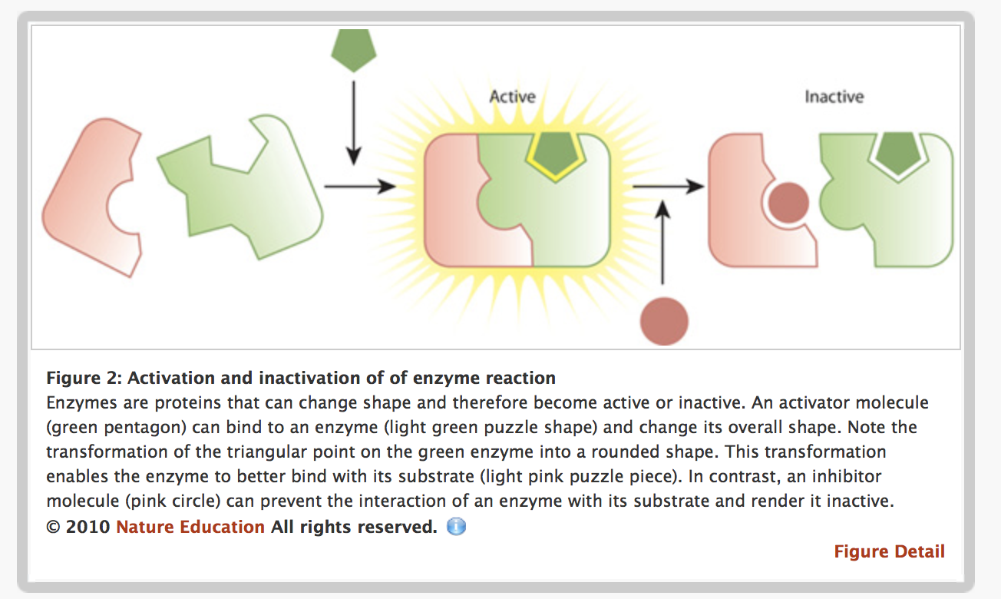
An, Cell Metabolism. Nature news. Available at: https://www.nature.com/scitable/topicpage/cell-metabolism-14026182on

Slide 8
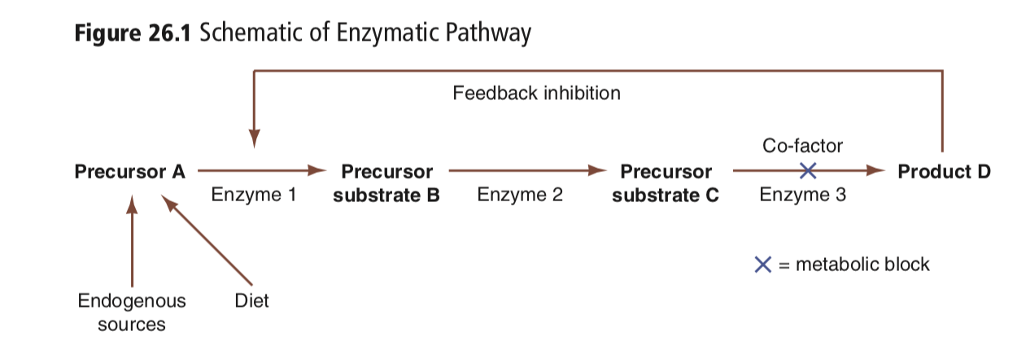
Pathophysiology of Impaired Metabolism
Accumulation of D results in inhibition of the pathway
impaired feedback inhibition
Impaired metabolism of nutrients can occur :
Deficient or absent enzyme activity
Defective gene that results in a change to the binding site of cofactors that are needed for a specific enzyme to function properly.
NOT present/Functional enzyme 3
This block can cause accumulation of toxic metabolites or def in product D

Slide 9
Phenylketonuria
PKU is caused by a defect in the gene that helps create the enzyme needed to break down phenylalanine.
deficiency of phenylalanine hydroxylase (PAH) ( enzyme)
This deficiency leads to the accumulation of Phe and its metabolites in tissues and body fluids of PKU patients

Slide 10
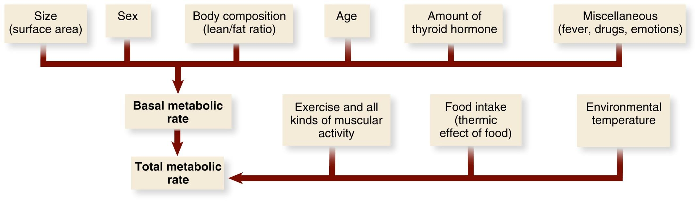
Basal metabolic Rate
BMR represents the amount of energy needed to sustain basic life processes such as respiration, heartbeat, renal function, brain and nerve function, blood circulation, active transport, and synthesis of proteins and other complex molecules.
7 COPYRIGHT © 2016 BY ELSEVIER INC. ALL RIGHTS RESERVED.
Notes:
BMR is MOSTLY effected by the amount of lean tissue or lean body mass (LBM) ( fat-free mass)
Lean mass is more metabolically active than adipose tissue( fat tissue)
Muscle is the major contributor to lean tissue, and even in resting basal state it has a moderately high energy expenditure
Visceral organs (internal organs ) especially the heart and liver, have a high metabolic rate

Slide 11
The Digestive tract
The main structures of the digestive tract include the oral cavity, esophagus, and stomach (upper digestive tract)
small and large intestines (called the lower digestive tract)
The accessory organs : Pancreas, liver, and gallbladder
Job of accessory organs:
provide or store secretions that ultimately are delivered to the lumen (interior passageway) of the digestive tract and aid in the digestive and absorptive processes.

Slide 12
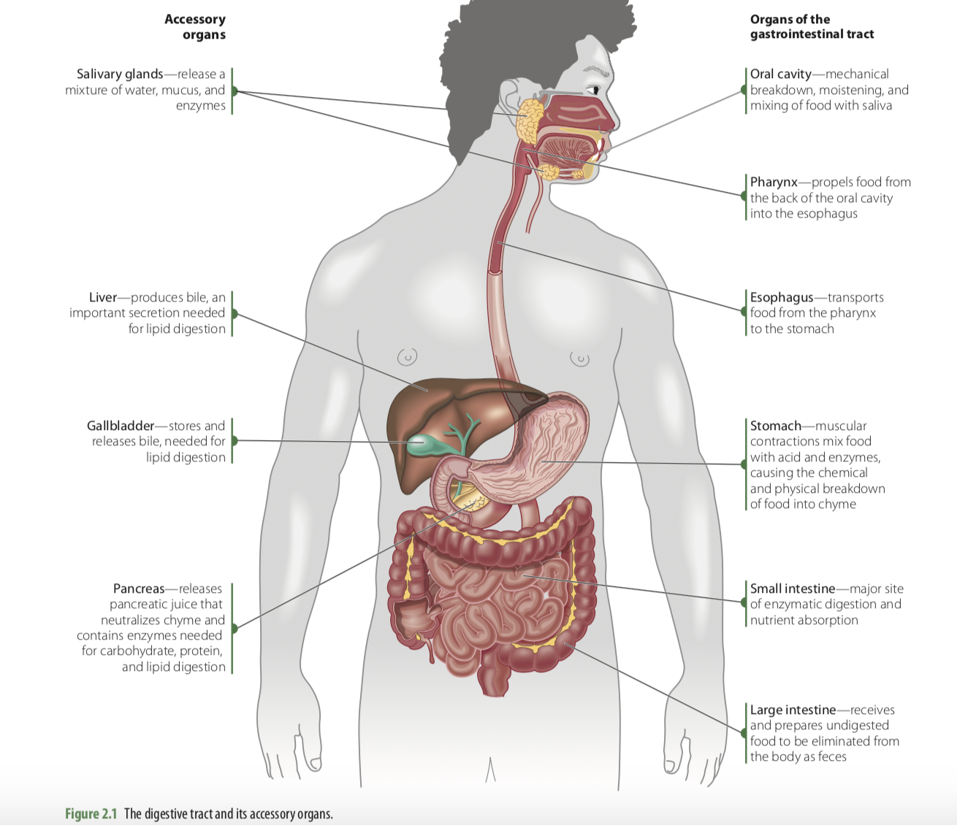

Slide 13
GI Tract Functions:
Motility-contraction of smooth muscle to break-up and move contents along; movement through the tube- mixing and transport of contents
Secretion- release of substances by cells
digestive agents (eg. HCl) lubricant (mucus)
Digestion: Physical digestion: mastication
Chemical Digestion- large molecules to smaller ones using enzymes. Predominately hydrolysis- breakdown into monomers
Absorption:
Uptake of substances by cells. Macronutrients, vitamins, minerals and liquids. Move from the intestine to blood or lymph
Excretion - Storage and Elimination: removal of wastes from the body

Slide 14
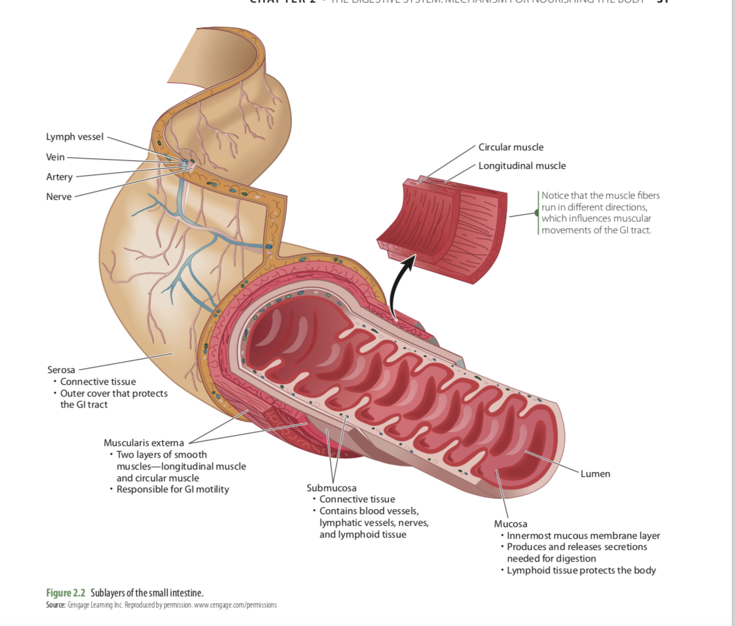

Slide 15
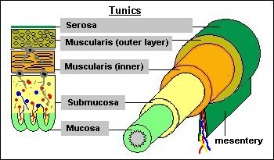
lumen and the four main tunics, or layers, of the gastrointestinal tract:
Mucosa: Inner most layer
Epithelial cells that line the lumen of the GI that comes in contact with the food we eat that is passing through the lumen
http://www.vivo.colostate.edu/hbooks/pathphys/digestion/basics/gi_microanatomy.html

Slide 16
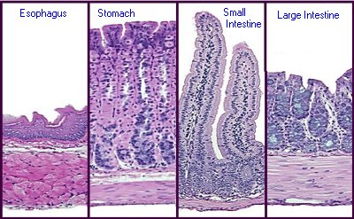
Mucosa: Inner most layer
Epithelial cells that line the lumen of the GI that comes in contact with the food we eat
most variable in structure and function
acts as a barrier and is both secretory and absorptive
Flattened epithelium Protective mucosa
Secretory
Absorptive
Water absorption
http://www.vivo.colostate.edu/hbooks/pathphys/digestion/basics/gi_microanatomy.html

Slide 17
The lymphoid tissue in the submucosa protects the body against ingested foreign substances.
The submucosa connects the first mucosal layer of the gastrointestinal tract to the muscularis externa, or third layer of the gastrointestinal tract.
The muscularis externa composed of two muscle layers, the inner circular layer and outer longitudinal layer. These two layers move perpendicularly to one another and form the basis of peristalsis( forward movement, muscles contract to push food mass forward)

Slide 18
