Slide 1
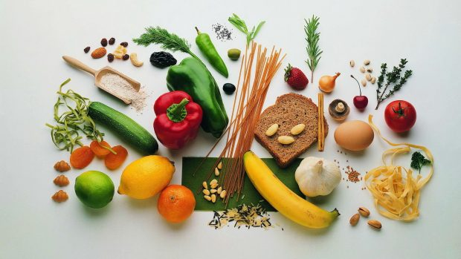
Lipids,
Protein and Vitamins

Slide 2

Objectives
To study the properties of lipids, proteins and vitamins.
To identify the nature of an unknown compound by carrying out different qualitative tests

Slide 3
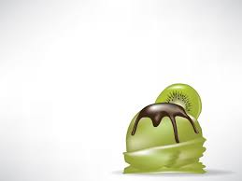
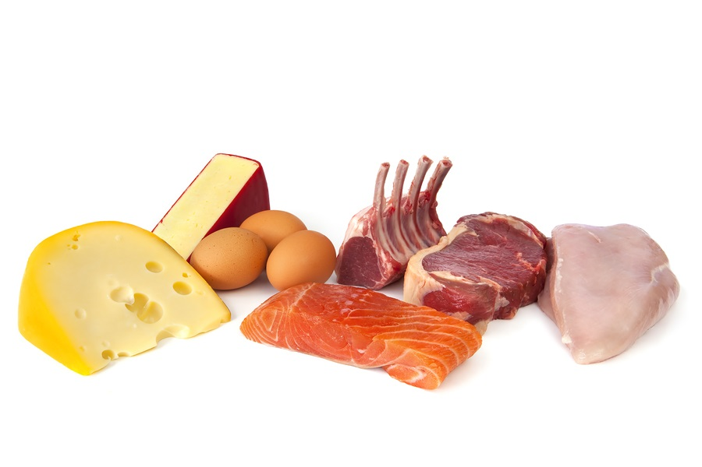
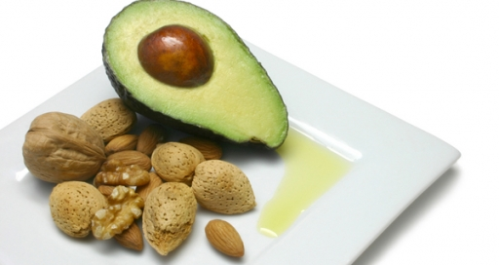
I. Lipids

Slide 4
Structure of Lipids
Lipids are organic compounds .
All lipids are INSOLUBLE in WATER (Hydrophobic molecules)
Some lipids have a hydrophobic and hydrophilic portion (amphipathic)

Slide 5
Classification of Lipids
According to their chemical structures can be classified into :
- Fatty acids
- Triacylglycerols
- Phospholipids
- Glycolipids
- Sphingolipids
- steroids
- and terpenes.

Slide 6
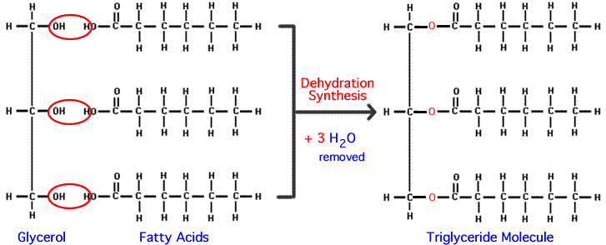
Fatty Acids
Simplest form of lipids.
Amphipathic molecules.
Triacylglycerols (Triglyceride) :

Slide 7
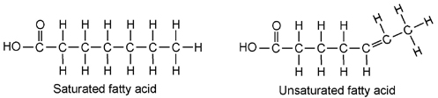
Types of Fatty Acids
Fatty acids can be :
- Saturated fatty acids:
- and unsaturated fatty acids:

Slide 8
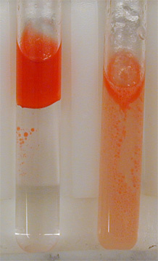
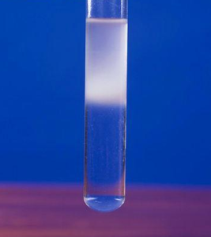
Identification of Lipids
Sudan III test :
- Sudan III is a red fat-soluble dye.
- reacts with the lipids or triglycerides to stain red in color.
Emulsion test:
- An emulsion is the formation of the solution as a lipid is dissolved in alcohol.
Sudan III test
Emulsion test

Slide 9
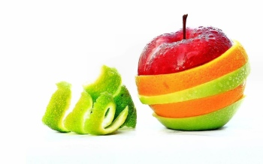
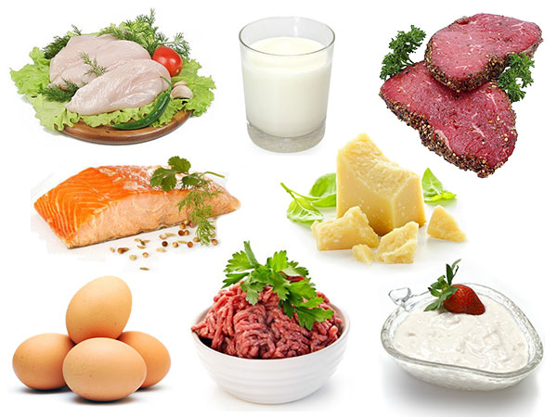
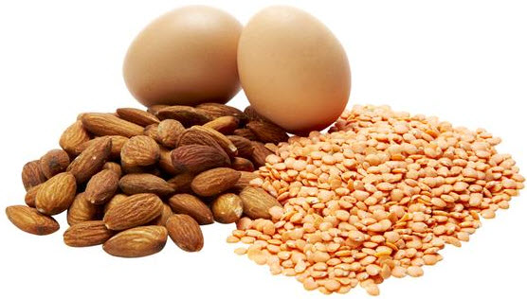
II. Proteins

Slide 10
Proteins
Made of C, H, O, N, sometimes S.
Proteins: are a polymer of amino acids linked by Peptide Bond formed during dehydration reaction .
Monomer is – amino acids
Polymer is a polypeptide
R
NH₃⁺
C
COO⁻
Carboxylic
acid group
Amino group
H

Slide 11
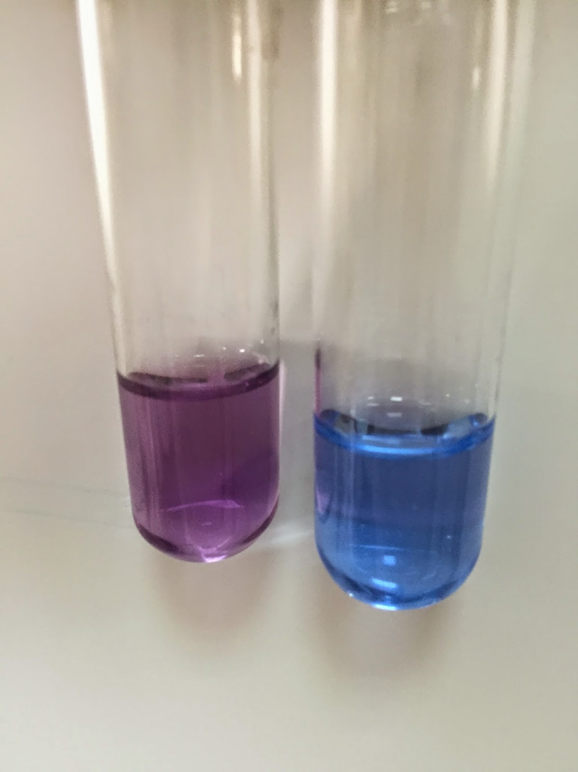
Identification Tests for proteins
Biuret test :
Test used to detect the presence of peptide bonds or proteins.
proteins form a violet colored complex with CuSO4 in a strongly alkaline solution.

Slide 12
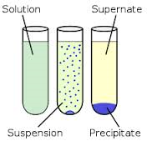
Identification Tests for proteins
Denaturation of Proteins: is a process in which the proteins losing its three dimensional structure.
Denaturing factor or compound :
strong acid or base, a concentrated inorganic salt, an organic solvent or heat.
Effect the protein solubility
Precipitation of protein .

Slide 13
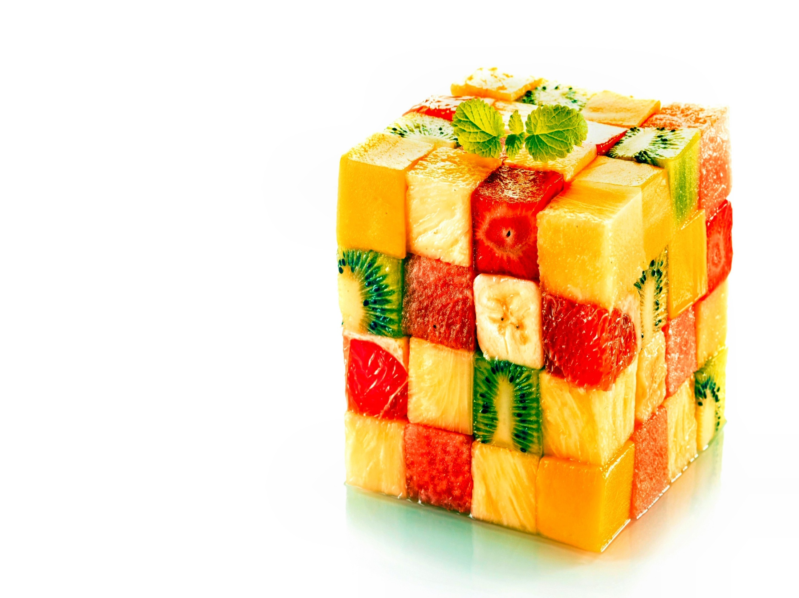
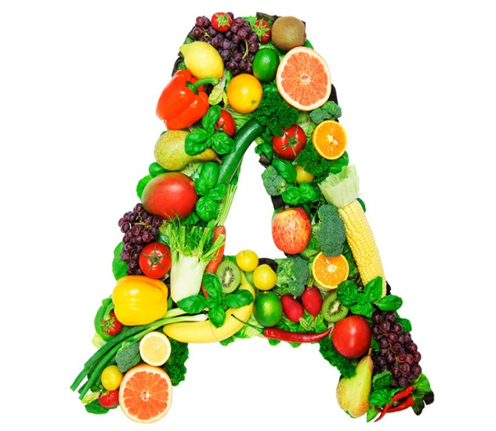
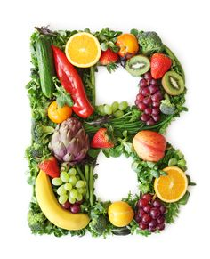
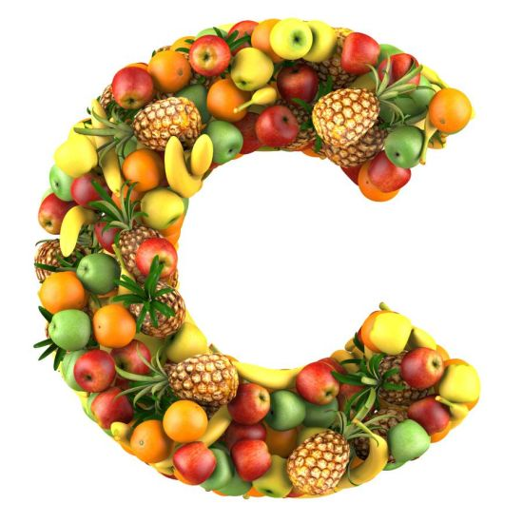
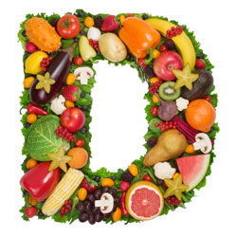
III. Vitamins

Slide 14
Vitamins
      Organic molecules that help regulate body processes.
      Vitamins have a wide variety of functions.
      There are 2 types of Vitamins:
      - Lipid-soluble vitamins (vitamin A, D, E, and K)
      - Water-soluble vitamins (vitamin C and B complex)

Slide 15
Identification Tests for Vitamins
DCPIP reduction test :
The test for vitamin C (ascorbic acid) identification .
DCPIP (dichlorophenol indophenol) is an oxidizing agent.
When DCPIP is added into vitamin C solution, the vitamin C reduces the dye (blue) to colorless

Slide 16
Identification Tests for Vitamins
Iodine reduction test:
The test for vitamin C (ascorbic acid) identification .
IKI (potassium iodide solution) is a complex blue-black color .
When ascorbic acid is added (IKI complex) , iodine is reduced to iodide ions, making the blue-black color disappear.

