Slide 1
Antihistamine
Sabha kathem

Slide 31
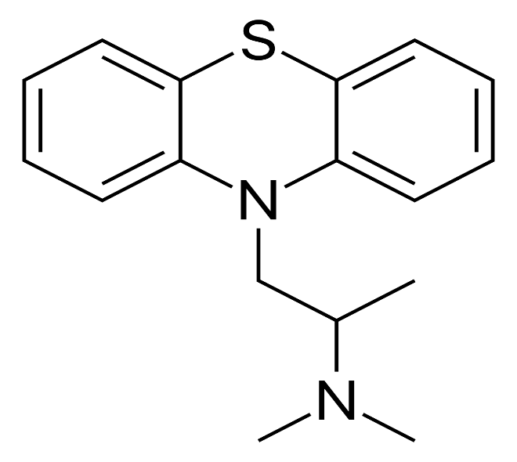

Slide 33
