Slide 1
Disorders of Ventilation & Gas Exchange

Slide 2
Introduction
The primary functions of the respiratory system are to remove appropriate amounts of carbon dioxide from the blood entering the pulmonary circulation and provide adequate amount of oxygen to blood leaving the pulmonary circulation.
This is accomplished through the process of ventilation, in which air moves into and out of the lungs, and diffusion, in which gases move between the alveoli and the pulmonary capillaries.
Although both affect gas exchange, oxygenation of the blood largely depends on diffusion, while removal of carbon dioxide depends on ventilation.

Slide 3
Hypoxemia
Hypoxemia refers to a decrease in blood oxygen levels that results in a decrease in tissue oxygenation.
Hypoxemia can occur as the result of hypoventilation, diffusion impairment, shunt, and ventilation–perfusion abnormalities.
Acute hypoxemia is manifested by increased respiratory effort (increased respiratory and heart rates), cyanosis, and impaired sensory and neurologic function. The body compensates for chronic hypoxemia by increased ventilation, pulmonary vasoconstriction, and increased production of red blood cells.

Slide 4
Hypoxemia
PO₂ less than 60 mm Hg
Cyanosis
Impaired function of vital centers
Agitated or combative behavior, euphoria, impaired judgment, convulsions, delirium, stupor, coma
Retinal hemorrhage
Hypotension and bradycardia
Activation of compensatory mechanisms
Sympathetic system activation

Slide 5
Hypercapnia
Hypercapnia refers to an increase in carbon dioxide levels.
The manifestations of hypercapnia consist of those associated with a decrease in pH (respiratory acidosis); vasodilation of blood vessels, including those in the brain; and depression of central nervous system function.

Slide 6
Hypercapnia
PCO₂ greater than 50 mm Hg
Respiratory acidosis
Increased respiration
Decreased nerve activity
Carbon dioxide narcosis
Disorientation, somnolence, coma
Decreased muscle contraction
Vasodilation
Headache; warm flushed skin

Slide 7
Question
True or false?
Both hypercapnia and hypoxemia will lead to respiratory failure if untreated.

Slide 8
Answer
True
Rationale: In both hypercapnia (PCO₂ greater than 50 mm Hg), tissues accumulate carbon dioxide; in hypoxemia (PO₂ less than 60 mm Hg), less oxygen is delivered to the tissues. In both cases, gas exchange is impaired, and respiratory failure will result unless the conditions are corrected (with oxygen, mechanical ventilation, etc.).

Slide 9
Disorders of the Pleura
Disorders of the pleura include pleuritis, pleural effusion, and pneumothorax.
Pleuritis, or inflammation of the pleura, characteristically causes unilateral pain that is abrupt in onset and exaggerated by respiratory movements.
Pleural effusion refers to the abnormal accumulation of fluid in the pleural cavity. The fluid may be a transudate (i.e., hydrothorax), exudate (i.e., empyema), chyle (i.e., chylothorax), or blood (hemothorax).

Slide 10
Pleura
Parietal pleura lines the thoracic wall and superior aspect of the diaphragm.
Visceral pleura covers the lung.
Pleural cavity or the space between the two layers contains a thin layer of serous fluid.

Slide 11
Pleural Effusion—Fluid in the Pleural Cavity
Hydrothorax: serous fluid
Empyema: pus
Chylothorax: lymph
Hemothorax: blood

Slide 12
Scenario
Mr. K presents himself with a stab wound.
Now he is having breathing problems, and his breath sounds are diminished on the side with the wound.
His trachea seems to be slanting toward the other side of his chest, and his heart sounds are displaced away from the wound.
He has an increased respiration rate and blood pressure, is pale and sweating with bluish nail beds, and has no bowel sounds.
Question
Explain the effects of the wound.

Slide 13
Pneumothorax
Pneumothorax refers to an accumulation of air in the pleural cavity that causes partial or complete collapse of the lung.
Pneumothorax can result from rupture of an air- filled bleb on the lung surface or from penetrating or nonpenetrating injuries.
A tension pneumothorax is a life-threatening event in which air accumulates in the thorax, collapsing the lung on the injured side and progressively shifting the mediastinum to the opposite side of the thorax, producing severe cardiac and respiratory impairment.

Slide 14
Pneumothorax
Air enters the pleural cavity.
Air takes up space, restricting lung expansion.
Partial or complete collapse of the affected lung:
Spontaneous: air-filled blister on the lung ruptures
Traumatic: air enters through chest injuries
Tension: air enters pleural cavity through wound on inhalation, cannot leave on exhalation
Open: air enters pleural cavity through the wound on inhalation and leaves on exhalation

Slide 15
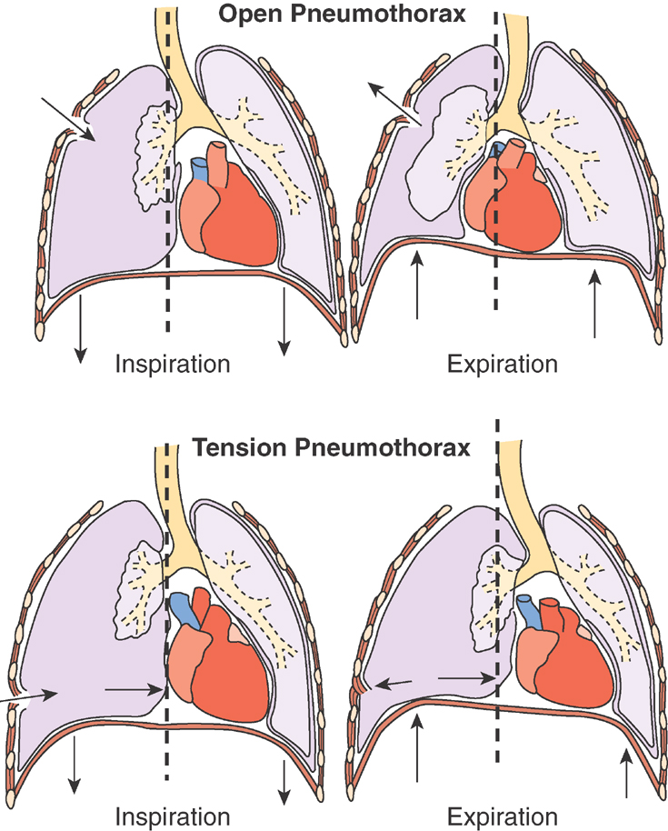
Pneumothorax (cont.)

Slide 16
Question
True or false?
Open pneumothorax is more life-threatening than tension pneumothorax.

Slide 17
Answer
False
Rationale: In open pneumothorax, inhaled air compresses the affected side’s lung, but during exhalation, the lung reinflates somewhat.
In tension pneumothorax, a sort of one-way valve exists—the air enters the affected side during inhalation, but is unable to leave when the patient exhales. Therefore, all of this air exerts increased pressure on the organs of the thoracic cage. Unless the pressure is relieved, tension pneumothorax is fatal.

Slide 18
Atelectasis
Atelectasis refers to an incomplete expansion of the lung.
Primary atelectasis occurs most often in premature and high-risk infants.
Acquired atelectasis occurs mainly in adults and is caused most commonly by a mucus plug in the airway or by external compression by fluid, tumor mass, exudate, or other matter in the area surrounding the airway.

Slide 19
Obstructive Airway Disorders
Obstructive airway disorders due to bronchial smooth muscle hyperreactivity or changes in bronchial wall structure, injury to the mucosal lining of the airways, or excess respiratory tract secretions are characterized by limitation in movement of atmospheric air into and out of the gas exchange portion of the lung.

Slide 20
Bronchial Asthma
Is a chronic disorder of the airways that causes reversible episodes of airway obstruction due to bronchial smooth muscle hyperreactivity and airway inflammation.
Extrinsic asthma is a type I hypersensitivity reaction triggered by an allergen; whereas intrinsic asthma is triggered by respiratory tract infections, exercise, drugs and chemicals, and gastroesophageal reflux.

Slide 21
Bronchial Asthma
An asthmatic episode is characterized by two types of responses—acute and late phase.
The acute-phase response results in immediate bronchoconstriction on exposure to an inhaled antigen and usually subsides within 90 minutes.
The late -phase response develops 4 to 8 hours after exposure to an asthmatic trigger; and involves inflammation and increased airway responsiveness that prolong the attack and cause a vicious cycle of exacerbations.

Slide 22
Airway Obstruction in Asthma
Inflammatory mediators
→ Airway inflammation
→ Increased mucociliary function
→ Edema
→ Epithelial injury →
→ Increased airway responsiveness
→ Bronchospasm
→ Airflow limitation

Slide 23
Extrinsic (Atopic) Asthma
Type I hypersensitivity
Allergen
→ Mast cells release inflammatory mediators.
Cause acute response within 10 to 20 minutes
→ WBCs enter region and release more inflammatory mediators.
Airway inflammation causes late-phase response in 4 to 8 hours.

Slide 24
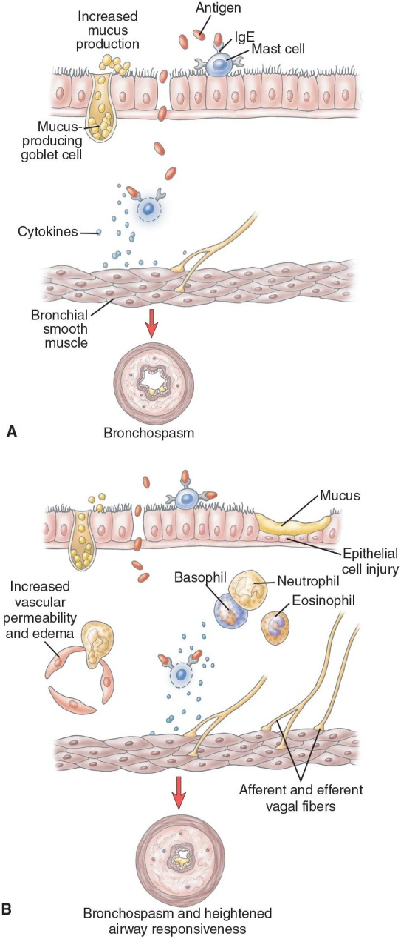
Bronchial Asthma

Slide 25
Intrinsic (Nonatopic) Asthma
Respiratory infections
Epithelial damage, IgE production
Exercise, hyperventilation, cold air
Loss of heat and water may cause bronchospasm.
Inhaled irritants
Inflammation, vagal reflex
Aspirin and other NSAIDs
Abnormal arachidonic acid metabolism

Slide 26
Question
Which of the following occurs in asthma?
Airway inflammation
Bronchospasm
Decreased ability to clear mucous
All of the above

Slide 27
Answer
D. All of the above
Rationale: Inflammatory mediators lead to airway inflammation, edema of the mucous lining of the airways, bronchospasm, and impaired ability to clear secretions. All of these things cause the airways to narrow during an asthma attack.

Slide 28
COPD
Chronic obstructive pulmonary disease (COPD) encompasses two types of obstructive airway disease: emphysema, with enlargement of air spaces and destruction of lung tissue, and chronic obstructive bronchitis, with increased mucus production, obstruction of small airways, and a chronic productive cough.
Persons with COPD often have overlapping features of both emphysema and chronic bronchitis, and both are manifested by eventual mismatching of ventilation and perfusion. As the conditions advance, signs of respiratory distress and impaired gas exchange become evident, with development of hypercapnia and hypoxemia.

Slide 29
COPD
Bronchiectasis is an uncommon form of COPD that is characterized by an abnormal dilation of the large bronchi associated with infection and destruction of the bronchial walls.

Slide 30
Chronic Obstructive Pulmonary Disorders
Emphysema
Enlargement of air spaces and destruction of lung tissue
Chronic obstructive bronchitis
Obstruction of small airways
Bronchiectasis
Infection and inflammation destroy smooth muscle in airways → permanent dilation

Slide 31
Mechanisms of COPD
Inflammation and fibrosis of the bronchial wall
Hypertrophied mucous glands → excess mucus
Obstructed airflow
Loss of alveolar tissue
Decreased surface area for gas exchange
Loss of elastic lung fibers
Airway collapse, obstructed exhalation, air trapping

Slide 32
Emphysema
Neutrophils in the alveoli secrete trypsin.
Increased neutrophil numbers due to inhaled irritants can damage alveoli.
α₁-antitrypsin inactivates the trypsin before it can damage the alveoli.
A genetic defect in α₁-antitrypsin synthesis leads to alveolar damage.

Slide 33
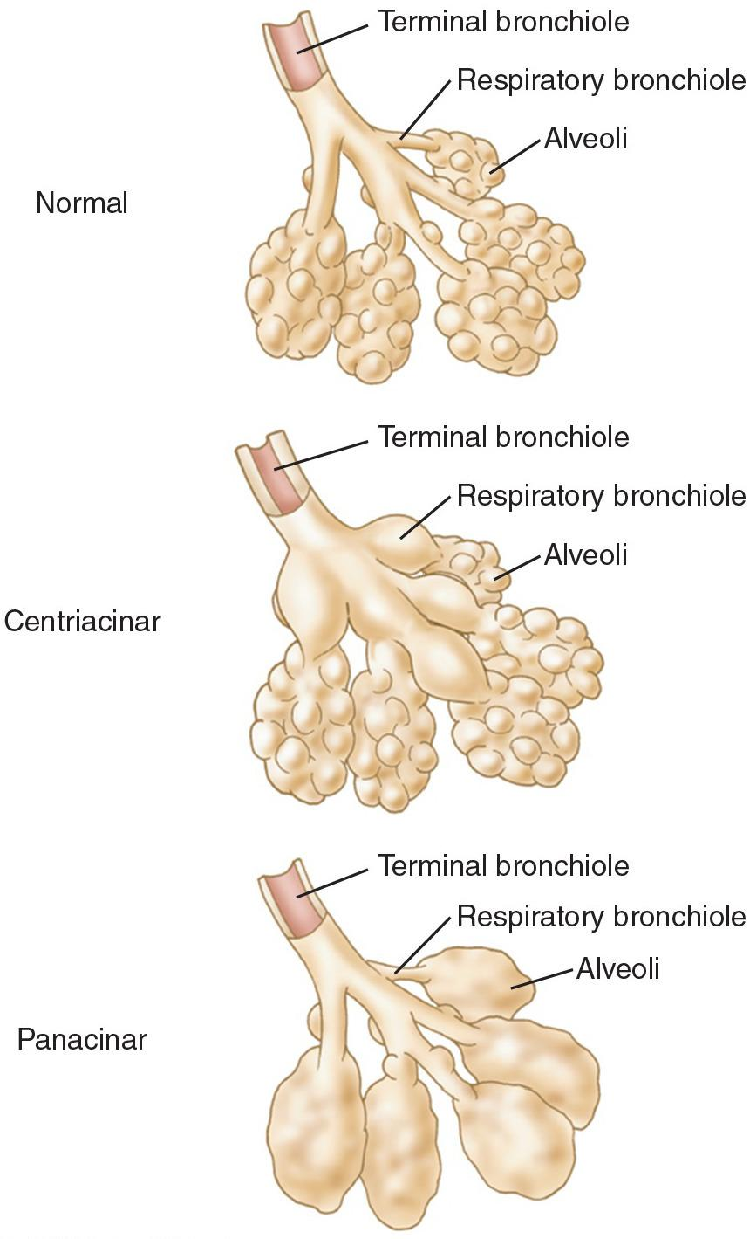
Types of Emphysema

Slide 34
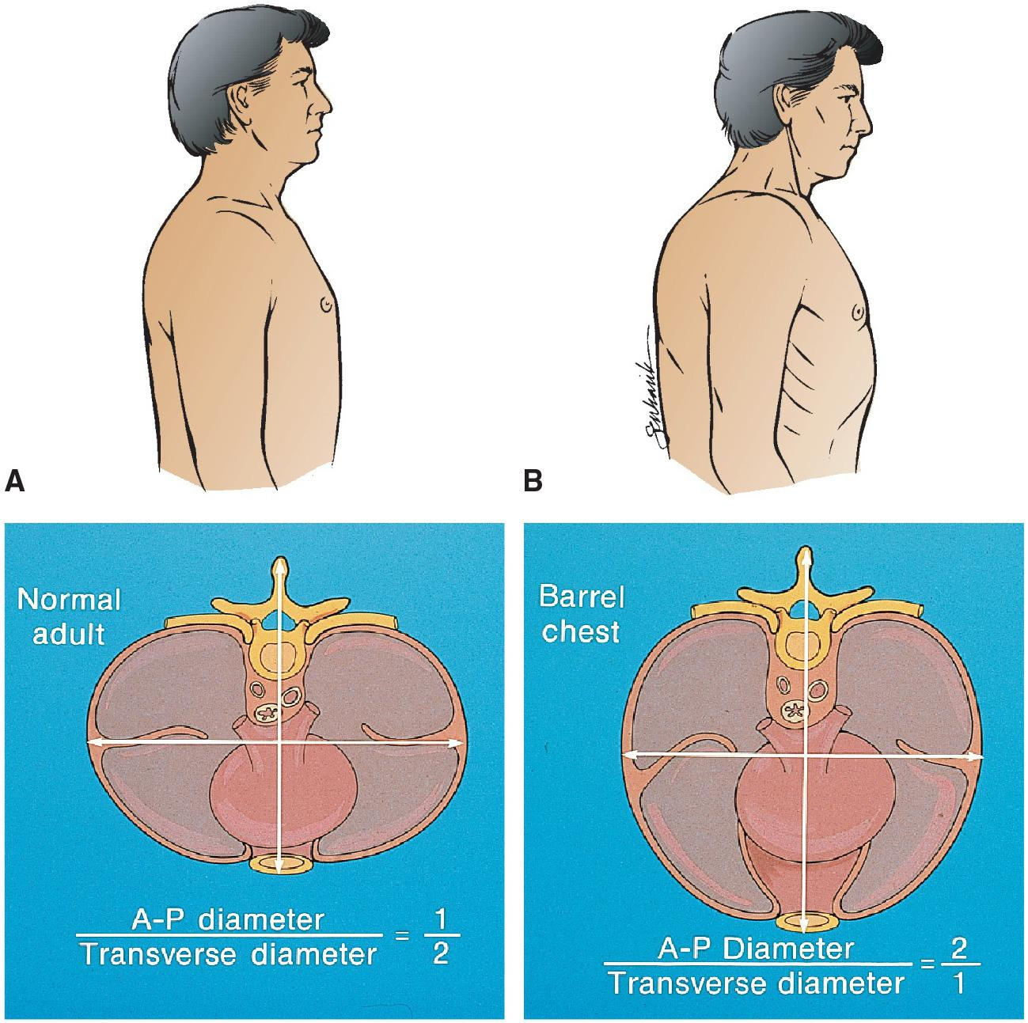
Chest Wall in Emphysema

Slide 35
Chronic Bronchitis
Chronic irritation of airways
Increased number of mucous cells
Mucus hypersecretion
Productive cough

Slide 36
Pink Puffers Versus Blue Bloaters
Pink puffers (usually emphysema)
Increase respiration to maintain oxygen levels
Dyspnea; increased ventilatory effort
Use accessory muscles; pursed-lip breathing
Blue bloaters (usually bronchitis)
Cannot increase respiration enough to maintain oxygen levels
Cyanosis and polycythemia
Cor pulmonale

Slide 37
Question
Which chronic obstructive pulmonary disease primarily affects the alveoli?
Asthma
Emphysema
Chronic bronchitis
Bronchiectasis

Slide 38
Answer
B. Emphysema
Rationale: In emphysema, alveolar walls are destroyed. The other chronic pulmonary diseases listed primarily affect the airways.

Slide 39
COPD and Blood pH
Discussion:
In what range will a COPD client's blood pH fall?
Why?

Slide 40
Consequences of COPD
COPD → decreased ability to exhale
→ Stale air in the lungs
→ Low O₂ levels → hypoxia
→ High CO₂ levels → hypercapnia
Which step will cause the central chemoreceptors to increase respiration?
Which will cause the peripheral chemoreceptors to increase respiration?

Slide 41
Scenario
A patient with chronic bronchitis has a barrel chest and cyanosis. His pulse oximeter reads 86% oxygenation. His PO₂ is 54 mm Hg. His PCO₂ is 56 mm Hg.
He is put on low-flow oxygen but complains of shortness of breath. Somebody turns the O₂ flow up. He is found in a coma with a PCO₂ of 59 mm Hg and blood pH of 7.2.
Questions:
What was the cause of the coma? Why?

Slide 42
COPD Consequences
In a COPD client, exhalation is inefficient and O₂ levels in the lungs decrease.
If blood goes through the lungs filled with stale air, it will not pick up much oxygen; it might even pick up CO₂.
Discussion:
What will the pulmonary arterioles do?
Which side of the heart will be affected? Why?

Slide 43
Cystic Fibrosis
Recessive disorder in chloride transport proteins
High concentrations of NaCl in the sweat
Less Na⁺ and water in respiratory mucus and in pancreatic secretions
Mucus is thicker
Obstructs airways
Obstructs the pancreatic and biliary ducts

Slide 44
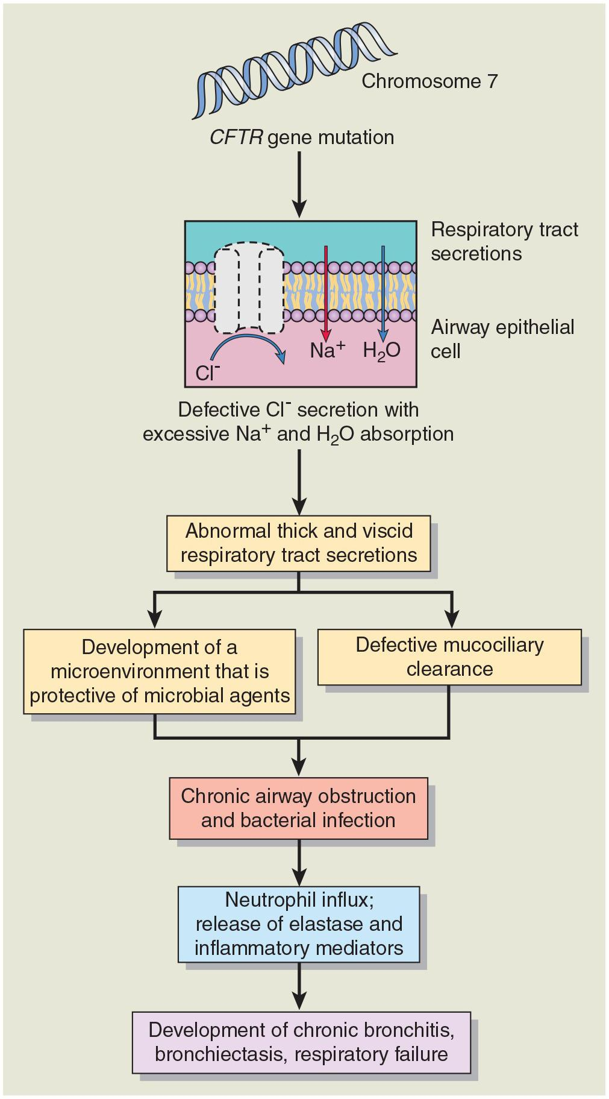
Pathogenesis of Cystic Fibrosis

Slide 45
Discussion
A client with cystic fibrosis is having
Respiratory problems
Digestive problems, flatulence, steatorrhea, weight loss
Question:
He does not understand why a respiratory disease would cause these problems. How would this be explained to the client?

Slide 46
CF
Cystic fibrosis (CF) is an autosomal recessive genetic disorder manifested by chronic lung disease, pancreatic exocrine deficiency, and elevation of sodium chloride in the sweat.
The defect causes exocrine gland secretions to become exceedingly viscid, and promotes colonization of the respiratory tract with P. aeruginosa and other organisms such as S. aureus.
Accumulation of viscid mucus in the bronchi, impaired mucociliary function, and infection contribute to the development of chronic lung disease and a decreased life expectancy.

Slide 47
Interstitial Lung Diseases
The interstitial lung diseases are a diverse group of lung disorders that produce similar inflammatory and fibrotic changes in the interstitium or alveolar septa of the lung.
As a result, the lungs become stiff and difficult to inflate, increasing the work of breathing and causing dyspnea and decreased exercise tolerance due to hypoxemia, without evidence of wheezing or signs of airway obstruction.

Slide 48
Interstitial Lung Diseases
These diseases include drug- and radiation-induced lung disease, environmental and occupational lung diseases caused by inhalation of organic and inorganic dusts, immunologic lung disorders such as those that accompany scleroderma, idiopathic pulmonary fibrosis.

Slide 49
Interstitial Lung Diseases
The restrictive lung disorders reduce the diffusing capacity of the lung, producing various degrees of hypoxemia, dyspnea, tachypnea, and eventual cyanosis.

Slide 50
Interstitial Lung Diseases
The pulmonary circulation is a low-pressure system that links the right heart and systemic venous system with the left heart and the systemic arterial system and functions as a conduit for exchange of the dissolved gases in the blood with the ventilated air in the alveoli.

Slide 51
PE
Pulmonary embolism develops when a blood-borne substance lodges in a branch of the pulmonary artery and obstructs blood flow.
The embolus can consist of a thrombus, air, fat. The most common form is thromboemboli arising from the deep venous channels of the lower extremities.

Slide 52
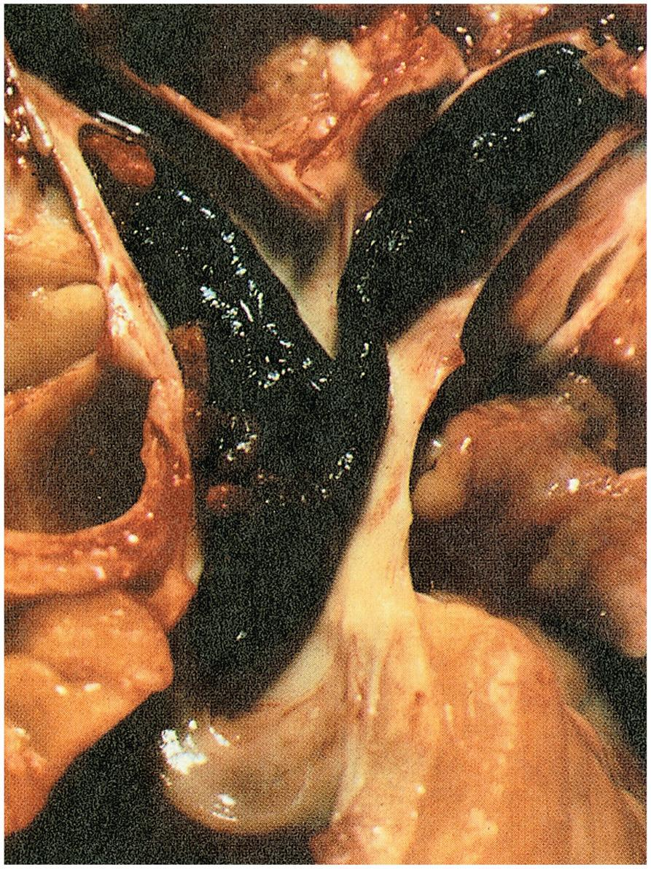
Pulmonary Embolism

Slide 53
PH
Pulmonary hypertension represents an elevation in the pulmonary arterial pressure.
It may arise as a secondary disorder associated with other disease conditions, usually cardiac or pulmonary, or as a primary disorder, characterized by abnormal proliferation and contraction of vascular smooth muscle, coagulation abnormalities, and marked intimal fibrosis leading to obliteration or obstruction of the pulmonary arteries and arterioles.

Slide 54
Pulmonary Hypertension
Secondary
Elevation of pulmonary venous pressure
Increased pulmonary blood flow
Pulmonary vascular obstruction
Hypoxemia
Primary
Blood vessel walls thicken and constrict

Slide 55
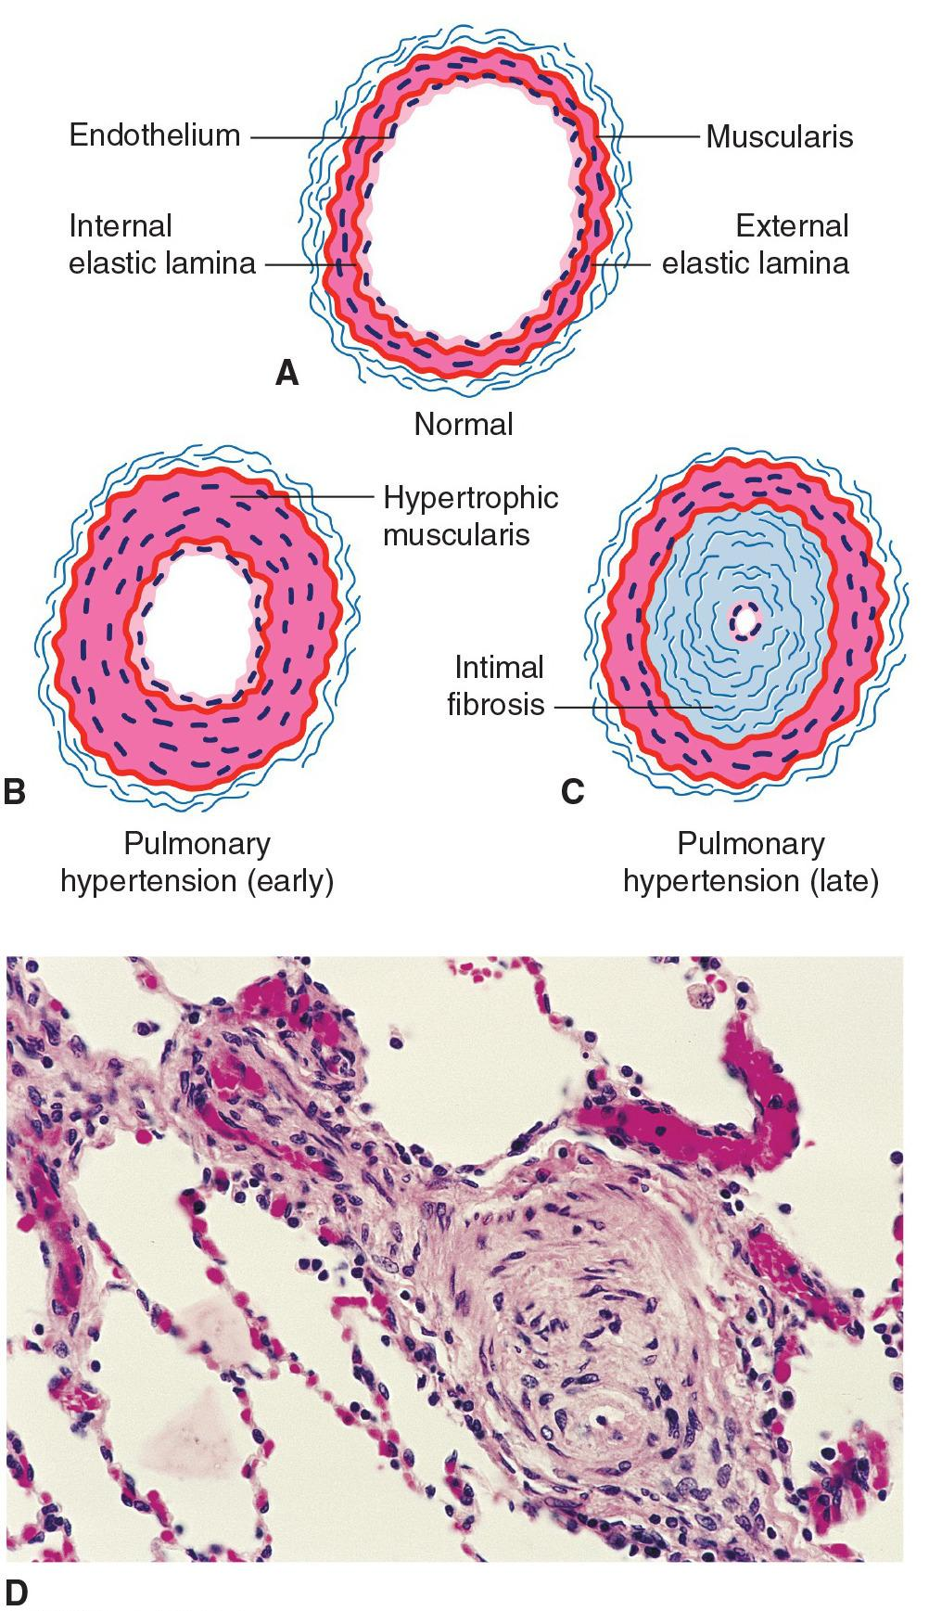
Pulmonary Arteries

Slide 56
Cor Pulmonale
Cor pulmonale describes right heart failure caused by pulmonary disease and long-standing pulmonary hypertension.

Slide 57
Cor Pulmonale
Right-sided heart failure secondary to lung disease or pulmonary hypertension
Decreased lung ventilation
Pulmonary vasoconstriction
Increased workload on the right heart
Decreased oxygenation
Kidney releases erythropoietin → more RBCs made → polycythemia makes blood more viscous
Increased workload on the heart

Slide 58
ARDS
The hallmark of acute lung injury and acute respiratory distress syndrome is a pronounced inflammatory response that affects the lung and may result in systemic organ failure.
The acute inflammatory response results in damage and dysfunction of the alveolar–capillary membrane of the lung.
Classically, there is interstitial edema of lung tissue, an increase in surface tension caused by inactivation of surfactant, collapse of alveolar structures, a stiff and noncompliant lung that is difficult to inflate, and impaired diffusion of the respiratory gases with severe hypoxia that is resistant to oxygen therapy.

Slide 59
Acute Respiratory Distress Syndrome
Exudate enters the alveoli
Blocks gas exchange
Makes inhalation more difficult
Neutrophils enter the alveoli
Release inflammatory mediators, proteolytic enzymes, reactive oxygen species

Slide 60
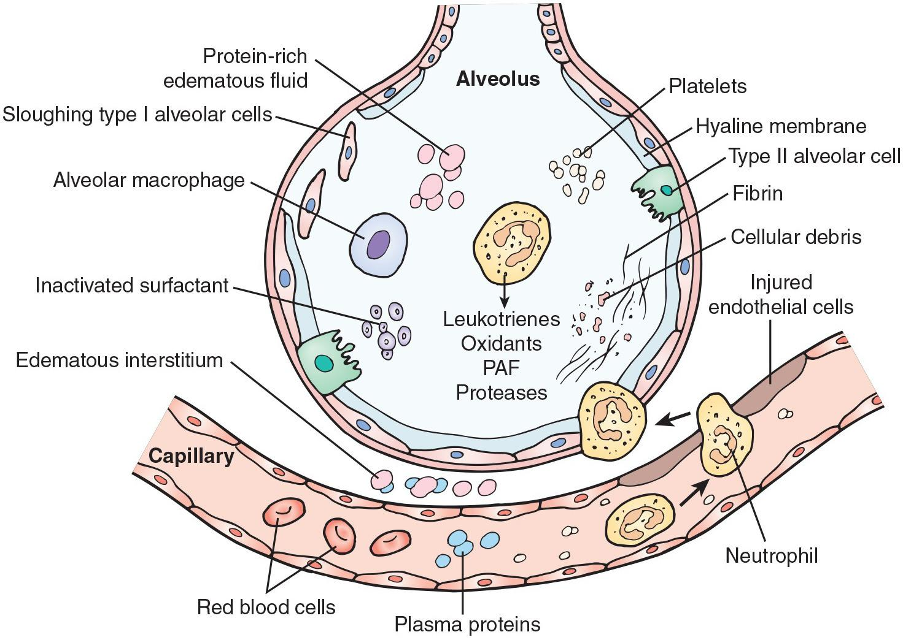
Mechanisms of Lung Changes in ARDS

Slide 61
Question
True or false?
Patients suffering from ARDS will be not necessarily be hypoxemic.

Slide 62
Answer
False
Rationale: In ARDS, the alveoli is filled with exudate, decreasing the available surface area for gas exchange. If gas exchange decreases, poorly oxygenated or unoxygenated blood is sent to the tissues (hypoxemia).

Slide 63
Causes of Respiratory Failure
Hypoventilation → hypercapnia, hypoxia
Depression of the respiratory center
Diseases of respiratory nerves or muscles
Ventilation/perfusion mismatching
Impaired diffusion → hypoxemia but not hypercapnia
Interstitial lung disease
ALI/ARDS
Pulmonary edema
Pneumonia

Slide 64
ARF
Acute respiratory failure is a condition in which the lungs fail to oxygenate the blood adequately (hypoxemic respiratory failure) or prevent undue retention of carbon dioxide (hypercapnic/ hypoxemic respiratory failure).
The causes of respiratory failure are many. It may arise acutely in persons with previously healthy lungs, or it may be superimposed on chronic lung disease.

Slide 65
ARF
Treatment of acute respiratory failure is directed toward treatment of the underlying disease, maintenance of adequate gas exchange and tissue oxygenation, and general supportive care. When alveolar ventilation is inadequate to maintain PO2 or PCO2 levels because of impaired respiratory function or neurologic failure, mechanical ventilation may be necessary.

