Slide 1
Chicago School

Slide 2
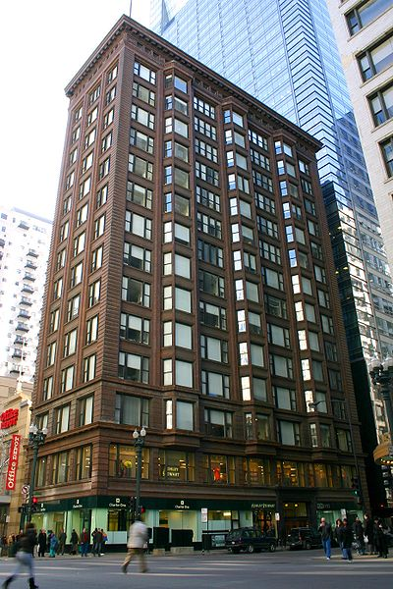
1890 – 1910
Problems facing American architecture
The absence of good architectural models
There was a need for a universal culture of architecture such as existed in Europe
Baux-arts system failed to produce an architecture appropriate to modern life.
Chicago Savings Bank Building
1904-05, Holabird & Roche

Slide 3
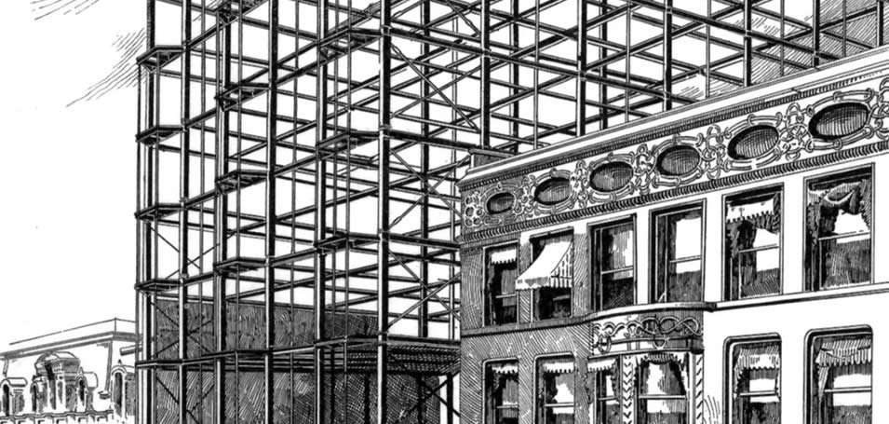
Although Schuyler praised American architects (Chicago school architects) for their attempts of adapting the technological advancements into their architecture, such as the elevator and the steel frame, the question of aesthetics remained unsolved.
He draws attention to the conflict between the architect as a manipulator of a visual language (classicist) and as an exponent of a changing technology (organicist).

Slide 4
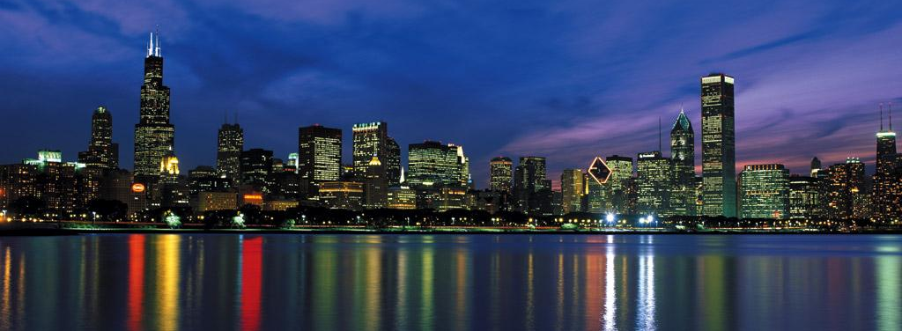
Chicago School Evolution
The great Chicago fire in 1871
Booming of the city due to massive reconstruction of the city – architects coming from all over the place to take part in the reconstruction phase and the opportunity they saw there to create a new architectural culture .
They didn’t fully reject the traditional Baux-arts style, however the tradition they endorsed was vague and adaptable to modern conditions; both technical and economical.

Slide 5
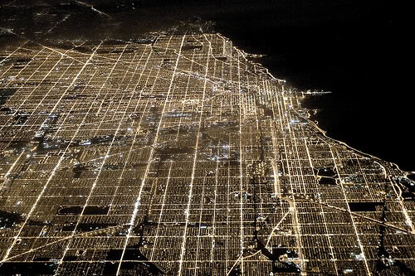

Slide 6
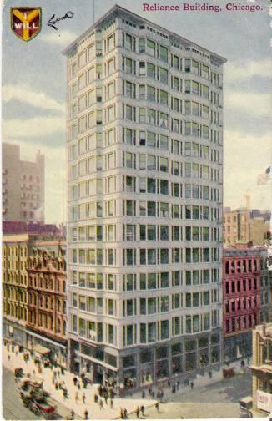
New construction was more than just rebuilding in more permanent materials. It was driven by explosive demographic and economic growth.
City became railroad center of continent.
Land became extremely expensive which led to Piling up stories to structures of 8, 12, 16 or more stories. Accessible by the elevator

Slide 7
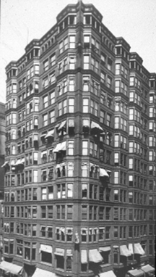
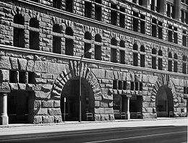
Problems of the new skyscraper
The technical limits of weight-bearing masonry had always imposed formal as well as structural constraints; those constraints were suddenly gone. None of the historical precedents were any help, and this new freedom created a kind of technical and stylistic crisis.
The last restrictions in height were removed when it became possible to support the external walls as well as the floors on the steel frame thus reducing the mass of the wall to that of thin cladding.
In some cases such as the auditorium building did not reflect the programme since every floor had exactly the same function. Tacoma building, similarity of functions were represented but it lacked monumental expression since it was a succession of of floors

Slide 8
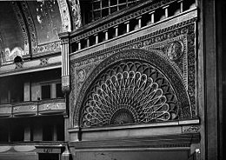
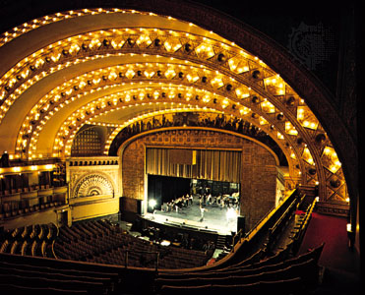
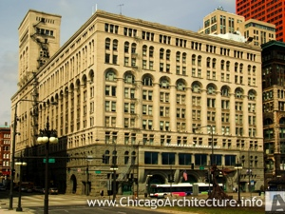
Sullivan believed that the ornament is an extension of the structure.

Slide 9
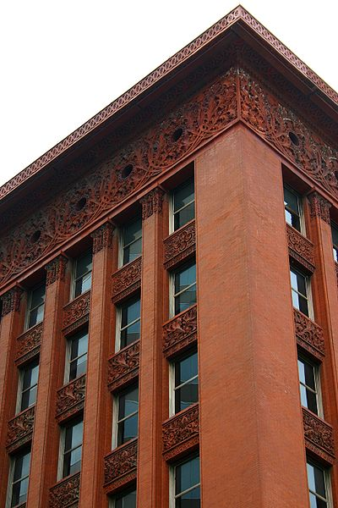
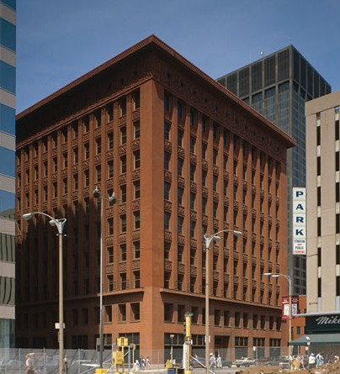
Wainwright building – Louis Sullivan dealt with this problem and offered a solution presented in this building – the organic principles

Slide 10
The organic idea can be traced back to the romantic movement of around 1800s – particularly to such writer as Schelling and the Shlegel brothers, who believed that the external form of the work of art should, as in plants and animals be the product of an inner force or essence rather than being mechanically imposed from without as they judged to be the case with classicism (Page 41).
However …
Although the auditorium building had impure solutions, yet it had the merit of presenting to the street a complex texture capable of being read as part of a continuous urban fabric. On the other hand the Wainwright building with its vertical emphasis and strongly marked corner pilasters, isolated itself from its context and became a self sufficient entity emphasizing the individuality of the business it both housed and represented (Page 41).

Slide 12
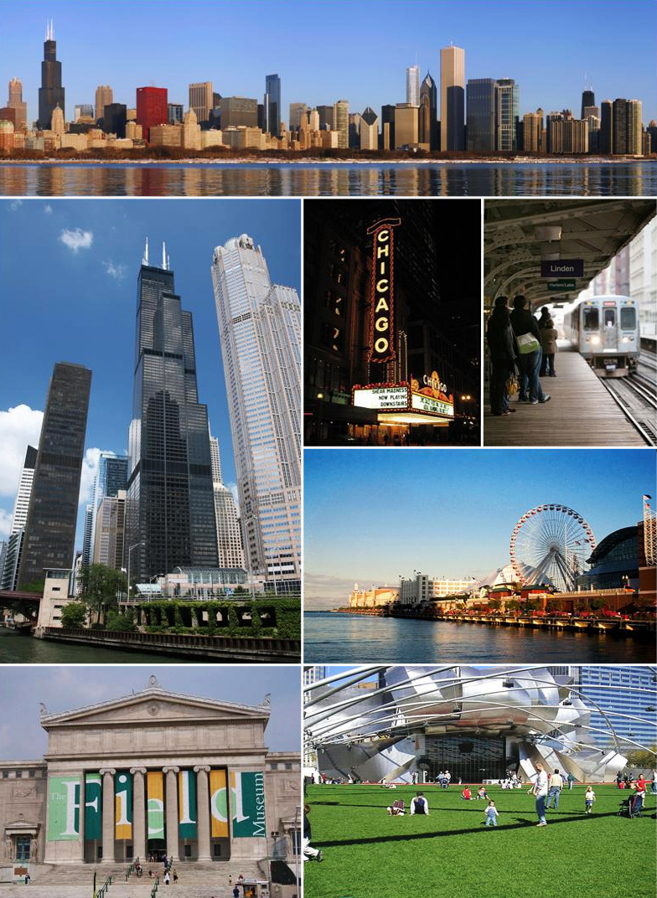

Slide 13
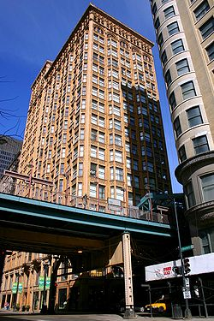
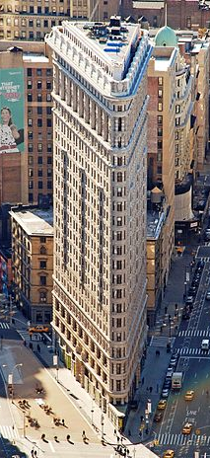
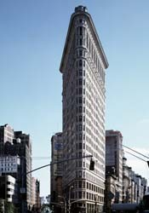
Individualism vs. Collectivism – Burnham vs. Sullivan (page 43)

Slide 14
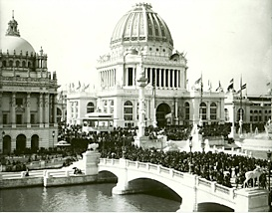
The Columbian Exposition – Frederick Law Olmsted (landscape) and Daniel Burnham (buildings)
Chicago was chosen to house the 1893 world exposition because it was seen to represent the dynamism of the mid-west, however the fair’s promoters were more interested in the creation of a national tradition than a regional one. They were looking for a ready made architectural language that could represent the united states as unified, culturally mature imperial power.
Page 44 – the choice of the Beaux arts principles

Slide 15
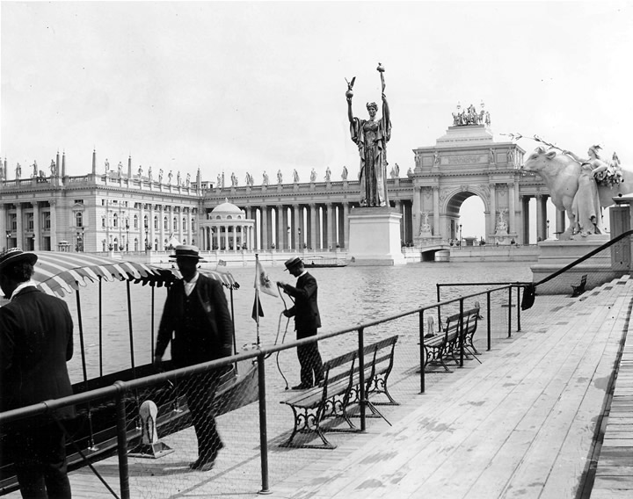
Burnham, unlike Sullivan, was able to see ‘functionalism as valid for a commercial architecture ruled by cost , and classicism as valid for an architecture representing national power and cosmopolitan culture.

Slide 16
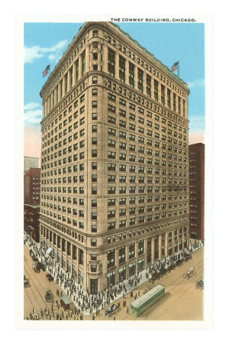
The City Beautiful Movement
The movement, which was originally most closely associated with Chicago and Washington DC, did not seek beauty for its own good but rather for the common good to create moral and civic virtue among urban populations.
Burnham’s urban design experience page 46
The Conway Building - Burnham

Slide 17
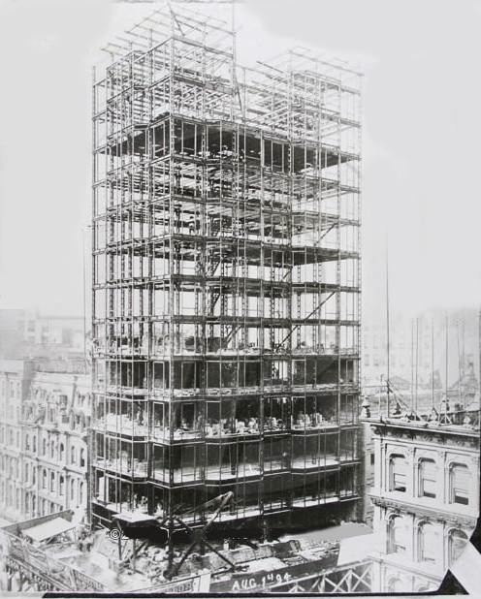
Carson, pirie and scott
Sullivan 1899
Burnham 1906
Holabird and Root 1961

Slide 18
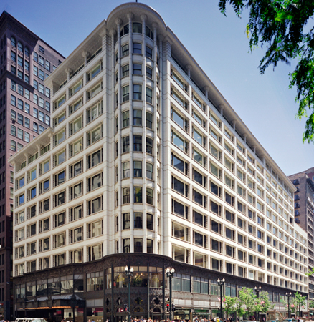

Slide 19
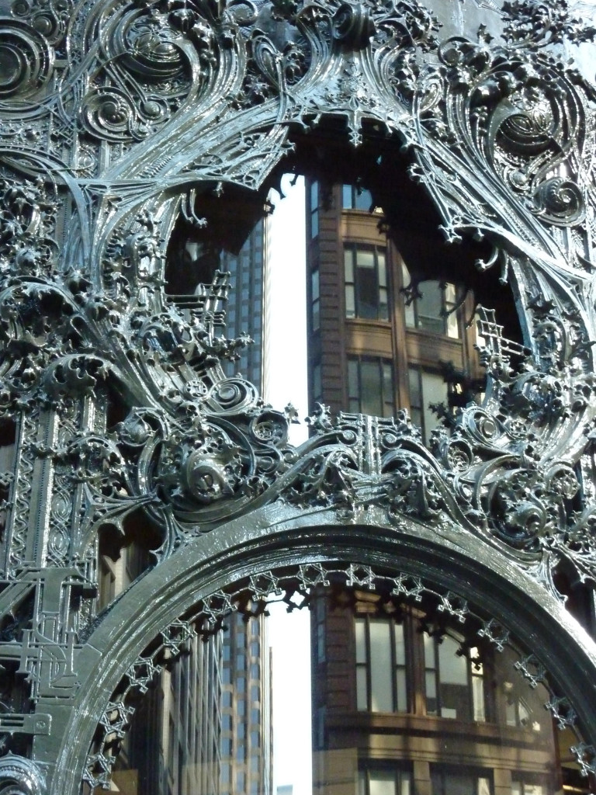

Slide 20
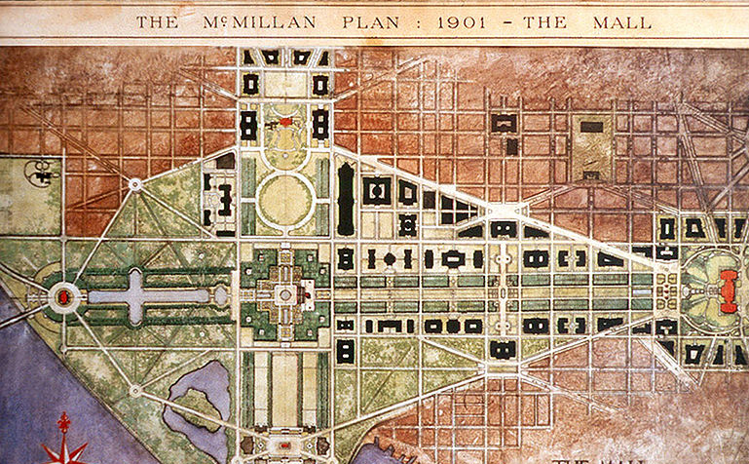
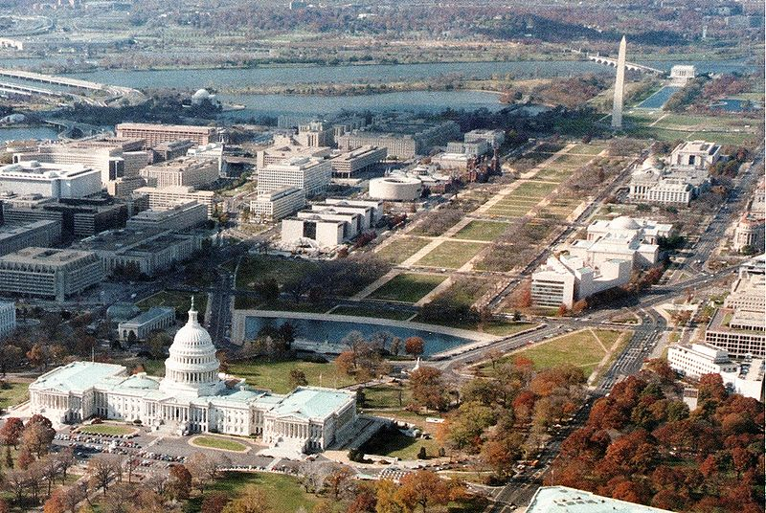

Slide 21
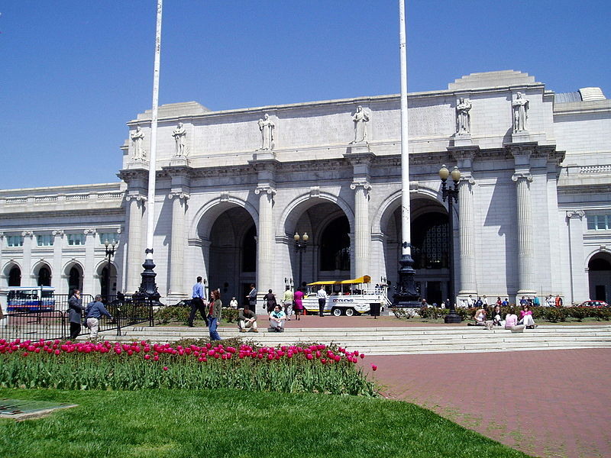
Union Station, DC

