Slide 1
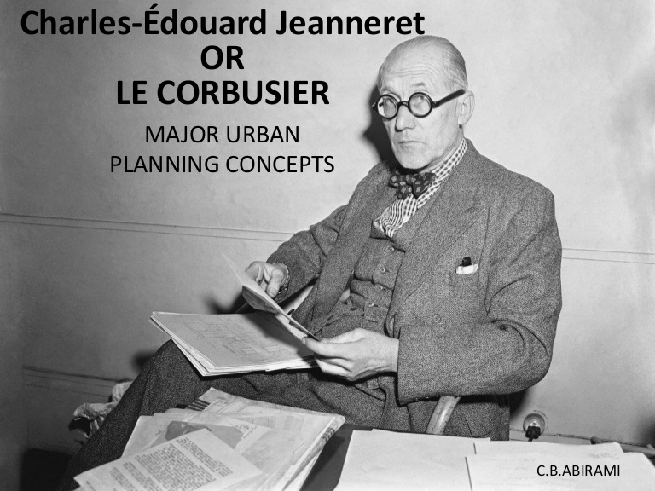
Le corbusier :
plan voisin de paris
About le corbusier
History
-plan of 1922
-plan of 1925
1887-1965

Slide 2
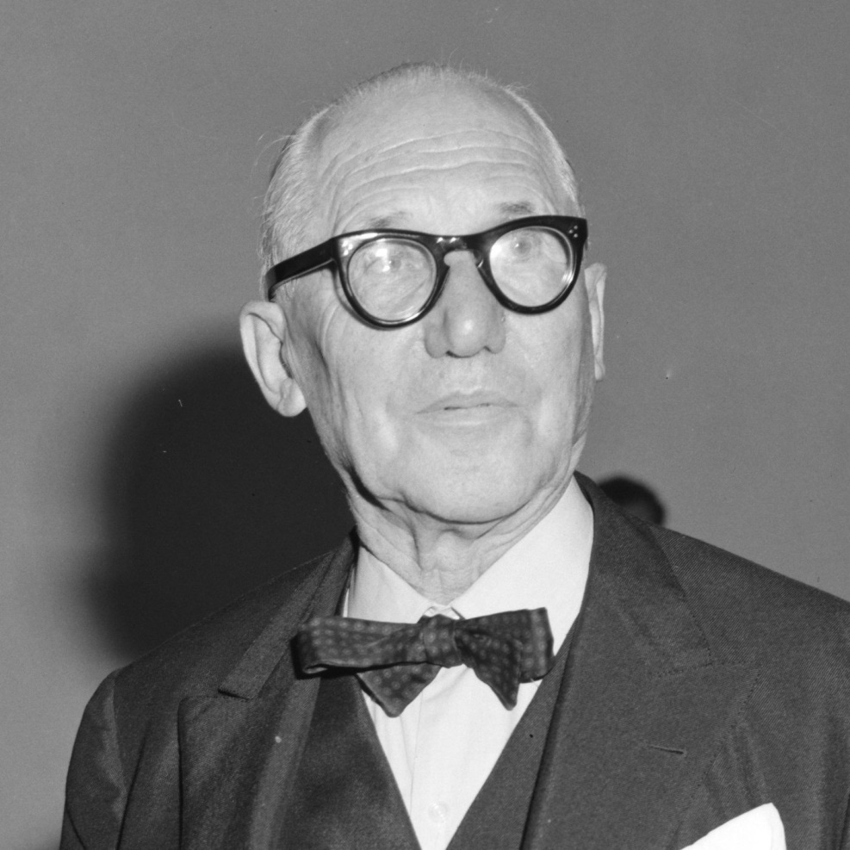
About le corbusier :
He is a Swiss-French architect, designer, painter, urban planner
and also a writer.
He was one of the most important pioneers of modern architecture.
He liked to use-made geometric shapes and grid architectural designs.
He was inspired by the idea of the house is a machine to live in, and the shape of the building is suitable with its function.
And this called the functional-
theory.
His thoughts in planning were the lifting columns at the building level above the ground level and exploitation the under of the buildings
And the use of gardens on the roofs of the buildings

Slide 3
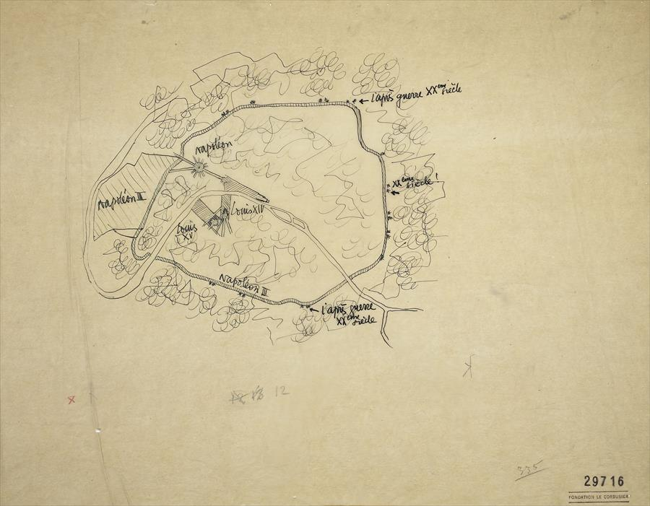
How le Corbusier think about his plan

Slide 4
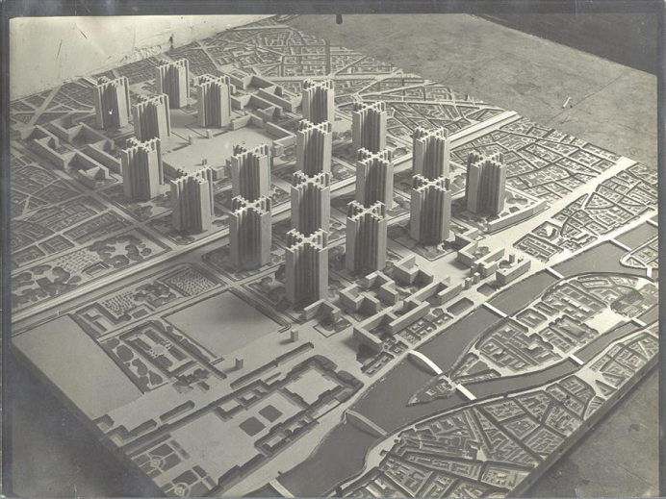
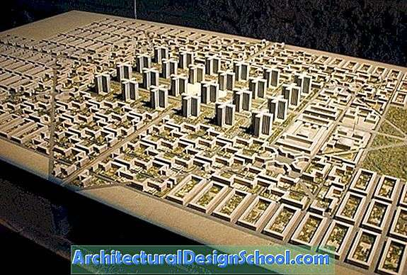
History from planning side :
On the planning side, le corbusier presented many studies and theoretical researches that played an important role in the development in the idea of modern planning.
Whereas in 1922 a plan was drawn up for
accommodate three million people, and
this was the basis for a new concept
in urban planning.
This project was the beginning
of a series of projects for
planning the city of paris,
and It was followed by the
voisin plan project in 1925,
then he radiant city project
in 1930 and another projects
in the international exhibition
in 1937.

Slide 5
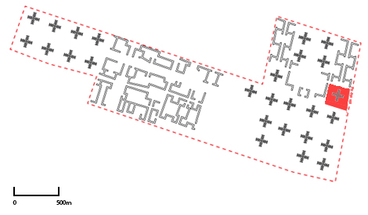
Le Corbusier's plan:
His most prominent ideas in this field was that the heart od the city should transform into commercial skyscrapers , surrounded by residential buildings and then independent houses ,while leaving 95% of the land for parks and gardens and making transportation streets at different levels.

Slide 6
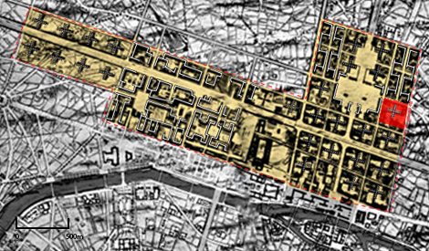
1922 plannng project:
Contemporary ideal industrial city
He was in an exhibition in Paris, where he presented his architectural and planning ideas for the city of
three million people .
Le Corbusier was interested in designing the city of three million people to achieve a complete separation between pedestrian traffic and the automatic movement of .transport

Slide 7
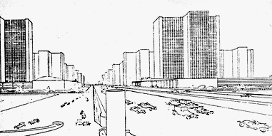
1- separation between pedestrian movement and mechanical movement in transport, so that the pedestrian movement came at the ground level, as for the automatic movement, it came at the first floor level, i.e. at a level higher than one floor of the natural ground level
Consequently, all buildings must be carried above the level of the natural ground in order to allow pedestrians freely to move over all lands without even interfering with their movement or interfering with the movement of transport.

Slide 8
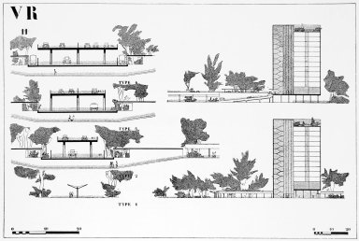
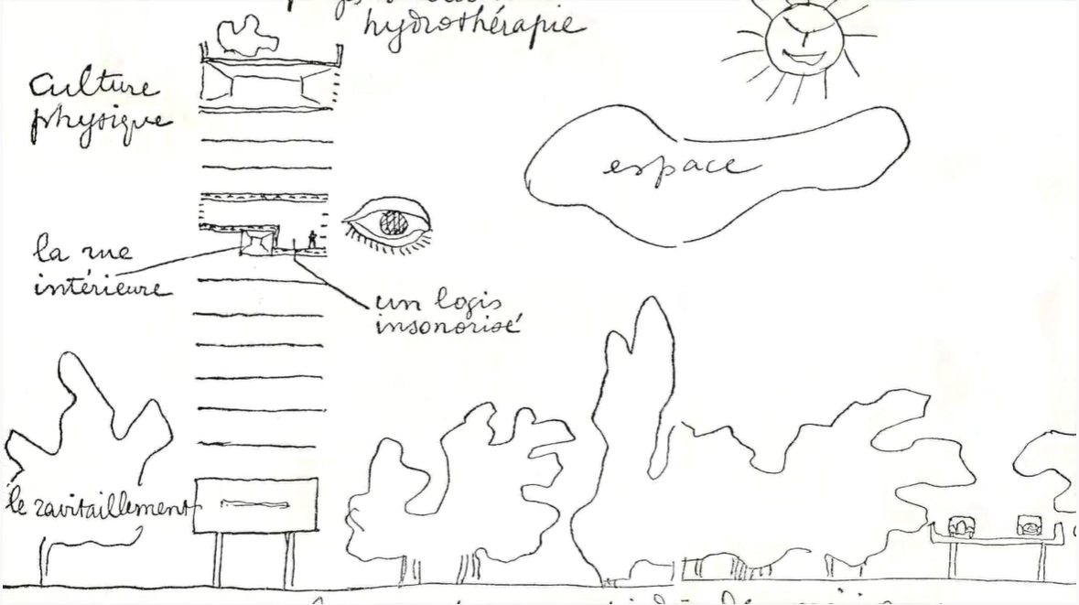
sections
Show how the buildings and streets are above the ground area and the ground area is only for pedestrian

Slide 9
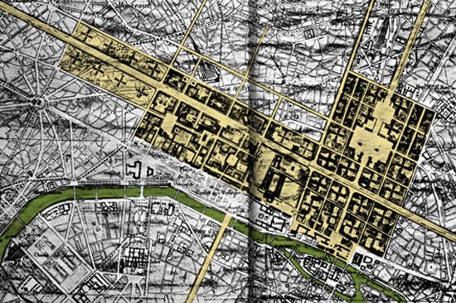
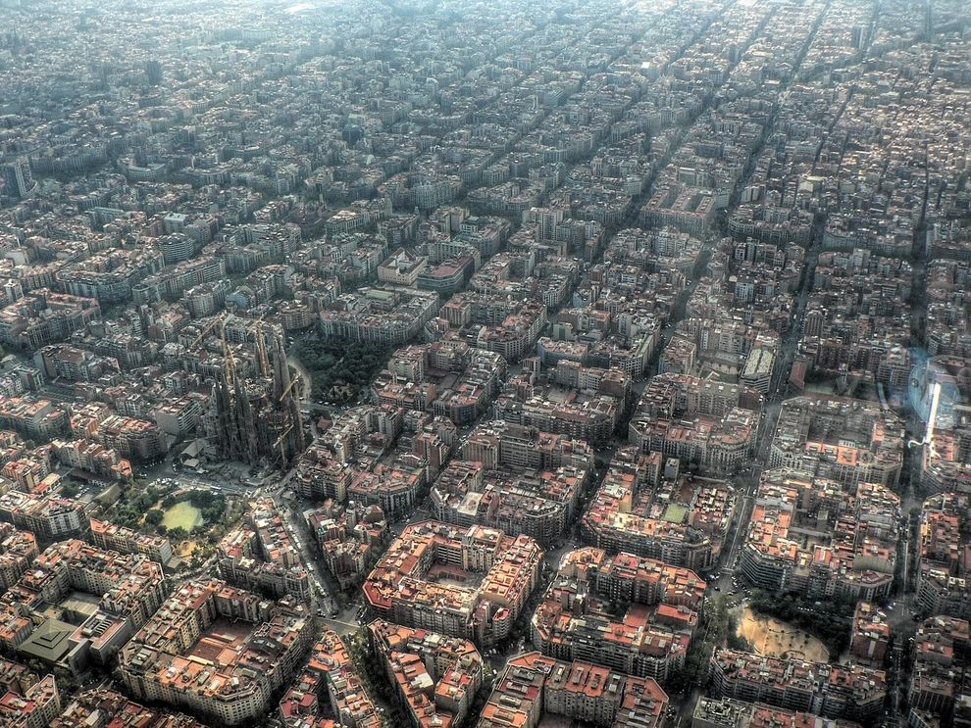
Transportation lines came within two grids, one of which is perpendicular to the lines forming huge squares, the other is oblique at an angle of 45 degrees

Slide 10
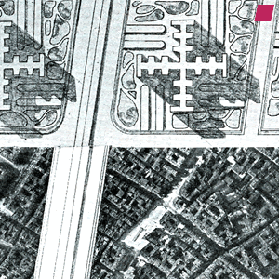
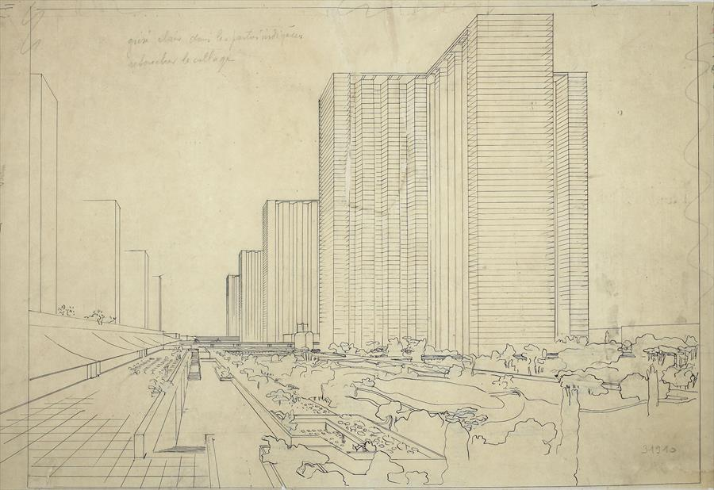
The commercial buildings were skyscrapers, with a horizontal plan in the shape of the Greek cross and 50 to 60 floors high, spaced from each other by a distance interspersed with the gardens.

Slide 11
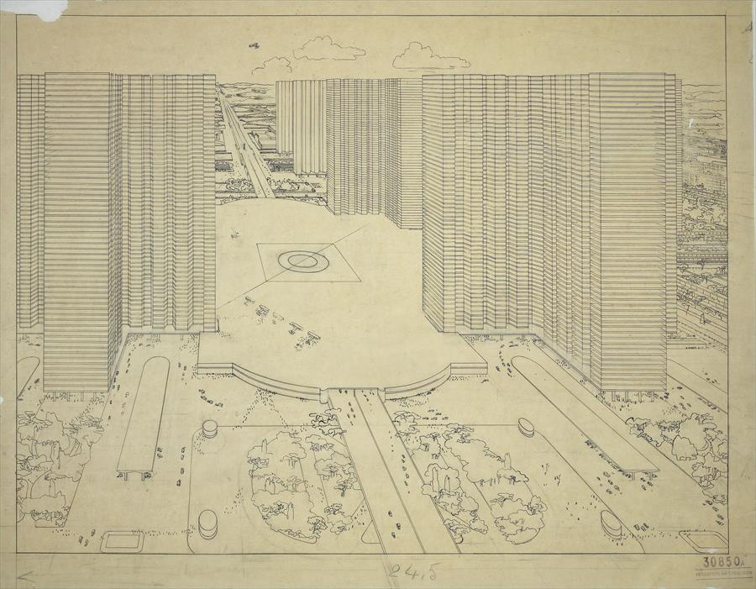
The city center its like a public open space for all people

Slide 12
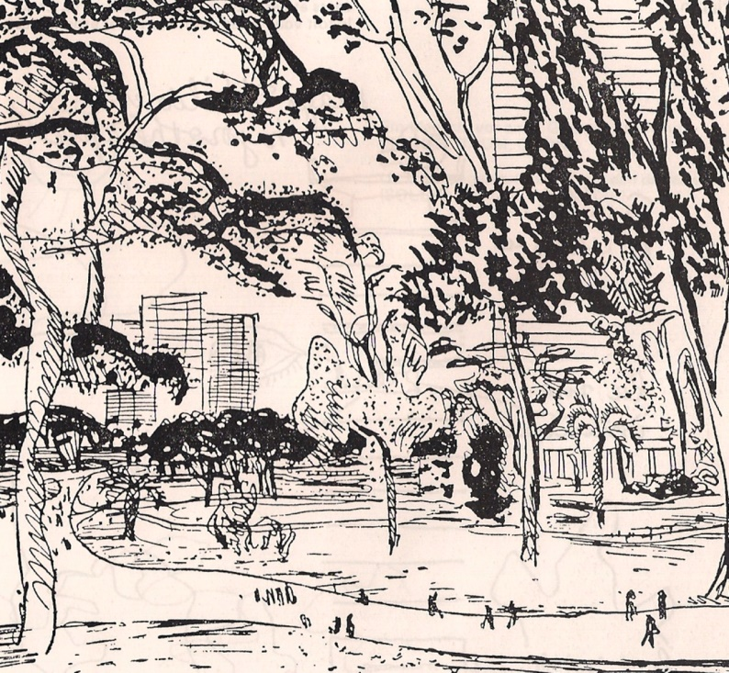
The gardens and open area on the ground floor

Slide 13
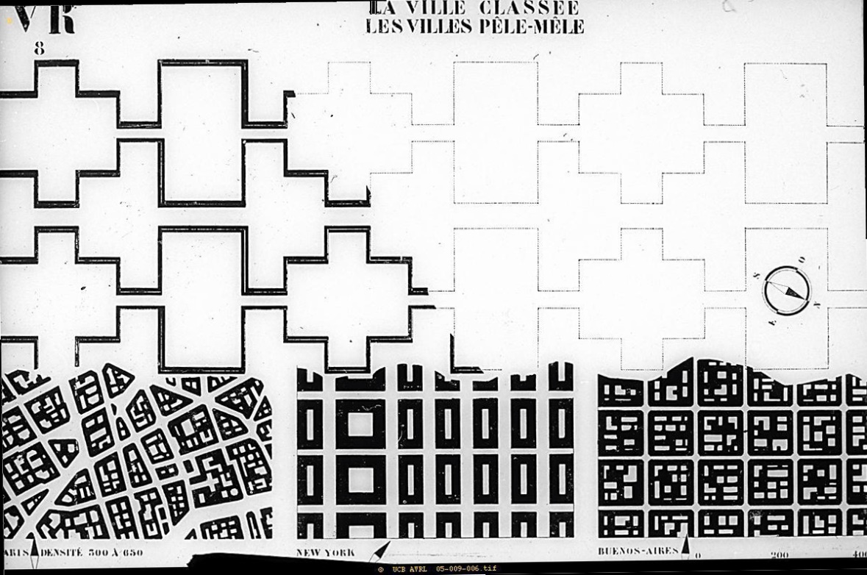
The residential buildings
-its like the zigzag shape .
Very thin
6 floor high
Between the zigzag shape there was garden and green areas
All the residential area were above the ground floor so that people can move on the ground floor freely

Slide 14
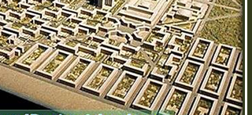
Independent
houses
Le Corbusier named them
((villas superposes
-Rectangles
-Large in size
- It is surrounded by open gardens
-And it is the last link in vegetation
-- And then comes the industrial areas-

Slide 15
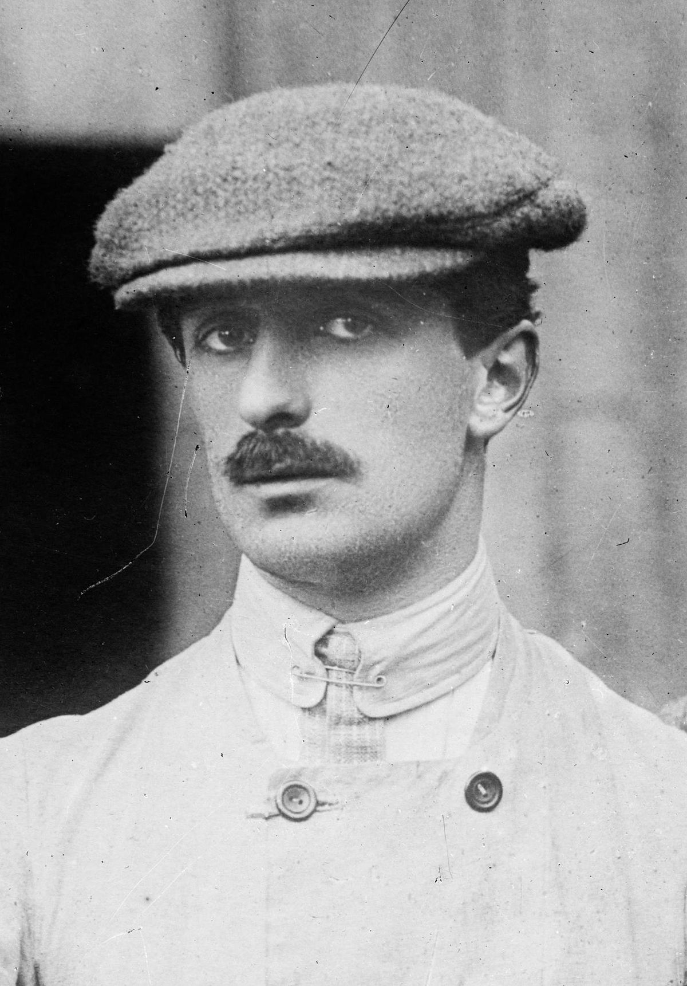
1925
Le Corbusier's plan caught Gabriel Voison’s attention (the maker of planes and cars) who funded Corbusier's studies so that his plans could be implemented

Slide 16
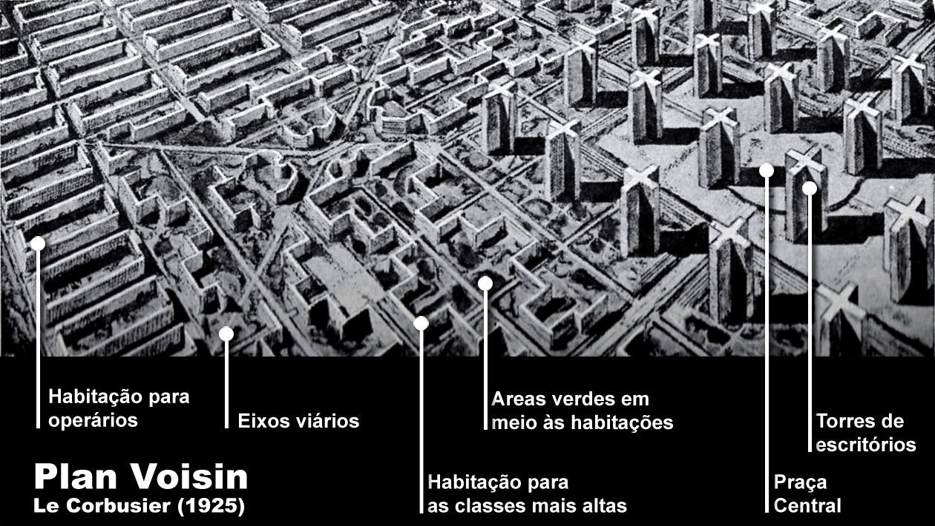

Slide 17
mareen shaheen 1180447

